Slide 1


Monitoring Water Quality of Inland Lakes by Remotely Sensed Observations
Wei Yang
Center for Environmental Remote Sensing
Chiba University, Japan
2017-June-1

Slide 2
Outline
Sect. 1
General introduction
Sect.2
Enhanced Three-band Index for monitoring Chlorophyll-a
Sect.3
SAMO-LUT algorithm for monitoring water constituent concentrations
Sect. 4
General conclusions
2

Slide 3






Advantage of Satellite Remote Sensing
Satellite remote sensing can provide
synoptic observations of water area
Waste Water
3

Slide 4
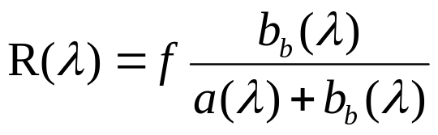

Physical Principle of Remote Sensing in Water Body
SATELLITE
Backward
b_{b}(λ)
Reflectance: R(λ)
Bio-optical model
Phytoplankton
Material
Tripton
CDOM
Absorbed
Pure Water
Target Water Area
a(λ)
Scattered
b(λ)
Inherent Optical Properties (IOP)
Specific Inherent Optical Properties (SIOP) = IOP/Concentration
4

Slide 5
Water Types: the Perspective of Remote Sensing
Case I waters : waters are those dominated by phytoplankton (e.g. open oceans).
Case II waters : waters are containing not only phytoplankton, but also non-phytoplankton suspended solids (i.e., tripton) and colored dissolved organic matters (CDOM) (e.g. coastal and inland waters).
Chl-a can be satisfactorily estimated with satellite images (Gordon & Morel, 1983)
Still challenging
5

Slide 6
Difficulty for Monitoring Case II Waters
Interactions between Different
Components
Case I waters
Case II waters
Phytoplankton
Tripton
CDOM
6

Slide 7
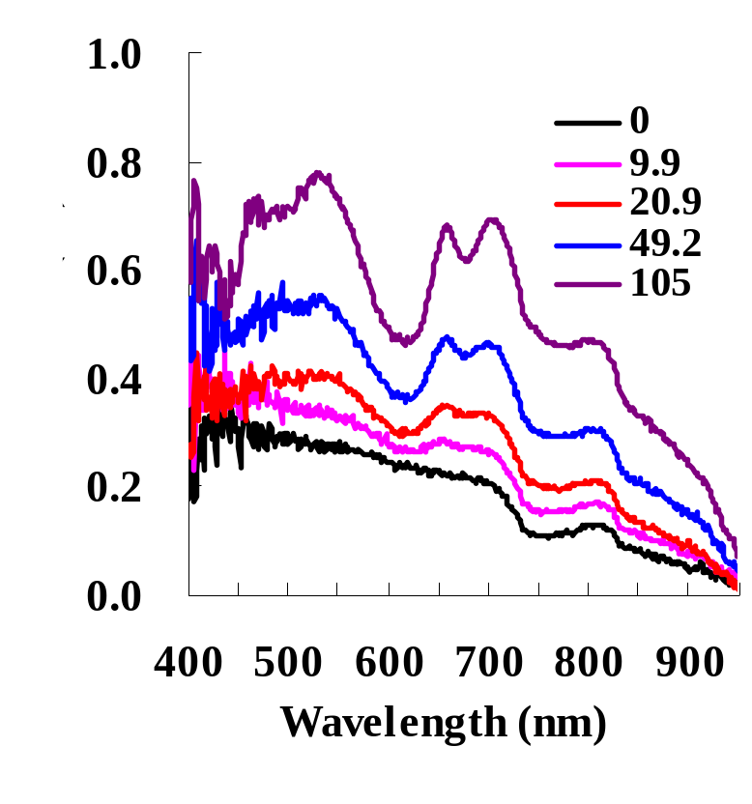
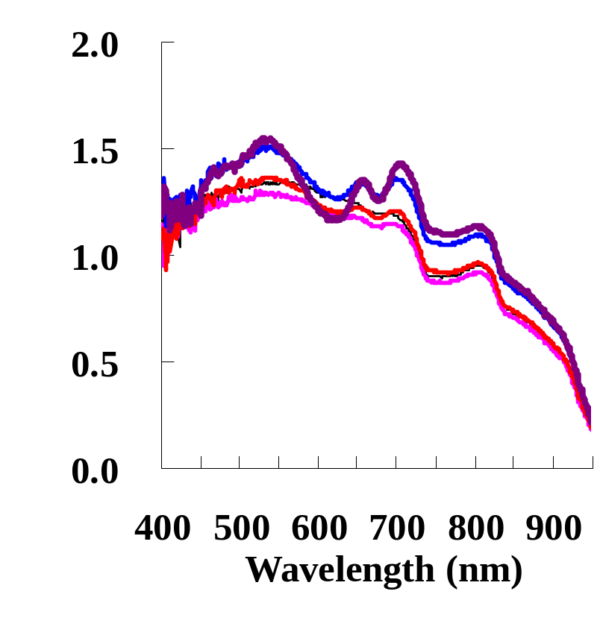
Reflectance spectra for case I and II waters
Case I waters
Case II waters
Tripton = 90 g m⁻³
7

Slide 8
Review of Previous Studies for Remote Sensing
in Case II Waters
A number of methods have been proposed, e.g., Matrix Inversion Method (Hoogenboom et al., 1998), Band-ratio index (Gons, 1999; Ammenberg et al., 2002), Three-band index (Gitelson et al., 2008), and so on.
The basic idea for all of the methods is to isolate the interactions between different components.
Among these methods, the 3-band index significantly outperformed other indices (Gitelson et al., 2008).
8

Slide 9
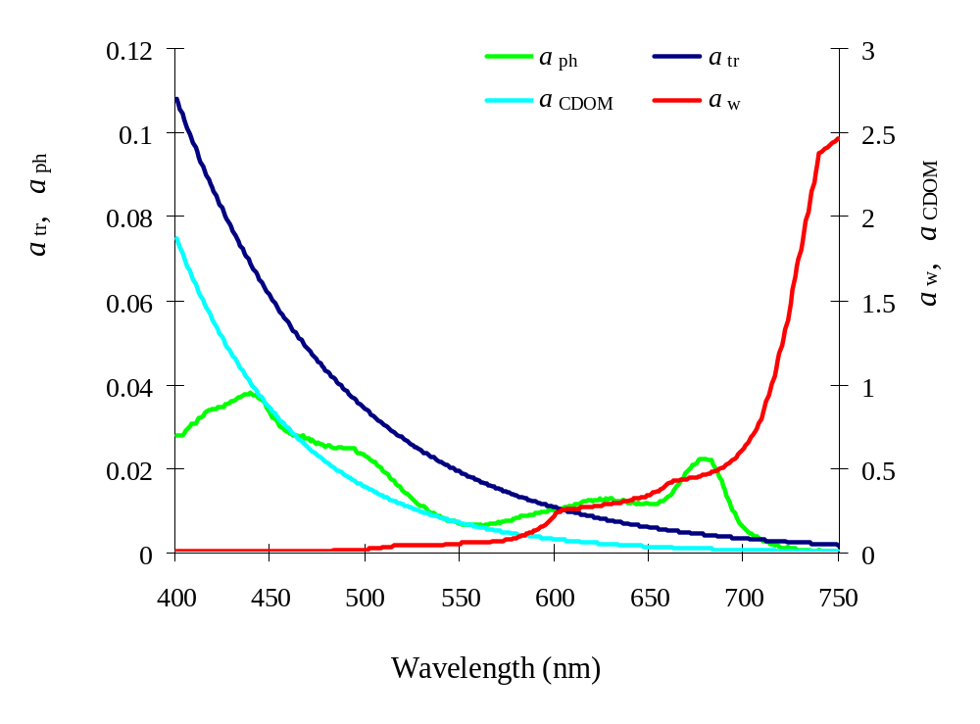
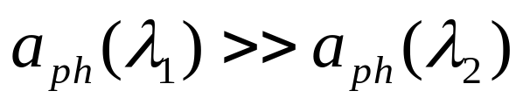
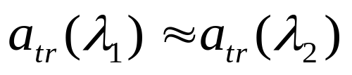
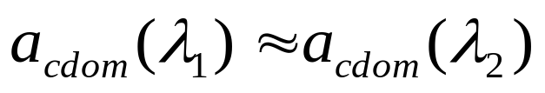
Principle of the 3-band index: Absorption
λ₃≈740nm
λ₂≈ 708nm
λ₁≈ 665nm
9

Slide 10
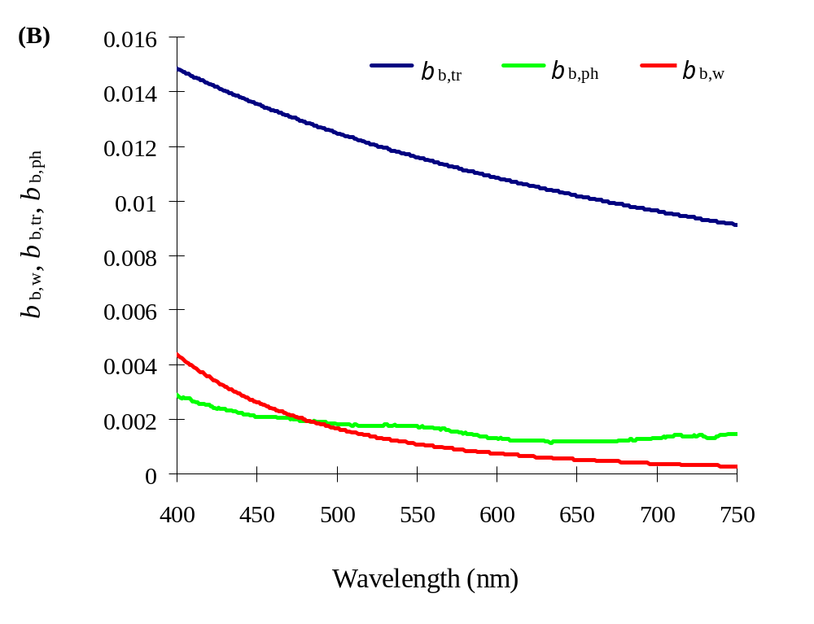
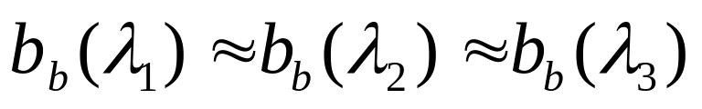
Principle of the 3-band index: Backscattering
λ₃≈740nm
λ₂≈ 708nm
λ₁≈ 665nm
10

Slide 11
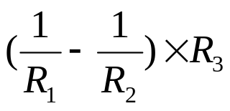
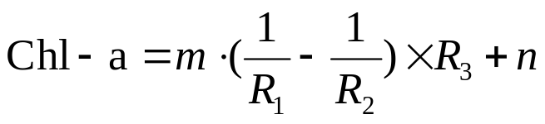
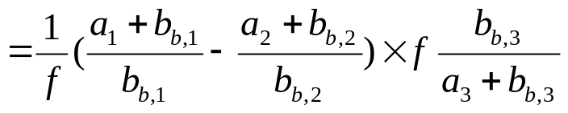
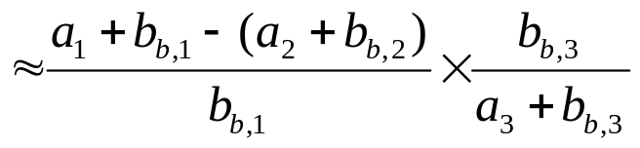
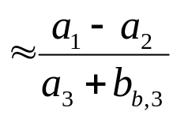

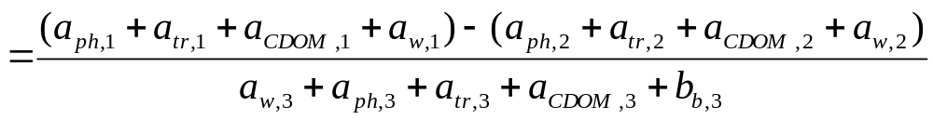
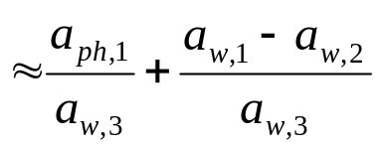
Principle of the 3-band index: Reflectance
=
Chl-a
0
3-band Index
Constants
11

Slide 12
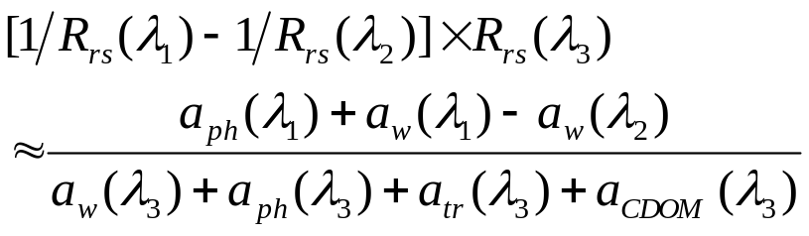


Problem of the 3-band index
For waters with high turbidity (e.g. some Asian Lakes), the assumption
is not reasonable anymore (Le et al., 2009).
In these cases, the 3-band index becomes:
Denominator includes the absorption not only
phytoplankton, but also tripton and CDOM
The existing methods still cannot provide satisfactory estimations for turbid case II waters.
12

Slide 13
Main objectives of my research
To develop more effective methods to isolate the interactions between water components
1
To validate their performances using simulation, in situ and satellite datasets
2
13

Slide 14
Section 2
An Enhanced 3-band Index for estimating Chl-a in turbid Case II waters
Sect. 2
14

Slide 15
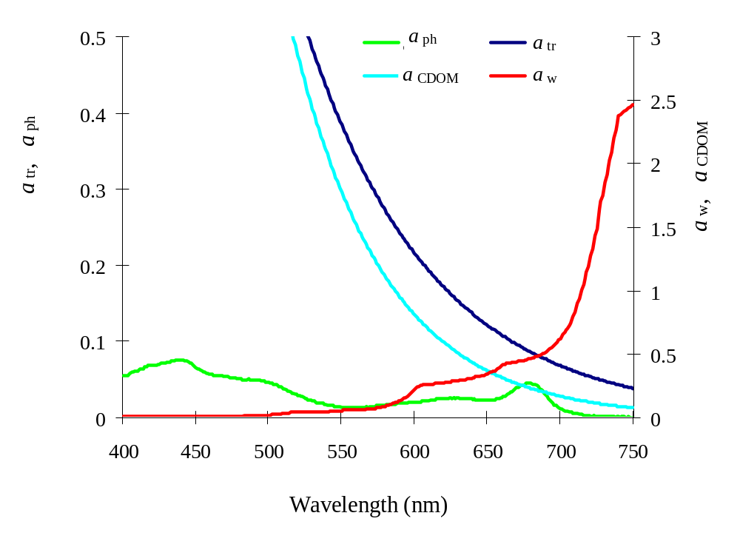
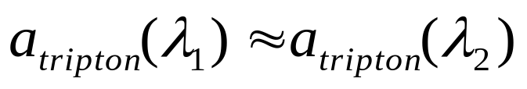
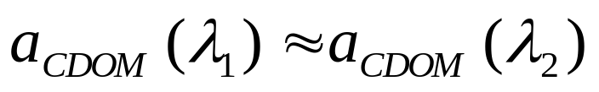
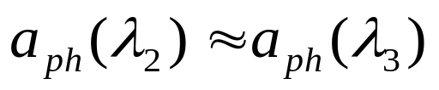
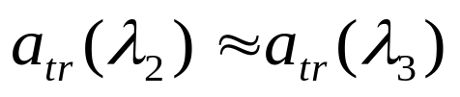
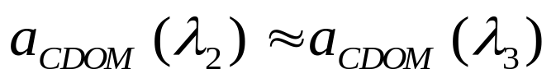
Absorption properties for turbid water case
(e.g. TSS=20 g m⁻³)
λ₃≈740nm
λ₂≈ 708nm
λ₁≈ 665nm
Hints for new index
15

Slide 16
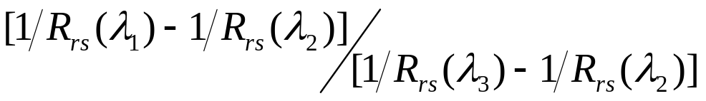
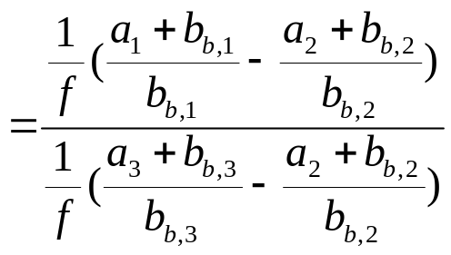
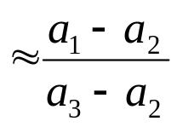

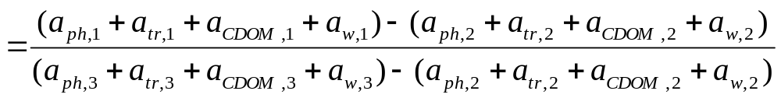
Development of the Enhanced 3-band Index
Chl-a
0
New Index
Chl-a = l × New Index + m
Constants
16

Slide 17
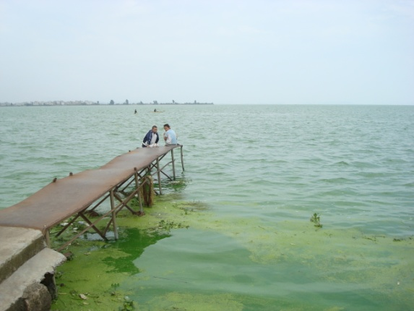
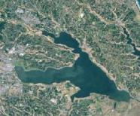
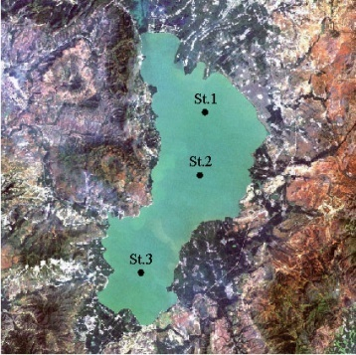
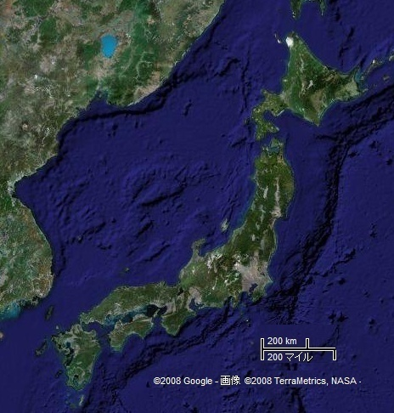
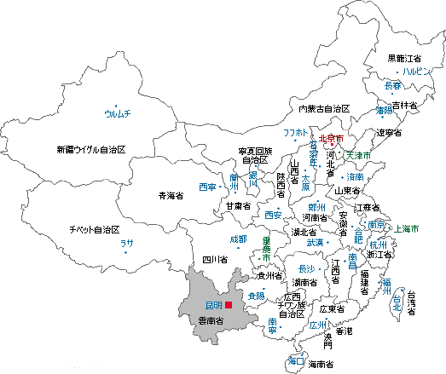
Study Areas
Lake Kasumigaura,
Japan
Lake Dianchi,
China
Location: Ibaraki
Area: 171 ㎞²(western)
Average depth：4 m
Case II water:
・mixture of phytoplankton, tripton, and CDOM
・dominant species
diatom（winter）
cyanobacteria（summer）
Field survey: 3 times
(Feb. 18, 2006; Aug. 7, 2008; Sep. 1, 2009; routine field survey)
total 61 sites
20km
Location: Yunnan Province, China
Area: 300 ㎞²
Average depth：6 m
Case II water:
・mixture of phytoplankton, tripton, and CDOM
・dominant species
cyanobacteria
Field survey: 4 times
(Oct. 23, 2007; Jul. 15, 2008; Mar. 12, 2009; Jul.-Aug., 2009)
Total 53 sites
30km
17
Notes:
17

Slide 18
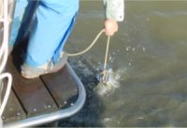
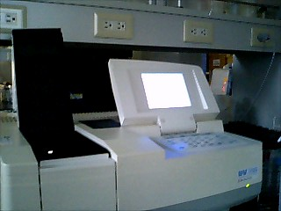
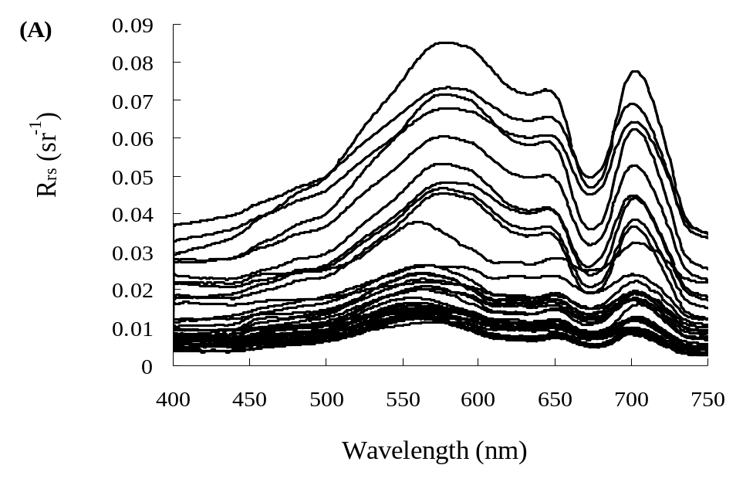
Data Collections
Phytoplankton (Chl-a)
Samples taken to lab;
SCOR-UNESCO equations.
Remote sensing reflectance
Water-leaving radiance;
Downward irradiance;
Downward radiance of skylight.
18

Slide 19
Results for Lake Kasumigaura, Japan
(A)
(B)
-3
)
120
)
120
100
-3
100
80
80
Measured Chl-a (mg m
Measured Chl-a (mg m
60
60
40
y = 282.18x + 29.12
40
y = 161.24x + 28.04
Original 3-band
2
Enhanced 3-band
R
2
= 0.90
20
R
= 0.82
20
0
0
-0.05
0.05
0.15
0.25
0.35
-0.1
0.1
0.3
0.5
0.7
Original three-band index
Enhanced three-band index
(C)
(D)
120
140
-3
)
100
y = 0.55x + 27.98
-3
)
120
y = 0.85x + 15.76
R
2
= 0.48
R
2
= 0.83
80
100
from original three-band index
from enhanced three-band index
60
80
Estimated Chl-a (mg m
Estimated Chl-a (mg m
40
RMSE = 13.97 mg m
-3
60
RMSE = 8.68 mg m
-3
20
MNB =
-
4.53%
40
MNB = 6.83%
Original 3-band
NRMS = 19.01%
Enhanced 3-band
NRMS = 12.30%
0
20
0
20
40
60
80
100
120
20
40
60
80
100
120
140
Measured Chl-a (mg m
-3
)
Measured Chl-a (mg m
-3
)
19

Slide 20
Results for Lake Dianchi, China
(A)
(B)
160
)
160
y = 119.57x + 10.26
)
y = 259.87x + 10.29
-3
Enhanced 3-band
Original 3-band
140
-3
140
R
2
= 0.84
R
2
= 0.91
120
120
100
100
Measured Chl-a (mg m
80
80
Measured Chl-a (mg m
60
60
40
40
20
20
0
0
0
0.1
0.2
0.3
0.4
0.5
0
0.25
0.5
0.75
1
1.25
Original three-band index
Enhanced three-band index
(C)
(D)
350
350
300
)
300
y = 0.89x + 8.67
-3
)
y = 0.58x + 35.72
-3
R
2
= 0.96
250
R
2
= 0.74
250
200
200
from enhanced three-band index
Estimated Chl-a (mg m
from original three-band index
150
Estimated Chl-a (mg m
150
100
RMSE = 41.29 mg m
-3
100
RMSE = 15.82 mg m
-3
MNB = 0.75%
Enhanced 3-band
MNB =
-
3.26%
Original 3-band
50
50
NRMS = 35.83%
NRMS = 21.43%
0
0
0
50
100
150
200
250
300
350
0
50
100
150
200
250
300
350
Measured Chl-a (mg m
-3
)
Measured Chl-a (mg m
-3
)
20

Slide 21
Section 3
Estimation of water constituent concentrations in case II waters by semi-analytical model-optimizing and look-up-tables (SAMO-LUT)
Sect. 3
Objective:
To provide information of not only Chl-a, but also tripton and CDOM.
21

Slide 22
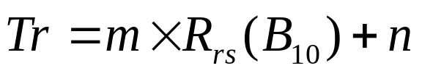
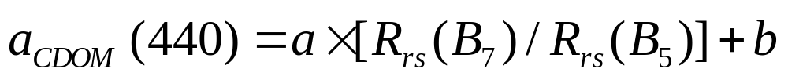
Selection of Three Previous
Semi-analytical Models
Chl-a estimation model (3-band index):
(Gitelson et al., 2008)
Tripton estimation model:
(Ammenberg et al., 2002)
CDOM estimation model:
(Ammenberg et al., 2002)
B₅, B₇, B₉, and B₁₀ denote MERIS bands 5 (555-565 nm), 7 (660-670 nm), 9 (703-713 nm), and 10 (750-757 nm), respectively
22

Slide 23
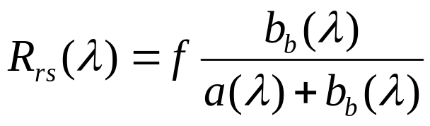
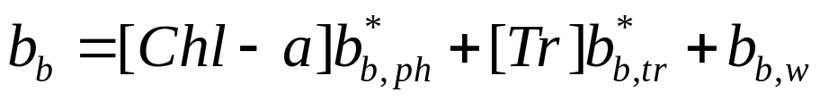
Simulation test for re-analyzing previous models
Remote-sensing reflectance generated from:
[Chl-a] ranges： 1-300 mg m⁻³;
[Tr] ranges： 1-250 g m⁻³;
[CDOM] ranges： 0.1-10 m⁻¹.
In total, 19,964 samples for regression analysis
23

Slide 24
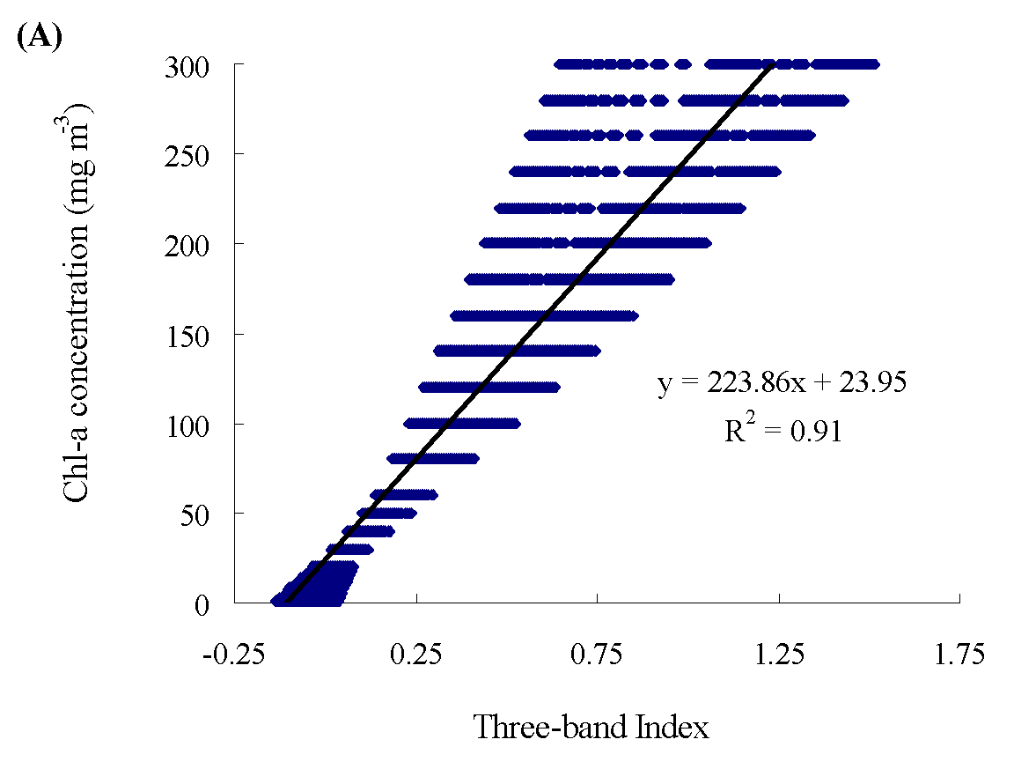
Problem for previous model
(Chl-a vs. 3-band index)
Chl-a=300 mg m⁻³
24

Slide 25
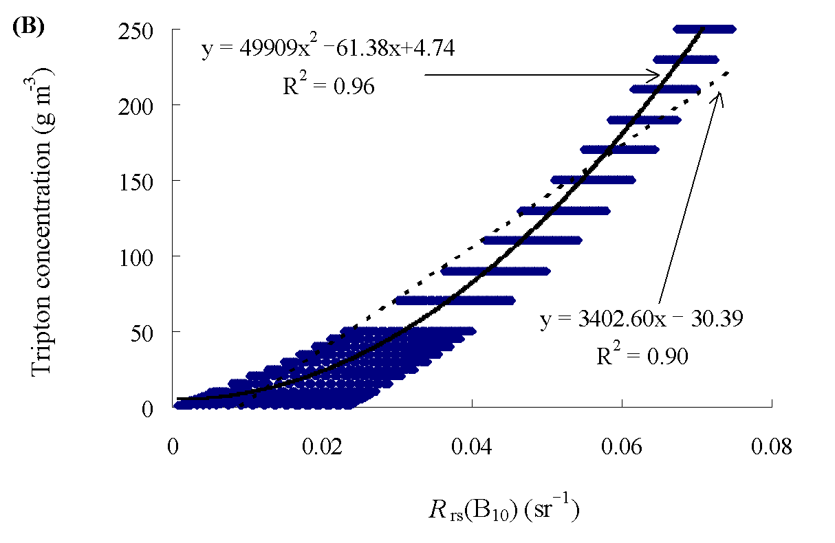
Problem for previous model
(Tripton vs. R_{rs}(B₁₀))
25

Slide 26
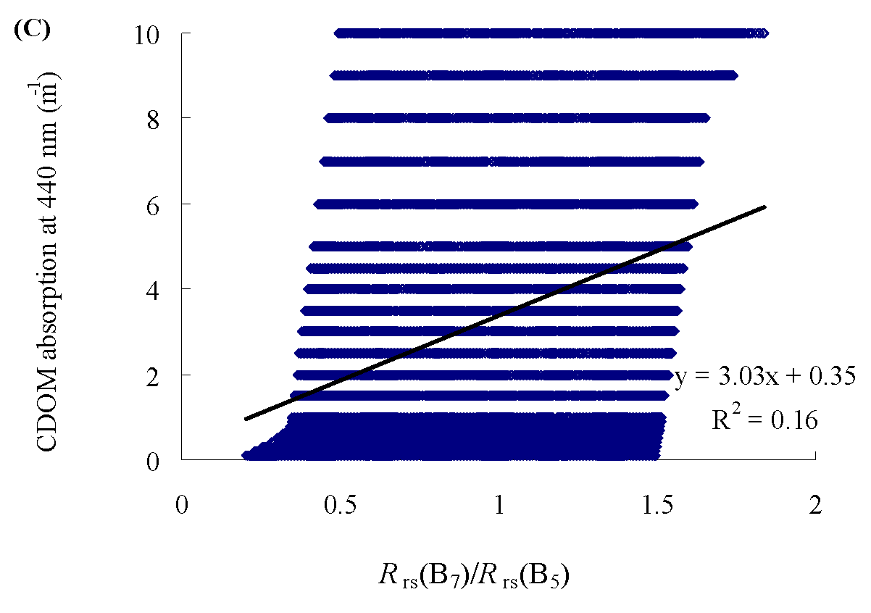
Problem for previous model
(CDOM Vs. R_{rs}(b₇)/ R_{rs}(b₅))
26

Slide 27
Development of the new algorithm
Semi-Analytical Model-Optimizing and Look-Up Table (SAMO-LUT)
Basic idea of this new method is an imaginary case II water, in which only one component changes while the other two are controlled as constants.
E.g. Tr and CDOM are constants; only Chl-a is changing :
Constants
R_{rs} is changing only with Chl-a.
Possibility for improving three-band index
27

Slide 28
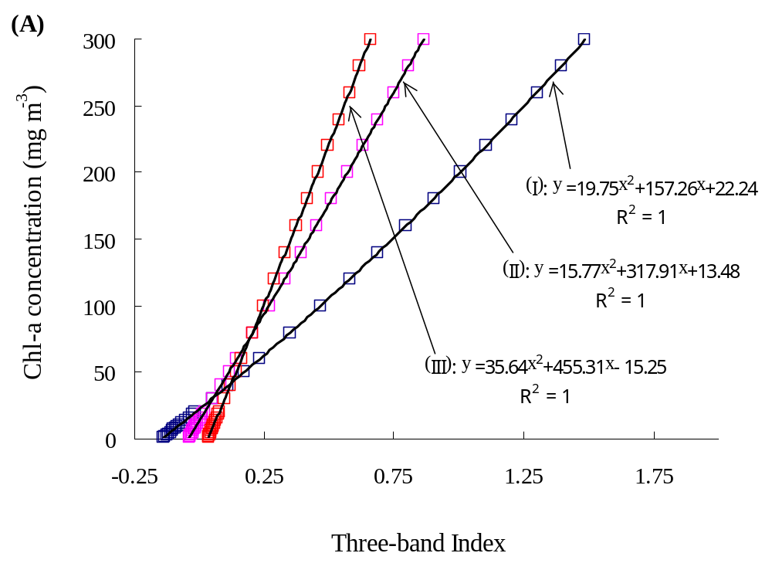
Example of tripton and CDOM controlled as constants
(e.g. Chl-a vs. 3-band index)
(I)Tr=1, CDOM=0.1
(II)Tr=110, CDOM=2
(III)Tr=250, CDOM=10
28

Slide 29
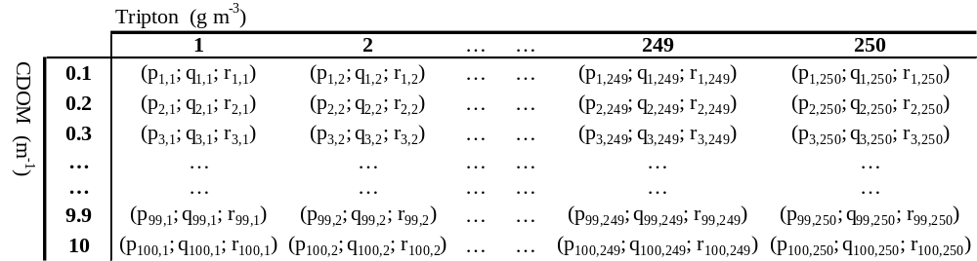
Construction of Look-up Tables (LUT) using simulation data
The coefficients of Chl-a model for each combination of Tripton and CDOM are stored in the LUT.
The practical problem is how to find the optimal models for a given pixel?
29

Slide 30
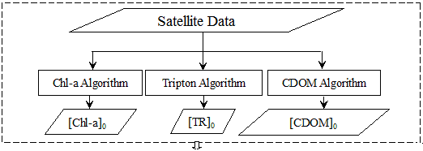

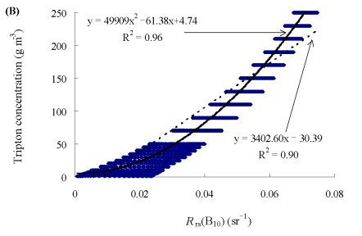

Iteration strategy in the SAMO-LUT method
(Step 1: getting initial values)
30

Slide 31
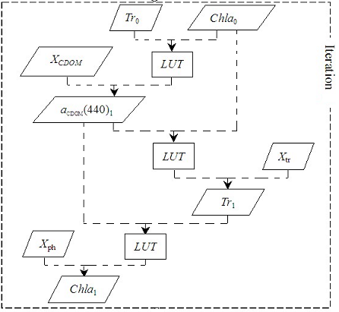
Iteration strategy in the SAMO-LUT method
(Step 2: optimizing estimation model)
Repeat !
Chla₀ = Chla₁
Tr₀ = Tr₁
31

Slide 32
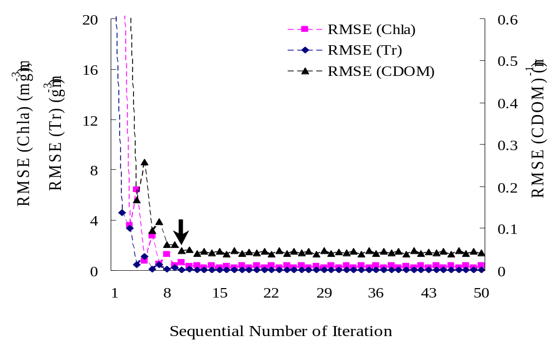
Ending the iteration by difference between the current and last iterations
10 times
32

Slide 33
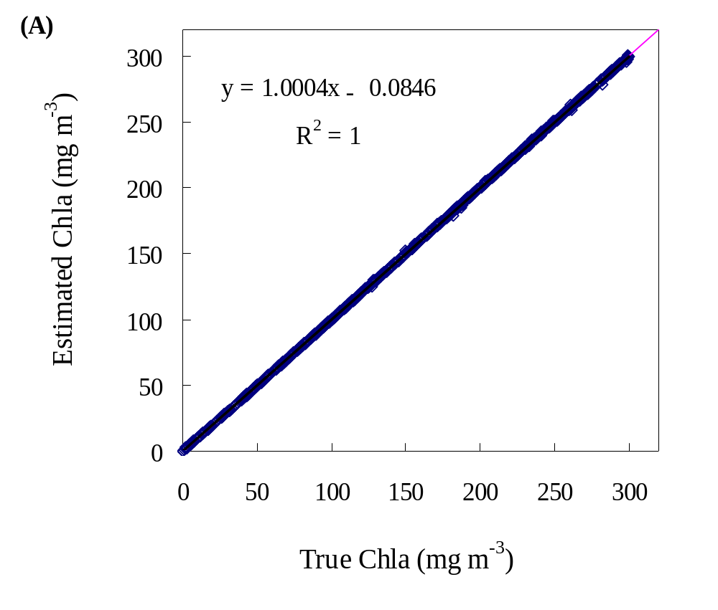
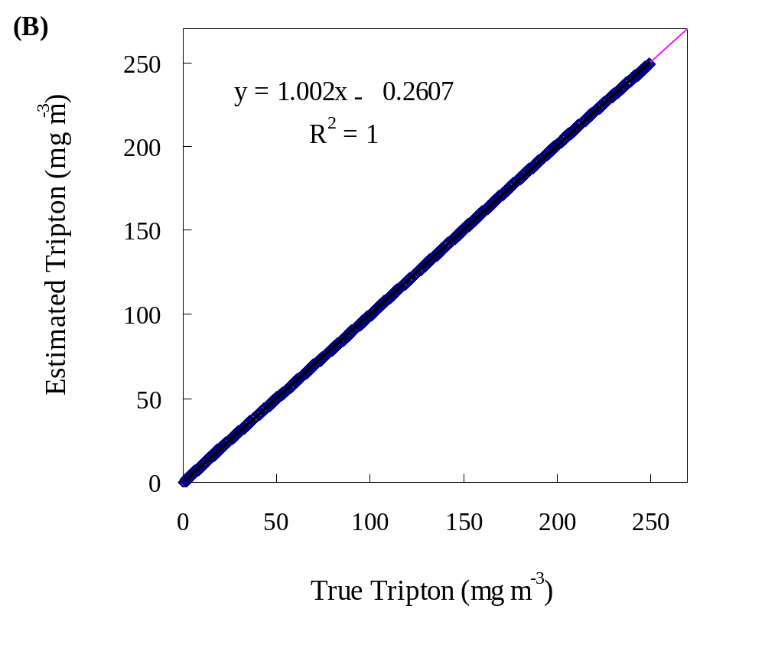

Validation results: By simulated data (noise-free)
RMSE
（0.43,0.42,0.06）
33

Slide 34



Validation results: By in situ data ( low noise)
RMSE
（3.4,1.8,0.2）
34

Slide 35



Validation results: by MERIS data ( high noise)
RMSE
(8.8, 6.9, 0.25)
35

Slide 36



Spatial Distribution of Water Quality
Kunming City
Weak Wind
Strong Wind
36

Slide 37



Long-term Monitoring in Lake Kasumigaura
(Matsushita, Jaelania, Yang et al., 2015, RSSJ)
Time-series of satellite estimation show high agreements with field measurements.

Slide 38

Conclusions: my proposed algorithms
38

Slide 39
Take-home Messages
Scientists in Chiba University, Japan are working on satellite monitoring of water quality.
Our proposed algorithm worked well in long-term monitoring of water quality parameters in Japan’s lakes.
We are challenging the continental/global monitoring of inland lakes, to aid the conventional investigations.
39

Slide 40

Thank you!

