Slide 1


Recursive Partitioning Method on Survival Outcomes for Personalized Medicine
Wei Xu, Ph.D
Dalla Lana School of Public Health, University of Toronto
Princess Margaret Cancer Centre
2nd International Conference on Predictive, Preventive and Personalized Medicine & Molecular Diagnostics

Slide 2
Outline
Statistical consideration on personalized medicine
Recursive partitioning method: prognostic tree and predictive tree on cancer research
Model construction and simulations
Application to a GWAS study on randomized clinical trial data
Conclusions and further directions
Notes:
2. First I will briefly discuss the statistical considerations on personalized medicine. And introduce the recursive portioning method (or so called tree based model). There are two types of tree models on cancer outcomes, one for prognostic purpose, the other for predictive purpose.
I will show some statistical algorithms for model construction and simulations. And implementation of the developed method on a randomized clinical trial study with genome wide association information. Finally some conclusions and further directions.

Slide 3
Personalized Medicine
Personalized Medicine is the idea of getting the right treatment on the right people based on their demographic, clinical, genetic, and genomic characteristics
This has seen by some medical researchers and pharmaceutical industries as the future of healthcare
Notes:
3. In these two days, there are a lot of excellent talks on personalized medicine which is the idea of getting the right treatment on the right people based on their demographic, clinical, genetic and genomic characteristics. This is seen by medical researchers and pharmaceutical industries as the future of healthcare.

Slide 4
Statistical Consideration
Statistical methods to help enable personalized medicine in cancer research face many challenges.
    High dimensional genetic and clinical data
    Work on censoring outcomes such as OS and PFS
    Treatment interactions with multiple risk factor on cancer outcomes
    Classify the patient population into homogeneous subgroups based on the covariate space
    The analytic results should have clear clinical interpretation
Notes:
4. Statistical methods can be used to help on personalized medicine development, especially on cancer research. However, there are still lots of challenges. The first challenge is the high dimensional data. For example, genome wide association data with millions of SNPs, high throughput genomic biomarkers, large number of clinical and demographic factors, and different treatment strategies. The study endpoint is another concern since most of the cancer studies are dealing with censoring outcomes such as overall survival and disease free survival. Most important, we aim to explore the treatment interaction with the multiple risk factors.
For personalized medicine, the goal is to classify the patients population into homogenous subgroups and apply targeted therapy. And such classifications are based on the high dimensional covariate space. At the end, the statistical modeling results should have clear clinical interpretation.

Slide 5
Recursive Partitioning Methods
This model is natural for personalized medicine as they partition the covariate space in a way that mimics the clinicians’ natural decision making process.
They have been used to create interpretable tools to classify prognosis (i.e. prognostic survival tree).
Notes:
5. Today I want to introduce the recursive partitioning method. The advantage of this algorithm is that it can partition the covariate space in a way that mimics the clinicians' natural decision making process which is very useful for personalized medicine. These methods have been used for prognostic purpose such as prognostic tree model.

Slide 6
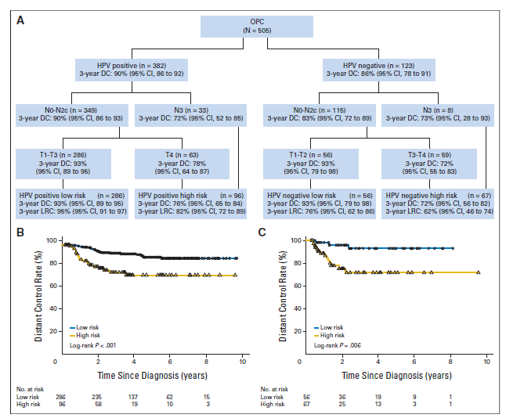
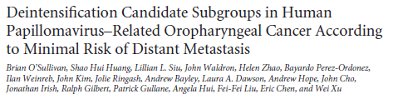

Notes:
6. For example, one of the studies we conducted on Oropharyngeal Carcinomas can create high risk subgroup and low risk subgroups on HPV+ and HPV- OPC patients separately based on the prognostic tree model.

Slide 7
Predictive Survival Tree
We extend survival trees to partition the covariate space based on having large differences in response to treatment. These methods could be used to create interpretable tools that help on the best treatment decision of patients (treatment interaction).
Age <70
Age ≥70
No Smoker
Smoker
RT
CRT
CRT
CRT
RT
HR=1.40
RT
HR=0.55
HR=0.95
Notes:
7. However, the prognostic tree didn't consider treatment effects on patients' outcome. The predictive tree, which try to create interpretable tools that can help to determine the best treatment strategies on specific patients. Instead of create high or low prognostic subgroup, it try to identify subgroups with the biggest difference of treatment response and accordingly to assign optimal treatment on specific subgroup.

Slide 8
Recursive Partitioning Algorithm
Tree based models usually consist of three parts:
    Splitting rule
    Pruning algorithm
    Final tree selection
For the predictive survival tree, all three parts need to be re-developed to reflect the difference of treatment effect for the subgroups.
Notes:
8. Statistically, there are three processes for the recursive partitioning model construction. The splitting rule, the pruning algorithm, and the final tree selection. Existing tree models have been developed for binary outcomes as classification tree, continuous outcomes as regression tree, and time to event outcomes as survival tree. However, for the predictive tree model, all three parts of the algorithm need to be re-developed to reflect the difference of treatment effect for the subgroups.

Slide 9
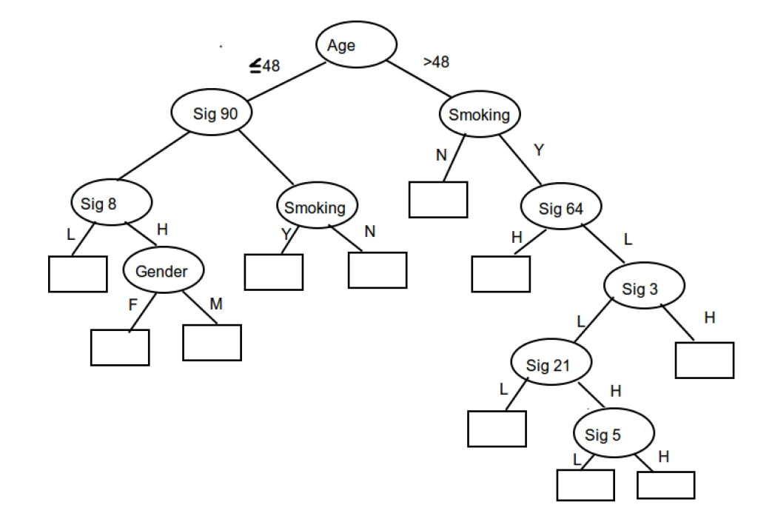
Splitting Rule
The splitting rule partitions the samples into many groups. It is applied recursively until there are very few samples in each group, or large number of groups are created.
Notes:
9. The splitting rule partitions the samples into many groups based on covariate space. For each split, it split the samples into two subgroup or say sub-nodes. It is applied recursively until there are very few samples in each group, or large number of subgroups are created.

Slide 10
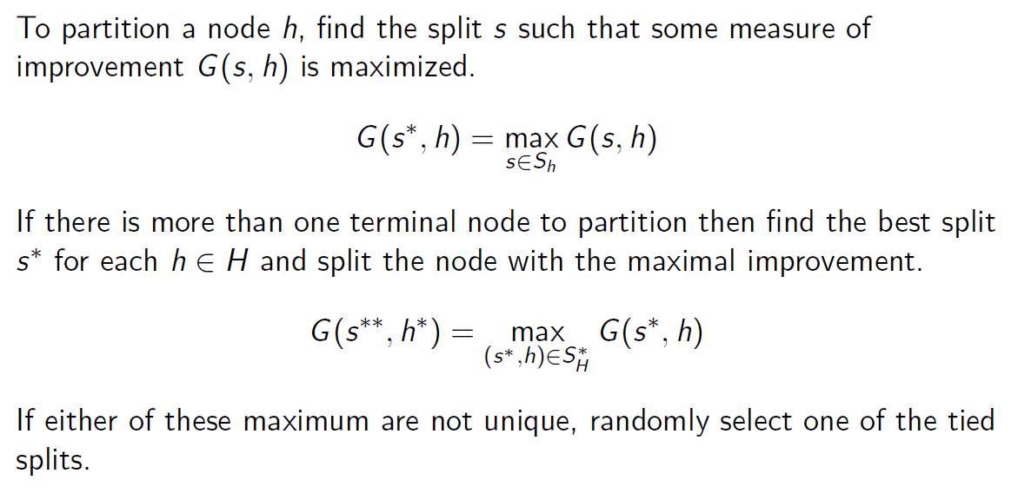
Splitting Rule
Notes:
10. For each split, it searches all the candidate splitting factors and choose the best split that maximize a splitting measure statistic.

Slide 11
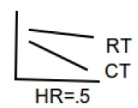
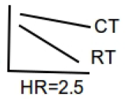
Different Splitting Rules
Prognostic Tree Split
Predictive Tree Split
Old
Young
Signature = H
Signature = L
Notes:
11. Depends on prognostic or predictive tree models, the splitting measure can be different. For example, the prognostic tree split is to maximize the different of survival performance between the two splitting nodes. And the predictive tree split is to maximize the different of HRs between the two splitting nodes.

Slide 12
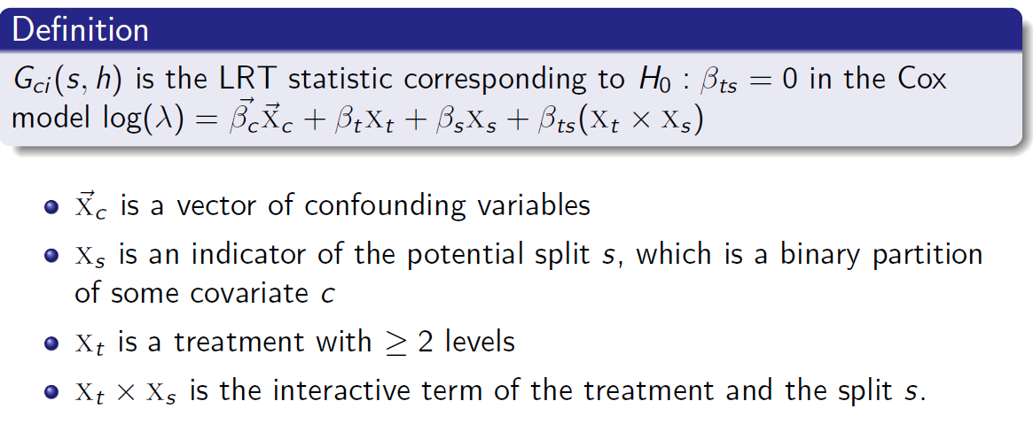
Splitting Rule for Predictive Survival Tree
The best split can be interpreted as the one that creates the two child nodes with the most statistically significant difference in response (i.e. OS) to treatments.
Notes:
12. The splitting measure of the predictive tree is based on a likelihood ratio test to assess the models with or without a treatment interactive term. Clinical covariates can be incorporated in the calculation to adjust for potential confounding effects.

Slide 13
Full Tree
Sig 1
High
Low
Smoking
T stage
No
Yes
Early
Late
T stage
Age
Gender
Young
F
M
Late
Old
Early
Sig 3
Sig 2
High
Low
Negative
Positive
N stage
Early
Late
Notes:
13. Apply the same splitting rule recursively, we can build up a full tree with lots of subgroups.

Slide 14
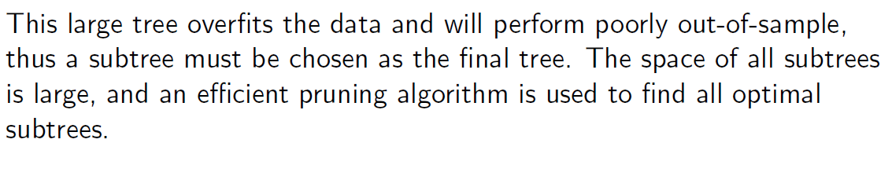
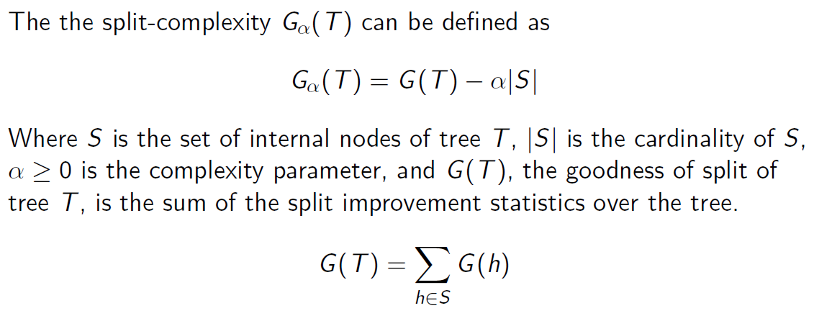
Pruning
Notes:
14. the full tree can be big and may over fit the data. the next step, pruning algorithm is very important to reduce the tree size. This algorithm is based on a split-complexity measure which give a penalty on the tree size. the bigger the tree, the larger the tree size, and the smaller the split complexity. The complexity parameter alpha here controls the magnitude of the penalty.

Slide 15
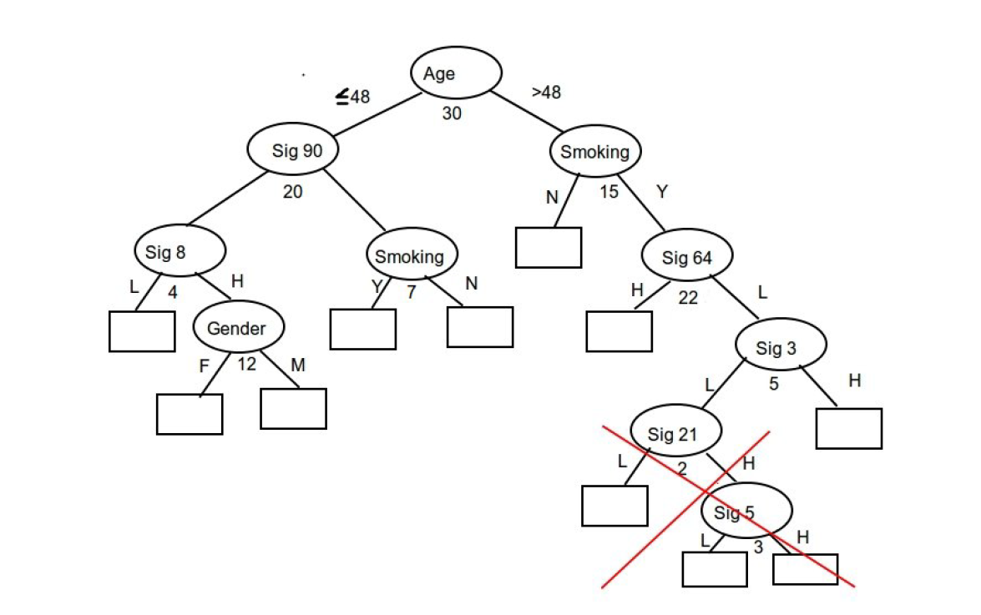
Pruning
Notes:
15-21. Under different values of the complexity parameter, the full tree can be trimmed from a complicated tree structure to totally no split.

Slide 16
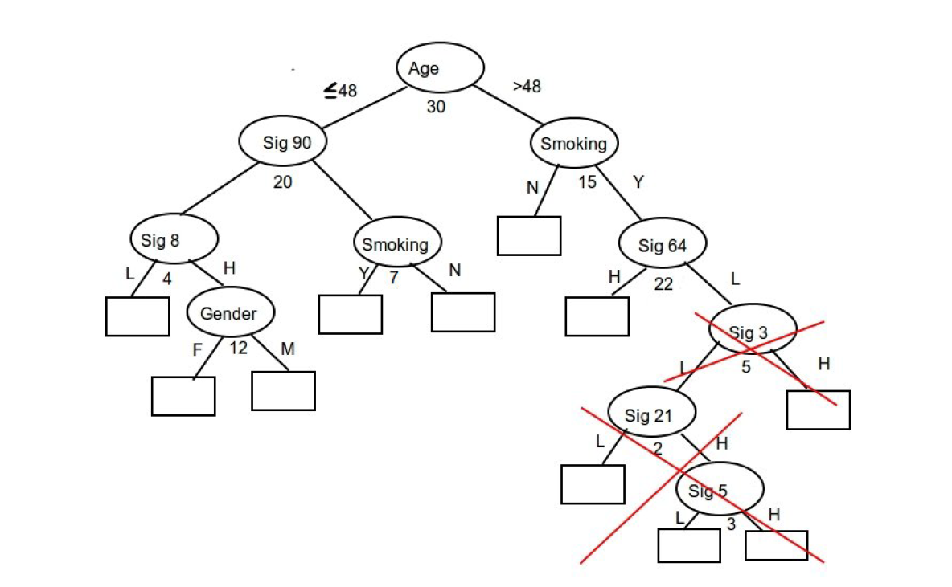
Pruning

Slide 17
Pruning

Slide 18
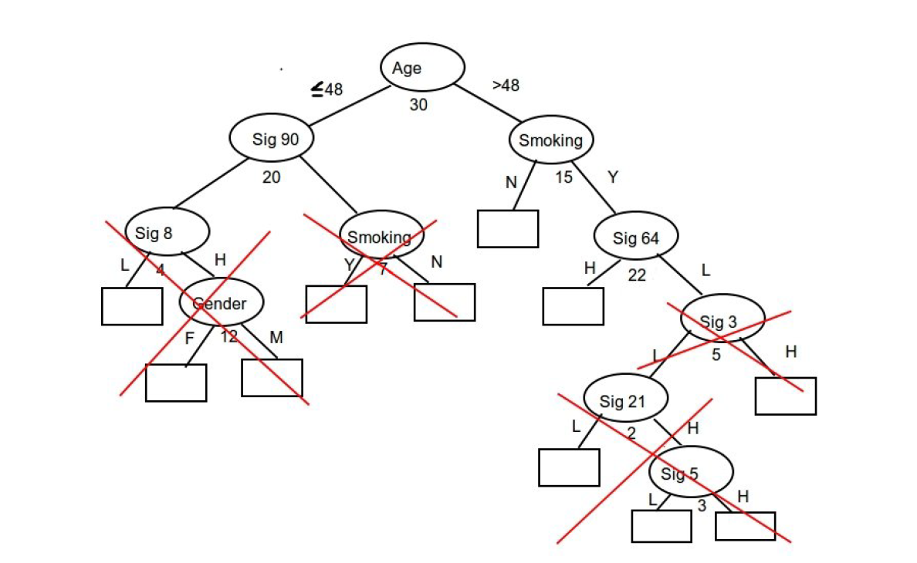
Pruning

Slide 19
Pruning

Slide 20
Pruning

Slide 21
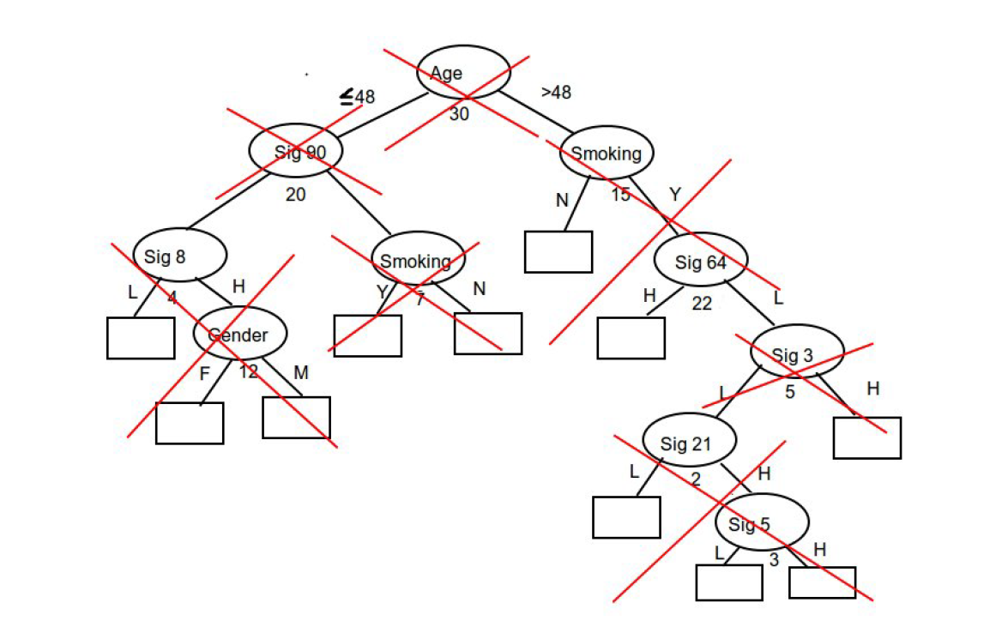
Pruning
Notes:
15-21. Under different values of the complexity parameter, the full tree can be trimmed from a complicated tree structure to totally no split.

Slide 22
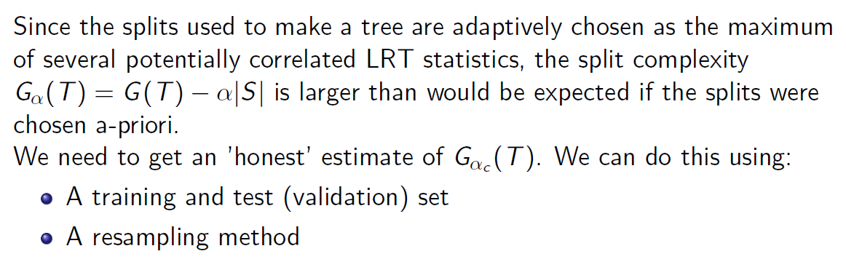
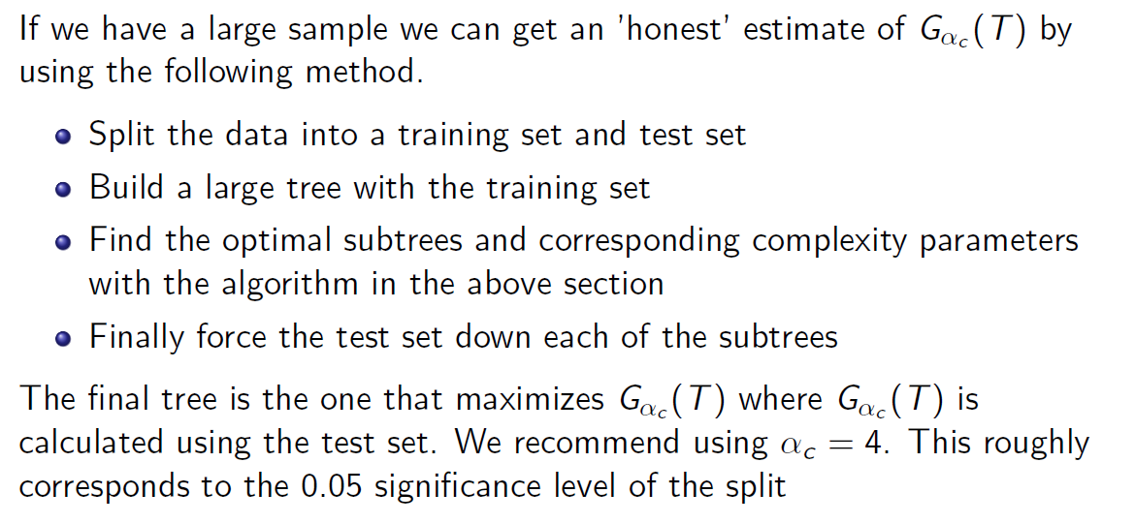
Final Tree Selection with Validation Set
Notes:
22. Now the question is, what is the optimal tree structure? This needs to calculate an honest estimation of split complexity. To do this, the first approach is to use a training and validation process, this is under the situation that there is a large data and we can randomly split it into the training and validation sets. We can use the training set to build up a full tree and use the validation set to calculate the corresponding split complexity. The optimal tree structure is the one with the maximized split complexity which is estimated from the validation data set.

Slide 23
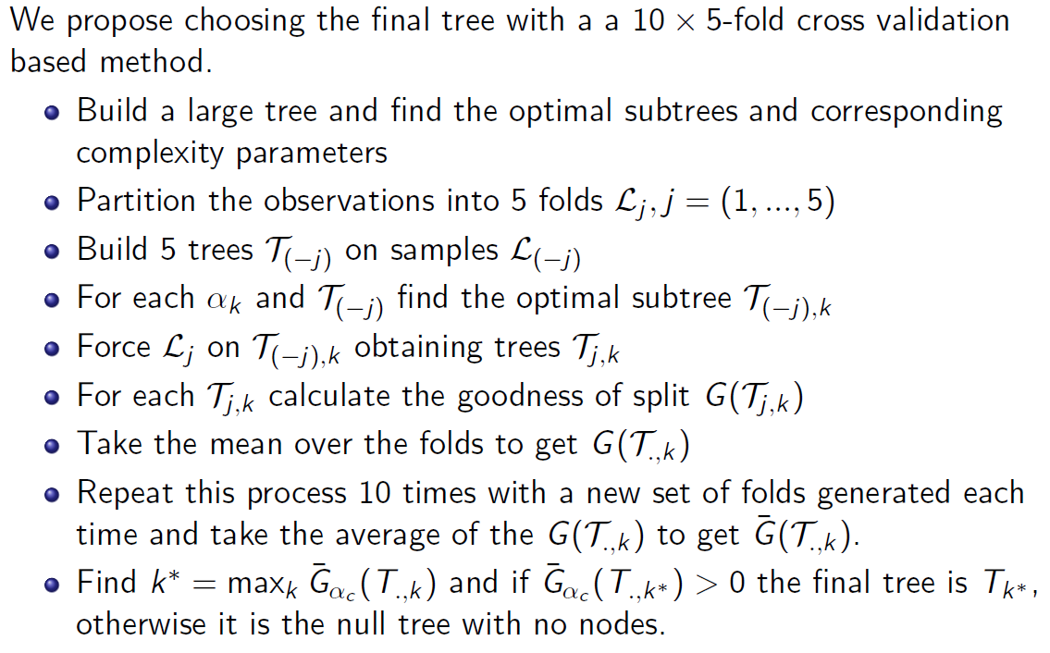
Final Tree Selection with Cross Validations
Notes:
23. For a data with smaller sample size, we can apply another approach called cross validation. I can skip the detailed technology here, but the idea is similar, use independent samples to provide honest estimation of the split complexity and choose optimal tree structures accordingly.

Slide 24
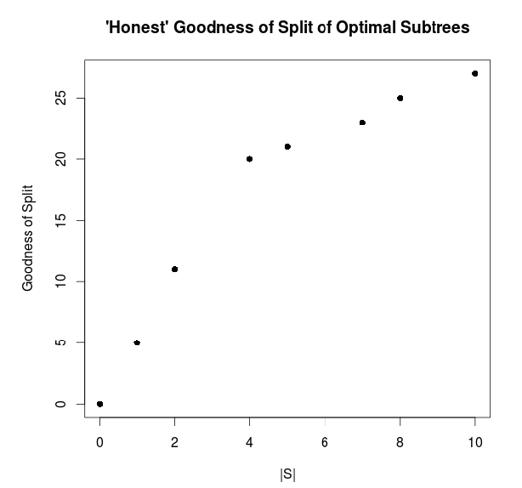
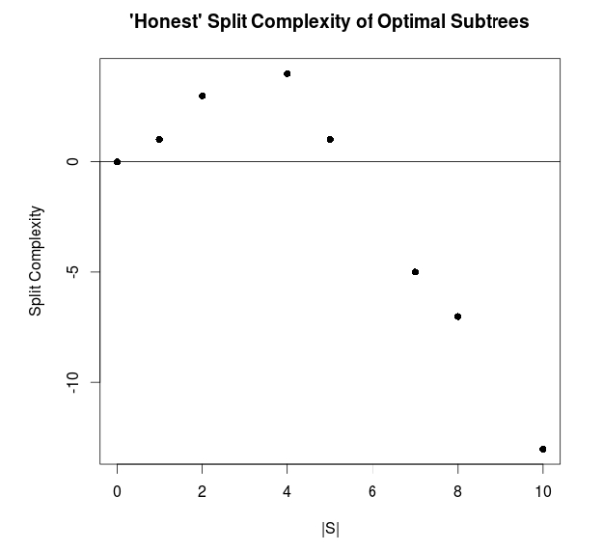
Final Tree Selection Example
Notes:
For illustration, we can see the difference of splitting measure and the splitting complexity. The splitting measure or say goodness of split keep increase when the tree size is getting bigger, but the split complexity is different. And the best tree structure is the subtree with the optimal split complexity.

Slide 25
Evaluation of the Decision Tree: Simulations
We simulate the following tree structures:
    The 'null' tree with no predictive factor (no split)
    A tree with a single true predictive factor (one split)
    A tree with two true predictive factor (two splits)
The number of potential genetic or clinical factors from 20 to 1000, and the risk factors are binary variables.
Different effect sizes and sample sizes were simulated with four confounders created that are associated with survival outcome.
Notes:
24. After the theoretical model construction, the next step is for evaluation. We designed comprehensive simulations under different situations of interactive effects and different number of splitting variables. For simplicity, all the factors are treated as binary. The magnitude of interactive effect and sample sizes varies and multiple confounders are created.

Slide 26
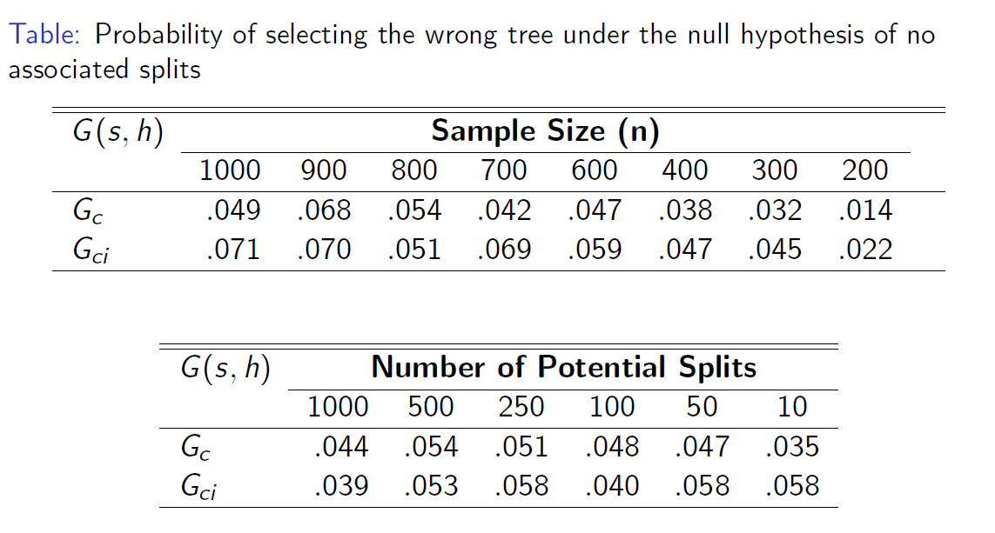
Evaluation of the Model: Type I Error
Notes:
25. Now let's see some simulation results. the first evaluation is on type I error. The wrong splitting rates are well under controlled given different sample sizes and different number of splitting factors even when the covariate space is huge.

Slide 27
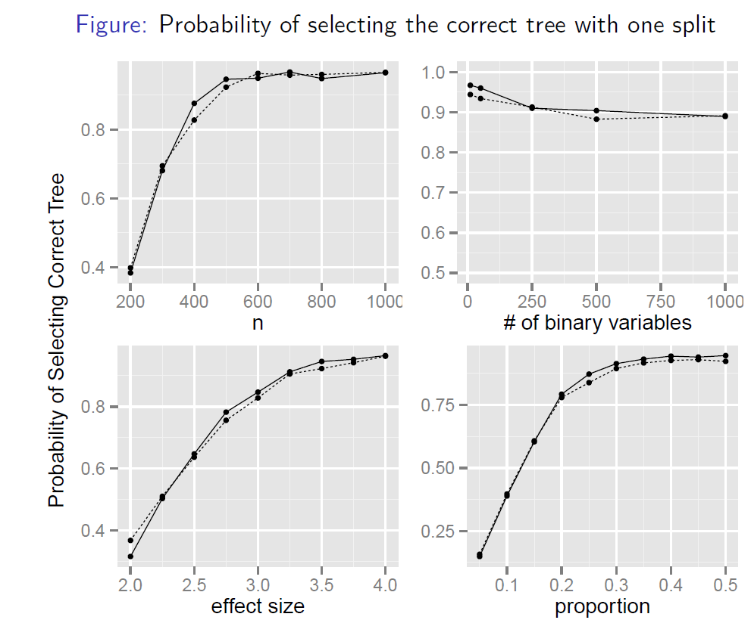
Evaluation of the Model: Statistical Power
Notes:
26. Then let's see the statistical power, the power of the model increase when the sample size increase, or when effect size increases, or the two treatment group are more balanced. When the number of splitting factors increase, the power decreases as expected. Interestingly, the power performed quite robust when the dimension of the covariate space is getting very high.

Slide 28
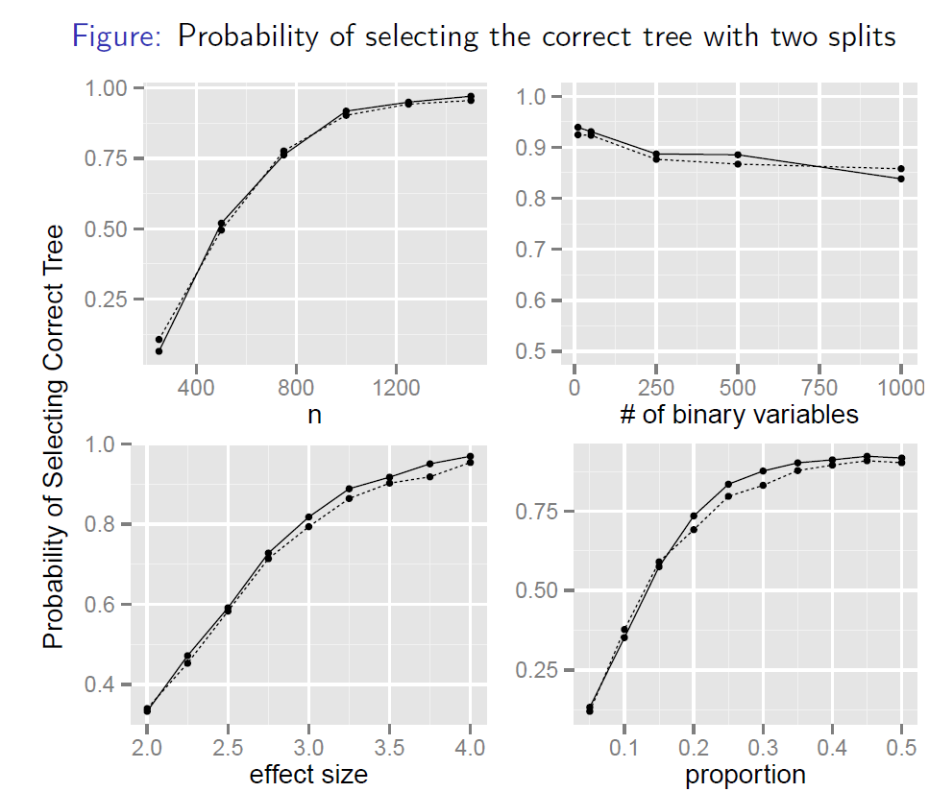
Evaluation of the Model: Statistical Power
Notes:
27. The performance of model with two split is similar to the model with only one split.

Slide 29
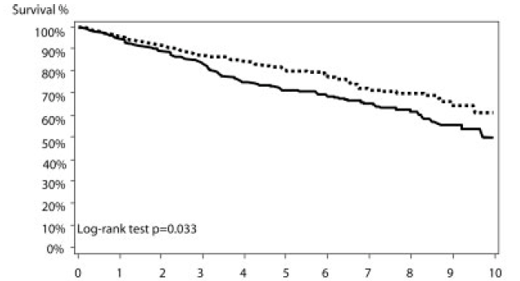
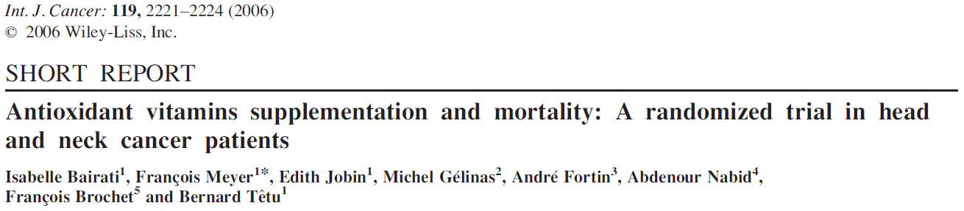
Application to a Clinical Trial Study
A randomized Phase III α-tocopherol/β-carotene placebo-controlled trial with 540 early stage HNC patients (Quebec).
Notes:
28. The simulation results demonstrate the good performance of the model. Then we apply the model on a real randomized clinical trial study with 540 early stage head and neck cancer patients. The study was conducted in Quebec of Canada with 10 years follow up. Interesting to see, the placebo group showed better performance on disease free survival.

Slide 30
Application to a Clinical Trial Study
GWAS data with 620,901 SNPs genotype information (Illumina 610K platform).
After genetic quality control:
515 patients (261 in the treatment arm and 254 in the placebo arm) with 543,873 SNPs.
PFS is the primary outcome with top three genetic principal component as the confounders.
Top 100 most prognostic significant SNPs were selected for predictive survival tree. Genetic dominant model was used for each SNP.
1000 validation data sets were used for pruning.
Notes:
29. What we conducted here is an extension study on pharmacogenetic assessment on genetic markers. Our goal is to assess gene-treatment interactions using the illumina 610K GWAS data. We applied genome scan on all the SNPs and use the top 100 SNPs with the highest prognostic signals for the predictive tree construction.

Slide 31
Application to a Clinical Trial Study
Final Decision Tree
1.35
rs16916113
0.34
rs7245010
1.62
rs290991
0.36
1.82
2.65
1.10
Subgroups are defined by SNP genotypes, wild type on the right, others on the left.
Hazard ratios (HRs) are presented for each subgroup.
Notes:
30. The final tree structure provide three splits and corresponding genetic markers. Each SNP genotype has been coded as wild type versus the others following a genetic dominant model. The numbers in each group are the HRs comparing the treatment group to placebo group. The initial group with all the samples have HR 1.35 show better placebo performance, after tree model construction, we identified subgroup with different treatment effect, and suggest different treatment strategy accordingly.

Slide 32
Conclusions
The predictive tree model can be used to assess treatment interactive effect of multiple risk factors such as multiple genetic markers or signatures
The method has well controlled type I error and is robust to the number of potential risk factors to be explored.
The method can adjust for potential confounders
The identified subgroups can help treatment decision on patients with specific characteristics.
Notes:
31. Finally some conclusions, the predictive tree model can be used to assess treatment interactive effect with large number of clinical and genetic or genomic markers, the biomarkers can be DNA, RNA, proteomics, or integrative signatures. This novel method has well controlled type I error and is robust to the number of potential risk factors. The method can adjust for potential confounders. The identified subgroups can help treatment decision on patients with specific characteristics.

Slide 33
Further Directions
The methods can be extended to the studies where there are more than two treatment arms.
The methods are based on parametric survival models. It can be extended to other clinical outcomes such as binary, ordinal, count.
Further extension on computing risk outcomes such as cause specific survival.
Further development on non-randomized retrospective clinical data for personalized medicine decision.
Notes:
32. Further directions include treatments with multiple arms, different clinical outcomes such as binary, ordinal, or count data. Another extension is the development on competing risk outcomes such as cause specific survival. The current model is based on randomized trial in which the treatment are randomly assigned and independent to other risk factors. How to extent the current model to non-randomized retrospective study is another direction.

Slide 34


Acknowledgement
Princess Margaret Cancer Centre
University of Toronto
Ryan Del Bel
Colleen Kong
Osvaldo Espin-Garcia
Dr. Brian O'Sullivan
Dr. Sophie Huang
Dr. Geoffrey Liu
Dr. Fei-Fei Liu
Laval University
Dr. Isabelle Bairati
Dr. Francois Meyer

