Slide 1

Wedad M. Nawar;
BDS. Faculty of Dentistry,
Alexandria University, Egypt
A Potential Role for Sex Hormone Receptor Antagonists in Treatment of Malignant Salivary Gland Tumors, as compared to Breast Cancer

Slide 2
Breast and salivary glands are similar morphologically
consequently we expect similarities in the pathological processes.

Slide 3
Since adjuvant hormonal therapy is recommended for hormone receptor positive breast tumors;
therefore the expression of sex hormones in Malignant Salivary Gland Tumors, and their potential use in treatment is being studied comparatively.

Slide 4
This Review discusses the following points :
Similarities between MSGTs and Breast Cancers
Role of hormones in treatment of breast cancers
Expression of sex steroid hormones in MSGTs
The potential role of hormones in treatment of MSGTs

Slide 5
1. How are MSGTs similar to Breast Cancers?
Breast and salivary glands are both tubulo-acinar exocrine glands
The same types of neoplasms can arise in both sites; such as pleomorphic adenoma, myoepithelioma, acinic cell carcinoma, oncocytic carcinoma, AdCC, MEC and SDC.

Slide 6
I- Mucoepidermoid Carcinoma of salivary glands
It is composed of a mixture of mucous, epidermoid and intermediate cells.
Some tumors also show variable numbers of clear cells.

Slide 7
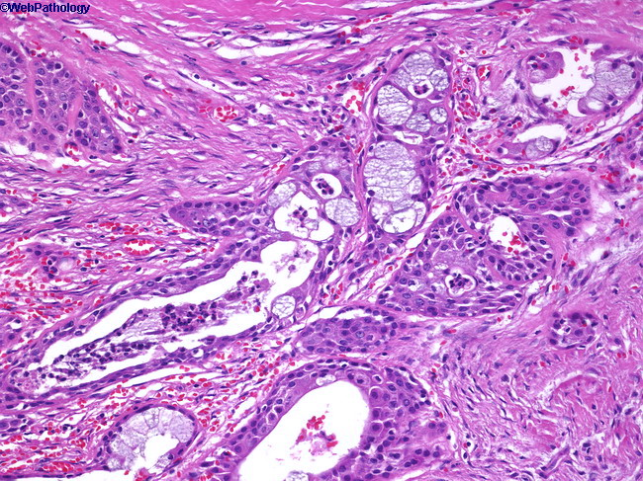
Low grade Salivary MEC

Slide 8
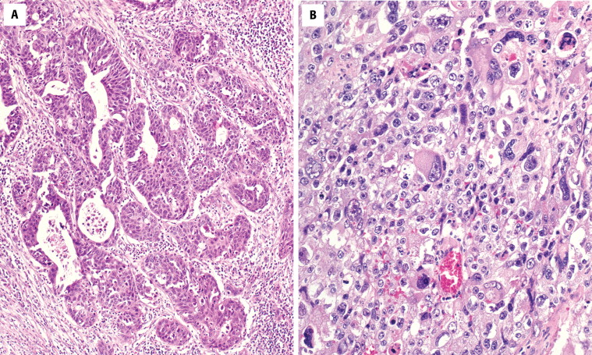
Intermediate-grade MEC showing limited cyst formation and nearly absent mucocytes.

Slide 9
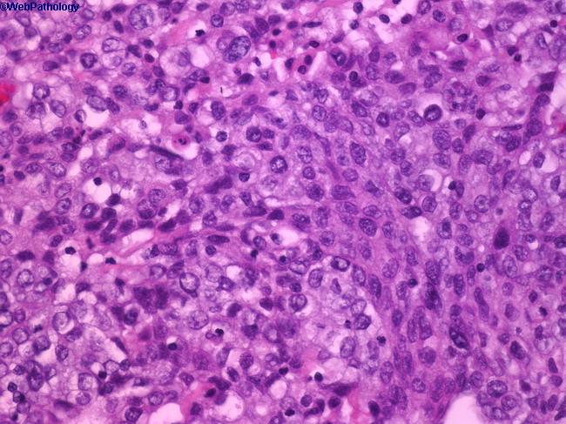
High grade Salivary MEC, A high-grade tumor with increased mitoses and profound pleomorphism.

Slide 10
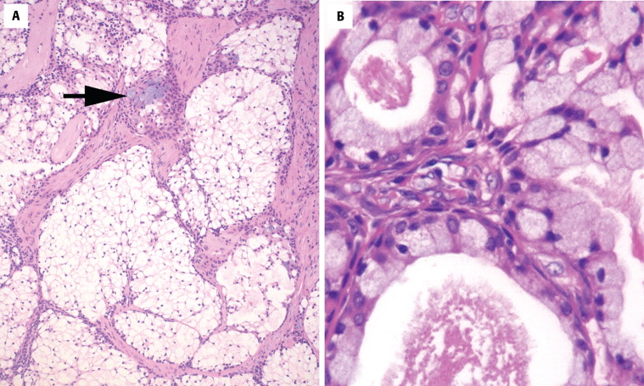
A, This mucoepidermoid carcinoma shows a predominantly clear cell pattern, although isolated mucocytes are noted (arrow). B, The mucocytes have fluffy cytoplasm and may surround secretions within the duct spaces.

Slide 11
Mucoepidermoid Carcinoma of breast
Mucoepidermoid carcinoma of the breast can also be categorized as low, intermediate and high grades.

Slide 12
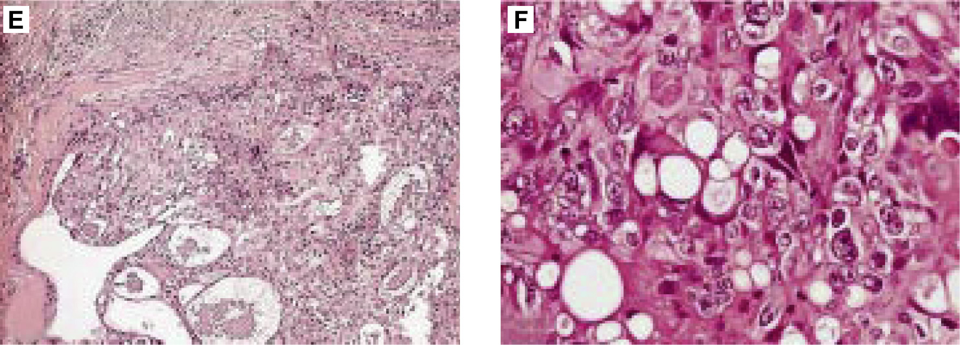
Low grade mammary mucoepidermoid carcinoma (MEC) composed of neoplastic nests outlined by basaloid cells and centrally containing epidermoid and mucous secreting cells

Slide 13
high power magnification of high grade mammary MEC showing a complex admixture of basaloid and epidermoid elements and mucous secreting cells

Slide 14
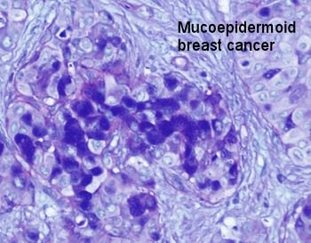
Mammary MEC, Alchian Blue

Slide 15
II- Adenoid Cystic Carcinoma of salivary glands
AdCC is composed of two main types of cells;
  myoepithelial cells and
  ductal cells.

Slide 16
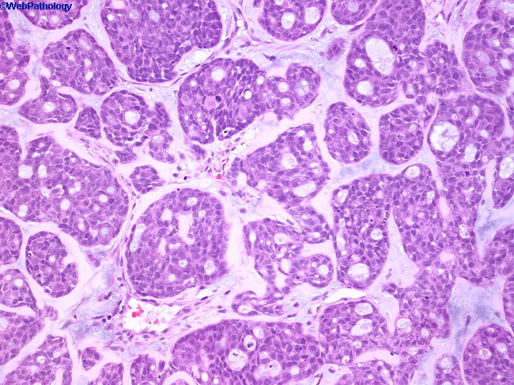
AdCC, Cribriform Pattern

Slide 17
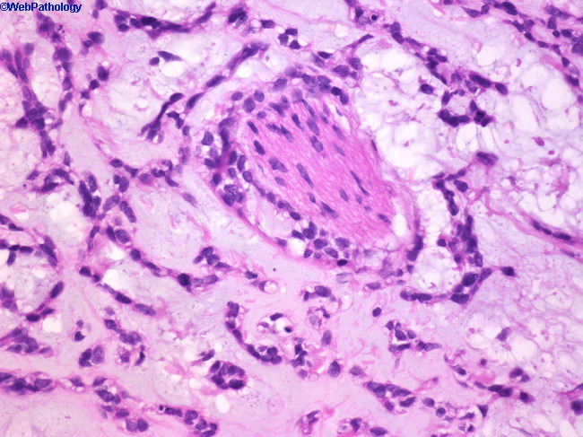
AdCC with Perineural Inavsion

Slide 18
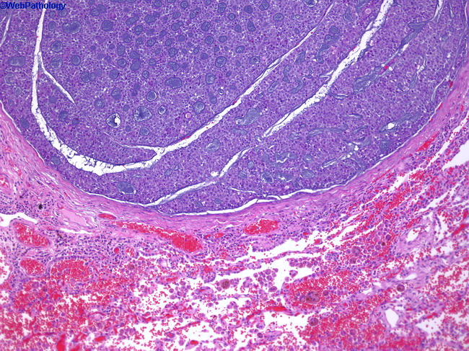
Lung metastasis of AdCC

Slide 19
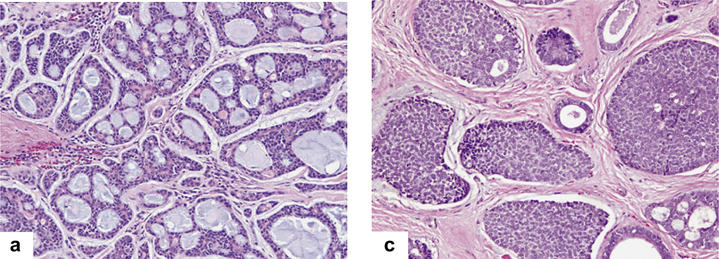
Low-grade adenoid cystic carcinoma of the salivary gland with predominant cribriform/tubular pattern.

Slide 20
High-grade adenoid cystic carcinoma of the salivary gland with greater than 30% solid pattern.

Slide 21
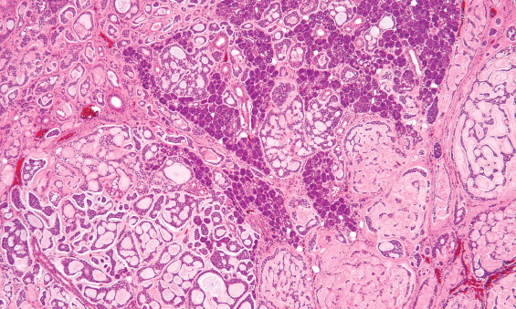
An adenoid cystic carcinoma showing multiple patterns of growth, although the cribriform and tubular areas predominate. Notice how the tumor is infiltrating between and around the parenchyma.

Slide 22
Adenoid Cystic Carcinoma of the Breast
AdCC of the breast is composed of large sheets, nests or small aggregates of round to oval cells, sometimes with hyperchromatic nuclei.

Slide 23
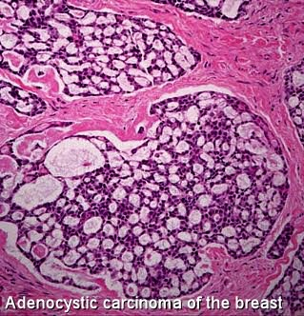
Adenoid cystic carcinoma of the breast showing cribriform architecture; composed of basaloid cells that outline spaces containing basal-like material and of eosinophilic cells lining true glandular lumina

Slide 24
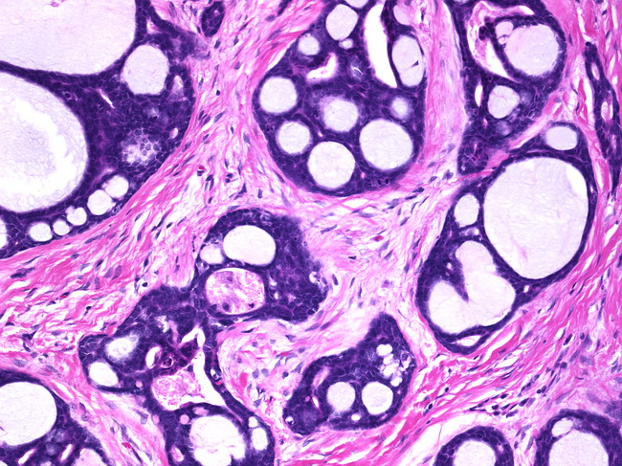
Cribriform pattern of AdCC

Slide 25
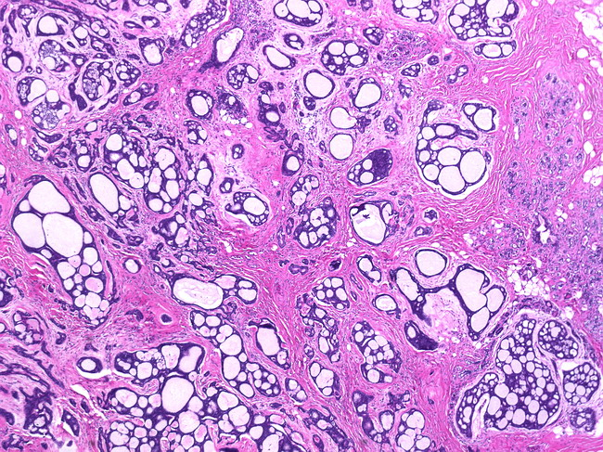
Cribriform pattern of AdCC

Slide 26
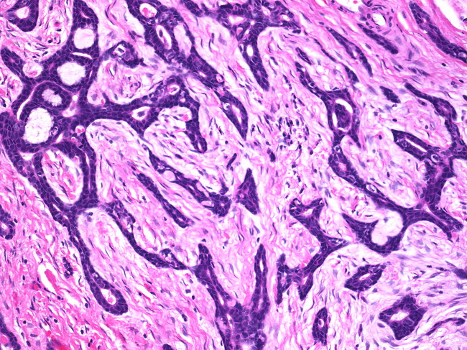
Trabecular pattern of AdCC

Slide 27
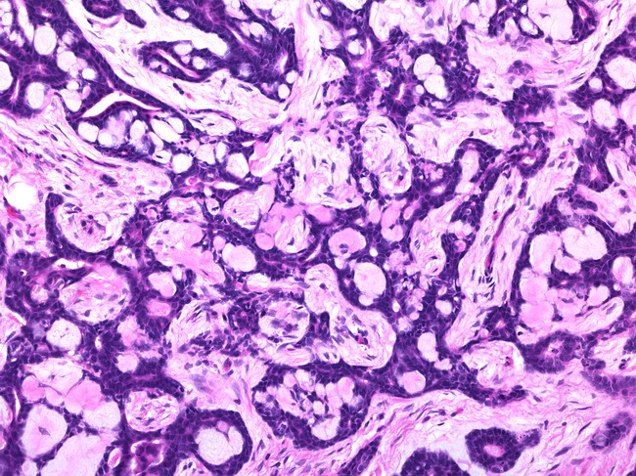
Trabecular pattern of AdCC

Slide 28
III- Salivary Duct Carcinoma
The morphology of SDC is characterized by cuboidal and polygonal cells forming ducts and nests; often with central necrosis.

Slide 29
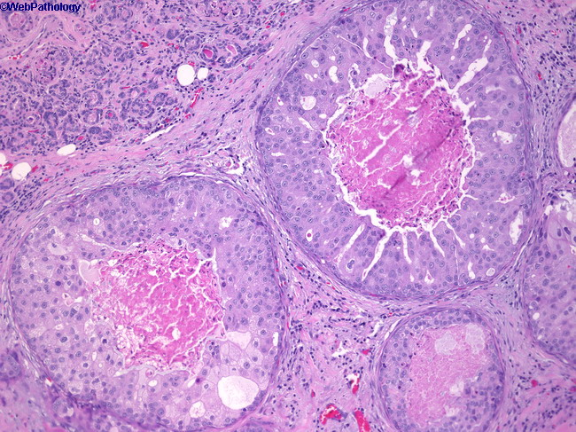
Salivary duct carcinoma

Slide 30
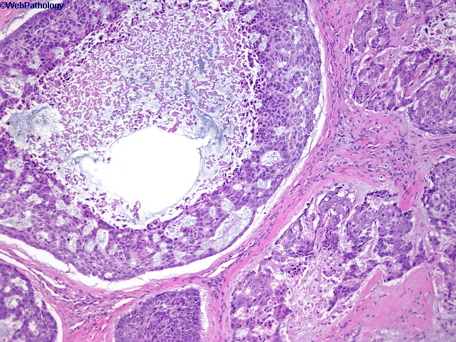
Salivary Duct Carcinoma

Slide 31
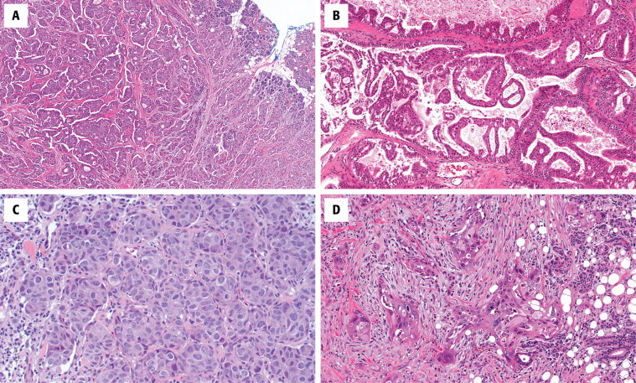
A more solid pattern of growth is noted, composed of large, polygonal tumor cells.

Slide 32
Mammary Duct Carcinoma
Several forms of histological architecture are recognised, the most common of which are:
cribriform,
solid,
Papillary, etc.

Slide 33
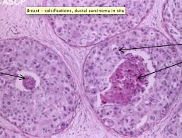
Ductal Carcinoma in-situ

Slide 34
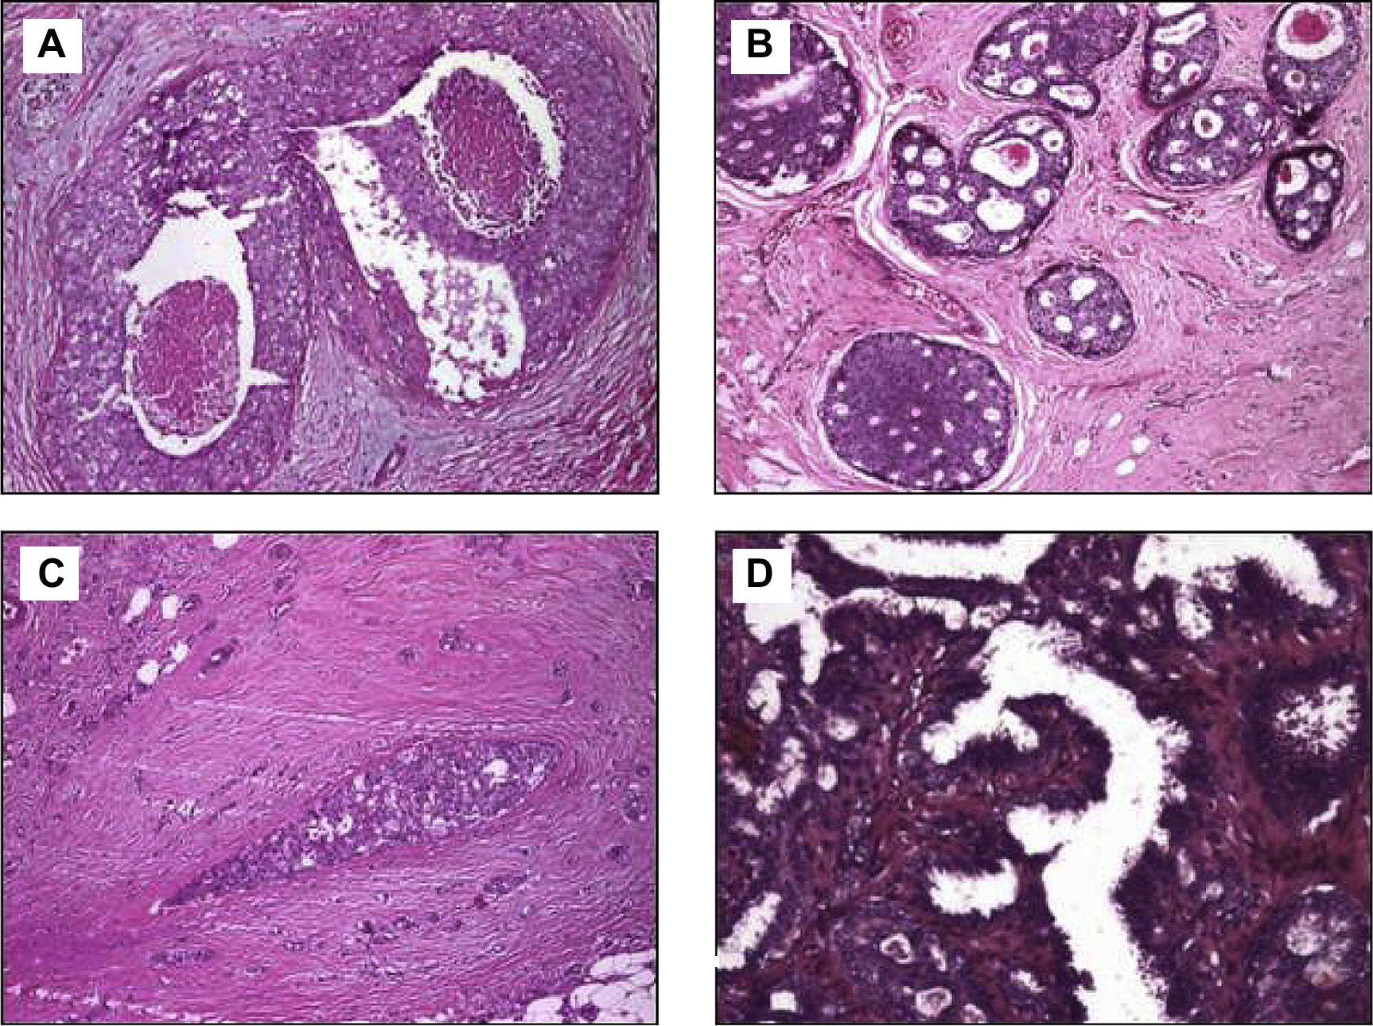
Cribriform-type ductal carcinoma in situ

Slide 35
Similarities between MSGTs and Malignant Breast Tumors
Role of hormones in treatment of breast cancers
Expression of sex steroid hormones in MSGTs
The potential role of hormones in treatment of MSGTs

Slide 36
2. Role of sex hormones in treatment of Breast Cancer
Estrogen promotes the growth of about 2 out of 3 of breast cancers; ER -positive cancers.
Because of this, several approaches to blocking the effect of estrogen or lowering estrogen levels are used to treat hormone receptor-positive breast cancers.

Slide 37
Tamoxifen, an ER antagonist
In ER-positive Breast Cancer patients, tamoxifen reduces recurrence and death rates significantly.
However Tamoxifen has no significant benefit in ER-negative women.

Slide 38

Strategies for treatment of ER-positive breast cancer:
1. Blocking ovarian function
  Ovarian ablation: by surgery or radiation. This has a permanant effect.
  Ovarian suppression: using drugs as GnRH. This has a temporary effect.

Slide 39
2. Blocking estrogen production
Using Aromatase Inhibitors- in postmenopausal women.

Slide 40
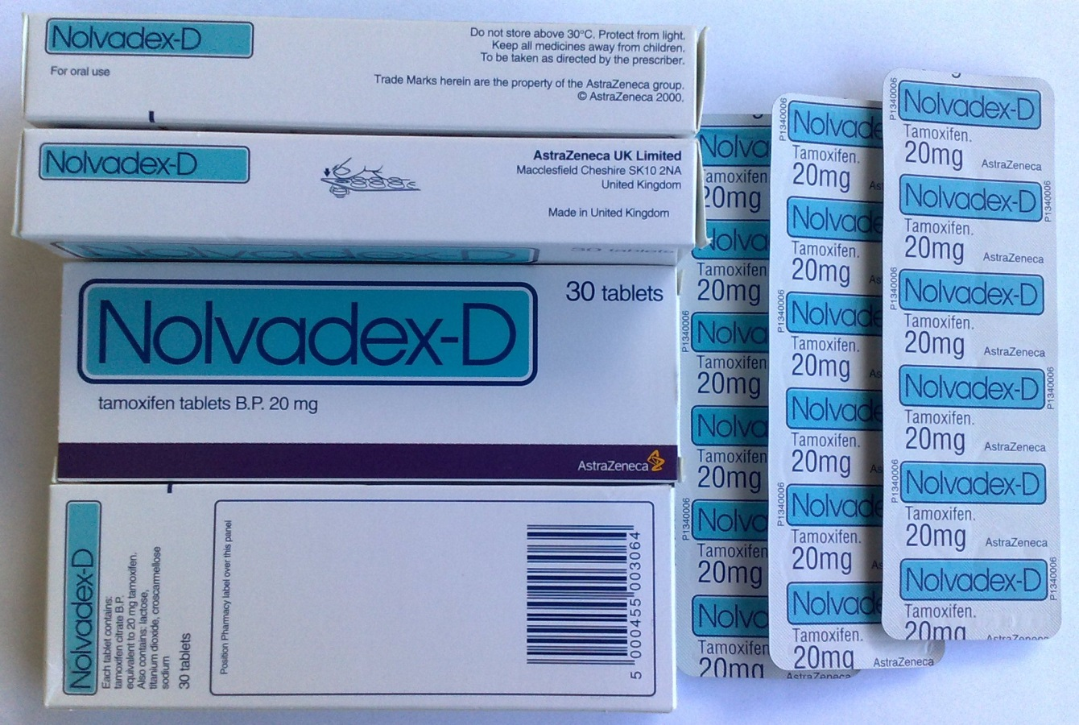
3. Blocking estrogen’s effects
SERMs such as tamoxifen, bind to estrogen receptors; preventing estrogen from binding.

Slide 41
Hormone therapy can be used as:
Adjuvant therapy for early-stage breast cancer to increase the likelihood of a cure.
Treatment of metastatic breast cancer several types are approved to treat metastatic hormone-sensitive breast cancer.

Slide 42
Neoadjuvant treatment of breast cancer The use of hormone therapy to treat breast cancer before surgery to reduce the size of a breast tumor to allow breast conserving surgery.

Slide 43
Prevention of the development of breast cancer in high risk women; since most early breast cancers are ER-positive.

Slide 44
Similarities between MSGTs and Malignant Breast Tumors
Role of hormones in treatment of breast cancers
Expression of sex steroid hormones in MSGTs
The potential role of hormones in treatment of MSGTs

Slide 45
3. Expression of sex steroid hormones in MSGTs:
Steroid receptors to estrogen and progesterone are present in:
Human breast cancer
Cancer of the prostate
Human colorectal cancer
Lymphoblastic leukaemia
Endometrial cancer

Slide 46
Expression of hormone receptors in salivary glands has been studied since White and Garcelon first described therapy with estrogen in salivary gland tumors in 1955.

Slide 47
Tables 1-3 summarize the reports of Estrogen, Progesterone and Androgen Receptors in AdCC, MEC and SDC respectively.

Slide 48
Table 1: Summary of the reports of ER, PR and AR in Adenoid Cystic Carcinoma
Author | Year | No. of Cases | ER+ | PR+ | AR+
Shick et al. | 1995 | 12 | 0 | 6 | 0
Jeannon et al. | 1999 | 6 | 3 | 0 | Np
Dori et al. | 2000 | 27 | 0 | 2 | Np
Moriki et al. | 2001 | 6 | Np | Np | 0
Nasser et al. | 2003 | 10 | 0 | 0 | 2
Pires et al. | 2004 | 72 | 0 | Np | Np
Miller et al. | 2004 | 5 | 0 | Np | Np
Ito et al. | 2009 | 30 | 0 | 0 | 2
Riad S. | 2009 | 11 | 0 | 1 | 8
TOTAL |  |  | 3/173 | 9/96 | 12/69
 |  |  | 1.73% | 9.4% | 17.4%

Slide 49
Table 2: Summary of the reports of ER, PR and AR in Mucoepidermoid Carcinoma
Author | Year | No. of Cases | ER+ | PR+ | AR+
Lamey et al. | 1987 | 1 | 0 | 0 | Np
Jeannon et al. | 1999 | 10 | 3 | 0 | Np
Moriki et al. | 2001 | 8 | Np | Np | 0
Nasser et al. | 2003 | 10 | 1 | 1 | 2
Pires et al. | 2004 | 136 | 0 | Np | Np
Ito et al. | 2009 | 30 | 0 | 0 | 2
TOTAL |  |  | 4/187 | 1/51 | 4/48
 |  |  | 2.1% | 2% | 8.3%

Slide 50
Table 3: Summary of the reports of ER, PR and AR in Salivary Duct Carcinoma
Author | Year | No. of Cases | ER+ | PR+ | AR+
Fan CY | 2000 | 13 | Np | Np | 9
Fan CY | 2001 | 12 | Np | Np | 11
Nasser | 2003 | 10 | 0 | 0 | 6
Williams | 2007 | 84 | Np | Np | 56
TOTAL |  |  | 0/10 | 0/10 | 82/119
 |  |  | 0 % | 0 % | 68.9%

Slide 51
Most of these studies do not support a role for ER and PR in AdCC, MEC and SDC.
However, SDC expresses androgen receptor (AR) in the majority of patients (68.9%).

Slide 52
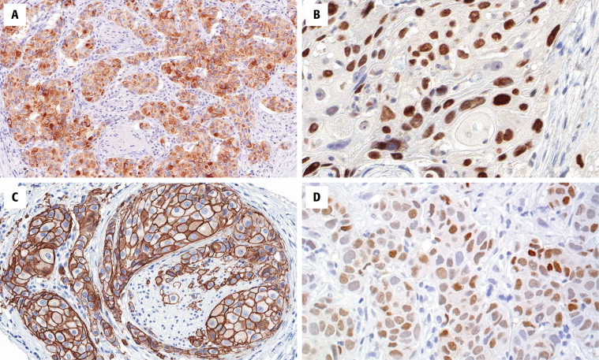
Androgen receptor gives a strong diffuse reaction in most of the tumor cell nuclei in salivary duct carcinoma

Slide 53
Therefore..
Immunostaining for AR on cytologic smears is useful for the diagnosis of these patients.
It was also suggested that the high expression of AR in SDC may play a role in tumor progression.
This may assist in triaging patients with SDCs for novel therapies.

Slide 54
Similarities between MSGTs and Malignant Breast Tumors
Role of hormones in treatment of breast cancers
Expression of sex steroid hormones in MSGTs
The potential role of hormones in treatment of MSGTs

Slide 55
4. What is the potential role of Hormones in treatment of MSGTs?
To date, no phase II trials have been performed, so it is difficult to define the role of hormone therapy in MSGTs.

Slide 56
Case # 1: Partial Remission of a case of AdCC by Tamoxifen
In 1997, Shadaba et al., UK reported a patient with an inoperable local recurrence of previously irradiated adenoid cystic carcinoma.

Slide 57
He was treated with tamoxifen, an estrogen receptor antagonist.
After 18 months of treatment, MRI showed a partial response, and further clinical progression of the disease was halted.

Slide 58
Case # 2: Partial Remission of 2 Patients with AdCC by Tamoxifen
Elkin and Jacobs in 2008 reported partial remission of two cases of AdCC in which tamoxifen, an ER anatagonist, was used.
Both patients obtained long-term stability of disease with no associated toxicity.

Slide 59
This treatment was recommended because:
There are no successful treatment modalities available for AdCC.
The low toxicity of ER antagonists.
This treatment (tamoxifen) has a potential disease-stabilizing effect.

Slide 60
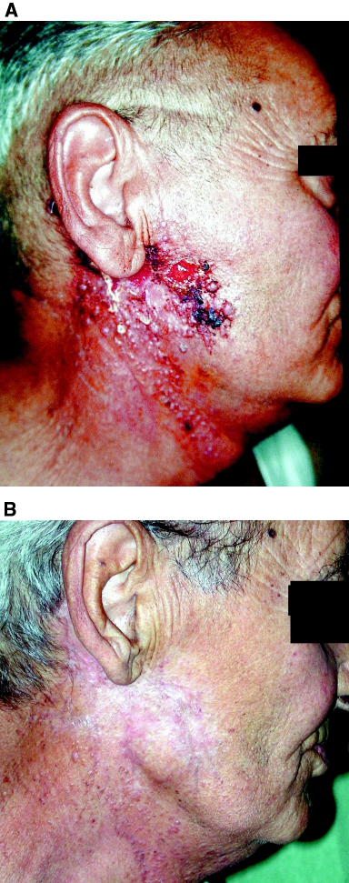
Case # 3: A recurrent case of adenocarcinoma in the parotid gland

Slide 61
In 2003, Locati et al reported complete remission of a recurrent case of AR-expressing adenocarcinoma in the parotid gland.
The patient was administered complete anti-androgen blockade.

Slide 62
Skin lesions reduced rapidly, until disappearance 2 months later.
Complete remission was confirmed by a CT scan.

Slide 63
Complete Remission of the Case of Adeno-carcinoma with Anti-androgens, 2 months later

Slide 64
Conclusion
In conclusion, MSGTs refractory to conventional therapy would possibly benefit from hormonal therapy.
However, there is no clear evidence that such treatment can bring clinical benefits.

Slide 65
Recommendations
Further studies concerning the expression of sex hormone receptors need to be evaluated with greater number of samples.
Standard protocols for such studies should be clarified by an approved organization to allow meta-analysis.

Slide 66
Clinical trials may be conducted in advanced cases, when the disease is refractory to conventional treatment (after taking the patients’ consents).

Slide 67
wedad.nawar@yahoo.com
Thank You

