Slide 1

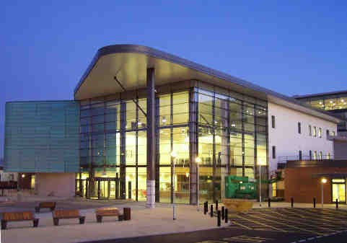
Does drinking alcohol give you brain damage?
School of Medicine
School of Medicine
Dr Wayne Grant Carter School of Medicine, University of Nottingham, Royal Derby Hospital Centre, Derby DE22 3DT. UK.
T: +44 (0)1332 724738
F: +44 (0)1332 724626
Email: wayne.carter@nottingham.ac.uk

Slide 2
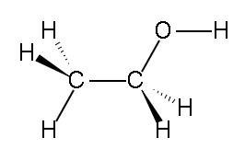
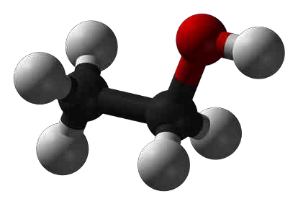
School of Medicine
School of Medicine

Slide 3
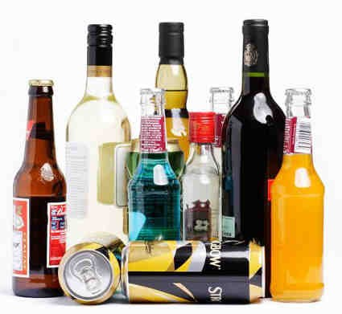
ADH4 ~10 million years
School of Medicine
School of Medicine
Alcohol fermentation ~10000 years ago
Wine making ~5000 years ago

Slide 4


School of Medicine
Deaths attributed to alcohol: 3.3 million/year, ~6 % of all deaths

Slide 5
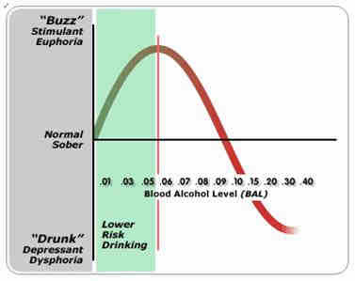
School of Medicine
School of Medicine

Slide 6

Molecular consequences:
School of Medicine
Altered cellular signalling
Hypoxia, altered redox state, increased NADH:NAD+ ratio
Increased fatty acid synthesis, decreased fatty acid oxidation
ROS: lipid peroxidation, protein adducts, membrane damage
Disruption of the methionine metabolic pathway:
reduced SAM and increased SAH.
Cell toxicity, apoptotic and necrotic cell death.

Slide 7
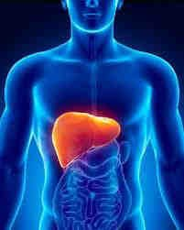
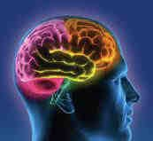
School of Medicine
Event Name and Venue

Slide 8
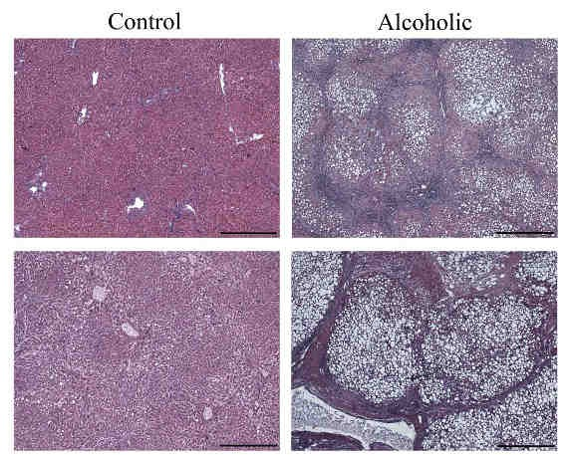
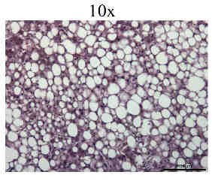
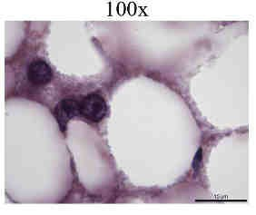
School of Medicine
Liver Damage

Slide 9
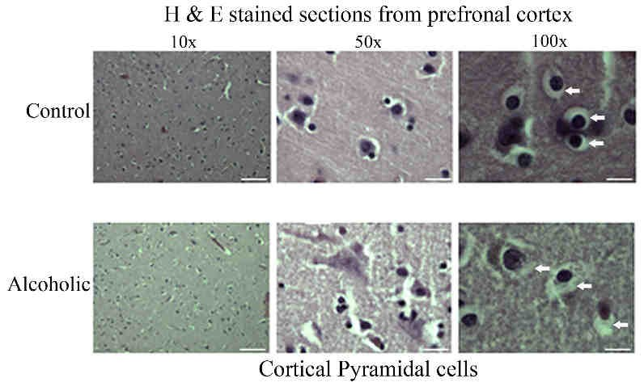
School of Medicine

Slide 10
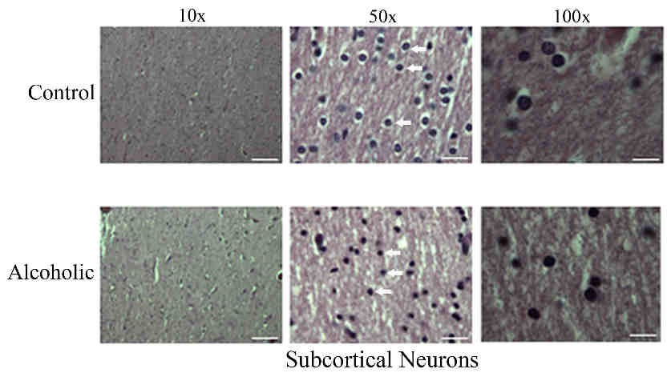
School of Medicine
10

Slide 11
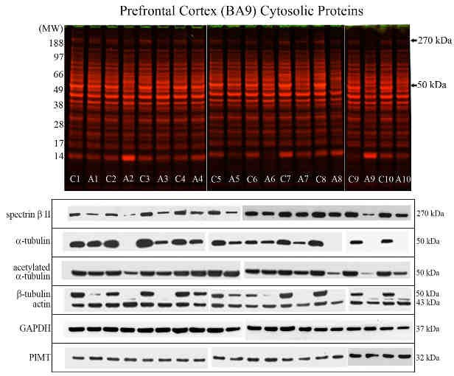
School of Medicine
Event Name and Venue
11

Slide 12
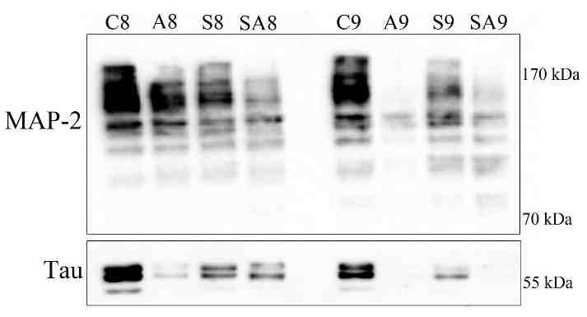
School of Medicine
12

Slide 13
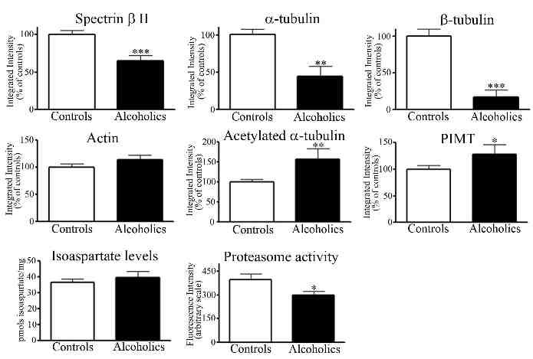
School of Medicine
Event Name and Venue
13

Slide 14
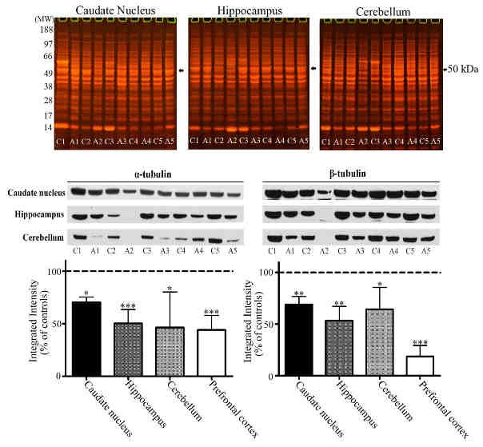
School of Medicine
Even
t Name and Venue
14

Slide 15
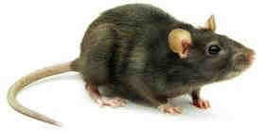
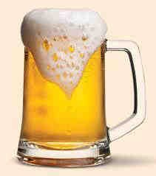
Male Wistar Rats
School of Medicine
Control (C) or Ethanol-fed (E), liquid diet
4-weeks, 36 % of calories as ethanol 25-50 mM blood ethanol concentration
2-3x the legal driving limit of 17.4 mM (0.08 % blood alcohol) in UK or USA.
15

Slide 16
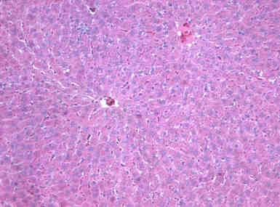
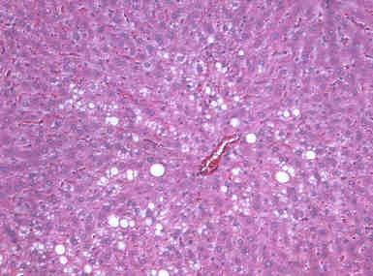
Control
School of Medicine
Ethanol
Liver damage
10/6/2015
16

Slide 17
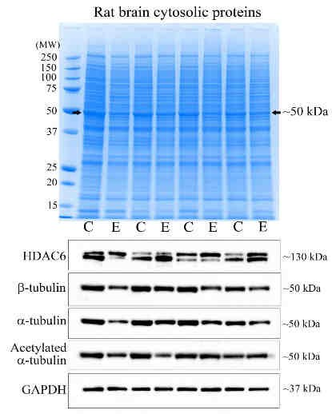
School of Medicine
17

Slide 18
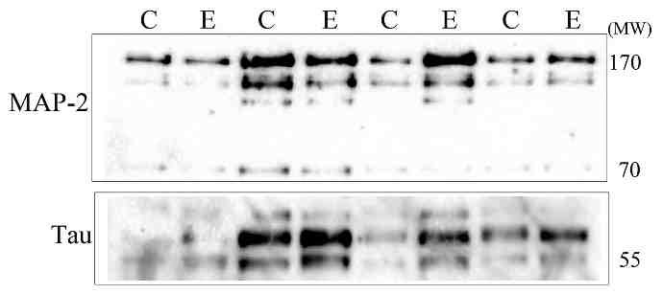
School of Medicine
Event Name and Venue
18

Slide 19
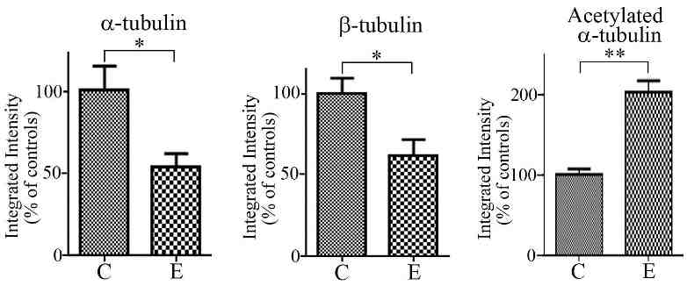
School of Medicine
19

Slide 20
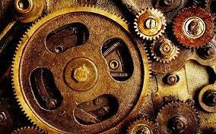
What is the mechanism that drives reduced tubulin levels?
School of Medicine
School of Medicine

Slide 21
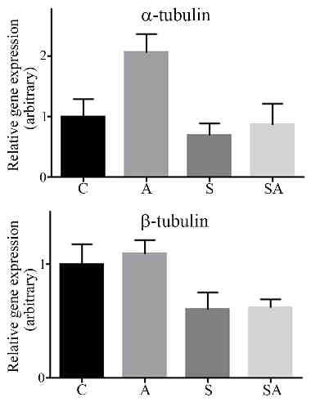
School of Medicine
Event Name and Venue
21

Slide 22
‘Tubulin code’
School of Medicine
School of Medicine
Modification
Acetylation
Detyrosination
Deglutamylation
Glutamylation
Polyamination
Glycosylation
Palmitoylation
Phosphorylation
Sumoylation
Ubiquitination
Isoaspartate formation
Succination

Slide 23

School of Medicine
23

Slide 24



Acknowledgements
School of Medicine
School of Medicine
Jack Enticott
Kusum Kharbanda Natalia Osna Dean Tuma
Amaia Erdozain Benito Morentin Luis Callado
24

Slide 25
School of Medicine
School of Medicine
24

