Slide 1
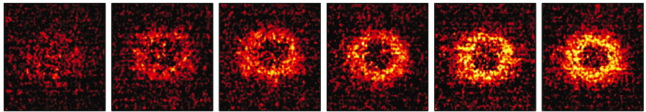


Phase separation and pair condensation in spin-imbalanced 2D Fermi gases
Waseem Bakr, Princeton University
International Conference on Quantum Physics and Nuclear Engineering London, March 2016

Slide 2


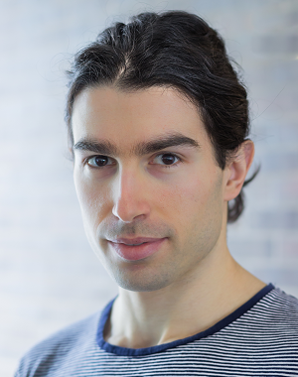
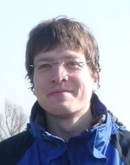
Thanks to:
Peter Brown
Debayan Mitra
Stanimir Kondov
Peter Schauss

Slide 3

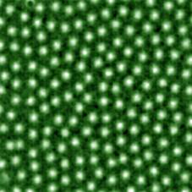
Superconductors in magnetic fields
How is superconductivity destroyed?
  Orbital limit: kinetic energy gap
  Clogston limit: Zeeman energy gap
Where is Clogston limit relevant?
  Layered organic superconductors
  Heavy fermion superconductors
  Neutral superfluids with spin imbalance: cold atoms

Slide 4
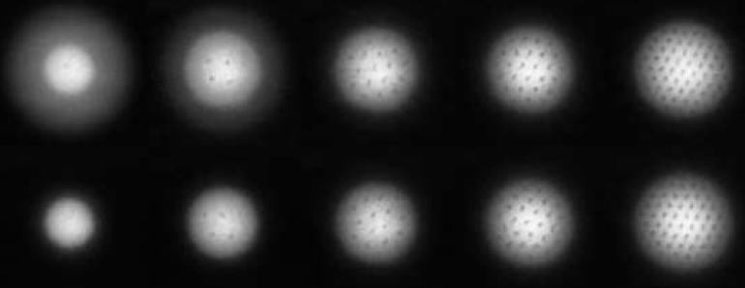
Spin imbalanced atomic Fermi gases
Degenerate Fermi gas with imbalanced populations in hyperfine states.
No spin-relaxation: effective Zeeman field.
Strong tunable attractive interactions give rise to superfluidity (Ketterle, 2006).
Spin imbalance:
In 3D:
Ketterle (MIT)
Hulet (Rice)
In 1D: Hulet (Rice)
In 2D: J. Thomas
(NC State)
Polarization

Slide 5
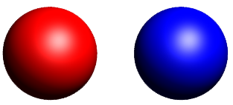
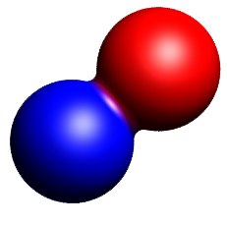
Tuning interactions in a Fermi gas
Scattering Length
Energy
BCS superfluid of
k-space Cooper pairs
Free atoms
Magnetic Field
Molecular state
Feshbach resonance due to crossing of singlet molecular state with a triplet state of free atoms
BEC of molecules

Slide 6
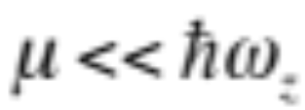
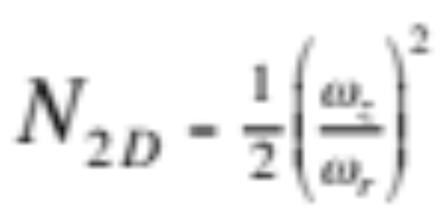

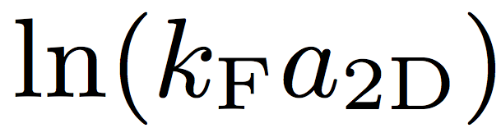
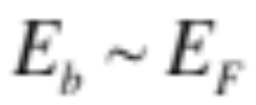
Strongly interacting 2D Fermi gases
Quasi-2D gas:
For non-interacting gas:
Two-body bound state even for weakest attractive interactions in 2D (unlike 3D).
Scattering amplitude in 2D is momentum dependent:
Coupling parameter is
Strongest interactions when

Slide 7
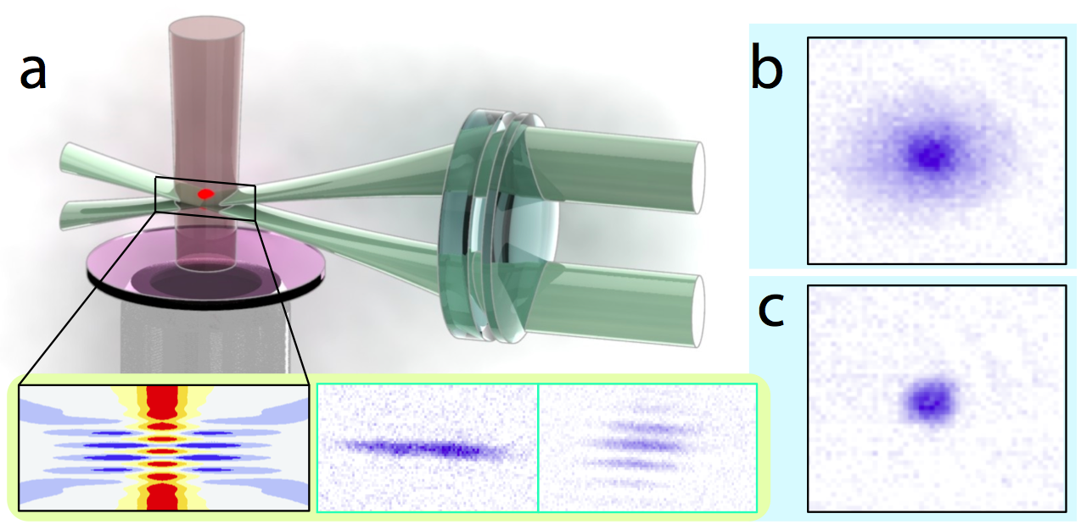
Realizing a spin-imbalanced 2D Fermi gas
Other 2D Fermi gas experiments: Kohl (Bonn), Thomas (NC State), Jochim (Heidelberg), Zwierlein (MIT), Turpalov (Russian Acad.), Vale (Swinburne)

Slide 8
Realizing a spin-imbalanced 2D Fermi gas
Degenerate Li-6, lowest two hyperfine states.
Prepare single 2D layer using “accordion lattice”.
Anisotropy about 180, allowing up to 16,000 atoms per spin state in 2D non-interacting gas.
RF manipulations allow preparing gas with arbitrary polarization.

Slide 9
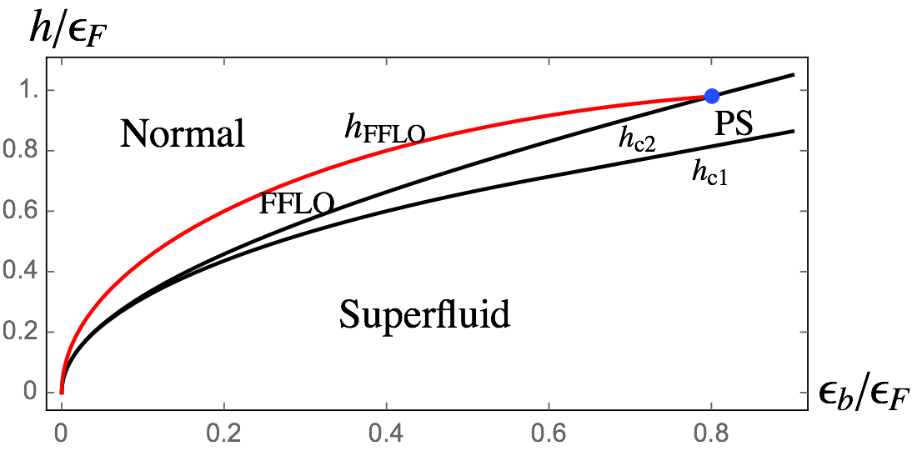
Phase diagram for a strongly interacting 2D superconductor in a Zeeman field
Total electron density is fixed, Zeeman field can flip spins.
FFLO phase (non-zero momentum condensate) is more stable in 2D than 3D.
D. Sheehy (2015)

Slide 10
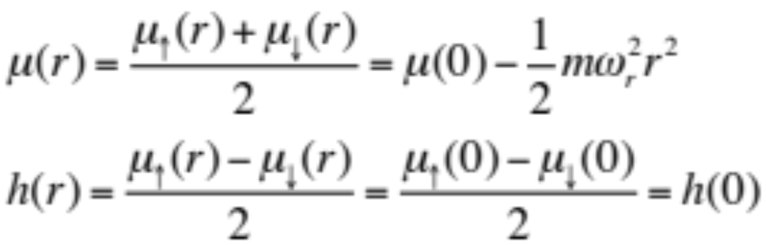
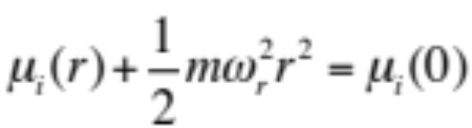
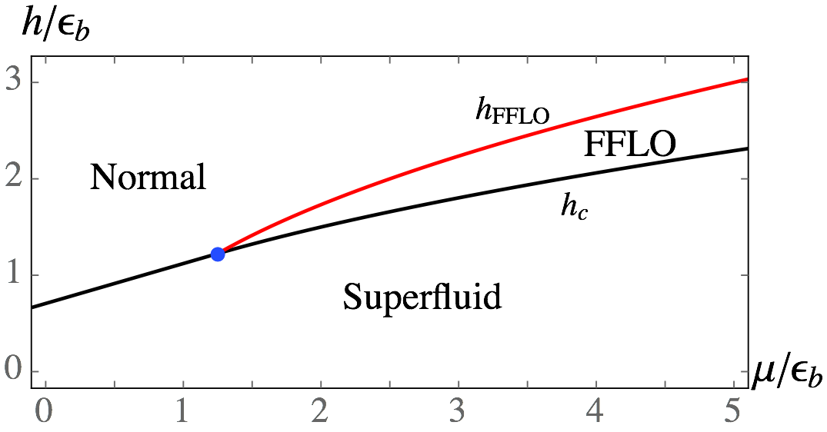
Phase diagram for a strongly interacting 2D ultracold Fermi gas
Think of trapped gas in local density approximation.
Trap scans a horizontal line in homogeneous phase diagram
D. Sheehy (2015)

Slide 11
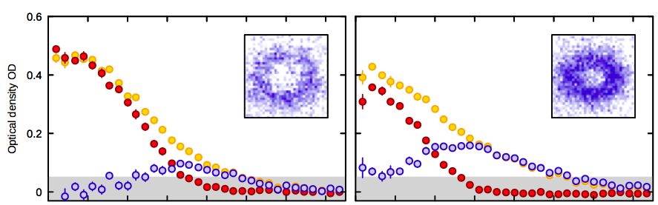

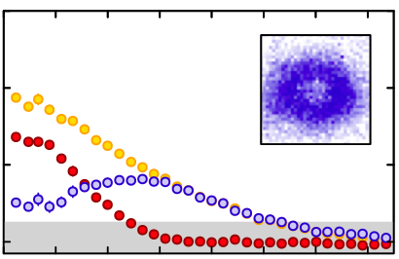
Observation of phase separation in the trap: spin-balanced core (condensate)
P = 0.2
P = 0.5
P = 0.8
B = 780 G

Slide 12
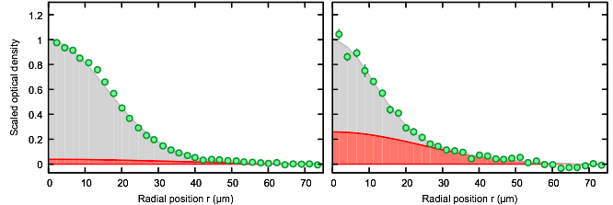
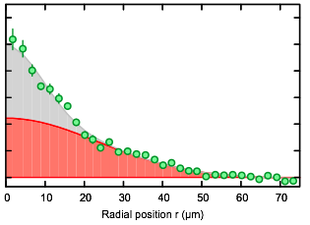
Observation of pair condensation
P = 0.2
P = 0.5
P = 0.8
Condensate fraction obtained from a bimodal fit to minority profile after 3 ms time of flight.
Find that condensation persists past phase separation: polarized condensates.

Slide 13
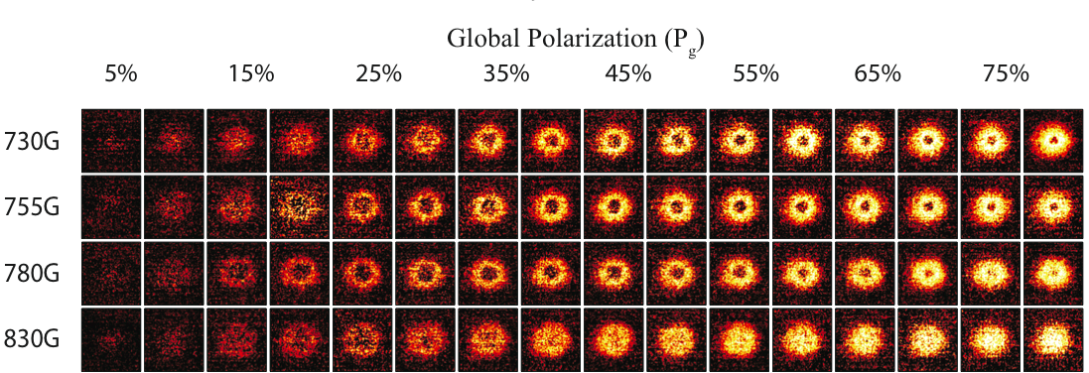
Effect of interactions

Slide 14
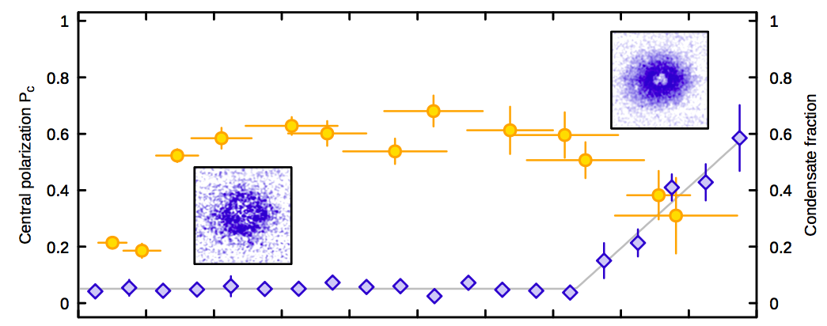
Stability of the spin-balanced core
730 G
Central polarization
Condensate fraction
Global polarization

Slide 15
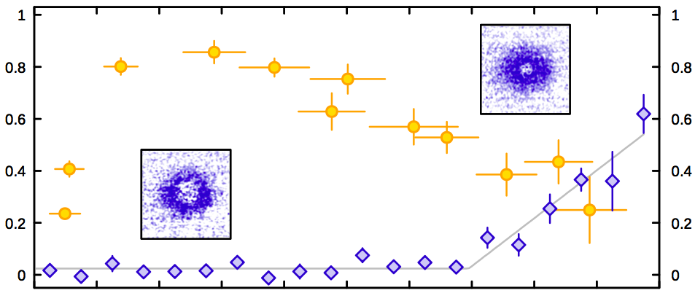
Stability of the spin-balanced core
755 G
Central polarization
Condensate fraction
Global polarization

Slide 16
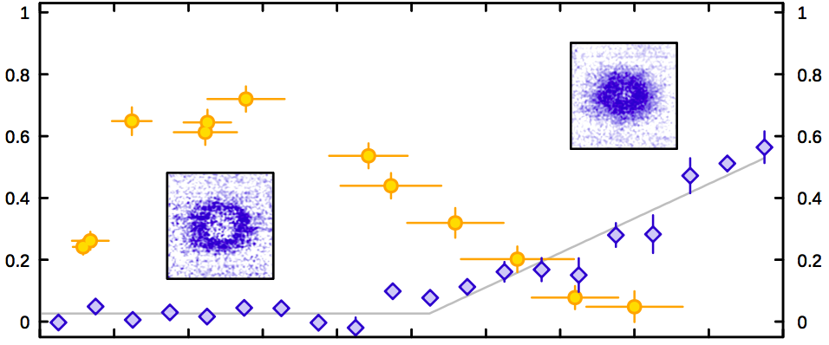
Stability of the spin-balanced core
780 G
Central polarization
Condensate fraction
Global polarization

Slide 17
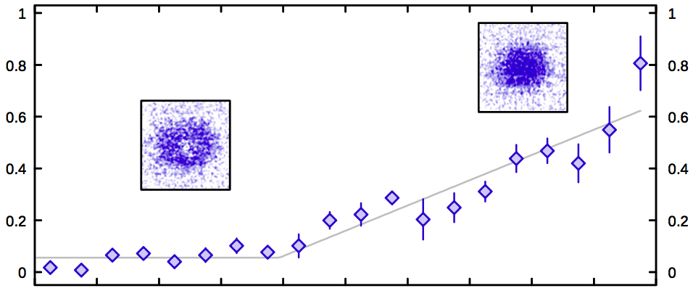
Stability of the spin-balanced core
830 G
Central polarization
Condensate fraction
Global polarization

Slide 18
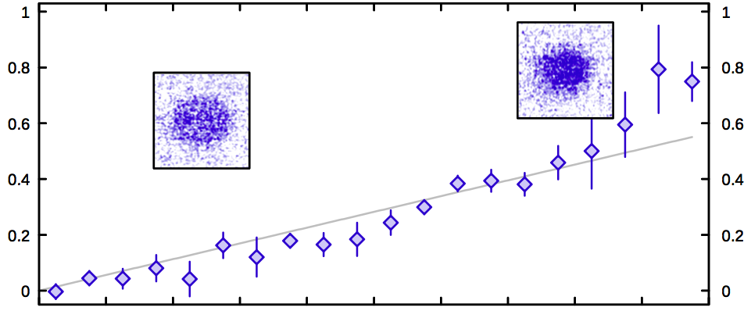
Stability of the spin-balanced core
920 G
Central polarization
Condensate fraction
Global polarization

Slide 19
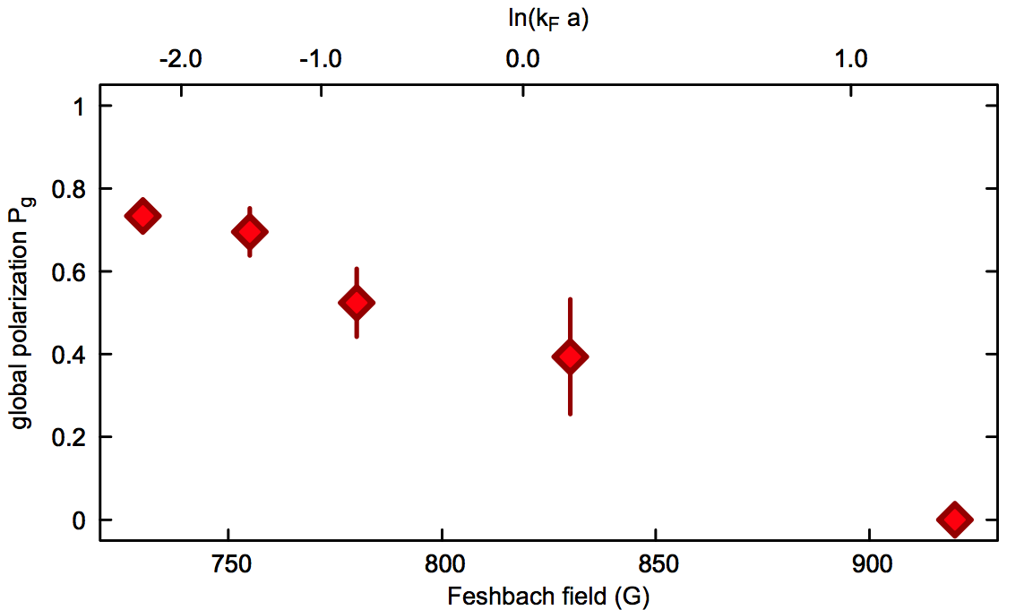
Stability of the spin-balanced core

Slide 20
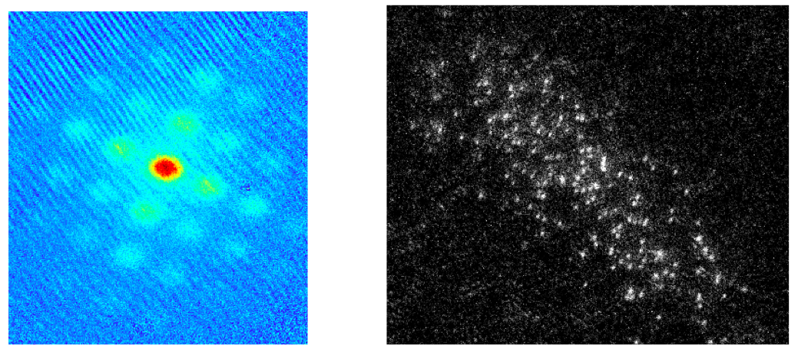
Outlook & conclusions
Observed separation of k=0 condensate from polarized gas.
Observed condensation past phase separation.
What’s in the region between the spin-balanced condensate and the fully polarized Fermi gas? Fermi liquid? Sarma phase?
Added a 2D lattice in the plane. Enhances FFLO pairing.
Have ability to see single atoms in the lattice: detect FFLO by imaging magnetization on atomic level.

