Slide 1
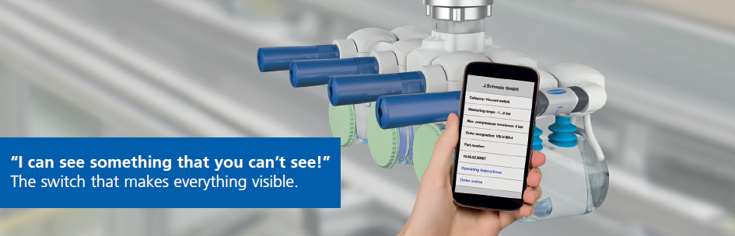
Intelligent Vacuum Technology in Automation:
Making it Industry 4.0 ready!
„I spy with my little eye“
The switch that makes everything visible
Walter Dunkmann
J. Schmalz GmbH
Head of Business Development, Vacuum Components
World Congress on Industrial Automation
July 20 – 22, 2015 San Francisco, USA

Slide 2
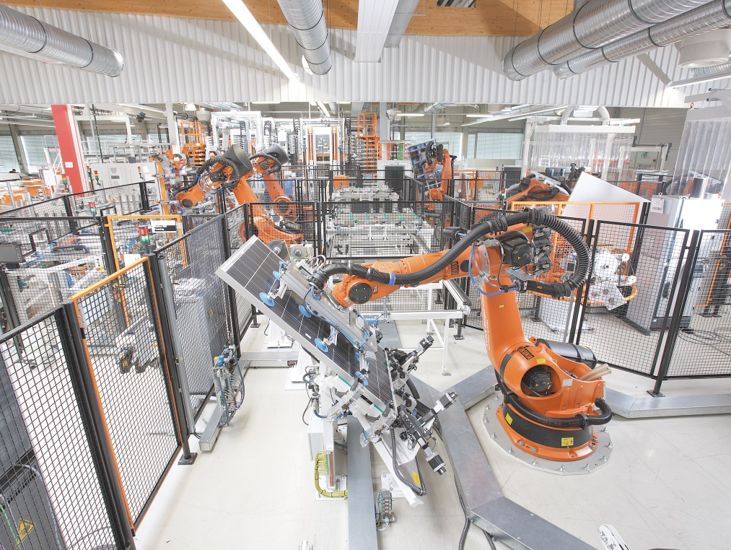
Agenda
Intelligence meets efficiency:
Schmalz eco nozzle technology
Industry 4.0:
Automation Technology in Transition
Smart Field Devices
Innovations in i-series:
Switch VSi & Vacuum terminal SCTMi
Conclusion

Slide 3
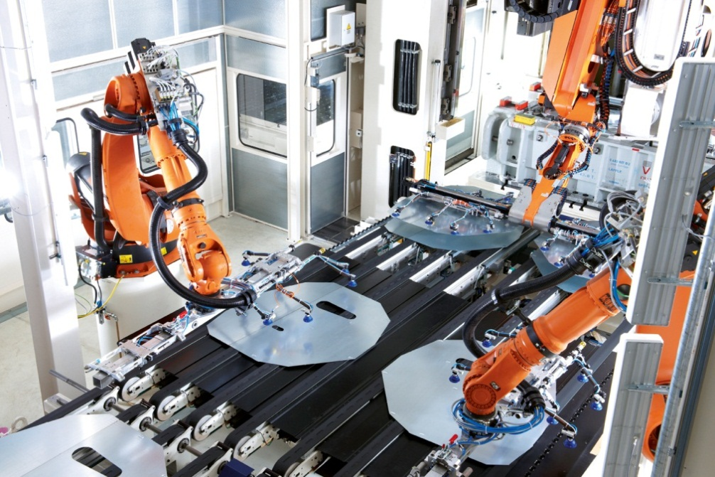
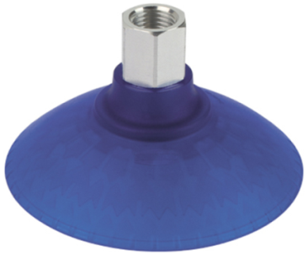
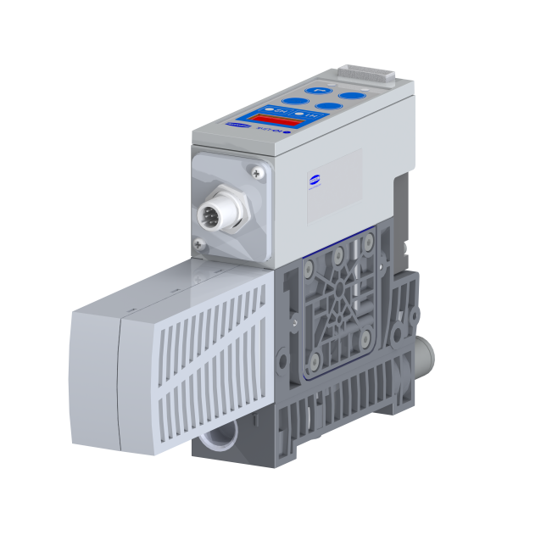
The process in focus
Core Aspects
Product efficiency
Process efficiency
„Efficient product
Implementation”
„Efficient process
implementation “

Slide 4
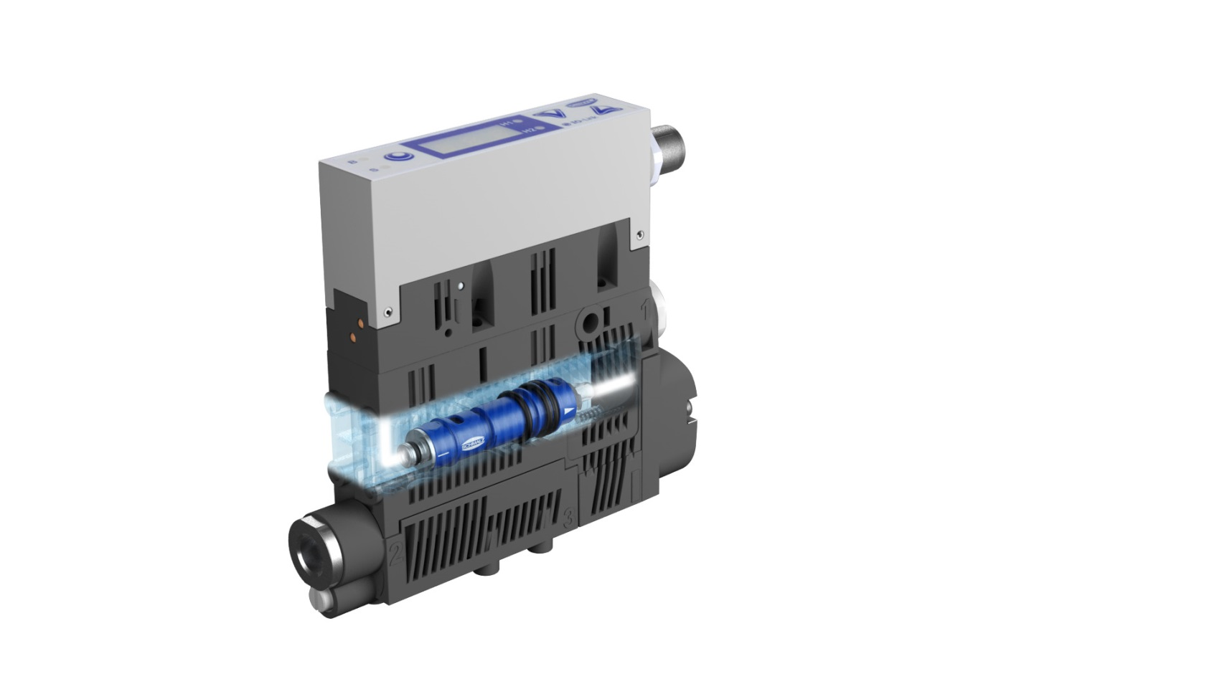
Agenda
Intelligence meets eficiency:
Schmalz eco nozzle technology
Schmalz eco nozzle technology
Ejector Module ecoPump SEP
Schmalz eco nozzle technology in Compact Ejectors

Slide 5
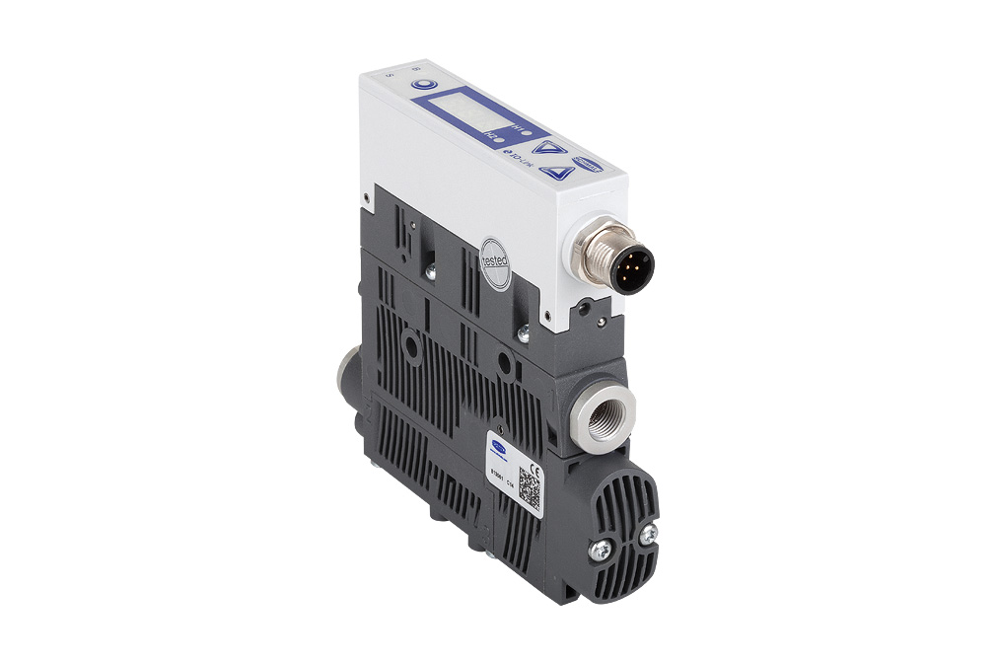
Schmalz eco nozzle technology
Taking energy efficiency to the next level
The new compact ejectors SCPS / SCPSi from Schmalz consume a minimal amount of energy and helps operators to sustainably reduce the energy consumption of their entire process.
Energy-efficient processes
A clever solution: The integrated energy and process control of Schmalz compact ejectors allows cost-effective operation under optimal process conditions.
Energy efficienct product
Optimized ejector core:
The compact ejectors SCPS/SCPSi with eco nozzle technology ensure minimal energy consumption by the product itself.

Slide 6
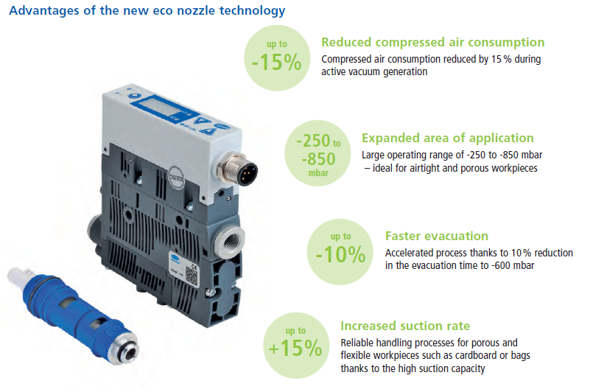
Schmalz eco nozzle technology

Slide 7
Agenda
Intelligence meets efficiency:
Schmalz eco nozzle technology
Schmalz eco nozzle technology
Ejector Module ecoPump SEP
Schmalz eco nozzle technology in Compact Ejectors

Slide 8
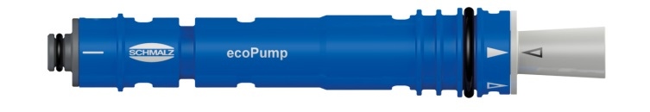
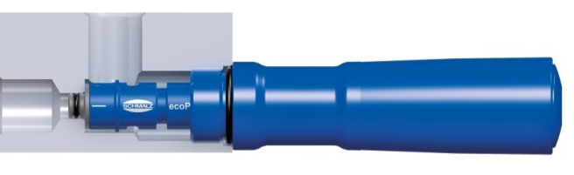

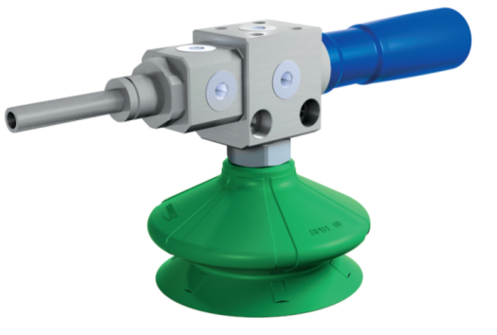
Ejector Module ecoPump SEP
Ejector Module ecoPump SEP
A vacuum generator as a machine element
Ejector Module ecoPump SEP
  Space-saving integration of efficient vacuum source close to the suction pads
  Machine-side integration by mounting cavity provided by the customer or by standard ecoPump-housing SFE
  Reduced to the basics ➔ No integrated valve control and system monitoring
Integration in mounting cavity
  From ready to install vacuum generators to built-in vacuum generators
Integration in standard housing SFE

Slide 9
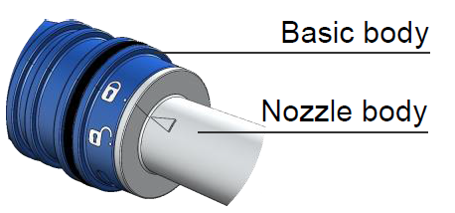
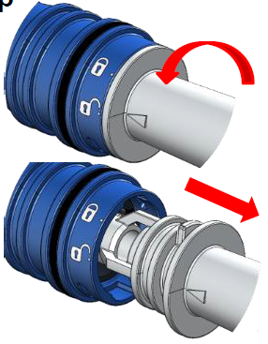
Ejector Module ecoPump SEP
What about Service?
Tool-free removal of the nozzle body by twist-lock
Cleaning of the nozzle body by rinsing with clear water and additional air cleaning
Filter-free operation offers longest service life
Maximal availability and performance with minimal maintenance!

Slide 10
Agenda
Intelligence meets efficiency:
Schmalz eco nozzle technology
Schmalz eco nozzle technology
Ejector Module ecoPump SEP
Schmalz eco nozzle technology in compact ejectors

Slide 11
Schmalz eco nozzle technology in Compact Ejectors
Compact Ejector SCPSb / SCPS / SCPSi
Vacuum generator with integrated functions
  solenoid valves for vacuum & blow-off control
  vacuum monitoring
  automatic air saving function (switches off the suction function once a safe vacuum value has been reached)
  condition monitoring with leakage control, measuring of evacuation times & vacuum control
  IO-Link interface for bidirectional communication (remote parametrization, transfer of recorded condition data to the field bus level)

Slide 12
Schmalz eco nozzle technology in Compact Ejectors
  Efficient eco nozzle technology as integrated Ejector Module → ecoPump SEP

Slide 13
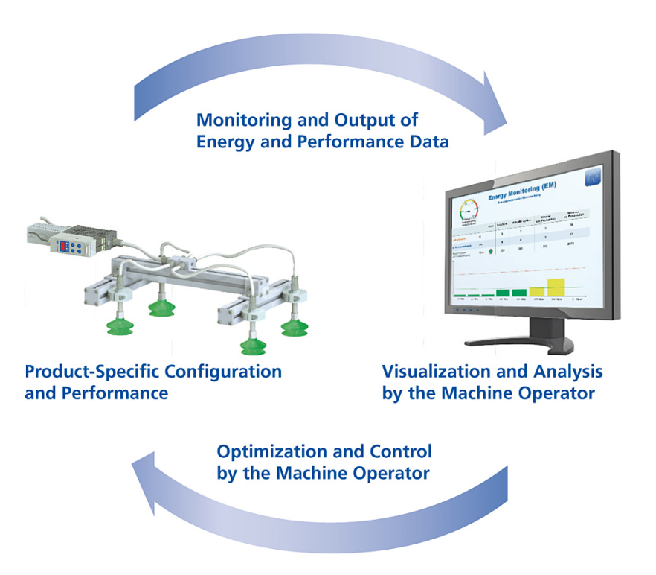
Schmalz eco nozzle technology in Compact Ejectors
How the energy and process control works
As a pioneer in the field of intelligent process communication, Schmalz has implemented energy and process control in its compact ejectors. Three innovative function modules ensure a maximum efficiency boost in automated applications.
Measure, monitor and optimize your energy consumption
The vacuum generators measure and monitor all energy and performance-related process data
The existing IO-Link master can be used for bidirectional communication with higher-level field-bus systems
The system operator can read, monitor and optimize the data in the controller to reduce the energy consumption of the entire vacuum system “from afar”

Slide 14




Schmalz eco nozzle technology in Compact Ejectors
More highlights
Condition Monitoring
Improves system availability with continuous system monitoring (leak-tightness and vacuum)
Allows faults to be detected and rectified even before the system is down
Energy Monitoring
Measures and monitors the vacuum system´s energy consumption
Identifies excessive energy consumption
Trend analysis per component, production cycle and shift
IO-Link interface
Bi-directional communication with all current field-bus systems
Recorded condition data can be viewed and used up to the highest level of control
Supports remote parameterization and remote diagnostics
Automatic air saving function
Decreases compressed air consumption by up to 80%
Switches off the suction function once a safe vacuum value has been reached until the next cycle or until the vacuum falls below this value

Slide 15
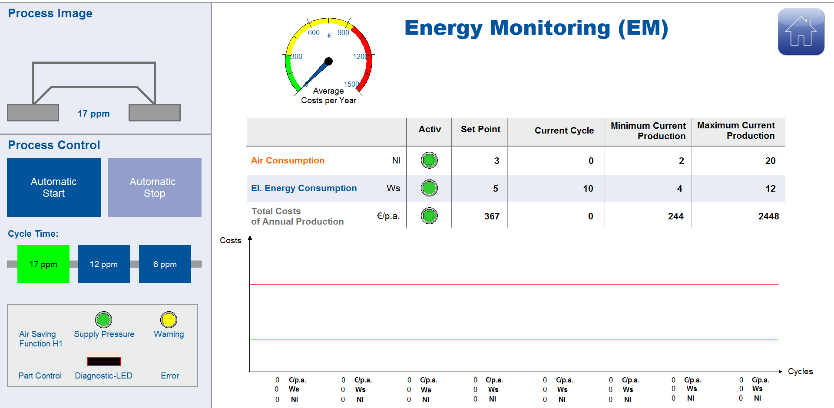
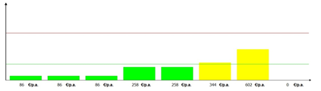
Schmalz eco nozzle technology in Compact Ejectors
Energy and Process Control – Energy Monitoring
Measuring of the current energy consumption
Identification of consumption trends and status
Optimization of the gripper system in terms of energy consumption and performance

Slide 16
Agenda
Intelligence meets efficiency:
Schmalz eco nozzle technology
Industry 4.0:
Automation Technology in Transition
Smart Field Devices
Innovations in i-series:
Switch VSi & Vacuum terminal SCTMi
Conclusion

Slide 17
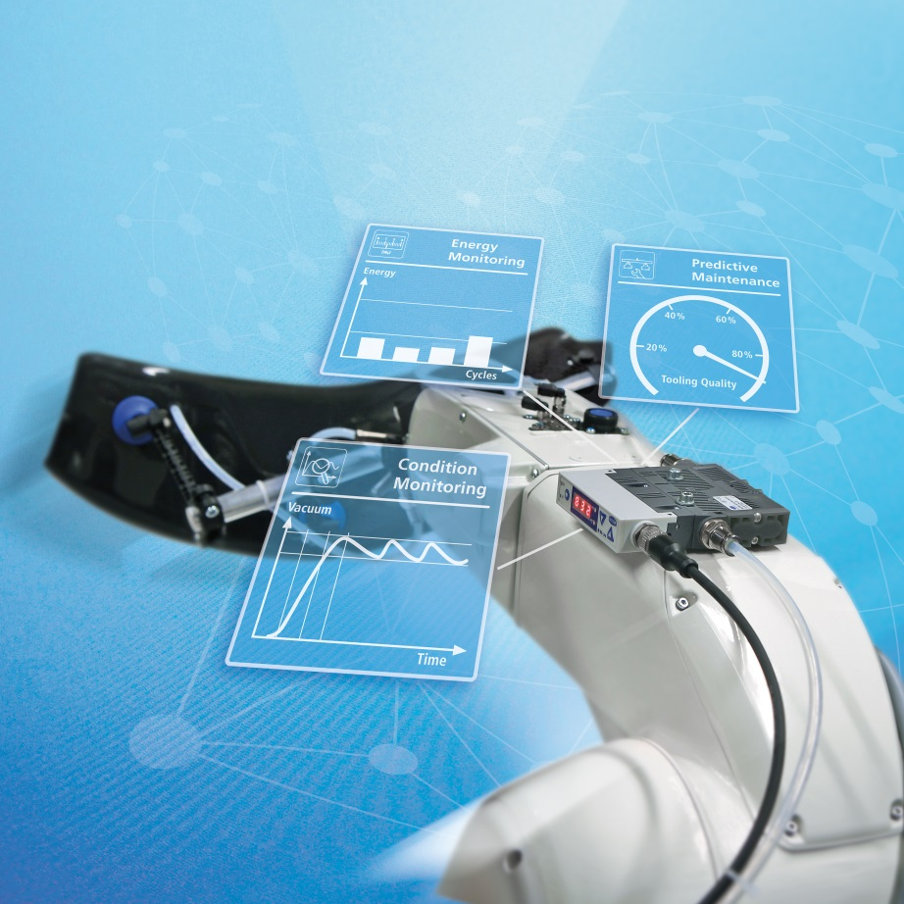
Industry 4.0: Automation Technology in Transition
The Internet of Things/ Industry 4.0:
features and benefits
Production becomes highly flexible, highly productive and resource-efficient
Individualization (batch size of 1) under efficient high-volume production conditions
The increasing complexity of the production and process becomes manageable
Autonomous production units organize themselves on an ad hoc basis– the product determines its own production process
Employees benefit from intelligent assistance systems

Slide 18
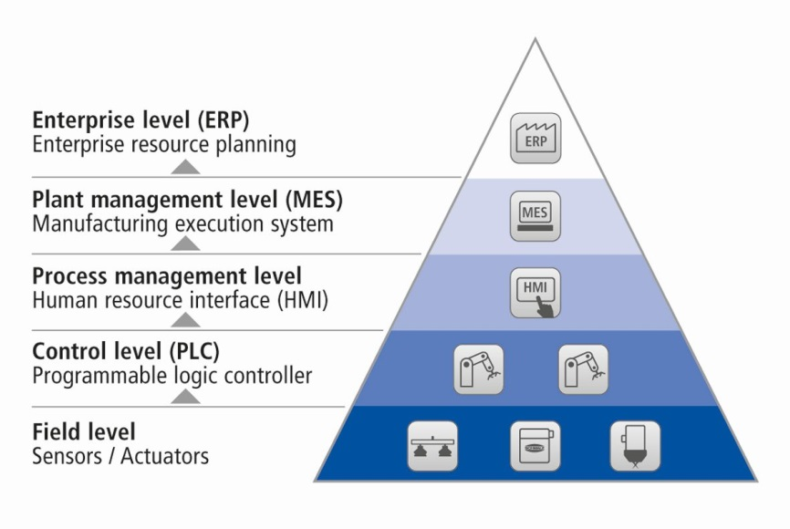
Industry 4.0: Automation Technology in Transition
Current communication structure:
Hierarchical architecture in traditional automation pyramid

Slide 19

Industry 4.0: Automation Technology in Transition
The future of the Internet of Things/ Industry 4.0:
Seamless communication in the automation cloud using intelligent Schmalz components
Data !
Real-time / PLC !

Slide 20

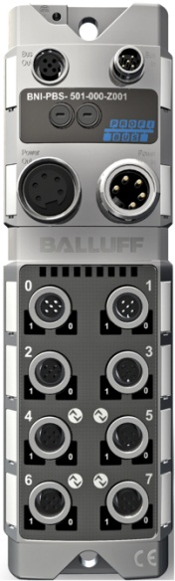
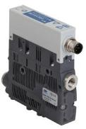
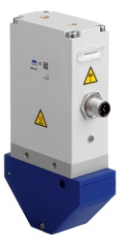
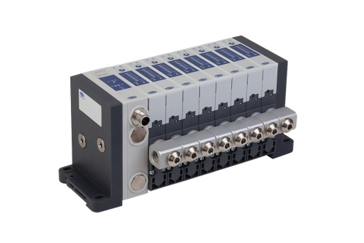
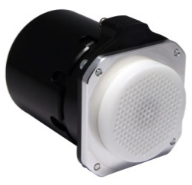
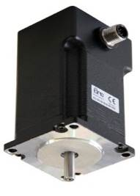
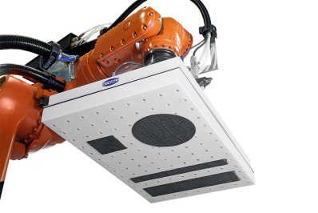
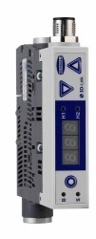
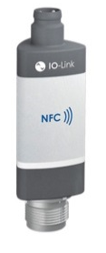
Challenge in I4.0 for end-effectors
PLC
Fieldbus
Power
Electrically driven
needle grippers
Compact ejectors
IO-LINK Master
Electrically driven grippers
Vacuum terminal
Motors
Vacuum sensors
Intelligent grippers
Data storage

Slide 21
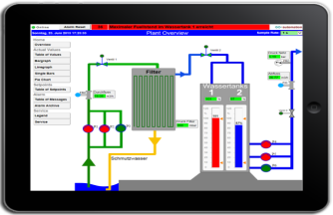
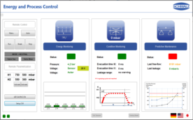






Challenge in I4.0 for end-effectors
PLC
Process data
Real-time communication
Fieldbus
Power
Electrically driven
needle grippers
Compact ejectors
IO-LINK Master
Electrically driven grippers
Vacuum terminal
Motors
Vacuum sensors
Intelligent grippers
Data storage

Slide 22
Agenda
Intelligence meets efficiency:
Schmalz eco nozzle technology
Industry 4.0:
Automation Technology in Transition
Smart Field Devices
Innovations in i-series:
Switch VSi & Vacuum terminal SCTMi
Conclusion

Slide 23
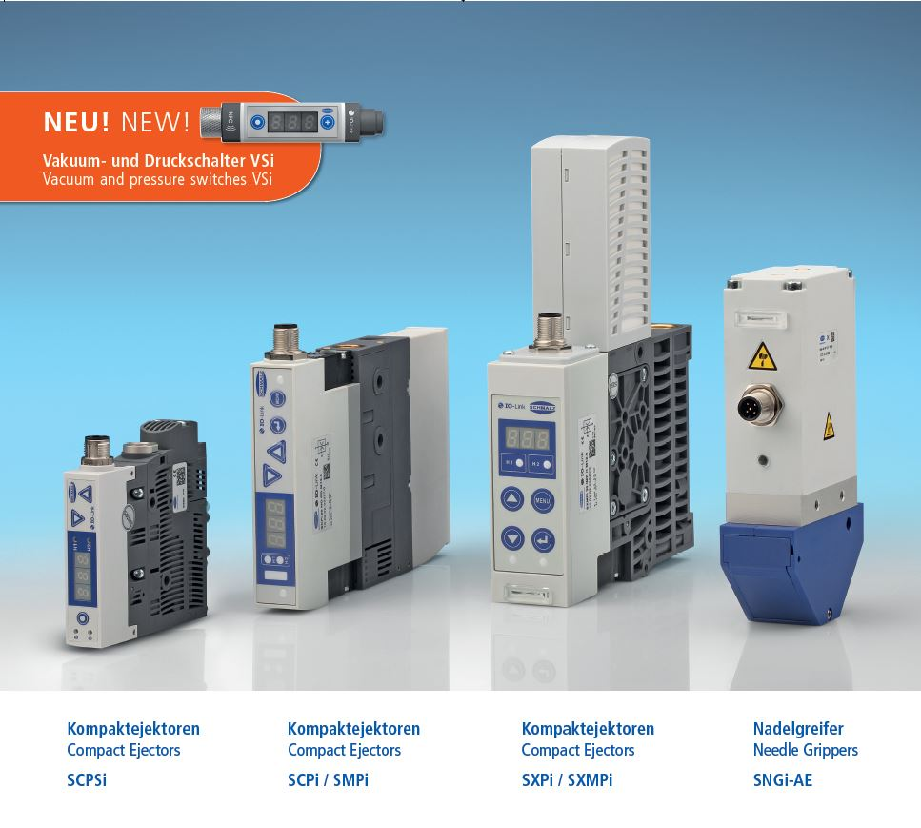
Smart Field Devices

Slide 24
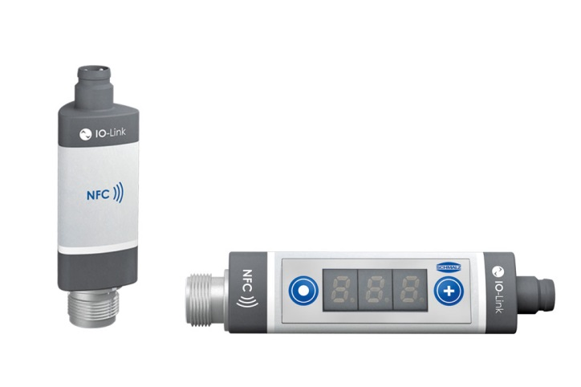
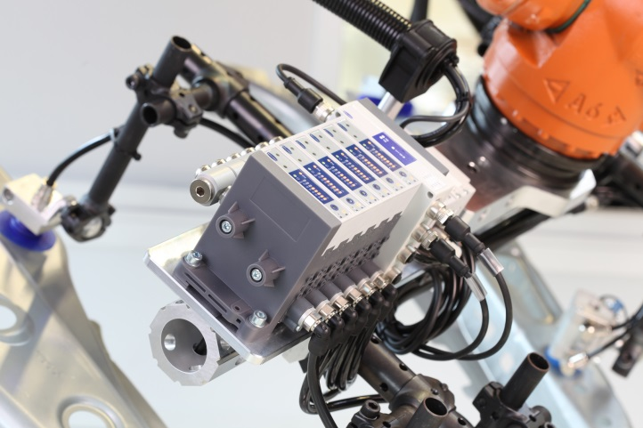
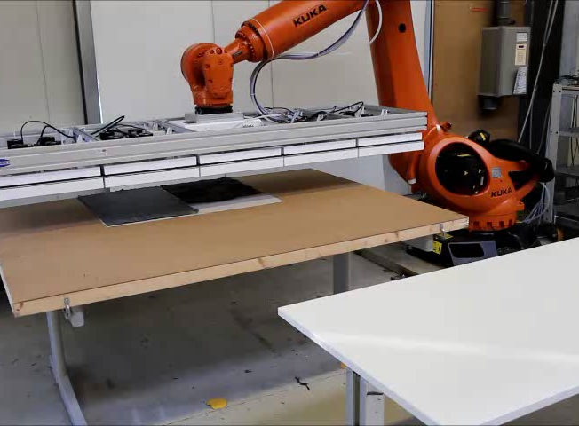
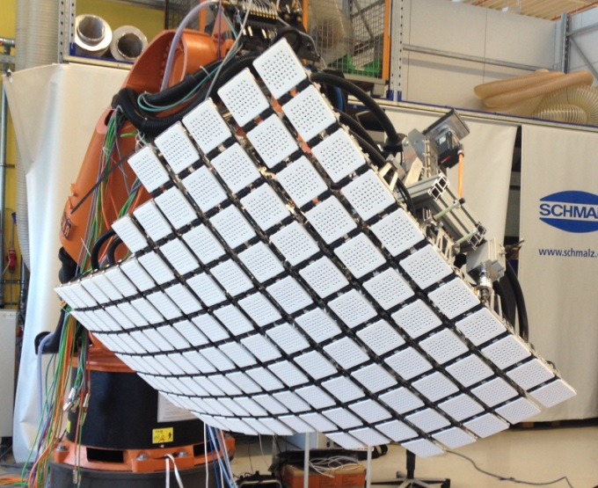
From intelligent field devices to intelligent end-effectors
VS/VSi - Vacuum-/ pressure switches
SCTMi - Vacuum terminal
Intelligent grippers

Slide 25
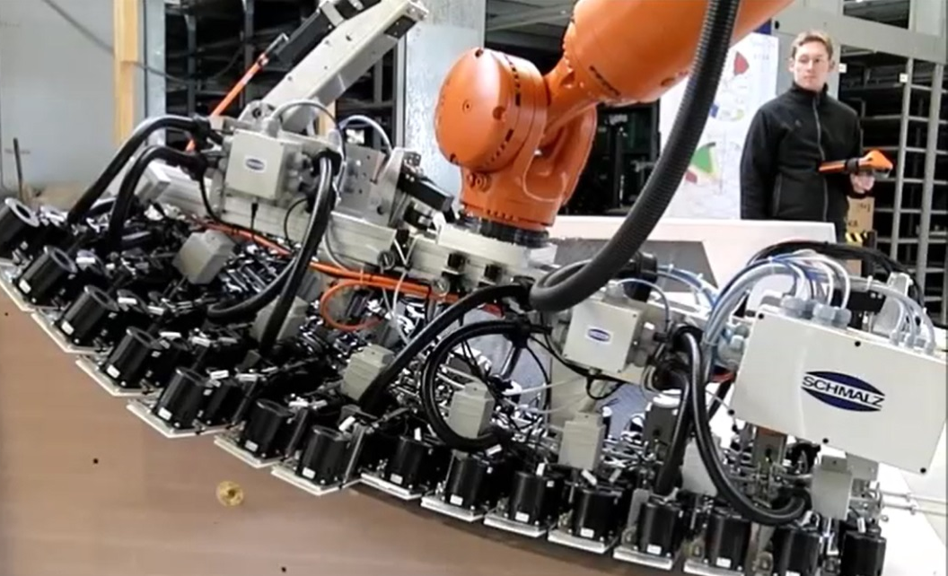

From intelligent field devices to intelligent end-effectors
Drape 2D cut parts on a double curved surface
Features
18 synchronized axes
127 individually adjustable high-speed blower
190 kg total weight
“Autonomous gripper”
Optimizes itself
Configures itself
Diagnoses itself
„4.0 - READY“

Slide 26
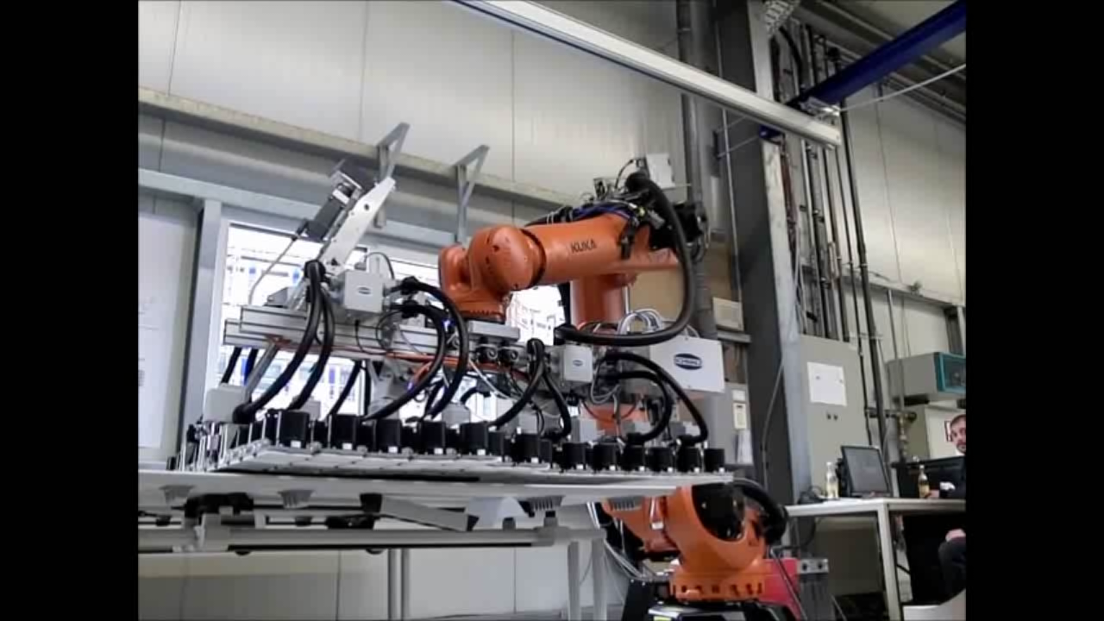
From intelligent field devices to intelligent end-effectors

Slide 27
Agenda
Intelligence meets efficiency:
Schmalz eco nozzle technology
Industry 4.0:
Automation Technology in Transition
Smart Field Devices
Innovations in i-series:
Switch VSi & Vacuum terminal SCTMi
Conclusion

Slide 28
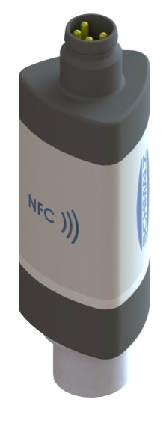
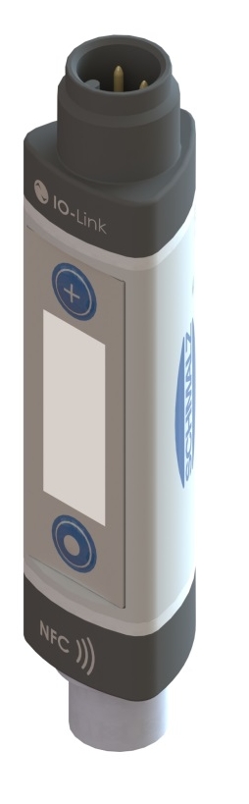

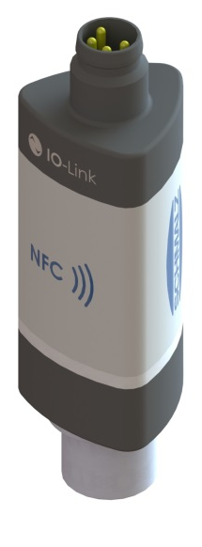
Vacuum and Pressure Switches VSi
Die nächste GENERATION!

Slide 29
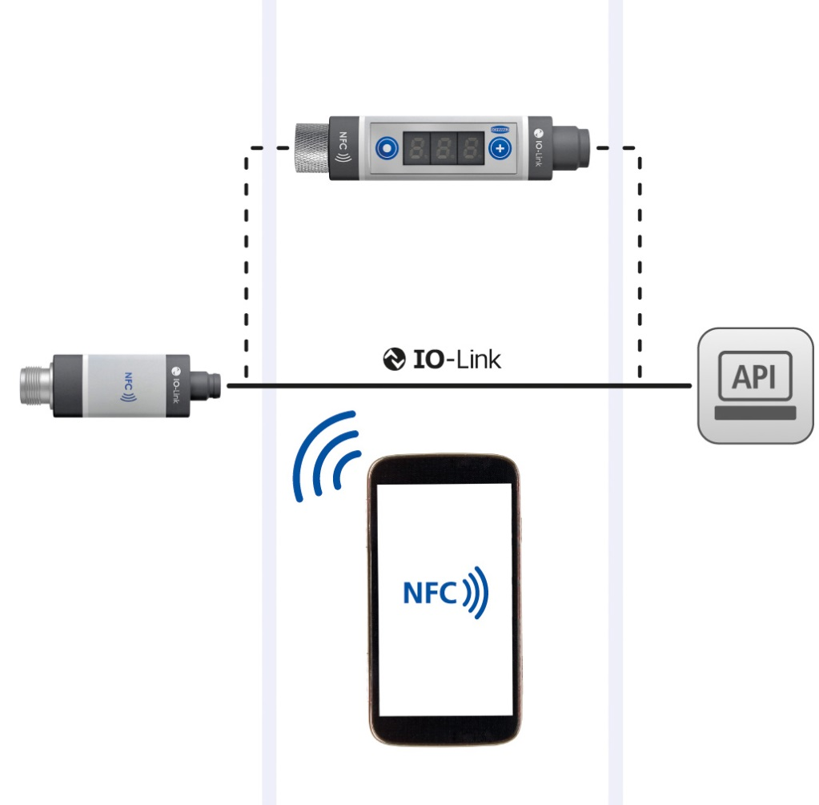
Vacuum and Pressure Switches VSi
Everything is Visible and remotely accessible:
via Display, the Controller and Your Smartphone
External Control and Indicator Display
Installed separately from the sensor unit, in the user‘s direct field of view
Settings such as switching points can be copied on the display and transferred to other switches
Visualization in the Controller panel via IO-Link
The condition data recorded can be viewed and used up to master level
Diagnostics and configuration via remote access
Output and Configuration via Smartphone
NFC technology allows data to be exchanged with an NFC-enabled smartphone
Simple access to service and maintenance information (e.g. type, serial number, operating instructions)
Rapid mobile troubleshooting by displaying detailed error messages
Process
Indication and
parametrization
Analysis
Control and indicator display
Sensor unit
Controller
NFC-enabled smartphone

Slide 30


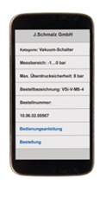







Vacuum and Pressure Switches VSi
Near Field Communication (NFC)
Smart Field Devices
…become more visible for the intelligent factory!

Slide 31





Vacuum and Pressure Switches VSi
Modular Design
Precise Measurement Directly in the Process
Switch in three versions without display, with integrated or external display
Compact sensor unit for installation directly on the suction pad, ensuring measurement with no line losses
External control and indicator display for integration in the user interface
VS…/ VSi… without display
VSi…SDI with external display
Simple Integration
IO-Link Communicates in all Common Field-bus Systems
Minimum effort required for installation
Quick and simple start of operations by copying device and process parameters
VSi…D with integrated display

Slide 32
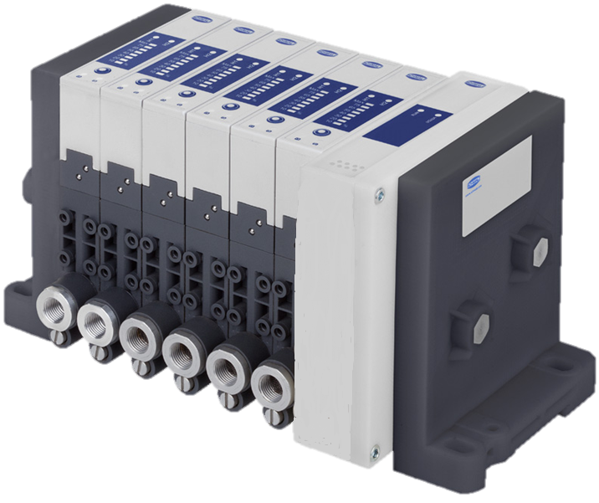
Vacuum Generators
Schmalz Compact Terminal SCTMi

Slide 33
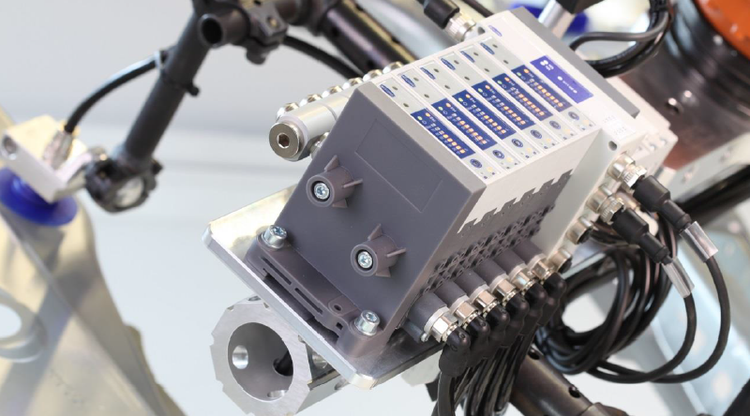
Schmalz Compact Terminal SCTMi
Communication via IO-Link and NFC
compact Vacuum terminal, digital IOs, IO-Link-Master, NFC
lean & efficient interfaces: 1x compressed air, 1x power & fieldbus
up to 16 intelligent & independent controllable vacuum circuits with EPC
Integration in all major field bus systems

Slide 34
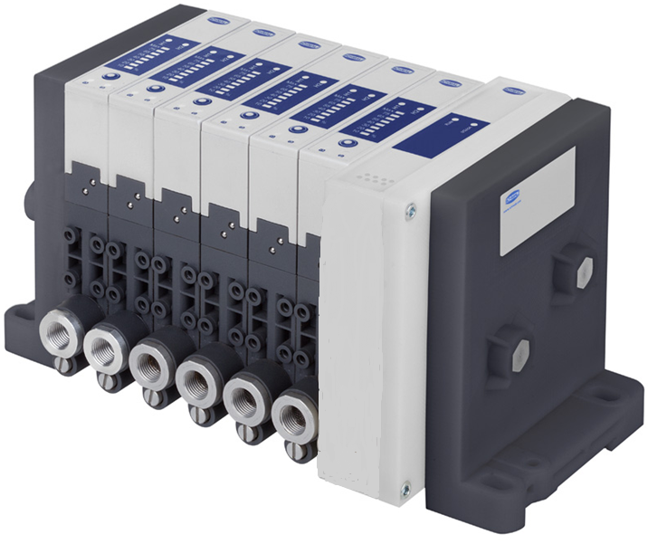
Schmalz Compact Terminal SCTMi
Structure, highlights & benefits
Low number of interfaces– high availability
NFC - interface
Each vacuum channel is individual addressable
Field bus- Connection via IO-Link or Ethernet
Up to 16 intelligent compact ejectors SCPSi – process transparency through EPC-data
Compact design – wide variety of applications

Slide 35



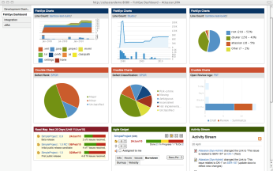
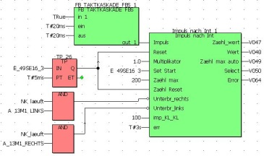




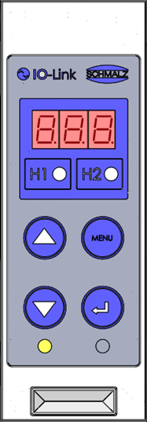
Services of Schmalz
Commissioning engineer
Maintenance engineer
Management
www.xxx.com
Services (business model)
Production optimization
Shutdown support
Technical documentation
Parts lists
Repeat order and reorder
Ethernet
Communication
with standardized services
Real-time
Ethernet
communication
NFC
SmartField
Device
Umwelt

Slide 36
Agenda
Intelligence meets efficiency:
Schmalz eco nozzle technology
Industry 4.0:
Automation Technology in Transition
Smart Field Devices
Innovations in i-series:
Switch VSi & Vacuum terminal SCTMi
Conclusion

Slide 37
Conclusion
The Internet of Things/ Industry 4.0 needs intelligent devices, that communicate with each other in the factory of the future– so called “Smart Field Devices”
The „i“-series of vacuum generators, needle grippers and the new Vacuum and Pressure Switches are armed with this intelligence
They collect all important process data, interpret them and communicate it all the way to the management level
The realized benefits in terms of 4.0 are:
  Optimization of energy consumption
  Prevention of errors and failure
  Increased performance / optimal process

Slide 38
Intelligent Vacuum Technology in Automation:
Making it Industry 4.0 ready!
„I spy with my little eye“
The switch that makes everything visible
Thank you for your attention!
World Congress on Industrial Automation
July 20 – 22, 2015 San Francisco, USA

