Slide 1


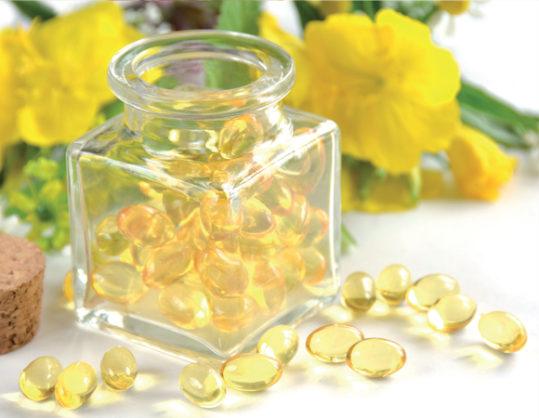
Safflower oil: an integrated assessment of phytochemistry, antiulcerogenic activity, and rodent and environmental toxicity
PROFESSOR WALBER TOMA
SANTA CECILIA UNIVERSITY - SANTOS-SP – BRAZIL
SÃO CAMILO UNIVERSITY – SÃO PAULO-SP - BRAZIL
walbertoma@unisanta.br
walbertoma@gmail.com

Slide 3
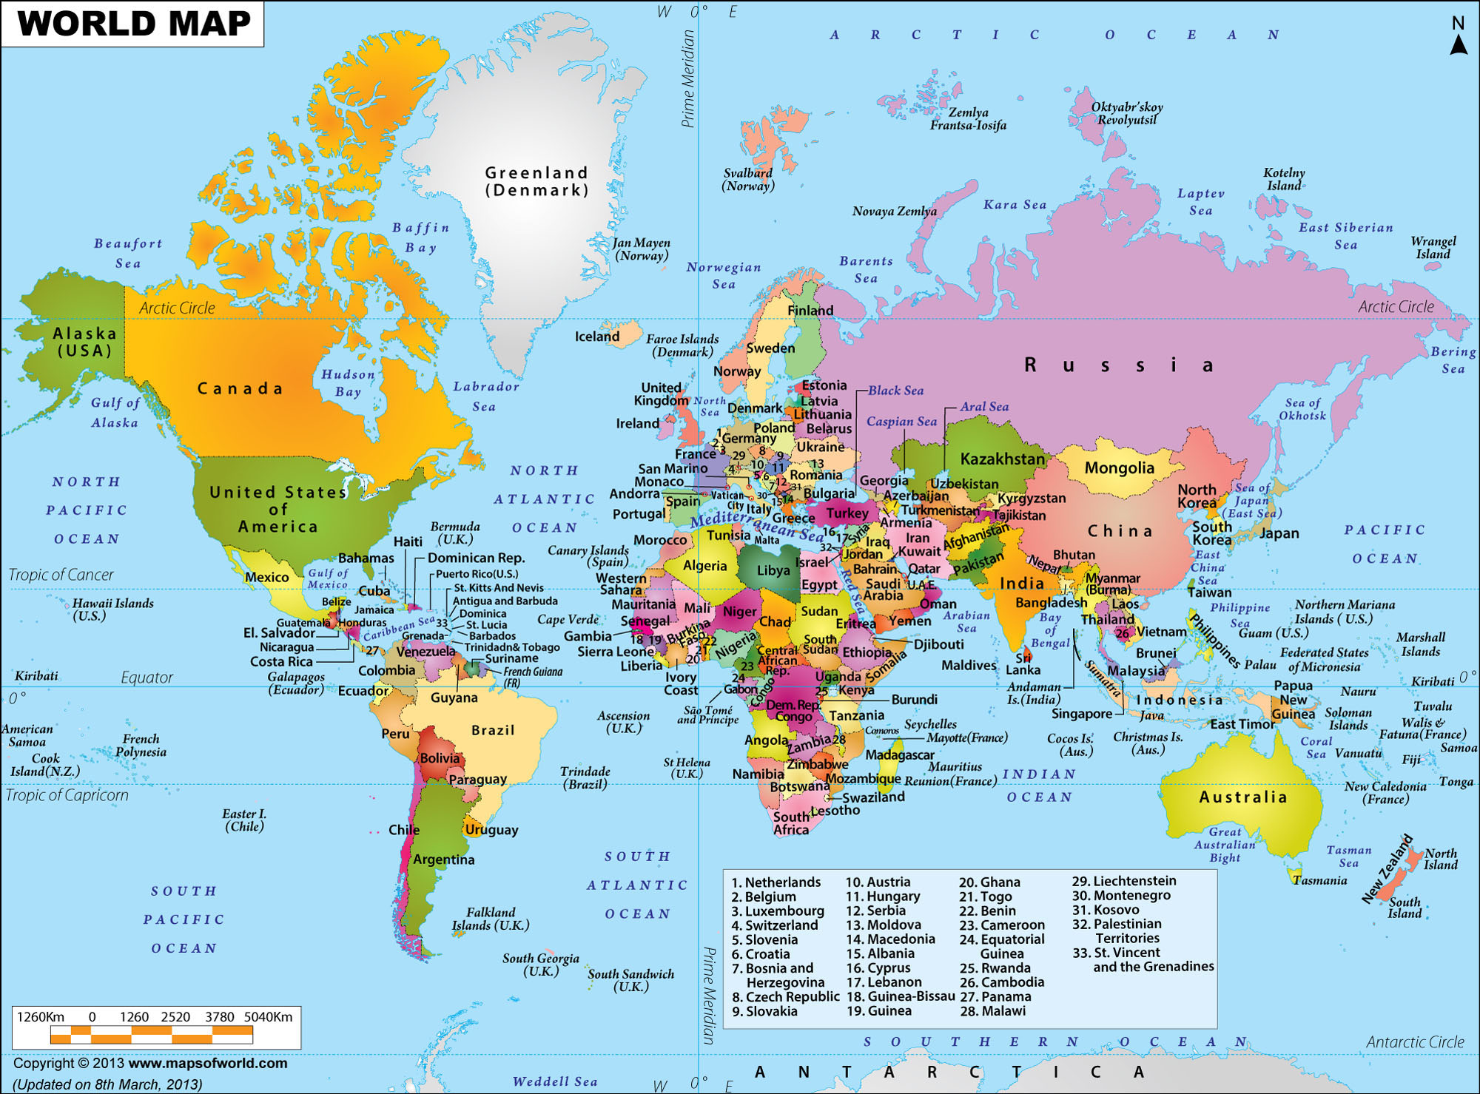
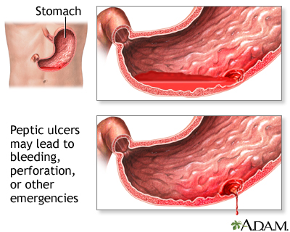
INTRODUCTION
The development of peptic ulcers is one of the world’s major gastro-intestinal disorders, including both gastric and duodenal ulcers, which affects 10% of the global population
(Zapata-Colindres et al., 2006)
There are several drug treatments used to treat gastric ulcer. However due to high incidence and constant recurrence of the symptoms of this disease it is still necessary studies aiming at new pharmacological treatments
for peptic ulcer

Slide 4
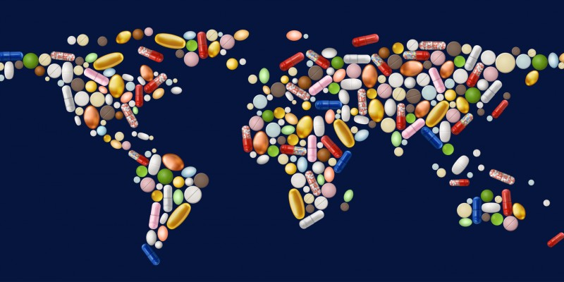
INTRODUCTION
Moreover, the monitoring of pharmaceutical
compounds in environmental matrices
has been addressed in several
studies in the last 20 years
Drugs excreted by patients can
contaminate rivers, even after treatment in wastewater-processing facilities
In addition, there is mounting evidence
that effluents from pharmaceutical factories could also be carrying drugs into the rivers
Thus, herbal compounds can be a therapeutic
alternative with less risk to the environment

Slide 5

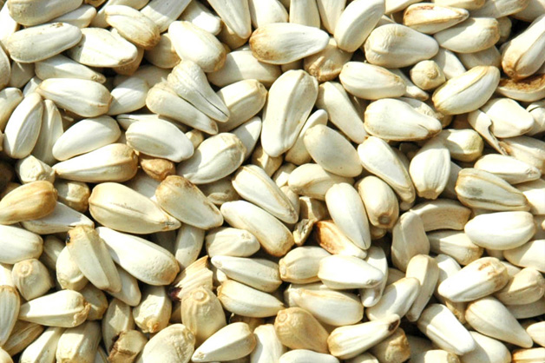
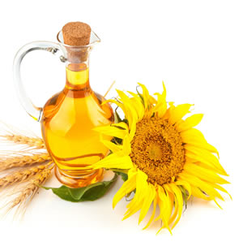
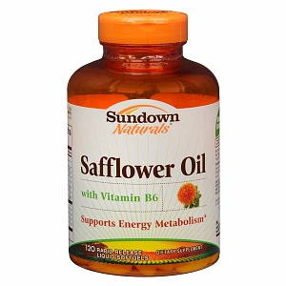
INTRODUCTION
In Brazil the Safflower oil
obtained from
Carthamus tinctorius L. (Asteraceae)
seeds is currently used
as a thermogenic
compound and as
treatment for problems
related to the
cardiovascular system
Carthamus tinctorius
Carthamus tinctorius Seeds
Safflower Oil
Safflower Oil

Slide 6
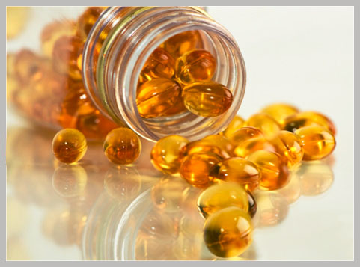
INTRODUCTION
The oral administration of Safflower Oil at doses of 750 mg/kg in rodents has been proven to have thermogenic properties and may thus
contribute to the treatment of obesity
(Takeuchi et al., 1995)
Other reports show that this oil has the capacity to
relieve constipation and ease rheumatic pains, and that it has laxative and antifungal activities
(Pintão & da Silva, 2008).
However, there have been no studies
regarding the use of this oil for the treatment of gastric ulcers,
or tests to determine its rodent toxicity (side effects) and environmental risks of this oil

Slide 7
OBJECTIVE
The aims of this present work were to:
1- Phytochemical Analysis of Safflower Oil (Sigma-Aldrich)
2- Antiulcer Activity and Mechanisms of Action
of Safflower Oil
3- Acute toxicity in rodent animals
4- Ecotoxicity Evaluation

Slide 8
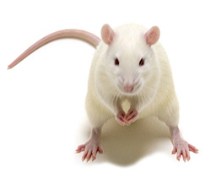
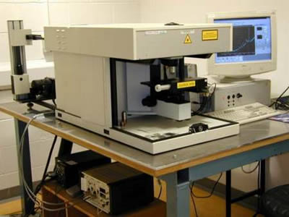
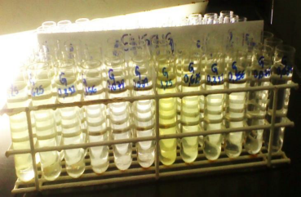
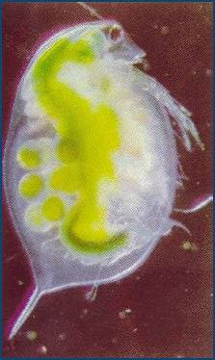
MATERIAL AND METHODS
PHARMACOLOGICAL ASSAYS USING ACUTE PROTOCOLS
Hydrochloric acid (HCL)/ethanol-induced gastric ulcer (Mizui & Doteuchi (1983))
NSAID-Induced gastric ulcers in cholinomimetic-treated mice (Rainsford (1978)
Determination of gastric secretion (Shay et al., 1945)
Determination of mucus in gastric content (Sun et al. (1991)
Acute toxicity assay
(Brito, 1994)
Single dose By Oral route OF Safflower oil (5 g/Kg) and observed the animals for seven days
Ecotoxicity assays with
Daphnia simillis (US EPA, 2002)
Daphnia similis were exposed to several concentrations of Safflower Oil for a period of 48 hs
PHYTOCHEMICAL ANALYSIS (Raman Spectroscopy)

Slide 9
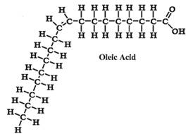

Results - RAMAN SPECTROSCOPy
Oleic Acid
Linoleic Acid
Figure 1 – Raman spectra obtained from linoleic acid, oleic acid authentic standards and safflower analysis. The peaks observed at 1655 cm-1 and 1265 cm-1 are consistent with the presence of C=C alkyl stretching and C-H ethylene, respectively. The four peaks observed in the region of 800- 980 cm-1 exhibit a pattern consistent with the Raman spectra profile of linoleic acid (Baeten et al., 2001; Silveira et al., 2010; 2012). Together, these observations indicate the presence of the unsaturated fatty acid linoleic acid, consistent with previously published data.

Slide 10
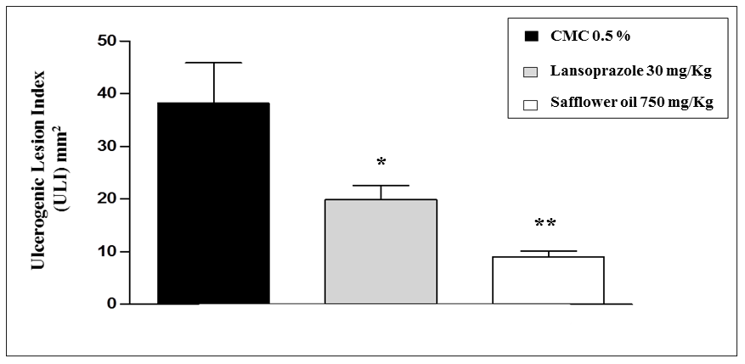
Results – ANTIULCER ACTIVITY
Lansoprazole 30 mg/kg
Safflower oil 750 mg/kg
Safflower Oil at overdose (5 g/Kg) by Oral Route not shows a toxicity effects
Figure 3 – The activity of antiulcerogenic safflower oil (750 mg/ kg) after oral administration in the model of gastric lesions induced by administration of HCl-ethanol in mice. Data are expressed as
mean ± S.D. ANOVA followed by Dunnet’s test with *P<0.05; ** P<0.01

Slide 11
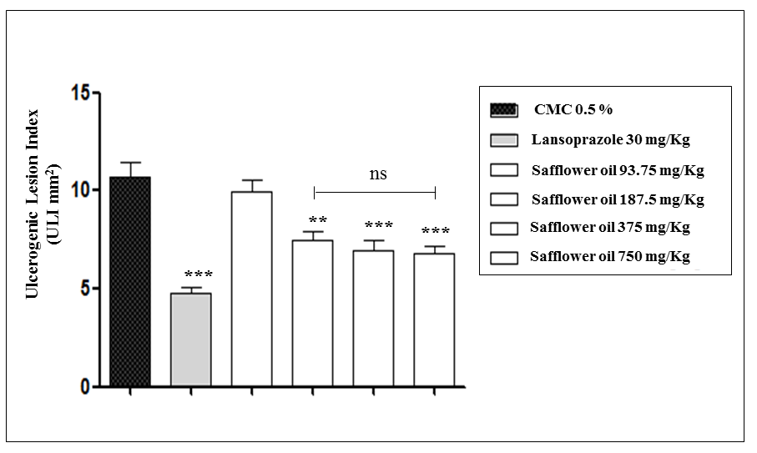
Results – ANTIULCER ACTIVITY
Lansoprazole 30 mg/kg
Safflower oil 93.75 mg/kg
Safflower oil 187.5 mg/kg
Safflower oil 375 mg/kg
Safflower oil 750 mg/kg
Figure 4 – Effects of vehicle, safflower oil and lansoprazole on Non-Steroidal Anti-Inflammatory Drug (NSAID) – induced gastric ulcers in cholinomimetic-treated mice. Data are expressed as mean ± S.D. ANOVA followed by Dunnet’s test. **P<0.01; *** P<0.001

Slide 12
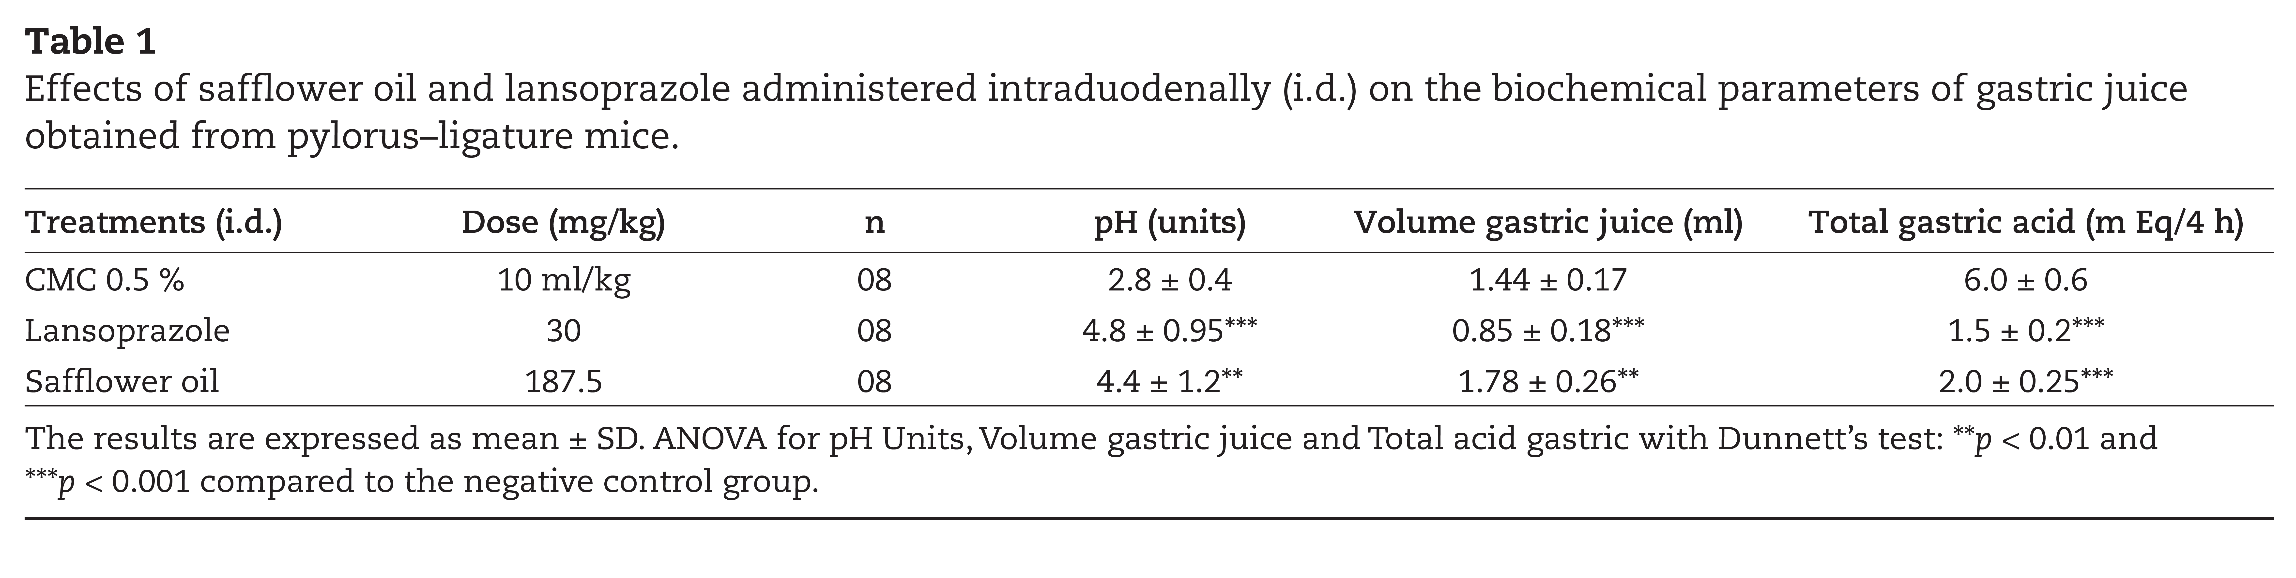
Results – ANTIULCER MECHANISM
The results are expressed as mean ± SD. ANOVA for pH Units, Volume gastric juice and Total acid gastric with Dunnet’s test: ***p,0.001

Slide 13
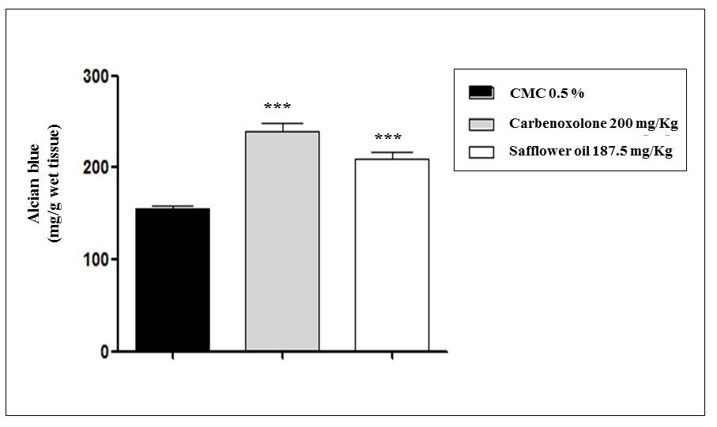
Results – ANTIULCER MECHANISM
Carbenoxolone 200 mg/kg
Safflower oil 187.5 mg/kg
Figure 5 – Effects of vehicle, safflower oil and carbenoxolone on adherent gastric mucous after pylorus ligature in rats. Data are expressed as mean ± S.D. ANOVA followed by Dunnet’s test. ***P<0.001

Slide 14
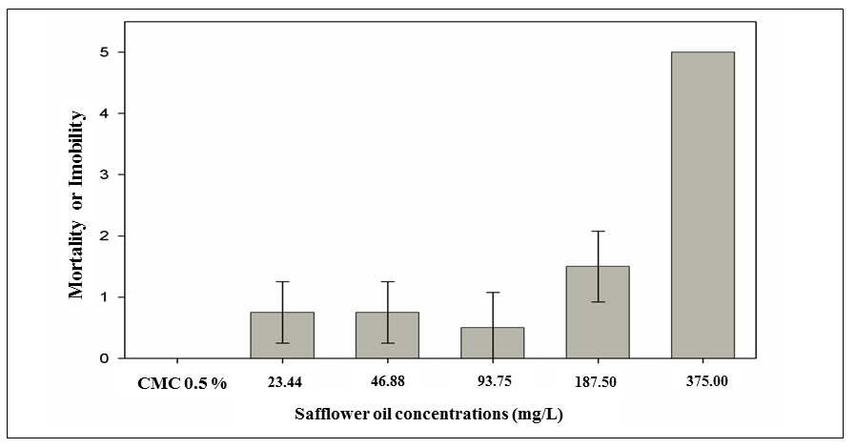
Results – ECOTOXICOLOGY ASSAY
Figure 6 – Results of acute ecotoxicity assay on Daphnia similis (means and standard deviation). At the end of 48 h of exposure, immobility and mortality were analyzed and the maximal effective concentration (EC50) was calculated using the Trimmed Spearman Karber statistical method.
EC50 = 223.17 mg/L
Safflower oil concentrations (mg/l)
NON TOXIC CE50 > 100 mg/L | HARMFUL CE50 between 10 e 100 mg/L | TOXIC CE50 between 1.0 e 10 mg/L | VERY TOXIC CE50 between 0.1 e 1.0 mg/L | EXTREMELY TOXIC CE50 < 0.1 mg/L
EUROPEAN DIRECTIVE FROM
COMMISSION OF THE EUROPEAN COMMUNITIES 1996 (CEC, 1996).
Technical guidance document in support of
commission directive 93/67/EEC on risk assessment for new
notified substances
223.17 mg/L

Slide 15
CONCLUSIONS
1- Phytochemical Analysis of Safflower Oil
Oleic and Linoleic Acid
2- Antiulcer Activity and Mechanisms of Action
of Safflower Oil
Cytoprotective Antiulcer Activity
3- Acute toxicity in rodent animals
Non toxic
4- Ecotoxicity Evaluation
Non toxic

Slide 16
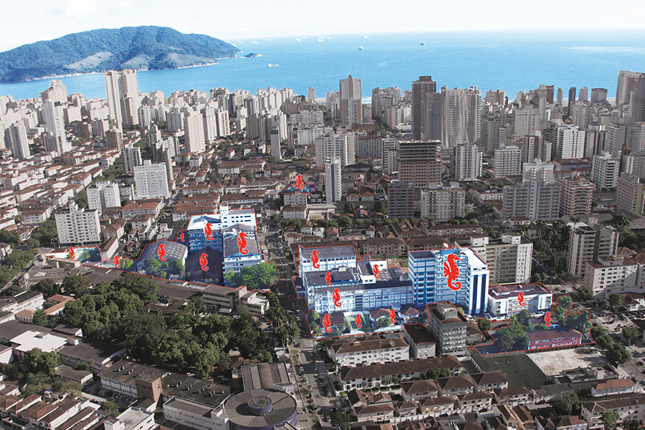
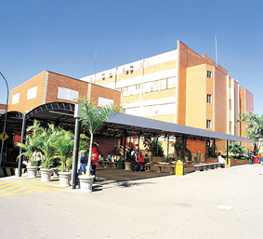
Thanks for your attention !!!
walbertoma@unisanta.br
walbertoma@gmail.com

