Slide 1




A proteomic study on the responses to arsenate stress by an acidophilic fungal strain Acidomyces acidophilus WKC1
W. Chan, D. Wildeboer, H. Garelick and D. Purchase
School of Science and Technology, Middlesex University
Presented by: Wai Kit Chan
In collaboration with

Slide 2
Source of
Arsenic
in the
environment
NATURAL SOURCES
Groundwater
Mining
activities
ANTHROPOGENIC SOURCES
Volcanic
activity
Metal
smelting
Burning of
fossil fuels
Agricultural
and farming
Preservative
of timber
Figure 1: Sources of arsenic in the environment

Slide 3
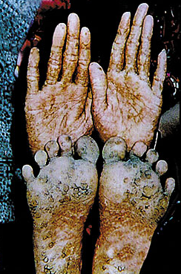

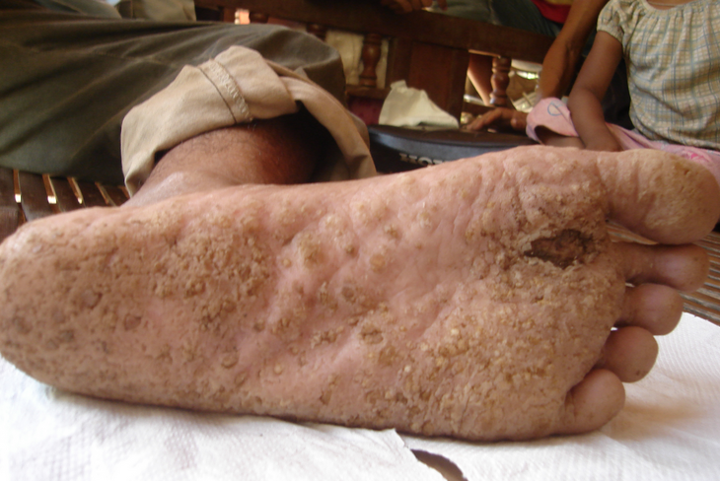
Health impacts of arsenic
Chronic arsenic poisoning (arsenicosis)
High oxidative stress- affect the structure of cardiovascular system and risk of cancer
Vitamin A deficiency- heart disease and night blindness
Skin colour change
Eye inflammation
Source: http://pubs.acs.org
Source: http://www.dngmresfoundation.org
Source: http://www.drfcambodia.net

Slide 4
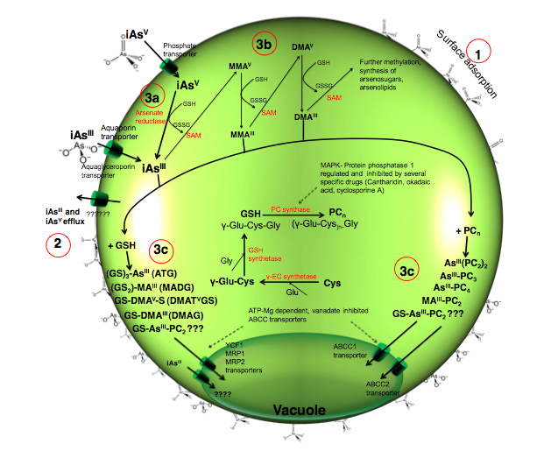
Representation of the theoretical arsenic tolerance/toxicity mechanisms in C. vulgaris

Slide 5

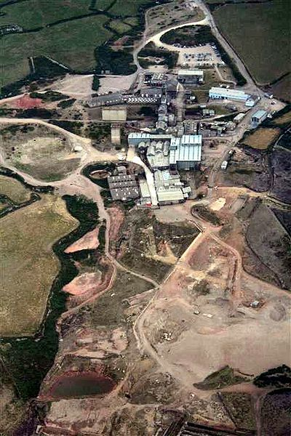
Sampling site
Soil samples were obtained from Geevor Tin Mine in Penzance, Cornwall
Located at the far end of Southwest England
It was operational between 1911 and 1990 during which time it produced about 50,000 tons of black tin
The site covering an area of 67 acres (270,000 m²)
The tin appear cassiterite (with around 65-70% tin)
Figure 2: Aerial shot of Geevor Tin-Mine
Source: Google (Assessed on 15th Feb 2014)
Figure 3: England map
Source: Google (Assessed on 15th Feb 2014)

Slide 6
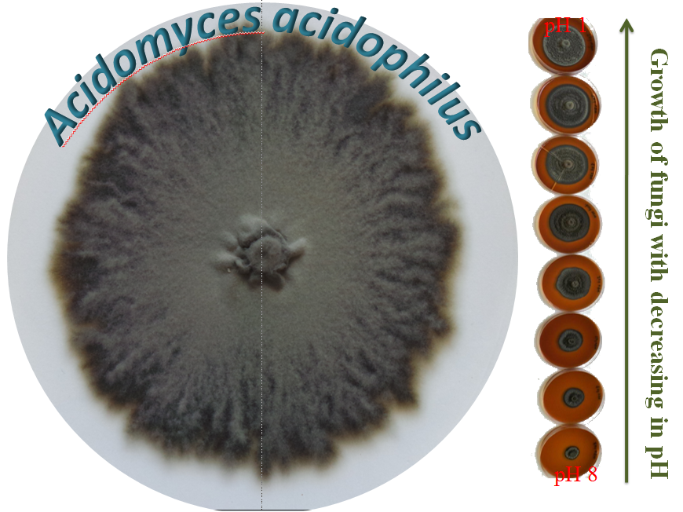
WHY FUNGI?
Very versatile biosorbents.
Able tolerate extreme levels of metal concentration, nutrient availability, pH and temperature (Dhankhar and Hooda, 2011).
Contain high proportion of cell wall materials with excellent biosorptive sites for metal binding such as the carboxyl, hydroxyls and amides in their biomasses (Akar et al., 2005).
In extreme condition such as acidic tin-mining soils, filamentous fungi are highly adaptable to grow in such extreme conditions (Buckova et al., 2007).
The perseverance of resting fungal spores with combined of its intrinsic resistance may provide as suitable organisms in developing bioremediation strategies.
Figure 4: Acidomyces acidophilus culture isolated from Geevor Tin Mine

Slide 7
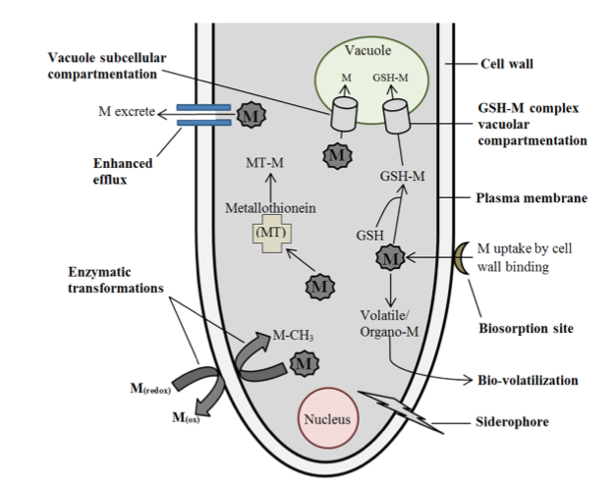
Metalloids detoxification mechanism by fungi
Figure 5: Diagrammatic overview of cellular detoxification mechanisms in metal/metalloid tolerance in observed fungi.

Slide 8
Methodology/results

Slide 9
Soil analysis
Fungal strain resistant and identification
Biosorption
Proteomic study
Physico-chemical parameters assessment
Soil texture
pH analysis
Cation exchange capacity
Organic matter content
Phosphate content
Arsenic and antimony tolerance test and isolate the most tolerant fungi
Optimizing biosorption parameters
pH
Biomass loading,
Contact time
Initial [As⁵⁺]
Fungal culture
LSM medium
Grow using rotator (log phase)
Expose with As⁵⁺ and/or Sb⁵⁺
Molecular identification of isolate
DNA
Protein
Sorption test with As⁵⁺ and/or Sb⁵⁺
Protein and enzyme preparation
Bead beater with control temp at 4ºC
Suspend with buffer
Centrifuge and supernantants stored in -80ºC
On SDA plate after 21 days incubation
Fungal strain cultivated in liquid salt medium (LSM) for 48 hrs
Concentration of heavy metal/metalloid(s)
Microwave assisted acid digestion
Three-step sequential extraction
Analyse concentration of As⁵⁺ by ICP-OES
CTAB
Adsoprtion isotherm
Langmuir model
Freundlich model
Formic acid and acetonitrile extraction with bead grinding
Extract with bead grinding
Soil microbial enumerations
Protein responses analysis
Enzyme activity analysis
PCR
DNA sequencing
BLAST to GenBank (NCBI).
MALDI TOF/TOF MS
Detection of vibration frequency
FT-IR
hybrid quadrupole-Orbitrap mass spectrometer

Slide 10
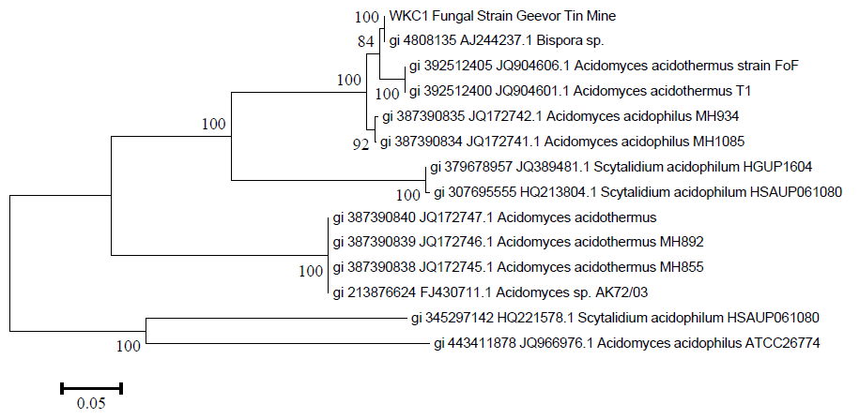
Identification of isolated fungal strain
Figure 6: Phylogenetic dendrogram (Scale bar = 5 represented nucleotide substitutions per 100 nucleotides. Numbers given at the nodes represent bootstrap values of 1000 replications).

Slide 11
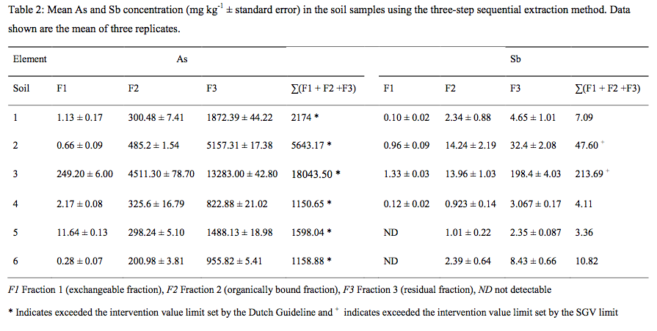
The availability of arsenic to be taken by the fungal strain is very low <40% (S3-S6) and <20% (S1-S2)
The remaining of the arsenic is still strongly bounded to the matrix
Figure 8: Percentage bioavailability of arsenic in soils obtained from the summation of fraction 1 and 2 of the three step sequential extraction.

Slide 12
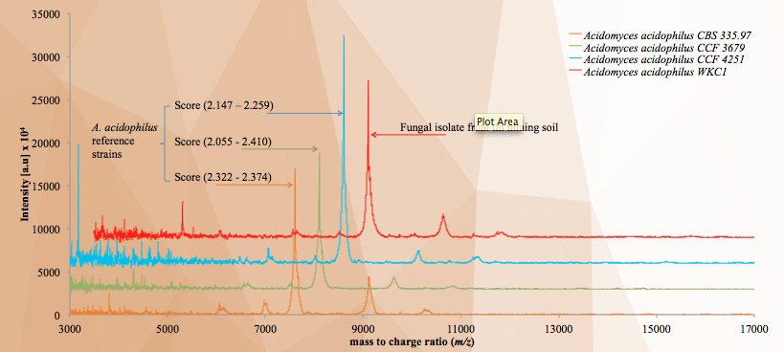
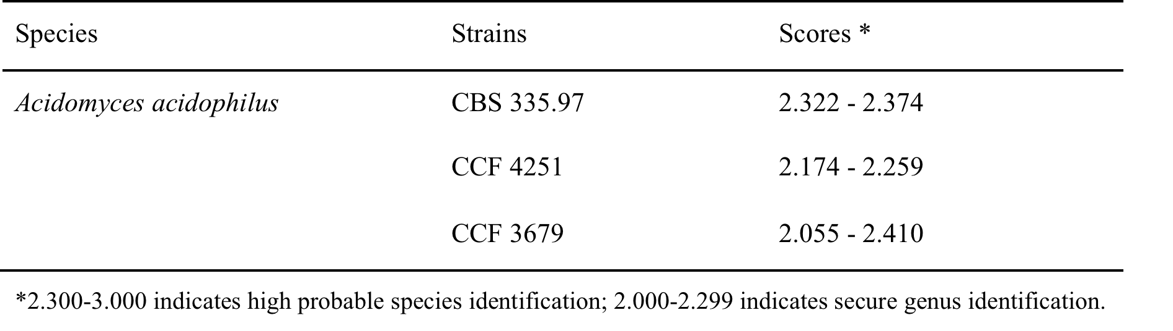
Figure 7: Representative MALDI-TOF/TOF mass spectra of tin mining soil fungal isolate and the A. acidophilus reference strains
Scoring

Slide 13
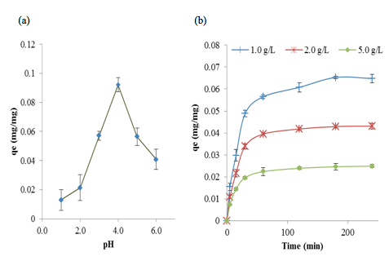
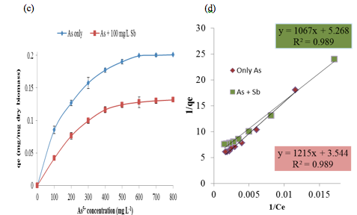
Biosorption analysis
Figure 6: Effects of pH (a), biomass loading and contact time (b) of As⁵⁺ biosorption, As⁵⁺ uptake and effect of Sb⁵⁺ on As⁵⁺ biosorption (c) and Langmuir plot of As⁵⁺ ions on A. acidophilus (d)

Slide 14
Biosorption analysis conditions and effects of each parameter
There was an increase from 0.07 to 0.09 mg mg⁻¹ of the amount of As⁵⁺ absorbed by isolated A.acidophilus as pH increased from 1.0 to 4.0. Therefore, the optimum pH for the biosorption analysis of As⁵⁺ was set at pH 4.0.
The biosorption analysis for both As⁵⁺ and Sb⁵⁺ loaded biomass was set at 120 min.
The sorption capacity by A. acidophilus decreased as the biomass loading increased from 1g L⁻¹ to 5.0 g L⁻¹.
Biosorption of As⁵⁺ capacity by A. acidophilus
The data from current study fitted the Langmuir isotherm model well.
Regression coefficient (R²) of 0.989
Small b values (0.01) imply strong binding of arsenic ions to Acidomyces acidophilus
Predicted maximum capacity of fungal strain uptake of As⁵⁺ by A. acidophilus was 170.82 mg g⁻¹ dry biomass compared to A. acidophilus CBS335.97 of 117.55 mg g⁻¹

Slide 15
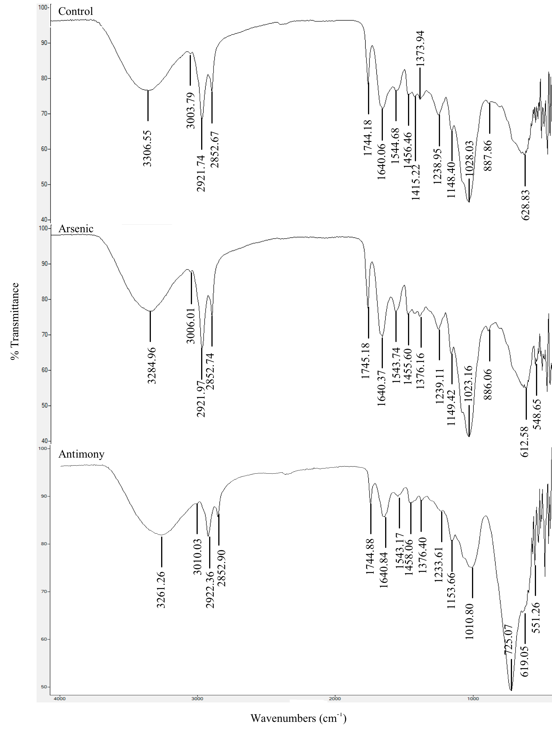
phosphate (-PO₄)
hydroxyl (-OH)
amino (-NH₂)
methyl (-CH₃)
sulphate (-SO₃)
Figure 7: FT-IR spectra of isolated A. acidophilus strain biomass (a) control, (b) As⁵⁺ loading and (c) Sb⁵⁺ loading.

Slide 16
Bioinformatics analysis:
Orthologs and FACT of arsenic resistance proteins
Saccharomyces cerevisiae
Acidomyces richmondensis
HOG1, Pho90p, Gtr1p, Msn4p, RPN4, Pho89p, MET30, Pho88p, PAP1, TSA1, YBP1p, Arr1p, Arr2p, ASK10, Rgc1p, FPS1, YCF1, MET31p, Arr3p, UBC4, HYR1, Met4p, Met32p, Crm1p, Cbf1p, Skn7p, YAP1, Pho84p, Pho87p, Msn2p, Sfp1p, Rap1p, Fhl1p, Sic1p,
Met30p
HOG1, Gtr1p, RPN4, MET30, Pho88p, PAP1, FPS1, YCF1,Arr3p, HYR1, Crm1p, Cbf1p, YAP1, Pho84p, Fhl1p, Met30p
Orthologs
Functional equivalence
Hog1, Gtr1p, Pap1, Arr3p, Crm1p, Cbf1p, Yap1, Pho88p, Fhl1p

Slide 17
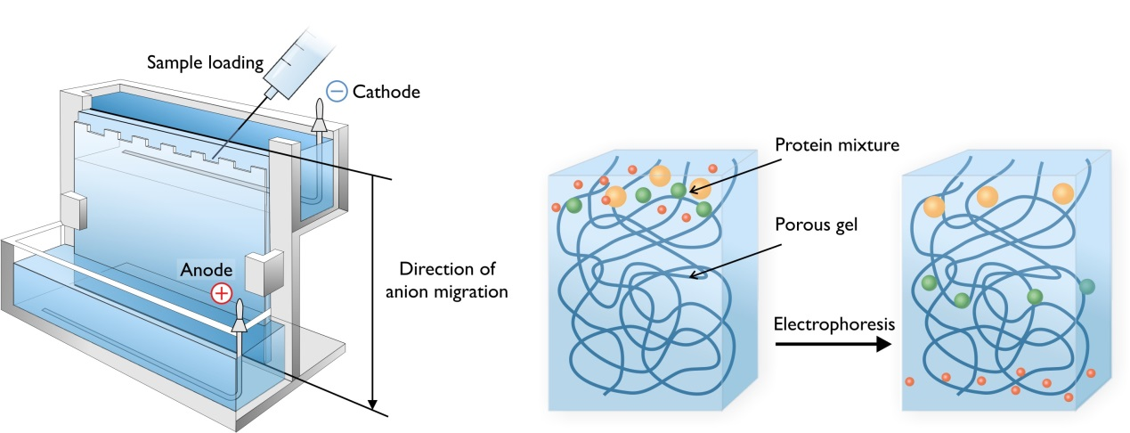
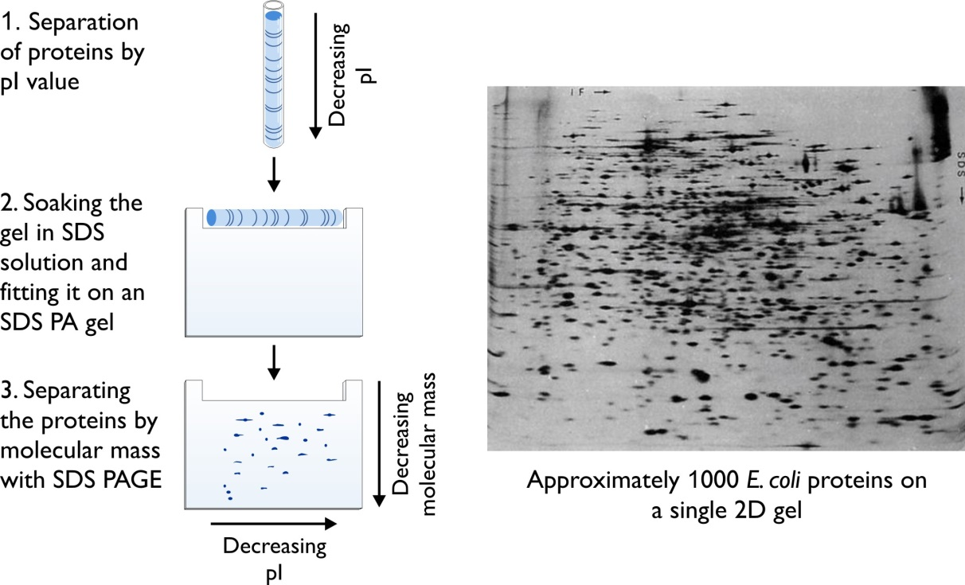
Proteomics analysis
2D Gel Electrophoresis
Limitations
A single protein can make multiple spots so number of proteins less than spots
Usually see only most abundant proteins
Separation limited by gel concentration and size
Basic and membrane bound proteins are not well separated by 2D gel electrophoresis.
Non-quantitative.

Slide 18
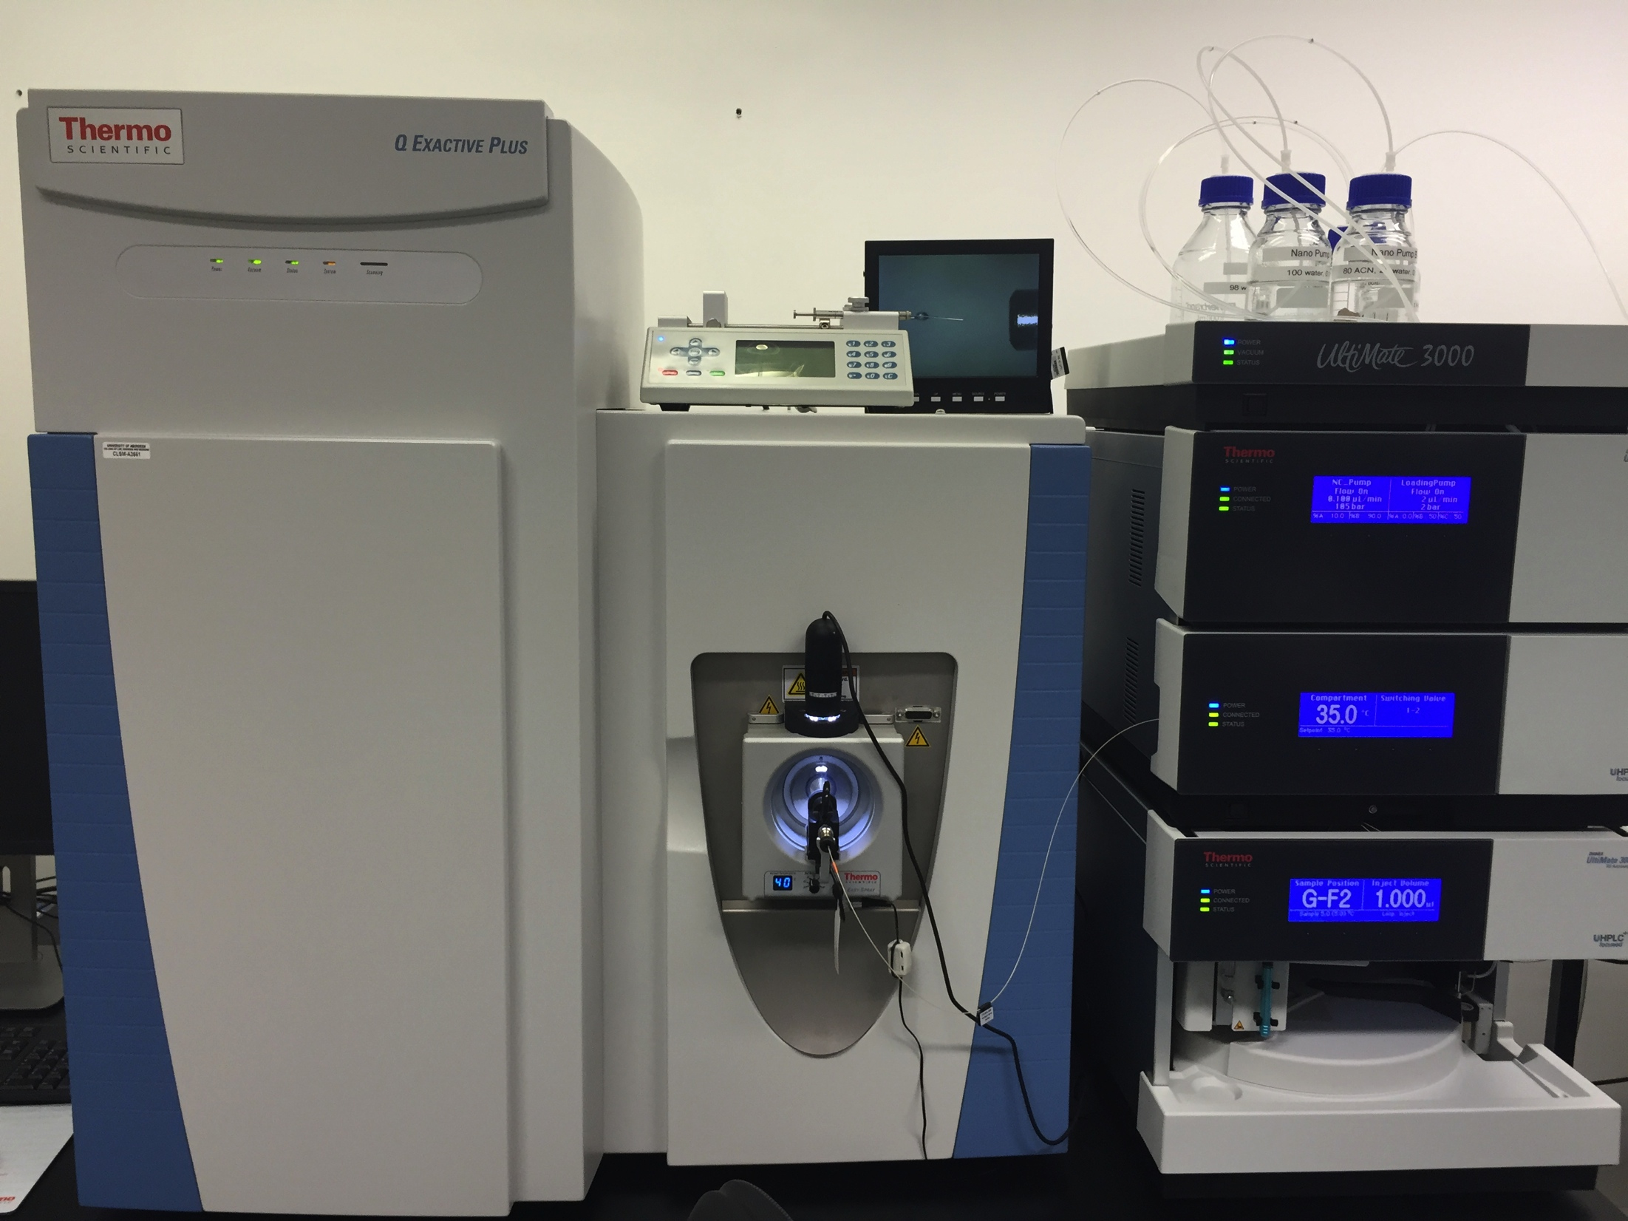
Proteomics analysis
Unique Features of the Q Exactive Plus
Characterize, quantify and confirm with unmatched confidence Resolving power up to 280,000
Maximum scan speed 12 Hz
Spectral multiplexing for enhanced duty cycle
RF-Lens ion source for increased sensitivity
Advanced Active Beam Guide intelligent ion beam management for high flux ion sources
Intact Protein Mode option for characterizing intact proteins with ease
Enhanced Resolution Option maximizing resolution at 280,000
Q Exactive Plus
hybrid quadrupole-Orbitrap mass spectrometer

Slide 19
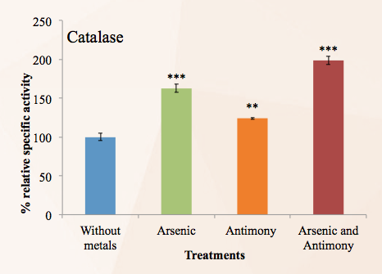
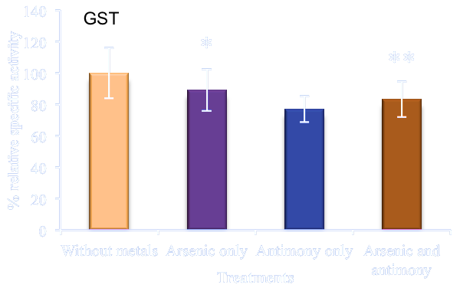
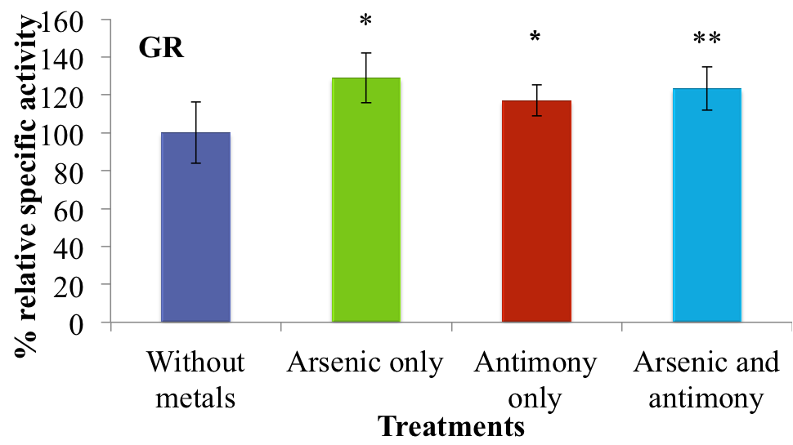
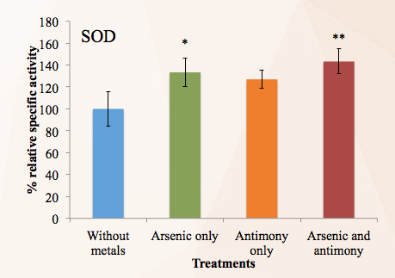
Enzymatic analysis

Slide 20
Proteomics analysis
A total of 262 differentially expressed proteins were detected
175 were upregulated and 63 were downregulated following exposure to arsenate.
These proteins included ones know to be involved in :
cellular stress responses (e.g. Hsp70),
energy production (e.g. SOD, formate dehydrogenase),
Transport (e.g. Pho88) and
proteins/enzymes synthesis (e.g. elongation factor 2)
In addition, 14 proteins were switched off (e.g. thiazole biosynthesis enzyme) and 10 proteins were switched on (e.g. iron ion binding, catalase activity) in the presence of arsenate

Slide 21
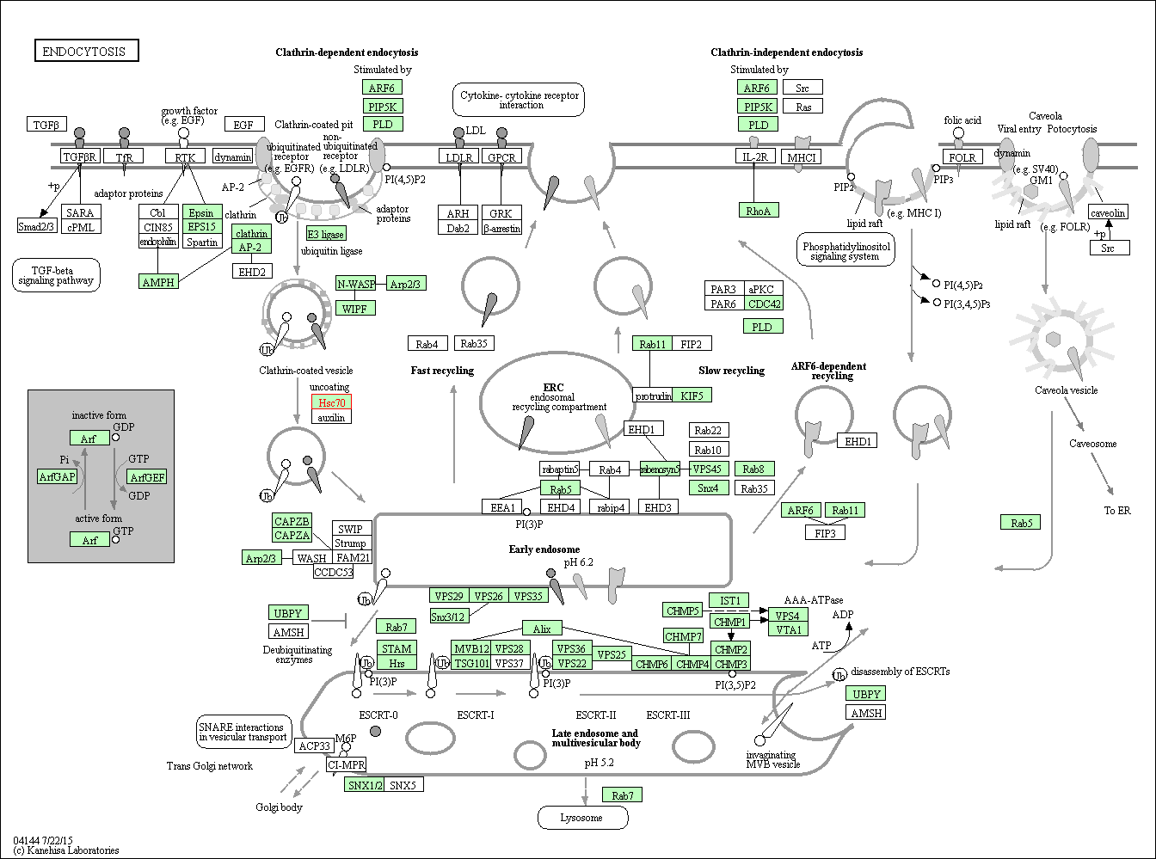
Hsp70 family ATPase SSA3- cellular stress response

Slide 22
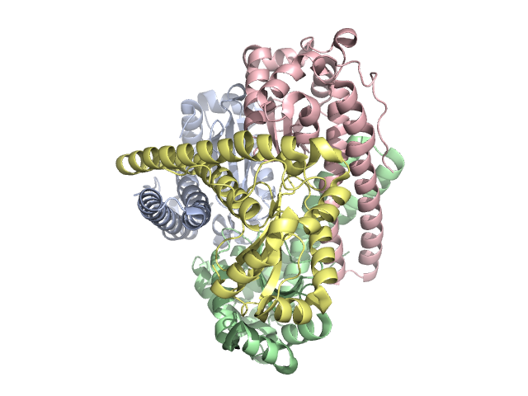
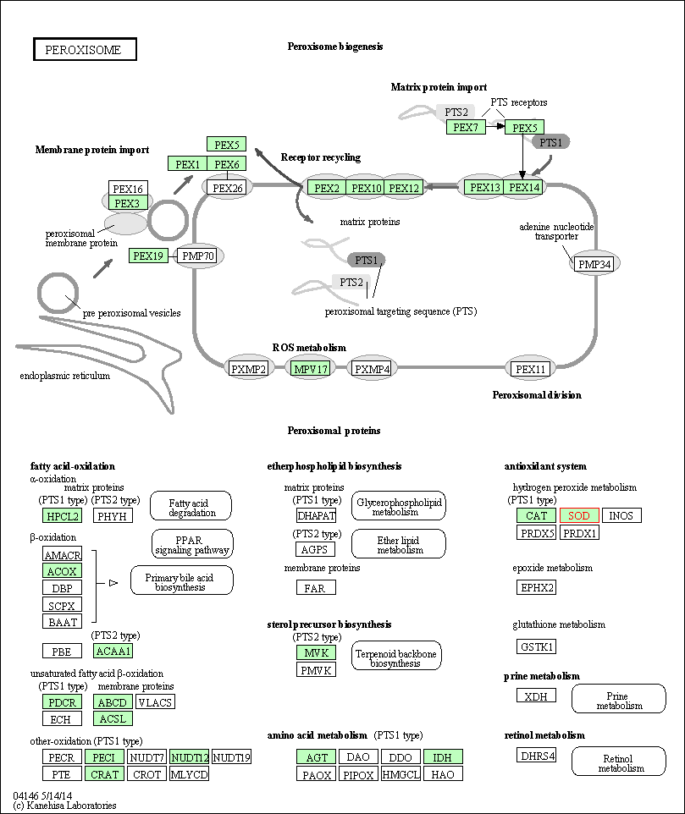
SOD- ion transport and catabolism

Slide 23
In conclusion
Technical enhancements to the original Q Exactive instrument
Maximize performance and reliability for large- and small-molecule applications,
Improving quantitation of low-abundance ions in the most complex matrices.
Provide reproducible quantitation results while delivering complete qualitative confidence.
An optional Protein Mode enhances analysis of intact proteins through sophisticated ion beam control and easy pressure adjustment, while optional 280,000 maximum resolution ensures maximum ID confidence in top down and Lipidomics as well as in small molecule applications.
The implementation of the Advanced Active Beam Guide is an intelligent ion beam management for high flux ion sources, which ensures the reliability and accessibility in proteomics study.

Slide 24
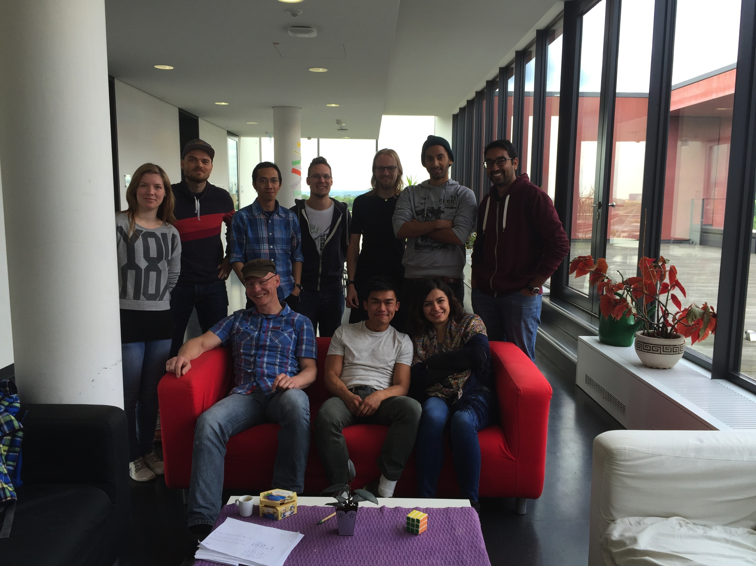


Thank you
In collaboration with

