Slide 1
GREETING
BUENOS DÍAS
GOOD MORNING
BONJOUR

Slide 2


University Badji Mokhtar Annaba, Algeria
Annaba Medical College
Départment of Pharmacy
Chemistry Laboratory Therapeutic
International Conférence on Toxicogenomics and Drug Monitoring and European Pharma Congress
August 25-27, 2015 Valencia, Spain
Tolerance of Imatinib Dasatinib and Nilotinib
in the treatment of Chronic Myeloid Leukemia.
Presented by
Dr. SOUDANI.W Chemistry Laboratory Therapeutic, Annaba, Algeria
Co-authors: Pr. DJAFER.R², Dr. DJEDDI.H³, Dr. BOUGHRIRA.S³, Pr. GRIFFI .F³.
2: Service of Toxicology CHU Annaba, Algeria
3: Service of Hematolgy CHU Annaba,Algeria

Slide 3
Introduction
The objective searched in the use of the anti-cancer treatment is to reach tumoral cells in order to destroy them in a way as selective as possible, while operating one or more targets, all this explains the multiplicity of the research undertaken in the field of cancerology.
Progress of molecular biology has allows the emergence of different therapeutic approaches which deeply do not affect the operation of the healthy cells: immunizing defenses of the organization, cellular differentiation, the angiogenesis and the apoptosis constitute the principal explored ways.

Slide 4
Introduction
However, these ways are generally unbalanced by surexpression of a protein having a strong activity tyrosin kinase, this led to the marketing of anti-cancer non cytotoxic: Imatinib (Imatib®,Glivec®) first inhibitor of receiver tyrosin kinase, this discovery was followed by the introduction of other molecules of the same classe Dasatinib, Nilotinib,…

Slide 5
Anticancer treatment
Indicate means used in the treatment of cancers, which interfere with the cellular cycle, either by modifying the structure of the DNA, or by disturbing the proteinic synthesis
They involve the reduction in the tumoral cells by two processes
Antimitotic effect
cytotoxic effect

Slide 6
Anticancer treatment
Chemotherapy
Anticancer Treatment
Hormone therapy
Immunotherapy
Targeted Therapy

Slide 7
Targeted Therapy
The targeted molecular therapies indicate antitumor molecules able to inhibit a oncogenic way directly implied in the carcinogenesis and the progression of the tumoral cells.
They aim at cellular events playing a main function in carcinogenesis, like the proliferation initiated by receivers tyrosin kinase of growth factor, and the angiogenesis.
Their targets can be membrane (EGFR, HER-2), cytoplasmic (mTOR), or present in the extracellular medium (VEGF).

Slide 8
Targeted Therapy
Glycoproteins obtained starting from a cellular clone and recognizing specifically only one type of antigen fixed on a cell or a foreign protein.
Monoclonal antibodies
Tyrosin kinase inhibitors
Block the activity tyrosin kinase of a receiver or a cytoplasmic protein essential to the transduction of the signal of proliferation.

Slide 9
Tyrosin Kinase Inhibitors
Monocibles Tyrosin Kinase Inhibitors
Multicibles Tyrosin kinase Inhibitors
  They block the activity tyrosin kinase of the receiver HER2.
  They block the activity tyrosin kinase of many receivers. Antiangiogénic, Antiproliférative and proapoptotic action.
  Gefitinib, Erlotinib,,,
  Imatinib, Dasatinib, Nilotinib,,,

Slide 10
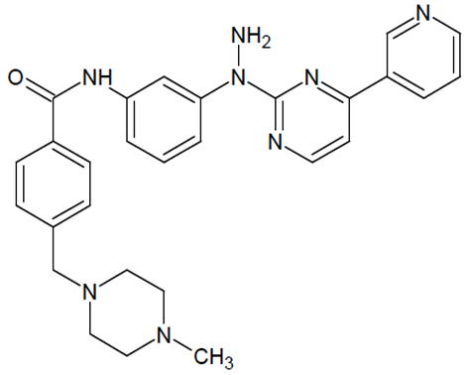
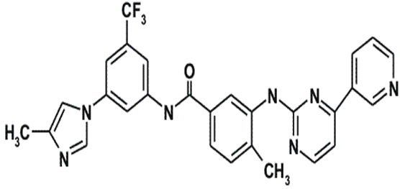
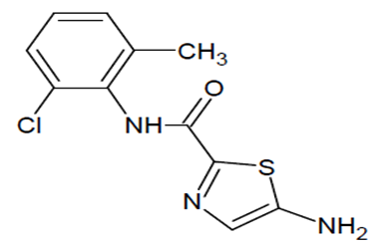
Tyrosin Kinase Inhibitors
Imatinib
Nilotinib
Dasatinib
Imatib®, Glivec®,
Tasigna®
Sprycel®

Slide 11
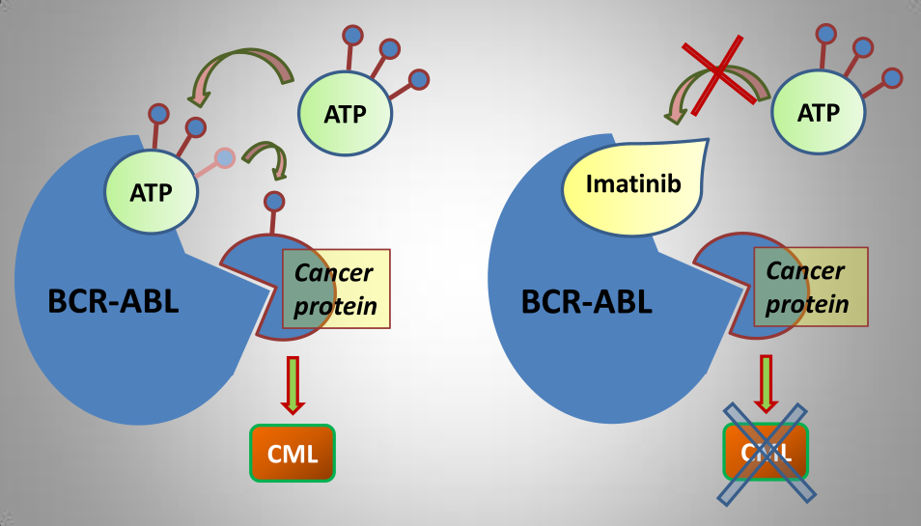
Tyrosin Kinase Inhibitors
Mode of action of Tyrosin kinase inhibitors

Slide 12


Objectives
Principal objective :
To evaluate the tolerance with the Inhibitors of Receivers
Tyrosin Kinase (ITK) among cancer patients.
Secondary objective :
To determine the carcinogenic risk factors among these patients.

Slide 13
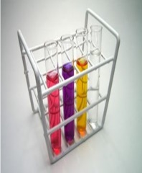
Material & Méthods
DESCRIPTIVE RETROSPECTIVE STUDY
33 cancer patients
17 men
16 women
Service of Hematology CHU ANNABA, ALGERIA
  Period: From December 2012 to May 2013

Slide 14
Material & Méthods
Information were collected on:
Monitoring sheets of the patients.
biological assessments.
Harvest of the Data
Data Analysis
Cards of investigations were seized on Excel 2010.
The data were expressed as a percentage, and averages.

Slide 15

RESULTS
Sexe of cancer patients
52%
48%

Slide 16
RESULTS
Age of cancer patients
Median age of 45 years and two extremes 17 years and 72 years

Slide 17
RESULTS
Professional situation
55%
21%
21%
3%

Slide 18
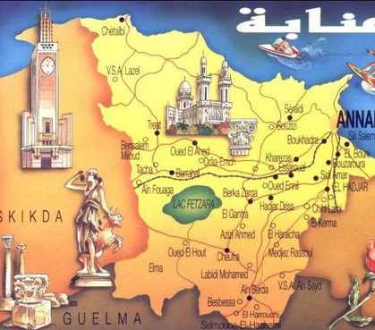
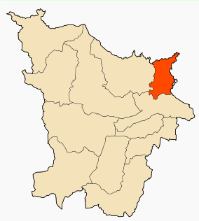
RESULTS
Geographical area

Slide 19
RESULTS
Pathological antecedents
3%
3%
3%
9%
9%

Slide 20
RESULTS
Carcinogenic factors
12%
3%
85%

Slide 21
RESULTS
Cancer
All the treated cases had a Chronic Myeloid Leukemia (CML) which accounted for 100% of the patients.

Slide 22
RESULTS
Therapeutic protocols
55%
21%
12%
15%
12%
12%
9%
3%
Imatinib
Imatinib
Dasatinib
Nilotinib

Slide 23
RESULTS
Symptomatic Treatment
11%
8%
13%
11%
35%

Slide 24
RESULTS
Tolerance to the Tyrosin Kinase Inhibitors
91%
86%
67%
57%
54%
50%
39%
39%
36%
14%
Imatinib
Imatinib
Dasatinib
Nilotinib

Slide 25
RESULTS
Specific effects of Imatinib: Imatib®
22%
30%
9%
22%

Slide 26
RESULTS
Communs effects of Imatinib: Imatib®
74%
35%
57%
35%

Slide 27
RESULTS
Complications of Imatinib: Imatib®
9%
9%
9%
13%

Slide 28
RESULTS
Specific effects of Imatinib:Glivec®
14%
14%
14%
14%
29%

Slide 29
RESULTS
Communs effects of Imatinib :Glivec®
14%
14%
14%
29%
29%
71%

Slide 30
RESULTS
Complications of Imatinib :Glivec®
Only one case having received hydroxyurée (Hydrea®) as a chemotherapy in first intention then Imatinib: Glivec®, which developed a colopathy with a respiratory allergy

Slide 31
RESULTS
Specific effects of Dasatinib:Sprycel®
17%
17%
17%

Slide 32
RESULTS
Communs effects of Dasatinib:Sprycel®
17%
33%
50%
33%

Slide 33
RESULTS
Specific effects of Nilotinib:Tasigna®
9%
9%
9%
9%
9%
18%

Slide 34
RESULTS
Communs effects of Nilotinib: Tasigna®
18%
9%
27%
27%

Slide 35

DISCUSSION
In our series thirty-three 33 cases, all the treated cancer patients had Chronic Myeloid Leukemia CML, which accounted for 100% of the cases, the frequency of each sex was half of the total manpower of our series.
The age bracket of the adult patients (15-60) years was the prevalent slice 85% with a peak for those having an age from 45 to 60 years with 40%, the majority of these adults are unemployed, which explains the prevalence of cancer at this population.

Slide 36
DISCUSSION
The unemployed represented half of the total manpower with a frequency of 54%, the stress pulled by the unemployed could be regarded as a factor predisposing to cancer which is added to the other noted carcinogenic factors ( the genetic factor at 4 cases and the professional exposure at one case).

Slide 37
DISCUSSION
The antigoutty medication were prevalent as symptomatic treatment with a frequency of 35%, this is explained by the increase in the uric acid ; principal biological Undesirable effect of Imatinib.
Then the antiacids (13%), then antihypertenseurs and coagulants in third position (11%), this to prevent or correct the undesirable effects like the hypertension, heartburn, and haemorrhage. this difference in frequencies is dependent on nature and the frequency on the noted undesirable effects.

Slide 38
DISCUSSION
The study of the tolerance showed that Imatinib: Glivec® gave only one case with complications colopathy and respiratory allergy; with disappearance of the osseous pains and the arterial hypertension wich was obtained with Imatinib: Imatib®; what confirms a good tolerance of the specialty of Glivec® compared to Imatib®.

Slide 39
DISCUSSION
We did not note any complication for Dasatinib and Nilotinib, with reduction in the specific effects (Dasatinib gave 17% of the osseous pains, Nilotinib 9% of osseous pains and 9% of myalgia), reduction in the asthenia (33% for Dasatinib and 9% for Nilotinib); this testifies to a better tolerance of the new Tyrosin Kinase Inhibitors Dasatinib and Nilotinib compared to the molecule of reference Imatinib (Imatib®, Glivec®).

Slide 40
CONCLUSION
According to the got results, We noted a good specificity of the undesirable effects of each Tyrosin kinase Inhibitor such as : osseous pains 30%, arterial hypertension 22%, an oedema (syndrome hand-foot) 9% for Imatinib: Imatib®, and anaemia with 18% for Nilotinib Tasigna®.
We noted the tolerance of the speciality of Glivec® compared to Imatib® and a better tolerance of the new Tyrosin Kinase Inhibitors Dasatinib and Nilotinib compared to the molecule of reference Imatinib (Imatib® or Glivec®).

Slide 41
CONCLUSION
Inspide of a limited manpower, the results got concerning nature and the frequency of the undesirable and toxic effects are well correlated with those announced in the reviews of literature.
Through these data we raise the interest of selection of the therapeutic protocols and the importance of a strict monitoring of the undesirable and toxic effects of targeted therapy.
We underline the role of the responsible authorities of health which must encourage the production of expensive medication, in order to improve the dispensation of new targeted therapy, which makes it possible to ensure the best taken in charge of the cancer patients.

Slide 42
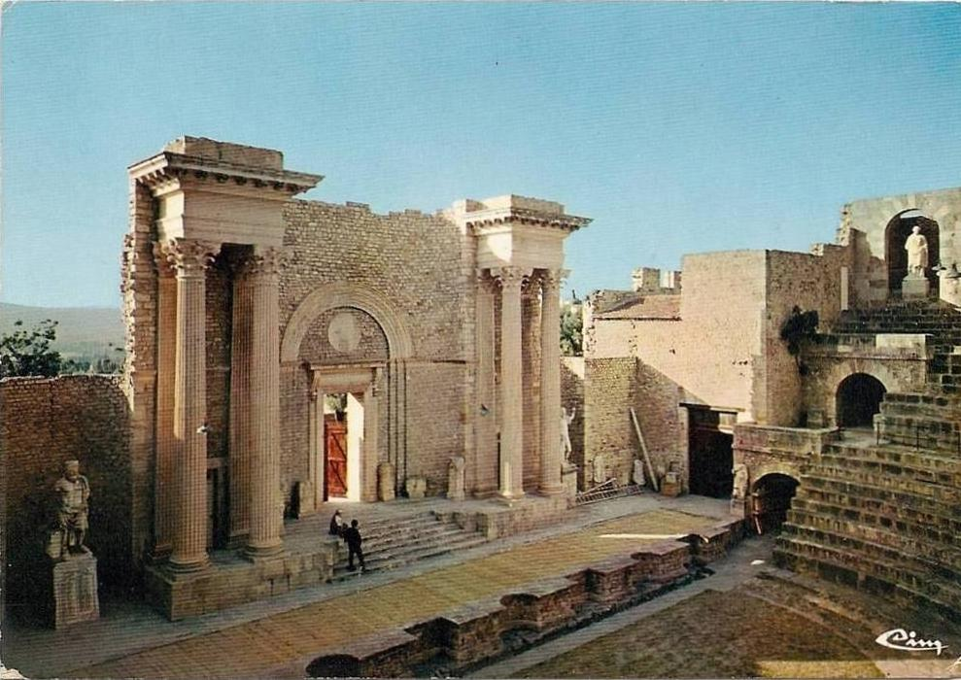
GRACIAS
THANK’S
MERCI

Slide 43
Bibliography
[01] Ardiet C. bastin G, Favre R,guide. Pratique de pharmacocinétique clinque en
oncologie, édition Frison-Roche. Paris (1989) P19-20-420
[02] Bernades-Genisson V, J.Bernadou, Berque-Bestel I. Traité de chimie thérapeutique.
Médicaments antitumoraux et perspectives dans le traitement des cancers Lavoisier,
France (2003) VOL6
[03] Bidert M, Berger F, Pelletier L . Annales de biologie clinique, les thérapies anti-
angiogénique de la théorie pratique, Edition France (2013) ,VOL71, P527-535
[04] Dorosz PH, Vital duran. Guide pratique des médicaments : Edition maloine
30e ,Paris, (2003)
[05] Guerin S, hill C. Epidémiologie des cancers, comparaison avec les USA ,(2010),
VOL97 P47-54
[06] Registre des tumeurs d’Alger INSP (2004) et 2007
[07] Serge K. guide de chimie médicinale et médicaments : Edition Lavoisier,Paris France
(2010), P722-772
[08] Jacob W, Gascon P, Jorgensen C . Développement des biothérapies en cancérologie,
Edition France. (2007), VOL13, P348-352
[09] Http://www.e-cancer.fr/cancerinfo,ressources.pdf
[10] Http://www.e-cancer.fr/epidémiologie-des-cancer
[11] Http://www.ligue-cancer.net/article/7498,la-thérapie-ciblée

