Slide 1
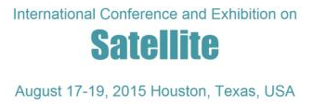
Enhancing LEED as a sustainable rating system by applying its Regional priority for all environmental regions
Dr.Wael Ahmed Shaaban Abo Neama
Associate Professor In Architectural Department, Faculty Of Fine Arts, Zamalek, Cairo, Egypt
E-mail Address: Wael.Aboneama@gmail.Com,
Mobile: (+20) 100 1426 210

Slide 2
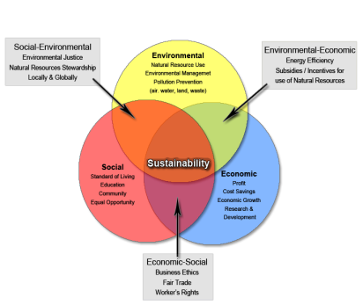
Abstract:
Sustainable design nowadays is not an option for the construction industry all over the world; it becomes a mandatory because of environmental requirements. Some countries all over the world have started in last decade of the twentieth century to create sustainable rating systems based on their environmental needs. The three pillars of sustainability which are environment, people and economy composite certain categories for each rating system. Those rating systems categories cover the project site, water consumption, Energy efficiency, planet atmosphere, construction regional material, and indoor quality. LEED as a rating system for sustainable design has started to be applied not just in the US but also in many countries in the Middle East and Egypt. LEED as sustainable rating system has a rigid category weights. The impact of this rigidity leads to unpractical situation, which is every part of the world suffers from certain lack of resources by the same amount, and it is not true. Countries are not the same in everything. For example in the Middle East, they have big area of desert and suffer from lack of potable water resources, but they have plenty of energy resources. Country like Japan lives on the opposite side. It means that each part of the world should have different category weights. That is the reason of creating many rating systems, but Regional priority as a category can make the balance for LEED to can modify all weights based on the region

Slide 3
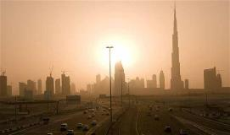
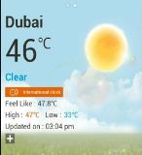

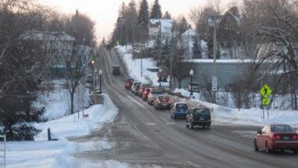
Introduction:
Each Rating System has been developed to meet the following underlying principles:
Ensure environmental quality through an accessible, holistic, and balanced measure of environmental impacts.
Use quantified measures for determining environmental quality.
Use best available science and best practice as the basis for quantifying and calibrating a cost-effective performance standard for defining environmental quality.
Reflect the social and economic benefits of meeting the environmental objectives covered.
Provide a common framework of assessment that is tailored to meet the ‘local’ context, including regulation, climate.
Regional environmental challenges are the most important items to have a rating system. Each part of the world is suffering from lack of one or more resources. Countries in a desert area such as the Middle East are suffering from lack water resources and hot weather. However, they have plenty of energy resources. On the other hand, European countries are suffering from lack of energy more than water resources, and they have cold weather. Moreover, the whole world is suffering from Global Warming Potential (GWP) and Ozone Depletion Potential (ODP). That means any region of the world will have specific credits, which measure the environmental priorities and challenges. Besides, it will have some general credits that serve the global challenges.

Slide 4
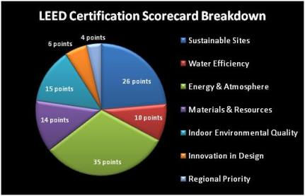
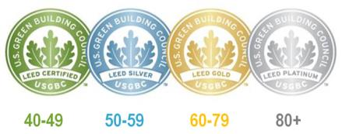
Literature review: LEED
Leadership in Energy and Environmental Design (LEED):
It is a set of rating systems for the design, construction, operation, and maintenance of green buildings, homes, and neighborhoods
Developed by the U.S Green Building Council (USGBC), LEED helps building owners and operators be environmentally responsible and use resources efficiently.
LEED standards have been applied to more than 7,000 projects in the United States and 30 countries, covering more than 1.5 billion square feet (140 km²).
Certification level
Buildings can qualify for four levels of certification:
Certified: 40–49 points
Silver: 50–59 points
Gold: 60–79 points
Platinum: 80 points and above

Slide 5
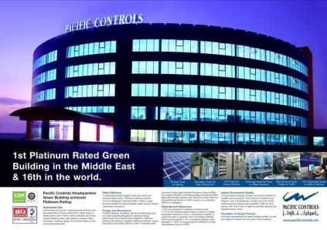
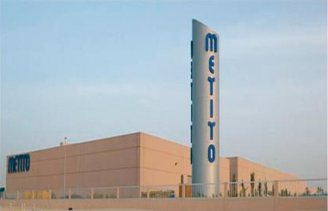
Methodology steps for enhancing LEED as an international rating system
Step One: LEED in the Middle East
1 - Pacific Controls Headquarters - LEED rating: Platinum,
In 2007, the Pacific Controls Headquarters based in Techno Park, Dubai became the first Platinum rated building in the Middle East and the 16th in the world for achieving 55 LEED points. The 11,000m², 5-storey, green building focuses on developing automation solutions and products for global markets..
2 - Metito Headquarters - LEEDs rating: Gold
Metito is an international company specialized in the design and supply of water and waste water treatment.
In 2007, Metito’s headquarters in Techno park, Dubai was certified as the first green building in the Middle East to receive the Gold LEED after having met green building standards, such as sustainable site development, water savings, energy efficiency and
indoor environmental quality.
3- Dubai International Academic City - LEED rating: Silver
The phase three complex at Dubai International Academic City (DIAC) has become the first certified academic facility in the Middle East. The DIAC, the world’s only free zone dedicated to higher education & MORE

Slide 6
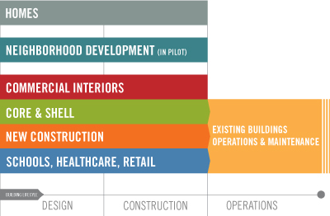
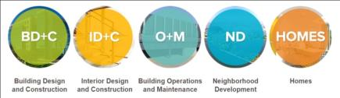
Methodology steps for enhancing LEED as an international rating system
Step two: Different types of LEED = More Specific
Each rating system groups requirements that address the unique needs of building and project types. There are five rating systems:
BD+C: Applies to buildings that are being newly constructed or going through a major renovation; includes New Construction, Core & Shell, Schools, Retail, Hospitality, Data Centers, Warehouses & Distribution Centers, and Healthcare
ID+C: Applies to projects that are a complete interior fit-out; includes Commercial Interiors, Retail and Hospitality
O+M: Applies to existing buildings that are undergoing improvement work or little to no construction; includes Existing Buildings, Schools, Retail, Hospitality, Data Centers, and Warehouses & Distribution Centers
ND: Applies to new land development projects or redevelopment projects containing residential uses, nonresidential uses, or a mix.
HOMES: Applies to single family homes, low-rise multi-family (one to three stories), or mid-rise multi-family; includes Homes and Multifamily Low-rise and Multifamily Midrise.

Slide 7
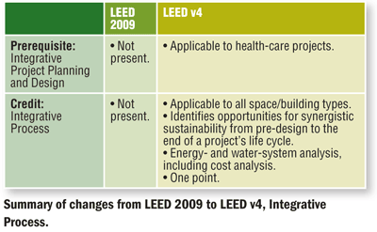
Methodology steps for enhancing LEED as an international rating system
Step three: Different versions of LEED = Enhancing through new parameters
As we update the rating systems, here's what has changed from LEED 2009:
New market sectors: data centers, warehouses and distribution centers, hospitality facilities (i.e. hotels), existing schools and existing retail, and mid-rise residential.
Increased technical rigor: revisions to credit weightings, new credits focused on integrative design, a life cycle approach to materials, and an increased emphasis on measurement and performance.
Streamlined services: An improved LEED user experience that makes the LEED Online platform more intuitive and introduces tools to make the LEED documentation process more efficient.

Slide 8
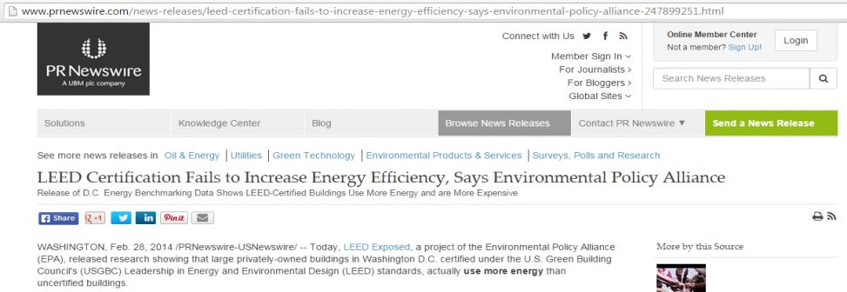
Methodology steps for enhancing LEED as an international rating system
Step four: Report on LEED certified project
WASHINGTON, Feb. 28, 2014 /PRNewswire-US Newswire/ Today, LEED exposed, a project of the Environmental Policy Alliance (EPA), released research showing that large privately-owned buildings in Washington D.C. certified under the U.S. Green Building Council's (USGBC) Leadership in Energy and Environmental Design (LEED) standards, actually use more energy than uncertified buildings.
Despite having the highest number of buildings in the country certified under LEED, Washington D.C. buildings are actually less energy efficient than the national average.

Slide 9
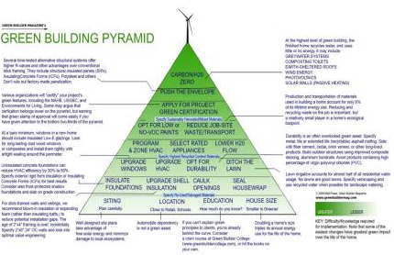


Methodology steps for enhancing LEED as an international rating system
Step five: Creating Local rating system to meet local environmental challenges
The procedures of getting LEED certificate certified, silver, gold, or even platinum is based on collecting points and achieving some very few prerequisites. After studying all prerequisites, we will find no one of them is focused on the regional environmental problems even inside the US. The problem is focused on some consultants who want to get LEED certificate in the Middle East and their concern of collecting points regardless of the importance of this point to the environment. For example, having LEED AP, having bicycle racks and lockers in a desert climate which is very rare to have transportation using bicycles. That means Middle East countries should have adequate rating system, which reflects theirs environmental needs.

Slide 10
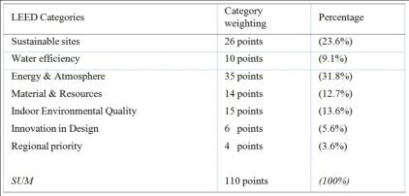
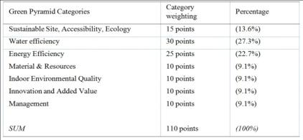
Methodology steps for enhancing LEED as an international rating system
Step six: The difference between international and local sustainability rating systems
Tables (1) and (2) clarify the difference between LEED as an international sustainability rating system in table (1) and Green Pyramid as Local one . It seems, both have approximately the same categories but the weight of each category reflects the importance and the need of each region for this category. For example, Water Efficiency has only (9%) in LEED, but it has (27%) in Green Pyramid as an Egyptian rating system. It means that Egypt is worried about the suffering of draught. Therefore, sustainable design will be the one, which saves water as much as it can. Each region in the world has its environmental problems and moving the weights from one category to another based on its needs.

Slide 11
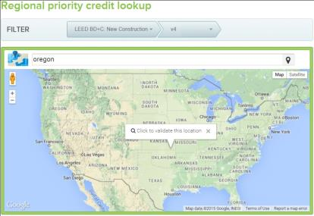
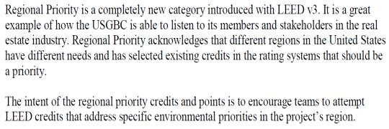
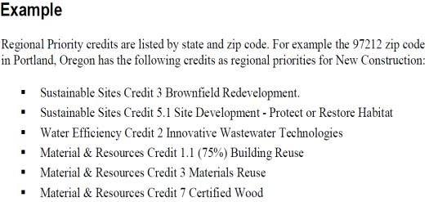
Methodology steps for enhancing LEED as an international rating system
Step seven: Regional priority in LEED
Not a Credit but first category for weights distribution

Slide 12
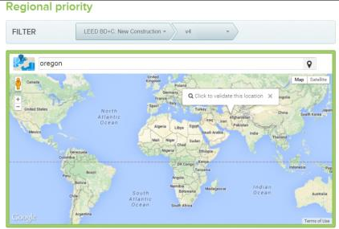
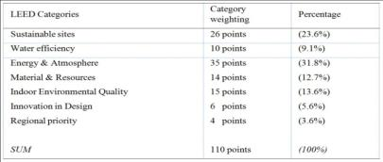
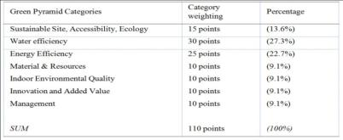
Results and findings of demolishing Cairo Tramline
The same concept of having certain weights for some credits related to specific locations in the united states should be applied globally for regions that use LEED as sustainable rating system. Changing category weights instead of making some credits as bonus for those regions. It will make LEED reflect each region requirements and needs. It will be more flexible and acts as a mirror for each country. For hot weather countries which suffers from draught “the water efficiency will be the heaviest weight, and even the prerequisites will change from region to another. For countries which suffer from lack of energy resources “Energy & atmosphere” will be the heaviest category. Architects and engineers will work for the entire environment not points collectors who don’t care this point is applicable for this location or not.
This can be done through regional priority category. But instead of being last category for only the US regions, it could be the first category which the user should enter his region to specify the weights of each LEED category.

Slide 13
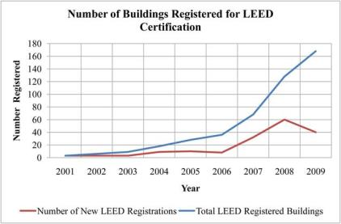
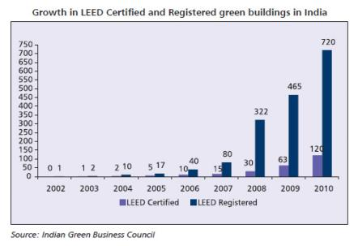
Discussion and analysis
LEED in other researches:
LEED offers an excellent opportunity to raise awareness for environmental issues, and to apply raised awareness to the field where lasting benefits will lead to measurable performance enhancements.
But unsubstantiated success cannot last forever. If the progenitors of LEED want the program to trickle down from its current rent-seeking use by the elites and the scurrilous to functional and popular use, the program procedures need to become vastly simplified and completely re-written, starting from desirable and achievable end-results and working backward toward effective means and methods to achieve the end-results. Only by crafting a system aimed toward avid users who share the same aspirations for environmental improvements.
As per the number of registered projects all over the world outside US, the vision should be globally. A lot of enhancement in many field can push forward LEED certification to be better for our environment and planet.
Source: leanurbanism.org – Modified by author

Slide 14
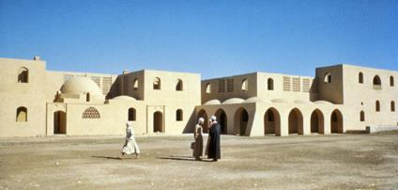
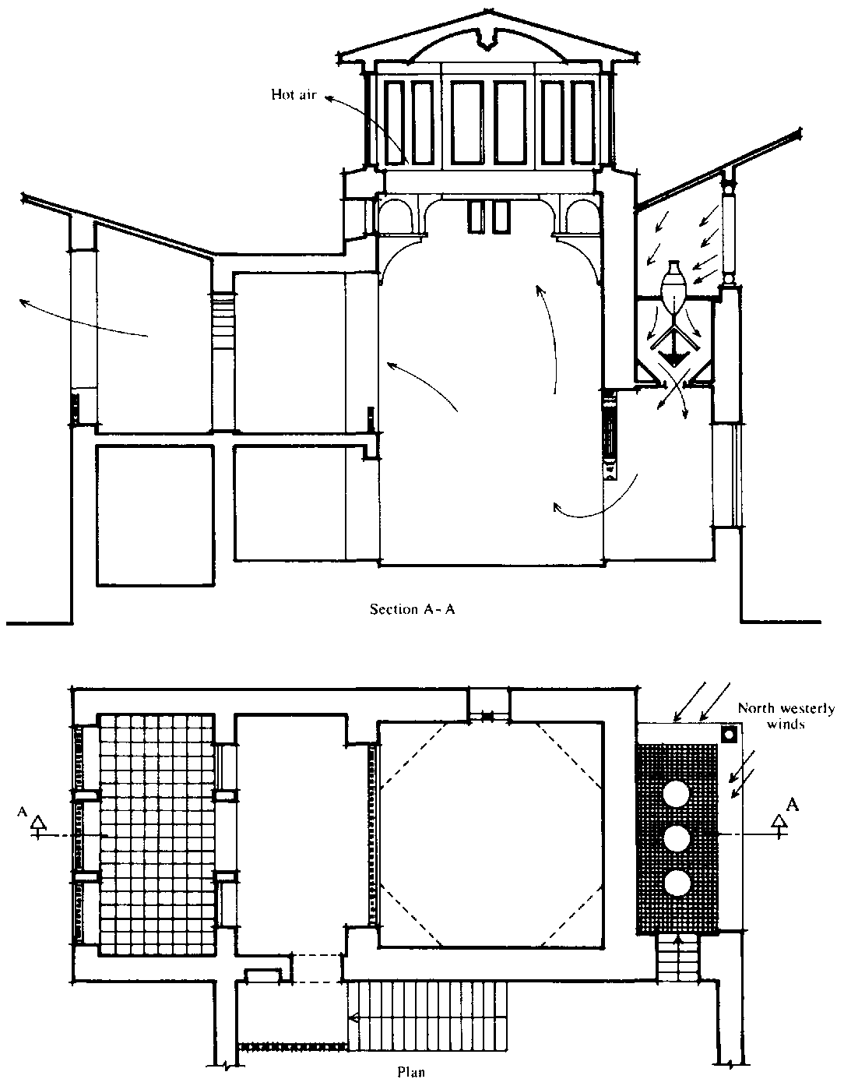
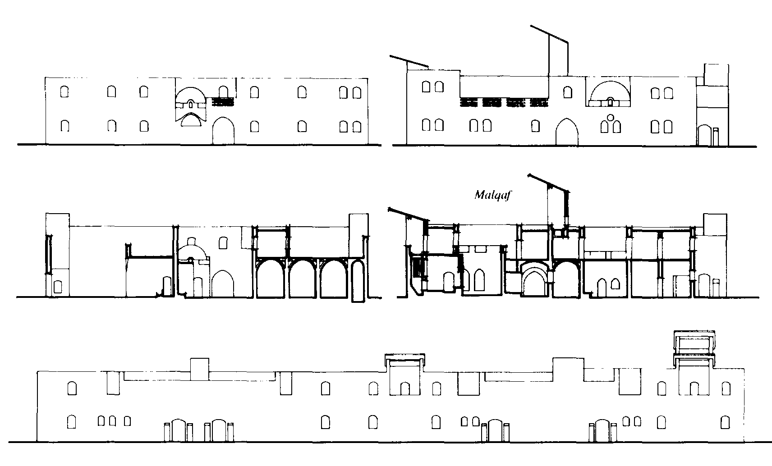
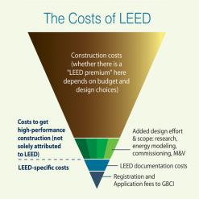
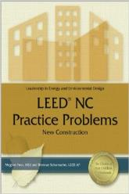
Discussion and analysis
LEED Disadvantages
LEED Does not Recognize Innovation of Building: LEED has become a status symbol rather than a means to create environmental friendly building. With the point system; architectures are more concerned about earning more points than creating environmental friendly buildings. Along with this fact; LEED provides 4 bonus points of 110 for innovative designs. But there is no parameter to gauge the innovativeness of a building. Hence; you are bound to lose even if you have created the most innovative green building. This is a big minus point of LEED.
LEED Does not Take Into Consideration Context and Performance of the Building: LEED itself is a very laughable concept because no matter how unsustainable the building is, or unsustainable building can even get LEED certification. LEED is a design tool and not a performance evaluation tool for buildings. Although LEED certified buildings can resort to energy perseverance and water use there is no guarantee that it is being followed.
LEED cost is not suitable for developed countries: LEED certificate’s cost should consider every part of the world. Vision is to protect our planet.

Slide 15
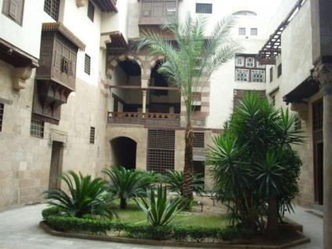
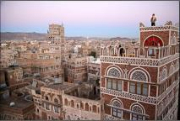
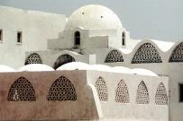

Conclusion and recommendations
There is no any part of the world similar to another in weather, land, culture, or anything else. The resources of our planet are not equally distributed everywhere. This is God wisdom to us for learning living together and protect our planet and develop our grandsons future.
Sustainable design seeks to reduce negative impacts on the environment, and the health and comfort of building occupants, thereby improving building performance. The basic objectives of sustainability are to reduce consumption of non-renewable resources, minimize waste, and create healthy, productive environments.
Basic criteria of water efficiency, energy saving, and the rest of all sustainable rating systems categories summarize all our environment’ needs from designers to take care of, however, the weight of each category is different from certain place to another.
LEED is a world wide rating system. It has a significant role to raise awareness for environmental issues and has become a target to get its certificate for owners, developers, and architects. They try to insure that their designs and final product goes in the right direction. Registered buildings for LEED certificates are from India, Middle East countries, Africa, and some European countries.
It is not applicable that the whole world countries need the same weight for all LEED categries.

Slide 16
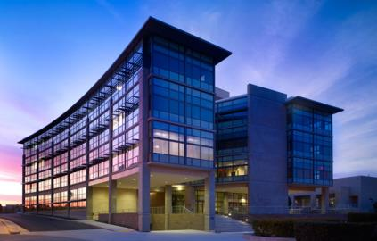
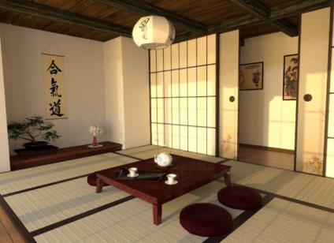
Conclusion and recommendations
Even inside the United States of America and due to its huge area, it could not be the same weight of all categories suitable for every state.
The reason of creating Regional Priority as bonus category for certain locations inside the US. If this concept is enlarged and dominate the philosophy of every category’s weight, it will be more suitable for the diversity of different locations.
Enhancing LEED is not limited to regional priority. It is unlimited process that has many varieties and inputs that need continuous study to get actual results for sustainable projects and environmental friendly.

Slide 17
Thank you,
Dr. Wael Aboneama

