Slide 1

Improving BIM as an Architectural Design tool towards Sustainability through applying LEED categories on its database
Dr.Wael Ahmed Shaaban Abo Neama
Dr. Wael A. Aboneama
Associate Professor In Architectural Department, Faculty Of Fine Arts, Zamalek, Cairo, Egypt
E-mail Address: wael.aboneama@gmail.com
Mobile: (+20) 100 1426 210

Slide 2
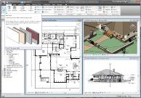
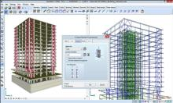
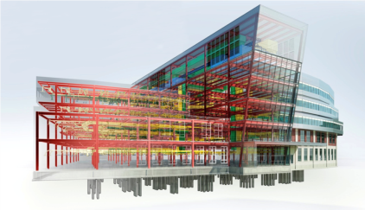
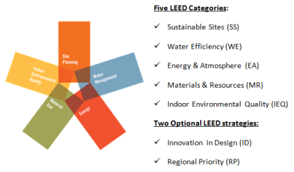
Abstract:
Architectural design was influenced through the last century by several high-tech design tools. Last decade Building Information Model "BIM" has proved its capabilities as an effective production tool for construction industry. It helps the architect to go through the construction documents accurately and faster for building calculations, coordination between all disciplines, and to carry out the architectural drawings faster with minimum problems. Architectural design tools development is running in two directions: First, one depends on developing a helpful tool for the architect to facilitate producing complicated forms and construction problems; the second one is the implementation of artificial intelligence to solve design problems and to lead towards better building performance. This research is oriented to the second direction.
In case of applying LEED categories, which describes sustainability principals into the BIM database, we will ensure that the outcome of this design tool will meet sustainability guidelines. One of the best direction of enhancing BIM as an architectural design and documentation tool is to enlarge the scope and hierarchy of its database to include LEED categories as one of the most important rating system in the world and applied in many regions. It will push architects forward towards sustainable designs and saving environmental resources based on up to date information

Slide 3
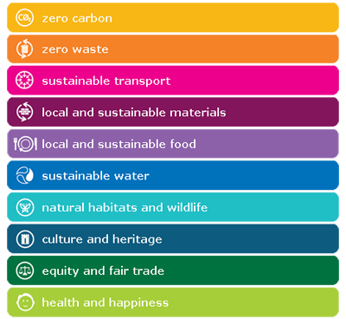
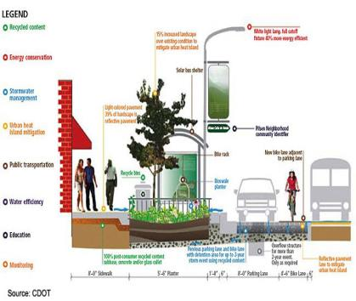
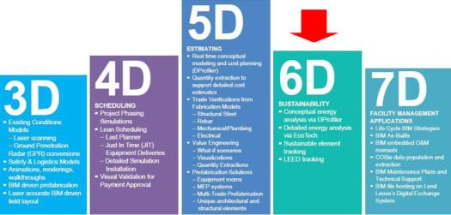
Introduction & Background:
Nobody can deny that there is no building design or construction document is not produced using one of the computer programs. Engineering and BIM "Building Information Model" programs are nowadays the design tools beside ruler, pencil, and protractor.
If we input the sustainability principals into those architectural programs database, we will ensure that the outcome of that program is revised against sustainability guidelines. That means we can protect our environment through enhancing the outcome of architectural design tools by applying sustainability principals into their database.
Architectural design tools specially BIM have many structural and constructional database to enhance building construction and coordination between different disciplines

Slide 4
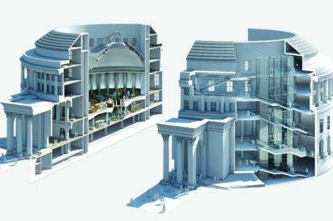
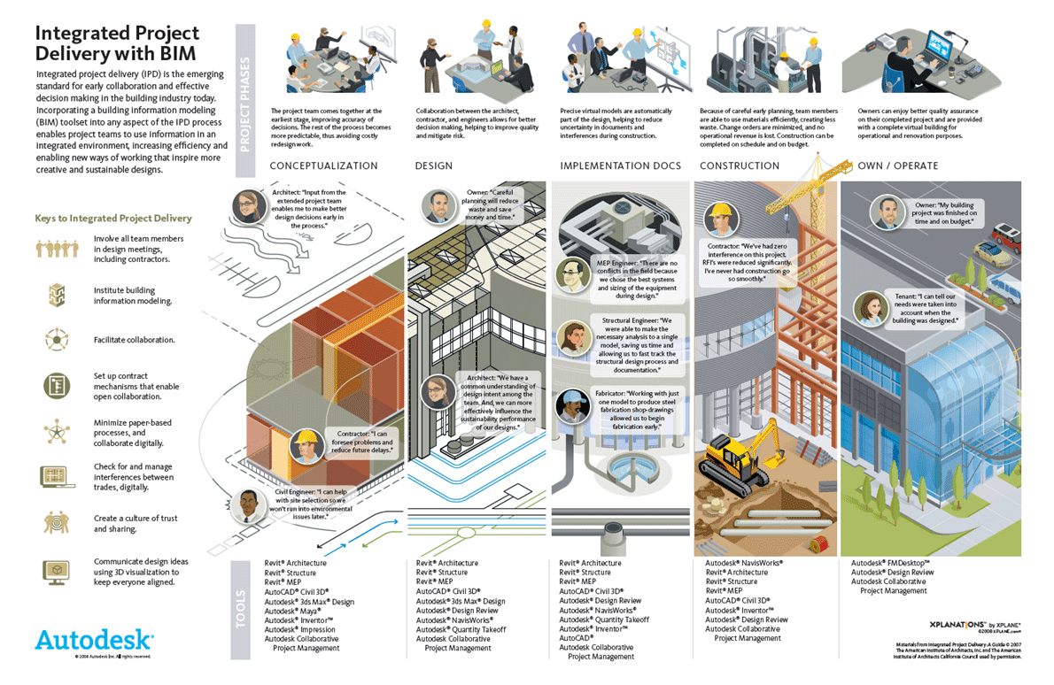
Literature review:
Building information modeling (BIM):
Building information modeling (BIM) is a process involving the generation and management of digital representations of physical and functional characteristics of all building components.
There are many definitions of Building Information Modeling (BIM), but it is simply the means by which everyone can understand a building through the use of a digital model. Modeling an asset in digital form enables those who interact with the building to optimize their actions, resulting in a greater whole life value for the asset.
BIM brings together all of the information about every component of a building, in one place. It makes it possible for anyone to access that information for any purpose, e.g. to integrate different aspects of the design more effectively
Since data is stored in a central place in a BIM model any modification to the building design will automatically replicate in each views such as floor plans, sections and elevation. This not only helps in creating the documentation faster but also provides stringent quality assurance by automatic coordination to the different views.

Slide 5
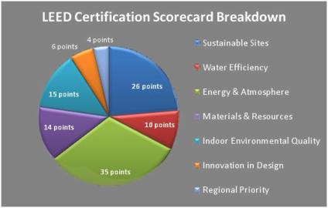
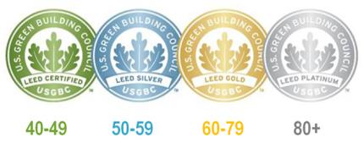
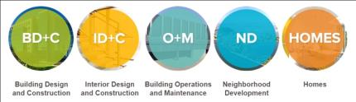
Literature review:
Leadership in Energy and Environmental Design (LEED):
It is a set of rating systems for the design, construction, operation, and maintenance of green buildings, homes, and neighborhoods
Developed by the U.S Green Building Council (USGBC), LEED helps building owners and operators be environmentally responsible and use resources efficiently. It is divided into:
BD+C: Applies to buildings that are being newly constructed or going through a major renovation; includes New Construction, Core & Shell, Schools, Retail, Hospitality, Data Centers, Warehouses & Distribution Centers, and Healthcare
ID+C: Applies to projects that are a complete interior fit-out; includes Commercial Interiors, Retail and Hospitality
O+M: Applies to existing buildings that are undergoing improvement work or little to no construction.
ND: Applies to new land development projects or redevelopment projects containing residential uses, nonresidential uses, or a mix.
HOMES: Applies to single family homes, low-rise multi-family (one to three stories), or mid-rise multi-family.

Slide 6


Methodology steps for improving BIM towards sustainability through LEED
Step One: Information as 5th dimension of Architecture
In 1946, Sigfried Giedion announced time as the fourth dimension of architecture. With the end of the 20th century and the role of the computer programs in architecture field, information has proven its position as the fifth dimension of architecture.
Sustainability as a part of BIM information:
It is the information related to long-term maintenance of responsibility, which has environmental, economic, and social dimensions, and encompasses the concept of stewardship, the responsible management of resource use. In ecology, sustainability describes how biological systems remain diverse and productive over time, a necessary precondition for the well-being of humans and other organisms. Long-lived and healthy wetlands and forests are examples of sustainable ecological systems.

Slide 7
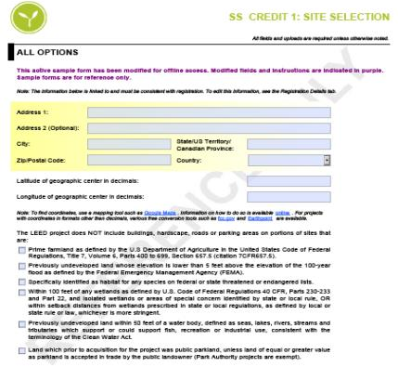
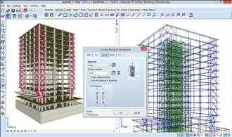
Methodology steps for improving BIM towards sustainability through LEED
Step two: Define sustainability by basis of LEED input data:
The method of adding LEED principals into BIM database will be extracted from the same process of applying any building information for registration on the USGBC website. A certain kind of application the user should complete with accurate reference. He defines the technology or type that the user chooses for his project. It is simply a list of choices or question should be answered to fulfill the building data entry.
For example: Category two “Water Efficiency” has many items. One of them water use reduction has 4 points. The user should apply which kind of devices and techniques he used for water use reduction. Even if the designer does not put this item in his agenda, he could not ignore it any more during the modeling of his project. He will face missing data input related to water use for his model during his work using the BIM. It will provide him also by the multiple techniques that he can use and choose the best one for his project and site.

Slide 8

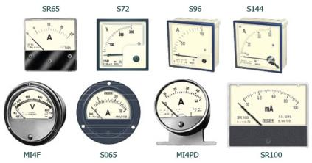
Methodology steps for improving BIM towards sustainability through LEED
Step three: Presenting the way of measuring the sustainability for buildings:
After defining sustainability into categories as discussed, the second step should present the way of measuring those categories and their classifications for any building design with technical equipments installation. The aim of this step is to summarize all sustainability categories and sub-items to be transformed into measurable database.
It should be several types of measuring for the variety of projects types and locations.

Slide 9
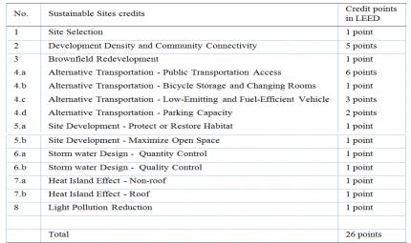
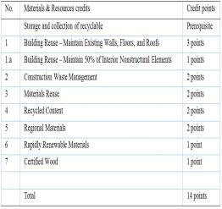
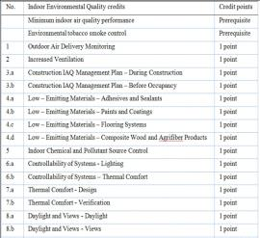
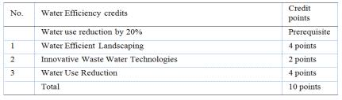
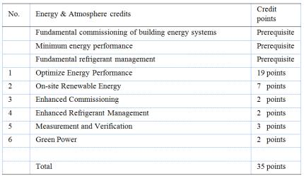
Methodology steps for improving BIM towards sustainability through LEED
Step four: Applying sustainability categories into design tools database:
After defining sustainability categories items and measurement concept, the next step is the implementation of those categories into design tool database.

Slide 10
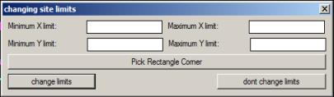



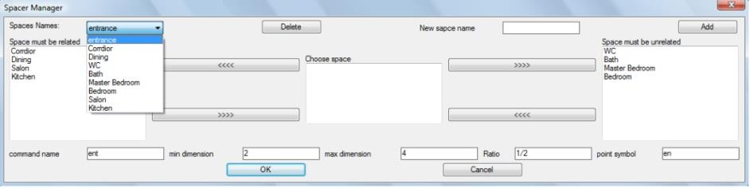
Methodology steps for improving BIM towards sustainability through LEED
Step five: Test the implementation:
Final step is to test this theory implementation. The aim of this step is only to ensure the interaction between the user and the design tool. It is only to proof that BIM can interact with the user based on sustainability database (Extracted from LEED) and provide him with the required steps in order. The user has the ability to input certain database from his own.
The examples illustrates certain database of space ratio determined by the user himself for indoor quality.

Slide 11
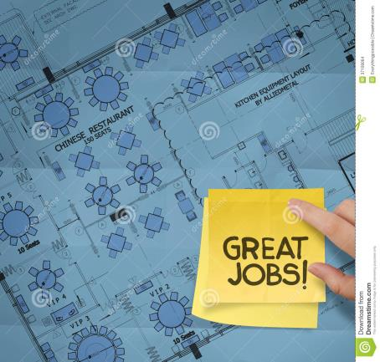
Results and findings using LEED principals as a database for BIM
This research does not produce an application with all LEED categories inside certain BIM software. It only tests certain data input and the ability of the program to review the input construction data against its database. The result was great.
To input all LEED sustainability categories inside any BIM software it will need a huge team of programmers and support. But the result moves towards better building performance and reviewed from the design tool before the rating system reviewers.
It will minimize designers and engineers mistakes. Provide them with up to date information and regulations. Prevents any neglecting from the designer side of sustainability principals even if he does not want to issue a sustainability certificate for his building

Slide 12
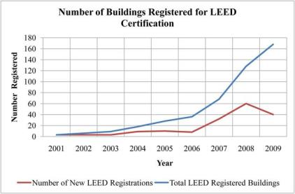
Results and findings using LEED principals as a database for BIM
Step One: Not all the buildings registered for sustainable certificate
As shown in all statistics that the number of registered building for sustainability certificates are increased year and after. But this increase is nothing against the real number of building construction all over the world.
It means that a very few portion of owners, developers, designers, architects, and engineers are care of the environment , but unfortunately, still a huge number do not care.

Slide 13
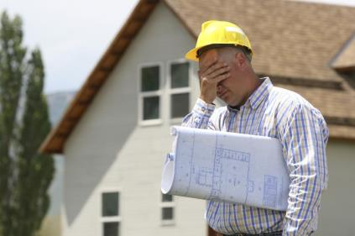
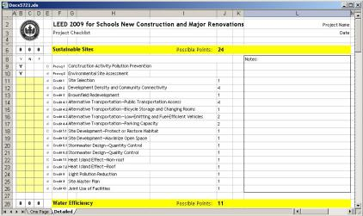
Discussion and analysis
LEED & BIM as a design tool:
The following part will discuss and analyze the effectiveness of BIM to review architectural design against sustainability:
Design tools have plenty of drawing and construction database specially BIM programs. They can help the architect against sustainability.
Sustainability rating systems such as LEED define certain forms for each category with reference numbers to can calculate building performance for this item. All those forms could be transformed into database information inside the design tool and present them sequentially to the user. It will help the user to be closer to sustainability gradually in the project to achieve high level of sustainability.
Sustainability has become the same as engineering disciplines to the architect. His design should comply with all its requirements, otherwise he will fall into the hall production against environmental requirements.
BIM is the designers and engineers drawing pencil nowadays. This tool can review against certain database.

Slide 14
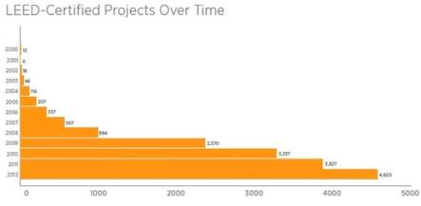
Conclusion and recommendations
LEED offers an excellent opportunity to raise awareness for environmental issues, and to apply raised awareness to the field where lasting benefits will lead to measurable performance enhancements.
Architects have a big role to protect our planet through following sustainable principals during the design process. BIM which is used to produce design and construction documents can help to review their project against sustainability guidelines
Each country should require sustainability study for each building with the permit documents to protect our planet. This study could be prepared as templates in design tools.
BIM now has become a mandatory for permit submission in some countries such as UAE.
Rating systems should define certain categories that can be implemented in all regions, and the difference between them will be on the weight of each category and its credit.
Each country should define a base case for different types of buildings and their consumption of water, energy, etc... It will help architects and engineers to define the sustainability level, which they should achieve.
BIM “Building Information Model” programs will be more helpful for sustainability review because they have plenty of constructional databases and can produce a list of used material. They are more prepared for sustainability database.

Slide 15
Thank you,
Dr. Wael Aboneama

