Slide 1

Tumor regression
by means of nanotherapy
with and without magnetic drug targeting
MG Krukemeyer, Wolfgang Wagner
Paracelsus-Strahlenklinik Osnabrück/Germany

Slide 2
Introduction
Experimental research into the treatment of primary
and secondary liver tumors shows promising alternatives.
Magnetic drug targeting is another possibility.
One modification of this method is coupling solely of iron oxides (Fe₃O₄) to cytostatics.

Slide 3
Introduction
Due the physiological capacity of the liver for phagocytosis,
the iron is sluiced into the liver,
and undergoes phagocytosis by the terminal vascular macrophages and is thereby absorbed.

Slide 4
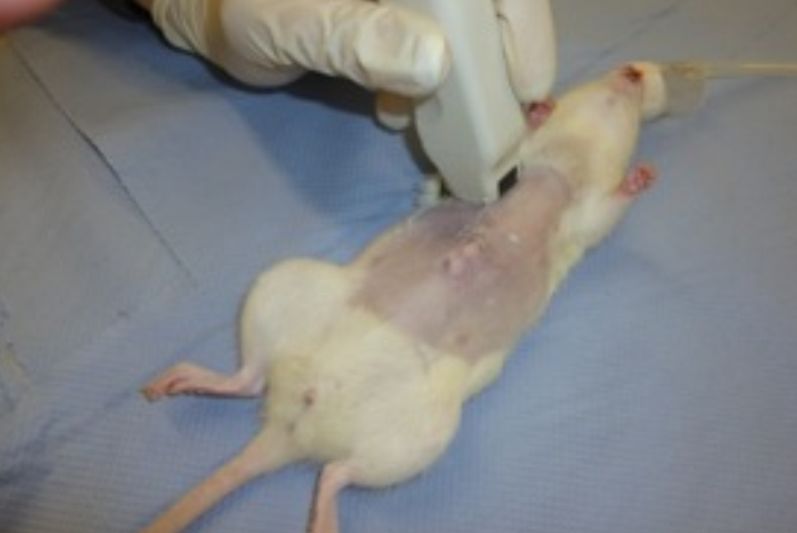
Animal studies
adult Wag/Rij rats
n=72
transfected with rhabdomyosarcoma R₁H
in their right gastrocnemius muscle
and in the liver
treated with Mitoxantrone
(Fe₃O₄)
with and without a magnet.

Slide 5
Methods
Mitoxantrone-iron oxide with and without
an extracorporal 0.6 tesla magnet
and uncoupled mitoxantrone were measured in plasma and tumor tissue
for different doses administration.

Slide 6
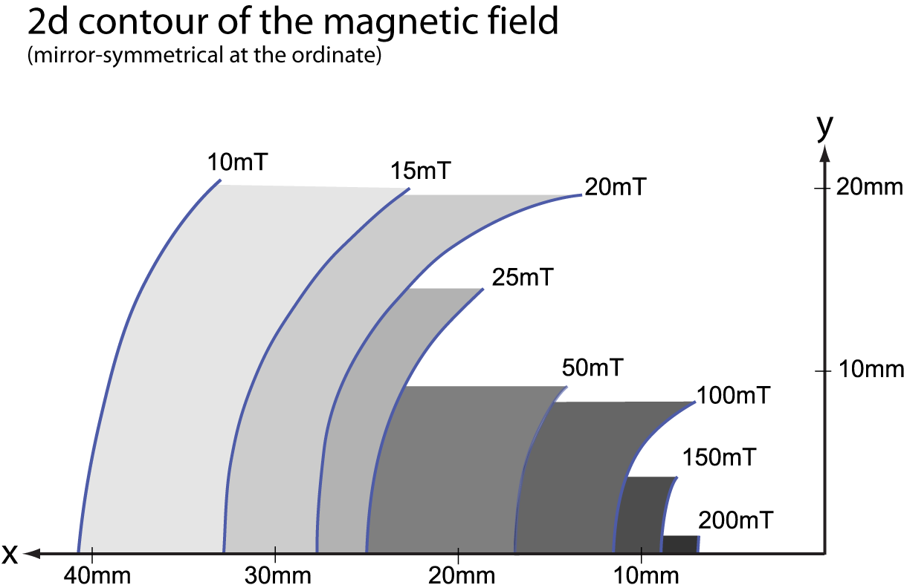
The unit of the force flux density B in the SI system [International System of Units] is the tesla. 1 tesla = 1 Vs M⁻⁰². The tesla unit was named after Nicola Tesla [1846 - 1943], a Serbo-American inventor and researcher in the field of electromagnetism.
4mm
Penetration
depth
4mm
In all our experiments we used a 0.6 tesla permanent magnet
The magnet was used for tumors outside the liver!

Slide 7
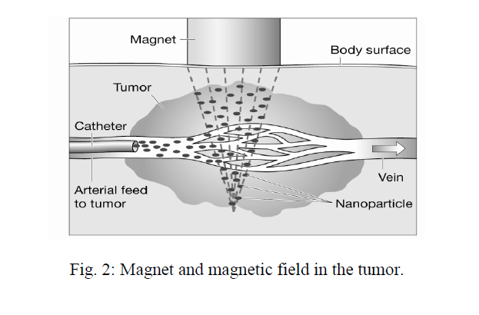
Principle of magnetic drug targeting
Iron particles will be concentrated under the magnet

Slide 8
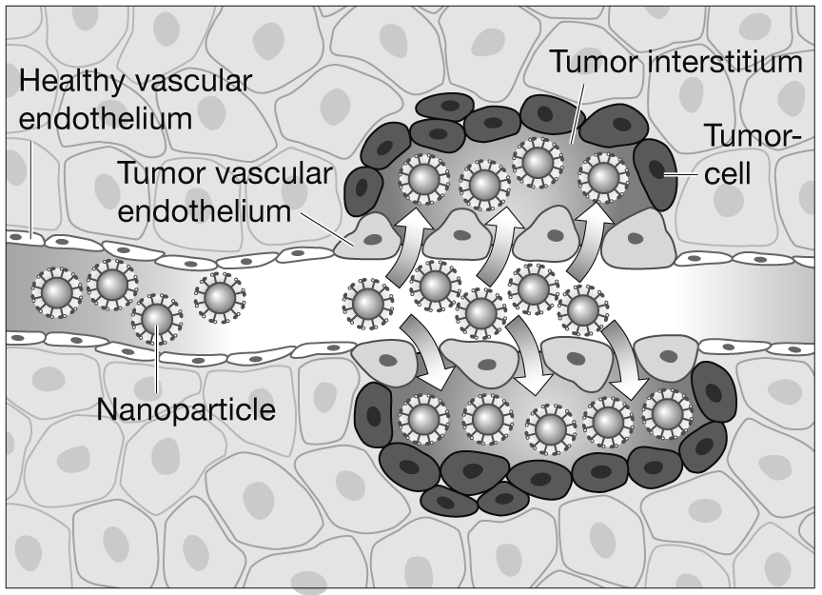
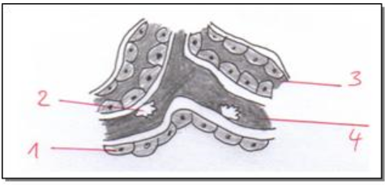
Reticuloendothelial system (RES)
Extravasation of the nanoparticles
in the tumor tissue because of
pathological endothelium
and absorbation
in the reticuloendothelial system (RES)
1 = liver cells
2 = Kupffer star cells
3 = bile flow
4 = sinusoidal epithelial cells

Slide 9
Study design and treatment plan
The animals were divided into three groups:
Group I comprised animals which received only mitoxantrone
in a dosage of 1 mg/kg BW.
Group II comprised animals which received mitoxantrone coupled with magnetic nanoparticles. The dosage was 1 mg/kg BW.
Group III as the control group received sodium chloride, 1 mg/kg BW.
Group | Administration | Drug | Number
I | i.v. | Mitoxantrone | 6♀ : 6 ♂
II | i.v. | Fe₃O₄ + Mitoxantrone | 6♀ : 6 ♂
III | i.v. | NaCl | 6♀ : 6 ♂
with and without magnet ∑ 72

Slide 10
A batch of 2 x 36 rats divided into groups each of 6 female and 6 male rats formed the basis of the study. 14 days before the start of therapy R₁H tumor cells were injected into the right-hand liver lobe and in the musculus gastrocnemius.
Day -3: Blood sample with blood count, iron and ferritin assay.
Day 0: Administration of substances and tumor ultrasound.
Day 1: Blood count, iron and ferritin assay.
Day 5: Blood count, iron and ferritin assay.
Day 14: Blood count, iron and ferritin assay.
Day 14: At the end of the study: Tumor detection by ultrasound.
Autopsy of the animals and measurement of tumor size.
Samples taken for pathohistological examination.

Slide 11
Drug
The active substance is mitoxantrone hydrochloride. Detachment of the iron oxide from mitoxantrone takes place during the half-life of mitoxantrone of approximately 30 minutes.

Slide 12
Parameter | Specifications
Product No. | 05-66-302 S55009
Product Name | nanomag^{R}-CLD-Mitoxantrone
Product Description | magnetic dextran composite particles, cross-linked
Surface | immobilized mitoxantrone
Size (mean) | 300 nm
Polydispersity index | < 0.2
Particle content | 14 mg/ml
Iron oxide content | 10.5 mg/ml
Mitoxantrone content | 0.6 mg/ml
Quantity | 33 ml
Shape | cluster-typed
Density | 2.5 g/cm³
Magnetization | 43 emu/g particles (H = 1,000 Oe)
Saturation Magnetization | > 67 emu/g particles (H = 1,000 Oe)
Stable in | aqueous buffers pH >4
Not stable in | organic solvents, acidic solutions pH < 4
Product form | suspension in 0.01M PBS (pH = 7.4) filled in 50 ml Macoflex Empty Bag in PVC
Particles per ml | 4.0*10E11
Particles per mg | 2.8*10E10
Sterility Status | non-sterile
Additional remarks | Storage at 2-8° for 6 months, do not freeze
Mitoxantrone is obtained from micromod Partikeltechnologie GmbH, Rostock, Germany.

Slide 13
Results of the tumor measurement
 | Volume in [mm³]
Group I | 24,83 mean
ID01 | 14,40
ID02 | †
ID03 | †
ID07 | 25,00
ID08 | 2,17
ID09 | 31,82
ID19 | †
ID20 | 44,80
ID21 | 23,04
ID28 | 30,97
ID29 | 12,85
ID30 | 18,90
 | Volume in [mm³]
Group II | 15,12 mean
ID04 | 7,68
ID05 | 13,44
ID06 | †
ID12 | 12,60
ID14 | 16,65
ID15 | 22,05
ID22 | 17,57
ID23 | 9,90
ID24 | †
ID31 | †
ID32 | 17,78
ID33 | 18,46
 | Volume in [mm³]
Group III | 18,83 mean
ID10 | 17,55
ID11 | 15,60
ID13 | †
ID16 | Reference
ID17 | 19,60
ID18 | 23,25
ID25 | †
ID26 | †
ID27 | 18,18
ID34 | †
ID35 | †
ID36 | †

Slide 14
The tumor volume showed the lowest growth
in Group II, which was treated
with mitoxantrone-coupled iron oxides.

Slide 15
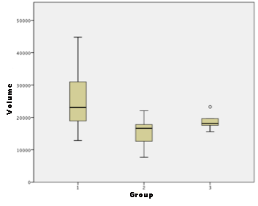
Box plot diagram of volume [mm³]
Each of the three diagrams comprises the study animals of its group.
The thick black line represents the average animal (called median or 50th percentile). The brown column shows the animals within the 25th and 75th percentile. The horizontal lines represent the minimum and maximum respectively. In Group III, the maximum lies more than 1.5 times away from the 75th percentile, and is therefore identified as an outlier by the circle. Significant difference between group I and group II.

Slide 16
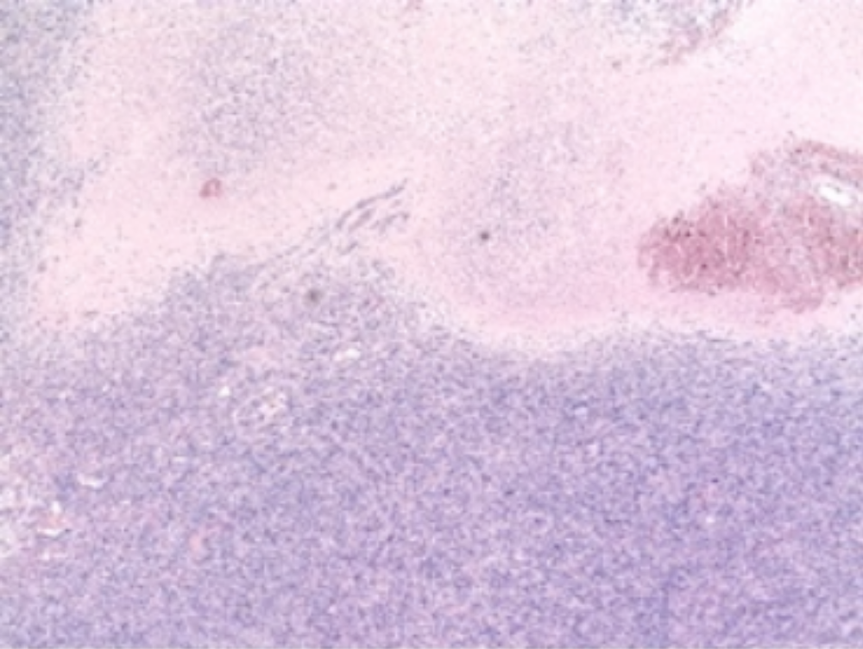
Group II, necrosis with erythrocyte extravasates.
In this tissue section the area of necrotic tissue makes up over 20 %

Slide 17
Results I
outside the liver
Mitoxantrone iron-oxide concentration in plasma
was significantly (p<0.05) lower
when a magnet was placed over the tumor area
and as low as uncoupled mitoxantrone.
Mitoxantrone coupled iron-oxide concentration in tumor tissue was always significantly higher
with magnetic drug targeting
when compared to uncoupled mitoxantrone.

Slide 18
Results II
Mitoxantrone coupled iron oxide (Fe₃O₄) reduces the tumor volume to a greater extend than administration solely of mitoxantrone.

Slide 19
Results III
inside the liver
Inside the liver and spleen the highest concentrations
of coupled mitoxantrone iron oxide could be measured
without a magnet because of adherence to RES.

Slide 20
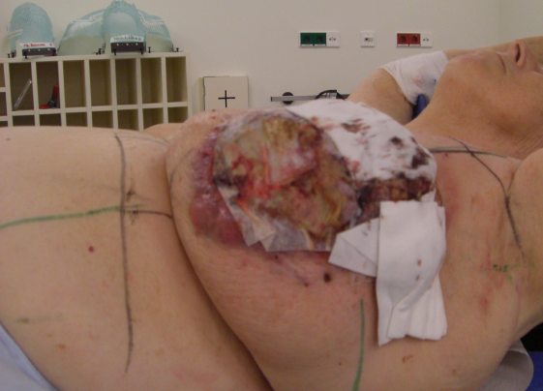
The case -
individual therapeutic trial
70-year old female patient
with metastasized mammary carcinoma on the left;
initial diagnosis May 2008.
Diagnostics: Computer tomography (CT) demonstrated an exulcerated tumorous mass approximately 10 cm in diameter in the region of the left breast (volume: 500 ml)

Slide 21
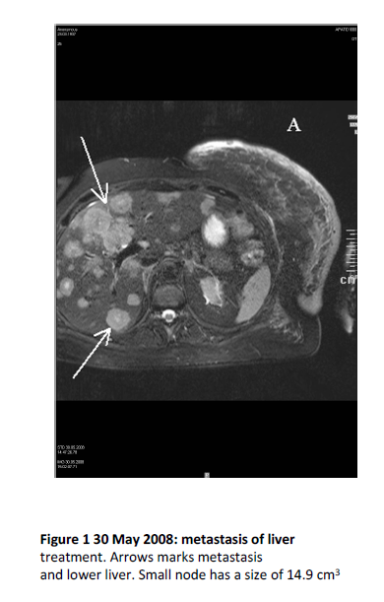
MR demonstrates
a massive tumor involvement of the liver

Slide 22
Therapy
Mitoxantrone-iron oxide [Fe₃O₄] corresponds to 32 ml fluids and 20 mg/m² body surface mitoxantrone.
Therapy started for four days.
After the end of each therapy a peripheral
blood sample was taken.
Normal dosis in systemic treatment is 14 mg/m² body surface.

Slide 23
Serum levels of iron oxide and ferritin
prior, during and after treatment
Parameter | Day -2 | Day 0 | Day 1
Iron µg/dl | 131 | 44 | 46
Ferritin ng/ml | 185,7 | 305,1 | 366,8
Parameter | Day 2 | Day 3 | Day 4 | After 2 weeks
Iron µg/dl | 96 | 117 | 151 | 119
Ferritin ng/ml | 535,4 | 729,5 | 1011,0 | 1985,0
Normal values Iron: 33 – 193 µg/dl
Ferritin: 34 – 310 µg/ml

Slide 24
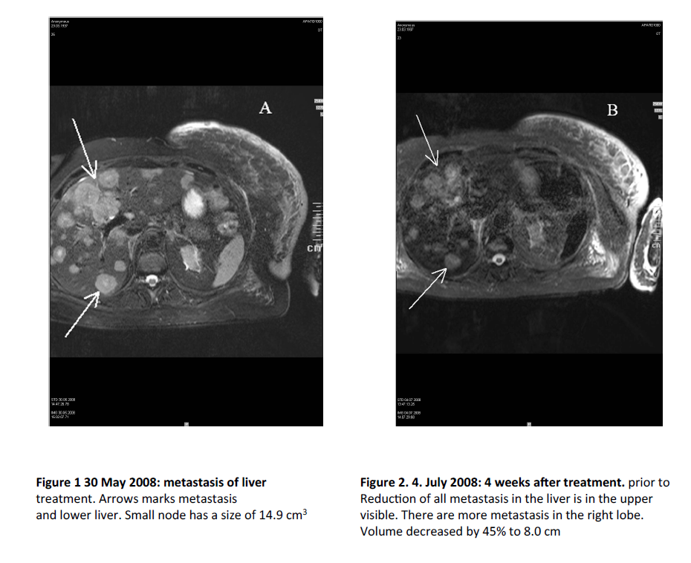
May 2008:
MR demonstrates
the liver full of metastases
July 2008:
MR demonstrates
a partial remission

Slide 25
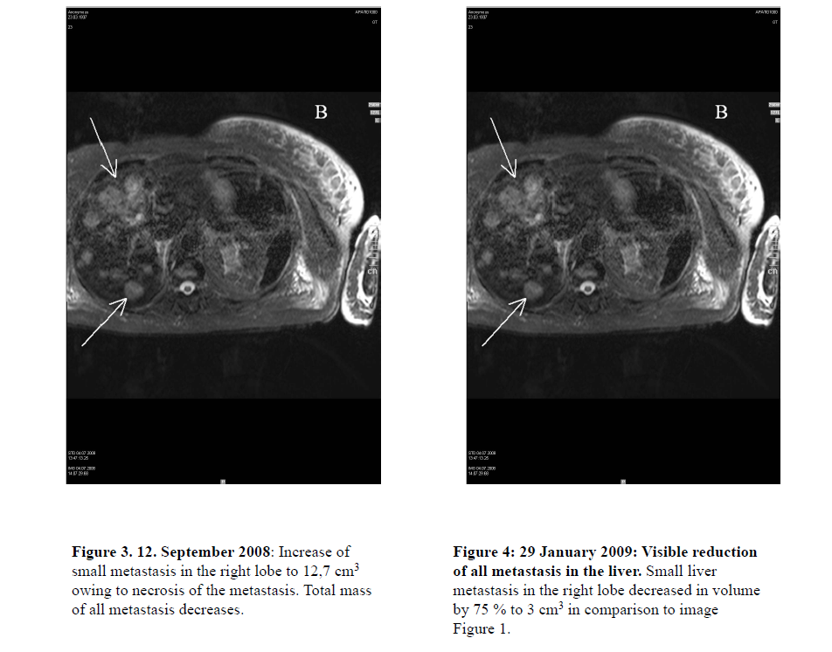
September 2008:
MR demonstrates
stable disease

Slide 26
Doses
Study doses | 20 mg/m² body surface
Normal doses in systemic therapy | 14 mg/m² body surface
The concentration of ferrofluids was 10.5 mg/ml,
which corresponds to 6.4 mg iron/ml solution
and 0.6 mg mitoxantrone/ml solution.

Slide 27
Therapy results
Tumor shrinkage in the liver was measured between 37,5 – 75% in size 3 months after the end of therapy ► partial remission
At this time blood values of the liver had been partially normalised. Hence, the anaesthesist was able to gain narcosis for breast ablation.
2 weeks later the patient was discharged from hospital
The patient survived about 2 years without clinical problems

Slide 28
Discussion I
By means of the RES fluid iron has a large adherence to the liver with high concentration of mitoxantrone in the target organ and low concentration in the blood.
In the end, the success can be explained by the fact that in the liver iron undergoes phagocytosis by the Kupffer star cells.
Hence, we were able to perform a nearly local therapy by systemical approach.

Slide 29
Discussion II
This new technique is a therapeutic option
for primary and secondary tumors
of the liver to reduce the tumor mass
with higher cytostatic concentrations
and less adverse effects for the patient,
especially if the patient is unable
to get a systemic standard therapy.

Slide 30
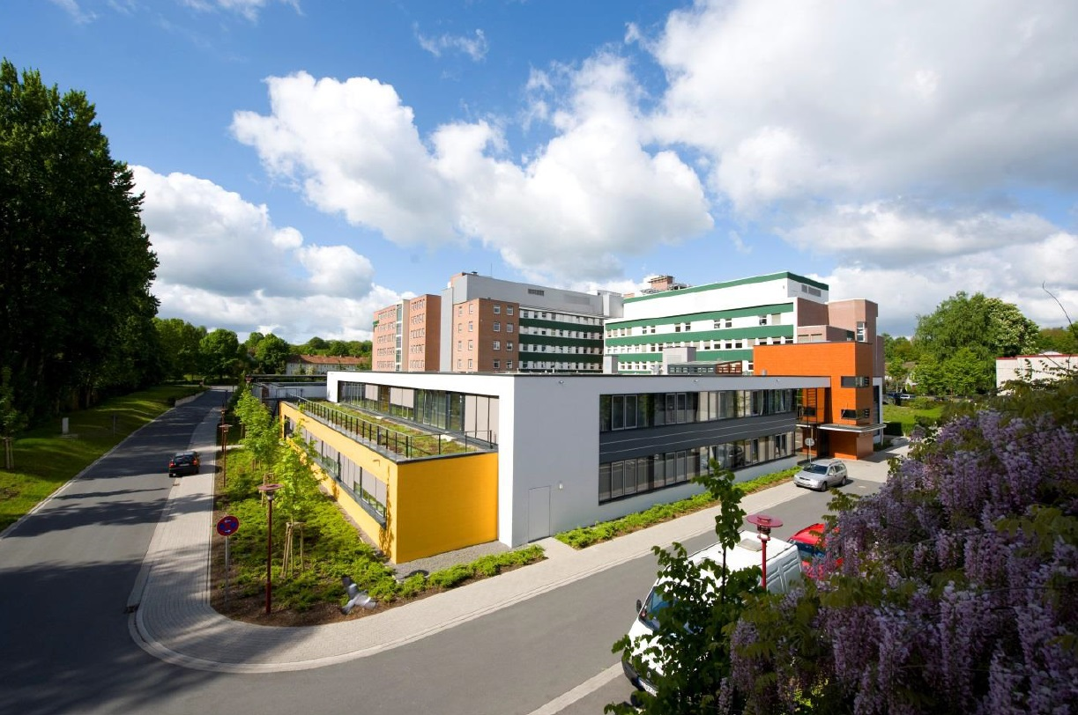
Thank you for your
kind attention!
Prof. Dr. med. W. Wagner
Paracelsus-Strahlenklinik Osnabrück
Am Natruper Holz 69
49076 Osnabrück / Germany
Phone: +49 (0) 541-966-4853
E-Mail: prof.wolfgang.wagner@paracelsus-kliniken.de

