Slide 1
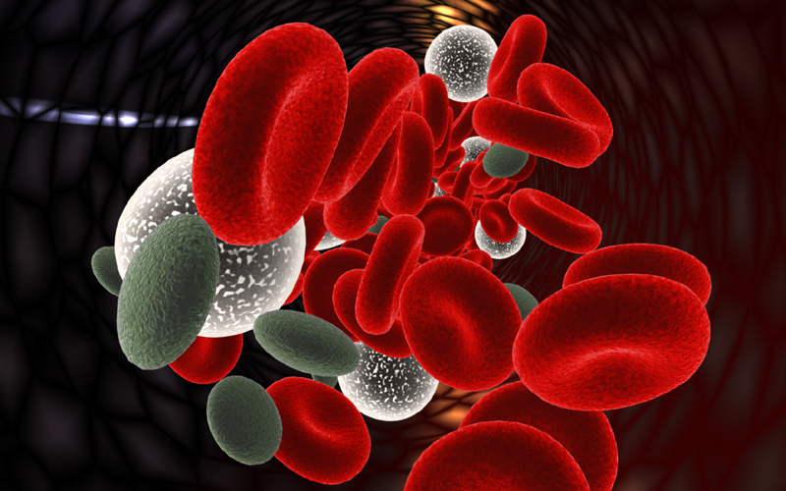

Thioredoxin-interacting (TXNIP) protein regulates
the differentiation of erythroid precursors
www.scientificimages.co.uk
Volker Blank
Lady Davis Institute for Medical Research
McGill University

Slide 2
Hematopoiesis
Specification
of HSC
Expansion/
Maintenance
Lineage Selection & Maturation
B-lymphocytes
Lymphoid
progenitor
T-lymphocytes
Erythrocytes
hematopoietic
stem cells
Mega-
karyocytes
Platelets
Mast cells
Myelo-
erythroid
progenitor
Neutrophil
Eosinophil
Monocytes/Macrophages
Osteoclasts
Notes:
2

Slide 3
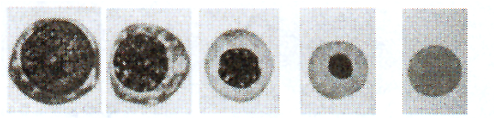
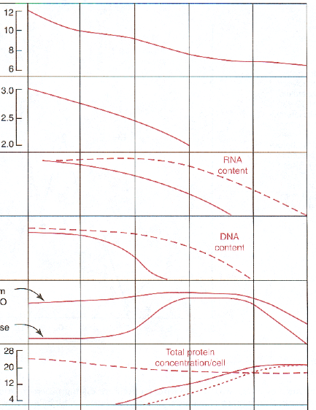
Erythroid maturation
- bone marrow
Poly
chro-
matic
Ortho
chro
matic
Baso-
philic
Pro-
erythroblast
Reticulocyte
Average
cell diameter
(μ)
Log of
cell volume
(μ³)
Rate of
RNA synthesis
Rate of
DNA synthesis
Enzymes from
ALA-S to PROTO
ALA-synthase
Hemoglobin
concentration
(10⁶μg)
50 hrs
30 hrs
50 hrs
40 hrs
bone marrow

Slide 4
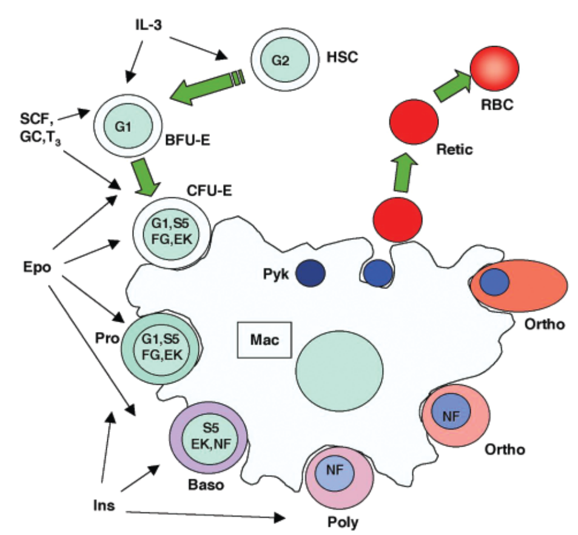
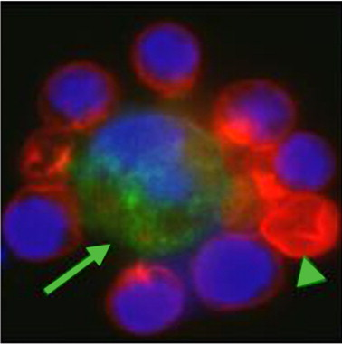
Regulation of erythroid development
External factors
IL-3
Stem Cell Factor (SCF)
Glucocorticoids (GC)
Thyroid hormone (T3)
Erythropoietin (Epo)
Insulin (Ins)
Transcription factors
GATA-2 (G2)
GATA-1 (G1)
STAT5 (S5)
FOG (FG)
EKLF (EK)
NF-E2 (NF)
Ingley et al. 2004 IUBMB Life 56(4):177-184
Lee et al. 2006 Blood 108: 2064-2071

Slide 5
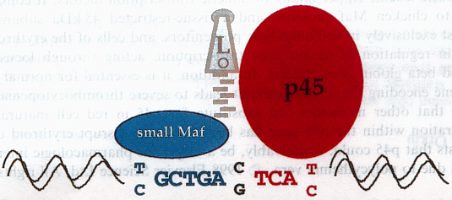
NF-E2 (nuclear factor erythroid 2)
- heterodimer (two subunits: p45 & small Maf)
- basic-leucine zipper
- large subunit specifically expressed in erythroid, megakaryocytic
and mast cell lineages
Notes:
5

Slide 6
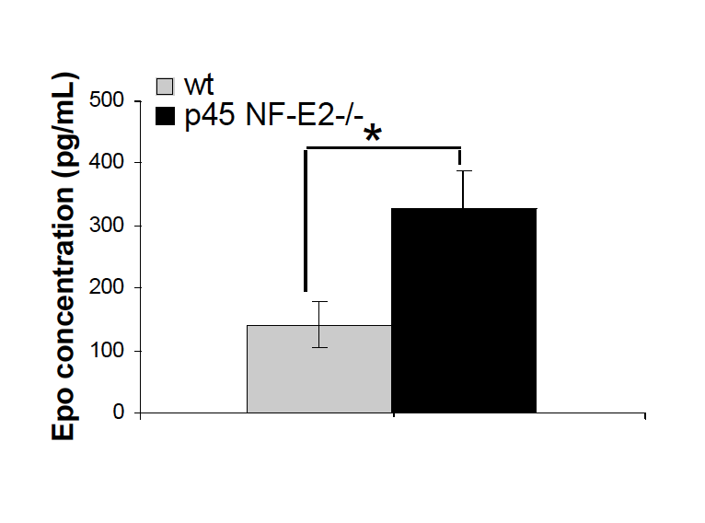
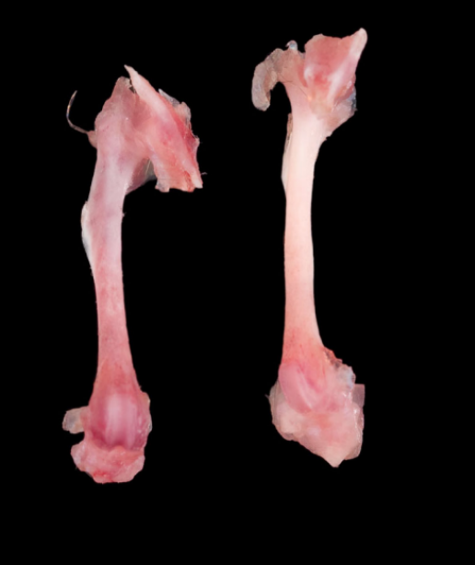
NF-E2 ^{-/-} mice
increase in spleen erythropoiesis
partial block in erythroid progenitor populations
increase in GATA-1 levels
- cell cycle: increase of cells in G1
Notes:
6

Slide 7
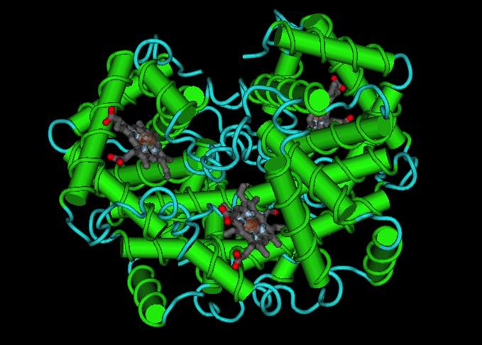
Hemoglobin synthesis
heme biosynthesis
iron uptake
globin gene expression
hemoglobin
α₂β₂ tetramer
α-chain 141aa
β-chain 146aa

Slide 8
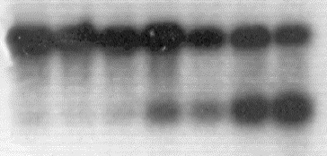

Erythroleukemia cells
Hemin or DMSO
MEL
globin gene
transcription
hemin
Control
1mM
10mM
20mM
50mM
100mM
200mM
actin
dosage
response
β_{maj}-globin
1
4
8
24
48
hours
time
course
actin
β_{maj}-globin

Slide 9
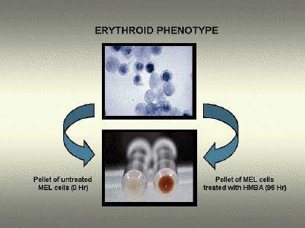
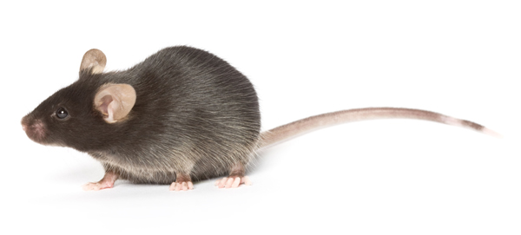
Models
MEL & G1-ER cells Mice
untreated
treated
(HMBA 96h)
cromosoma.cib.csic.es
Notes:
9

Slide 10
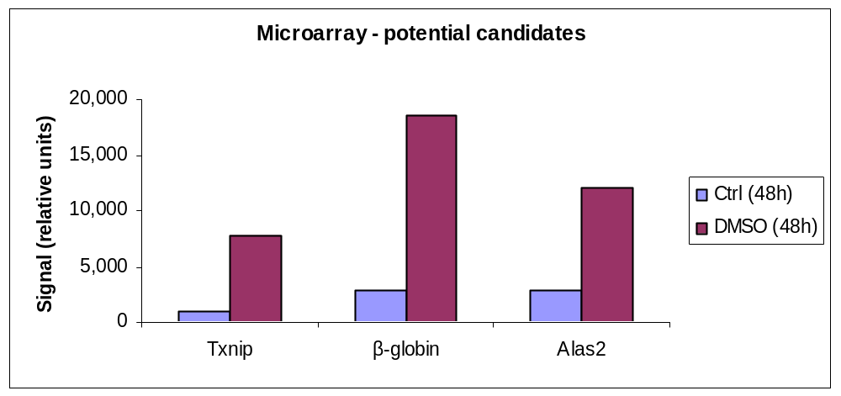
Genechip expression array (Affymetrix 430A)
- MEL cells
- differentially expressed TXNIP

Slide 11
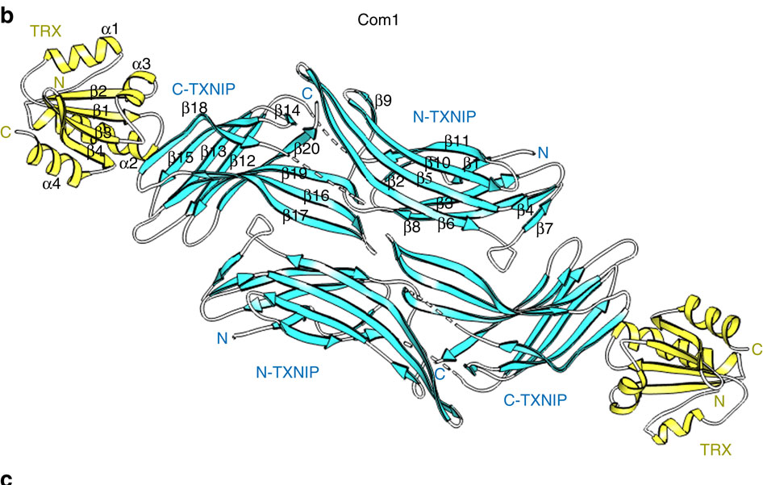
TXNIP (Thioredoxin interacting protein)
ubiquitously expressed, ~50 kDa
cytoplasm, nucleus, mitochondria, cell membrane
tumor suppressor (expression reduced in many tumors)
overexpression induces cell cycle arrest
role in oxidative stress by inhibiting activity or bioavailability of thioredoxin
(Huang et al, Nature 2013)

Slide 12
TXNIP ^{-/-} mice
Metabolism In fasting conditions:
hypoglycemia
insulin
triglycerides
fatty acids in plasma
(Hui et al. 2004, Donnelly et al. 2004, Oka et al. 2006)
Carcinogenesis hepatocellular carcinoma (40% of mice) (Sheth et al. 2006)
hepatocellular and bladder tumors (carcinogen-induced)
(Kwon et al. 2010, Nishizawa et al. 2011)
Hematopoiesis impaired maturation of NK cells (Lee et al. 2005)
impaired function of dendritic cells (Son et al. 2008)
altered HSCs (Jeong et al. 2009, Jung et al. 2013)

Slide 13
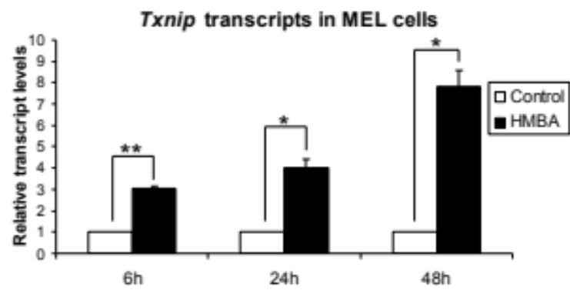
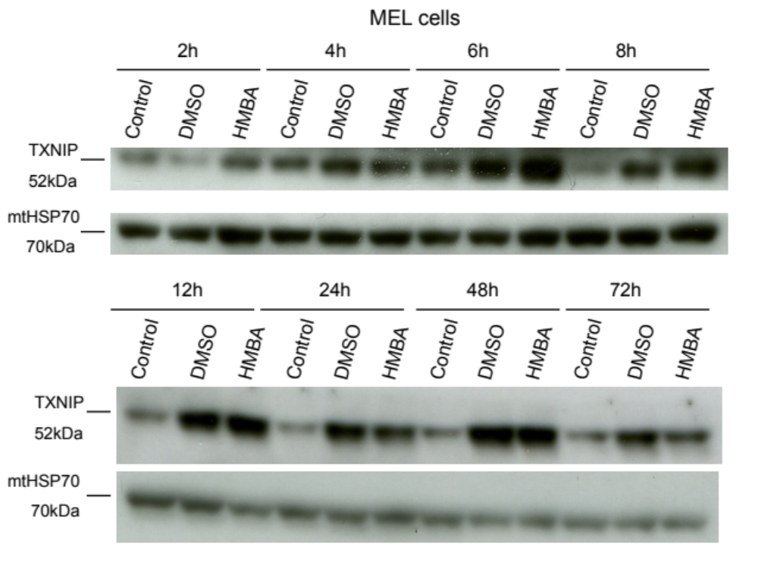
Induction of TXNIP in differentiating MEL cells
Notes:
13

Slide 14
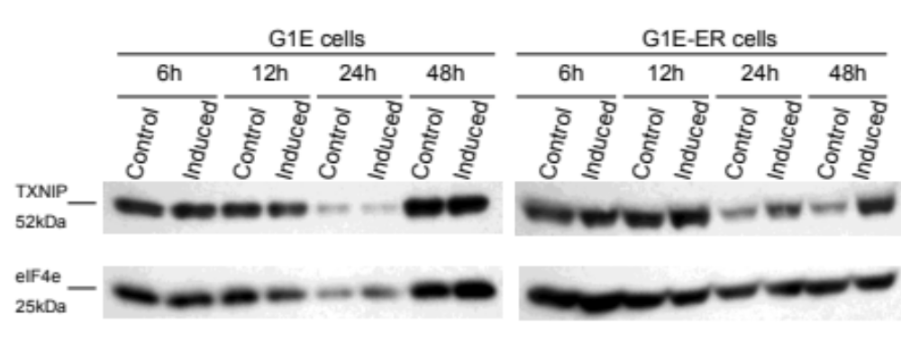
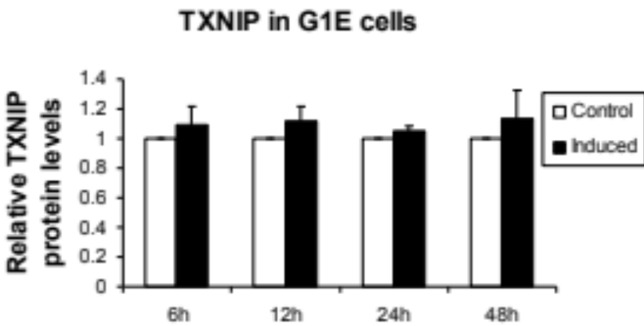
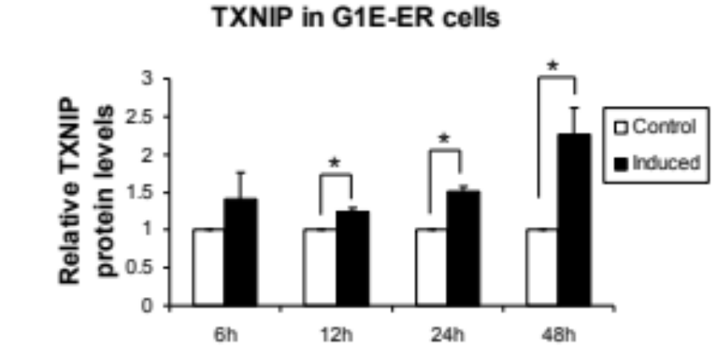
Induction of TXNIP in differentiating G1E-ER cells
Notes:
14

Slide 15
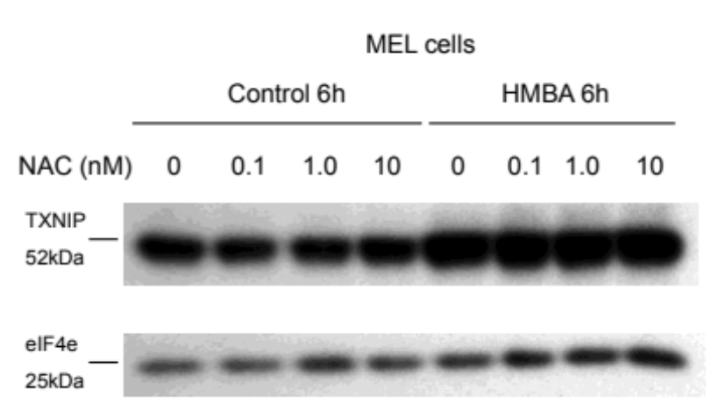
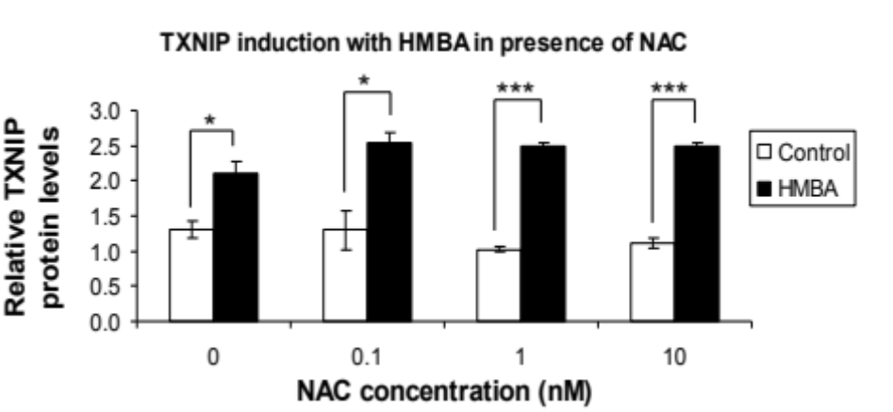
TXNIP & ROS scavenger NAC
- TXNIP upregulation with HMBA unchanged
Notes:
15

Slide 16
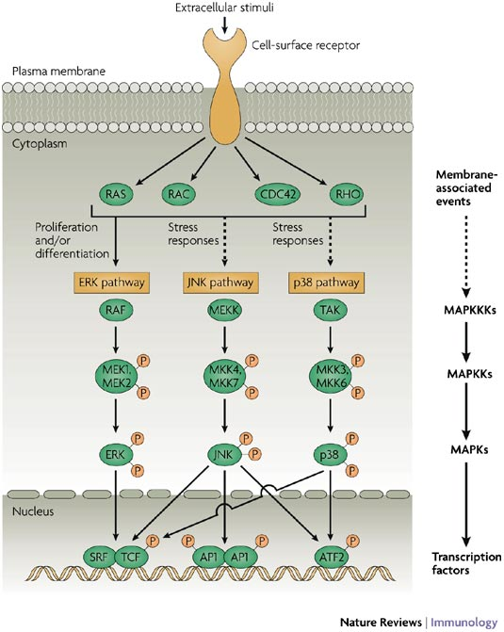
MAP kinase pathways
Liu et al. Nature Reviews Immunology 7, 202–212 (March 2007)

Slide 17
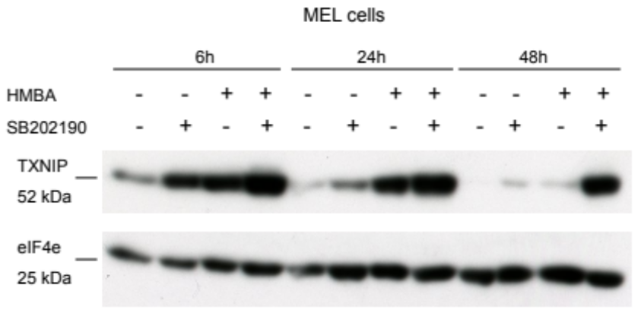
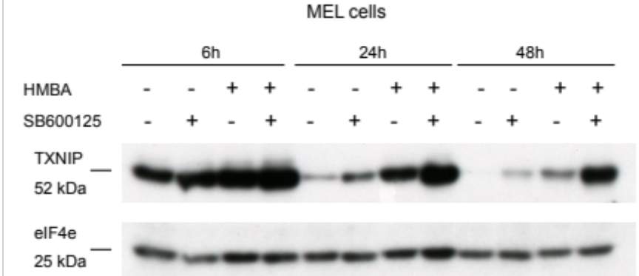
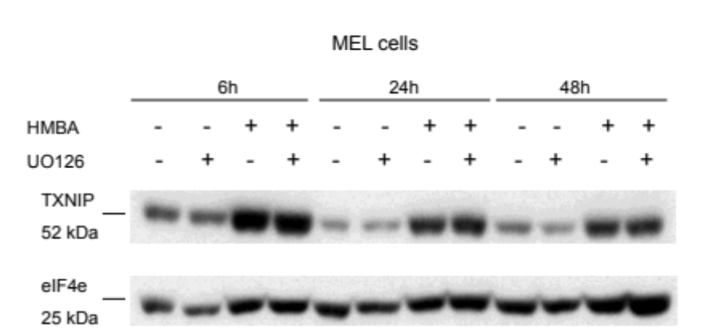
TXNIP – Regulation of MAP kinases
p38 inhibitor
JNK inhibitor
ERK inhibitor
Notes:
17

Slide 18
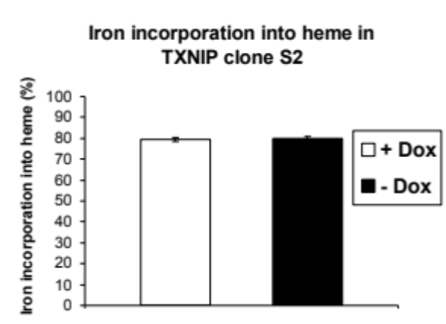
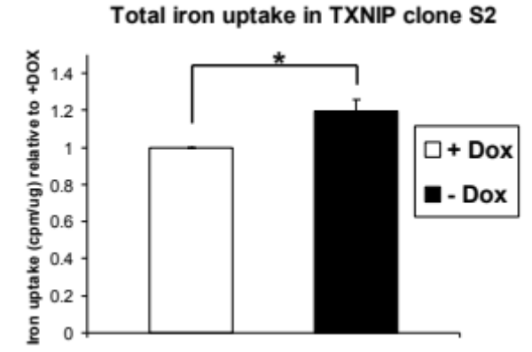
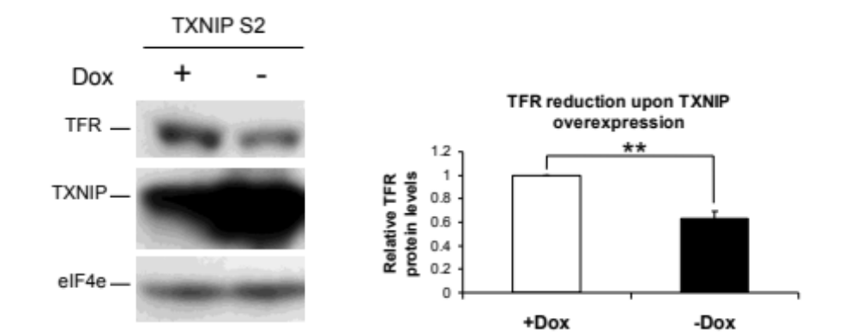
TXNIP overexpression
- increases iron uptake
- decreases TFR expression
Notes:
18

Slide 19
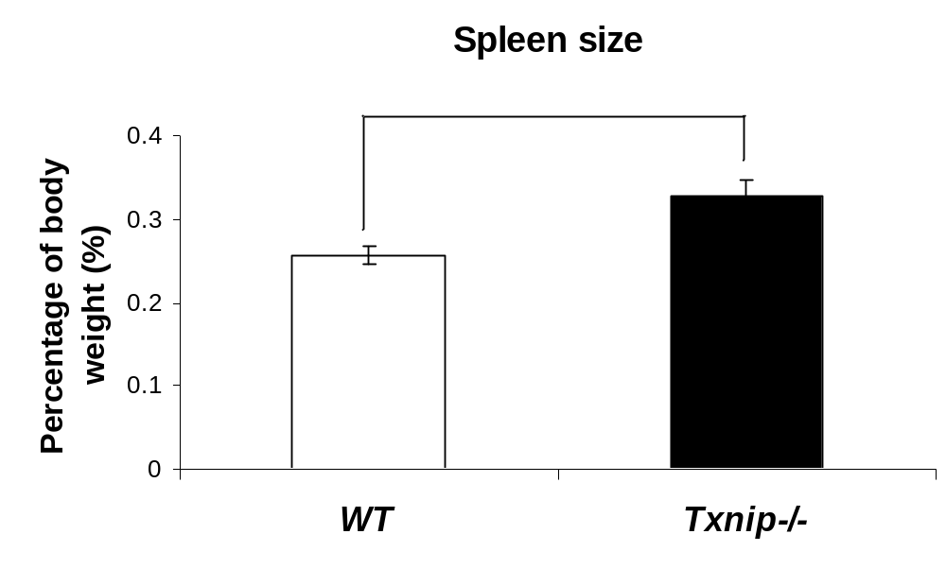
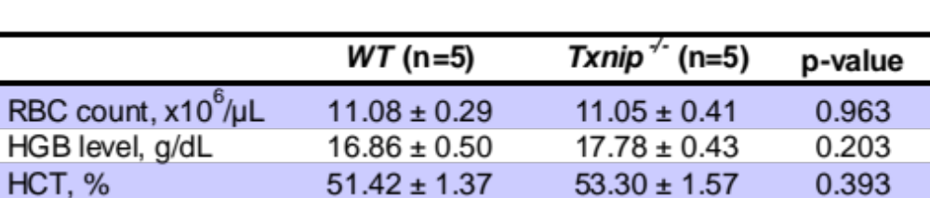
Analysis of Txnip^{-/-} mice
- spleen size
- blood parameters
Notes:
19

Slide 20
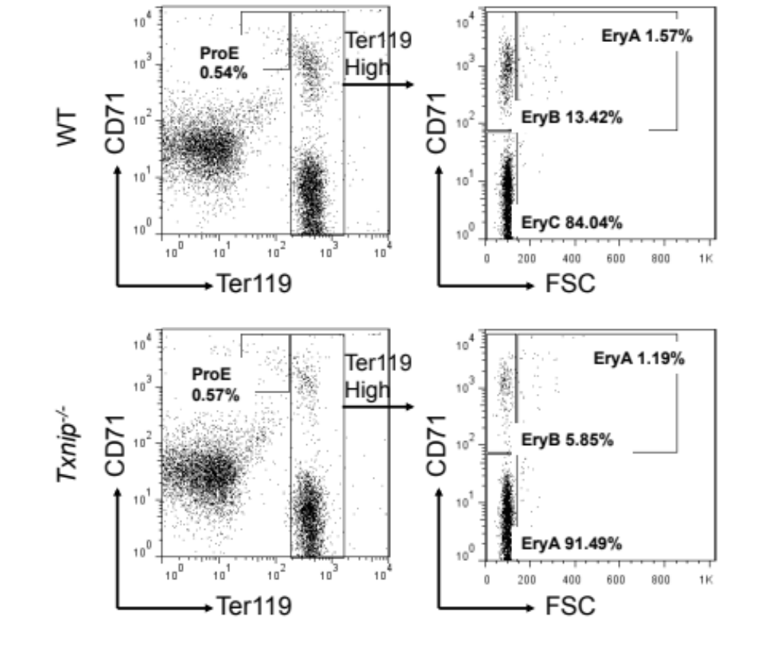
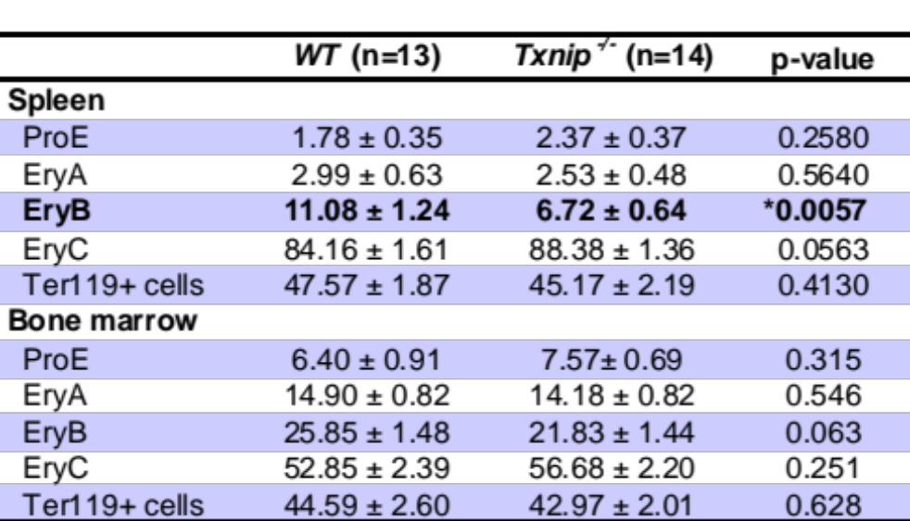
Erythroid precursor populations in Txnip^{-/-} mice
- spleen
ProE proerythroblasts
EryA basophilic erythroblasts
EryB late basophilic and polychromatic erythroblasts
EryC orthochromatic erythroblasts and erythrocytes
Notes:
20

Slide 21
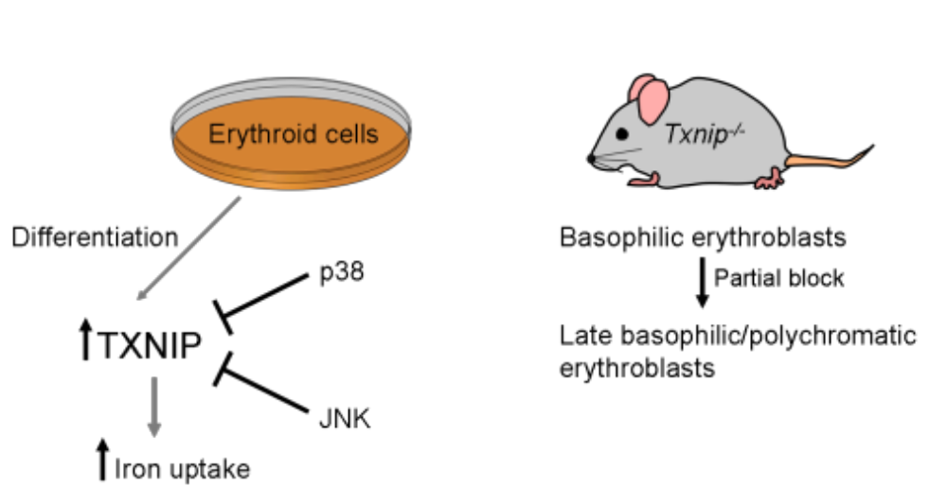
Model
- Role of Txnip in erythroid differentiation
Notes:
21

Slide 22
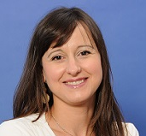
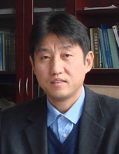
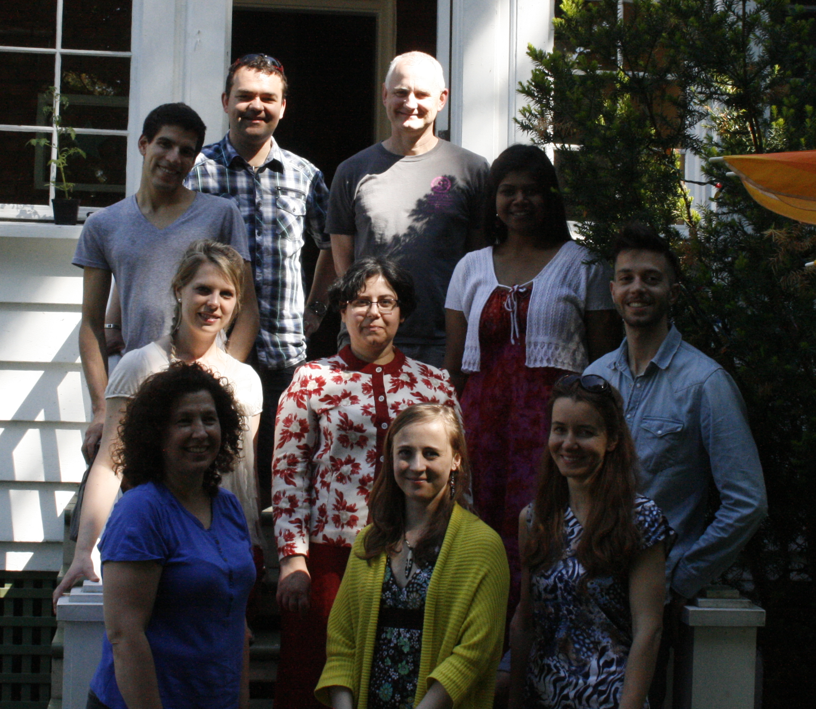
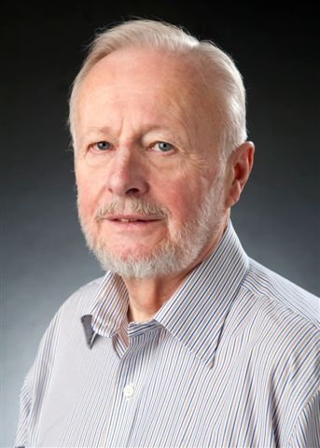





Acknowledgements
Marilène Paquet
(MUHC, McGill)
Gregory
Chevillard
Simon T. Hui (UCLA)
Isadore
Dodard-Friedman
Meenakshi
Kannan
Prem Ponka
(McGill University)
Daniel Garcia Santos
Marc Mikhael
Marina
Bury
Zaynab
Nouhi
Thibaut
Dutruel
Mitchell Weiss
(Children’s Hospital,
Philadelphia)
Anna
Derjuga
Jadwiga Gasiorek
Vera Solovieva
The Cancer Research
Society

