Slide 1

About OMICS Group
OMICS Group International is an amalgamation of Open Access publications and worldwide international science conferences and events. Established in the year 2007 with the sole aim of making the information on Sciences and technology ‘Open Access’, OMICS Group publishes 400 online open access scholarly journals in all aspects of Science, Engineering, Management and Technology journals. OMICS Group has been instrumental in taking the knowledge on Science & technology to the doorsteps of ordinary men and women. Research Scholars, Students, Libraries, Educational Institutions, Research centers and the industry are main stakeholders that benefitted greatly from this knowledge dissemination. OMICS Group also organizes 300 International conferences annually across the globe, where knowledge transfer takes place through debates, round table discussions, poster presentations, workshops, symposia and exhibitions.

Slide 2
About OMICS Group Conferences
OMICS Group International is a pioneer and leading science event organizer, which publishes around 400 open access journals and conducts over 300 Medical, Clinical, Engineering, Life Sciences, Pharma scientific conferences all over the globe annually with the support of more than 1000 scientific associations and 30,000 editorial board members and 3.5 million followers to its credit.
OMICS Group has organized 500 conferences, workshops and national symposiums across the major cities including San Francisco, Las Vegas, San Antonio, Omaha, Orlando, Raleigh, Santa Clara, Chicago, Philadelphia, Baltimore, United Kingdom, Valencia, Dubai, Beijing, Hyderabad, Bengaluru and Mumbai.

Slide 3

Fractal modification of Curie-Weiss law based improved impedance of doped BaTiO₃-ceramics
V.V. Mitić^{1,2}, Lj. Kocić¹ , V. Paunović¹
¹ Faculty of Electronic Engineering, University of Nis, Serbia,
² Institute of Technical Sciences of the Serbian Academy of Sciences and Arts

Slide 4
Abstract
A new approach based on fractal geometry and correlation between microstructure-nanostructure and rare-earth properties and other additives doped BaTiO₃-ceramics and electronics properties, is applied. The grain contacts geometry based on different stereological models and especially intergranular contact surface fractal morphology was the subject of several papers of these authors [7-34]. The main conclusion was that intergranular capacities have higher values then expected which is induced by contact surfaces sizes augmentation as a consequence of their fractal nature. Bigger micro-capacities was justified by virtually having bigger dielectric constants which was performed by introducing fractal correction factor a₀ > 1, as a multiplier to the usual dielectric constant e_{r} to gain the bigger value a₀e_{r}. In further BaTiO₃-ceramics micro-electronics fractal theory development, different fractal methods were used to describe complexity of the spatial distribution of BaTiO₃-grains, as well as pores [13-15]. This led to fractal correction factor revisited model, which considers existence of surfaces fractality, pores fractality and the inner liquid dynamics and solid state sintering phase within ceramics material represented by the Brownian motion model. The new correction factor a is a function of these three ceramics fractality “sources”. Here, the relationship between a and a₀ is established for doped BaTiO₃-ceramics using the Curie-Weiss law and temperature as an omnipresent sintering parameter. Also, the model of two grains contact impedance is studied for different a and frequency values. Ву the control of shapes and contact surfaces numbers on the the entire BaTiO₃-ceramic sample level, the control over structural properties of these ceramics can be done, with the aim of correlation between material electronic properties and corresponding microstructure. The fractal nature for analysis of the ceramics structure providing a new approach for modeling and prognosis the grain shape and relations between the BaTiO₃-ceramic structure, micro- and nano-, and all other electronic properties in the light of new frontier for higher level electronic circuits integration.
Keywords: BaTiO₃-ceramics, fractal, microstructure, micro-capacity, micro- impedance.

Slide 5
Introduction
Barium-titanate ceramics are one of the most important electronic ceramics for the small size and multilayer capacitors of high capacitance manufacture. For these applications this ferroelectric is usually doped with various additives such as Er⁺, Ho³⁺, Mn²⁺, Nb⁵⁺, Yb³⁺, and some oxides, in attempt to achieve a temperature stable dielectrics. It is shown that dielectric constant depends strongly on grain and pore size in the ferroelectric state, i.e. the finer the grain size, the higher the dielectric constant. The investigation of microstructure characteristics of undoped and doped BaTiO₃ in function of consolidation parameters is a necessary step in barium-titanate ceramics processing and designing. Structure investigations provide better understanding for dialectic properties, especially from the point of view of the relative dielectric constant response of pure and doped BaTiO₃-ceramics. Fractal method traces a new approach for describing and modeling the grain's shape and relations between BaTiO₃-ceramics structure and electrical properties. It gives more natural approximation to the grain's boundary, but the construction uses recursive random algorithms. Particle shape is a fundamental powder property, affecting powder packing and thus bulk density, porosity, permeability, cohesion, flowability, attrition, interaction with fluids, covering power of pigments, resistance, capacity, magnetic permeability etc. Introducing mathematically well-established fra­c­­tal sets theory in the powder metallurgy science, new materials, nano-technology, “free-floating” metallic drops processing, various ceramics technologies, graphene oxide flakes, literally from trash recycling to self-healing materials.

Slide 6
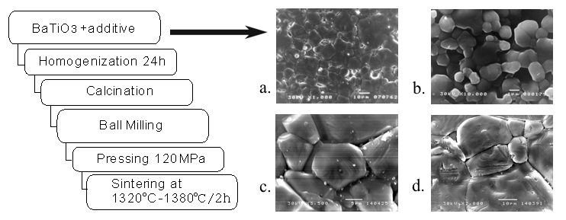
Using the fractal theory modern developments, offers enough firm arguments to support modelling, predicting and many modern technological processes control, as outstan­ding examples of fractal-based structures. Estimation the fractal analysis main parameter - the Hausdorff or fractal dimension, for all relevant morphologies that appear in sintering processes. By using obtained values, study their impacts on distribution of energy, temperature, surface tension, dielectric constants, rate of densification etc. The fractal analysis is used in ceramics materials to quantify the particle’s structure complexity, granular complexes, sintering processes, pores distribution changes etc.
Fig.1. Doped BaTiO3 powder preparation. a. 0.5wt%Er/1320 ºC; b. 1.0wt%Yb₂O₃/1350 ºC;
c. 0.01wt% Ho/1380 ºC; d. 0.1wt%Ho/1350ºC;

Slide 7
Experimental procedure
In this paper, Er₂O₃, Ho₂O₃, Mn₂O₃, Nb₂O₃, Yb₂O₃, doped BaTiO₃-ceramics were used for microstructure characterization, and modeling.
The samples were prepared from high purity (>99.98%) commercial BaTiO₃ powder (MURATA) with [Ba]/[Ti]=1,005 and Ho₂O₃ powders (Fluka chemika) by conventional solid state sintering procedure. The content of Ho₂O₃ ranged from 0.50 to 2.0 wt% .
Starting powders were ball-milled in ethyl alcohol for 24 hours. After drying at 200ºC for several hours, the powders were pressed into disk of 7mm in diameter and 3mm in thickness under 120 MPa.
The compacts were sintered from 1320ºC to 1380ºC in air for four hours. The microstructures of sintered and chemically etched samples were observed by scanning electron microscope (JEOL-JSM 5300) equipped with energy dispersive spectrometer (EDS-QX 2000S).

Slide 8
Fractality and ceramics grains’ contacts
Electronics ceramics, especially BaTiO3-ceramics, are made out of very fine powder having the maximum Ferret diameter. These particles have so high surface energy to fuse together and to make sintered ceramics. As it is well known^{[1-6]}, many powder materials have fractal structure, and nowadays it is well established, documented and widely accepted fact (Figure 2). Fractal geometry, systematically introduced by Benoit Mandelbrot^{[1,2]} during the end of sixth and at the beginning of seven decade of the last century (for a constructive approach, see Barnsley^{[3]} ) as an efficient toll for describing complex non-Euclidean shapes. Shapes which are not fractal are the exception, said Mandelbrot. The fractal geometry key concept is the unique number that is connected with fractal object which is known as fractal dimension, a concept introduced sixty years before by Felix Hausdorff. If DH_{f} denotes fractal dimension, the simple inequality DH_{f} > DT , where DT is topological dimension, has been suggested by Mandelbrot as an acceptable (although not complete) definition of fractal objects.
B. Mandelbrot, The Fractal Geometry of Nature (3ed.), W. H. Freeman, San Francisco, 1983.
B. Mandelbrot, Les objets fractals, forme, hasard et dimension, Flammarion, Paris, 1975.
M. Barnsley, Fractals Everywhere. Academic Press, 1988.
B. H. Kaye, A Random Walk Through Fractal Dimensions, Wiley-VCH 1994.
A. Naman, Mechanical Property and Fractal Dimension Determination in Li2O*2SiO2 Glass-ceramics, University of Florida, 1994.
N. M. Brown, The Fractal Dances of Nature, Penn State News, Wednesday, November 19, 2014.

Slide 9
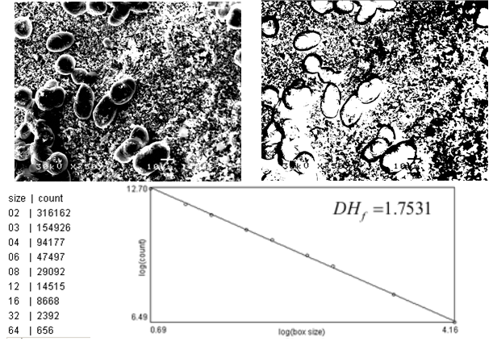
Fig. 2. Above. The BaTiO₃ doped with 0.5wt%Ho ceramics, sintered on 1320 ºC/120 MPa for 4 hours SEM sample (left) and its BW electronic image; Below: Fractal dimension of the sample extracted by gray level box counting method gives DH_{f} = 1.7531.

Slide 10
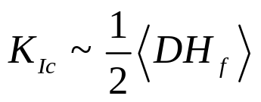


Jack Mecholsky, a professor at Penn State expressed his attitude towards a new science: „Fractal geometry is probably the most useful math ever invented.” In 1976, Mecholsky, then at Sandia National Labs, together with Dann Passoja were among the first trying to apply new fractal geometry on metal fracture surfaces. In 1984 Mecholsky suggested a fractals project for her senior thesis in ceramic science. He, Passoja, and Karen Feinberg took samples of brittle ceramics, broke them, and measured the fractal dimension of the fracture surface [Brown]. They found that the toughness of the material was proportional to the fractal dimension,
where
is toughness and
is the decimal part of the fractal dimension.

Slide 11
Applied to BaTiO₃ and similar perovskite ceramics, a grain contour line typically satisfies 1.06 < DH_{f} (contour) < 1.08 ^{[7,8]} which is much in agreement with other author’s measurements results (see Smirnov ^{[9]} , p.38). The DH_{f} value depends on the sintering phase, and for the surface of a grain it is 2.079 < DH_{f} (grain’s surface) < 2.095 ^{[10]} . Many considerations and numerical work has been spent in two-grain contact area size approximate evaluation. Different models were studied having supposition that one or both grains belong to one of three approximate classes: polyhedrons or prisms (P), spheres (S) or ellipsoids (including spheroids) (E). All possible two grains contact combinations have been considered: P-P, S-S, E-E, P-S, P-E and S-E ^{[10-12]} .
7. V. V. Mitić, Lj. M. Kocić, M. M. Ristić, The Interrelations between Fractal and Electrical Properties of BaTiO3-Ceramics, The American Ceramic Society 99th An­nual Meeting and Exposition, Cincinnati, Ohio, May 4-7, p. 199, 1997.
8. Mitić V.V., Kocić M.Lj., Miljković M., Petković I., Fractals and BaTiO3-Ceramic Microstructure Analysis. Mikrochim. Acta 15, 365-369, Springer-Verlag (1998).
9. Smirnov B.M., Physics of fractal clusters, Contemporary problems in Physics, Nauka, Moscow 1991.
10. V. V. Mitić, Lj. M. Kocić, Z. I. Mitrović, M. M. Ristić, BaTiO3-Ceramics Microstructure Controlled Using Fractal Methods. Abstract Book of 100th Annual Meeting and Exposition of the American Ceramic Society, May 3-6, 1998, p. 190.
11. P. Petković, V. V. Mitić, Lj. Kocić, Contribution to BaTiO3-Ceramics Structure Ana­lysis by Using Fractals, Folia Anatomica, 26, Suppl. 1, pp. 67-69, 1998.
12. V. V. Mitić, Lj. M. Kocić, I. Z. Mitrović, M.M. Ristić, Shapes and Grains Structures Stochastic Modelling in Ceramics, Proc. of S4G - International Conference on Stereology, Spatial Statistics and Stochastic Geometry, Prague, Czech Republic, June 21-24, pp. 209-215, 1999.

Slide 12
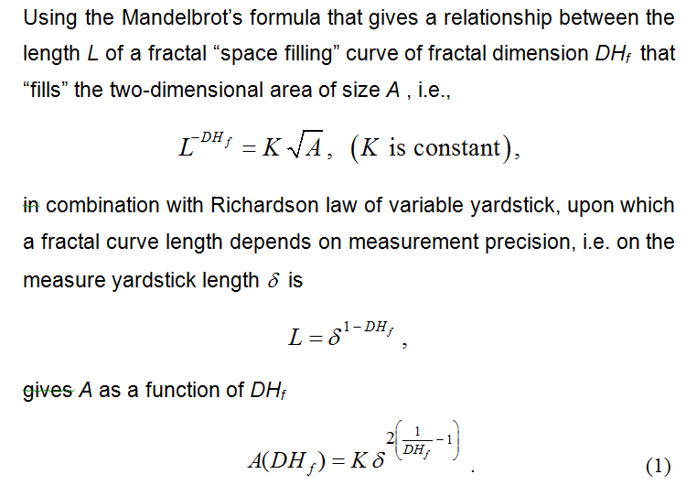

Slide 13
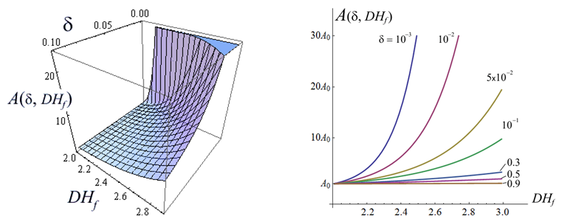

Fig. 3. Size of the contact area vs. fractal dimension. A₀ in the right 2D graph is the area size for ideally flat contact surface.

Slide 14
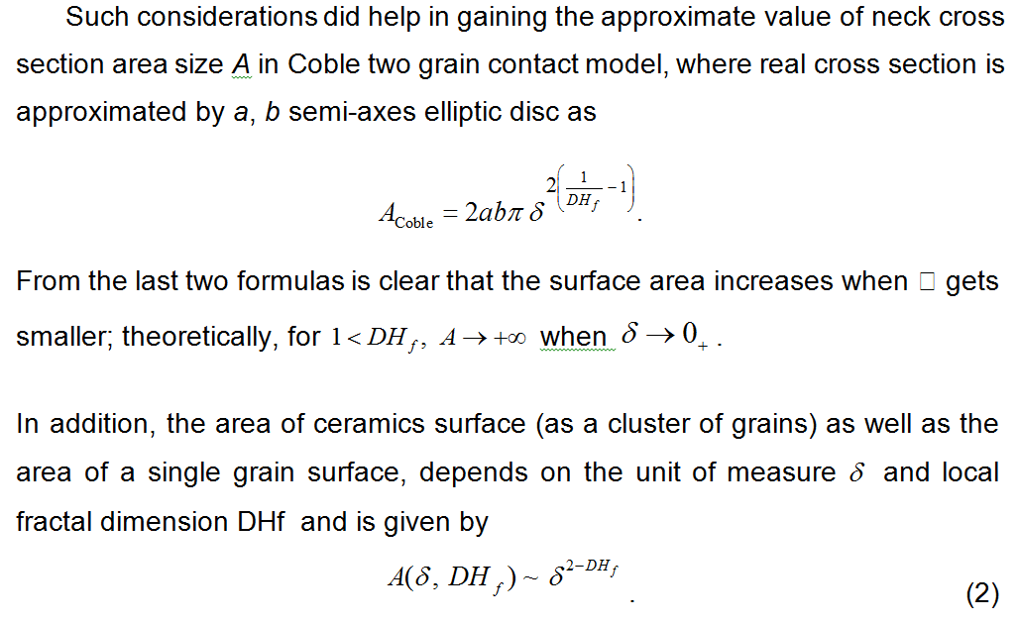

Slide 15
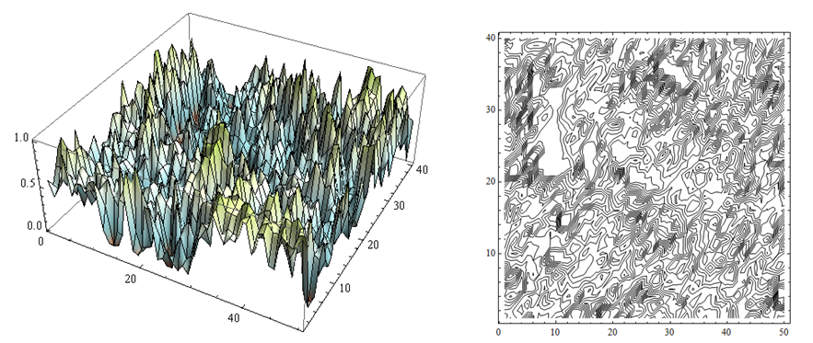
The relationship (2) is illustrated by the graphs at Figure 3. The increasing of the contact area size with more precise measuring (smaller d) is evident for all fractal dimensions > 2. Even for „smooth“ fractal surfaces, i.e. surfaces with DH_{f} close to 2 (as it is the case with BaTiO₃-ceramics grains surfaces having 2.079 < DH_{f} < 2.095), the area size A duplicates its value if the unit of measure d decreases for the factor 2.87389 x 10⁻⁴ .
Fig. 4. Left. Reconstruction of 3D-surface for BaTiO₃ sample from Fig. 2; Right. Level lines of the same surface. Picks represent grains.

Slide 16
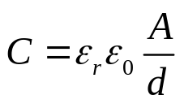
While the fractal dimension of BaTiO₃-ceramics grain’s surface is modest, the dimension of the specimen surface is much higher, as Figure 4 shows. The fractal dimension is calculated using max-gray level box-counting method of the SEM, which yields DH_{f} = 1.7531. For other specimens similar values are obtained in range from 1.7529 to 1.8025.
These results led to revision of the formula for parallel-plate capacitor with plates area A and a separation d (d << A^{1/2})
(3)
where e_{r} and e₀ are dielectric constants of BaTiO₃-ceramics grains’ contact zone and in vacuum respectively. Namely, the intergranular microcapacitor, formed in the contact zone of two ceramics grains is not a parallel-plate capacitor. It is a fractal capacitor that may be thought of as being product of a iterative process described by the Figure 5, left. The top subfigure shows a parallel-plate capacitor as described above. It corresponds to a capacitor (denoted by C₀) with adjacent grains’ perfectly flat contact surfaces which does not exist in reality. On the contrary, the contact surface is rough and uneven, so that the following fractal model will be a good approximation. Suppose that the flat parallel geometry of C₀ (Figure 5, left) is replaced by three flat capacitors „Z“-shaped configuration connected in parallel, forming the unique capacitor C₁.

Slide 17
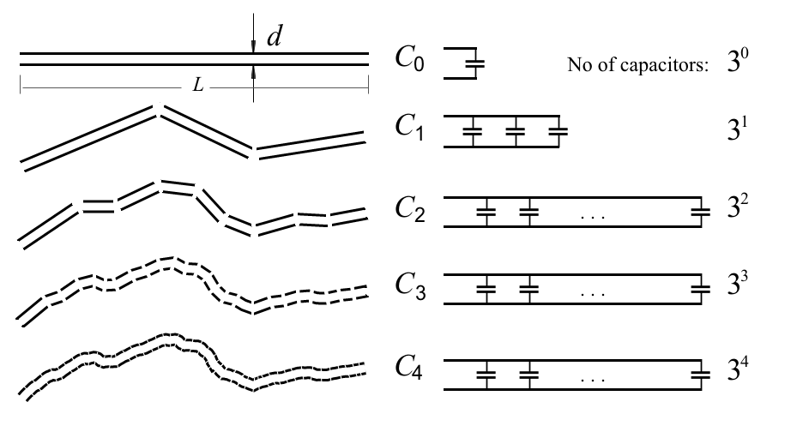
Fig. 5. Constructive way to explain fractal character of an intergranular microcapacitor.

Slide 18
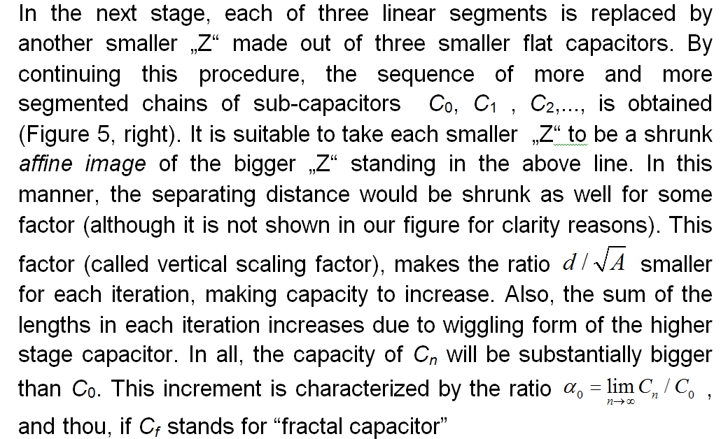
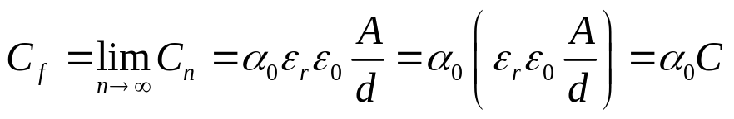
(4)
where C is capacity of the capacitor having ideally flat plates.

Slide 19
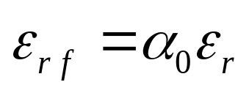
Since, C_{f} > C it follows that a₀ > 1. This effect of increasing capacity due to fractality of contact zone is referred by these authors as the a-correction of the intergranular capacity or, which is the same, dielectric constant, by stating ^{[13, 14]}
Indeed, the increasing in capacity is the consequence of micro-structure, not of macro-parameters like grains’ position or size. Consequently, it may be consider as an intrinsic BaTiO₃-ceramics characteristic and also doped BaTiO₃-ceramics.
13. V. V. Mitić, Lj. Kocić, Z. I. Mitrović, Fractals and BaTiO3-Ceramics Intergranular Impedance, Gordon Research Conference: Ceramics, Solid State Studies in, Kimball Union Academy, Meriden, New Hampshire, August 1-6, 1999.
14. V. V. Mitić, Lj. Kocić, Z. I. Mitrović, Primena fraktala u modelu intergranularne impedanse BaTiO3-keramičkih materijala. Naučni skup: "Trijada Sinteza-Struktura-Svojstva-Osnova tehnologije novih materijala", Beograd, Novembar 16-18, 1999, str. 65-66.

Slide 20
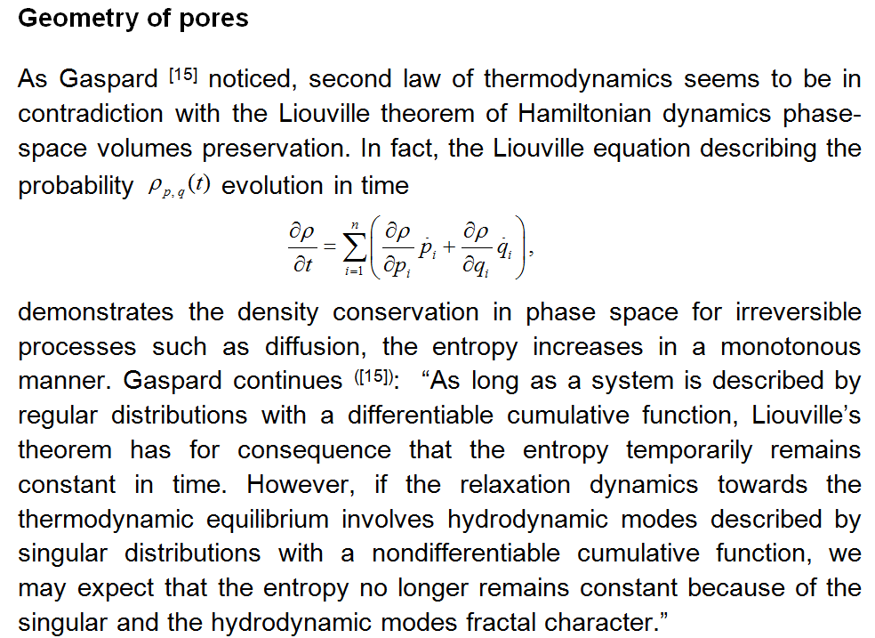
15. P. Gaspard, Chaos, Fractals And Thermodynamics, Bulletin de la Classe des Sciences de l’Acad´emie Royale de Belgique, 6e s´erie, tome XI (2000) 9-48.

Slide 21
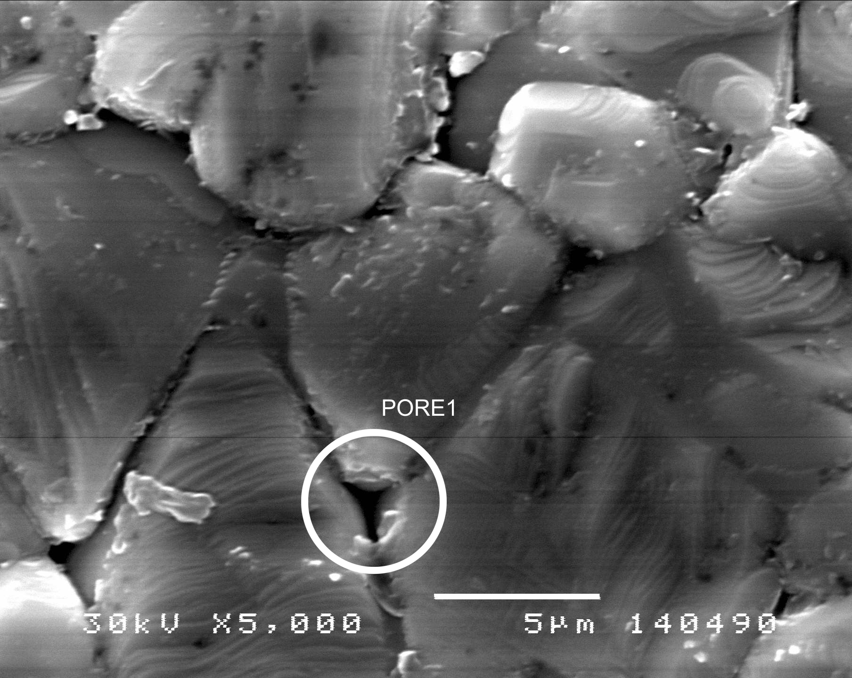

Slide 22
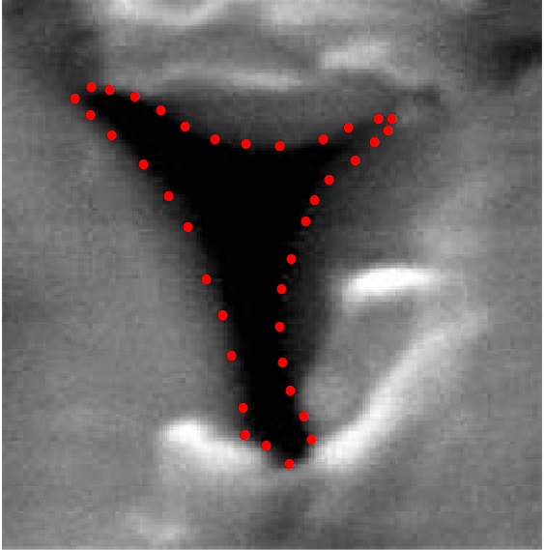
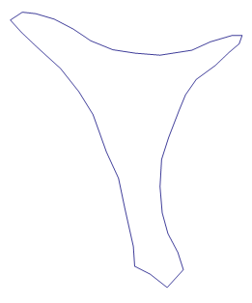
The chosen pore is processed by sampling its contour points to get a polygonal representation
that gives the approximately pore’s outline.

Slide 23
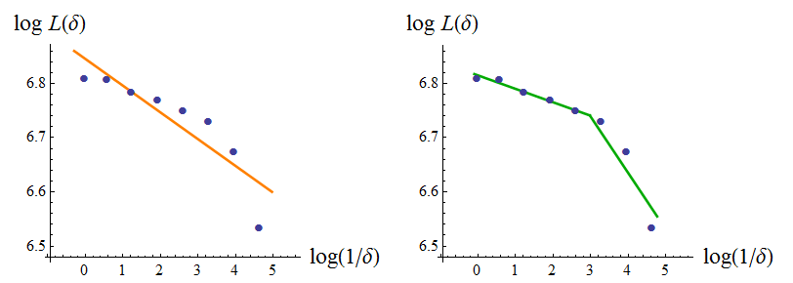
The Richardson method ^{[1]} and Kaye’s modification ^{[4]} , help to retrieve the approximate
fractal dimension of the pore’s outline.
Using 8 different “yardstick” lengths the eight points are obtained in the log-log
diagram, gives DH_{f} = 1.0493 ;
The modification of Brian Kaye gives DH_{f} = 1.06427 as the average of 1.02478 (upper,
“textural” slope and lower, “structural”, more slanted slope1.10376.

Slide 24
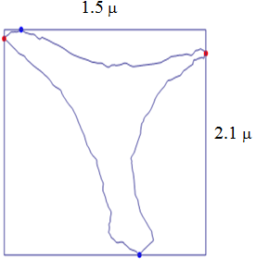
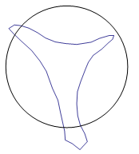
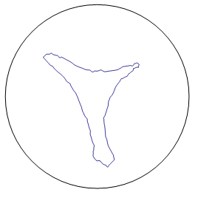
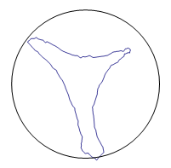
Polygonal approximation:
Equivalent circle radius = 0.8636 μ
Equivalent perimeter = 5. 42624 μ
3rd pre-fractal approximation:
Equivalent circle radius = 1.07818 μ
Equivalent perimeter = 6.77442 μ
5th pre-fractal approximation:
Equivalent circle radius = 1.43756 μ
Equivalent perimeter = 9.03245 μ

Slide 25
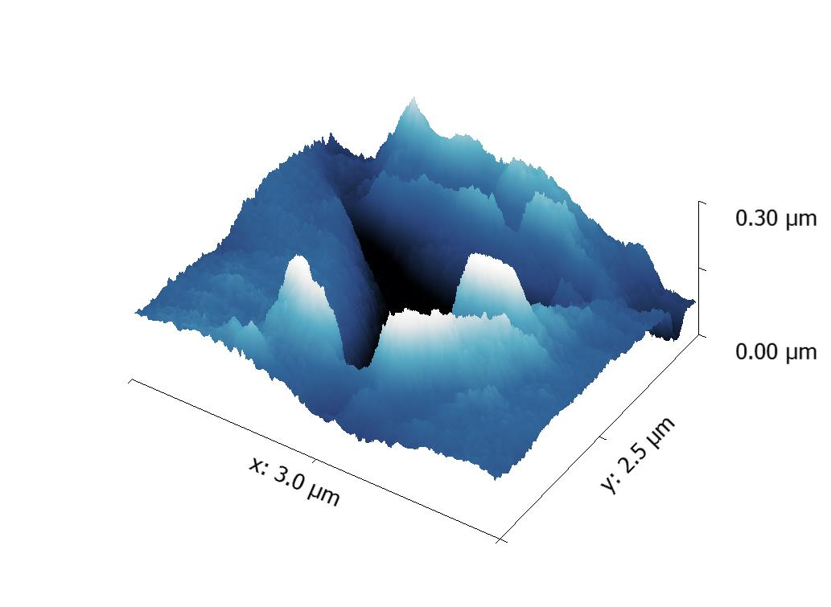
Pore 3D reconstruction. Pore’s walls fractality causes increasing of capacity on the micro level. Knowing the fractal dimension (even approximately) helps getting a more realistic model that may explain many micro-processes nature.

Slide 26
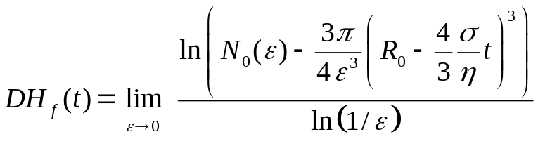
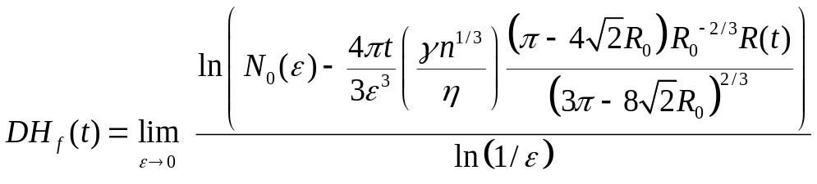
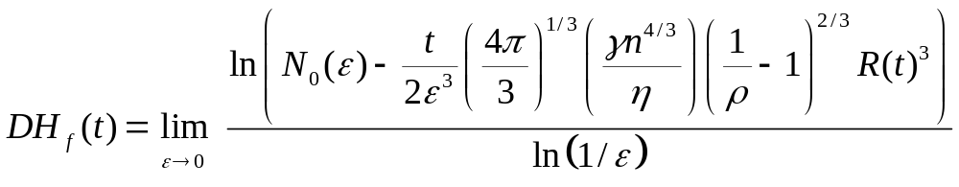

Behavior of pores wall fractal dimension durin sintering process:
1-st stage of viscous sintering
2-nd stage of viscous sintering
3-th stage of viscous sintering
Taking in account processes such are densification and coarsening, the fractal dimension is expected to slightly increase. In the limiting case of ideal sintering, .

Slide 27
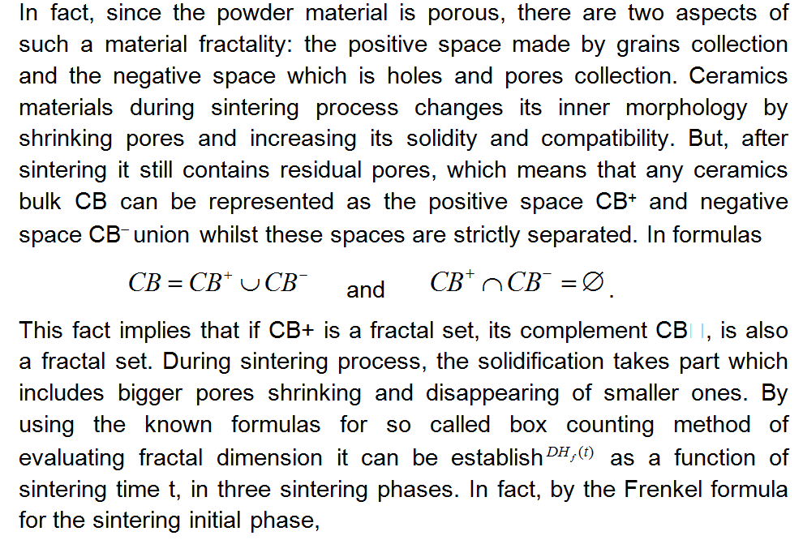

Slide 28
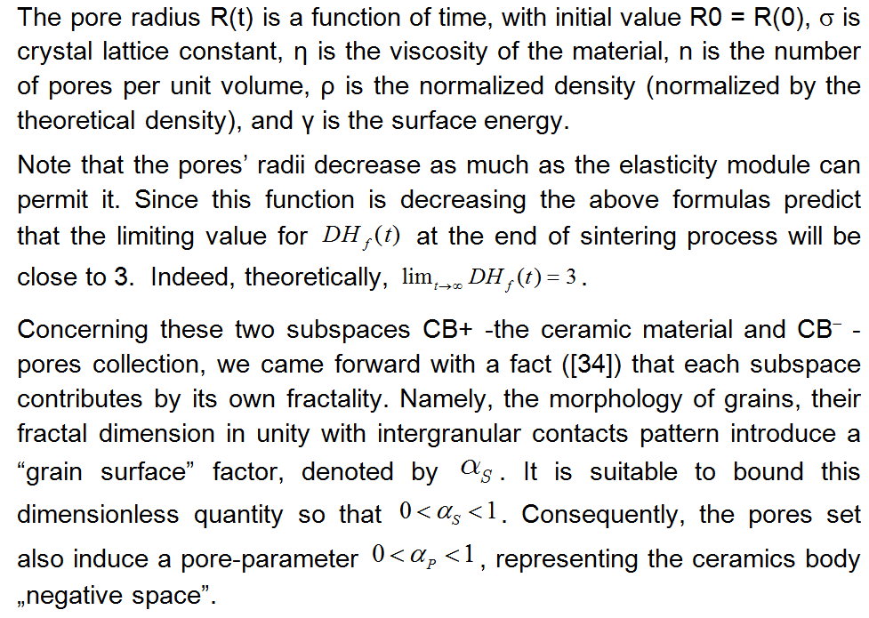

Slide 29
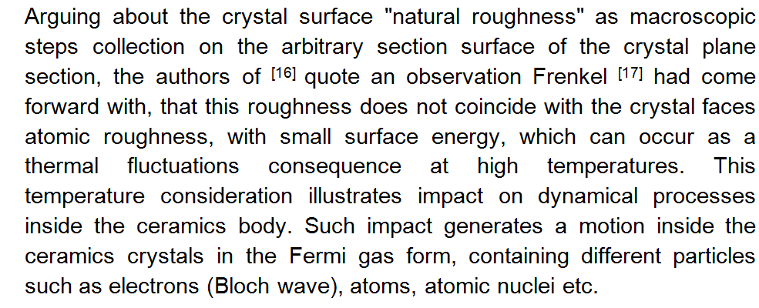
16. L. E. Geguzin, N. I. Ovčarenko, Poverhnostnaya energiya i processy na poverhnosti tverd’h tel, Uspehi F. N. (1962) 76 (2), 283-324.
17. Ya. I. Frenkel, O poverhnostnom polzanii častic u kristallov i estestvennaya šerohovatost’ estestvennyh granej, ŽETF 16 (1),(1948).
18. V.V. Mitić, V. Paunović, Lj. Kocić, Dielectric Properties of BaTiO3 Ceramics and Curie-Weiss and Modified Curie-Weiss Affected by Fractal Morphology, in: Advanced Processing and Manyfacturing Technologies for Nanostructured and Multifunctional Materials (T. Ohji, M. Singh and S. Mathur eds.), Ceramic Engi¬neering and Science Proceedings, Vol. 35 (6) 2014, pp. 123-133.

Slide 30
Dielectric constant of ferroelectrics materials depend on temperature and reaches a maximum value at Curie temperature and decreases with further increase in temperature according to the Curie-law ε_{r}=C/T-T_{o .} One of the reasons to use a modified BaTiO₃ is that, the additives have the effect of shifting Curie temperature i.e. shifts the maximum value of permittivity in the temperature range in which it can be exploited. The additives which have a higher valency then those being replaced, when present at level exceeding about 0.5wt% generaly inhibit crystal growth and move the Curie temperature towards lower values. Higher valency additives at low concentrations <0.2wt% generally lead to low resistivity of the modified BaTiO₃ .
For the investigation ferroelectrics behavior in paraelectric phase beside the Curie Weiss law we can use modified Curie-Weiss relations which describe the deviation from linearity ε_{r} = f (T) due to the diffuse phase transformations and the dielectric constant frequency dependence*.
The purpose of this paper is the dielectric properties Ho doped BaTiO₃ ceramics investigation in function of different amount of dopant concentration and fractal correction related to fractal-like structure of the material. The Curie-Weiss and modified Curie-Weiss law is used to clarify the influence of dopant on the dielectric properties and phase transformation in BaTiO₃.
* I. Isupov, “ Some problems of diffuse ferroelectric phase transition“, Ferroelectric 90, (1989).

Slide 31
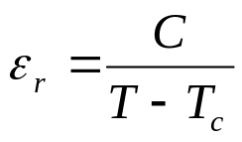
The Curie temperature (T_{C}), determined from the maximum of the dielectric constant ε_{r} in the dielectric temperature characteristic, was in the range from 124 to 129ºC being lower for low doped Ho-BaTiO₃.
All specimens have almost sharp phase transition and follow the Curie-Weiss law (Fig. 4). For T > Tc (Tc- the Curie temperature), ε_{r} obeys the Curie-Weiss law
with Curie constant C=1.5⋅10⁵.
The Curie constant (C) decreases with the increase of additive amount and have an extrapolated Curie-Weiss temperature (T₀) down to lower temperature (Fig.5 and Fig.6). In 0.01wt % doped samples, that exhibit a high density, the Curie constant is higher compared to the high doped samples. It is known that the value of Curie constant is related to the grain size and porosity of samples. The highest value of C (C=1.50⋅10⁵) was measured in 0.01 Ho-BaTiO₃-ceramics. The Curie constant C and the Curie-Weiss temperature T₀ values were given in Table 1.

Slide 32
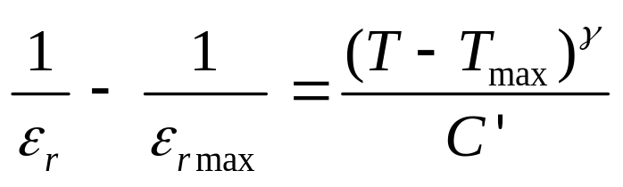
In order to investigate the Curie-Weiss behavior, modified Curie-Weiss low is used. To quantify the diffuseness i.e. the diffuse phase transformation of ε_{r} at T_{max} the equation proposed by Uchino and Nomura* has been used:
were (γ ) is the critical exponent of nonlinearity and C’ is a Curie like constant.
The critical exponent gama (γ ) was calculated from the best fit of curve ln(1/ε_{r} - 1/ε_{m}) vs. ln (T - T_{m}), where the γ represents the slope of curve (Fig 7).
The critical exponent γ is in the range 1≤ γ ≤ 2, 1 for a sharp phase transformation and 2 for diffuse phase transformation. For BaTiO3 single crystal γ is 1.08 and for modified BaTiO3 gradually increases up to 2 for diffuse phase transformation.
* K. Uchino, S. Nomura; Ferroelectric Lett. Sec., 44, 55–61, (1982)

Slide 33


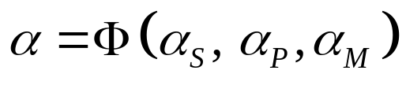
This temperature consideration illustrates impact on dynamical processes inside the ceramics body. Such impact generates a motion inside the ceramics crystals in the Fermi gas form, containing different particles such as electrons (Bloch wave), atoms, atomic nuclei etc. In essence this motion has Brownian character and impose necessity of introducing the third fractality factor–factor .
Our hypothesis is that BaTiO₃-ceramics working temperature must be influenced by these three fractality factors, making correction of „theoretic” temperature as
where a is fractal corrective factor. It is natural that all three factors a_{S}, a_{P}, a_{M}, influences a as follows
The argument for this expectation hides in the fact that geometrically irregular motion of huge particles number has to unleash an extra energy to the system.

Slide 34
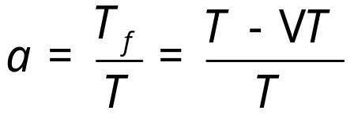

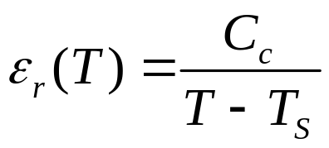
In other words, fractality of system represented by three factors aS, aP and aM, should increase overall energy of the system, and this increment must be subtracted from the input energy which is in fact, an input thermal energy denoted by T. In other words,
so that
Back to capacity formula gives us a hint of alpha correction embodied in the corrective coefficient a0 . To find connection between a0 and a consider the Curie-Weiss law, giving temperature dependence dielectric constants of BaTiO3-ceramics grains’ contact zone

Slide 35
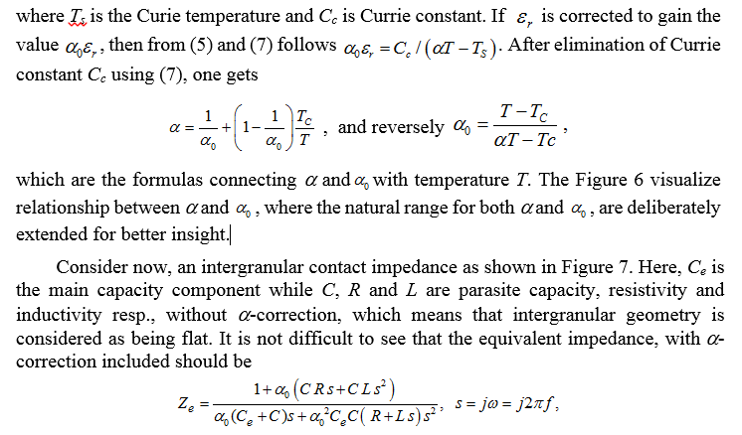

Slide 36
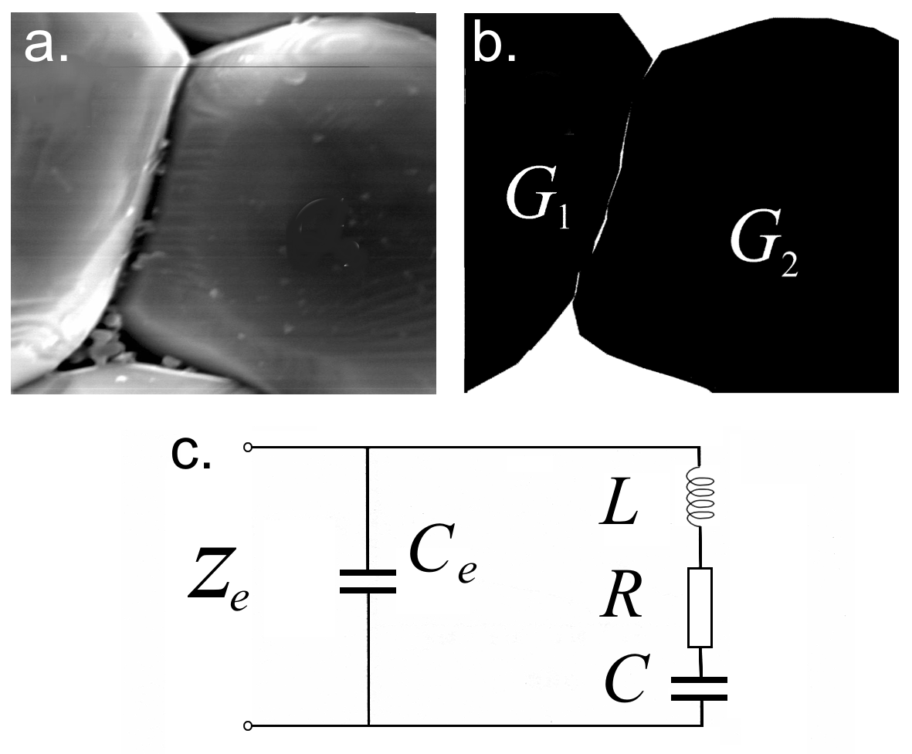
Fig. 6. a.Two grains of BaTiO3-ceramics doped with 0.1% of Ho₂O₃, sintered at 1350C.
b. Shematic illustration of G₁-G₂ contact. c. Equivalent micro-impedance without a-correction.

Slide 37
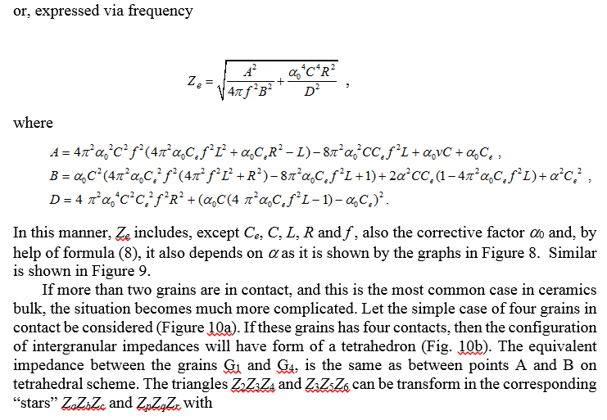

Slide 38
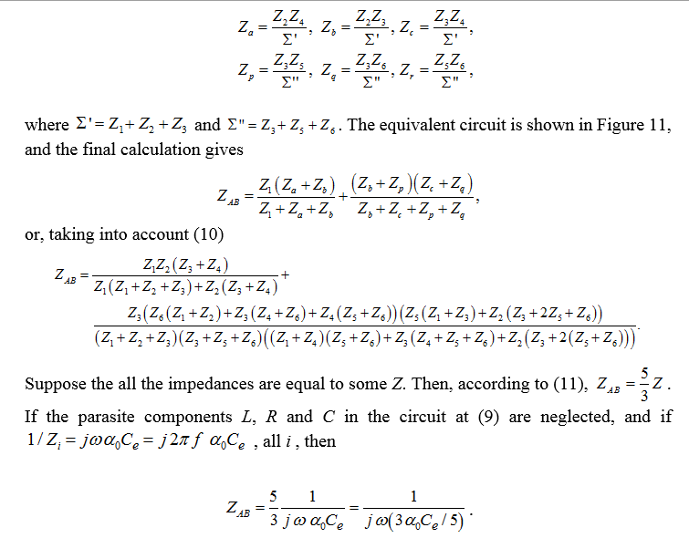

Slide 39
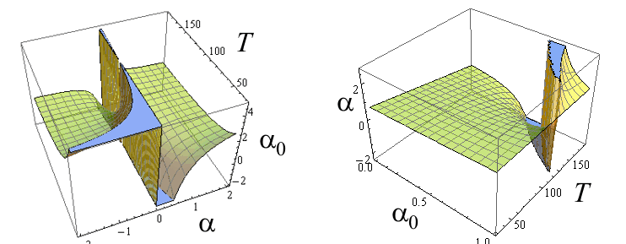
Fig. 7. Left. c_{e}=0.1; c=0.01; L=0.001; Right. c_{e}=0.01; R=1; L=0.001;{a,0,1},{f,1,80}.

Slide 40
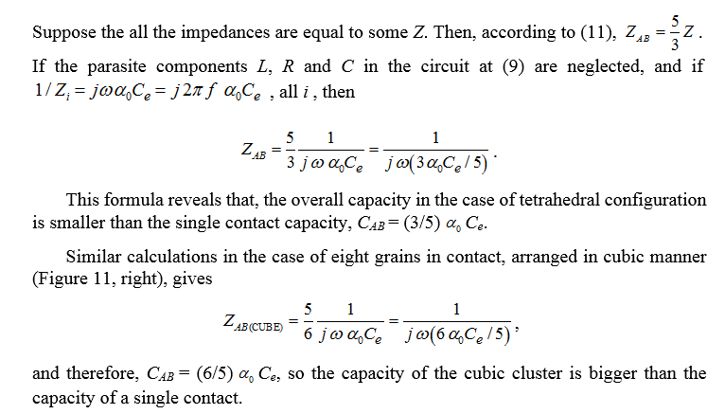

Slide 41
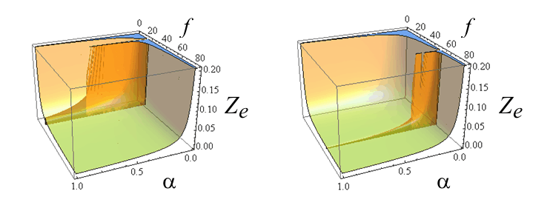
Fig. 8. The intergranular impendence Z_{e} given by (9) as a function of 0 < a < 1 and 5 < f < 50, T=80ºC for c_{e}=0.5; c=0.01; L=0.01; R=0.002 (left); and for c_{e}=0.5; c=0.001; L=0.01; R=0.002; (right). Physical units are neglected.

Slide 42
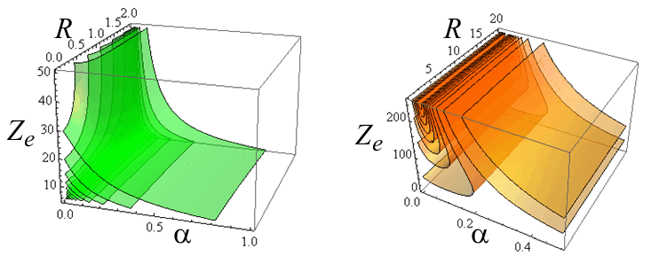
Fig. 9. The level surfaces of intergranular impendence Z_{e} given by (9) as a function of 0 < a < 1, 0 < R < 2, T=80ºC and f = 1(8)80 and for c_{e}=0.1; c=0.01; L=0.001 (left); c_{e}=0.01; R=1; L=0.001 (right); Physical units are neglected.

Slide 43
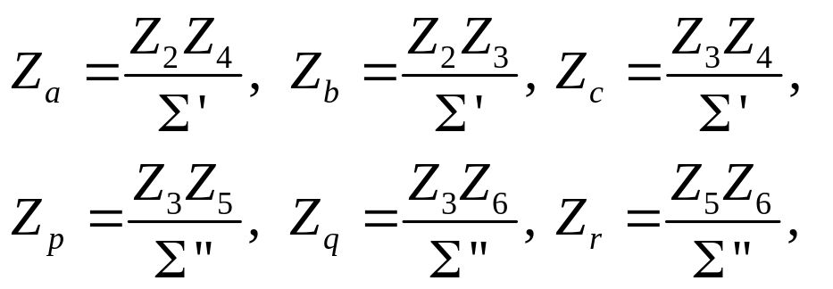


If more than two grains are in contact, and this is the most common case in ceramics bulk, the situation becomes much more complicated. Let the simple case of four grains in contact be considered (Figure 10a). If these grains has four contacts, then the configuration of intergranular impedances will have form of a tetrahedron (Fig. 10b). The equivalent impedance between the grains G₁ and G₄, is the same as between points A and B on tetrahedral scheme. The triangles Z₂Z₃Z₄ and Z₃Z₅Z₆ can be transform in the corresponding “stars” Z_{a}Z_{b}Z_{c} and Z_{p}Z_{q}Z_{r} with
(10)

Slide 44
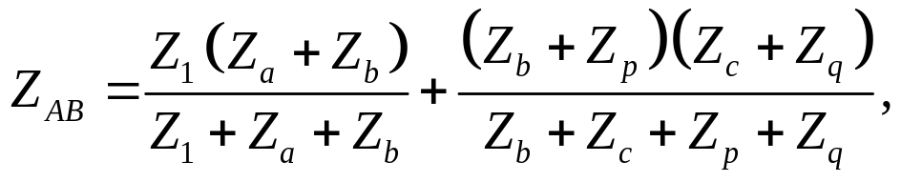
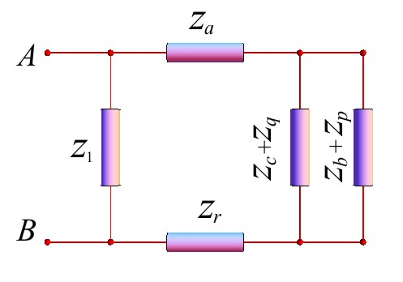
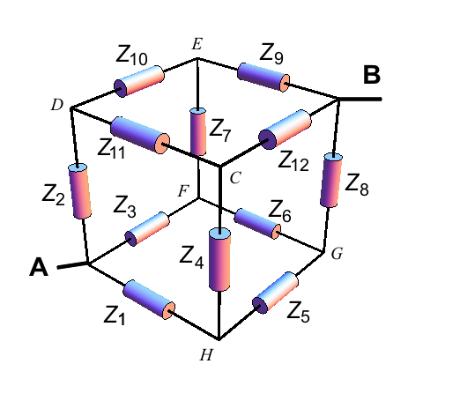
The equivalent circuit is shown in Figure 11, and the final calculation gives
Fig. 10. Left. The equivalent circuit for the four grains contacts. Right. Cube of impedances.

Slide 45
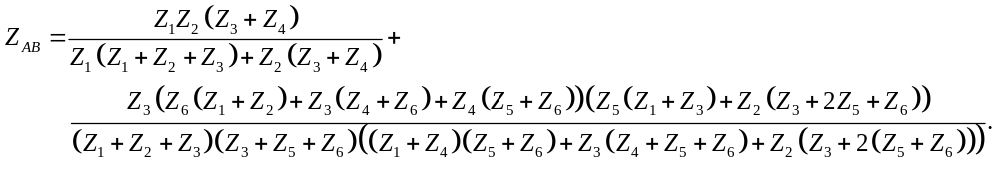
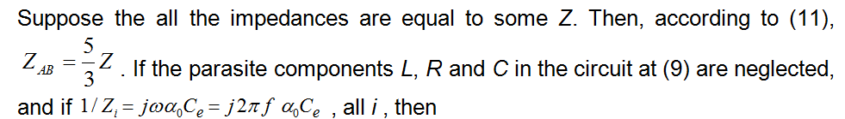
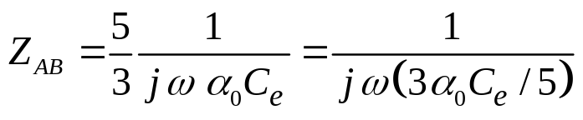
or, taking into account (10), one gets

Slide 46
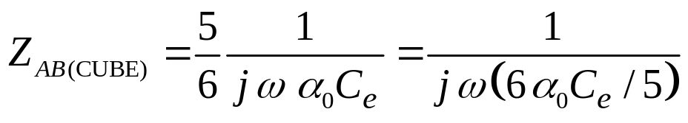
This formula reveals that, the overall capacity in the case of tetrahedral configuration is smaller than the single contact capacity,
C_{AB} = (3/5)a₀ Ce.
Similar calculations in the case of eight grains in contact, arranged in cubic manner (Figure 11, right), gives
and therefore, C_{AB} = (6/5) α₀ Ce, so the capacity of the cubic cluster is bigger than the capacity of a single contact.

Slide 47
OUTLOOK
In this article the doped BaTiO₃-ceramics fractality and some consequences are investigated. It is not new that ceramics, from powder phase through all sintering phases, exhibits fractal structure and microstructure posting the basis for ceramics’ dielectric, ferroelectric, PTCR and piezoelectric properties. Based on previous investigations (papers [7-35]) where some of BaTiO₃-ceramics elements fractality and also for doped BaTiO₃-ceramics were established, a new approach to intergranular capacity is developed. Also, the relationship between the size of contact area and its fractal dimension is formulated. It is shown that the fractal form of an intergranular contact zone may be presented as a chain of micro-capacitors forming one bigger capacitor. It is shown how the capacity increases as the complexity of contact zone increases. The alpha correction of intergranular capacity is introduced to reflect increasing of capacity due fractal character of intergranular contact. The correction factor is a0>1 Next, the pores geometry in BaTiO₃-ceramics material is investigated with conclusion that all pores collection in ceramic body is a fractal object too. The porosity behavior is studied in all of sintering process three phases, Frenkel, Scherer and Mackenzie-Shuttleworth, and corresponding formulas for box-dimension of pores are established. Third source of fractality, except intergranular surface geometry quantified by the factor aS and pore system that yields factor aP, in BaTiO₃-ceramics is interior movements of different particles, subatomic, atomic, molecular etc. Due to its Brownian nature, it also has fractal character defined by the third factor aM. These three factors aS , aP, and aM, are arguments of a functional parameter a that represents all of them. The relationship between a and a0 is established and two different models of grain clustering is considered. Four grains-tetrahedral, that diminishes total capacity of four intergranular contacts for 40% while the eight grains-cubic connection increases it for 20%.

Slide 48
REFERENCES
B. Mandelbrot, The Fractal Geometry of Nature (3ed.), W. H. Freeman, San Francisco, 1983.
B. Mandelbrot, Les objets fractals, forme, hasard et dimension, Flammarion, Paris, 1975.
M. Barnsley, Fractals Everywhere. Academic Press, 1988.
B. H. Kaye, A Random Walk Through Fractal Dimensions, Wiley-VCH 1994.
A. Naman, Mechanical Property and Fractal Dimension Determination in Li2O*2SiO2 Glass-ceramics, University of Florida, 1994.
N. M. Brown, The Fractal Dances of Nature, Penn State News, Wednesday, November 19, 2014. Barnsley M. Fractals Everywhere. Academic Press, 1988.
V. V. Mitić, Lj. M. Kocić, M. M. Ristić, The Interrelations between Fractal and Electrical Properties of BaTiO3-Ceramics, The American Ceramic Society 99th An­nual Meeting and Exposition, Cincinnati, Ohio, May 4-7, p. 199, 1997.
Mitić V.V., Kocić M.Lj., Miljković M., Petković I., Fractals and BaTiO3-Ceramic Microstructure Analysis. Mikrochim. Acta 15, 365-369, Springer-Verlag (1998).
V. V. Mitić, Lj. M. Kocić, Z. I. Mitrović, M. M. Ristić, BaTiO3-Ceramics Microstructure Controlled Using Fractal Methods. Abstract Book of 100th Annual Meeting and Exposition of the American Ceramic Society, May 3-6, 1998, p. 190.
Kocić M.Lj., Mitić V.V., Mitrović I., A Model for Calculating Contact Surfaces of BaTiO3-Ceramics. Science of Sintering, Vol. 30 (1), (1998), pp. 97-104.
P. Petković, V. V. Mitić, Lj. Kocić, Contribution to BaTiO3-Ceramics Structure Ana­lysis by Using Fractals, Folia Anatomica, 26, Suppl. 1, pp. 67-69, 1998.
V. V. Mitić, Lj. M. Kocić, I. Z. Mitrović, M.M. Ristić, Shapes and Grains Structures Stochastic Modelling in Ceramics, Proc. of S4G - International Conference on Stereology, Spatial Statistics and Stochastic Geometry, Prague, Czech Republic, June 21-24, pp. 209-215, 1999.
V. V. Mitić, Lj. M. Kocić, I. Z. Mitrović, Fractals in Ceramic Structure, Proc. of the IX World Round Table Conference on Sintering held in Belgrade from 1-4. September 1998: Advanced Science and Technology of Sintering, edited by Stoja­nović et al, Kluwer Academic/Plenum Publishers, New York, pp. 397-402, 1999.

Slide 49
V. V. Mitić, Lj. M. Kocić, I. Z. Mitrović, Fractals and BaTiO3-Ceramics Intergranular Impedance, Gordon Research Conference: Ceramics, Solid State Studies in Ceramcs, Kimball Union Academy, Meriden, New Hampshire, August 1-6, 1999.
V. V. Mitić, V. B. Pavlović, Lj. Kocić, V. Paunović, D. Mančić, Application of intergranular and fractal impedance model on optimisation of BaTiO3 properties, 33rd International conference and exposition on Advanced ceramics and composites, Daytona Beach, p.14, 2009.
V. V. Mitić, V. B. Pavlović, Lj. Kocić, V. Paunović, D. Mancić, Application of the Intergranular Impedance Model in Correlating Microstructure and Electrical Properties of Doped BaTiO3, Science of Sintering, 41 [3] (2009) 247-256.
V. V. Mitić, V. Paunović, D. Mančić, Lj. Kocić, Lj. Zivković, V. B. Pavlović, Dielectric Properties of BaTiO3 Doped with Er2O3 and Yb2O3 Based on Intergranular Contacts Model, Ceramic Transactions, 204 (2009) 137-144.
V. V. Mitić, V. Paunović, V. B. Pavlović, Lj. Kocić, M. Miljković, Lj. Živković, Fractal analysis of the microstructure of BaTiO3 ceramics, EMAS 2009, p. 270.
V. V. Mitić, V. B. Pavlović, Lj. Kocić, V. Paunović, D. Mančić, Intergranular Fractal Impedance analysisof Microstructure and electrical properties Model on Optimization of BaTiO3 Properties, Advances in Electronic Ceramics II, vol. 30 br. 9, str. 79-91, (2010).
V. V. Mitić, V. Pavlović, Lj. Kocić, V. Paunović, J. Purenović, J. Nedin, M. Miljović, Advanced electroceramics microstructure fractal analysis, 4th Serbian Congress for Microscopy, 4SCM 2010, pp.61-62, 2010.
V. V. Mitić, V. Pavlović, Lj. Kocić, V. Paunović. Lj. Živković, Fractal geometry and properties of doped BaTiO3 ceramics, CIMTEC 2010, Italy, p.93, 2010.
V. V. Mitić, V .B. Pavlović, Lj. Kocić, V.Paunović, M. Miljković, Lj. Živković: Fractals and Intergranular contacts if doped BaTiO3, Electronic Materials and aplications 2010, USA, p. 43.
J. Purenović, V.V. Mitić, L. Kocić, V. B. Pavlović, V. Paunović, and M. Purenović. 2011. Electrical Properties and Microstructure Fractal Analysis of Magnesium-Modified Aluminium-Silicate Ceramics. Science of Sintering 43 (2): 193-204.

Slide 50
V. V. Mitić, V. Paunović, J. Purenović, Lj. Kocić, V. Pavlović. The processing parameters influence on BaTiO3-ceramics fractal microstructure and dielectric characteristics. Advances in Applied Ceramics: Structural, Functional and Bioceramics Vol 111, No. 5&6, pp.360-366, 2012.
V.V. Mitić, V. Paunović, J. Purenović, S. Janković, Lj. Kocić, I. Antolović, D. Rančić, The contribution of fractal nature to BaTiO3-ceramics microstructure analysis, Ceramics International 2012 38 (2):1295-1301.
J. Purenović, V. V. Mitić, Lj. Kocić, V. Pavlović, M. Randjelović, M. Purenović, Intergranular area microalloyed aluminium-silicate ceramics fractal analysis, Science of sintering, 45 (1): 117-126. 2013.
V. V. Mitić, Lj. M. Kocić, V. Paunović, V. Pavlović, BaTiO3-ceramics sintering parameters fractal corrections, new frontiers, Science of Sintering, 46 (2014) 149-156.
V. V. Mitić, V. Paunović, Lj. M. Kocić, Dielectric properties of BaTiO3-ceramics and Curie-Weiss and modified Curie-weiss affected by fractal morphology, Materials Science & Technology 2014, October 12-16, Pittsburgh PA.
V. V. Mitić, V. Paunović, Lj. M. Kocić, Curie-Weiss Low Fractal Modification, Materials Science & Technology 2014, October 12-16, Pittsburgh PA.
V. V. Mitić, V. Paunović, Lj. M. Kocić, Slobodanka Janković, Enriched Schottky Barrier Affected by Fractality of BaTiO3 Ceramics, Materials Science & Technology 2014, October 12-16, Pittsburgh PA.
V. V. Mitić, S. Z. Nikolić, Lj. Kocić, M. M. Ristić, Dielectric Properties of Barium-Titanate Ceramics as a Function of Grain Size. Advances in Dielectric Ceramic Materials, Ceramic Transactions, Volume 88, 215-223, (1998).
V. V. Mitić, Lj. Kocić, Z. I. Mitrović, Fractals and BaTiO3-Ceramics Intergranular Impedance, Gordon Research Conference: Ceramics, Solid State Studies in, Kimball Union Academy, Meriden, New Hampshire, August 1-6, 1999.
V. V. Mitić, Lj. Kocić, Z. I. Mitrović, Primena fraktala u modelu intergranularne impedanse BaTiO3-keramičkih materijala. Naučni skup: "Trijada Sinteza-Struktura-Svojstva-Osnova tehnologije novih materijala", Beograd, Novembar 16-18, 1999, str. 65-66.

Slide 51
V.V. Mitić, V. Paunović, Lj. Kocić, Dielectric Properties of BaTiO3 Ceramics and Curie-Weiss and Modified Curie-Weiss Affected by Fractal Morphology, in: Advanced Processing and Manyfacturing Technologies for Nanostructured and Multifunctional Materials (T. Ohji, M. Singh and S. Mathur eds.), Ceramic Engineering and Science Proceedings, Vol. 35 (6) 2014, pp. 123-133.
P. Gaspard, Chaos, Fractals And Thermodynamics, Bulletin de la Classe des Sciences de l’Acad´emie Royale de Belgique, 6e s´erie, tome XI (2000) 9-48.
Л. Е. Гегузин, Н. И. Овчаренко, Поверхностная энергия и процессы на поверхности твердых тел, Успехи Ф. Н. (1962) 76 (2), 283-324.
Я. И. Френкель, О поверхностном ползании частиц у кристаллов и естественная шероховатость естественных граней, ЖЭТФ 16 (1),(1948).
Smirnov B.M., Physics of fractal clusters, Contemporary problems in Physics, Nauka, Moscow 1991.

