Slide 1


STIMULI-SENSITIVE COMBINATION NANOPREPARATIONS OF siRNA AND CHEMOTHERAPEUTIC DRUGS TO TREAT MULTIDRUG RESISTANT CANCER
Vladimir Torchilin, Ph.D., D.Sc.
Center for Pharmaceutical Biotechnology and Nanomedicine, Northeastern University, Boston, MA 02115, USA
Las Vegas, October 27-29, 2014

Slide 2
The idea of combination therapy of multidrug resistant (MDR) tumors is based on using siRNA down-regulating proteins involved in tumor defense mechanisms (Pgp, survivin, Bcl2) together with traditional chemotherapeutics.
Problems: - stabilization and delivery siRNA in vivo;
- synchronization of drug and siRNA;
- co-loading of a drug and siRNA on the
same nanocarrier

Slide 3
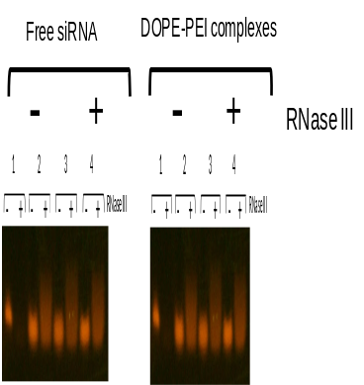
Challenges with siRNA delivery
Even after almost 15 years since RNAi was described by Fire and Mello, there are no FDA approved, siRNA-based therapies, for the treatment of cancer. Eight siRNA-based formulations, for cancer therapy, are currently in the different phases of clinical trials*
Problems**
Rapid degradation by serum nucleases
Poor cellular uptake due to inherent anionic charge
RNase III
* Davidson, B. L., & McCray, P. B. (2011). Current prospects for RNA interference-based therapies. Nature Reviews Genetics, 12(5), 329-340.
** Adapted from Navarro, G., S. Essex et al. Drug Delivery and translational medicine (2011)
Notes:
Brief intro abt siRNA 20-25nt result of dsRNA cleavage in eukaryotes by Dicer protein, base pair to mRNAs and prevent translation hence powerful tool for gene silencing. siRNA degradation in blood- few minutes. Time? Why RNase III chosen- specific to dsRNA, 1U/mcg siRNA. Poor cellular uptake reason – negative charge due to phosphate backbone? Charge? B16F10 – murine melanoma cells what? Read about Hoechst - The dyes bind to the minor groove of double-stranded DNA with a preference for sequences rich in adenine and thymine , Lysotracker – fluorescent aciditropic dye

Slide 4
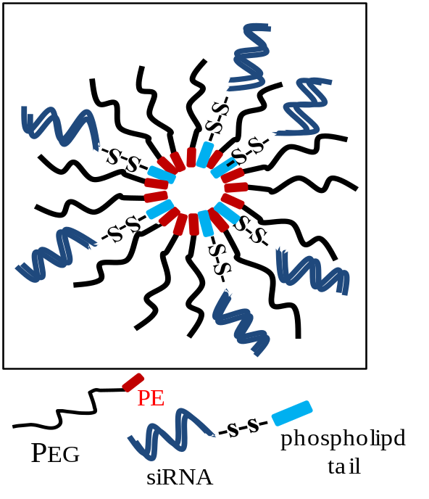
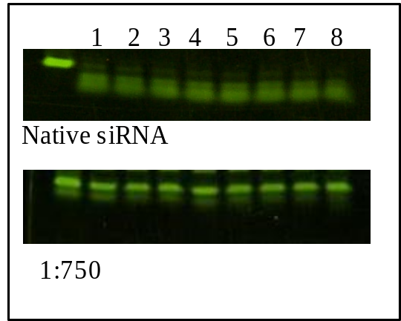
New system for effective stabilization and delivery of siRNA:
Reversible siRNA-phospholipid conjugate in PEG-PE polymeric mixed micelles
Left panel: Schematic structure of siRNA-PE/PEG-PE mixed micelles.
Right panel: stability of siRNA against nucleolysis in 1:750 mixed micelles compared to that of the free siRNA at different time-points till 24 h

Slide 5
Gene silencing of different formulations containing a 84 nM concentration of siRNA
Cell viability on GFP-C166 after
a 48 h incubation of different siRNA formulations
40
35
100
30
84.00
79.45
25
75
% of gene silencing
20
% of cell viability
50
15
10
25
18.33
5
0
0
siRNA/
lipofectamine
naked siRNA
1:750
1:200
1:500
1:750
Formulations
Formulations
Left panel: % of gene silencing induced in GFP-C166 cells (comparison between naked siRNA and siRNA-PE in 1:750 mixed micelles formulation).
Right panel: cell viability in the presence of various siRNA-PE-containing PEG-PE-based formulations in comparison with same amount of siRNA used as the Lipofectamine formulation.

Slide 6
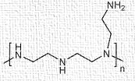
Polyethylenimine (PEI)-based siRNA micelle-like nanocarriers
Pros*
Proton sponge effect due to cationic nature
Synthetic flexibility (Linear/branched)
Cationic charge condenses siRNA and facilitates cell uptake
Low molecular weight PEI (1.8 kDa) is non-toxic
Cons*
Toxicity (High molecular weight > 25kDa)
Non-specific interaction with serum proteins
RES mediated removal

Slide 7
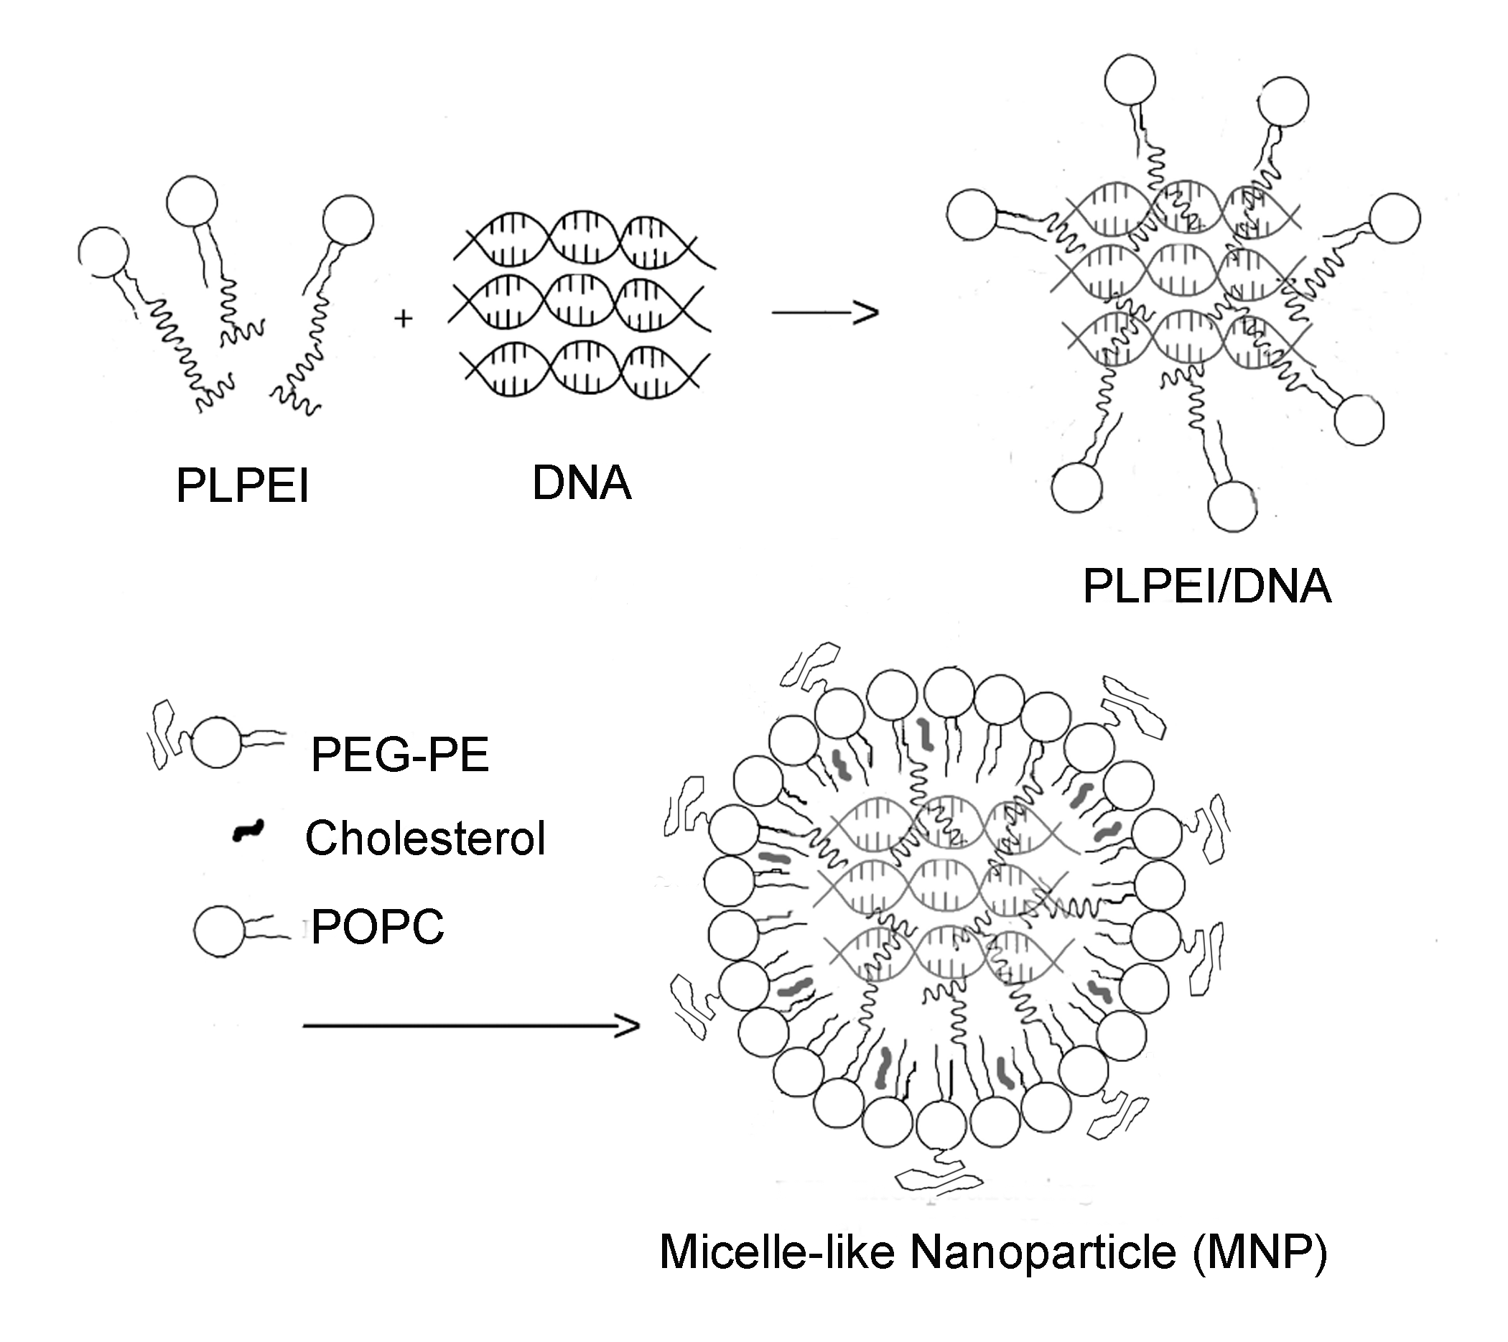
Self-assembly PEI-lipid nanoparticles
Driven by electrostatic interaction (DNA/siRNA complexation) followed by hydrophobic interaction (formation of lipid monolayer coat )
Simple and quantitative DNA/siRNA loading procedure
High DNA/siRNA loading capacity (30 wt%)
Combine polyplexes with sterically-stabilized micelles

Slide 8
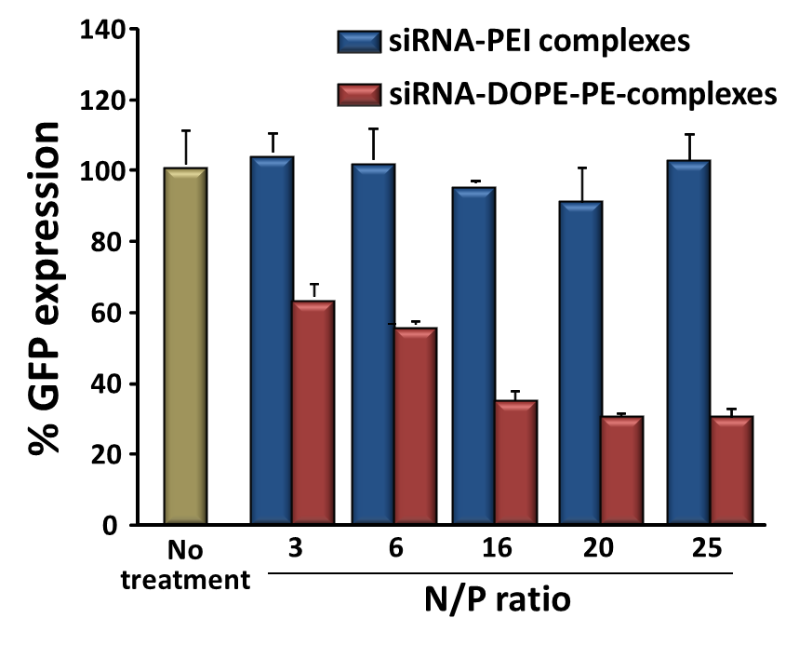
Gene silencing efficacy of the PEI–lipid/siRNA(GFP) complexes in cells that stably express GFP
GFP flourescence was measured by cytometry. The absence of GFP suppression was observed for non-modified PEI complexes, while a 75 % GFP signal reduction was seen for PEI-PE complexes.

Slide 9
Endosomal escape of DOPE-PEI
Positive chloroquine lysomotropic dependency seen in case of DPPE-PEI not in the case of DOPE-PEI
Bafilomycin abolished the GFP downregulation ability of DOPE-PEI and not DPPE-PEI
The greater efficacy of DOPE-PEI in the gene downregulation is due to its ability for endosomal escape
Navarro, Essex et al. , Nanomedicine, (USA) 2013
Notes:
Pre-incubation for 1 hr with 50nM CQ and 175nM BFA

Slide 10
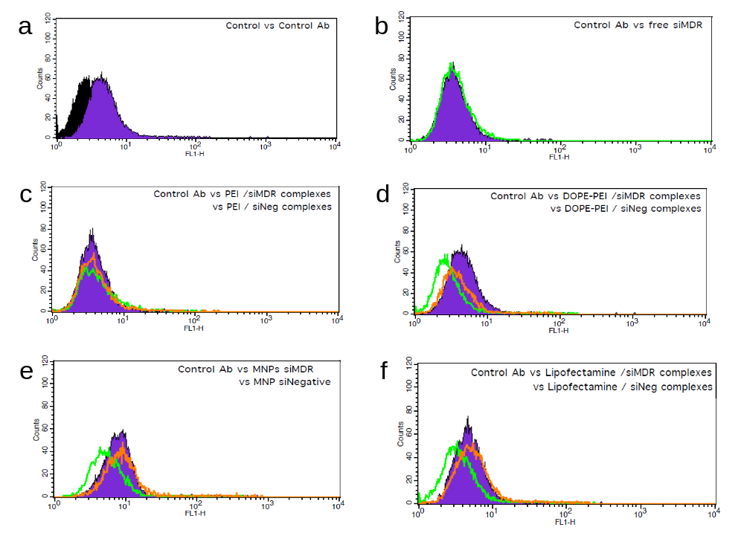
P-glycoprotein (P-gp) downregulation by DOPE-PEI-based nanocarriers
The in vitro tumor model chosen was the drug resistant, human breast cancer MCF7/ADR cells
DOPE-PEI-based complexes and MNPs containing siMDR1 (siRNA targeting MDR1 gene) successfully downregulated the surface expression of P-gp
Navarro, Essex et al., Nanomedicine (Lond.), 2012

Slide 11
ADDING STIMULI SENSITIVITY

Slide 12
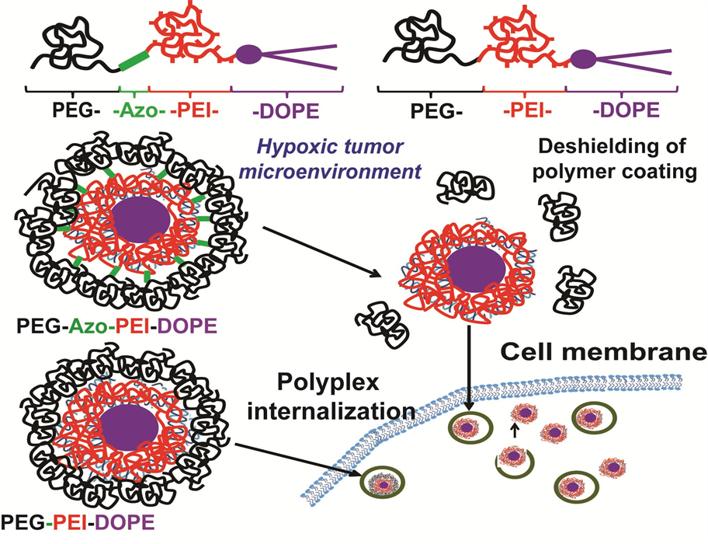
A schematic structure of the nanosystem to target siRNA and drugs to hypoxic areas in tumors

Slide 13
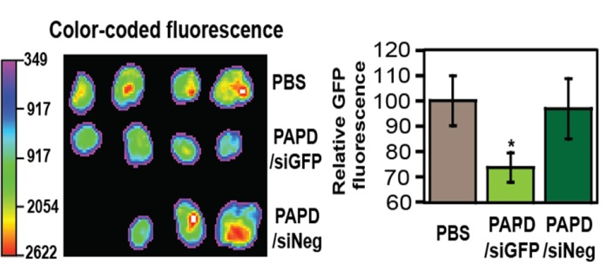
In vivo silencing activity
A
B
A - Ex vivo fluorescence optical imaging of tumors 48h after injection of PBS , PEG-Az-PEI-PE/anti-GFP siRNA complexes (PAPD/siGFP, n=4), PEG-Az-PEI-DOPE/negative siRNA complexes
B - Cell-associated fluorescence of dissociated tumors by flow cytometry

Slide 14

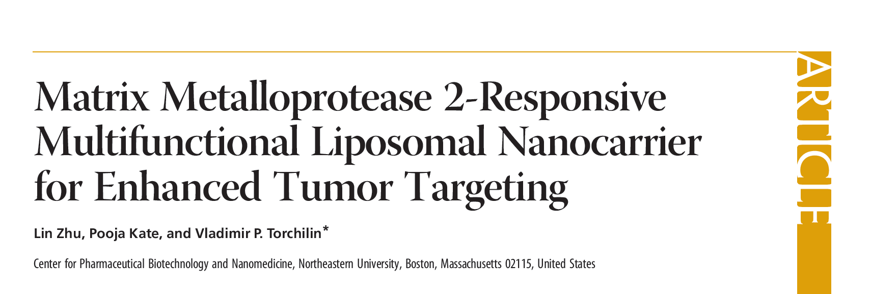
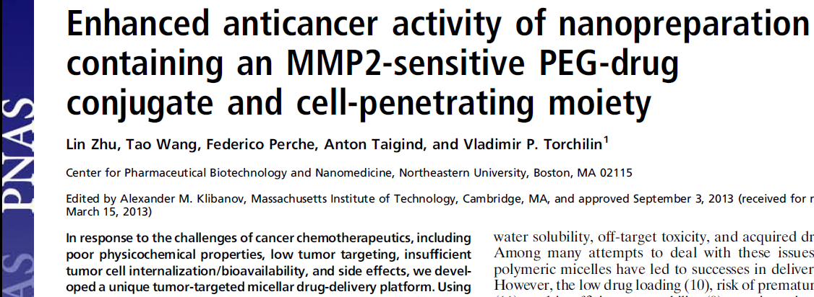
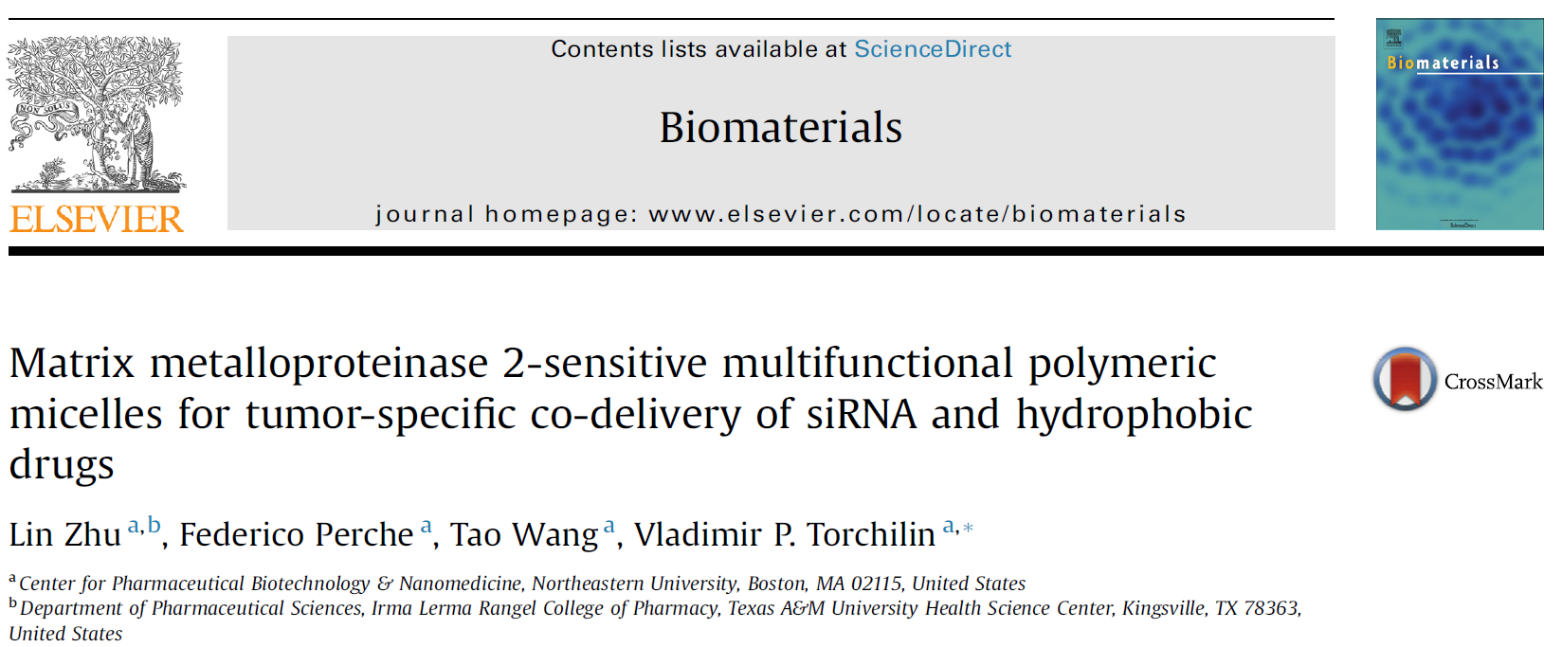

Slide 15
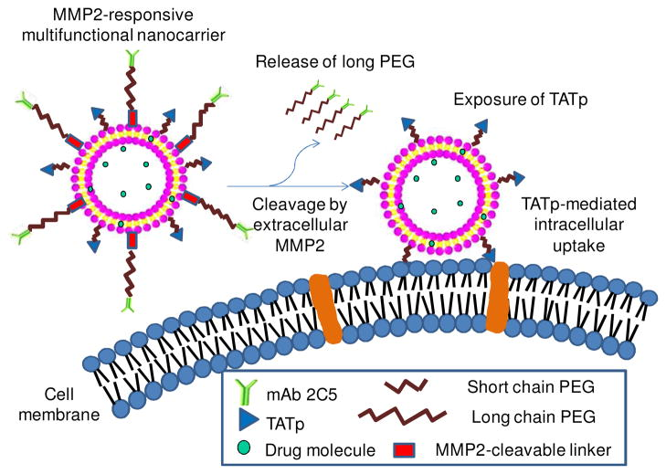

Slide 16
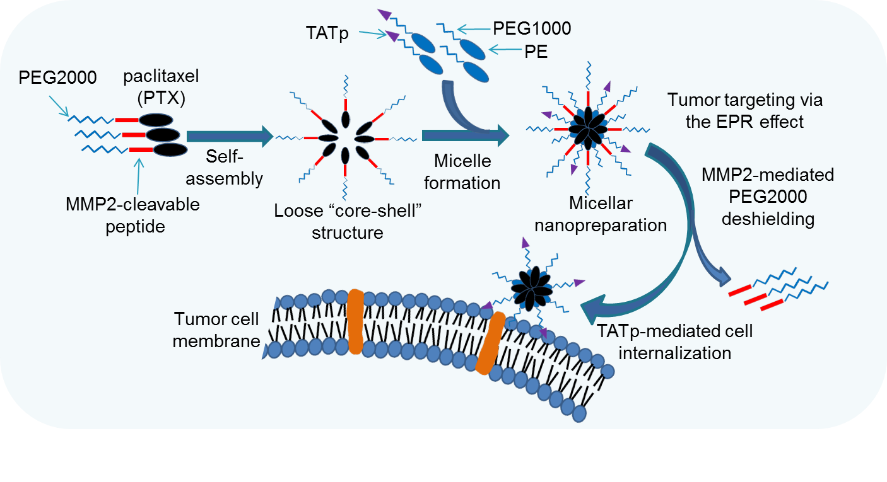
Nanopreparation Containing MMP2-sensitive PEG-paclitaxel Conjugate and Cell Penetrating Moiety
PEG1000-PE: a building block for nanocarrier
TATp-PEG1000-PE: a cell-penetrating moiety
PEG2000-peptide-PTX: (1) an MMP2-cleavable prodrug
(2) a self-assembly building block
PE, phosphatidylethanolamine
Zhu L, et al. (2013), PNAS, 110(42):17047-52.
Zhu L, et al., Patent No. PCT/US2013/072216.

Slide 17
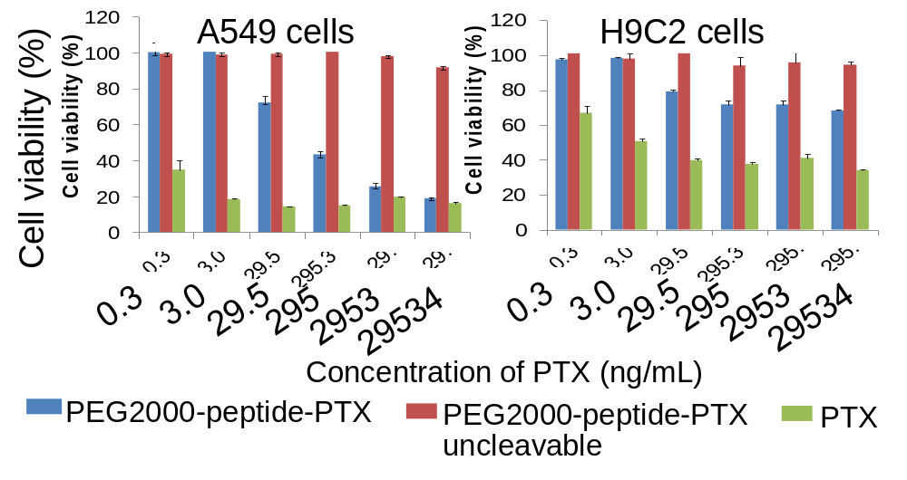
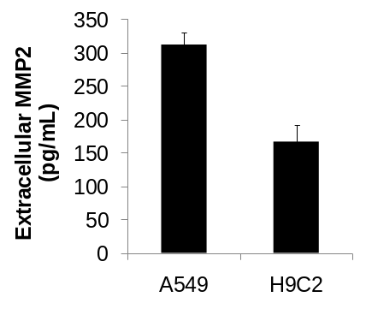
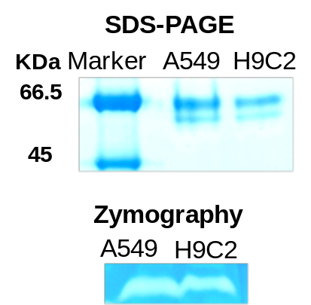

MMP2-triggered Tumor Cell-specific Cytotoxicity
A
B
Cytotoxicity in A549 and H9C2 cells (A)
Incubation time: 72h
MMP2 secretion
The 2-day media was concentrated and analyzed using SDS-PAGE (B) and zymography (C).
Human MMP2 (EMD Biosciences): 66.5K Da
MMP2 ELISA (D)
The media was directly analyzed by MMP2 ELISA kit (sensitivity < 10pg/mL, Boster Immunoleader ).
D
MMP2 ELISA
SDS-PAGE
KDa
Marker
A549
H9C2
66
45
C
Zymography
A549
H9C2

Slide 18
COMBINATION THERAPY

Slide 19
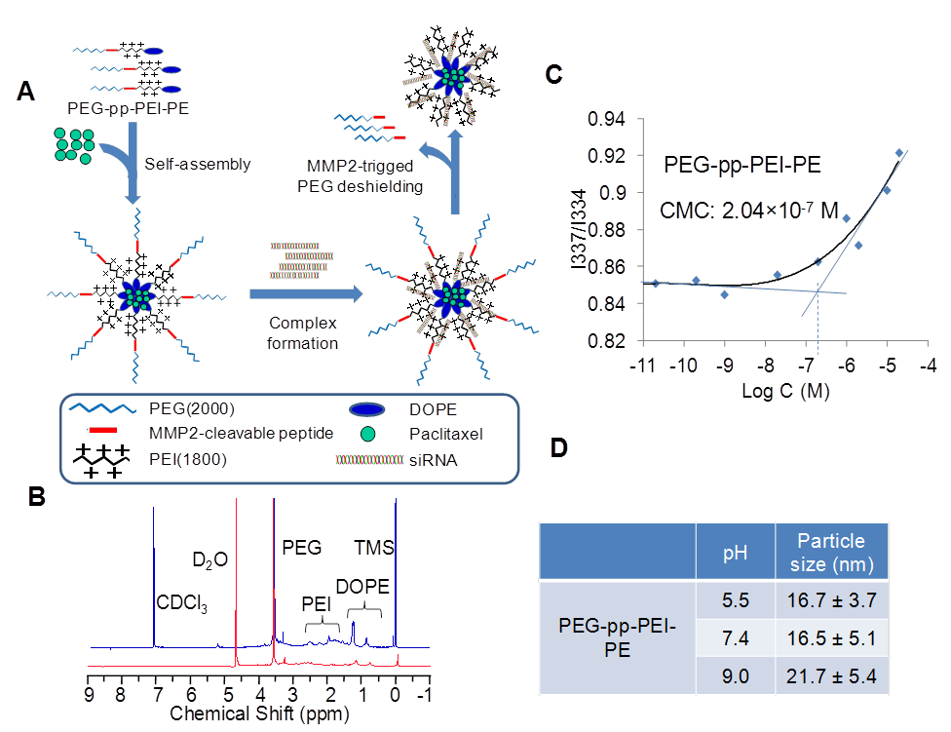

Slide 20
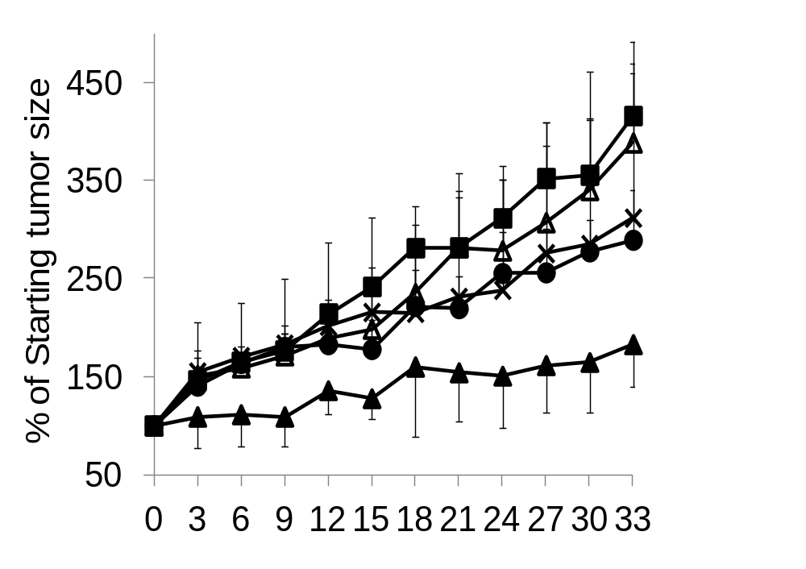

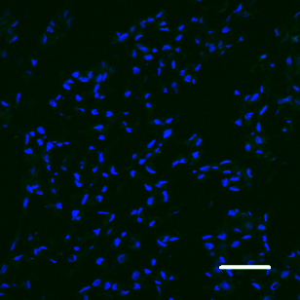
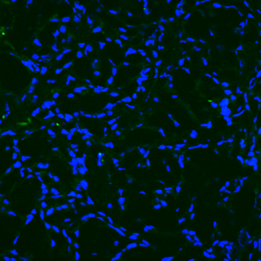
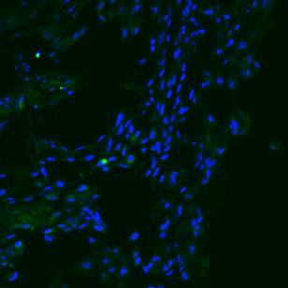
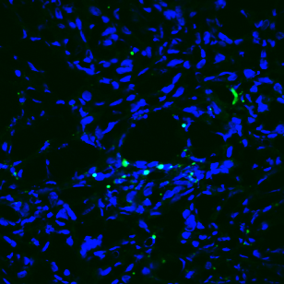
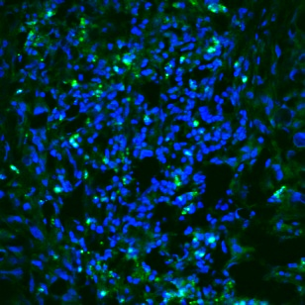
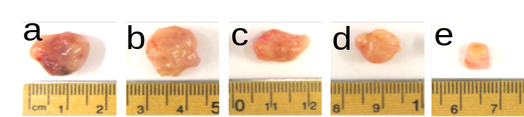
Tumor Growth Inhibition and Tumor Cell Apoptosis
A
B
a
d
a
b
c
b
e
c
50µm
50µm
*
*
*
*
d
e
Days post-administration
a, HBSS; b, TATp-PEG1000-PE/PEG2000-peptide-PTX (nonsensitive); c, PEG2000-PE/PTX; d, Free PTX; e, TATp-PEG1000-PE/PEG2000-peptide-PTX (MMP2-sensitive)
Tumor growth inhibition (A) and tumor cell apoptosis analyzed by TUNEL assay (B). Dose: 5mg/Kg PTX.

Slide 21
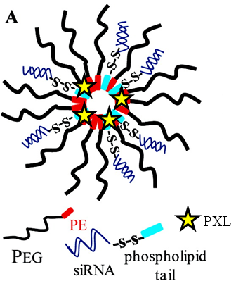
A . Schematic structure of survivin siRNA-S−S-PE/PXL PEG-PE mixed micelle.
B. Physic characteristics of survivin siRNA PM and PM containing survivin siRNA and PTX in combination (survivin siRNA/PXL PM)
A
B
Formulation | Diameter (nm ± SD) | P.I. ± SD
Survivin siRNA PM | 21.5 ± 3.3 | 0.160 ± 0.05
Survivin siRNA/PXL PM | 25.0 ± 3.6 | 0.190 ± 0.07

Slide 22
Doxorubicin cytotoxicity in (A) resistant and (B) sensitive MCF-7 cells after treatment with siRNA nanopreparations
A
120
B
Doxorubicin alone
80
Doxorubicin alone
100
Free siRNA-MDR-1
Free siRNA-MDR-1
siRNA-MDR-1
nanopreparation
60
siRNA-MDR-1
nanopreparation
80
Cell Viability (%)
Cell Viability (%)
60
40
40
20
20
MCF-7 RESISTANT
MCF-7 SENSITIVE
0
0
24 h
48 h
72 h
96 h
24 h
48 h
72 h
96 h
Doxorubicin incubation time
Doxorubicin incubation time
MCF-7 resistant and sensitive cells were treated with formulations prepared with siRNA targeting MDR-1 (siMDR). Cells were treated with doxorubicin (1µg/mL) for 24, 48, 72 and 96 h and cell viability was measured. Data are expressed as the mean ± SD (n=3).

Slide 23
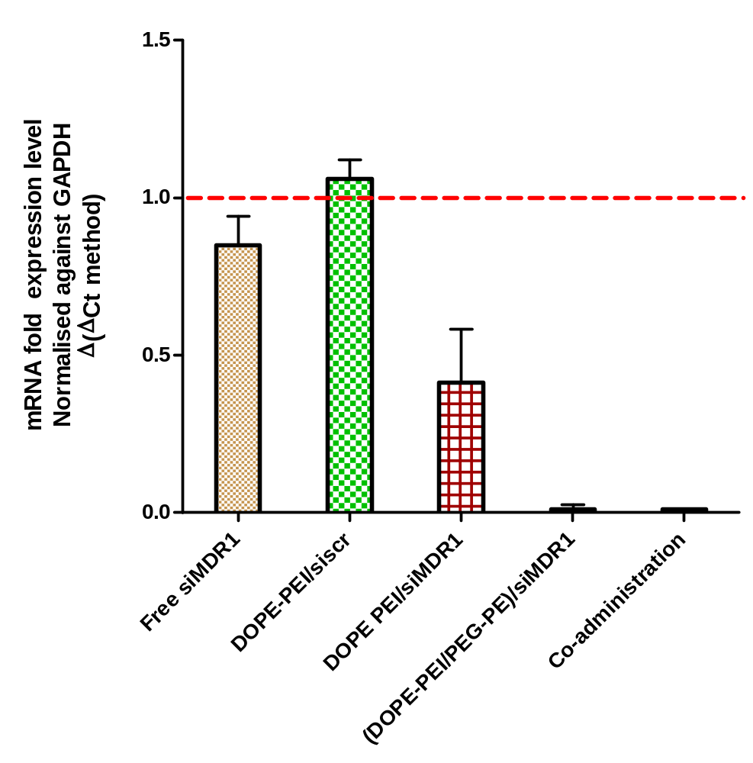
PCR to evaluate MDR1 downregulation in tumors
All treatment groups significantly down regulated the MDR1 gene with respect to the control groups
#, ^ and * - Respective treatment groups are statistically very significant than free siMDR1 and DOPE-PEI
” - Treatment groups statistically significant than DOPE-PEI/siMDR1
#
^”
*”

Slide 24
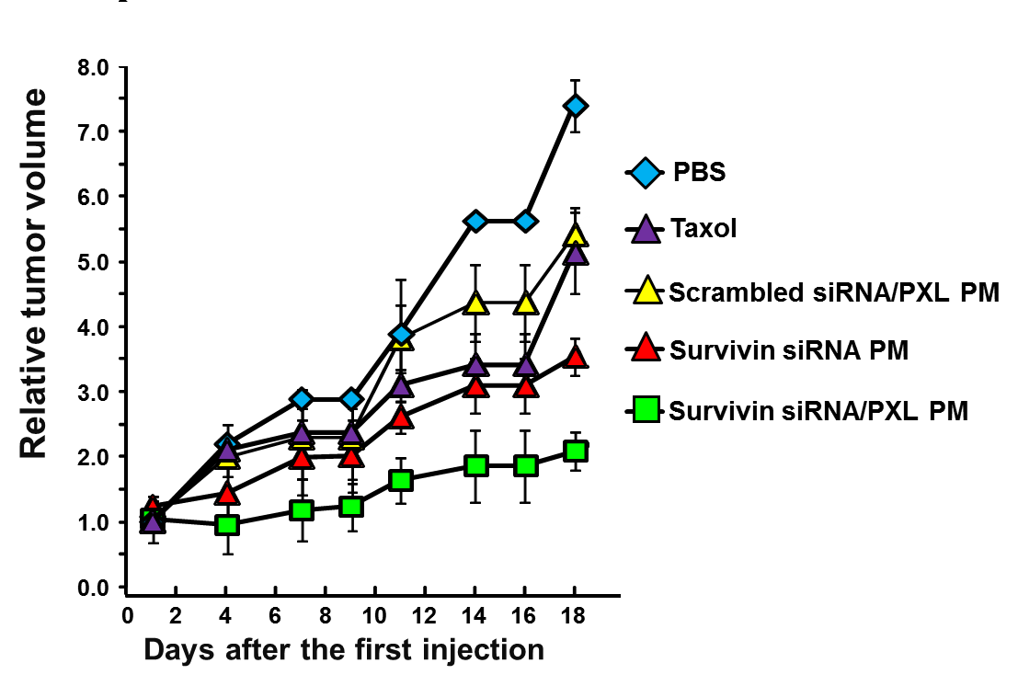
Therapeutic efficacy of NP containing survivin siRNA and PXL in combination on SKOV3-tr resistant ovarian cancer xenograft
*Relative tumor volume: Tumor volume in mm³ on day ‘n’ (Vn) / tumor volume at the start of the treatment (Vo) plotted versus time in days.

Slide 25
NEW CONCEPTS IN COMBINATION THERAPY USING LIPOSOMAL DRUGS

Slide 26
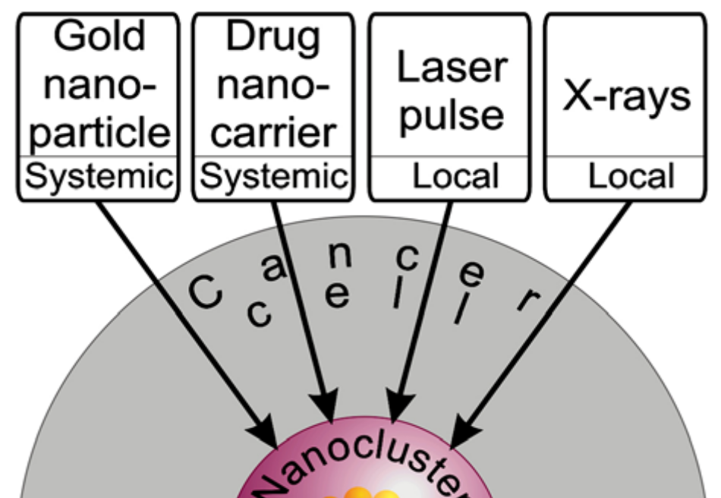
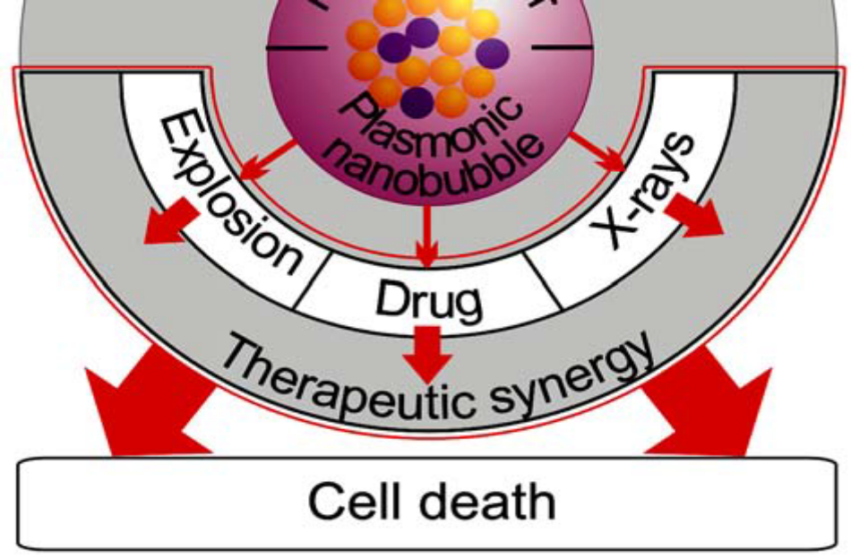

Slide 27
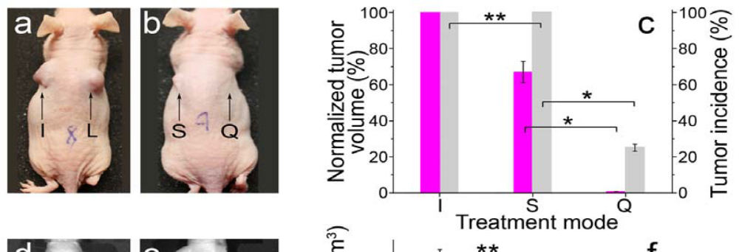
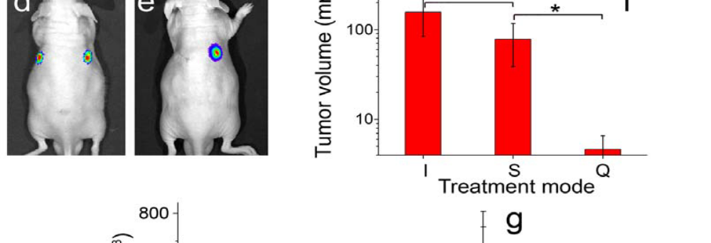
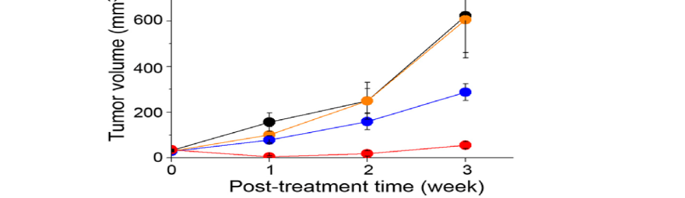
Quadrapeutics treatment of HNSCC in mouse models

Slide 28
