Slide 1



About OMICS Group
OMICS Group International is an amalgamation of Open Access publications and worldwide international science conferences and events. Established in the year 2007 with the sole aim of making the information on Sciences and technology ‘Open Access’, OMICS Group publishes 500 online open access scholarly journals in all aspects of Science, Engineering, Management and Technology journals. OMICS Group has been instrumental in taking the knowledge on Science & technology to the doorsteps of ordinary men and women. Research Scholars, Students, Libraries, Educational Institutions, Research centers and the industry are main stakeholders that benefitted greatly from this knowledge dissemination. OMICS International also organizes 500 International conferences annually across the globe, where knowledge transfer takes place through debates, round table discussions, poster presentations, workshops, symposia and exhibitions.

Slide 2
About OMICS International Conferences
About OMICS Group
OMICS International is a pioneer and leading science event organizer, which publishes around 500 open access journals and conducts over 300 Medical, Clinical, Engineering, Life Sciences, Pharma scientific conferences all over the globe annually with the support of more than 1000 scientific associations and 30,000 editorial board members and 3.5 million followers to its credit.
OMICS International has organized 500 conferences, workshops and national symposiums across the major cities including San Francisco, Las Vegas, San Antonio, Omaha, Orlando, Raleigh, Santa Clara, Chicago, Philadelphia, Baltimore, United Kingdom, Valencia, Dubai, Beijing, Hyderabad, Bengaluru and Mumbai.

Slide 3


Metabolomics study of Ketosis-Associated Increases in FGF21 in Wild-type and PPAR alpha Knockout Mice.
Vladimir Tolstikov, Ph.D.
4th International Conference and Exhibition on
Metabolomics & Systems Biology
April 27-29, 2015, Philadelphia, USA

Slide 4
Presentation overview
Analytical Platform and workflow.
Case study
- FGF21 (Hepatic dietary adaptation)
Summary

Slide 5
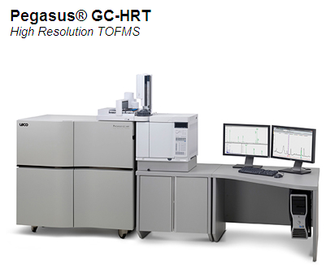
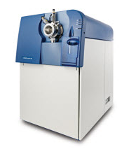
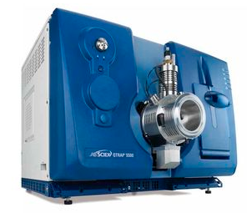
Lilly Metabolomics Platform
Ultimate combination of targeted and non-targeted approaches.
Volatiles | Alchohols | Organic acids
Essential oils | Amino acids | Organic amines
Esters | Catecholamines | Nucleosides
Perfumes | Fatty acids | Nucleotides
Terpenes | Phenolics | Oligosaccharides
Carotenoids | Prostanglandins | Peptides
Flavanoids | Steroids | Co-factors
Perfumes | Sugar phosphates | Polar Lipids
GC/MS
LC/MS
PEGASUS GC-HRT accurate mass TOF
Gerstel ALEX/CIS MultiPurpose Autosampler
Triple quad 5500
Triple TOF 5600 accurate mass
Throughput capabilities 7000 - 15000 samples per year

Slide 6
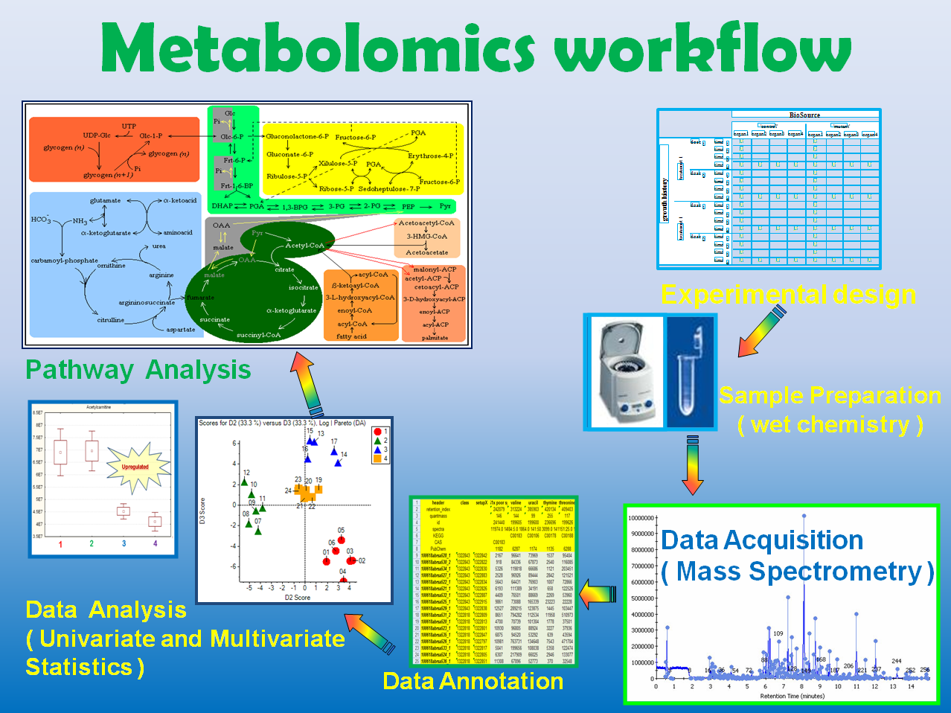
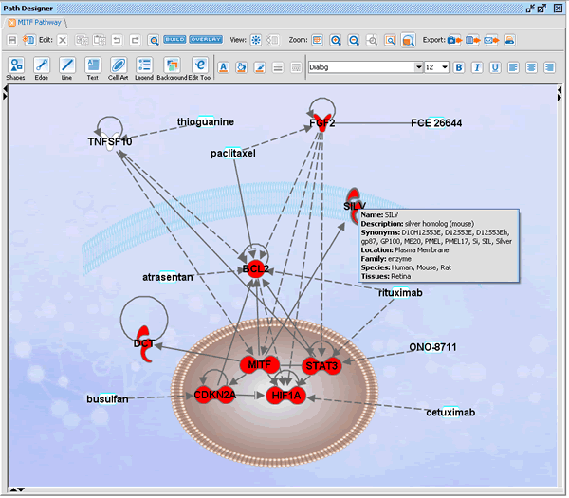
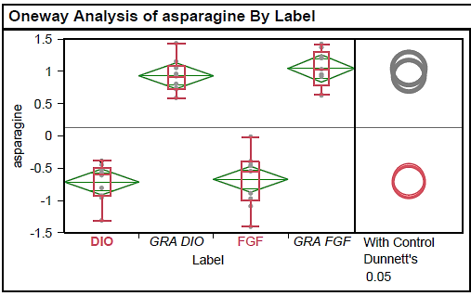
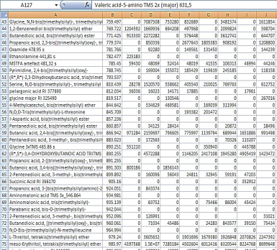
Data pre-processing

Slide 7
A
Workflow
Sample Harvest
and Storage
Biological Metadata
Sample Extraction
Extraction Metadata
Standard Operational
Procedure
Sample Preparation
Internal standards, Derivatization
Experiment
Submission
Sample Analysis
Standards QC, pooled QC, randomization
Chromatography Metadata
Mass Spectrometry Metadata
Raw Data
Metabolite Peak
Annotation
Data normalization, background subtraction, missing values
Analytical
Protocols
Processed Data Collection
and Organization
Statistical Analysis
Pathway Analysis

Slide 8
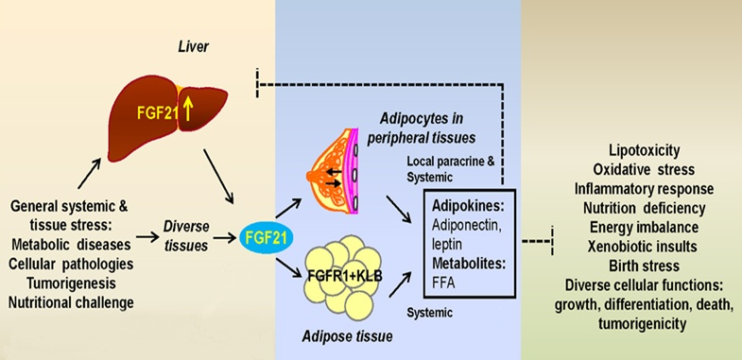
Case Study: FGF21 dietary induction
Adapted from Luo and McKeehan (2013)
Fasting &
Ketogenic diet
PPARa
In mice FGF21 is strongly induced in liver by prolonged fasting via PPAR-alpha and in turn induces the transcriptional coactivator PGC-1α and stimulates hepatic gluconeogenesis, fatty acid oxidation, and ketogenesis. Wiki
FGF21 regulates mitochondrial activity and enhances oxidative capacity in adipocytes, resulting in increased phosphorylation of AMPK, increased cellular NAD+ levels and activation of SIRT1. Wiki

Slide 9
Study design
1- wild type fed with chow diet,
2- PPARa knockout mice fed with chow diet,
3- wild type fed with ketogenic diet,
4- PPARa knockout mice fed with ketogenic diet,
5-wild type fed fasting,
6- PPARa knockout mice fed fasting.
Each group contained 5 animals
Treatments – 24 hours
Liver samples were harvested for metabolomics analyses

Slide 11
Fasting and ketogenic diet induce different FGF21 responses in WT and PPAR alpha KO mice
Plasma FGF21 levels correlate with liver expression changes.

Slide 12
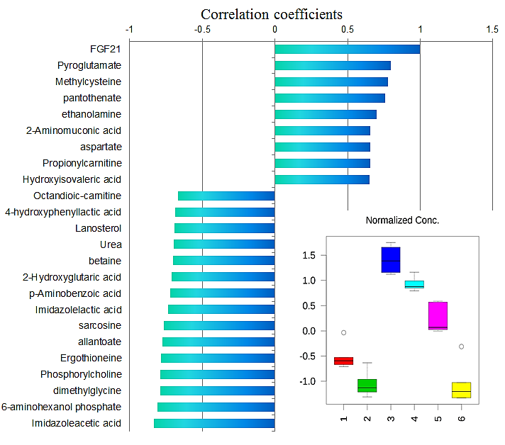
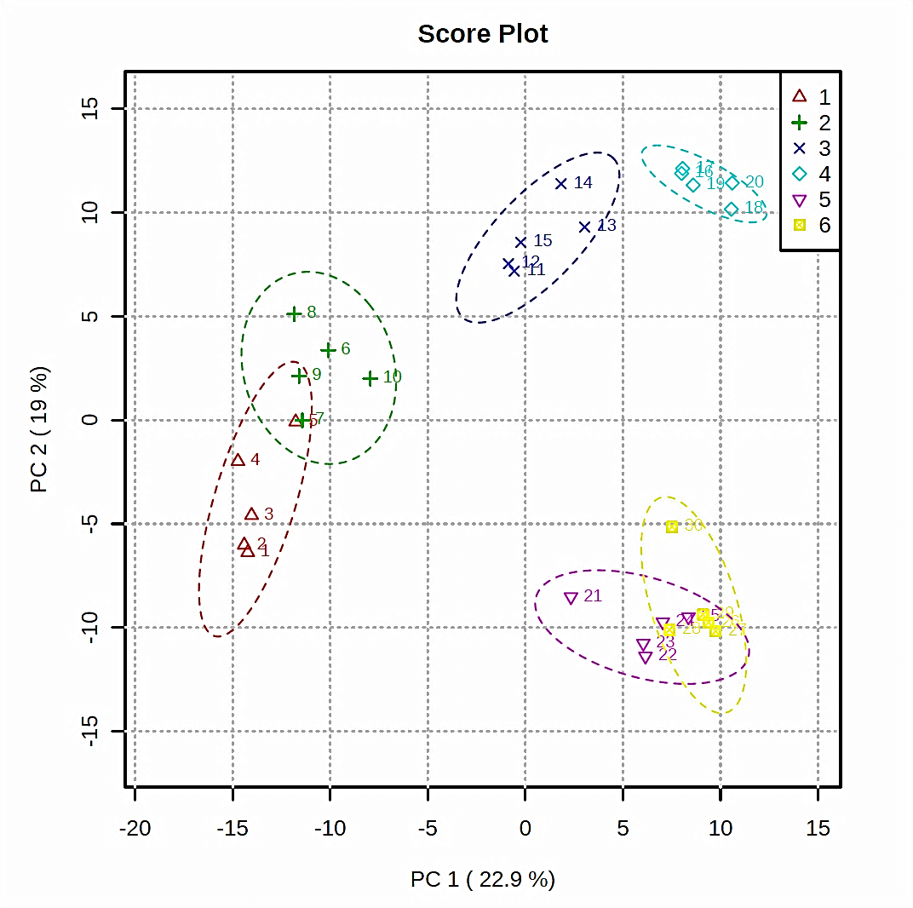
FGF21
1- wild type fed with chow diet, 2- PPARa knockout mice fed with chow diet,
3- wild type fed with ketogenic diet, 4- PPARa knockout mice fed with ketogenic diet,
5- wild type fed fasting, 6- PPARa knockout mice fed fasting.
Liver samples were analyzed using global metabolomics - > 300 metabolites

Slide 13
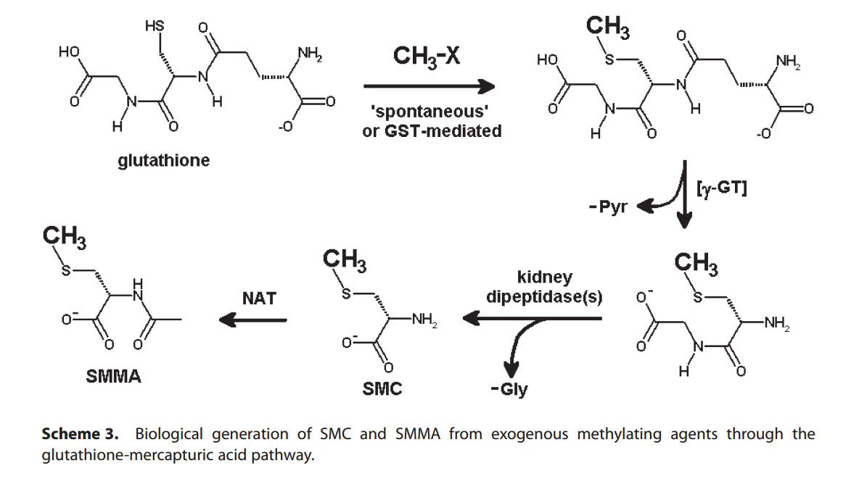
Measurement of S-methylcysteine and S-methyl-mercapturic acid in human urine by alkyl-chloroformate extractive derivatization and isotope-dilution gas chromatography–mass spectrometry, Biomed. Chromatogr. 2011; 25: 330–343

Slide 14
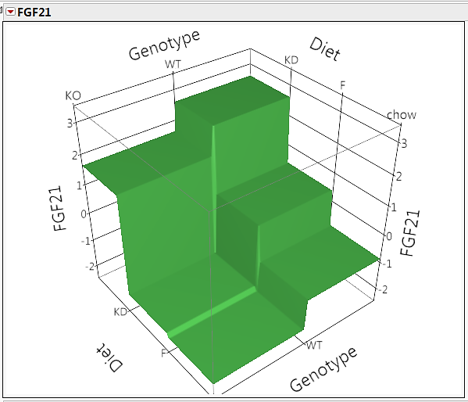
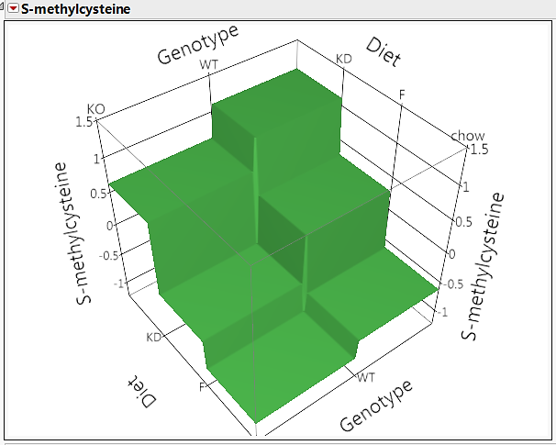
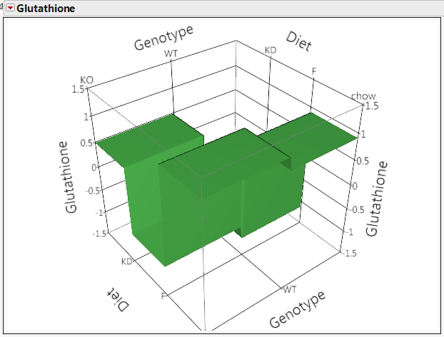
Glutathione-mercapturic pathway. γ-GT - Gamma-glutamyltransferase, dipeptidase – hepatic cysteinylglycine S-conjugate dipeptidase

Slide 15
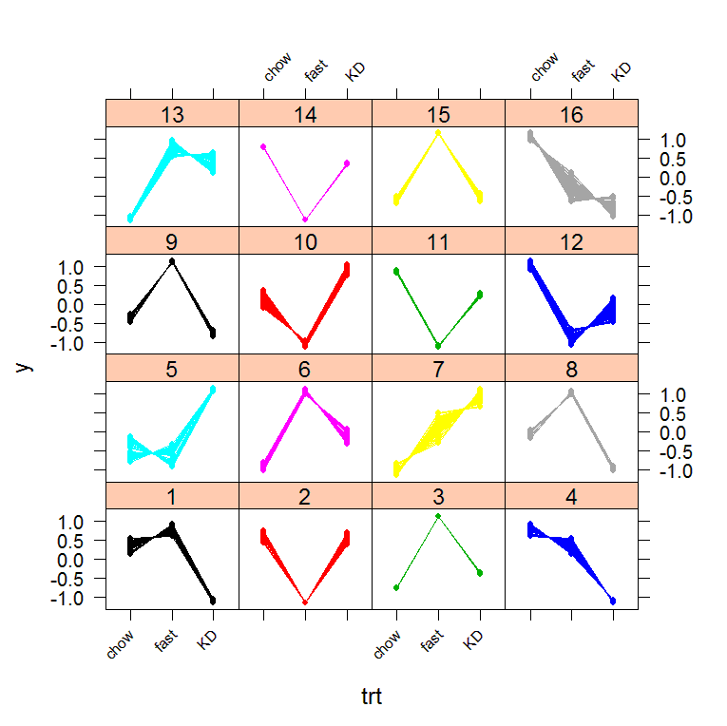
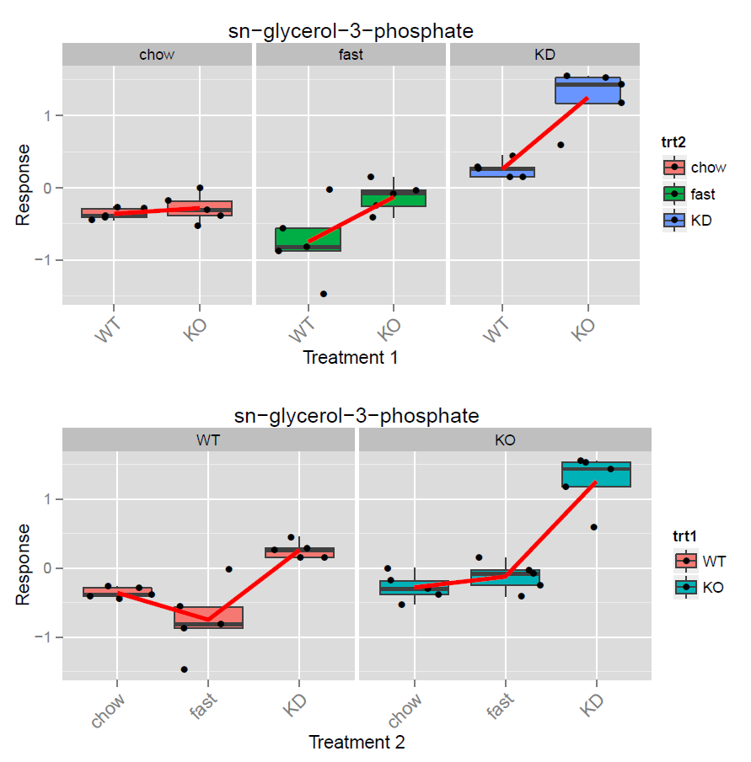
Curve clustering analysis identified 2−dehydro−D−gluconate, deoxyribose−phosphate, and glycerol−3−phosphate as metabolites associated with FGF21 production independent of the regulation of PPARα. This suggests increased TCA cycle activity, elevated lipid accumulation, altered amino acid metabolism and oxidative stress are associated with PPARα-independent increases in FGF21.
Curve clustering analysis revealed potential metabolic biomarkers for PPARa independent regulation of FGF21 production in liver.

Slide 16
Network Analysis in IPA. Experimental data comparing chow and ketogenic diet fed wild type mice (left panel). Molecule Activity Prediction results are shown on the right panel.
Blue = inhibition. Orange = activation.

Slide 17
Summary
A ketogenic diet dramatically increases and sustains endogenous FGF21 production in wild-type and PPARα KO mice indicating PPARα-independent regulation of FGF21.
Comprehensive metabolomics platform provided information on metabolic alterations for more than 300 polar metabolites in mouse liver.
A cluster of metabolites associated with FGF21 production in PPARα KO mice was identified and suggests this increase is associated with increased metabolic stress in the liver.
Pattern correlation analysis suggests significant changes to the transmethylation pathway.
Curve clustering analysis isolated group of potential metabolic biomarkers associated with PPARα-independent increases in FGF21 levels.
Network analysis in IPA provides a mechanistic hypothesis for observed changes.

Slide 18
Acknowledgments
Dr. Ming-Shang Kuo, PhD, Dr. James W. Perfield, PhD
Research Fellow Research Scientist
Alexander Nikolayev, MS Dr. Han Wu, PhD
Consultant Scientist Research Scientist
Anthony Butterfield, MS
Consultant Biologist

Slide 19
Let Us Meet Again
We welcome you all to our future conferences of OMICS International
Please Visit:
www.metabolomicsconference.com
www.conferenceseries.com
http://www.conferenceseries.com/clinical-research-conferences.php

