Slide 1

Process development for pneumococcal protein vaccines based on recombinant pneumococcal surface protein A (PspA) and hybrids of PspA and pneumolysin toxoid
10th Euro Global Summit and Expo on Vaccines & Vaccination
June 2016
Stefanie Kraschowetz¹, Douglas Borges de Figueiredo¹, Eneas Carvalho¹, Gilson Campani Jr. ², Gabriel Gonçalves Silva², Eliane N. Miyaji¹, Thiago R. Converso¹, Luciana C. C. Leite¹, Teresa C. Zangirolami², Joaquin Cabrera-Crespo¹ and Viviane M. Gonçalves¹
1.Centro de Biotecnologia, Instituto Butantan, São Paulo, SP, Brazil; 2.Departamento de Engenharia Química, Universidade Federal de São Carlos, São Carlos, SP, Brazil

Slide 2
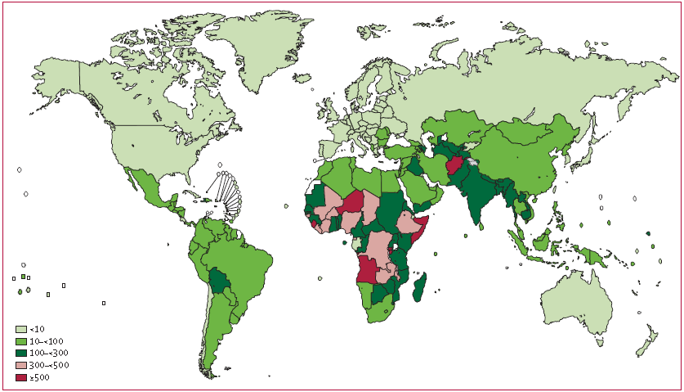
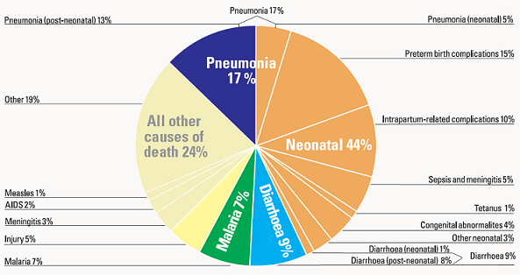
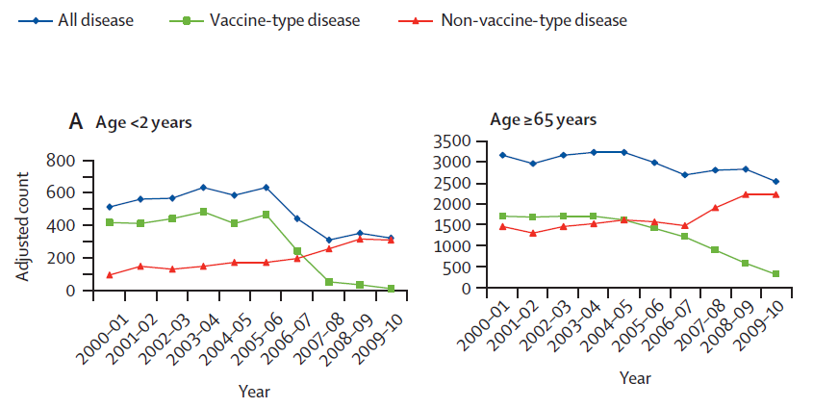
Streptococcus pneumoniae
Otitis and sinusitis, pneumonia, meningitis, bacteremia and sepsis
There is a large number of serotypes (>90) and vaccines are formulated with few of them, therefore the vaccination leaded to the increase of non-vaccine serotypes
Data from 2012. Source: CHERG 2013
Pneumonia kills more children than diarrhoea.
About half of pneumonia deads are due to pneumococcus.
Protein vaccines could offer serotype-independent protection
Pneumococcal deaths in children aged 1–59 months per 100 000 children younger than 5 years. O’Brien et al. Lancet 2009; 374: 893–902

Slide 3
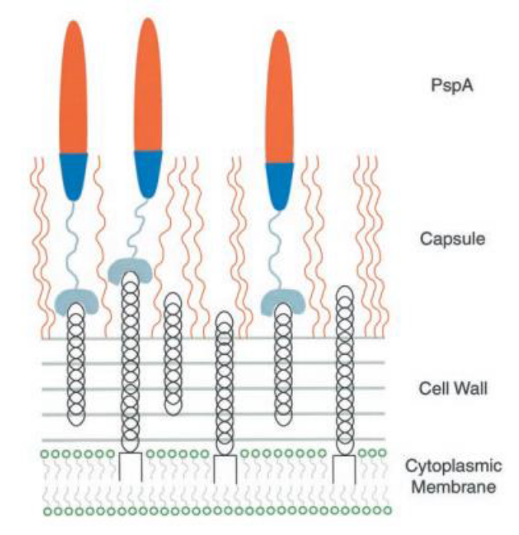
Pneumococcal surface protein A - PspA
α-helix
Choline binding
Virulence factor
Present in all strains of S. pneumoniae
Binds to human lactoferrin, preventing its bactericidal action
Inhibits deposition of C3, hampering phagocytosis
PspA94: family 1, clade 2, isolated from S. pneumoniae strain ST94/01
PspA4Pro: family 2, clade 4, strain ST255/00, first proline-rich block
CDR
Pro-rich
Cloned region
Family | Clade
1 | 1, 2
2 | 3, 4, 5
3 | 6
Blue: electropositive; red, electronegative
Adapted from Jedrzejas, Lamani e Becker, 2001

Slide 4
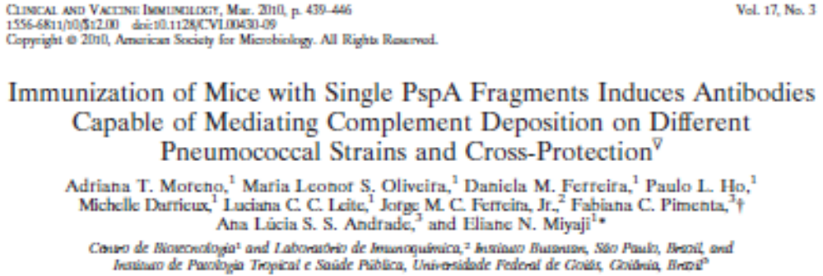
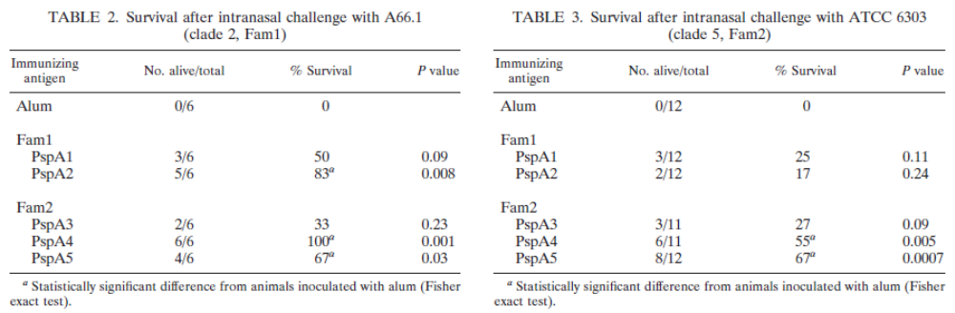
PspA4Pro cross-reactivity

Slide 5
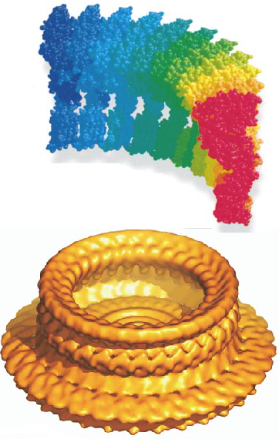
Pneumolysin
Intracellular toxin released in vivo during autolysis
Binds to plasma membrane cholesterol and forms oligomers, generating pores that result in lysis of target cells
Adjuvant properties
PdT: detoxified pneumolysin mutant
  3 mutations:
  Cys-428→Gly
  Trp-433→Phe
  Asp-385→Asn
  Reduces hemolytic activity
  Abolishes pore formation
  Reduces toxin ability to bind to IgG and cancels the ability to activate the complement pathway
(Gilbert et al, 1999; Tilley et al, 2005)

Slide 6
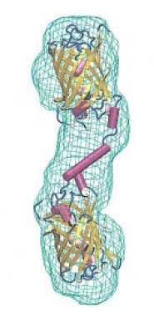
Hybrid proteins
Genetic fusion of two or more proteins can enhance or change the character of both molecules.
Genetic fusion can increase enzymatic or antigenic activity of each protein.
The production of hybrids can substantially reduce costs, because two proteins are produced and purified in a single process.
Arai et al, 2004

Slide 7
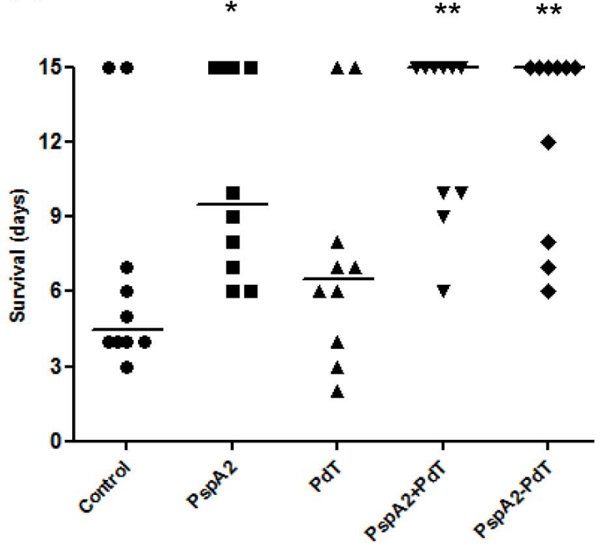
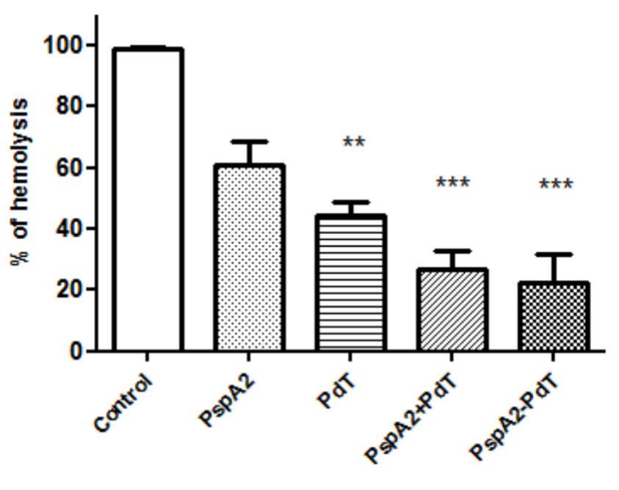
PspA94-PdT without linker
A
B
A) Hemolytic activity of Ply on red blood cells in presence of antisera generated against recombinant and hybrids proteins. One-way ANOVA with a Tukey’s Multiple Comparison Test.; **p,0.01; ***p,0.001. B) Mouse immunization with rPspA-PdT confers protection against pneumococcal sepsis with strains bearing heterologous PspAs. BALB/c mice immunized with 3 doses of rPspAs, rPdT, co-administered or hybrid proteins were challenged with lethal doses of pneumococcal strains. The mice were monitored for 15 days and differences between the survival rates in each group were analyzed by Mann–Whitney U test, *p,0.05; **p,0.01 for treated versus control groups.
Goulart et al. 2013, PLOS One 8:e59605 doi:10.1371/journal.pone.0059605.g006

Slide 8
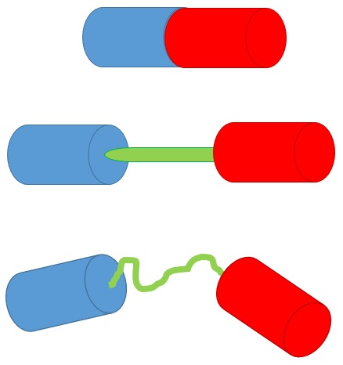
Hybrid proteins with linkers
Molecular linkers provide stability to the hybrid molecule
Rigid helix-forming linker: A(EAAAK)_{n}A
Flexible linker: glycines and serines (GGGGS)_{n}
Zhao et al. (2008) reported a hybrid without any linker that was unstable, but became stable with molecular linkers separating the molecules.

Slide 9
Objectives
Develop the purification process for recombinant PspA4Pro.
Produce recombinant hybrid molecules composed of the pneumococcal proteins PspA94 and PdT cloned without or with molecular linkers.
Determine of the stability of the hybrids, in order to include the most stable molecule in the formulation of a new pneumococcal protein vaccine.

Slide 10
Materials & Methods
Purification of PspA4Pro
Cell lysis
continuous high pressure homogenizer
Cultivations in 10 L-bioreactor at LaDaBio, UFSCar, Prof. Teresa C. Zangirolami:
  Horta et al. (2011) Bioprocess Biosyst. Eng. 34:891-901
  Horta et al. (2014) Braz. J. Chem. Eng. 31:457-468
  Horta et al. (2015) Braz. J. Chem. Eng. 32:821-829
  Campani et al. (2016) Chem. Eng. Proc. 103:63-69
Clarification
cetyltrimethyl ammonium bromide
Anion exchange chromatography
Q-Sepharose
Protein characterization:
SDS-PAGE
Western blot
Circular dichroism
HPSEC
Lactoferrin binding
pH adjustment
Cryoprecipitation
-20 °C
Cation exchange chromatography
SP-Sepharose

Slide 11
Materials & Methods
Purification of hybrids
Cell lysis
continuous high pressure homogenizer
Clone for production of PspA94-PdT without linker in E. coli M15 and pQE30 (Goulart et al. 2013, PLOS One 8:e59605)
Cultivations in 10 L-bioreactor at LaDaBio, UFSCar, Prof. Teresa C. Zangirolami
Clarification
cetyltrimethyl ammonium bromide
Anion exchange chromatography
Q-Sepharose
Hydrophobic interaction chromatography
Phenyl-Sepharose
OR
Metal affinity chromatography
IMAC-Sepharose
Gel filtration chromatography
Superose 12
PspA94-PdT
PspA94-PdT
PspA94-RL-PdT

Slide 12
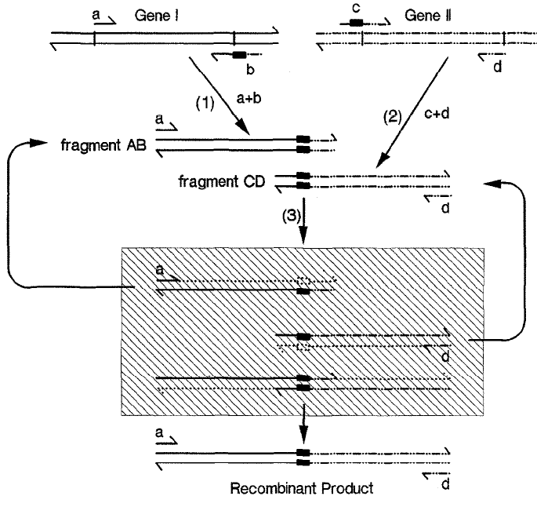
Materials & Methods
Overlap extension PCR technique to amplify the genes of the hybrids with linkers, 3 reactions:
1st and 2nd PCR amplifies each gene with half the linker
3rd PCR fuses the products of the first two reactions
Enzyme: Q5 High fidelity Taq DNA polymerase
Rigid linker: A(EAAAK)₂ A
Flexible linker: (GGGGS)₂
Insertion in pET-28a
Expression in E. coli BL21 Star (DE3) pLysS
(Horton et al., 1989)

Slide 13
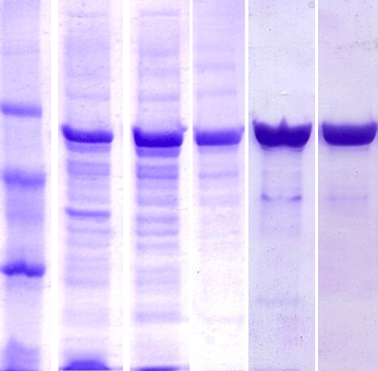
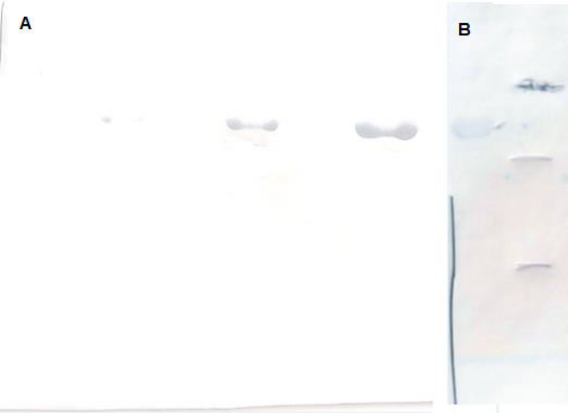
Results – PspA4Pro purification
1
2
3
4
5
97
66
PspA4Pro
w/o His-tag
45
Recovery 38.5%
Purity 97.5 %
Purification factor 3.3
EU reduction >99.9%
30
20
1) Homogenate, 2) CTBA Clarified, 3) Q-Sepharose fraction, 4) Cryo pH 4.0, 5) SP-Sepharose fraction
2μg
5μg
10μg
10μg
Binding of PspA4Pro to human lactoferrin. A) 2 mg/mL purified PspA4Pro (gray) and 1 mg/mL human lactoferrin (black). B) Mixture of PspA4Pro and human lactoferrin. Black curve: 2 mg/mL PspA4Pro and 0.5 mg/mL lactoferrin. Gray curve: 1 mg/mL PspA4Pro and 1 mg/mL lactoferrin. Bold curve: 1 mg/mL PspA4Pro and 2 mg/mL lactoferrin
A) Western Blot of increasing amounts of purified PspA4Pro; B) Ponceau stain

Slide 14
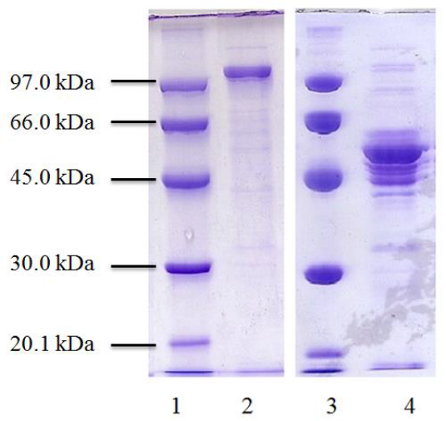
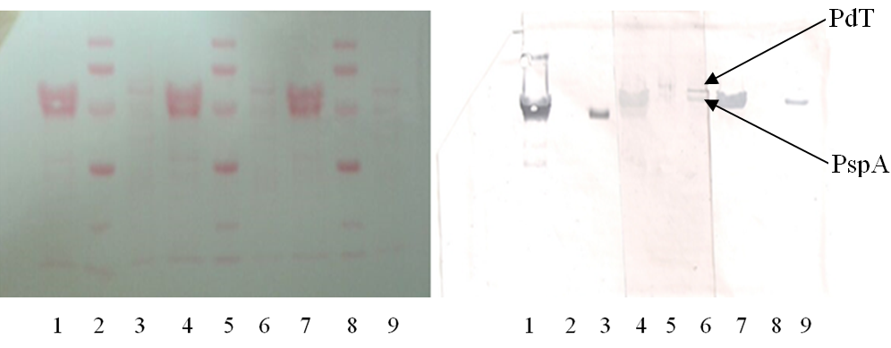
Results – PspA94-PdT w/o linker
Cloning in E. coli M15 using pQE30 as a vector (Goulart et al. 2013)
SDS-PAGE of purified PspA94-PdT without linker
Immediately after purification (2)
After storage at 4°C for 15 days (4)
Molecular marker (1 and 3)
N-terminal sequencing of IMAC non-adsorbed fraction
Q Q Q L P K A E S R | L E M A N K A V N D F
PspA
Cleavage site
PdT
Phenyl fraction (1, 4 & 7)
Molecular marker (2, 5 & 8)
Initial fraction (3, 6 & 9)
Nitrocellulose membrane (left) and Western blot (right) revealed with anti-PspA94 (lanes 1-3), with anti-pneumococcal whole cell (lanes 4-6) and with anti-PdT (lanes 7-9).

Slide 15
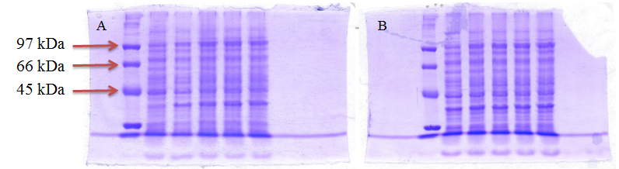
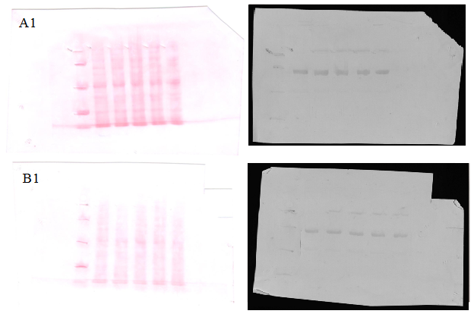
Results – flexible linker
PspA-FL-PdT
PspA-FL-PdT
truncated synthesis
B2
PspA-FL-PdT
truncated synthesis
A2
E. coli BL21 Star (DE3) pLysS carrying pET-28a/pspA-FL-pdT: A) Clone 5 A; B) Clone 5 B. Upper: SDS-PAGE of culture samples before and after 4 h induction. Bottom: Nitrocellulose membrane (left) and Western blot (right) revealed with anti-pneumococcal whole cell antibodies.

Slide 16
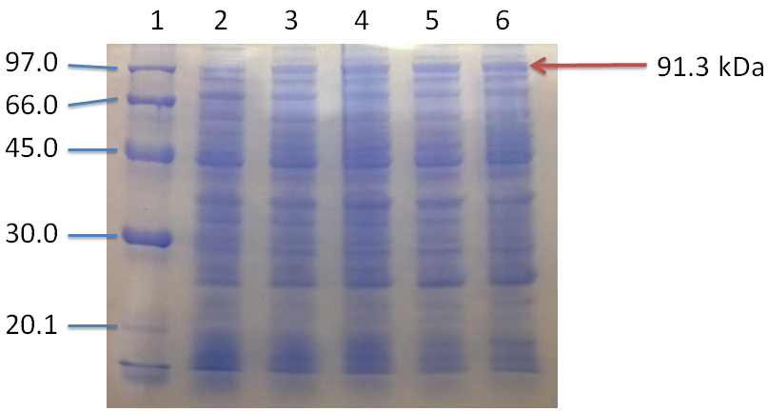
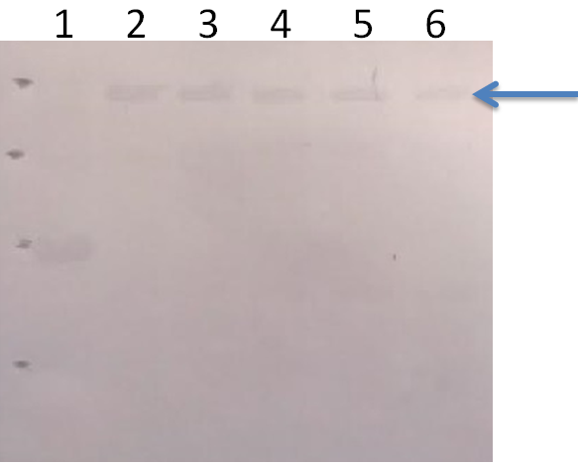
Results – rigid linker
E. coli BL21 Star (DE3) pLysS carrying pET-28a/pspA-RL-pdT
New hybrid protein recognized by antibodies anti-pneumococcal whole cell
100% plasmid stability before and after 4 h induction
1) Molecular marker, 2) before induction, 3) 1 h induction, 4) 2 h induction, 5) 3 h induction, 6) 4 h induction. Western Blot revealed with anti-pneumococcal whole cell antibodies

Slide 17
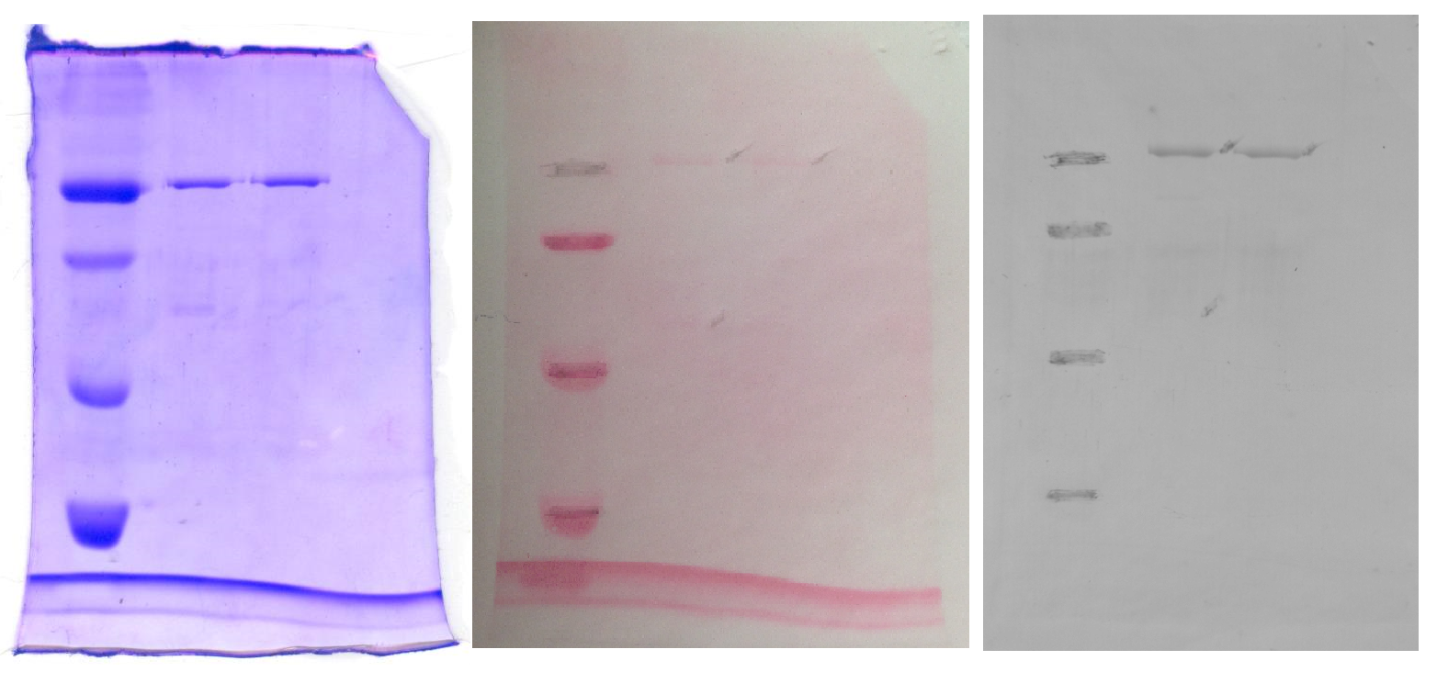
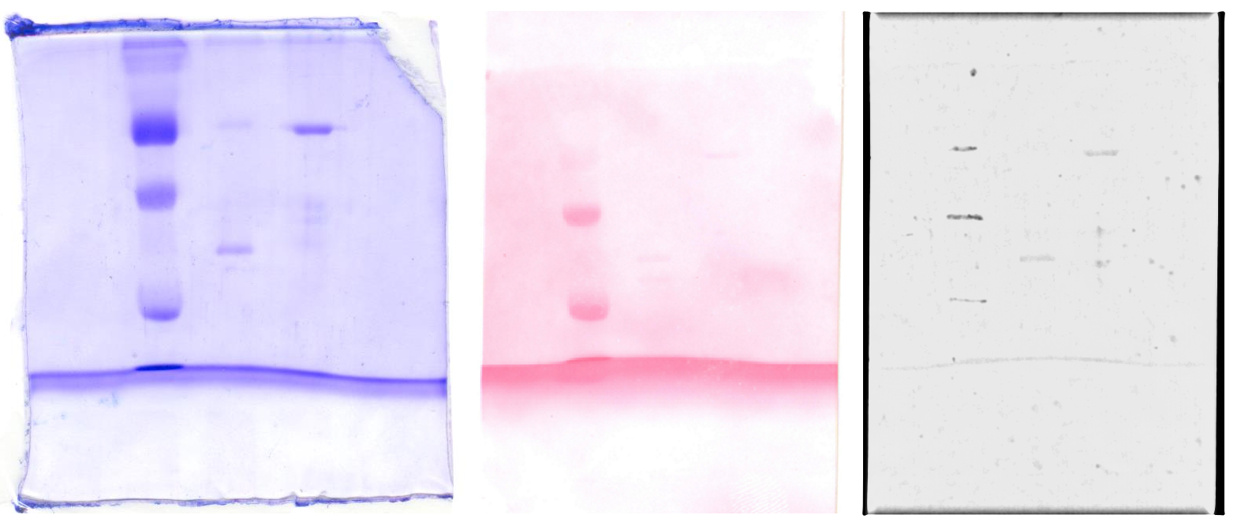
Results – rigid linker
After purification, PspA-RL-PdT was stable for 4 week at 4°C and at least 20 weeks at -20°C
1
2
3
1
2
3
1
2
3
PspA-RL-PdT
PspA-RL-PdT
degraded protein
1) molecular marker, 2) 4 °C, 3) -20 °C.
Western Blot revealed with anti-pneumococcal whole cell antibodies

Slide 18
Conclusions
PspA4Pro purification resulted in biologically active protein with 97.5 % purity, 38.5% yield, and EU reduction >99.9%
PspA-PdT without linker was instable, which impaired to reach the desired purity (>95%), remaining between 85%-86%
PspA94-FL-PdT and PspA94-RL-PdT were successfully cloned into pET-28a and plasmids were stable (100% of antibiotic resistant colonies)
The expression of pspA-FL-pdT resulted in truncated synthesis of the hybrid, probably due to glycine codons
The inclusion of the rigid linker increased the stability and PspA94-RL-PdT was obtained with 95% purity
Optimization of the PspA-RL-PdT production is still need

Slide 19



Thank you!
Laboratório de Bioprocessos
Centro de Biotecnologia
Instituto Butantan
viviane.goncalves@butantan.gov.br

Slide 20
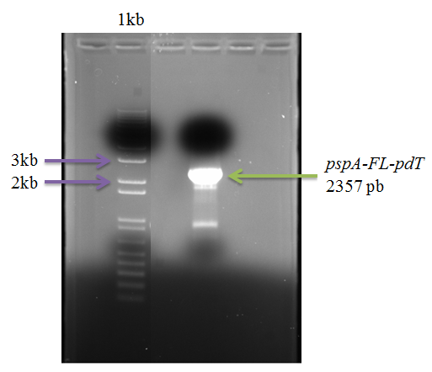
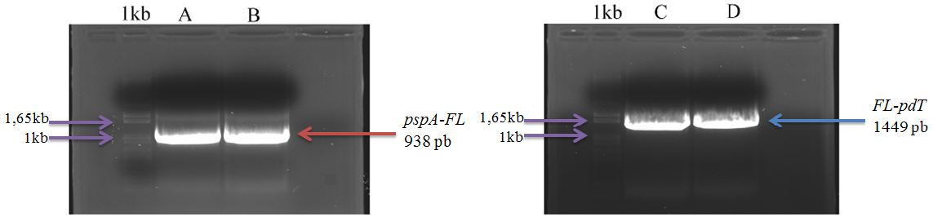
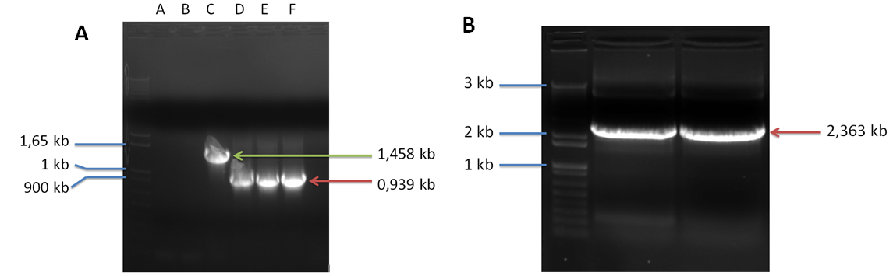
Results - cloning
PCR products
pdT
pspA94-RL-PdT
pspA94

Slide 21
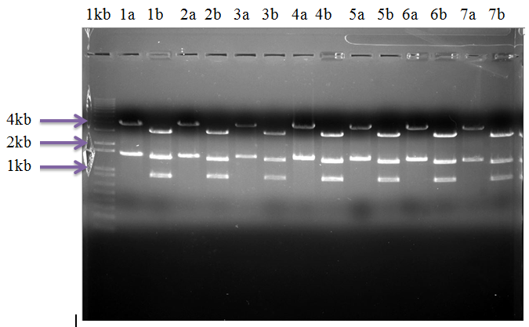
Results – cloning pspA-FL-pdT
pGEM-T/pspA-FL-pdT
Cloning strain: E. coli DH5α
Restriction map confirmed all clones
Sequencing confirmed only clone 5
a: Hind III, b: EcoR I

Slide 22
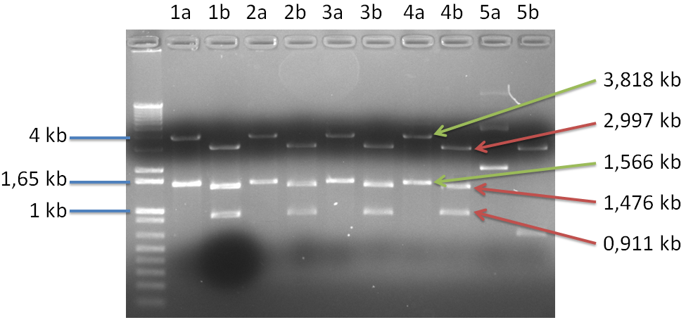
Results – cloning pspA-RL-pdT
pGEM-T/pspA-RL-pdT
Cloning strain: E. coli DH5α
Restriction map eliminated clone 5
Sequencing confirmed clone 4 and eliminated clones 1-3
Green: Hind III, red: EcoR I

