Slide 1
Social innovations and e-health business models
Vivian Vimarlund
Professor in Informatics
Professor in Health Informatics
Linköping University,
and
Jönköping University, International Business School
Sweden
Valencia, 2015

Slide 2
Motivation and the market potential
Ageing population
  The longer people live, the more healthcare services they require
  BY 2050 PEOPLE OVER 60 TO INCREASE BY MORE THAN 1 BILLION (United Nations)
Rising number of chronic patients and long-term conditions
  By 2030 there will be 171 million persons with chronic conditions in the US
  Over one third of the European population above the age of 15 have a chronic disease (WHO).
  Rising demand for long-term treatment and routine checks
Healthcare budget challenges
  Rising cost for long-term treatment and routine checks
Patients want to proactively manage their condition and match it to their lives and careers
Many cancellations (ca 20% of all bookings)
  Care given at home
Maintain or increase care delivery quality
  Shortage of staff — long waiting times
  Physician visit is ca 20 minutes
  Different policies related to participation of patients, safety
Technological innovations
Rapid growth health IT
Mobile device
Tele-health
Cloud and exchanges

Slide 3
Social innovations and digital coordination
Many countries in Europe develop strategies to foster the use of e-Health services and develop a systems centric knowledge two side market
Business models are perceived as important:
  Achieve a sustainable implementation and use of social innovations
  Develop cost- effectiveness at the organizational level

Slide 4
The new innovation paradigm
    This implies an increasing importance of social innovation as compared to technological innovation
      several challenges that has to be over-win to develop sustainable business models

Slide 5
      From single to complex ecosystems
Innovations (EHR) Single market |  |  |  | Social innovation (Digital patient)
Technological innovations economic effectiveness |  | One single application/enterprise |  | Social innovations in business, civil society, state
Information/ organizations | Process | Quality | Costs Control | Participation Collective expertise | Procedures | Behaviours
Partnership between governement ,non-profits and/or private organizations, academia, and all levels of government
social in both their ends and their means – new ideas, products, services and models that simultaneously meet social needs (more effectively than alternatives) and create new social relationships or collaborations. (02/02/2015 EU)

Slide 6
Changing roles: Buyers and Sellers / Sellers and Sellers/ Buyers and Buyers
Buyers and sellers transact business. A market exists whenever there is buying and selling
The law of Demand. As price increases the quantity demanded will decrease and as price decreases the quantity demanded will decrease
Society becomes an
annex to the economy
and market forces
Individual participation
collaboration of stakeholders
Interdisciplinarity
Society/Consumers
The Market
Products and
Services
Price (demand and supply)
Public sector
Society
Non-profit
Taxes
Reimbursements
Environment
Goods, services ,products or models
That meet social needs
(more effectively
than alternatives) and create
new social relationships or
Collaborations
Social innovations are new practices
for resolving societal challenges,
which are adopted and utilized by the individuals,
social groups and organizations concerned
Society/Co-producers
Co-production
Social challenges
Goods, services, products , models
Patients understand his/her health issues

Slide 7
A Societal innovation: A National Health Account
Initiative from the Swedish Ministry of Health and Social Affairs
An “account” where all citizens can save, overview and manage health information
  Personal identity
  Electronic signature
Third-party applications can be connected to the account
  Fitness, relatives, alternative medicine, primary and specialized care
The Swedish eHealth Agency will certify third-parties according to ethical and technical requirements

Slide 8
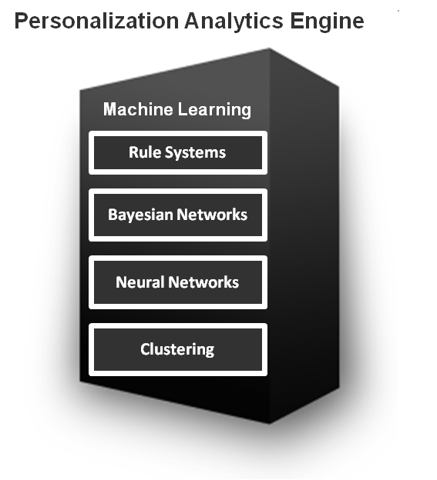


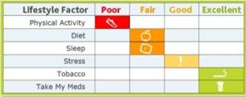

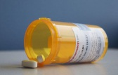

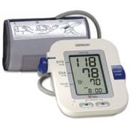









Virtual and digital
Individual Information
Personalization Profile
Tools for Self-Management
(Mobile, Web & Email)
Health Behaviors &
Measurable Outcomes
Demographic Profile
Interactions with HC
Messages
Health tips
Questions
Engagement Tools
Biometric feedback
Incentives
- Carrots
- Sticks
Friends & Community
Competition
Engagement Profile
Biometric trends
Health habit modifications
Self-tracks most days
Outcomes
Weight
Blood sugar
Blood pressure
Physical activity
Self assessment responses
Reallocation of resources
Improve outcomes and life quality
Born: 1966
Health Habit Profile
Surveillance
Alerts prevent
Real time information
Big data
Reduce incidence or
progression of chronic
diseases
Nearly patients
Self-assessments
Tracking
Usage pattern
Social network
Interactions tailored at increasingly personal levels as more data is collected over time

Slide 9
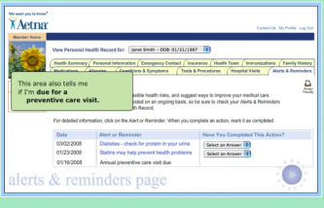

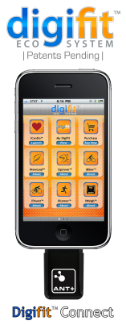
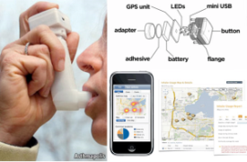

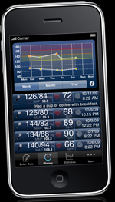
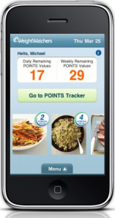
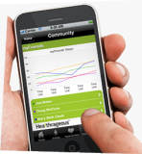
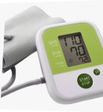






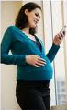
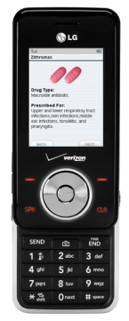
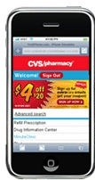
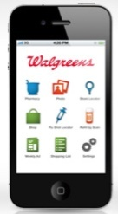
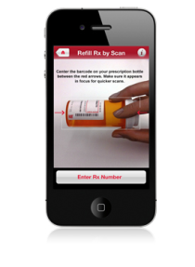
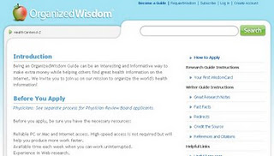
Business models for Outside and Inside providers/suppliers/Customers
 | Chronic Care Management
Education | Adherance
AetnaPersonal
Health record
Asthmapolis
mySymbicord
Heartwise
Healthrageous
WellApps
Pregnancy
CVS / Walgreens Application for Refills
Organized Wisdom
Pill Phone
Refill by Scan

Slide 10
Business Models:
The plan implemented by a company to generate revenue and make a profit from operations. The model includes the components and functions of the business, as well as the revenues it generates and the expenses it incurs
Crowdsourcing
    on e-collaboration and e-participation
    selling users a service rather than product
Social Networking,
  online collaboration and file sharing and public participation and collaboration.
  to influence consumer opinions and behaviors
Mashup,
  interactive web-based model application hybrid that combines data and content from the third party sources, resulting in new and distinct information (Wikipedia)
Product customization,
  customized products and services
  customer can be directly involved in designing the products and purchasing products
Open Market
  an individual do business as buyers and sellers
    Subscription
    Two tariff principle

Slide 11
Issues that affect sustainability in a two side market
Transaction costs
Consumer
Behaviour,
Service variation
Open market competition
Externalities
Information Asymmetrie
Roles
Relations
Public or out-of pockets services
Norms and principles
Willigness to pay, rules and
Policies, price mechanisms
compensatioins, payment alternatives
Value creation; price
Multi-side markets
Busines models
In a single market consumers and care providers + private actors
Sell and buy

Slide 12
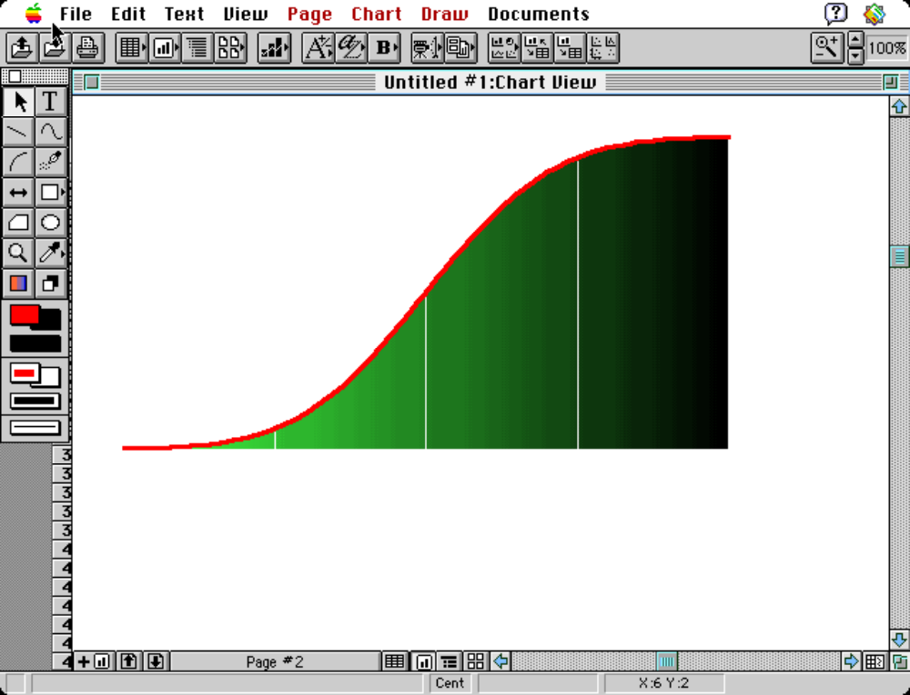
Social innovations in healthcare
-
+
Known by
nobody
Knowledge
distance
Known by
nobody
Known by
everybody
Known and delivered by
the supplier/producer
Known and/or demanded by
the consumer

Slide 13
Known by everybody?
Prerequisites | Users / Citizens | Care provider | Entrepreneur / Private actors
Knowledge about the health account and added services | x
Service quality and trust | x
Clear use of expression and concepts |  | x
Lab results are shared with the patient |  | x
Shared access to patient data |  | x
Quality of data gathering |  | x
An open market that allows actors to compete |  |  | x
Clear guidelines concerning certification and rules |  |  | x
A new view of doing business, innovative business models and payment alternatives |  |  | x
Notes:
Citizens and care providers seem to focus on non-market issues (related to security, trust, quality) while private actors focus on new ways of doing business.

Slide 14
Information AssymetriE / TC/ Agent Principal
High Wealth
Superior services
Rolls Royce
Ferrari
Out of pocket services
Lexus
Mercedes
Good to have services
Toyota
Honda
Differentiated/Customized
Complementary/specialized services
Must have services
Low Wealth

Slide 15
Assymetric knowledge
Customers often lack reference prices for service
Service variability limits knowledge
Collection of price information by customers is difficult
Why to pay twice?
Temporary or permanent?
Reallocation of resources

Slide 16
Business models as a complement : P4 all
Social innovations unclear value
  Revenue stream – How revenue is generated and its frequency
  Distribution channel – The required mechanism for getting the innovation into customers’ hands. Who push the bottom ?
  Price – How much the business/organization can charge for its products or services
  Competitive differentiation – The degree to which the innovation is unique
  Intellectual property (IP) – The importance of IP protection to the success of the business model.
  Other barriers to entry – Factors that could serve as barriers to adoption (e.g., high switching cost, bran or customer loyalty, access to distribution channels, etc.).
  Training requirements – The extent to which specialized training is required to utilize the innovation.
  Clinical hurdles – The complexity and duration of the clinical requirements that need to addressed in order to commercialize the innovation.
  Financial requirements – The level of investment necessary to develop and commercialize the innovation.
  Risk/liability – The level of risk to all stakeholders from either adopting of failing to adopt the innovation

Slide 17
Questions ?
Thank you for your attention

