Slide 1
About OMICS Group
OMICS Group is an amalgamation of Open Access Publications and worldwide international science conferences and events. Established in the year 2007 with the sole aim of making the information on Sciences and technology ‘Open Access’, OMICS Group publishes 500 online open access scholarly journals in all aspects of Science, Engineering, Management and Technology journals. OMICS Group has been instrumental in taking the knowledge on Science & technology to the doorsteps of ordinary men and women. Research Scholars, Students, Libraries, Educational Institutions, Research centers and the industry are main stakeholders that benefitted greatly from this knowledge dissemination. OMICS Group also organizes 500 International conferences annually across the globe, where knowledge transfer takes place through debates, round table discussions, poster presentations, workshops, symposia and exhibitions.

Slide 2
OMICS International Conferences
OMICS International is a pioneer and leading science event organizer, which publishes around 500 open access journals and conducts over 500 Medical, Clinical, Engineering, Life Sciences, Pharma scientific conferences all over the globe annually with the support of more than 1000 scientific associations and 30,000 editorial board members and 3.5 million followers to its credit.
OMICS Group has organized 500 conferences, workshops and national symposiums across the major cities including San Francisco, Las Vegas, San Antonio, Omaha, Orlando, Raleigh, Santa Clara, Chicago, Philadelphia, Baltimore, United Kingdom, Valencia, Dubai, Beijing, Hyderabad, Bengaluru and Mumbai.

Slide 3
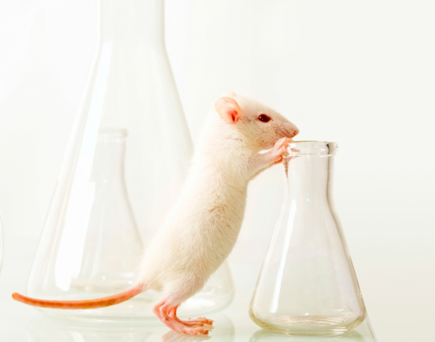
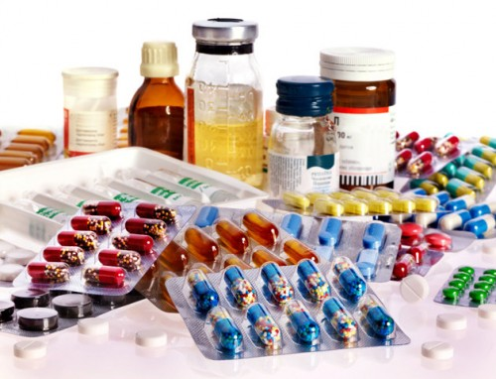
WORLD CONGRESS ON
PHARMACOLOGY – 2015
July 20-22, Brisbane, Australia
Workshop on
“Current And Future Trends in New Drug Development in Type-2 Diabetes Mellitus”
By
Dr Vivek Lal, Ph.D., M.D., F.Cl.R.
Associate Professor (Pharmacology)
College of Medicine, King Faisal University
Kingdom of Saudi Arabia

Slide 4
Sequence of discussion
Introduction and Objectives
Current drug therapy of T2DM
Shortcomings of current modalities
Recent advances
Putative targets of future drug research
Group activity
Conclusion

Slide 5
Introduction
T2DM : Some alarming facts
366 million patients globally
May rise to 552 million by 2030 (International Diabetes Federation)
Developing nations – alarming increase in incidence
Undiagnosed cases in Africa
Adoption of unhealthy lifestyle - major problem

Slide 6
Objectives of Workshop
Drug therapy of T2DM
Where we are?
Where are we headed?
New drugs in the pipeline
What are the fallacies / drawbacks of current trends?
What should we target for optimal management of T2DM – closest to a physiological control.

Slide 7
Current drug therapy of T2DM
Stimulation of insulin secretion – Insulin secretagogues (Sulfonylureas, meglitinides, D-phenylalanine derivatives)
Facilitation of insulin action in liver, muscle and adipose tissue (Biguanides)
Partial reduction of insulin resistance (Thiazolidinediones)

Slide 8
Current drug therapy of T2DM
Delaying intestinal glucose absorption (α-glucosidase inhibitors)
Enhancing action of incretins (GLP-1 agonists, DPP-4 inhibitors)
Inhibition of glucose reabsorption in kidneys (SGLTs)
Miscellaneous drugs (Pramlintide, Colesevelam)

Slide 9
Thus, where are we, currently?
Flogging a dying horse! (Insulin secretagogues)
~ Insulin resistance a bigger problem than deficiency
~ Overstimulation of beta cells may be counter-productive
~ May lead to hypoglycemia
Delaying intestinal glucose absorption
~ Unphysiological – increases sugar content of feces with related adverse effects

Slide 10
Where are we?
Enhancing incretin action (GLP-1 agonists & DPP Inhibitors)
~ GLP-1 stimulates insulin secretion
(predominant action)
~ Di-peptidyl Peptidase (DPP) Inhibitors prevent
breakdown of GLP-1 : similar action
Promoting glycosuria! (SGLT2 Inhibitors)
~ Unphysiological! Prevent glucose reabsorption
at renal PCT - glycosuria

Slide 11
Where are we?
Colesevelam
Indirect action through Farsenoid X receptor (FXR)
FXR – a nuclear receptor involved in cholesterol, glucose and bile acid metabolism – activation inhibited by Colesevelam.
May impair glucose absorption
May aggravate hypertriglyceridemia + other ADRs
Adjuvant drug at best!

Slide 12
Where are we?
Bromocriptine
A dopamine agonist
Minimal HbA1c reduction by unknown mechanisms
Many ADRs
Mild to modest efficacy
Use in T2DM questionable

Slide 13
Where are we?
Currently, only the following groups appear rational:-
Biguanides (euglycemic agents)
~ reduce hepatic glucose production
~ Promote peripheral glucose utilization
Thiazolidinediones (PPAR-γ ligands)
~ PPAR-γ receptors modulate expression of genes
involved in lipid / glucose metabolism, insulin
signal transduction & adipocyte differentiation.
~ Facilitate insulin action in T2DM

Slide 14
Rational drugs in T2DM (Contd)
Pramlintide [Islet Amyloid Polypeptide (IAPP) analog]
~ Prevents insulin over-secretion [(-)ve feedback]
~ Reduces glucagon secretion
~ Delays gastric emptying (attenuates post-
prandial surge in blood glucose levels)
~ Decreases appetite centrally

Slide 15
Where are we headed?
Failed attempts!
- Rimonabant – depression!
- Dual PPAR-α+γ agonists (Glitazars – Muraglitazar
& Tesaglitazar) – dual action of enhancing
insulin action & ↓plasma TGs + ↑HDL. High
adverse effects like heart failure.
- Fasiglifam – development terminated (2013) due
to safety concerns (Liver toxicity)

Slide 16
Where are we headed?
11beta-hydroxysteroid dehydrogenase type 1 (11-β HSD-1) inhibitors
Inhibit the oxidoreductase catalyzing conversion of 11 ketoforms (cortisone) into active gluco-corticoids.
This prevents excessive glucocorticoid action which accentuates T2DM.
Again, an indirect approach!

Slide 17
Glycogen Phosphorylase Inhibitors
Inhibit conversion of glycogen into glucose
Expected lowering on blood glucose in T2DM
Selectivity of action on liver doubtful – breakdown of glycogen in skeletal muscles is essential
Clinical evaluation mandated
Glucokinase Activators
Increase insulin secretion – similar limitations as other insulinsecretagogues!
Promote glucose uptake and reduce release of glucose from liver. Multiple clinical concerns(+)

Slide 18
Protein tyrosine phosphatase 1B inhibitors
PTP 1B is a cytosolic protein tyrosine phosphatase
Implicated as a negative regulator of insulin signal transduction
PTP 1B inhibitors can thus overcome insulin resistance
Several classes of such inhibitors are under investigation

Slide 19
GPR-119 agonists
G-Protein coupled Receptor-119 expressed in pancreas & GIT
Activated by lipid amides
Leads to release of Insulin, GLP-1 and GIP
Likely to have similar problems as insulin secretagogues

Slide 20
Glucagon Receptor Antagonists
Under development
Block action of glucagon – block glucagon mediated glycogenolysis and subsequent hyperglycemia
Useful only in patients with overexpression of glucagon receptors
May accentuate hypoglycemia
Adjuvant drugs at best!

Slide 21
What we can do…..finally!
Objectives for rational pharmacotherapy of T2DM
Islet beta cells should not be strained further
Insulin resistance to be overcome at all levels
~ By direct action on insulin receptors
~ Insulin facilitators
Increased sugar levels in feces & urine to be avoided
Effective reversal of Insulin antagonism

Slide 22
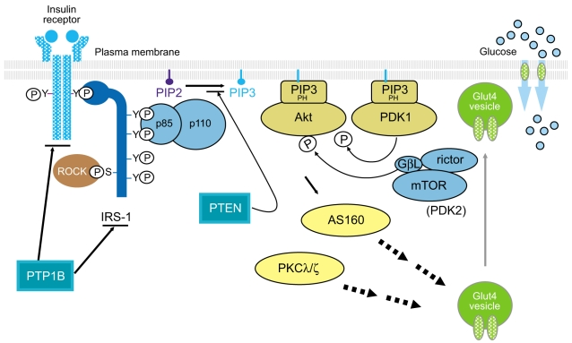
Insulin Receptor & Signal Transduction

Slide 23
Insulin Signal Transduction (Brief)
Insulin binding to cell surface receptor
Tyrosine phosphorylation of Insulin Receptor Substrates (IRSs)
Activation of PI3K by binding of IRSs on its regulatory subunit
Activation of 3-phosphoinositide dependent protein kinases
(PDK-1 & PDK-2)
Activation of Akt/Protein kinase B (PKB) / atypical protein kinase Cλ/ζ
Activation of 160 kDa substrate (AS 160)

Slide 24
Insulin Signal Transduction (Brief)
Activation of AS 160
Translocation of Insulin mediated GLUT-4 from I/cellular vesicles to plasma membrane
Extra to intracellular transport of glucose
-----------------------------------------------------------------------
Rho-Kinase (ROCK1 & ROCK2)
Facilitates insulin stimulated IRS-1 associated PI3K activity
(by 632/635 serine phosphorylation of IRS-1)
Negative ROCK activity promotes insulin resistance

Slide 25
Negative modulators for insulin signalling
Physiological regulation of insulin action =
Balance between phosphorylation and
dephosphorylation of IR by Protein tyrosine
phosphatases
Additionally, a lipid phosphatase (PTEN) hydrolyzes conversion of PIP3 to PIP2 → antagonizes the PI3K pathway of insulin signal transduction → can contribute to insulin resistance

Slide 26
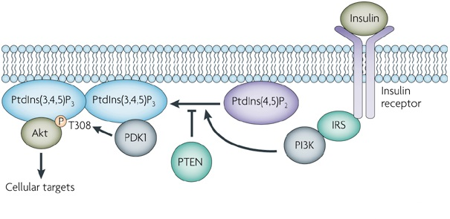
Insulin Receptor : Normal Signal Transduction
(PIP3)
(PIP3)
(PIP2
Normal Signal Transduction

Slide 27
Target 1: Inhibition of serine phosphorylation of IRS-1
(PIP3)
(PIP3)
(PIP2)
Serine Phosphorylation
Reduced attraction of IRS to PI3K
Thus, inhibition of serine phosphorylation of IRS-1 can reduce insulin resistance

Slide 28
Target 2 : Correction of mitochondrial dysfunction
Mitochondrial dysfunction in insulin target tissues → activation of several serine kinase
Serine phosphorylation of IRS-1
Insulin Resistance
Thus, drug induced manipulation to prevent mitochondrial dysfunction can prevent insulin resistance

Slide 29
Target 3: Inhibition of over-expression of p85alpha subunit of PI3K
Overexpression of p85alpha subunit of Phosphatidylinositol (PI) 3 kinase – seen in overfeeding related insulin resistance
Inhibition of overexpression of p85alpha subunit or immunological inhibition of this protein – expected to reduce insulin resistance

Slide 30
Target 4: Stimulation of a novel insulin receptor signalling platform
Membrane associated mammalian neuraminidase-1 (Neu1) + matrix metallo-proteinase-9 (MMP-9) + Neuromedin B G-protein coupled receptor (GPCR)
Essential for insulin induced IR stimulation
Many ligands (Oseltamivir / Piperazine / BIM-23127 respectively) can block these enzymes / receptor proteins → insulin resistance

Slide 31
Target 4: Stimulation of a novel insulin receptor signalling platform
Thus, individual or combined stimulation of these cross talk mechanisms can overcome or decrease insulin resistance
Novel ligands can be searched by receptor ligand matching techniques, which can stimulate individual entities

Slide 32
Target 5 : Inhibition of PTEN
PTEN is a negative modulator of insulin signal transduction
Its inhibition might be attempted by blocking this lipid phosphatase by novel blockers
Alternatively, its expression may be inhibited on chromosome 10
This can also contribute to overcoming insulin resistance

Slide 33
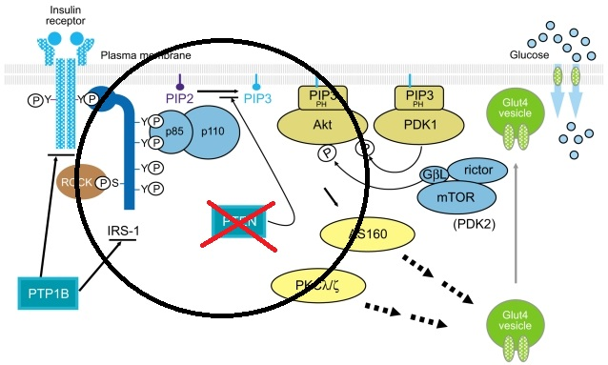
Inhibition of PTEN

Slide 34
Group Activity
All participants are now requested to jot down their own ideas about future research in T2DM management, especially with an overview of the shortcomings of the currently available drugs.

Slide 35
Conclusion
Currently available pharmacological management of T2DM has many shortfalls!
Hypoglycemia, weight gain, altered lipid profile and most importantly a poor glycemic control are major problems.
Of late, research got directed towards reducing blood sugar by irrational means – iatrogenic glycosuria and loss of sugars in stools – inherently dangerous!

Slide 36
Conclusion
Out of the on-going research, only glycogen phosphorylase inhibitors and Protein Tyrosine Phosphatase 1B (PTP 1B) inhibitors show some promise
This workshop intended to suggest future research targets which may reduce insulin resistance
Mainstay of T2DM treatment is reduction of insulin resistance, and not insulin secretion!
This can precede future gene therapy!

Slide 37


Slide 38
Let us meet again..
We welcome you all to our future conferences of
OMICS International
3rd World Congress on Pharmacology
On
August 08-10, 2016 at Birmingham, UK http://pharmacology.pharmaceuticalconferences.com/

