Slide 1


“FIFTEEN YEARS” OF EXPERIENCE IN EDUCATION FOR SUSTAINABLE DEVELOPMENT
THE REALITY IN HIGHER EDUCATION around the world
Vítor Manteigas
Escola Superior de Tecnologia da Saúde de Lisboa, ESTeSL, Instituto Politécnico de Lisboa, Lisboa Portugal
Instituto de Ciências Sociais, Universidade de Lisboa, Lisboa, Portugal

Slide 2
INTRODUCTION (i)
Education is essential for sustainable development and it is imperative the common citizens learn the path to sustainability. Today’s education is crucial to the ability of current and future leaders and citizens create solutions and find new ways for a future that we want to be better (UNESCO, 2014a)
Education for Sustainable Development (ESD) is defined by UNESCO as an approach to teaching and learning that allows each human being acquire the knowledge, skills, attitudes and values ​​needed for a Sustainable Future (UNESCO, 2014b)
In recent years, the ESD has been a part, all over the world, of the speeches related to education (Springer, 2015)

Slide 3
INTRODUCTION (ii)
The United Nations (UN), by designating the period 2005-2014 as the Decade of Education for Sustainable Development, put in the «agenda» the need for policy makers and education professionals find ways in which the ESD become an integral part of formal and non formal education (Springer, 2015)
Through the development of concepts such as sustainable management of materials and the use of resource, and incorporating dialogue on these matters with the academic communities and governing bodies of schools, students can develop skills relevant to their lifestyle become sustainable (Mathar, 2015)
Therefore it’s relevant to: (i) identify the different programs that educational institutions have used to work the issues of ESD; and (ii) identify the major areas of work that have been developed, associated with ESD, by educational institutions, with a focus in higher education institutions.

Slide 4
METHODS
Study based on the final report of the Decade of Education for Sustainable Development (UNESCO, 2014c) and referenced articles in research databases indexed on ScienceDirect®, published in the period 2000-2015 (full years).
Was applied meta-analysis as a methodology of research using the following keywords: "eco schools", "green schools", "green campus", "eco campus", "eco universities" and "green universities".
Articles where the keywords (used as inclusion criteria) were referenced were identified and then were also identified journals that were often used for publication, regardless of the impact factor, as well as the keywords used in papers, to identify the “main” areas of study.
Results were analyzed and will be presented strictly based on descriptive statistics

Slide 5
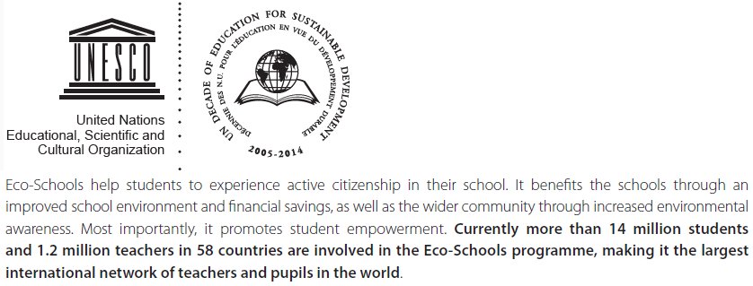
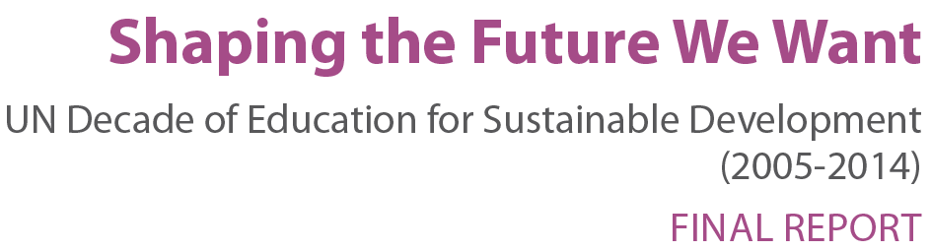

RESULTS & DISCUSSION (i)
PROGRAMMES OF “EDUCATION FOR SUSTAINABLE DEVELOPMENT“
UNESCO ASPnet
Green Pack
Young Masters ' Programme on Sustainable Development
GUPES
COPERNICUS Alliance
ProsPER.Net
MESA
ARIUSA
    Eco-Schools. Programme managed internationally by the Foundation for Environmental Education (FEE), which involves 1,200,000 teachers and 14,000,000 students in 58 countries.

Slide 6
RESULTS & DISCUSSION (ii)

Slide 7
RESULTS & DISCUSSION (iii)

Slide 8
RESULTS & DISCUSSION (iv)

Slide 9

RESULTS & DISCUSSION (v)
OUR EXPERIENCE IN ESD…
(ABAE, 2016)

Slide 10

RESULTS & DISCUSSION (vi)
OUR EXPERIENCE IN ESD…
432000
STUDENTS
0,83% OF ECO-SCHOOLS IN THE PROGRAMME AND 4,8% OF HIGHER EDUCATION INSTITUTIONS IN PORTUGAL
227
MUNICIPALITIES
1200
TEACHERS
20
PROJECTS
1500
tons WEEE
1440
SCHOOLS
78% PUBLIC
SCHOOLS
14% OF
PORTUGUESE SCHOOLS ARE ECO-SCHOOLS
(ABAE, 2016)

Slide 11
RESULTS & DISCUSSION (vii)
OUR EXPERIENCE IN ESD…
  THE SEVEN STEPS OF THE PROGRAMME ARE:
    Establishing an ECO-SCHOOL COUNCIL.
    Undertaking an ENVIRONMENTAL REVIEW/AUDIT.
    Implementing an ACTION PLAN.
    MONITORING and EVALUATING ACTIONS carried out.
    LINKING THE PROGRAMME TO LEARNING on school.
    INFORMING and INVOLVING the school and wider community.
    Developing an ECO-CODE.
(FEE, 2016)

Slide 12



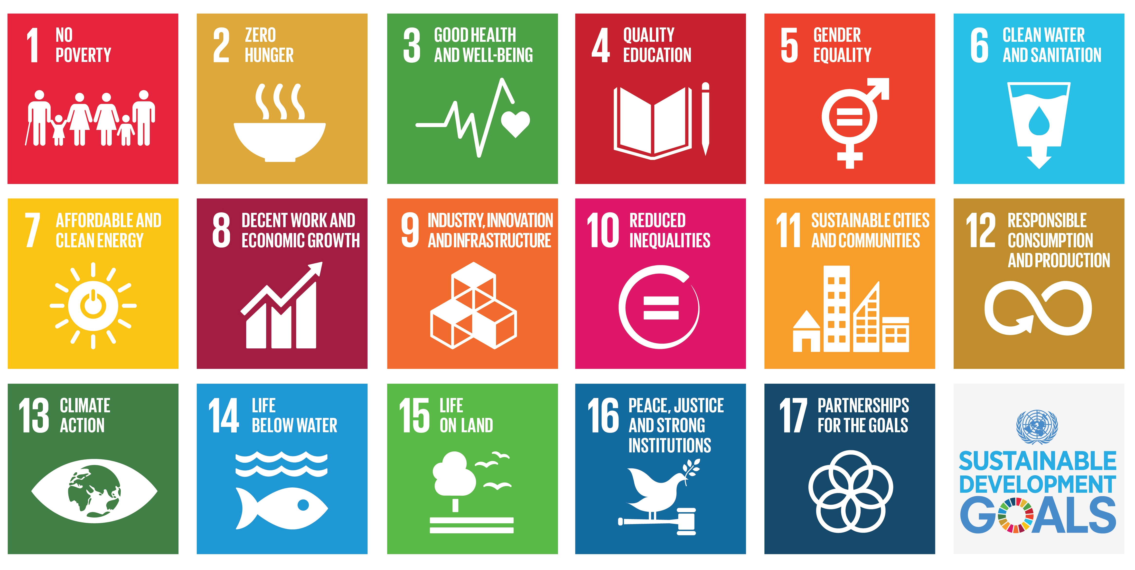






RESULTS & DISCUSSION (viii)
OUR EXPERIENCE IN ESD…
BASIC THEMES
WATER
WASTE
ENERGY
THEMES OF THE YEAR
HEALTHY AND SUSTAINABLE FOOD
OUTSIDE SPACES
GEODIVERSITY
FOREST
ADDITIONAL THEMES
BIODIVERSITY, NOISE
TRANSPORT/SUSTAINABLE MOBILITY
SEA, ORGANIC FARMING
CLIMATE CHANGE
ROUT OF THE 20
ORGANIC VEGETABLE GARDEN
RECYCLING OF WEEE
HEALTHY AND SUSTAINABLE FOOD
REUSE & RECYCLING OF TEXTILES
ECO-ENERGY REPORTER

Slide 13
CONCLUSIONS
Over the past 16 years, especially the last 10, the educational institutions have intensified their efforts at sustainable development, with significant efforts to introduce sustainability into its practices (and research!).
The names associated to the educational institutions, of basic education (including secondary education) or higher education, which have been developing work in specific programmes of ESD, have not been consensual. In the particular case of the Eco-Schools Programme the designations used are "Eco-Schools“ and "Green Schools“ for the basic education and "Eco-Universities", "Eco-Campus“ and "Green Campus“ for higher education.
Most of the work done by the schools is related to the structural issues of schools (school building), energy issues and, of course, sustainability.

Slide 14
REFERENCES
ABAE (2016). Contributo de dois Programas – Eco-Escolas e Jovens Repórteres para o Ambiente – para dois dos Objetivos de Desenvolvimento Sustentável. Lisboa: Associação Bandeira Azul da Europa, Margarida Gomes.
FEE (2016). Foundation for Environmental Education. [online], http://www.fee.global/. [retrieved 15-03-2016].
Mathar, R. (2015). A Whole School Approach to Sustainable Development: Elements of Education for Sustainable Development and Students’ Competencies for Sustainable Development. In R. Jucker & R. Mathar (eds.), Schooling for Sustainable Development in Europe: Concepts, Policies and Educational Experiences at the End of the UN Decade of Education for Sustainable Development. Springer International Publishing Switzerland
Springer (2015). Schooling for Sustainable Development in Europe: Concepts, Policies and Educational Experiences at the End of the UN Decade of Education for Sustainable Development. Springer International Publishing Switzerland: R. Jucker & R. Mathar (eds.), http://dx.doi.org/10.1007/978-3-319-09549-3_1.
UNESCO (2014b). Education for sustainable development (ESD). [online], http://www.unesco.org/new/en/education/themes/leading-the-international-agenda/education-for-sustainable-development/. [retrived 08-03-2016].
UNESCO (2014a). Education for sustainable development. [online], http://www.unesco.org/new/en/education/themes/leading-the-international-agenda/education-for-sustainable-development/education-for-sustainable-development/. [retrived 10-03-2016].
UNESCO (2014c). Shaping the Future We Wan: UN Decade of Education for Sustainable Development (2005-2014), FINAL REPORT. United Nations Educational, Scientific and Cultural Organization: Carolee Buckler & Heather Creec.

