Slide 1



Comparative peptidome analysis of the mucus from seven gastropod species.
Viroj Tachapuripunya, Sittiruk Roytrakul, Pramote Chuamnanpuen, Teerasak E-kobon
National Center for Genetic Engineering and Biotechnology, Thaniland
Bioinformatics and Systems Biology Unit, Computational Biomodelling Laboratory for Agricultural and Technology (CBLAST), Thailand
Department of Zoology, Faculty of Science, Kasetsart University, Thailand
Department of Genetics, Faculty of Science, Kasetsart University, Thailand

Slide 2
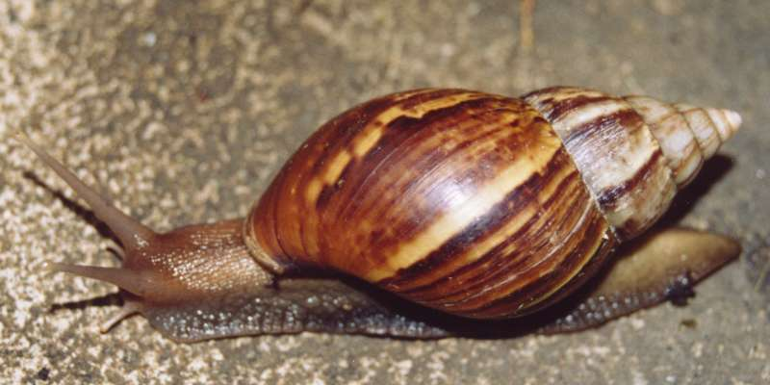
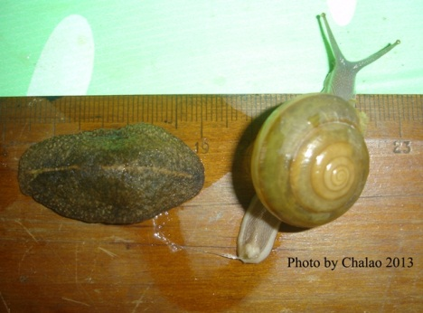
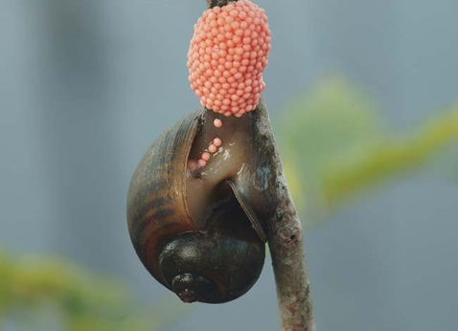
Introduction
- Snails and Slugs
- Phylum Mollusca, Class Gastropoda
- Various habitats
- Quick adaptation and reproduction
- Some are agricultural pests
.
- Mucus
- Sticky and resilience like glue
- help snails and slugs locomotion, defense against infection, etc.
- Within-species communication and reproductive attraction (Chase, 2007)
- Wound-healing properties on damaged shells (Wagge, 1951)
Achatina fulica Semperula siamensis and Cryptozona siamensis Pomatia canaliculata
Ref: https://upload.wikimedia.org http://www.siamensis.org http://axcela.lonza.com/

Slide 3
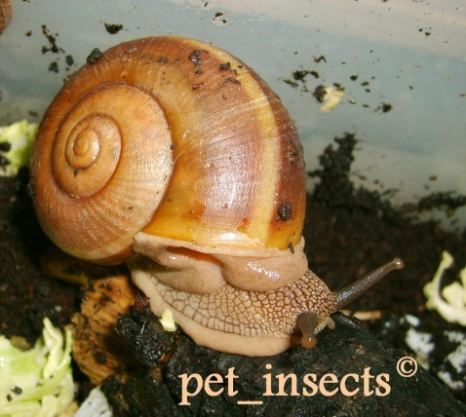
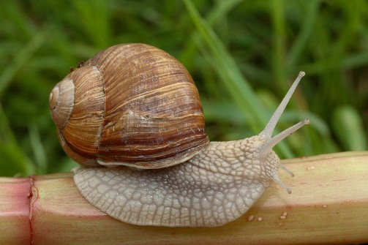

Introduction
- Mucus composition
- Mostly water with proteins, carbohydrates, and minerals
- Several bioactive molecules: achatinin, mytimacin-AF, etc.
(Biwas et al., 2000)
- Applications in pharmaceutical medical and cosmetic products
Do mucus secreted from different gastropod species have peptides
or proteins in common?
Cyclophorus fulguratus Hemiplecta distincta Helix pomatia
Ref : http://www.discoverlife.org http://s568.photobucket.com https://upload.wikimedia.org

Slide 4
Objective
To extract mucus and characterize peptidomes from the mucus of seven gastropod species.

Slide 5
Materials and Methods
Gastropod mucus extraction
Mucus protein quantification Lowry assay
Separation of the mucus samples by 1D-SDS-PAGE
Gel image analysis by Gel analyzer Program
1
4
In-gel trypsin digestion
Peptide identification by LC-MS/MS
Comparative peptidome analysis using R
5
7

Slide 6
Materials and Methods: Gastropod samples
- 5 Heterobranchs & 2 Caenogastropods
- Samples were washed and cleaned before mucus extraction.
No | Scientific name | Group | Place of collection
1 | Achatina fulica | Heterobranchia | A garden at Faculty of Science, Kasetsart University, Bangkok, Thailand
2 | Pomacea canaliculata | Caenogastropoda | A canal near Faculty of Science, Kasetsart University, Bangkok, Thailand
3 | Cryptozona siamensis | Heterobranchia | Sakaerat Environmental Research Station Sakaerat Biosphere Reserves, Nakhon Ratchasima, Thailand
4 | Semperula siamensis | Heterobranchia | A tree shop, Patumthani, Thailand
5 | Hemiplecta distincta | Heterobranchia | Chet Khot-Pong Kon Sao Nature Study Centre, Saraburi, Thailand
6 | Cyclophorus fulguratus | Caenogastropoda | Sakaerat Environmental Research Station Sakaerat Biosphere Reserves, Nakhon Ratchasima, Thailand
7 | Helix pomatia | Heterobranchia | A garden in Lisbon, Portugal

Slide 7
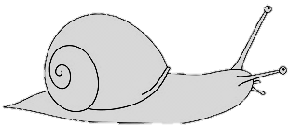
Materials and Methods: Gastropod mucus extraction by gently disrupt the foot tissue
1-2 ml of distill water

Slide 8
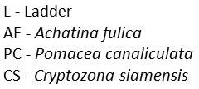
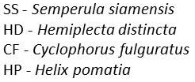
Results: Mucus protein contents
Average protein concentration from seven gastropod species is 1.44 µg/µl.
The mucus of Semperula siamensis had the highest protein concentration.
Gastropod
species

Slide 9
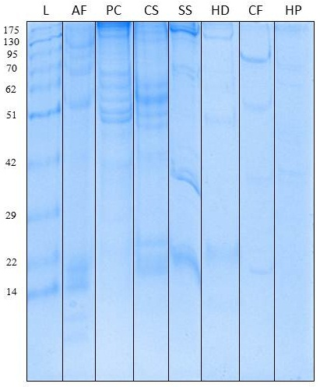
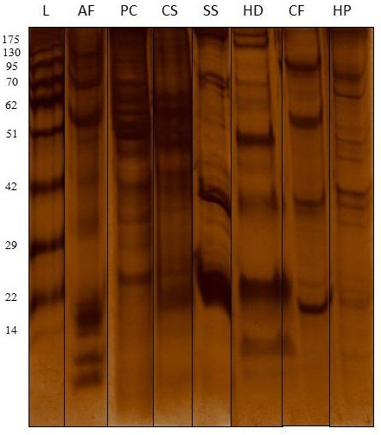
Results: gastropod mucus separated on 1D SDS gels
Different band patterns across seven species
Mucus from the same snail species had highly similar band profiles.
More bands appeared after silver staining.

Slide 10
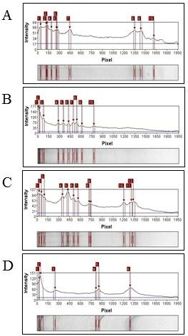
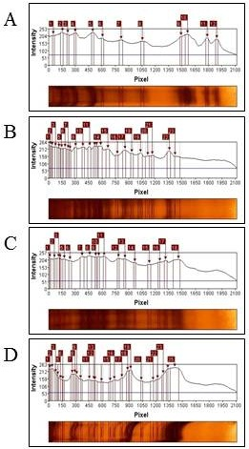
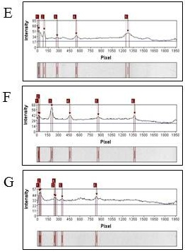
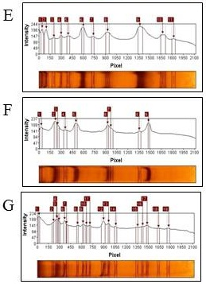
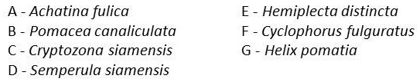
Results: Gel image analysis of mucus band patterns
Gel image analysis by GelAnalyzer program showed different numbers of
protein bands and intensity.

Slide 11
Results: Peptides identified from gastropod mucus
- 2,820 peptides were founded in total and 1,317 peptides shared between these
seven gastropod species.
Peptide
sequence
AF = Achatina fulica
PC = Pomacea canaliculata
CS = Cryptozona siamensis
SS = Semperula siamensis
HD = Hemiplecta distincta
CF = Cyclophorus fulcuratus
HP = Helix pomatia
Gastropod species

Slide 12
Results: Properties of the identified peptides
Several short peptides were identified with similar physicochemical properties.
 | peptide number | average mass | average length | average hydrophobicity | average + charged | average - charged
AF | 2731 | 888.3253 | 8.277554 | 145.413 | 2.654339 | 0.732699
PC | 2415 | 877.3349 | 8.172257 | 143.2505 | 2.615321 | 0.718427
CS | 2360 | 873.5107 | 8.14322 | 142.9225 | 2.618644 | 0.722458
SS | 2415 | 881.6808 | 8.209524 | 143.6244 | 2.65383 | 0.726294
HD | 2404 | 869.2819 | 8.103577 | 143.2113 | 2.604825 | 0.702995
CF | 2393 | 874.6917 | 8.151275 | 142.9068 | 2.618471 | 0.715838
HP | 2396 | 874.9594 | 8.156093 | 141.9366 | 2.641903 | 0.715359

Slide 13
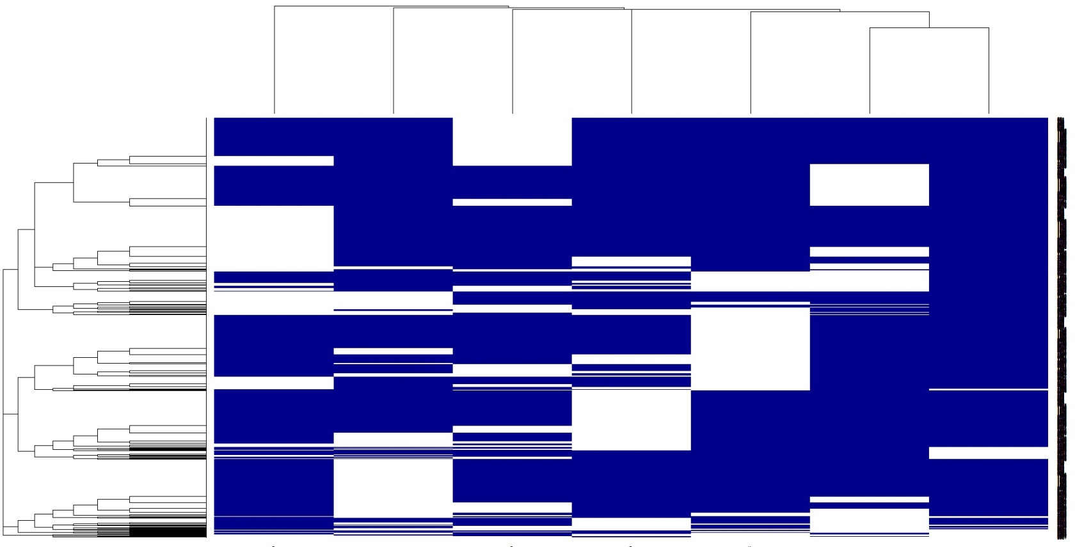
Results: Clustering of mucous peptide patterns
After removing the peptides found in all species, clustering unique peptides
showed different peptide patterns across the seven gastropods species.
- These peptide patterns might be used to distinguish different gastropod species.
peptides
CS HP CF PC HD SS AF
Gastropod species

Slide 14
Discussions
The mucus extracted from seven gastropod species showed different band patterns on SDS-Polyacrylamide gels confirmed by the MS-identified peptides.
Common peptides could play important roles as part of the core mucous proteins or being constituent of the proteoglycans in the mucus.
Variable peptides could be part of unique mucous proteins secreted from the protein glands or from different food sources. More genome information on these gastropods will confirm this findings.

Slide 15
Conclusion
This study successfully extracted and characterized the mucus from seven gastropod species.
SDS-PAGE separation and MS-peptide sequencing identified common and variable peptides from the mucus of seven gastropod species.
The peptide patterns might be used to identify gastropod species from the mucus source. Their bioactive properties will be further characterized for future medical and cosmetic applications.

Slide 16
References
Chase, R., The function of dart shooting in helicid snails. American Malacological Bulletin, 2007. 23(1): p. 183-189.
WAGGE, L.E., The Activity of Amoebocytes and of Alkaline Phosphatases during the Regeneration of the Shell in the Snail, Helix aspersa. Quarterly Journal of Microscopical Science, 1951. s3-92(19): p. 307-321.
Biswas, C., D. Sinha, and C. Mandal, Investigation on interaction of Achatinin, a 9-O-acetyl sialic acid-binding lectin, with lipopolysaccharide in the innate immunity of Achatina fulica snails. Mol Immunol, 2000. 37(12-13): p. 745-54.

Slide 17


Acknowledgements
Dr.Teerasak E-kobon
Dr.Pramote Chuamnanpuen
Dr.Sittiruk Roytrakul
- Do Day Dream Co., Ltd., Bangkok, Thailand
- National Center for Genetic Engineering and Biotechnology, Thailand
- Bioinformatics and Systems Biology Unit, Computational Biomodelling Laboratory
for Agricultural and Technology (CBLAST), Kasetsart University, Thailand
- Department of Zoology, Faculty of Science, Kasetsart University, Thailand
- Department of Genetics, Faculty of Science, Kasetsart University, Thailand

