Slide 1

A Medico-judicial framework for rehabilitation of forensic psychiatric patients in Zimbabwe
Virgininia Dube
http://djvcreative.com/89468/912540/portfolio/headache-relief-center-of-america-logo

Slide 2
Introduction and Context
Forensic psychiatric patients are admitted for rehabilitation in what are called Special Institutions in Zimbabwe
These institutions are hospitals located within a prison setting
Patients are discharged from Special institutions following the recommendations of the Special Boards and Mental Health Review Tribunal
Their port of exit is to a general psychiatric hospital for rehabilitation and not into the community as expected
They often stay in these institutions for more than five years and some are eventually sent back to Special Institutions creating a revolving door scenario

Slide 3
Observation
I observed that there were no guidelines for forensic psychiatric practice and no clear documentation on procedures to be followed in the rehabilitation process in Zimbabwe
An average Zimbabwean should have been able to follow the entry-exit process in the continuum of care for the forensic psychiatric patient
At the time of the conception of the research study, the medico- judicial marriage with regards to rehabilitation of forensic psychiatric patients in special institutions was blurred and discordant

Slide 4
Methodology
Grounded theory (Charmaz 2006,2014)
Exploratory partially mixed sequential dominant status design
Theoretical framework: Pierre Bourdieu’s, conceptual canon of habitus, field and capital

Slide 5
Participants
Purposefully selected
Theoretical sampling
Included:
  Judiciary
  Patients
  Patients’ family
  Psychiatrists
  Nurses
  Social workers
  119 documents/ patients’ files

Slide 6
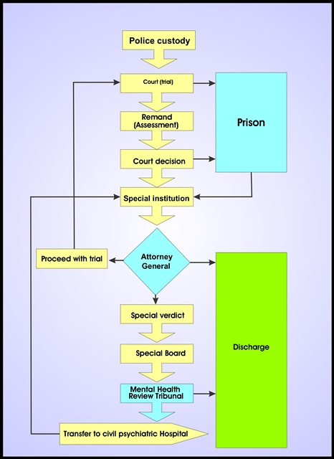
Findings

Slide 7
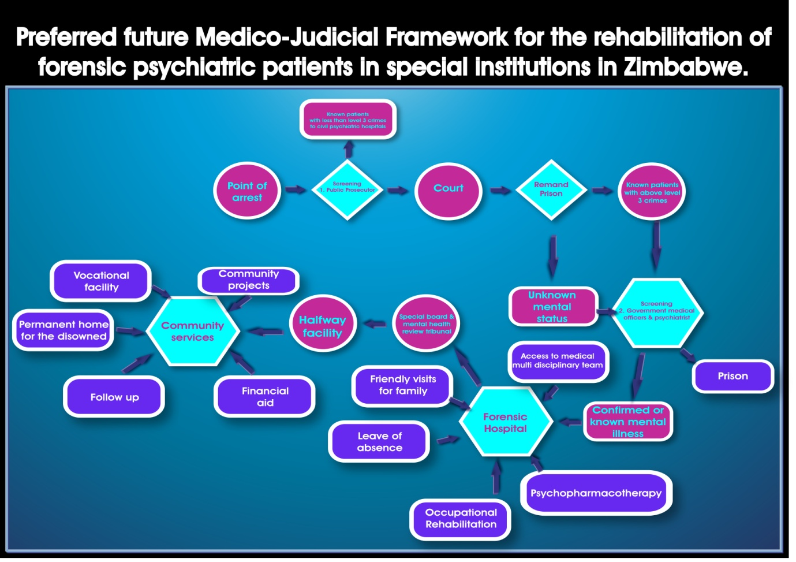

Slide 8
Guidelines for implementing the framework: The vision of a new medico-judicial cosmos
Exposing the dinosaur of obsolescence: Revision of the Mental Health Act of 1996
Change of names and location for the special institutions: Renaming and finding a new home for forensic psychiatry, ‘the bastard child’
Realigning the conatus seseconservandi: Medical staffing of the remand prison
Realigning the engine and the anchor: In-service training workshops for the judiciary

Slide 9
Locating the missing pieces: Awareness campaigns
Repairing the cracked mirror: More psychiatric trained staff than guards in forensic hospital
Exposing the dinosaur of pluralism: Special office and separate clerk of court
Embracing a world without clones: Separating criminal mental patients and forensic psychiatric patients

Slide 10
Navigating the libido dominandi: Integrating the Mental Health Act with the Prison Act of 1996

Slide 11
Contact
virgydube@gmail.com

