Slide 1

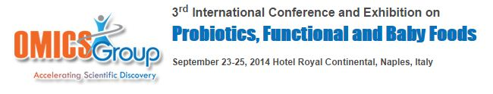
Potential Clinical Applications
of
Probiotics
Vikas Kumar
Associate Professor of Pharmacology
Indian Institute of Technology (Banaras Hindu University)
Varanasi, India

Slide 2
Probiotics - the Science
Microbial ecosystem and mucosal immunity
The intestine contains extensive microbiota (10¹⁰ bacteria cells), located mainly in the colon
The small intestine has a larger bacterial load that consists of facultative anaerobes such as Lactobacilli, Streptococci and Enterobacteria as well as anaerobes such as Bifidobacterium, Bacteroides and Clostridium at levels of 10⁴-10⁸ cells/gm of contents

Slide 3
Contd….
The intestine is the body’s most important immune function–related organ
60% of the body’s immune cells are present in the intestinal mucosa
The immune system controls immune responses against:
Dietary proteins
Prevention of food allergies
Pathogenic microorganisms
Viruses (Rotavirus, Poliovirus)
Bacteria (Salmonella, Listeria, Clostridium etc.)
Parasites (Toxoplasma)

Slide 4
Probiotics - Health Concept
Probiotics health effects exerted by live and viable microorganisms
Probiotics application is independent of the site of action and route of administration
Probiotics application include sites such as the oral cavity, the intestine, the vagina and the skin
In case of probiotic foods, the health effect is usually based on alteration of the gastrointestinal micro flora and therefore based on survival during gastrointestinal transit

Slide 5
Beneficial Effects of Probiotics
Promote lactose digestion
Build resistance to enteric pathogens
Digest food and compete for nutrients with pathogens
Produce bacteriocins to inhibit pathogens
Modulate immune system
Decrease blood lipids and aid in heart diseases
Enhance intestinal barrier function
Stimulate epithelial mucin production
Scavenge superoxide radicals
Compete for adhesion with pathogens
Modify pathogen-derived toxins

Slide 6
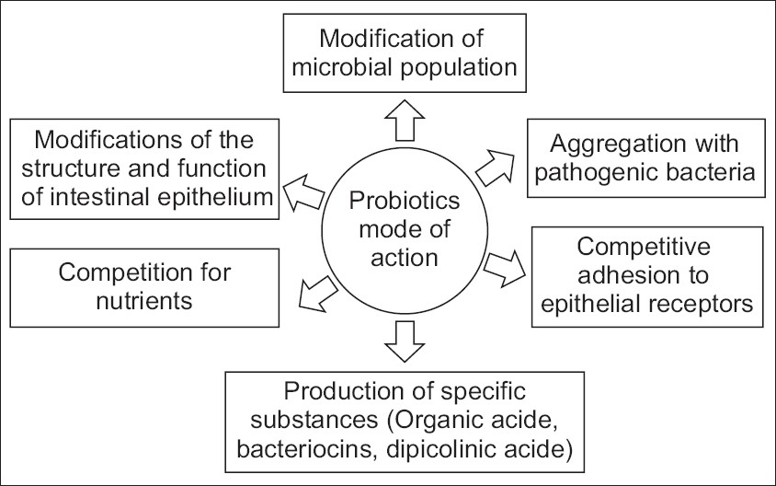
Probiotics - Mode of Action
Tiwari et al, 2012

Slide 7
Probiotics - Clinical Applications
Diarrhea
Colon cancer
Cardiovascular diseases
Prevention of Helicobacter pylori infection
Allergy
Hepatic encephalopathy
Inflammatory bowel disease (IBD)
Irritable bowel syndrome (IBS)
Lactose malabsorption
Urogenital infections

Slide 8
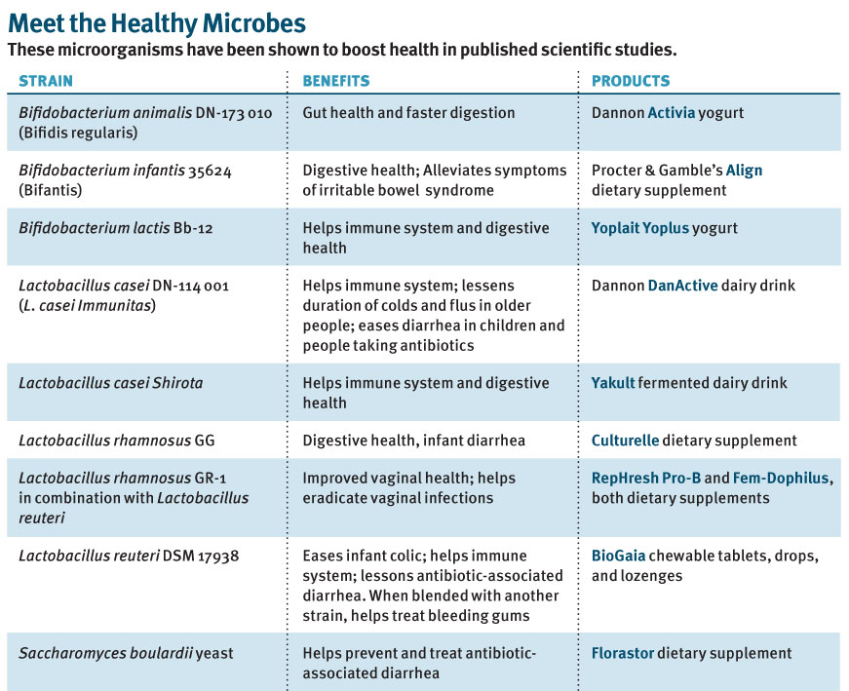
Johannes, 2012

Slide 9
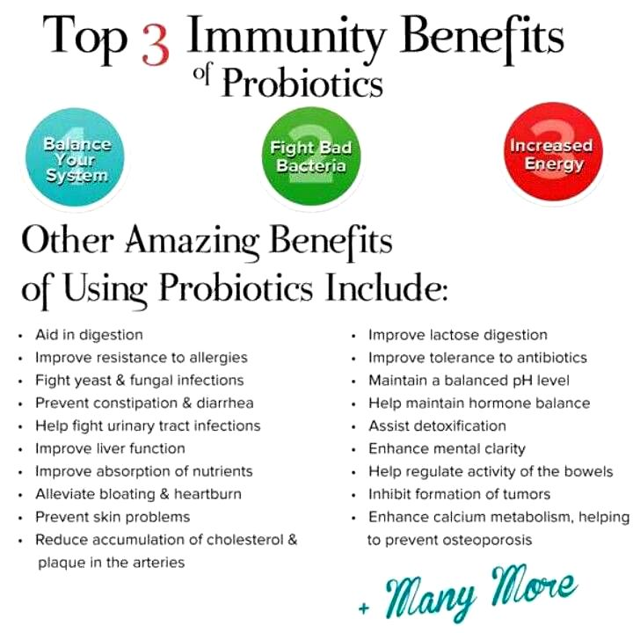
URL: http://fermentingsolutions.files.wordpress.com/2014/03/probiotics-benefits.png?w=361&h=356

Slide 10
Probiotics against Diarrhea
Probiotic strains Lactobacillus reuteri, L. rhamnosus GG, L. casei and Saccharomyces cerevisiae (boulardii) significantly decreases the duration of diarrhea in children
Probiotics
Oral Rehydration Salts
Shortens the duration of
acute diarrheal illness in children

Slide 11
Contd….
Probiotics
Modulation of gut microbiota
Production of antimicrobial substances
Competition for adhesion sites
Stimulation of mucus secretion
Modulation of immune response
Prevention of Diarrhea

Slide 12

Antibiotic Associated Diarrhea
Disease
Antibiotic treatment
Disturbance of
gut microbiota
Probiotics
Balance Microbiota
Clostridium overgrowth produces toxins
Diarrhea

Slide 13
Probiotics and Cancer
Enzymes of Gut Flora
Glycosidase
β- glucuronidase
Azoreductase
Nitroreductase
Probiotics
Pre-carcinogens
Active carcinogens
Oligofructose plus two probiotic strains (L. acidophilus and L. casei) supplementation in humans helped to decrease levels of these gut flora enzymes

Slide 14
Contd….
Probiotics
Binding/inactivation of mutagenic compounds
Production of anti-mutagenic compounds
Suppression of growth of pro-carcinogenic bacteria
Reduction of the absorption of carcinogens
Enhancement of immune function
Inﬂuence on bile salt concentrations
Prevents Cancer Growth

Slide 15
Probiotics and Heart Diseases
Probiotics
Assimilation of cholesterol by bacterial cells
Deconjugation of bile acids by bacterial acid hydrolases
Cholesterol-binding to bacterial cell walls
Reduction of hepatic cholesterol synthesis
Redistribution of cholesterol from plasma to liver
Bacterial production of short-chain fatty acids
Reduction of blood cholesterol level

Slide 16
Helicobacter pylori Infection
Probiotics
Production of antimicrobial substances
Stimulation of the mucus secretion
Competition for adhesion sites
Stimulation of speciﬁc and non-speciﬁc immune responses
Prevention of Helicobacter pylori infection

Slide 17
Probiotics and Allergy
Probiotics
Reverse increased intestinal permeability
Enhance gut-specific IgA responses
Promote gut barrier function
Modulation of immune response
Enhance IL-10 and cytokines production that promote production of IgE antibodies
Beneficial in Allergy and Atopic diseases

Slide 18
Hepatic Encephalopathy
Probiotics
Decrease portal blood ammonia by reduced bacterial urease activity
Decrease portal blood pH due to less ammonia absorption
Decrease inflammation and oxidative stress due to reduced ammonia toxins
Reduce uptake of other toxins
Prevention of Hepatic Encephalopathy

Slide 19
Inflammatory Bowel Disease
Probiotics
Modulation of immune response
Modulation of gut microbiota
Beneficial in Inflammatory Bowel Disease

Slide 20
Ulcerative colitis
The probiotic strain E. coli Nissle strain may be equivalent to Mesalazine in maintaining remission of ulcerative colitis
Probiotics have shown efficacy to induce and maintain remission in children and adults with mild-to-moderate ulcerative colitis

Slide 21
Irritable Bowel Syndrome
Probiotics
Reduction of intestinal gas production
Modulation of gut microbiota
Beneficial in Irritable Bowel Syndrome
Probiotic strains Bifidobacterium Infantis in addition to Lactobacillus reuteri may improve Colicky symptoms within one week of treatment

Slide 22
Lactose Malabsorption
Probiotics
Action of bacterial β-galactosidase on lactose
Relief from Lactose Indigestion
Streptococcus thermophilus and L. delbrueckii subsp. bulgaricus improve lactose digestion and reduce symptoms related to lactose intolerance

Slide 23
Urogenital Tract Disorders
Probiotics
Production of antimicrobial substances
Competition for adhesion sites
Competitive exclusion of pathogens
Relief from Urogenital Infection

Slide 24
Probiotics in Pregnancy
Bacterial vaginosis, increases the risk of preterm labour and infant mortality
Probiotics decrease the risk of bacterial vaginosis and maintain normal Lactobacilli vaginal flora
L. rhamnosus GG and B. lactis BB12 can be prevented atopic dermatitis of newborn babies in 50% of cases, if mothers ingest probiotics during pregnancy and newborns ingest them during the first 6 months of life

Slide 25
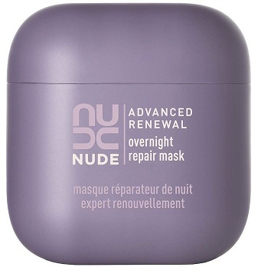
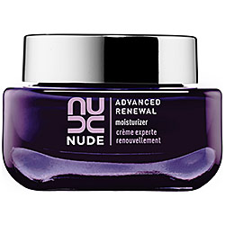
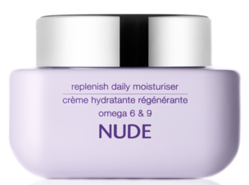
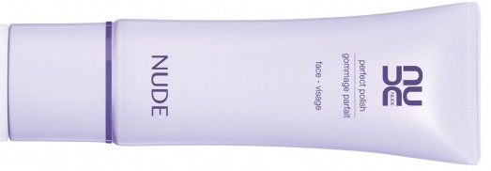
Probiotics in Skincare Products
Probiotic skincare product NUDE Skincare© was first introduce in 2007 by NUDE Brands Ltd., UK/USA
Probiotics help balance internal digestion and also stabilize microflora on the skin
Yogurt increases certain probiotic strains in skin that protect skin from environmental stressors, soothes skin and improves moisture retention

Slide 26
Future Trends and Research
The benefits of probiotics go way beyond gut health
Probiotics
Inflammatory cytokines
Neurotransmitter release
Useful in Depression
&
Anxiety

Slide 27
Contd….
Probiotics
Reduces pathogenic bacteria in the nasal passages
Balances microflora in the nasal cavity
Useful in Nasal Congestion
&
sinusitis

Slide 28
Contd….
Probiotics
Inflammatory cytokines in skin
Microbial flora in skin
Useful in Acne, Psoriasis, Eczema and Dermatitis

Slide 29
Contd….
Probiotics
Development of new strains
Improves insulin sensitivity
Facilitates glucose transport
Reduces blood LDL level
Useful in Type-2 Diabetes
&
Obesity

Slide 30
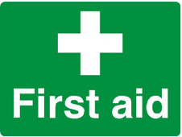
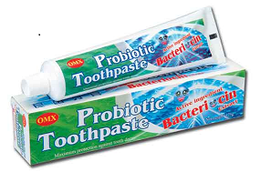
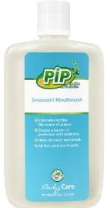
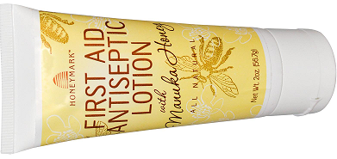
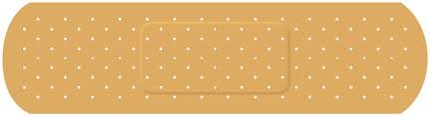
Contd….
Probiotics
Production of antibiotic that
kills pathogenic microbes
Development of oral hygienic products
Probiotic strains incorporate into antiseptic powder and lotions

Slide 31
Conclusion
Probiotics have clearly established as an adjuvant in the management of lactose malabsorption and acute diarrhea, particularly acute infant diarrhea
Probiotic agents appear promising for the management of C. difficile colitis, atopic disease, necrotizing enterocolitis and other gut conditions, such as inflammatory bowel disease
Further, well-designed clinical trials, involving large numbers of patients, are mandatory to achieve definite evidence of the preventive and curative role of probiotics in medical practice

Slide 32
Thank you
for your attention !

