Slide 1
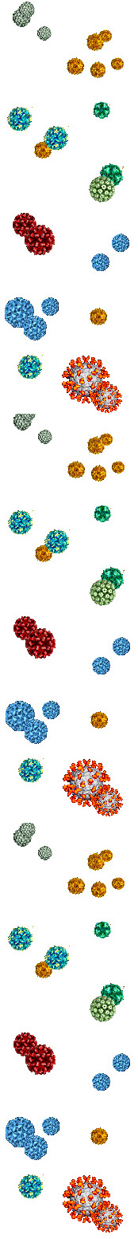

The HBx oncoprotein of hepatitis B virus promotes
cell transformation by stimulating rDNA transcription
and ribosome biogenesis
Vijay Kumar, Ph.D.
(vijay@icgeb.res.in)
Scientist, Virology Group
International Centre for Genetic Engg. and Biotechnology (ICGEB)
New Delhi, India
Virology-2015, Atlanta
07 Dec. 2015

Slide 2
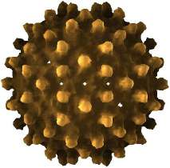
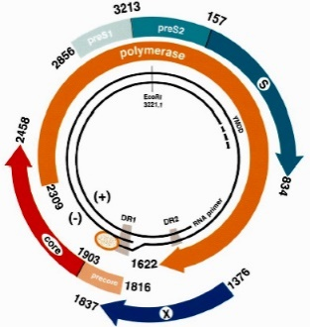
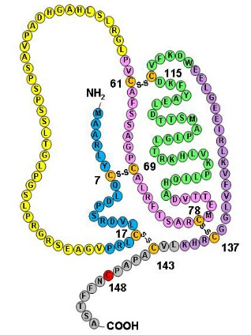
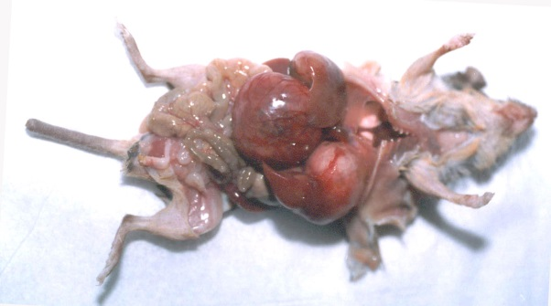
Oncogenic properties of HBx
HBV (DNA virus)
HBx oncoprotein
154 aa long, 16.5 KDa,
Transactivator
Cell transformation in culture
Possible mechanisms of HCC
HBx transgenic mice
Deregulation of cell cycle checkpoints
Mitogenic signaling (e.g., MAPK, ras etc)
Oncogenic cooperation (e.g., c-Myc)
Interference with proteasomal machinery (e.g., Skp2, USP37)

Slide 3
Ribosome biogenesis: Achilles heel of cancer?
Q
Does viral HBx support ribosome biogenesis
during
Hepatocarcinogenesis?

Slide 4
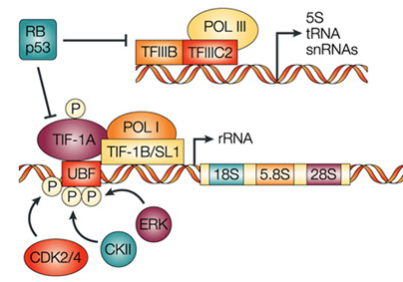
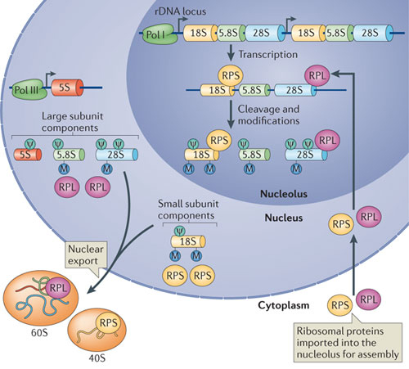
Pol I transcription & ribosome biogenesis

Slide 5
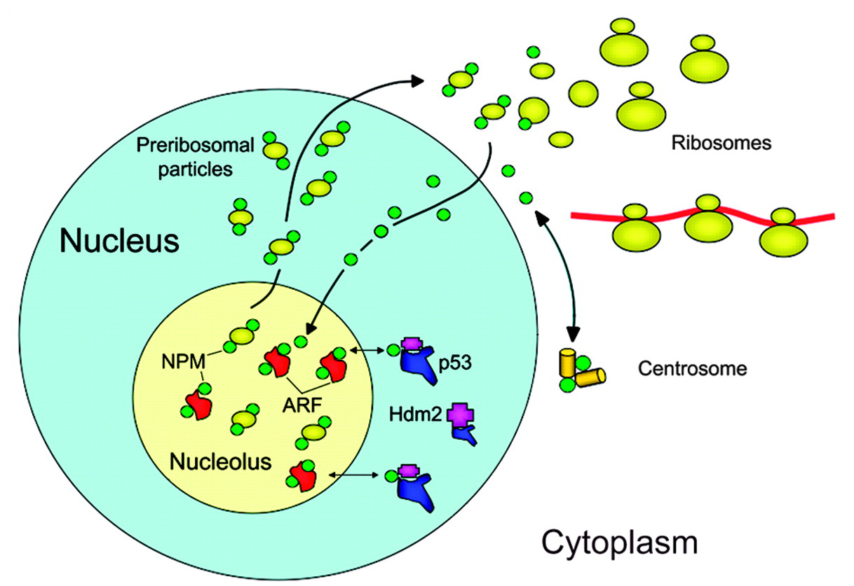
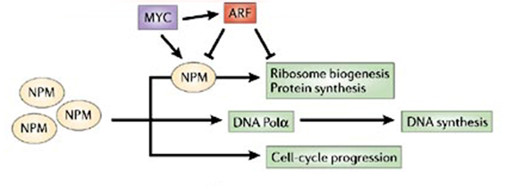
Nucleolar protein nucleophosmin (NPM) & ribosome biogenesis
NPM (B23), Nucleolin & fibrillarin
~20% of the total nucleolar protein content
(~700 proteins)
NPM

Slide 6
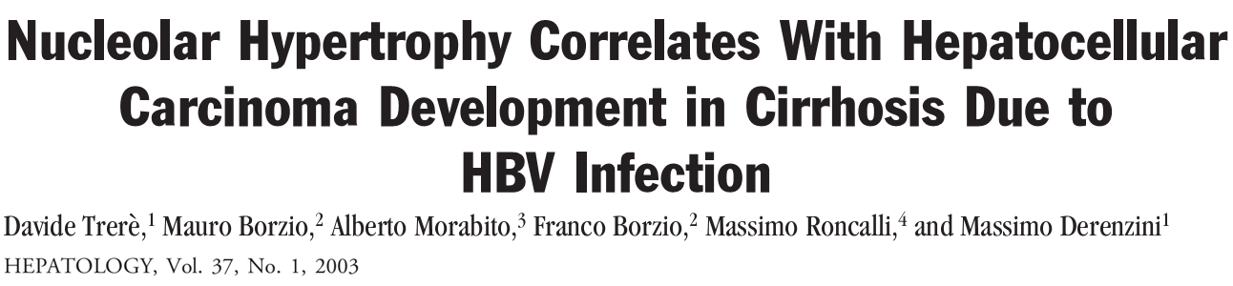
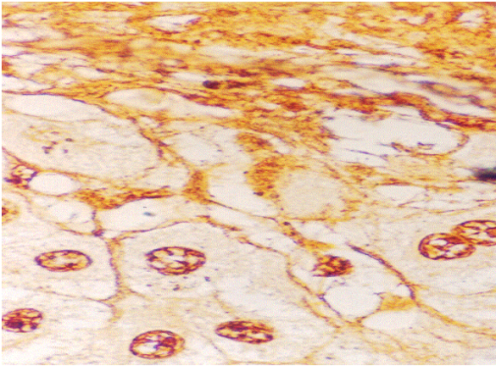
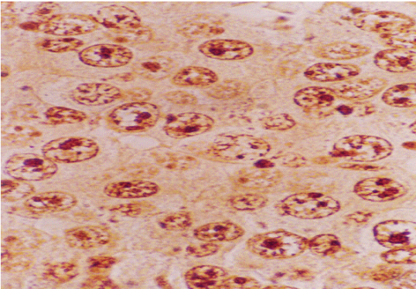
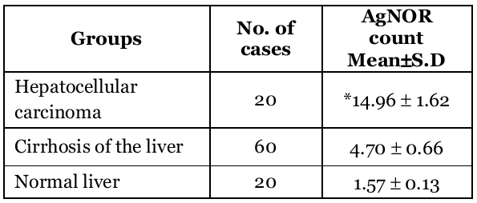
No. of AgNOR (Argyrophilic nucleolar organizer region) dots rises with increasing proliferative activity of cells
Liver section with cirrhosis of the liver
Liver section showing hepatocellular carcinoma
*p<0.001
Tahseen et al, Biomedica , 2006

Slide 7
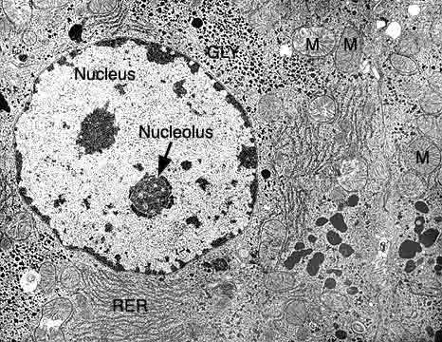
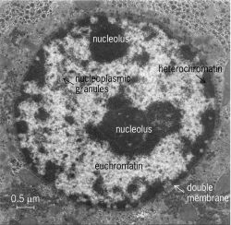
Alteration in the nucleolar architecture of hepatocytes
Normal
HCC

Slide 8
Scope of our study
How does HBx influence the UBF-NPM axis
& enhance
rDNA transcription, Ribosome biogenesis & Cell transformation
Ahuja et al., BBA, 1853, 1783-1795, 2015
Rajput et al., Virol J, 12, 62, 2015

Slide 9
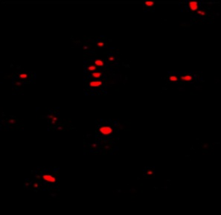
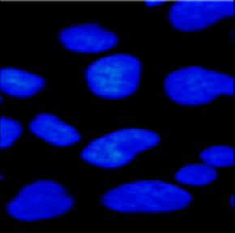
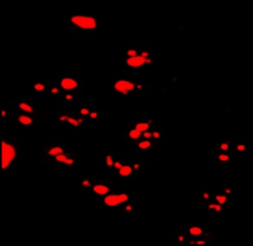
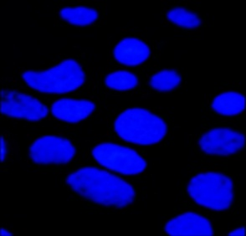
UBF expression in the presence of HBx
α-UBF
DAPI
Vector
HBx
 UBF expression in cells

Slide 10
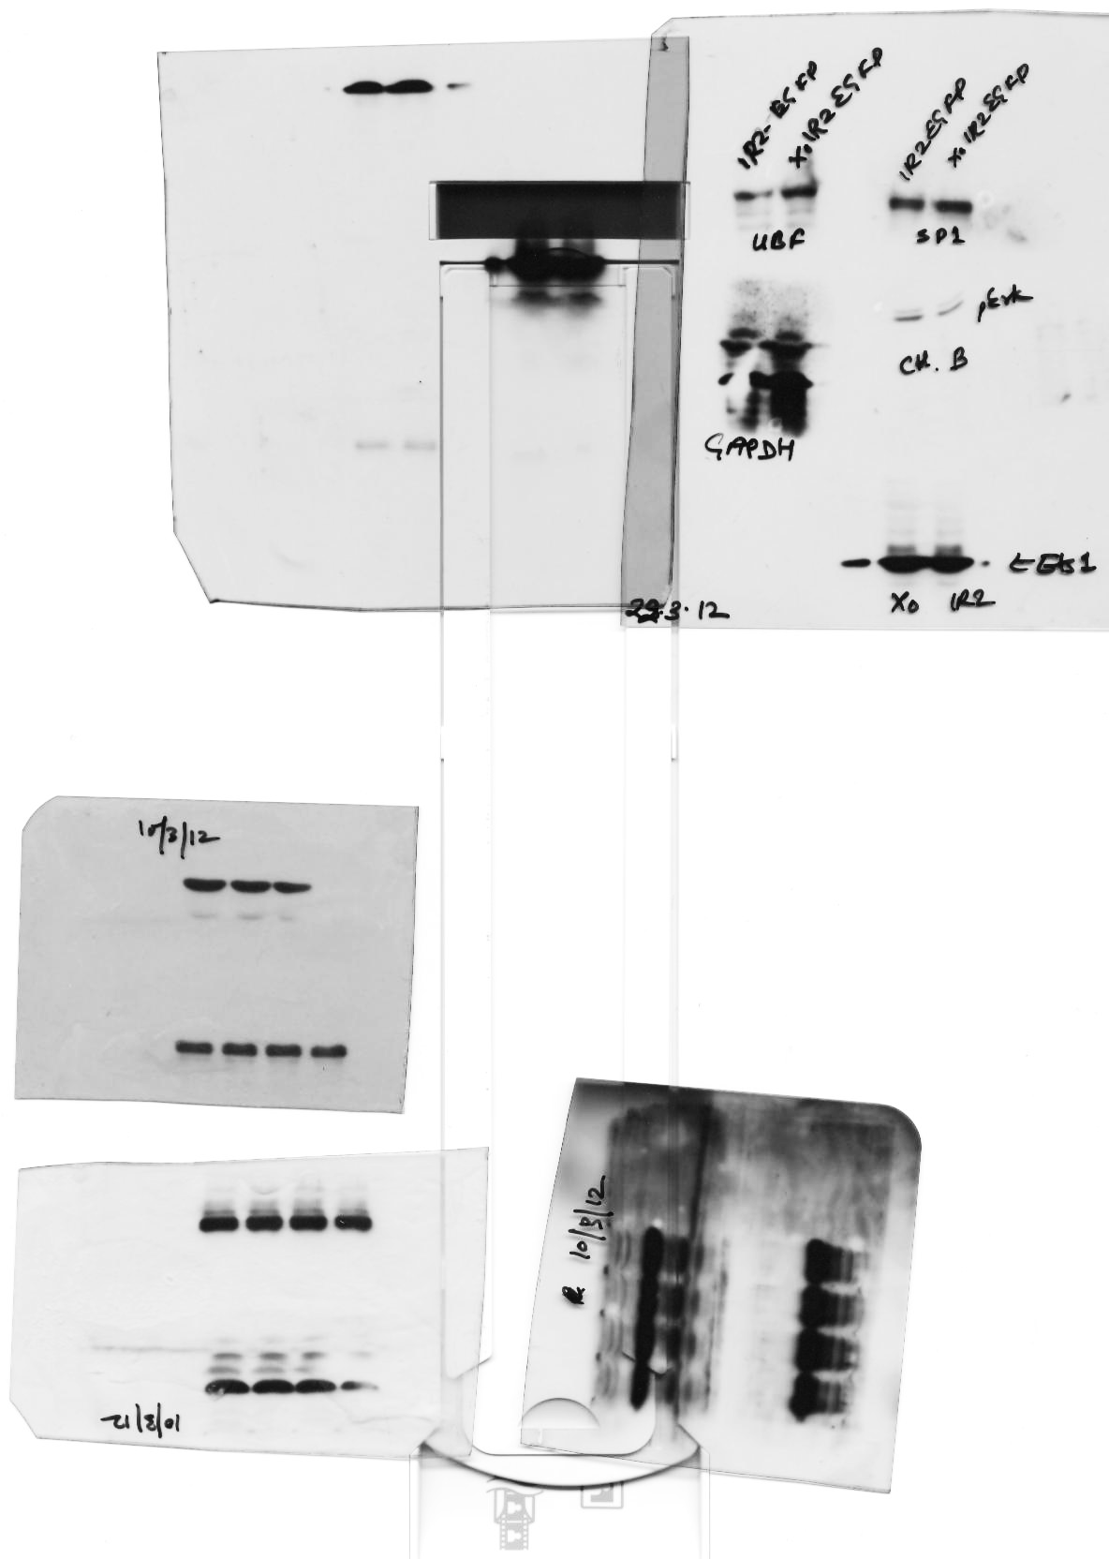


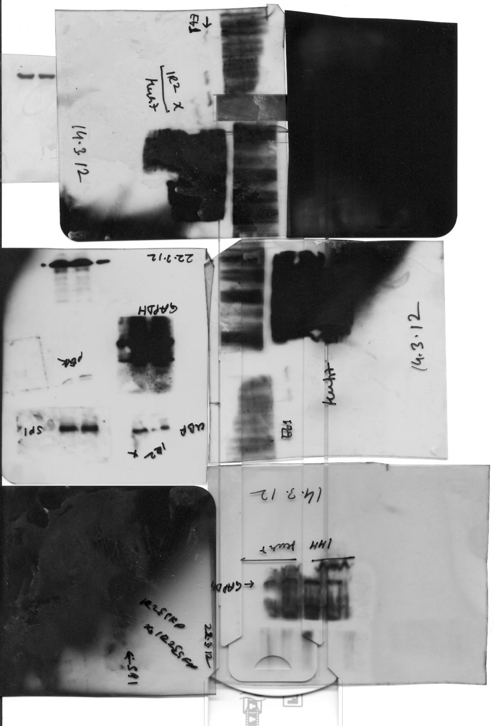

 UBF expression in the presence of HBx
A
B
*
C
*
*
Relative expression of UBF mRNA
Relative expression of UBF mRNA
mRNA
Vector HBx
Vector HBx
Huh7
IHH
HepG2
HepG2.2.15
A’
B’
C’
HepG2.2.15
Huh7
IHH
HepG2
α-UBF
α-UBF
α-UBF
1 1.8
1 1.6
1 1.4
Protein
α-HBx
α-HBx
α-HBx
α-GAPDH
α-GAPDH
α-GAPDH
Vector HBx
Vector HBx

Slide 11
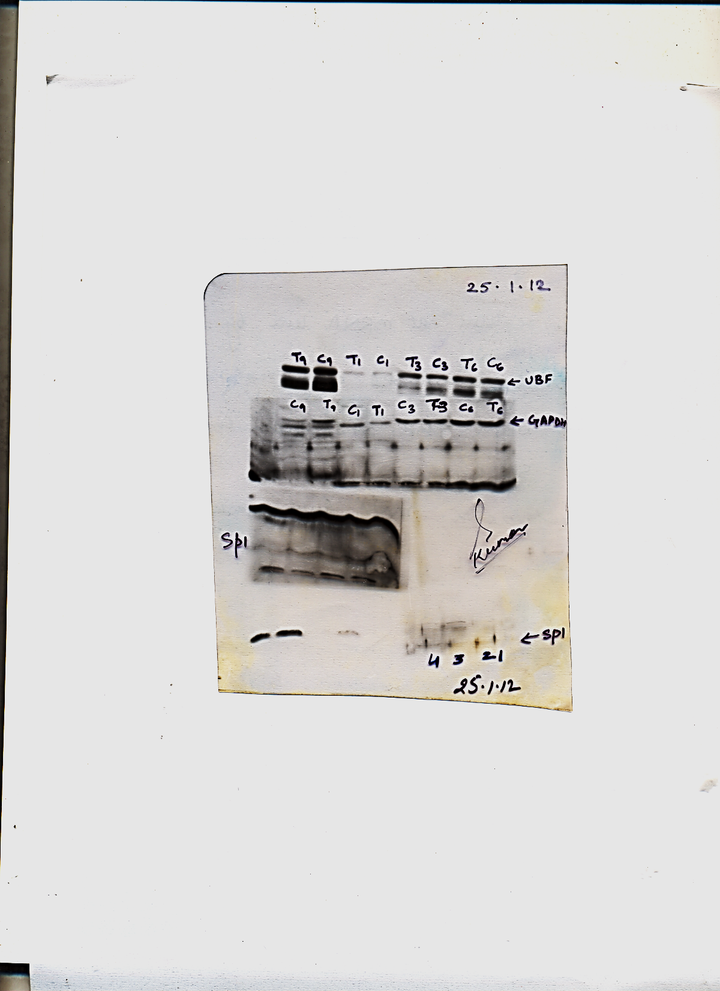


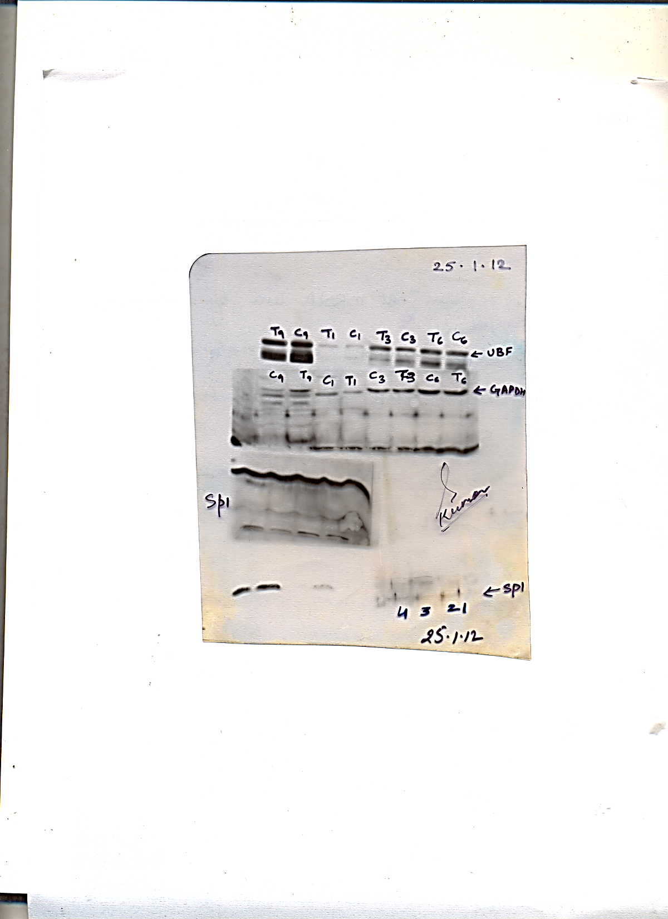


 UBF expression in the HBx transgenic mouse liver
A
*
*
*
Relative expression of UBF mRNA
Relative expression of UBF mRNA
Relative expression of UBF mRNA
mRNA
Control
X15-myc
Control
X15-myc
Control
X15-myc
1 3 6
Animal age (months)
B
α-UBF
1 1.7
1 1.6
1 2.0
Protein
α-GAPDH
Control
X15-myc
Control
X15-myc
Control
X15-myc
1 3 6
Animal age (months)

Slide 12
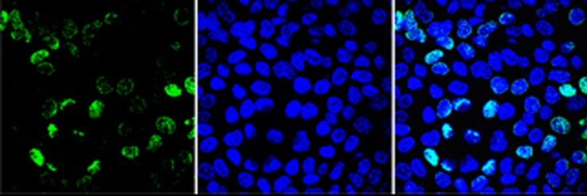
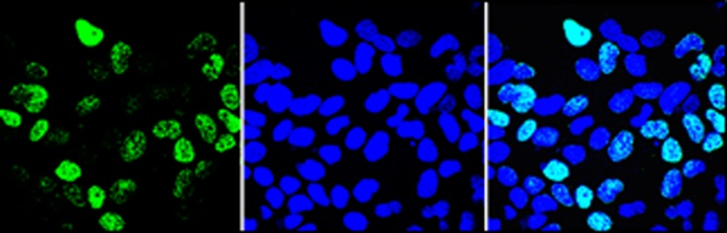
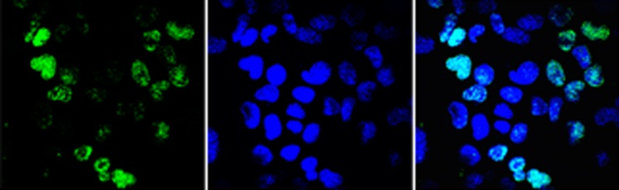
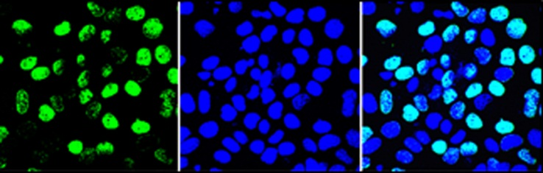
 Cell proliferation following HBX-UBF co-expression
BrdU DAPI Merge
*
*
*
*
HBx + UBF UBF HBx Vector
 BrdU incorporation in cells

Slide 13
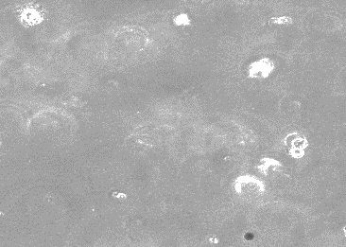
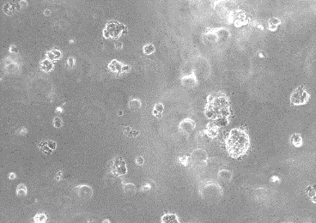
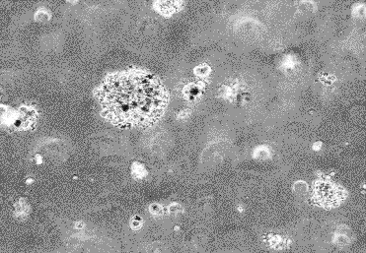
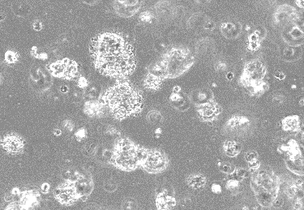
Oncogenic co-operation between HBx & UBF
Vector HBx
*
*
UBF HBx + UBF
 Colony formation

Slide 14
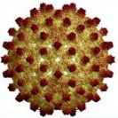
Summary : HBx-UBF interaction
HBV
HBx
Upstream Binding Factor (UBF)
RNA pol I on rDNA
rDNA transcription &
Ribosome biogenesis
Cell proliferation &
Cell transformation

Slide 15
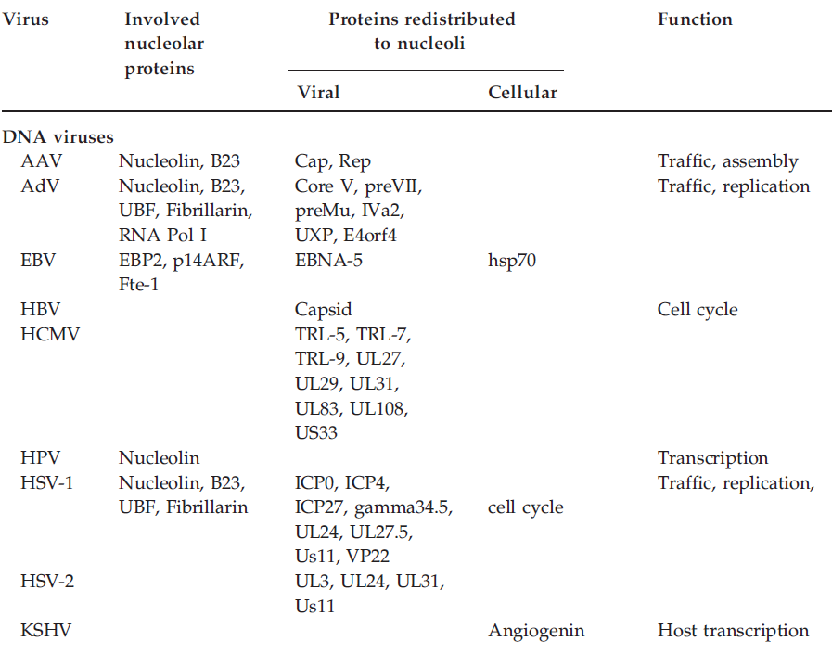
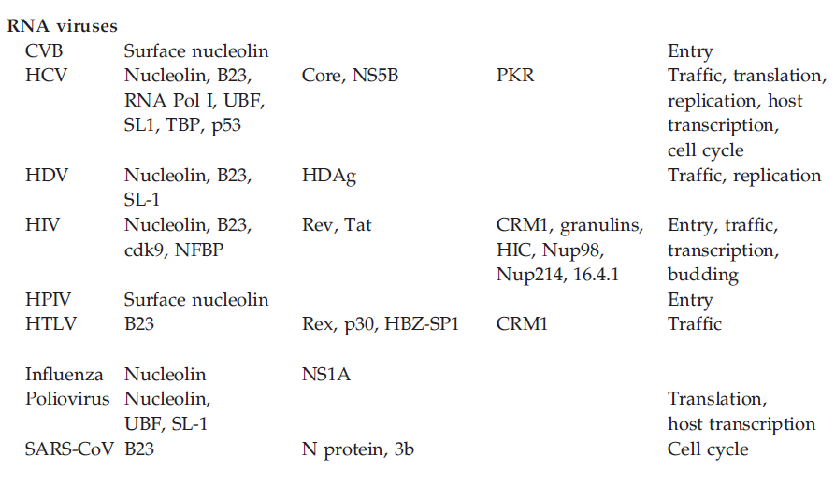
Do viruses alter Nucleolar protein levels?
??
Anna Greco,
Rev. Med. Virol., 2009

Slide 16
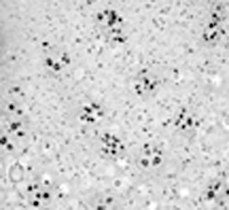
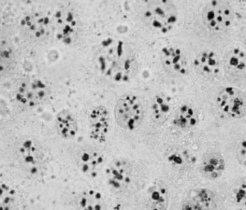






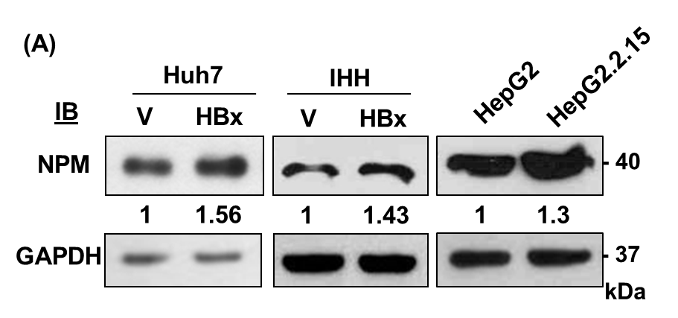
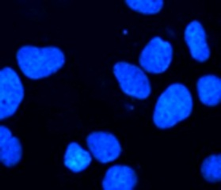
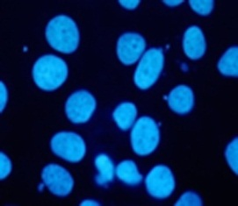
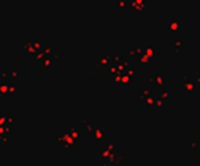
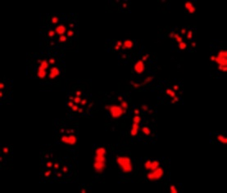
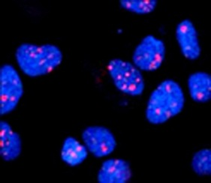
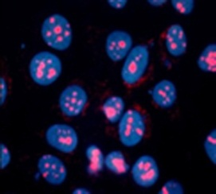



Status of Nucleolar proteins in the presence of HBx
Control
HBx Tg
mouse
A
Vector HBx
C
HBx transfection
Cell lines
13% 23%
AgNOR staining: Cells Liver tissue
B
Vector HBx
DAPI
α-Fibrillarin
D
Tg. HBx mouse
1
3
Age (months)
C
T
C
T
WB
α-NPM
Merge
α-Fibrillarin
α-GAPDH
1 2 3 4

Slide 17
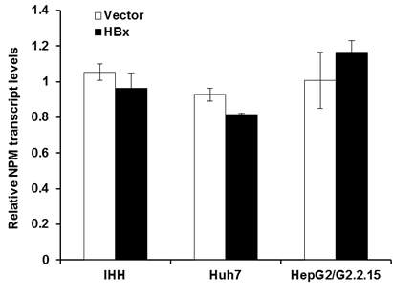
NPM gene expression in the presence of HBx
No change in NPM transcript levels (by RT-qPCR)

Slide 18
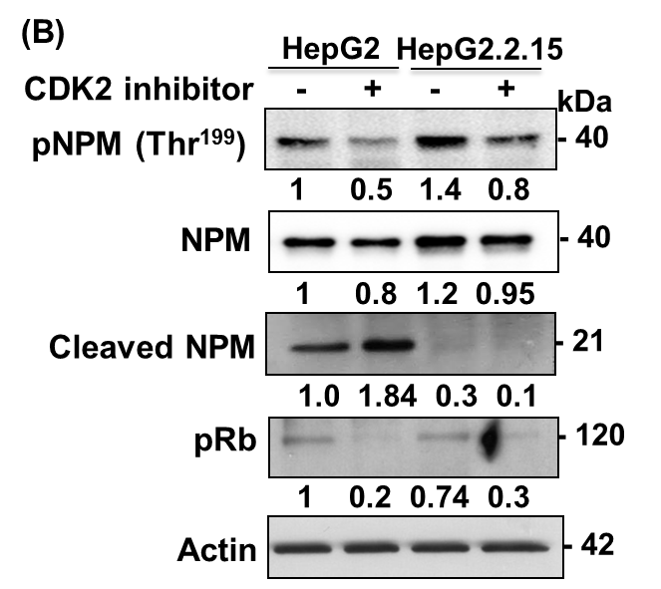
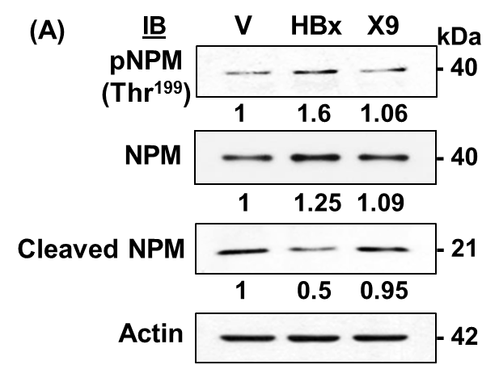

NPM protein is stabilized in the presence of HBx
NPM cleavage
 phosphorylation by CDK2 &  proteolytic cleavage

Slide 19


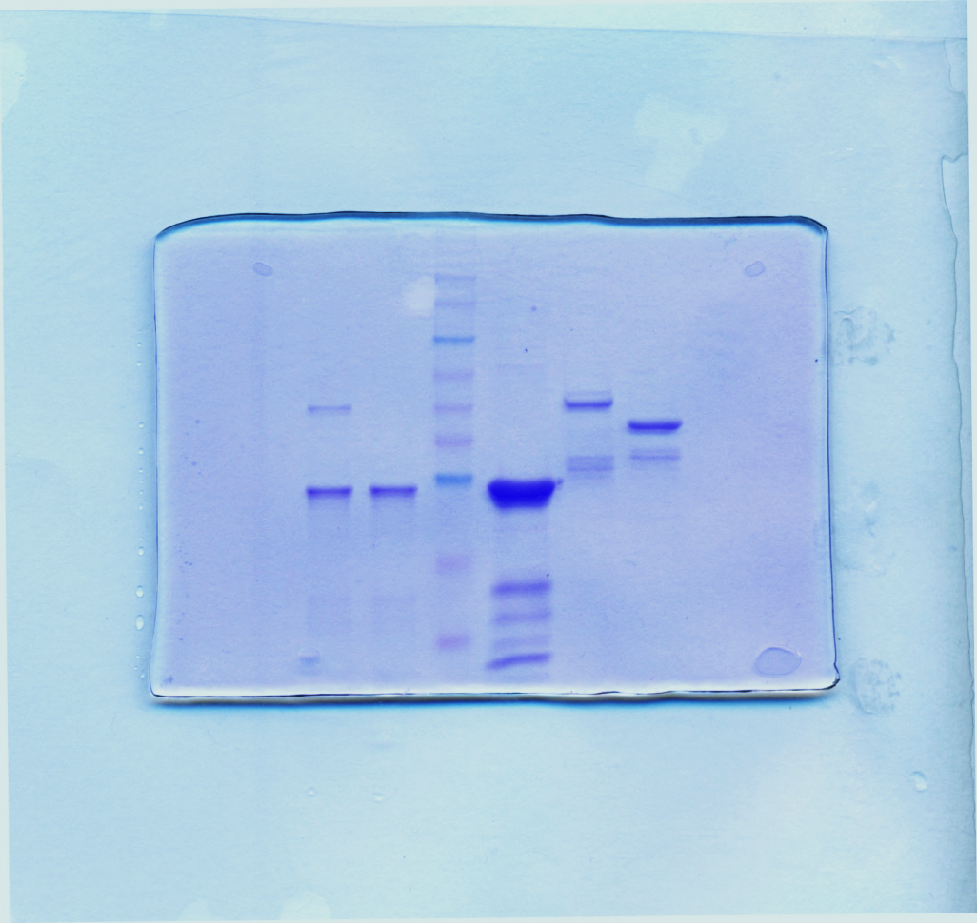
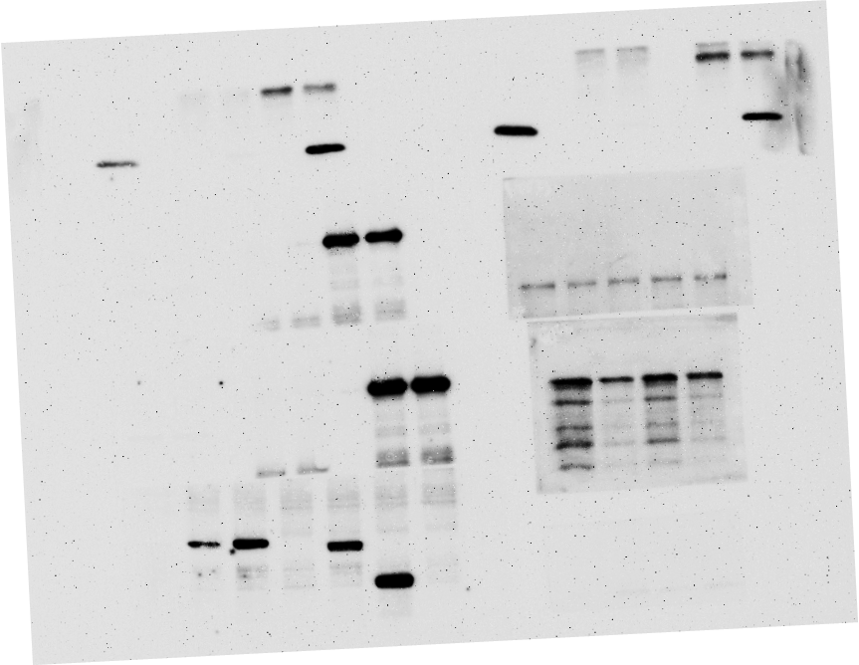

Direct interaction between HBx & NPM
His-NPM +
A
Input
IP: NPM
B
MBP-HBx
MBP-HBx
MBP
His-NPM
Marker
Marker
MBP
V HBx
V HBx
IB
kDa
MBP-HBx
-95-
MBP
IB
α-NPM
-70-
-62-
α-HBx
α-HBx
-51-
-42-
α-NPM
-29-
1 2 3 4
5 6 7
8 9
Input
His-Pull down
His-Pull down
Coomassie staining
Western Blot
C

Slide 20
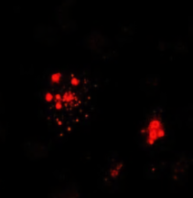
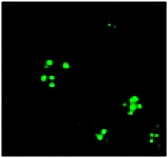























Nucleolar translocatin of HBx by NPM
A
HA-HBx
FLAG-NPM
DAPI
Merge
WT-NPM
NPM C1
NPM C2
NPM C3
NPM | NPM localization | HBx localization | Interaction with HBx
WT-NPM (overexpressed / endogenous) | Nucleoli | Cytoplasm, nuclear, nucleolar | +
NPM C1 | Nucleoli/ Nucleoplasm | Cytoplasm | -
NPM C2 | Nucleoli/ Nucleoplasm | Cytoplasm | -
NPM C3 | Nucleoli/ Nucleoplasm | Cytoplasm | -
NPMc | Cytoplasm | Cytoplasm | +
NPMc
B
HBx
NPM
DAPI
Merge
HepG2.2.15

Slide 21

HBx-NPM co-expression:  rDNA transcription
#
#
A
*
*
B
#
+ HBx

Slide 22


HBx-NPM co-expression:
 Ribosome biogenesis & cell proliferation
B
A
C

Slide 23
HBx-NPM co-expression:  Cell-transformation
A
I
II
Vector
B
HBx
NPM+HBx
NPM C3+HBx
Colony formation assay

Slide 24
Summary: HBx-UBF-NPM axis in HCC
HBx
HBx
 stability
NPM
NPM
HBx microenvironment
 UBF expression
 NPM stabilization
 Nucleolar transport of HBx
 rDNA transcription &
cell proliferation
Conclusions:
Engagement of Pol I machinery
by HBx - a novel mechanism of virus-induced oncogenesis.
HBx
HBx
NPM
NPM
Nucleolar
translocation
cdk2
 UBF expression
P
HBx
NPM
P
HBx
Nucleolus
rDNA promoter
NPM
Nucleosome Disassembly
Ribosome biogenesis
Abnormal cell proliferation
RNA Pol I
Caspase-3
Nucleosomes
Transcription factors

Slide 25



Acknowledgements
Pallavi Rajput
Funding:
ICGEB – Core grant
CSIR - (Council of Scientific and Industrial Research, Govt. of India)
DBT (Department of Biotechnology, Govt. of India)
Richa Ahuja

Slide 26

Thank you
Wildflower Hall, Shimla, India

