Slide 1



The Prince Charles Hospital
Metro North Hospital
and Health Service
Clinical Effectiveness of Physiotherapy-led Vestibular Service in tertiary hospital
Vicky Stewart (nee Woodhead), BPhty
Senior Physiotherapist, TPCH; PhD student, ACU
Vicky_stewart@hotmail.com.au
PhD Supervisors: Prof. Nancy Low Choy & Dr. Dilani Mendis

Slide 2
Why look at clinical effectiveness?
Dizziness/ Vertigo are common reasons for ED presentations
(Kroenke & Hoffman, 2000)
Vestibular Disorders in Emergency Department (ED): not optimally managed (Newman-Toker, 2009)
Referral to Physiotherapy Vestibular Rehab from ED: not routine practice (to assess and manage vestibular disorders) (Polsenek, 2008)
Vestibular disorders not managed optimally may cause:
  Ongoing symptoms of dizziness/ vertigo (Herdman, 2000)
  Medical consultations/ referrals, re-presentation to hospital
  Medication use (Buchman, 2010)
  Interference with daily activities (Whitney, 2000)
  Loss of balance, falls and fall related injuries (Hall, 2004)
  increased healthcare costs (Lo & Harada, 2013)

Slide 3
Current Vestibular Service
No. of referrals for outpatient vestibular- physio
1 FTE Vestibular Physiotherapist
- 0.4 FTE permanent since Jan 2014
- 0.6 temporary since Jan 2015 (Awaiting business case)
Receive referrals from MOs in ED / wards (630 bed hospital)
  - Assess patients whilst in ED/ wards
  - Run daily out-patient Vestibular Rehab Physiotherapy Clinics
Notes:
630 bed hospital

Slide 4
Vestibular Rehabilitation (VR)
VR incorporates:
Physical manoeuvres to remove particles from the canals (BPPV) (Bhattachayya, 2008)
Education of the patient (Herdman, 2000)
Exercise regimes that aim to maximise vestibular adaptation, thus reducing vertigo, dizziness and nausea (McDonnell, 2015)
Habituate patients to motion sensitivity (Clendaniel, 2010)
Improve balance and gait (Hillier & McDonnell, 2011)
Introduce substitution strategies as required (Herdman, 2000)

Slide 5
Aims of the Study
To investigate clinical effectiveness of a physiotherapy-led, hospital-based vestibular service by:
  Determining initial and longer-term outcomes
  Comparing immediate & delayed intervention pathways.

Slide 6
Methods of study
Design:
Prospective, observational study, reporting baseline, discharge and follow-up outcomes
Settings:
Emergency/ acute hospital setting/ hospital-based vestibular clinic
Participants:
Adults presenting to hospital with non-emergent dizziness
Exclusion criteria:
- Known cardiac/ stroke diagnosed;
- Unable to provide informed consent (intoxication, mental disability, language barrier);
- Fracture/ injury limiting assessment

Slide 7
Methods
Patients presenting to hospital with non-emergent dizziness,
screened (VST) & referred to Physio Vestibular Service
Aim 1:
Determine clinical effectiveness of Physio-led, hospital based vestibular service
Physiotherapy Assessment & VR Treatment
Discharge Assessment completed – Short term effectiveness?
3/12 Follow-up Assessment completed – Longer term effectiveness?

Slide 8
Methods
Patient presenting to hospital with non-emergent dizziness,
screened (VST) & referred to Physio Vestibular Service
Determined by availability and timing of the referral
Immediate Intervention pathway
Treatment commenced whilst in hospital / immediate post-discharge period (48 hours)
Delayed Intervention Pathway
Discharged home from hospital
Placed on wait-list for vestibular assessment & management
Aim 2: Determine clinical outcomes for immediate & delayed referral pathways
Follow-up Physiotherapy Treatment
Discharged: assessment completed
3/12 Follow-up assessment completed

Slide 9
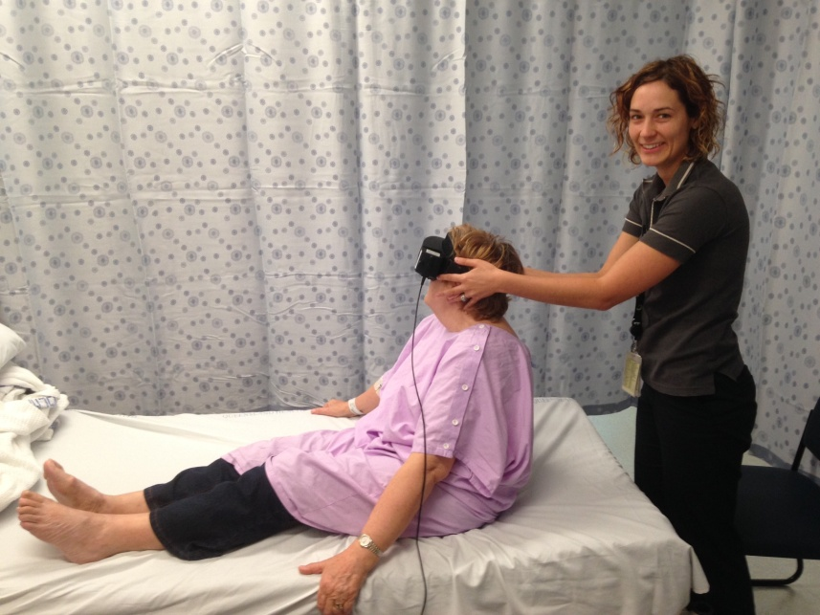
Clinical diagnostic tests on Initial Assessment
Video Frenzel and Video HIT utilized for assessment
Comprehensive subjective examination
Nystagmus: Spontaneous, Gaze-evoked
Smooth Pursuit and Saccadic Eye Movement
Test of Skew Deviation
VOR Cancellation Test
Head Impulse Test (HIT)
Head-Shaking Nystagmus (HSN)
Positional Tests including Hallpike-Dix and Head Roll Test
Pressure/ Fistula testing when indicated
DVA static vs. dynamic
Vestibular diagnostic clinical tests used to categorise patients:
  Vestibular impairment
  Non-vestibular impairment
Notes:
All clinical diagnostic tests were completed by a trained vestibular physiotherapist on initial assessment to categorise patients as vestibualr or non-vestibular.
I performed all diagnostic assessments

Slide 10
Vestibular Disorder Diagnosis
Test | Diagnosis
Positive Hallpike Dix, Head Roll Test (Bhattachayya, 2008) | BPPV
Positive head impulse test / video head impulse test + Acute vestibular crisis history (nil central features) (Luxon, 2007) | Acute vestibular neuritis, unilateral/ bilateral vestibular hypofunction
Episodic symptoms of fluctuant hearing loss, vertigo, tinnitus or ear blockage confirmed by a specialist (Luxon, 2007) | Meniere’s Disease
Migraine headaches as per international headache criteria and vestibular symptoms of imbalance, vertigo/ dizziness/ unsteadiness (Lempert, 2013) | Migraine Vertigo
Direction-changing gaze-evoked nystagmus or pure down-beating/ up-beating/ torsional nystagmus (Herdman, 2000) | Indicative of central pathology
If unclear and symptoms of vestibular dysfunction presented, the patient was categorised as ‘other vestibular’ and referred for further specialist assessment

Slide 11
Outcome Measures
Initial/ Discharge/ Follow-up assessment
Subjective improvement in dizziness (McDonnell, 2015)
  Patient report improved/ same/ worse
Vestibular Screening Tool (VST) (Stewart, 2015)
  Scores of ≥4/8 indicate vestibular disorder
  Demonstrates concurrent validity with DHI
  2 point change demonstrates clinically meaningful change
Dizziness Handicap Inventory (DHI) (Jacobson, 1990)
  Scores >60 = severe vestibular dysfunction, greater functional impairment (Whitney, 2004)
Functional Gait Assessment (FGA) (Wrisley, 2004; Wrisley, 2010)
  ≤22/30 predict prospective older fallers
Activities Balance Confidence Scale – Short form (Schepens, 2010)
  Balance confidence measure 0-100%.
Notes:
Don’t talk about each specific OM here

Slide 12
Results - Demographics
Characteristics | Total Group (n=193) | Immediate Intervention (n=112) | Delayed Intervention (n=81)
Mean age ± SD (y) | 64 ± 15 (19–94) | 63 ± 16 (30–94) | 65 ± 14 (19–91)
Female, n (%) | 115 (59.6) | 63 (56.3) | 52 (64.2)
Falls past 12-months, n (%) | 57 (29.5) | 28 (25.5) | 29 (36.7)
Independent Gait, n (%) | 152 (78.8) | 77 (77.8) | 75 (93.8)
Non-vestibular, n (%) | 37 (19.2) | 22 (19.6) | 15 (18.5)
Vestibular, n (%) | 156 (80.8) | 90 (80.4) | 66 (81.5)

Slide 13
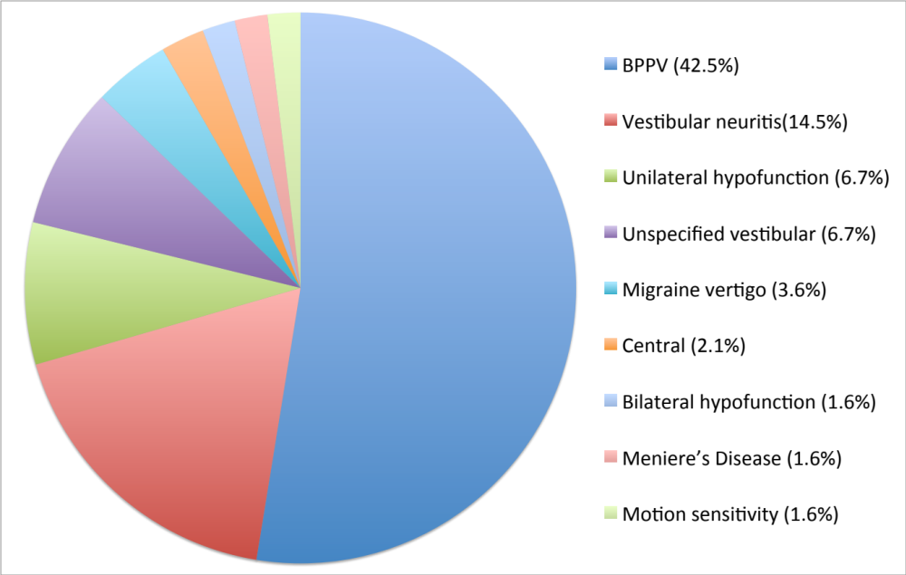
Clinical Vestibular Diagnosis

Slide 14
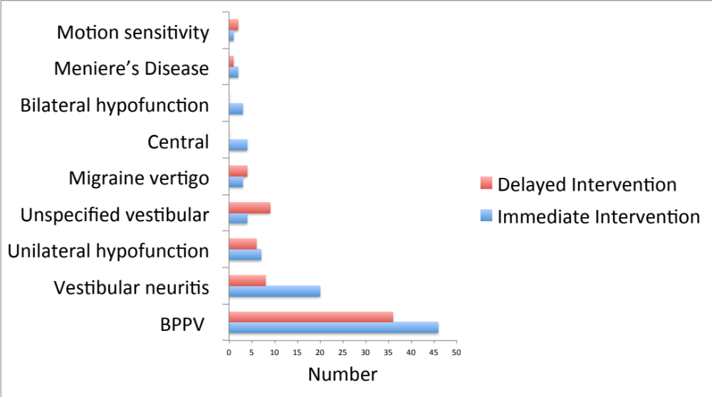
Intervention Groups
Clinical Vestibular Diagnosis

Slide 15
Results
 | Total Group (n=193) | Immediate (n=112) | Delayed (n=81)
Diagnosed as vestibular | 156 (80.8%) | 90 (80.3%) | 66 (81.5%)
Completed discharge Ax | 105 (67.3%) | 67 (74.4%) | 38 (57.6%)
Completed Follow-up Ax | 73 (69.5%) | 44 (65.7%) | 29 (76.3%)
Immediate and delayed groups completed similar No. of Physiotherapy sessions: 3.24 – 3.28
Immediate group assessed within 48hrs of presenting to hospital
Delayed group waited an average 22 days (3-77 days) for initial Ax

Slide 16
Subjective Improvement
No significant difference in subjective rating scale between immediate and delayed groups (p>.05)

Slide 17
Vestibular Screening Tool (VST)
Significant difference between immediate and delayed group on initial Ax
Notes:
No significant worsening between discharge and follow-up assessment

Slide 18
Vestibular Screening Tool (VST)
Significant difference between immediate and delayed group on initial Ax
Both groups’ scores were abnormal (ie. ≥4/8) on initial Ax
Notes:
No significant worsening between discharge and follow-up assessment
Discuss what VST means

Slide 19
Vestibular Screening Tool (VST)
***
Significant difference between immediate and delayed group on initial Ax
Both groups’ scores were abnormal (ie. ≥4/8) on initial Ax
Significant improvements between initial–discharge, initial–follow-up, for both groups
Notes:
2 point change clinicallly meaningful change

Slide 20
Dizziness Handicap Inventory (DHI)
* (.01)
Mild significant difference between immediate and delayed groups on initial assessment

Slide 21
Dizziness Handicap Inventory (DHI)
Mild significant difference between immediate and delayed groups on initial assessment
Immediate and Delayed groups were approaching the ‘severe’ DHI level

Slide 22
Dizziness Handicap Inventory (DHI)
***
No significant difference between immediate and delayed groups on initial assessment
Immediate and Delayed groups were approaching the ‘severe’ DHI level
Significant improvements between initial and discharge, initial and follow-up, for both groups

Slide 23
Functional Gait Assessment (FGA)
***
Significant difference between immediate and delayed groups on initial assessment

Slide 24
Functional Gait Assessment (FGA)
***
Significant difference between immediate and delayed groups on initial assessment
Both groups scored below 22/30 on initial Ax = predictive of falls

Slide 25
Functional Gait Assessment (FGA)
***
***
***
Significant difference between immediate and delayed groups on initial assessment
Both groups scored below 22/30 on initial Ax = predictive of falls
Significant improvements between initial and discharge, initial and follow-up, for both groups

Slide 26
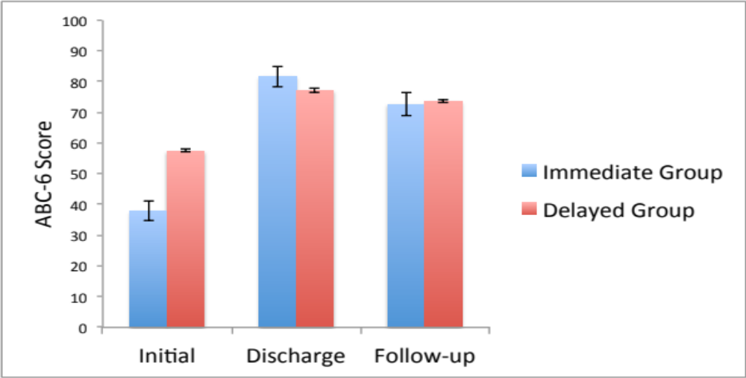
Activities Balance Confidence: Short Form 6
***
***
* (.01)
Significant difference between groups at initial assessment
Both groups scored below 60/100 on initial – low balance confidence
Significant improvements by discharge and folllow-up assessment

Slide 27
Summary
People who present to hospital with a vestibular dysfunction have:
  Moderate - severe dizziness impairment
  Significant functional limitations
  Increased risk of falling
  Poor community ambulation
  Low balance confidence
Resultant symptoms and functional impact of a vestibular disorder do not always spontaneously resolve, even 3 weeks after hospital.
Physio VR intervention produced significant improvements in:
  Dizziness impairment
  Balance confidence
  Functional gait
Results were maintained 3 months post discharge
Notes:
- There were no significant differences between the immediate/ delayed groups by discharge or follow-up, demonstrating that both groups achieved similar results.
- The significant improvements in self-reported dizziness impairment and functional gait and balance performances maintained three-months after discharge
- No significant differences in the improvement achieved in self-reported dizziness impairment (VST, DHI, DHI sub-categories) and balance confidence (ABC-6) between the immediate and delayed groups.

Slide 28
Summary
Delayed group had persistent symptoms until management commenced (> 3weeks after ED presentation) ie did not spontaneously improve
Both immediate and delayed physiotherapy intervention groups responded to VR & achieved similar results by D/C
Significant improvements maintained three-months after discharge
A physiotherapy-led vestibular service demonstrated clinical effectiveness in Mx of dizzy patients presenting to hospital
Patients presenting to hospital with a suspected vestibular disorder should be considered for referral to a physiotherapy-led vestibular service in the hospital setting.

Slide 29
Limitations/ further Research
Limitations:
Differences in patient profile in the immediate & delayed groups whilst in ED is unknown
Costs to patients & healthcare service for delayed group not calculated
Further Research:
Psycho-social impact on patients during wait-list period requires FU
Rate of falls, representations/ re-admissions to hospital requires FU
Proportion referred to Audiology/ Neurology/ ENT/ Psychology for FU
Longer-term (>3/12) follow-up required
Burden of Care to be established

Slide 30
References
Kroenke, K., & Hoffman, R. M. (2000). How common are various causes of dizziness? A critical review. Southern Medical Journal, 93(2), 160-167.
Newman-Toker, D. E., Camargo, C. A., Jr., Hsieh, Y. H., Pelletier, A. J., & Edlow, J. A. (2009). Disconnect between charted vestibular diagnoses and emergency department management decisions: a cross-sectional analysis from a nationally representative sample. Academic Emergency Medicine, 16(10), 970-977. doi: 10.1111/j.1553-2712.2009.00523.x
Polsenek, S. H., Sterk, C. E., & usa, R. J. (2008). Screening for vestibular disorders: a study of clinicians' compliance with recommended practices. Medical Science Monitor, 14(5), 238-242.
Herdman, S. (2000). Vestibular Rehabilitation. Philadelphia: FA Davis Company.
Buchman, A. S., Shah, R. C., Leurgans, S. E., Boyle, P. A., Wilson, R. S., & Bennett, D. A. (2010). Musculoskeletal pain and incident disability in community-dwelling older adults. Arthritis Care Res (Hoboken), 62(9), 1287-1293. doi: 10.1002/acr.20200
Bohannon, R.W. (1997). Comfortable and maximum walking speed of adults aged 20-79 years: Reference values and determinants. Age Ageing, 26, 15-19.
Hall, C.D., Schubert, M.C., & Herdman, S.J. (2004). Prediction of fall risk reduction as measured by dynamic gait index in individuals with unilateral vestibular hypofunction. Otology & Neurotology, 25(5), 746-751.
Lo, A. X., & Harada, C. N. (2013). Geriatric dizziness: evolving diagnostic and therapeutic approaches for the emergency department. Clinical Geriatric Medicine, 29(1), 181-204. doi: 10.1016/j.cger.2012.10.004
Bhattacharyya, N., Baugh, R. F., Orvidas, L., Barrs, D., Bronston, L. J., Cass, S., . . . Haidari, J. (2008). Clinical practice guideline: benign paroxysmal positional vertigo. Otolaryngology Head Neck Surgery, 139(5 Suppl 4), S47-81. doi: 10.1016/j.otohns.2008.08.022

Slide 31
References
McDonnell, M. N., & Hillier, S. L. (2015). Vestibular rehabilitation for unilateral peripheral vestibular dysfunction. Cochrane Database of Systematic Reviews, 13(1). doi: 10.1002/14651858.CD005397.pub4
Clendaniel, R.A. (2010). The effects of habituation and gaze stability exercises in the treatment of unilateral vestibular hypofunction: a preliminary results. Journal of Neurologic Physical Therapy, 34(2), 111-116.
Hillier, S. L., & McDonnell, M. (2011). Vestibular rehabilitation for unilateral peripheral vestibular dysfunction. Cochrane Database Systematic Reviews(2), CD005397. doi: 10.1002/14651858.CD005397.pub3
Luxon, L. M., & Bamiou, D. E. (2007). Vestibular system disorders. In A. H. Schapira (Ed.), Neurology and clinical neuroscience (Vol. 1, pp. 337-353). Philadelphia: Mosby Elsevier.
Lempert, T. (2013a). Vestibular Migraine. Semin Neurol, 33(3), 212-218.
McDonnell, M. N., & Hillier, S. L. (2015). Vestibular rehabilitation for unilateral peripheral vestibular dysfunction. Cochrane Database of Systematic Reviews, 13(1). doi: 10.1002/14651858.CD005397.pub4
Stewart, V., Mendis, M.D., Rowland, J., & Low Choy, N. (2015). Construction and Validation of the Vestibular Screening Tool for use in the Emergency Department and Acute Hospital Setting. Archives of Physical Medicine Rehabilitation, 96, 1253-1260.
Jacobson, G. P., & Newman, C. W. (1990). The development of the Dizziness Handicap Inventory. Archives Of Otolaryngology--Head & Neck Surgery, 116(4), 424-427.
Wrisley, D.M., & Kumar, N.A. (2010). Functional Gait Assessment: Concurrent, discriminative and predictive validity in community dwelling older adults. Phys Ther, 90(5), 761-773.
Wrisley, D.M., Marchetti, D.F., Kuharsky, D.K., & Whitney, S.W. (2004). Reliability, internal consistency, and validity of data obtained with the functional gait assessment. Phys Ther, 84, 906-918.

Slide 32
Acknowledgements & Funding
Acknowledgements: Sue Lewandowski (Physiotherapist) Dr Jeff Rowland (Specialist)
Funding: HP Research Grant ($20,000.00) QRPN Research Grant ($2,000.00)

Slide 33
Questions?
Thank-you
vicky_stewart@hotmail.com.au

Slide 34
Clinical Diagnosis | Total (n = 193) | Immediate (n = 112) | Delayed (n = 81)
- Non-vestibular, n (%) - Vestibular: n (%) | 37 (19.2) | 22 (19.6) | 15 (18.5)
BPPV | 82 (42.5) | 46 (41.1) | 36 (44.4)
Vestibular neuritis | 28 (14.5) | 20 (17.9) | 8 (9.9)
Unilateral hypofunction | 13 (6.7) | 7 (6.3) | 6 (7.4)
Bilateral hypofunction | 3 (1.6) | 3 (2.7) | 0 (0.0)
Migraine vertigo | 7 (3.6) | 3 (2.7) | 4 (4.9)
Meniere’s Disease | 3 (1.6) | 2 (1.8) | 1 (1.2)
Central | 4 (2.1) | 4 (3.6) | 0 (0.0)
Motion sensitivity | 3 (1.6) | 1 (0.9) | 2 (2.5)
Unspecified vestibular | 13 (6.7) | 4 (3.6) | 9 (11.1)

Slide 35
Results - Demographics
Characteristic | Total group (n = 193) | Immediate Intervention (n = 112) | Delayed Intervention (n = 81)
Mean age ± SD (y) | 64 ± 15 (19–94) | 63 ± 16 (30–94) | 65 ± 14 (19–91)
Female, n (%) | 115 (59.6) | 63 (56.3) | 52 (64.2)
Falls past 12 months, n (%) | 57 (29.5) | 28 (25.5) | 29 (36.7)
Independent gait, n (%) | 152 (78.8) | 77 (77.8) | 75 (93.8)

Slide 36
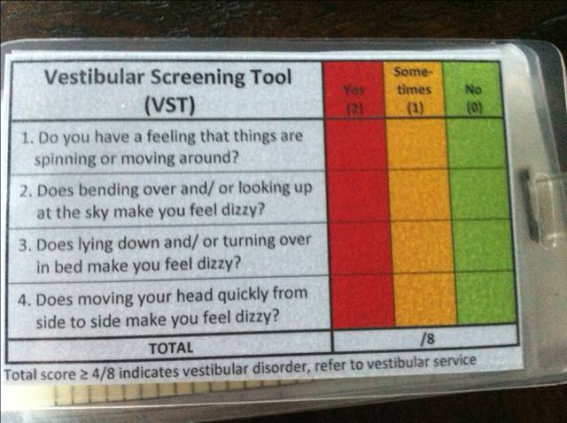
29_85 30_85 31_85 32_85 33_85
VST: Vestibular Screening Tool (Stewart et al, 2015)
Stewart, V., Mendis, M.D., Rowland, J., Low Choy, N.L. (2015) Construction and Validation of the Vestibular Screening Tool for Use in the Emergency Department and Acute Hospital Setting. Archives of Physical Medicine and Rehabilitation 96 (12): 2153-60
VST is Valid & Reliable tool for use in hospital setting
High Sensitivity (83%) & Specificity (84%) for identifying a likely vestibular disorder when patients present to hospital with non-emergent dizziness
Uni-dimensional internal construct validity
High inter-rater reliability (0.988 ICC)
High intra-rater reliability (0.878 ICC)

Slide 37
29_85 30_85 31_85 32_85 33_85
VST Validation Results Study #1
Vestibular Disorder
VST Scores ≥ 4/8:
    Predict vestibular dysfunction as cause to non-emergent dizziness
≥4/8
VST Scores ≤3/8:
    Non-vestibular cause to dizziness more likely
Non-Vestibular Disorder

Slide 38
VST – Vestibular Screening Tool
 | Yes | Sometimes | No
1. Do you have a feeling that things are spinning or moving around?
2. Does bending over and/ or looking up at the sky make you feel dizzy?
3. Does lying down and/ or turning over in bed make you feel dizzy?
4. Does moving your head quickly from side to side make you feel dizzy?
Yes = 2
Sometimes = 1
No = 0
TOTAL / 8
Notes:
The responses requested for each question are Yes, Sometimes and No.
The Questions on the VST are:
Do you have a feeling that things are spinning or moving around?
Do you feel unsteady, as though you may lose your balance?
Does bending over and/ or looking up at the sky make you feel dizzy?
Does lying down and/ or turning over in bed make you feel dizzy?
Does moving your head quickly from side to side make you feel dizzy?
2. Yes = 2 Points
Sometimes = 1 point
No = 0 points
TOTAL out of 10 points

Slide 39
Statistics
Means / SD outcome measures determined for initial, discharge & follow-up assessment
Linear mixed Models
  Determined significance of the mean difference of measures across continuum of care
  Compared differences in mean scores between immediate & delayed intervention groups

