Slide 1
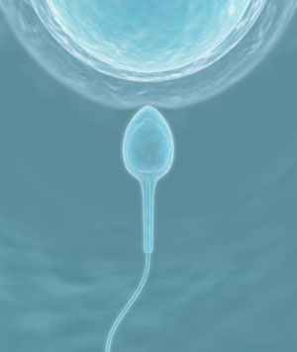
6th World Congress on Biotechnology
Association of novel candidate genes with impaired spermatogenesis in infertile patients: Genomic & transcriptomic approach
Vertika Singh
Doctoral Student
Department of Molecular & Human Genetics
B.H.U., Varanasi

Slide 2
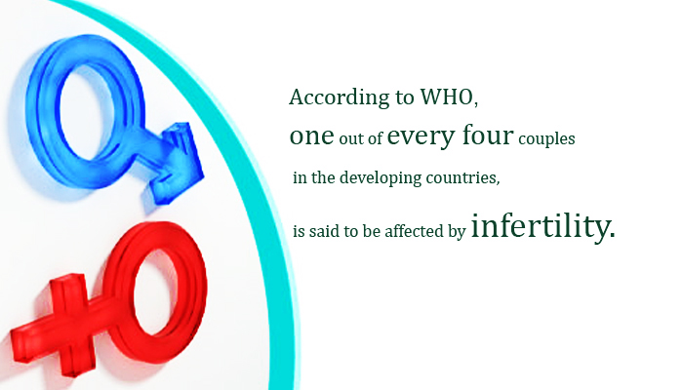
Definition of Infertility
Infertility applies to couples who fail to achieve a pregnancy after 1 year of regular coitus without any contraception.

Slide 3
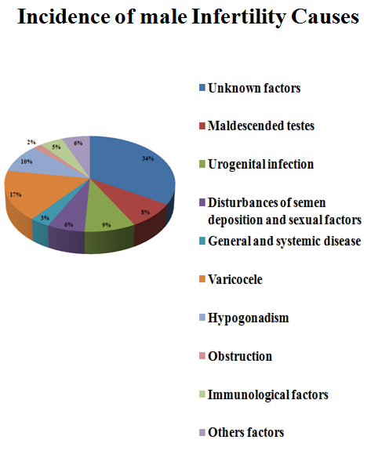
Etiology

Slide 4
Spermatogenesis
Spermatogonia A
MITOSIS
SPERMATOCYTOGENESIS
Spermatogonia B
Spermatocyte I
Altered gene expression of important pathways can affect the process of spermatogenesis.
Aberrant epigenetic regulation may also affect the formation of spermatozoa.
MEIOSIS
Spermatocyte II
SPERMATOGENESIS
Round Spermatid
Elongated Spermatid
SPERMIOGENESIS
DIFFERENTIATION
Mature spermatozoa

Slide 5
A complex multifactorial phenotype.......
Apoptosis
DNA damage and Repair pathway
Y-chromosome
?
?
?
Cytogenetic
Human Male Infertility
Detoxification pathway
?
?
Steroids and Cytokines
Epigenetics
Signal Transduction
?
?
?

Slide 6
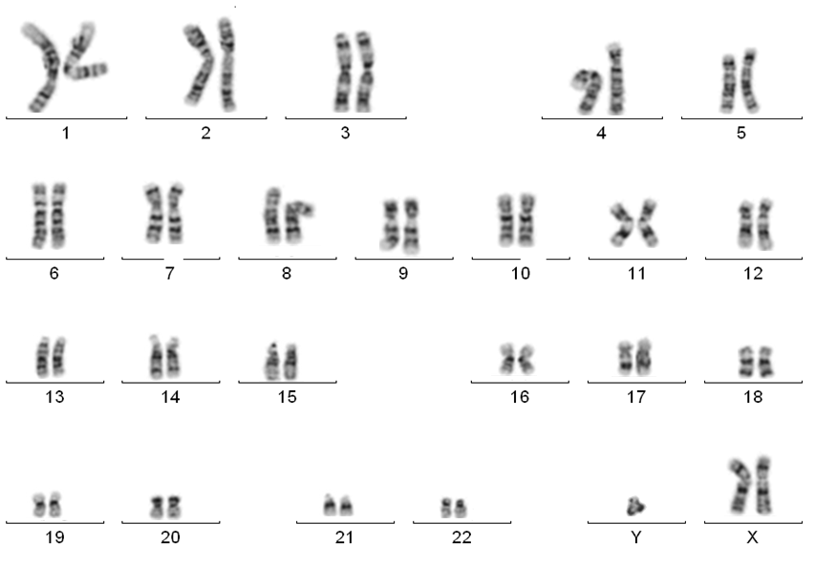
Cytogenetic Analysis
47, XXY
Total number of patients analyzed | 472
Number of patients with normal karyotype | 447
Number of patients with abnormal karyotype | 25/472 (5.29%)
Klinefelter (47,XXY) | 12/472 (2.54%)
Klinefelter mosaic (47,XXY/46XY/45X) | 13/472 (2.7%)
Chromosomal rearrangements | 0/472
Total percentage of patients with abnormal karyotype: 5.29%

Slide 7
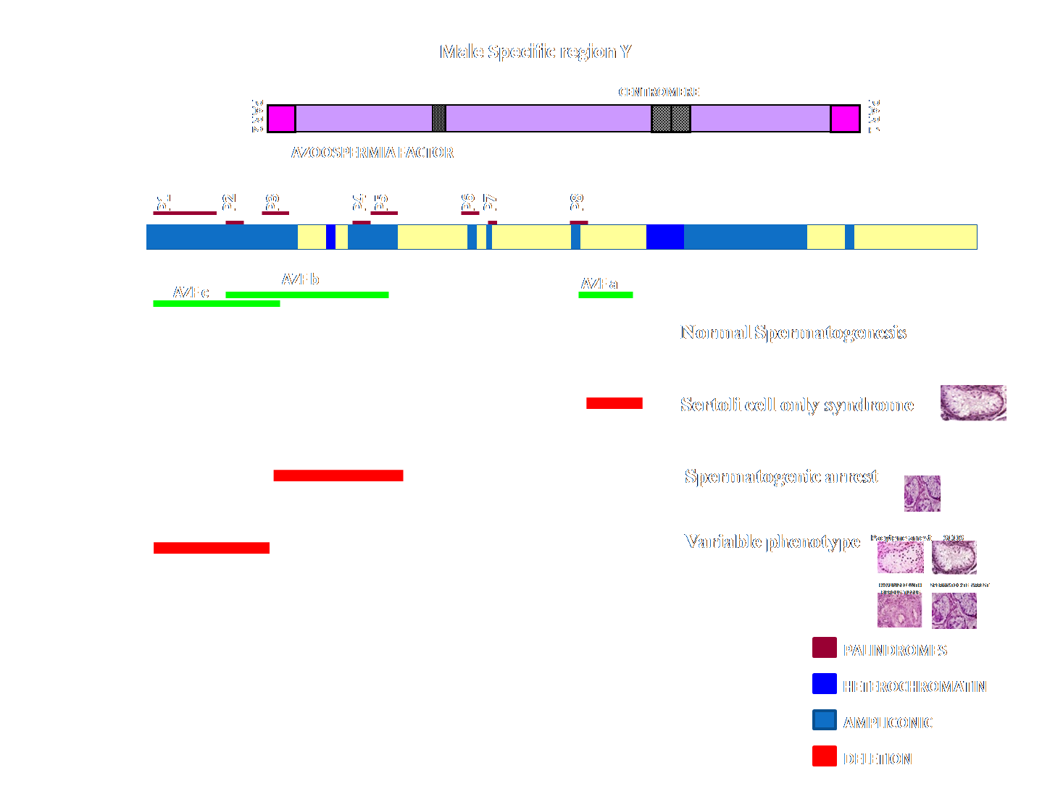
Y Chromosome microdeletion analysis
Total number of patient : 412
Number of Patient with Y chromosome microdeletion: 24
Total percentage of Y chromosome microdeletions: (5.82%)
AZF a deletion 0/412
AZF b deletion 2/412 (0.48%)
AZF c deletion 21/412 (5.09%)
AZF a+b deletion 0/412
AZF b+c deletion 1/412 (0.24%)
AZF a+c deletion 0/412
AZF a+b+c deletion 0/412

Slide 8
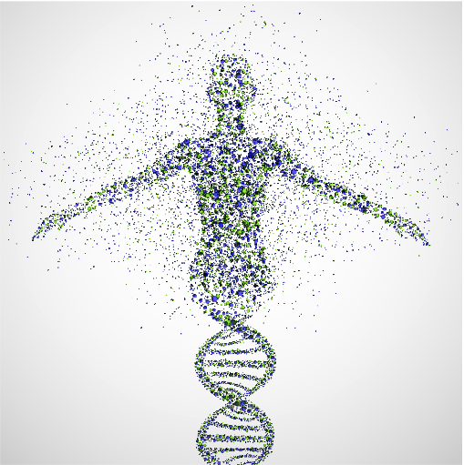
After Y chromosome. Lets explore at the genome level…..

Slide 9
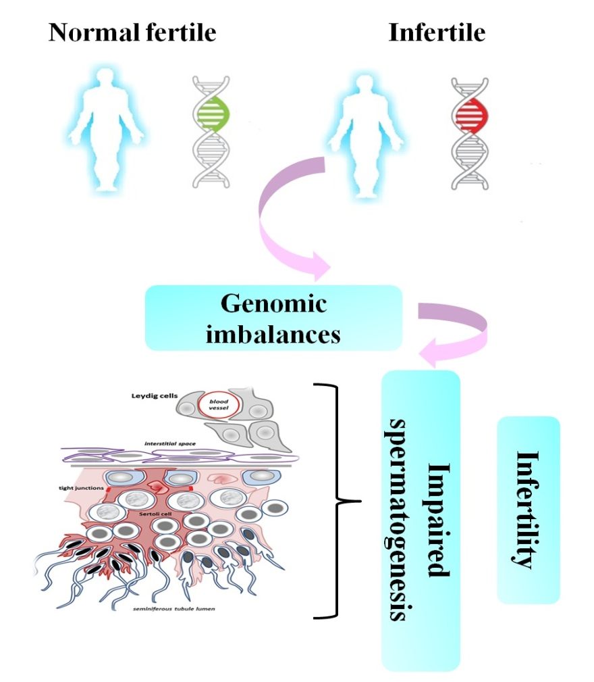
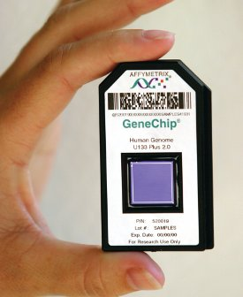
Chromosomal microarray approach to understand the whole genome imbalances associated with infertile patients
Hypothesis

Slide 10
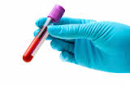
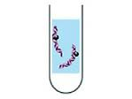
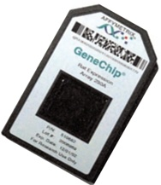
Analysis of genomic imbalances in Azoospermic infertile patients with different testicular phenotypes using cytogenetic microarray
Collection of Peripheral blood
Cases: 14
Normal fertile control: 8
DNA isolation
Cytoscan™ 750K array(Affymetrix, USA)
Analysis by ChAS software
(Chromosomal analysis suite)

Slide 11
Results

Slide 12
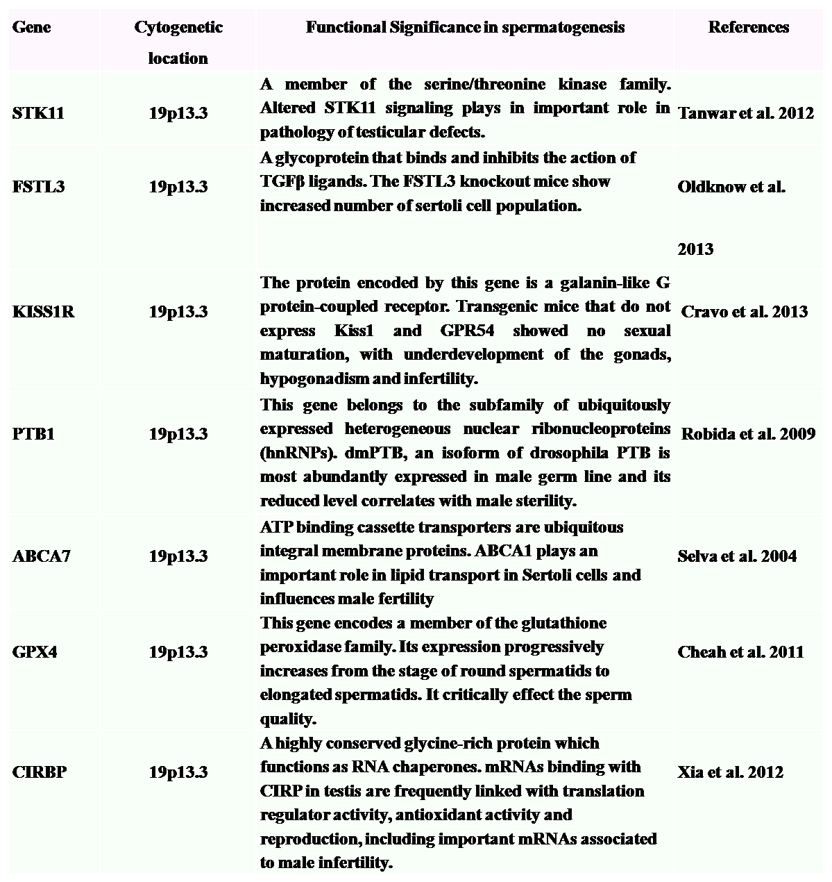
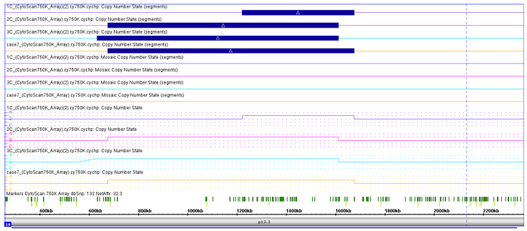
Common gain in the 19p13.3 region
Common gain in the 19p13.3 region in 4 (28.5%) cases.
Genes: STK11, FSTL3, PTB1, KISS1R, ABCA7, GPX4, CIRBP
Representation of the extent of gain in 19p13.3 region with the help of ChAS software, Affymetrix. (1C,2C,3C ; SCO and Case 7 ; Hypospermatogenesis)
CYTOARRAY BREAKPOINT
19p13.3 (gain)
Sample 1C : Chr19:1,221,968-1,676,383
Sample 2C : Chr19:675,955-1,612,855
Sample 3C : Chr19:633,754-1,612,855
Sample 4C: Chr19:675,955-1,676,383
Table showing functional significance of the common genes in 19p13.3 region obtained through microarray analysis in infertile patients

Slide 13
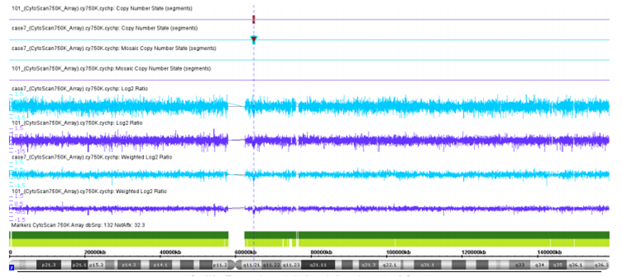
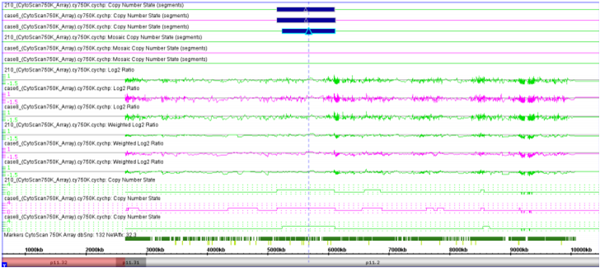
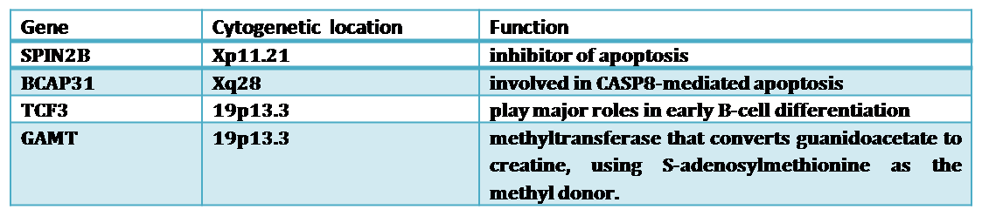
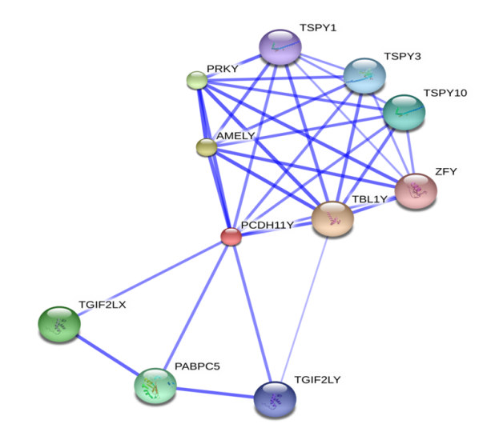
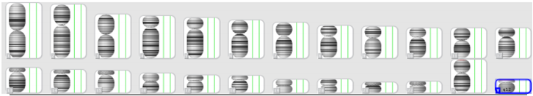
Common gain in Yp11.2 region in 3 cases (21.4%)
Gene : PCDH11Y (present in the pseudoautosomal region (PAR) important
for pairing during meiosis)
Common deletion in 7q11.2 region in 2 (14.2%) cases
Gene: ZNF92
Representation of the extent of deletion in 7q11.2 region observed in two infertile samples observed with the help of ChAS software, Affymetrix. (Cae101; SCO and Case 7 ; Hypospermatogenesis).
Representation of the extent of gain in Yp11.2 region observed in three infertile samples observed with the help of ChAS software, Affymetrix. (Case 210, Case 6; SCO and Case 9; Maturation arrest).
Table showing some other genes found to be duplicated in cases
Figure representing karyoview of control (normal fertile) samples through ChAS software, Affymetrix.
Putative model showing the molecular interaction of proteins using STRING software

Slide 14
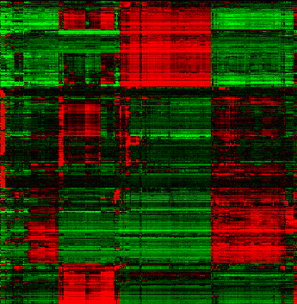
What the transcriptome data tells……………

Slide 15
The transcriptome analysis revealed an upregulation of duplicated genes
Gene |  | Fold change
GPX4 | Glutathione peroxidase 4 (phospholipid hydroperoxidase) | 5.08
CIRBP | Cold inducible RNA binding protein | 5.14
STK11 | Serine/threonine kinase 11 | 5.66
KISS1R | KISS1 receptor | 3.75

Slide 16
List of differentially expressed pathways from infertile patients and the genes involved
IL12A | interleukin 12A (natural killer cell stimulatory factor 1, cytotoxic lymphocyte maturation factor 1, p35) | Immunological pathway
IL10RA | interleukin 10 receptor, alpha
IL13 | interleukin 13
IL13RA2 | interleukin 13 receptor, alpha 2
IL18R1 | interleukin 18 receptor 1
MTHFD2L | methylenetetrahydrofolate dehydrogenase (NADP+ dependent) 2-like | Folate metabolism pathway
MTHFD1 | methylenetetrahydrofolate dehydrogenase (NADP+ dependent) 1, methenyltetrahydrofolate cyclohydrolase, formyltetrahydrofolate synthetase
DHFRL1 | dihydrofolate reductase-like 1
MTHFSD | methenyltetrahydrofolate synthetase domain containing
GSTM1 | glutathione S-transferase mu 1 | Detoxification pathway
GSTCD | glutathione S-transferase, C-terminal domain containing
GSTP1 | glutathione S-transferase pi 1
GSTM4 | glutathione S-transferase mu 4
GSTT1 | glutathione S-transferase theta 1
GSTM5 | glutathione S-transferase mu 5
GSTA2 | glutathione S-transferase alpha 2

Slide 17
ATM | ataxia telangiectasia mutated | Apoptosis pathway
ATR | ataxia telangiectasia and Rad3 related
ATXN3L | ataxin 3-like
ATXN10 | ataxin 10
ATXN7 | ataxin 7
BARD1 | BRCA1 associated RING domain 1
BRAP | BRCA1 associated protein
BRIP1 | BRCA1 interacting protein C-terminal helicase 1
BARD1 | BRCA1 associated RING domain 1
COBRA1 | cofactor of BRCA1
BAP1 | BRCA1 associated protein-1 (ubiquitin carboxy-terminal hydrolase)
CNTROB | centrobin, centrosomal BRCA2 interacting protein
CCNH | cyclin H
DCAF6 | DDB1 and CUL4 associated factor 6
DCAF12L2 | DDB1 and CUL4 associated factor 12-like 2
MLH3 | mutL homolog 3 (E. coli)
MMS22L | MMS22-like, DNA repair protein
MRE11A | MRE11 meiotic recombination 11 homolog A (S. cerevisiae)
MSH4 | mutS homolog 4 (E. coli)
NTHL1 | nth endonuclease III-like 1 (E. coli)
PARP8 | poly (ADP-ribose) polymerase family, member 8
PARP12 | poly (ADP-ribose) polymerase family, member 12
PARP1 | poly (ADP-ribose) polymerase 1
PAPOLB | poly(A) polymerase beta (testis specific)
POLD3 | polymerase (DNA-directed), delta 3, accessory subunit
RAD17 | RAD17 homolog (S. pombe)
RAD21 | RAD21 homolog (S. pombe)
RAD21L1 | RAD21-like 1 (S. pombe)
RAD54B | RAD54 homolog B (S. cerevisiae)
RAD9B | RAD9 homolog B (S. pombe)
RFC3 | replication factor C (activator 1) 3, 38kDa
XRCC4 | X-ray repair complementing defective repair in Chinese hamster cells 4
DNA repair pathway

Slide 18
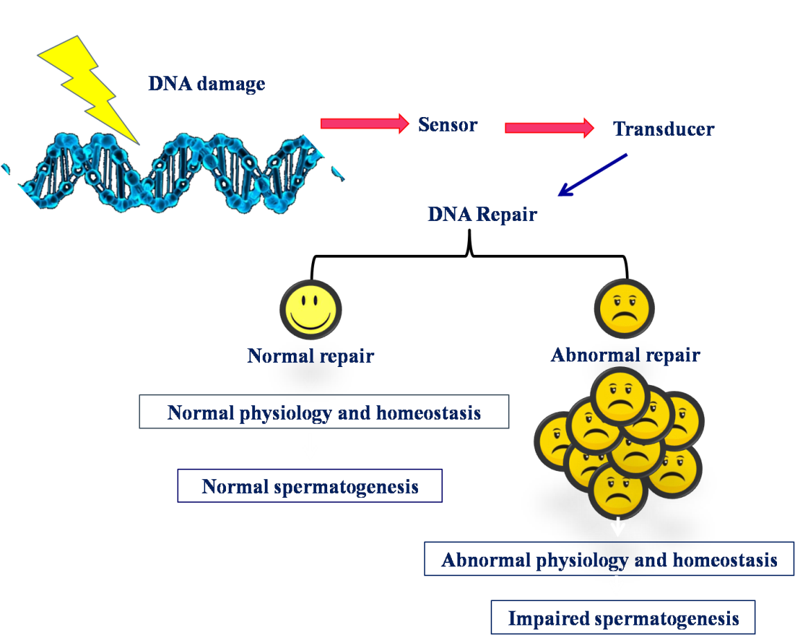
Hypothesis
It is crucial for any DNA damage, incurred during crossing over and other phases of meiosis, to be detected and repaired. An ineffective DNA repair during these phases may effect spermatogenesis leading to male infertility.

Slide 19
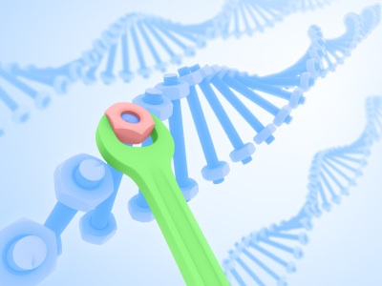
The DNA repair pathway

Slide 20
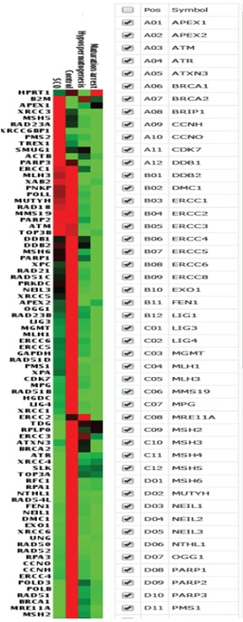
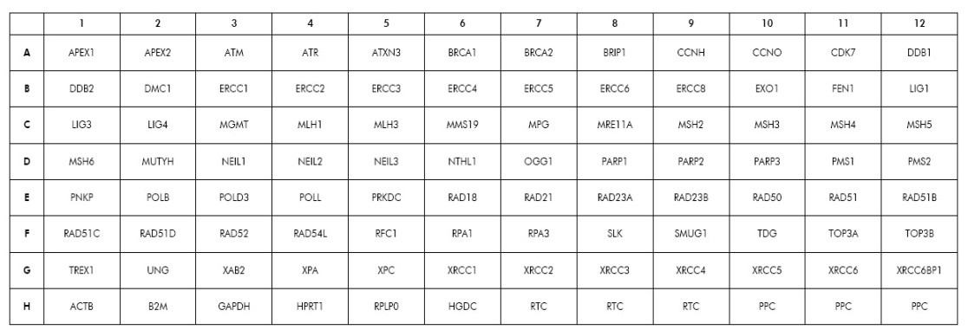
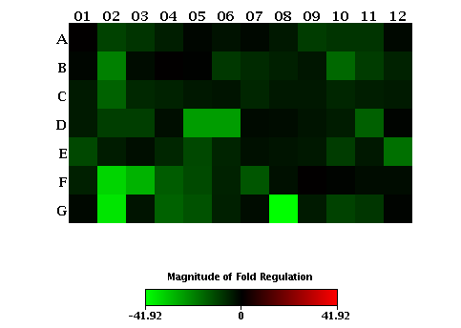
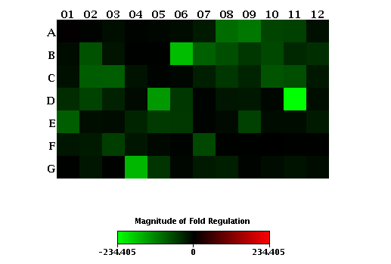
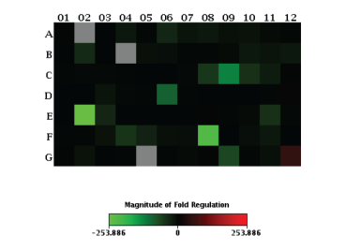
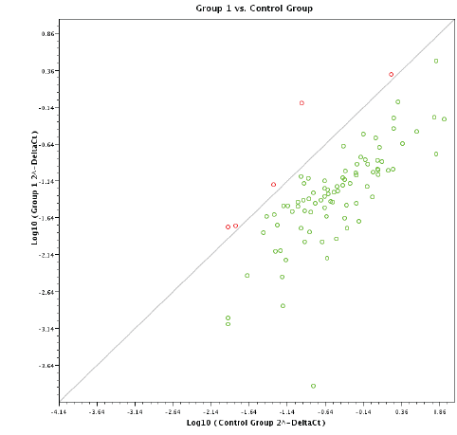
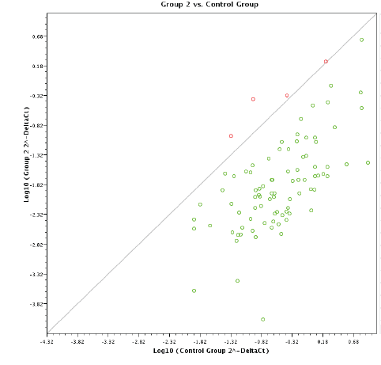
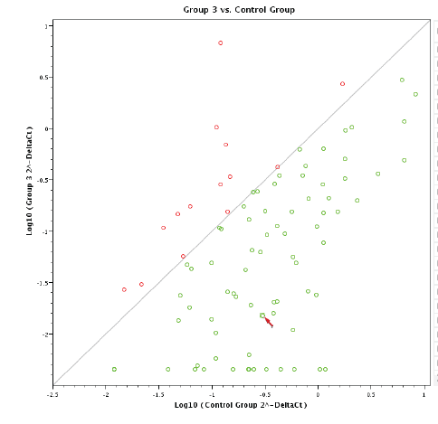
Visualization of fold change regulation
Layout of the array plate
Hypospermatogenesis Maturation arrest Sertoli cell only syndrome

Slide 21
Number of genes found to be significantly down-regulated in cases as compared to control
Gene | Pathway | Fold regulation | Phenotype
NEIL3 (Nei Endonuclease VIII-Like 3) | Base Excision Repair | -143.144 | Maturation arrest
NTHL1 (Nth Endonuclease III-Like 1) | Base Excision Repair | -96.9562 | Sertoli cell only syndrome
POLB (Polymerase (DNA Directed), Beta | Base Excision Repair | -254.886 | Sertoli cell only syndrome
BRIP1 (BRCA1 Interacting Protein C-Terminal Helicase 1) | Nucleotide Excision Repair | -100.753 | Maturation arrest
CCNH (Cyclin H) | Nucleotide Excision Repair | -111.085 | Maturation arrest
ERCC4 (Excision Repair Cross- Complementation Group 4) | Nucleotide Excision Repair | -175.011 | Maturation arrest
ERCC5 (Excision Repair Cross- Complementation Group 5) | Nucleotide Excision Repair | -88.4252 | Maturation arrest
PNKP (Polynucleotide Kinase 3'-Phosphatase) | Nucleotide Excision Repair | -88.3134 | Maturation arrest
SLK (STE20-Like Kinase) | Nucleotide Excision Repair | -228.724 | Sertoli cell only syndrome
XPA (Xeroderma Pigmentosum, Complementation Group A) | Nucleotide Excision Repair | -170.676 | Sertoli cell only syndrome
MSH2 (MutS Homolog 2) | Mismatch Repair | -130.932 | Sertoli cell only syndrome
PMS1 (Postmeiotic Segregation Increased 1) | Mismatch Repair | -235.405 | Maturation arrest
MGMT (O-6-Methylguanine-DNA Methyltransferase) | Other repair gene | -87.8776 | Maturation arrest
LIG4 (Ligase IV, DNA, ATP-Dependent) | Double Strand break repair | -84.898 | Maturation arrest
ERCC6 (Excision Repair Cross- Complementation Group 6) | Nucleotide Excision Repair | -71.8303 | Maturation arrest

Slide 22
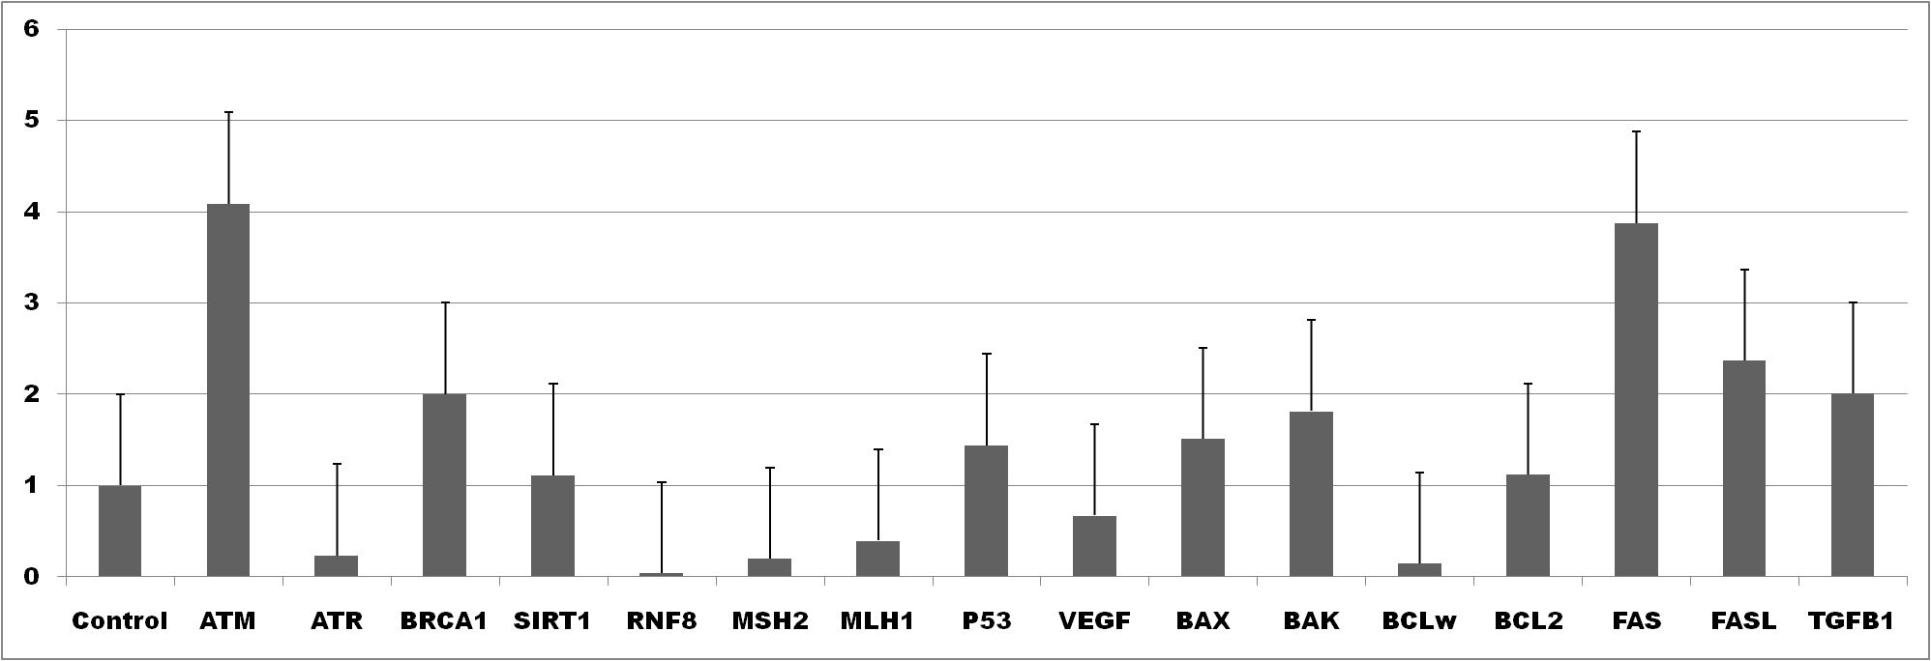
Validation of candidate genes from DNA damage, repair and apoptosis pathway in more number of samples at transcript level
Bar graph showing Fold change (2 ^{-Δ ΔCt}) in expression through quantitative Real time PCR
= Up-regulation
= Down-regulation
P=0.02
P=0.03
P=0.03
P=0.01
P=0.02
P=0.002
P=0.004
FOLD CHANGE
P=0.03
P=0.001
P=0.009
P=0.02
P=0.01
Controls (obstructive azoospermia) (n= 15)
Cases (Impaired Spermatogenesis) (n= 42)

Slide 23
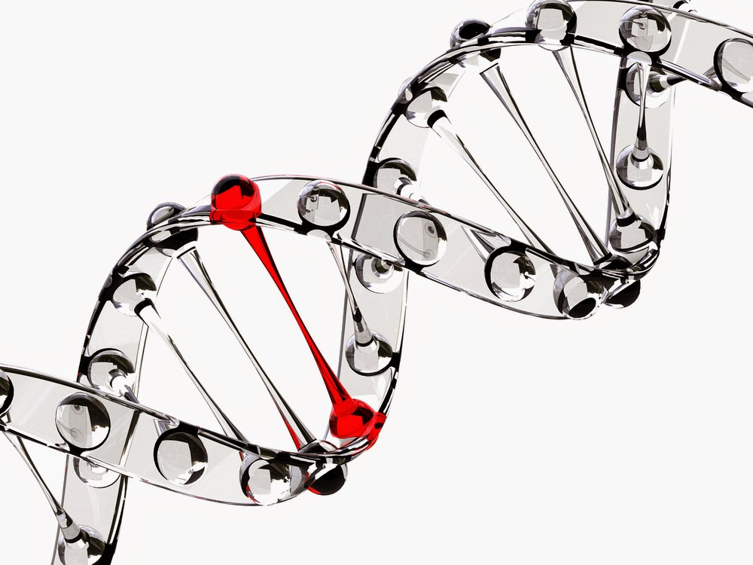
Candidate Gene variants from DNA damage, repair, immunological, detoxification, folate metabolism and apoptotic pathway and their association with human male infertility

Slide 24
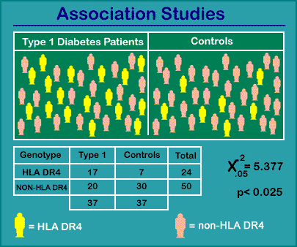
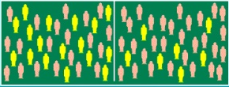
Association studies: An approach to find an allele which is significantly more or less frequent in a group of affected individuals (male infertile patients) than in a group of comparable non-affected individuals (individuals with proven fertility).
A allele
B allele
Immunological Pathway
One carbon folate pathway
IL-1RN
VNTR
3953 C>T
MTHFR
1298 A>C
Pathways
Apoptosis
Detoxification
FAS FASLG GRTH
-670 G>A -844C>T IVS6+55G/T
-1377G>A
GSTT1, GSTM1
Null deletion

Slide 25
Folate metabolism pathway
Methylenetetrahydrofolate reductase (MTHFR) is a candidate gene of the folate and homocysteine metabolic pathway and catalyses methylation of 5, 10 methylenetetrahydrofolate, which contributes to the methyl group in the conversion of homocysteine to methionine. DNA methylation plays an important role in the regulation of spermatogenesis
Allele and Genotypes frequencies of MTHFR A1298C mutation in idiopathic infertile patients and fertile male controls
Polymorphism | Case (n=151) | Control (n=140) | OR | 95%CI | p-value
AA | 66 (43.7) | 64 (45.7) | 1 | - | -
AC | 76 (50.3) | 74 (52.9) | 1.00 | 0.6231 to 1.5918
CC | 9 (6.0) | 2 (1.4) | 3.44 | 1.0092 to11.7899 | 0.04*
AC+CC | 85 (56.3) | 76 (54.3) | 1.08 | 0.6833 to 1.7205 | -
An association of 1298C allele with infertility in homozygous conditions.
The MTHFR 1298CC genotype is an additional genetic risk factor for idiopathic male infertility in an Indian population.

Slide 26
APOPTOSIS PATHWAY
Apoptosis of testicular germ cells is critical for spermatogenesis and maintains the homeostasis within the testis. A balance between growth and loss of the cells is maintained during spermatogenesis.
The spermatogonial apoptosis plays a major role in maintaining spermatocyte density as well as in the safeguard of Sertoli cells and fit the seminiferous tubule shape.
It also helps in eliminating defective germ cells and thus in maintaining normal spermatogenesis. FAS system has been implicated to be key regulator of spermatogenesis.
Polymorphism | Case (n=204) | Control (n=217) | OR | 95%CI | p-value
FAS 670 A>G
A | 263 (64.5%) | 252 (58.5%) | 0.76 (0.5792 to 1.0082) | 0.02* | 0.03*
G | 145 (35.5%) | 182 (41.5%)
FAS 1377 G>A
G | 213 (52.2%) | 229 (53.8%) | 1.02 (0.784 to 1.3471) | 0.87 | 0.92
A | 195 (47.8%) | 205 (46.2%)
The study showed statistically significant protective association of FAS 670 A/G with human male infertility. Allele and genotype did not differ significantly between patients and controls for FAS-1377G/A.

Slide 27
Apoptosis pathway
Fas/FasL expression in the human testis is developmentally regulated and it may be involved in quality control mechanism of the sperms. The FASLG –844 C>T (rs763110) functional polymorphisms is located in the binding motif of transcription factors disrupt CAAT/enhancer-binding protein.
Polymorphism | Case (n=204) | Control (n=217) | OR | 95%CI | p-value
FASLG 844 C>T
T | 264 (64.7%) | 307 (70.5%) | 0.87 (0.6399 to 1.1902) | 0.38 | 0.43
C | 96 (35.3%) | 128 (29.5%)
FASLG –844C>T polymorphism, allele and genotype distribution did not differ significantly between patients and controls (OR: 1.03, 95% CI= 0.7638 to 1.3952, P=0.83). Thus SNP-844C>T of the FASLG gene is not associated with male infertility risk in the analyzed patients.

Slide 28
Immunological pathway
Interleukin-1 (IL-1) is a regulatory cytokine that plays an important role in the maintenance of the immune environment of the testis, regulation of junction dynamics and cell differentiation during spermatogenesis.
Globally the first report that links IL1RN VNTR polymorphism with human male infertility.
Polymorphism | Case (n=204) | Control (n=217) | OR | 95%CI | p-value
IL1RN VNTR
IL1RN*1 | 223 (54.7%) | 273 (62.9%) | 1 (Reference) | - | -
IL1RN*2 | 177 (43.4%) | 158 (36.4%) | 1.37 (1.0386 to 1.8082) | 0.01* | 0.02*
The number of repeats is of functional significance as these repeats contain binding sites for transcription factors.
The study indicates risk of IL1RN2 variant with male infertility. To our best knowledge, this is the first report that links IL1RN VNTR polymorphism with human male infertility.

Slide 29
Detoxification pathway
Detoxification pathway is involved in regulation of spermatogenesis by reducing oxidative stress and contributes in the maintenance of global methylation in concert with other pathways.
Glutathione-S-transferases (GSTs) are family of phase II antioxidant enzymes involved in the cellular detoxification of various physiological substances and they reduce ROS to less reactive metabolites
Polymorphism | Case (n=204) | Control (n=217) | OR | 95%CI | p-value
GSTT1
Present | 192 (94.1%) | 176 (81.1%) | 1 (Reference) | - | -
Null | 12 (5.88%) | 41 (18.9%) | 0.3 (0.1729 to 0.5466) | 0.00005* | 0.0001*
GSTM1
Present | 150 (73.5%) | 148 (68.2%) | 1 | - | -
Null | 54 (26.5%) | 69 (31.8%) | 0.83 (0.5481 to 1.257) | 0.37 | 0.43
The study showed statistically significant protective association of GSTT1 null genotype with human male infertility. study underscores the significance of combined effect of GSTT1 and GSTM1 null genotypes in modulating the risk of male infertility.

Slide 30

Conclusion
The present study suggests that the pathology of human male infertility is associated with a number of genetic variations involved in the regulation of diverse biological pathways and it opens up new horizons for further investigation of the role of these genes in spermatogenesis.

Slide 31
Significance of the study
These studies will help in identifying the imbalances in the infertile population which differ with the control population group.
The variations will provide a platform for understanding the pathophysiology of Male Infertility at genomic and transcriptomic level.
Leads generated from the study will help in deciphering the etiology of human male infertility.
It will further help in proposing testicular phenotype based biomarkers and molecular targets.
The outcomes will also help clinicians in counseling and management of male infertility .

Slide 32

What remains unanswered…….
Investigation of the epigenetic status of duplicated genes to check if the duplication is affecting the gene expression.
The effect of gene dosage on increasing the severity of infertile phenotype and the underlying mechanism is yet to be explored at the functional level.
To understand that compromised DNA damage, DNA repair , apoptosis, immunological and detoxification pathways in the testicular cells may impair the process of spermatogenesis which may subsequently drive the normal testicular phenotype towards development of different degrees of spermatogenic impairments.

Slide 33

Thank you for listening…

