Slide 1
Venky Ramakrishna PhD
Celldex Therapeutics, Hampton NJ, USA
Antibody Targeting of Human CD27 with Varlilumab (CDX-1127) identifies genes
and pathways related to inflammation
www.celldextherapeutics.com

Slide 2
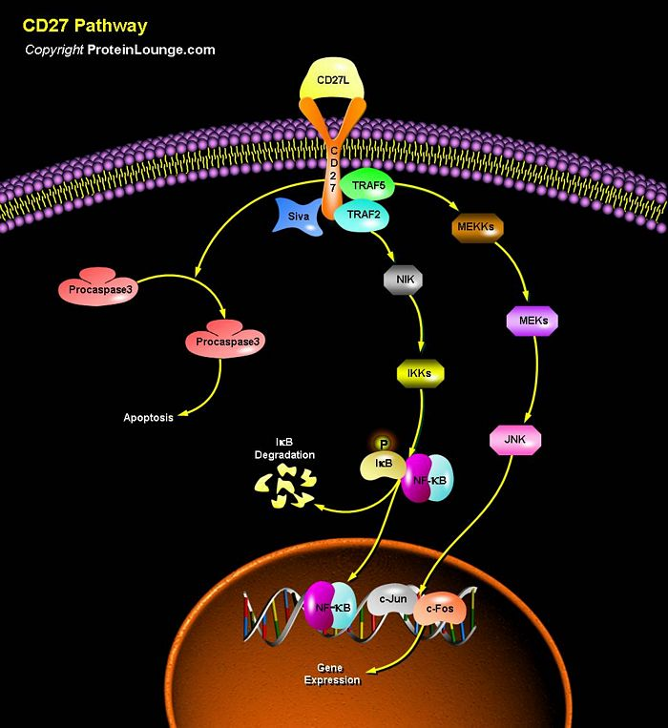

Slide 3
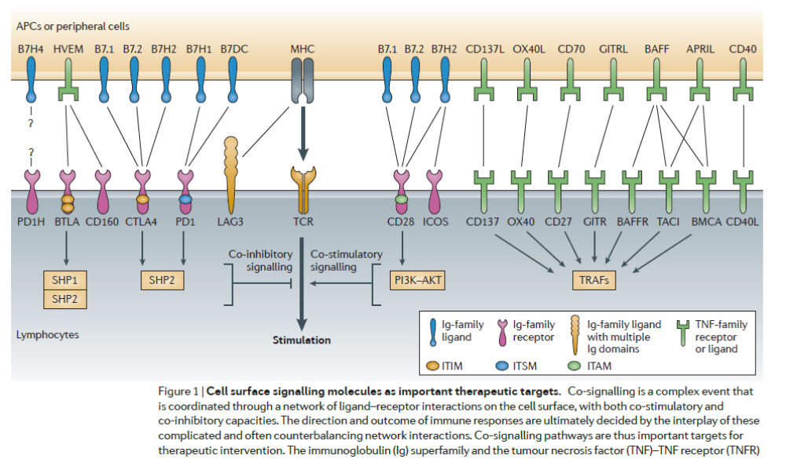
Targeting Cell Surface Molecules for Immune Modulation with mAbs
Sheng Yao, Yuwen Zhu and Lieping Chen Nat. Rev. Drug Disc. 2013; 130

Slide 4
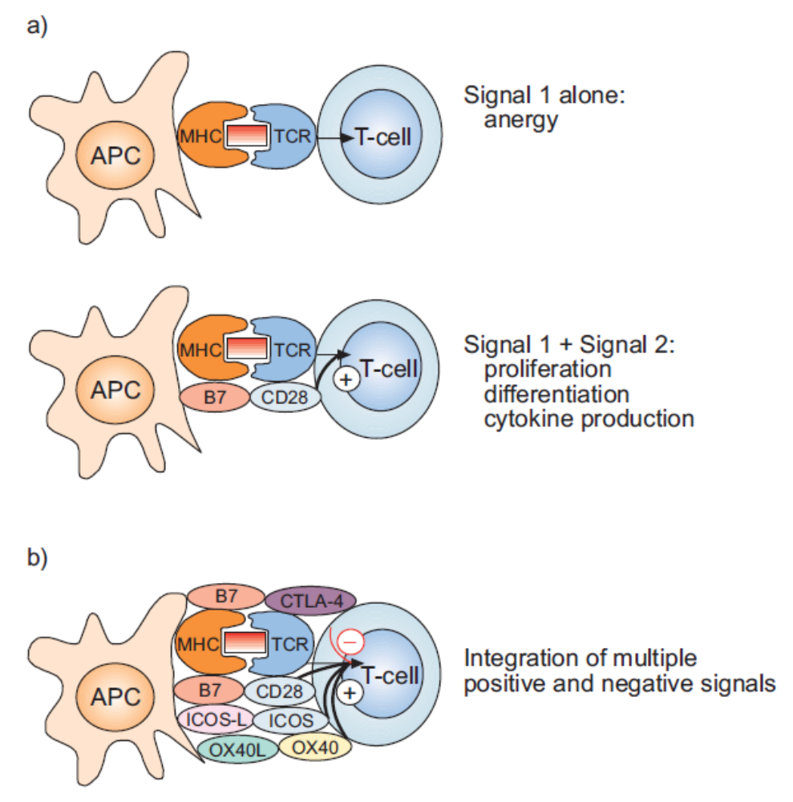
To Costimulate or Not to Costimulate?

Slide 5
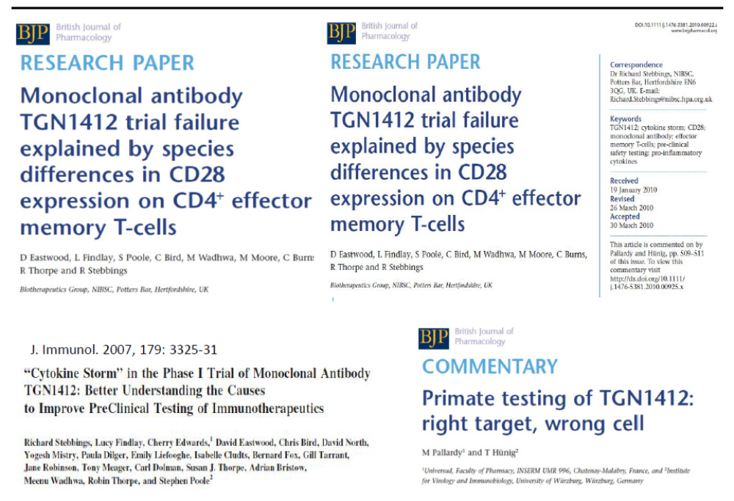

Slide 6
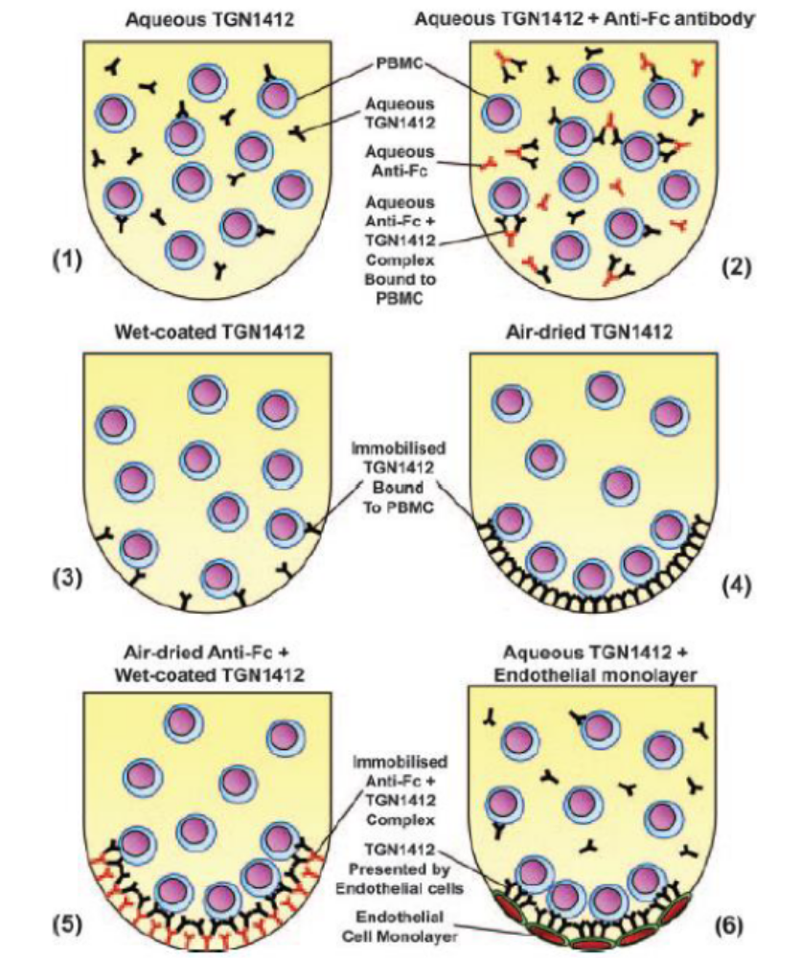
Predicting the Storm

Slide 7
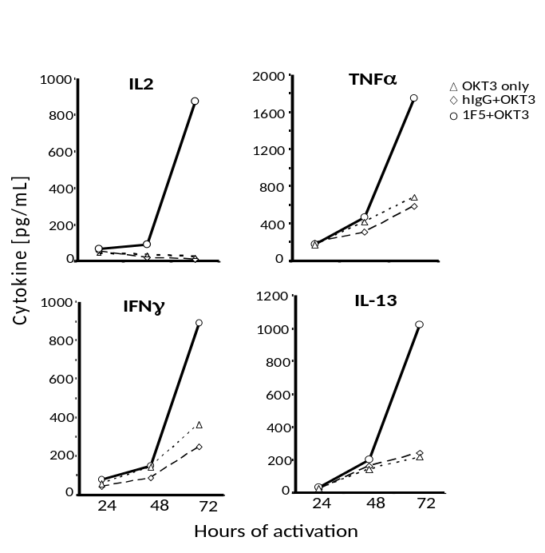
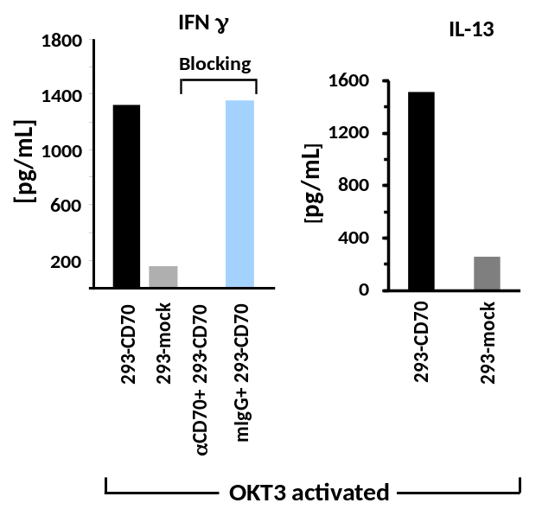
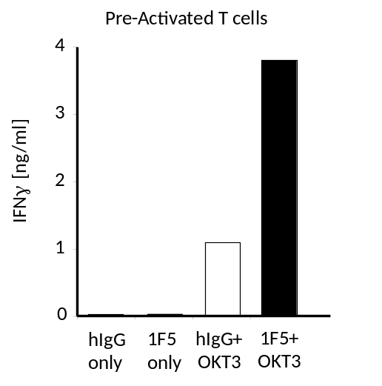
Costimulation with Varlilumab- Kinetics, TCR-dependence & Signaling Pathways
A
B
Inhibitor added
Inhibitor added
Inhibitor added
C
D
Inhibitor added
200
200
200
Untreated
Untreated
Untreated
Untreated
AG490/
AG490/
AG490/
JAK2
JAK2
150
JAK2
150
150
BAY11
BAY11
BAY11
-
-
-
7082/
7082/
7082/
I
I
Ik
B
B
100
Bα
100
100
% IFNγ response
SB203580/
SB203580/
SB203580/
p38
p38
p38
MAPK
MAPK
MAPK
2
2
2
-
-
-
Aminopurine/
Aminopurine/
Aminopurine/
PKR
PKR
50
PKR
50
50
ERK1/2
PD98059/
PD98059/
PD98059/
MAPKK
MAPKK
MAPKK
or
or
or
0
0
0
Celastrol/
Celastrol/
Celastrol/
NF
NF
NFk
B
B
OKT3+
αCD28
OKT3+
αCD27
B
Costimulation with Varlilumab parallels that with natural ligand- CD70.
Removal of signal 1 (OKT3) abolishes Varlilumab effect.
CD28 and CD27 costimulation follow distinct downstream pathways

Slide 8
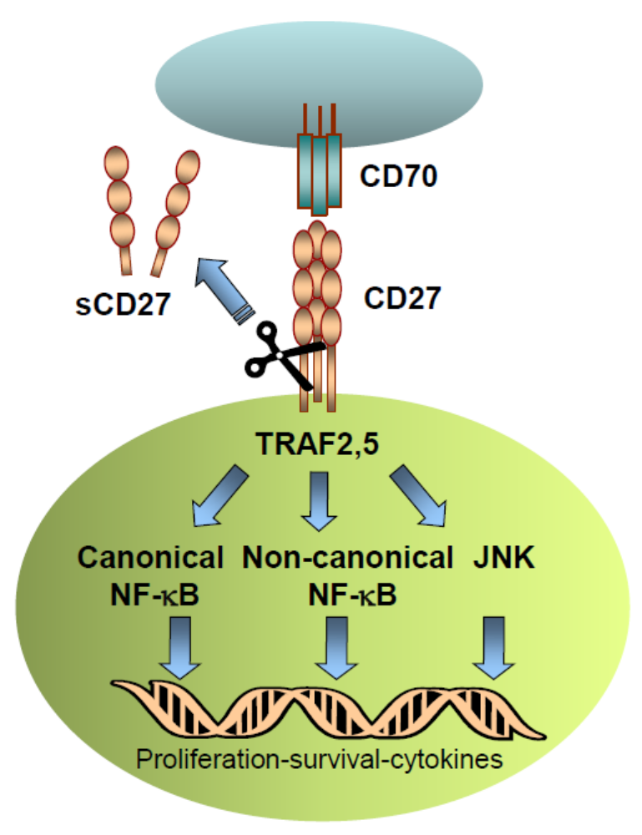
sCD27 shedding
Circulating biomarker
Cell culture Supes
Activation of T cells
Marker of favorable
immune response

Slide 9
Does 1F5 per se cause sCD27 shedding?
sCD27 ELISA
+ OKT3
83219
83761
50
40
U/mL
30
20
10
hIgG
1F5
αCD28
OKT3
hIgG
1F5
αCD28
Shedding is a consequence of T cell activation provided by TCR triggering or
signal 1 (OKT3) and further augmented in the presence of costimulatory signals
via CD27 or CD28 (signal 2). Circulating CD27 as a prognostic serum biomarker in clinically
responding patients to immunotherapy has been addressed by Schlom et al. (next slide)

Slide 10
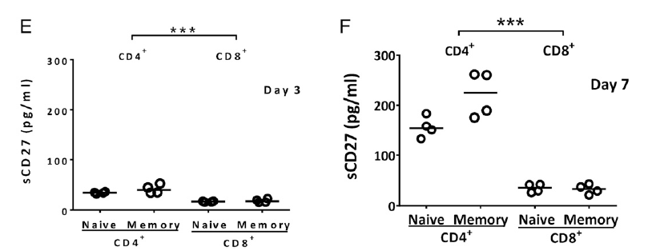
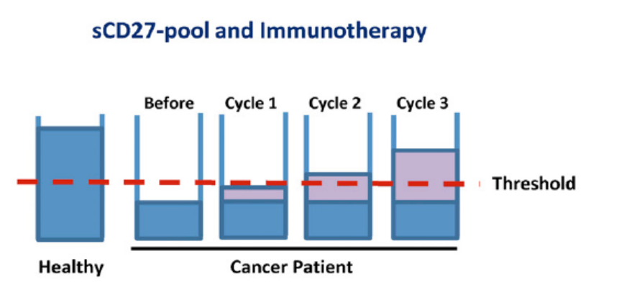
Patients responding to immunotherapy have elevated sCD27 levels
Huang J. et al. (2013) sCD27 pool in humans may contribute to T cell activation
and tumor immunity. Journal of Immunology 190: 6250-6258

Slide 11
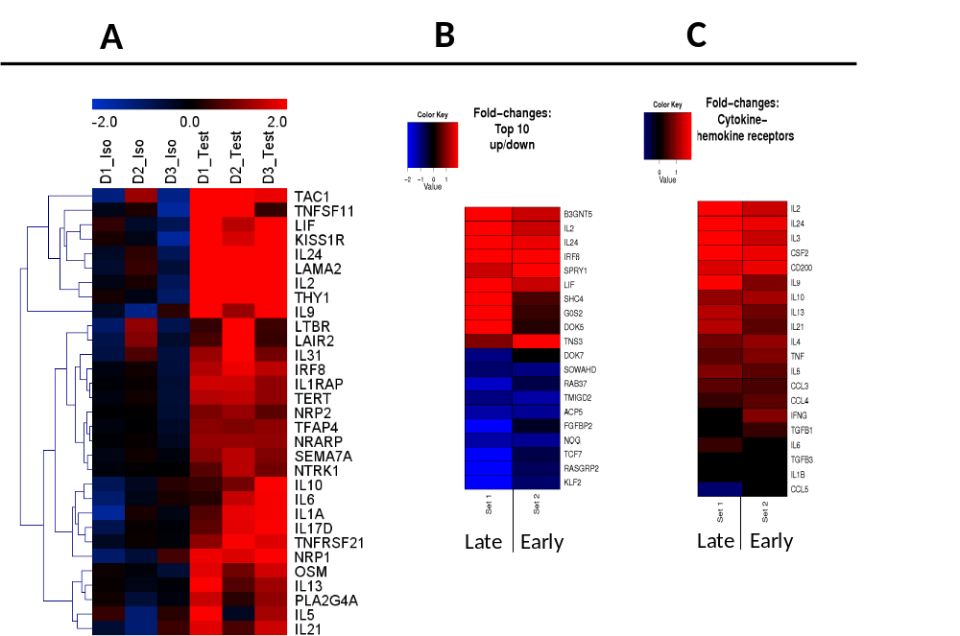
Molecular footprint of Gene Expression changes in Varlilumab-treated T cells
Heatmap showing hierarchical clustering of highly enriched annotated select gene transcripts of cytokines
transcription factors and interferon response elements contributing to inflammation - upregulated (red) or
downregulated (blue) in Varlilumab-treated and control-treated lymphocytes (A); Early and Late changes in
genes with Varlilumab treatment- Top 10 genes Up (red) or Down (blue) or changes in cytokine chemokine
receptors shown as fold changes over control (B and C). (Total probes on chip 29,833 with 320 genes Up and 441 Down)

Slide 12
Biomarkers associated with CD27 costimulation of TCR-triggered T cells – microarray analysis
Costimulatory
  4-1BB↑
  GITR↓
  OX40↓
Cell signaling
  Sprouty-1
    MAPKK/ ERK1/2
    JAK2
    FGF-2
  TNFRSF21 [DR6]
    IL-13 production
    B cell differentiation
Coinhibitory
  CTLA-4↓
  Tim-3↑
  LAG-3↓
  BTLA↑
  ICOS↓
  PD-1↑

Slide 13
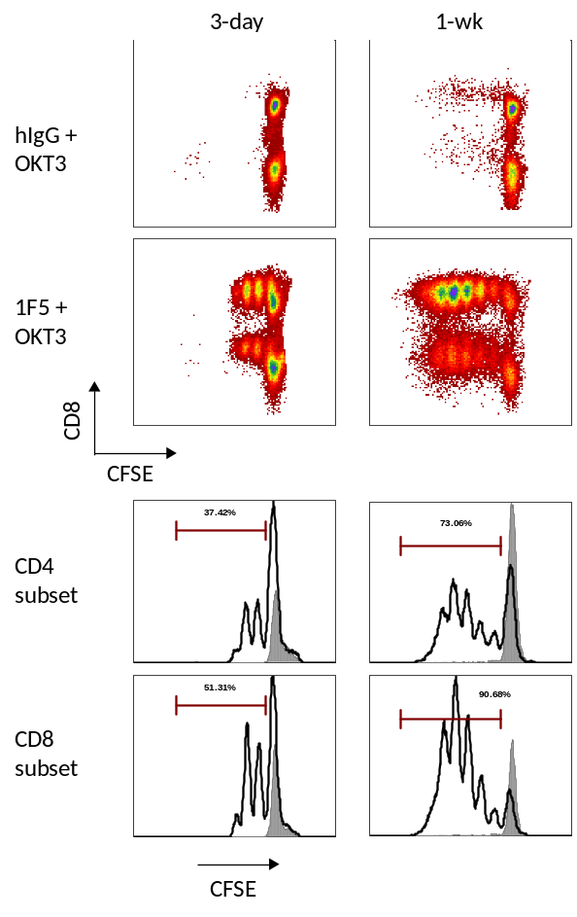
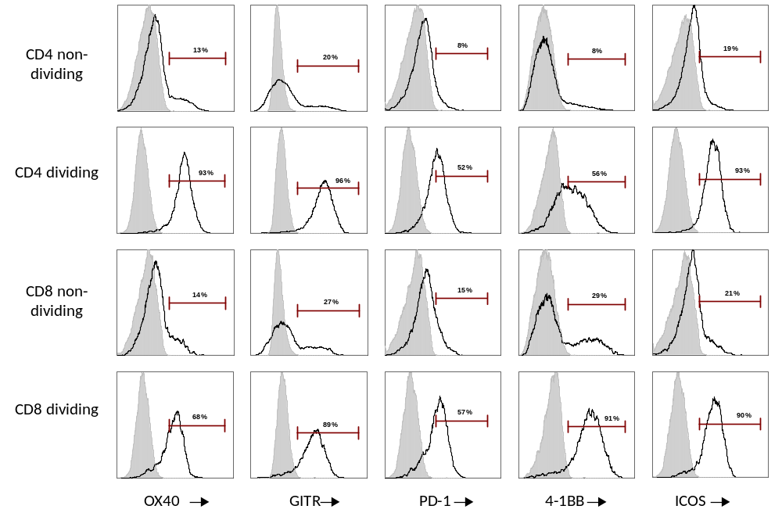
Varlilumab-induced expression of co-signaling molecules in proliferating CD8+ and CD4+ lymphocytes
A
B
Varlilumab treatment of T cells ensures propagation of recently
activated T cells with sustained survival mechanisms potentially
afforded by co-expression of positive (4-1BB, OX40, ICOS and GITR)
or negative (PD-1, CTLA-4, BTLA) regulators.

Slide 14
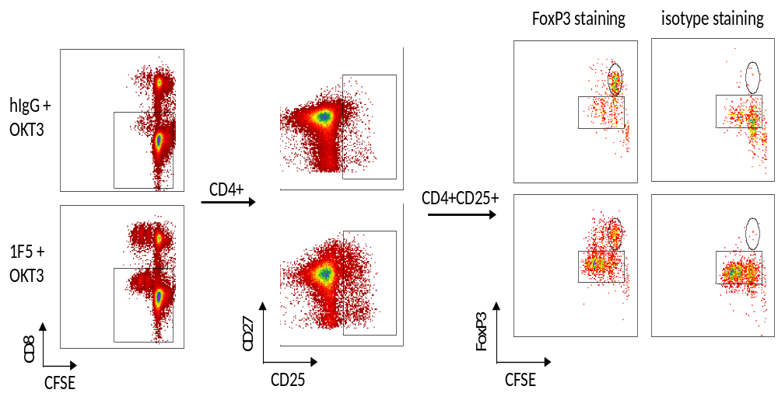
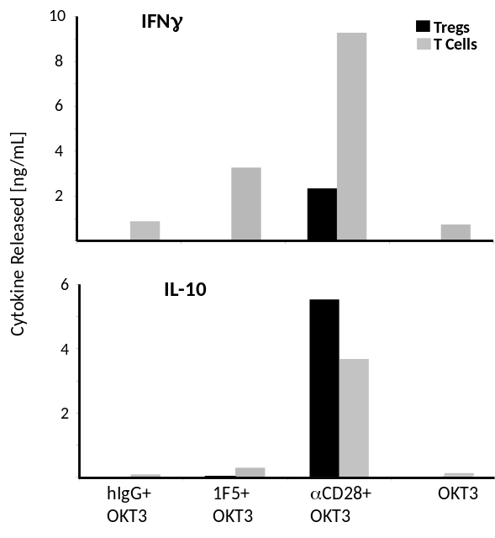
Costimulatory requirements of Tregs may substantially differ from those of non-Tregs (i.e. effector T cells)
Detection of Tregs in a Pan T cell prep; CFSE
stained T cells in a 3 day Varlilumab culture
Crosslinking CD27 with Varlilumab on Tregs is akin to
crosslinking GITR with GITR-Abs. Understanding how
closely receptors interplay requires specific knowledge
of receptor availability, Ab affinity, cells and tissues that
express them and status of inhibitory circuits (CTLA-4,
PD-1, BTLA, Tim-3, KLRG1, LAG-3 etc.).
Purified Tregs (MACS kit)-
CD4/CD25hi/FoxP3 (nTregs)

Slide 15
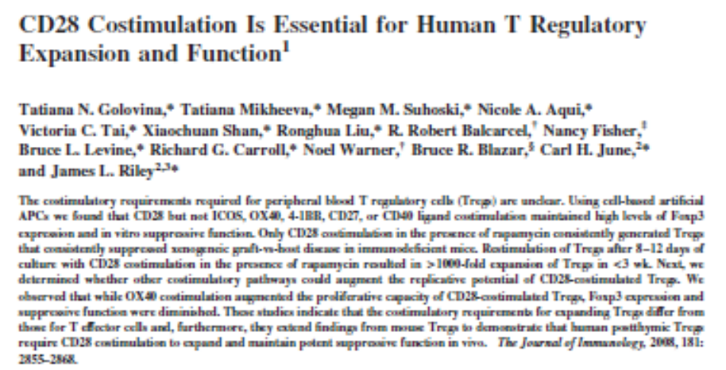
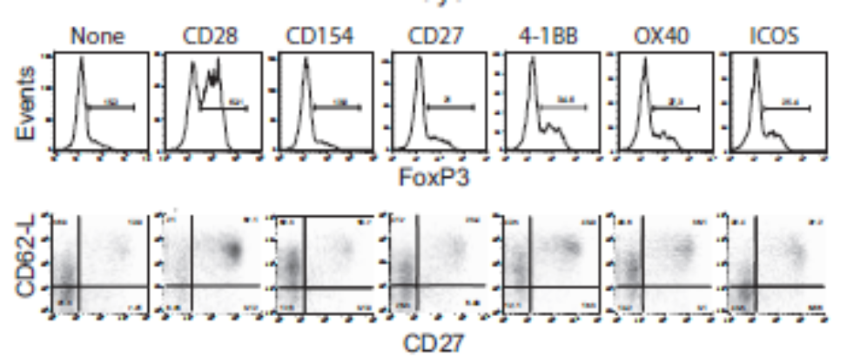
Costimulation via CD28 is the only way to expand Tregs

Slide 16
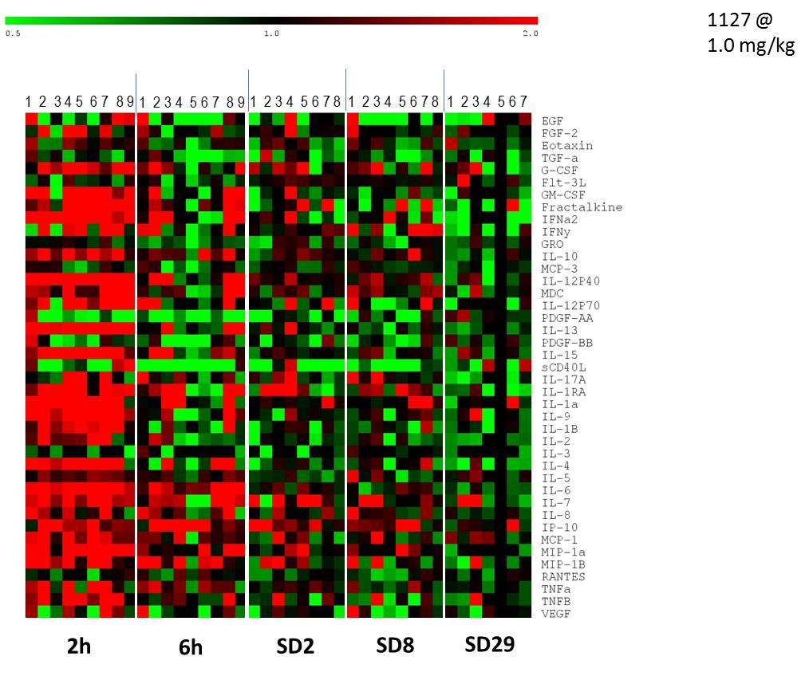
Clinical Immune Response Modifiers in Patients receiving Varlilumab
Solid tumors: Melanoma, Ovarian, Colorectal, Renal, NSCLC, Prostate, Pancreatic
Circulating biomarkers in serum

Slide 17
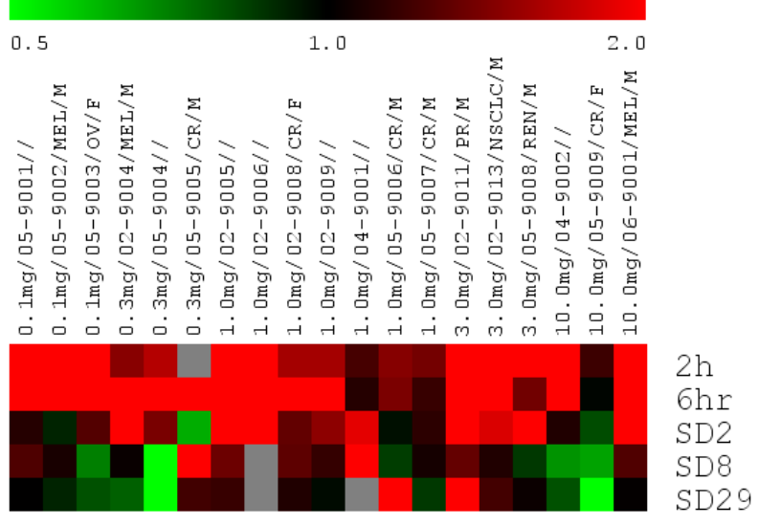
IP-10 [CXCL10] signature
Heatmap of serum IP-10 protein; fold-change over PreVaccine sample
Screening for serum biomarkers for prognostic/ diagnostic purposes
There may be other signatures worth pursuing but this one looks
consistent and promising. Currently we’re building the infrastructure
to have data mining and bioinformatics capability in house.

Slide 18
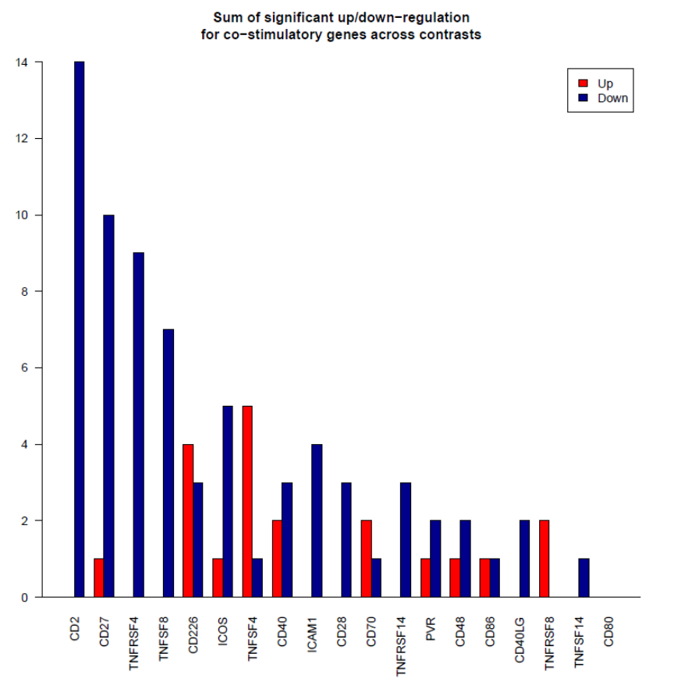
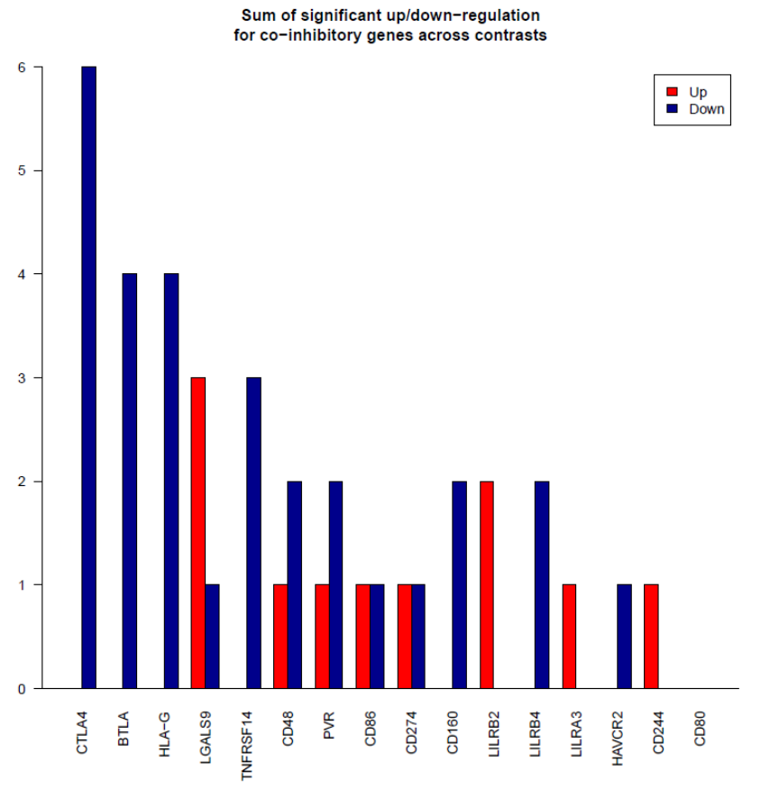
CDX-1127 Phase I PAXgene RNAseq Data: Source FiosGenomics, UK
In vitro studies show some degree of overlap with patient data
with regard to PD-1/L1, CTLA-4, LIGHT, Spry-1, FGF-2, CD40LG etc.

Slide 19
Congruence between In vitro and Human Phase I
BRMs T cells In Vitro* Patient Serum*
CD27 shedding + ??
sCD40L + +
IL-2 + +
IL-12p40/p70 -- +
IL-15 -- +
IL-9 -- +
IL-17A -- +
IL-1b, IL-6 -- +
IFNs + +
TNF + +
IL-13 + +
IP-10 + +
MIP-1 + +
MCP-1 + +
* 72h post Varlilumab
* 2h post Varlilumab @ 1.0mg/kg dose

Slide 20
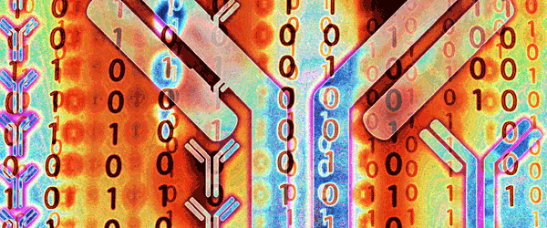
Acknowledgements
Celldex Team, NJ & MA
Dr. Tibor Keler, SVP/CSO
Dr. Henry Marsh VP R&D
Dr. Biwei Zhao
Karuna Sundarapandiyan
External Collaborators
Dr. Nir Yosef, UC Berkeley, CA
Dr. Michael DeSalvo, Phalanx Biotech, CA
Dr. Max Bylesjo, FiosGenomics, UK
Dr. Jutta Kollett, Miltenyi-Biotec, Germany

