Slide 1
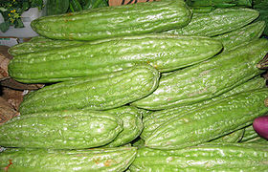
THE STUDY OF HEPATOTOXICITY
EFFECT OF Mormordica charanthia ON RAT’S LIVER by s.venkataramanan

Slide 2
DESCRIPTION OF PLANT
Momordica charantia L. is commonly known as bitter gourd is economically important medicinal plant (Palada.M.C et al 2003). It is well known for its medicinal properties.
Momordica charantia Linn (Karela) commonly known as Bitter melon or Bitter gourd is tropical and subtropical climber of the family Cucurbitaceae.(Sushil Sharma)
It is known with different common names in different languages i.e. Hindi – Karela; English – Bitter gourd; Sanskrit – Karavelli; Marathi – Karli; Gujarati – Karelo; Bangali – Baramasiya; Kannada – Karali; Malayalam – Kaypa; Tamil – Pakar; Telugu – Kakara.(Madhu Gupta)

Slide 3
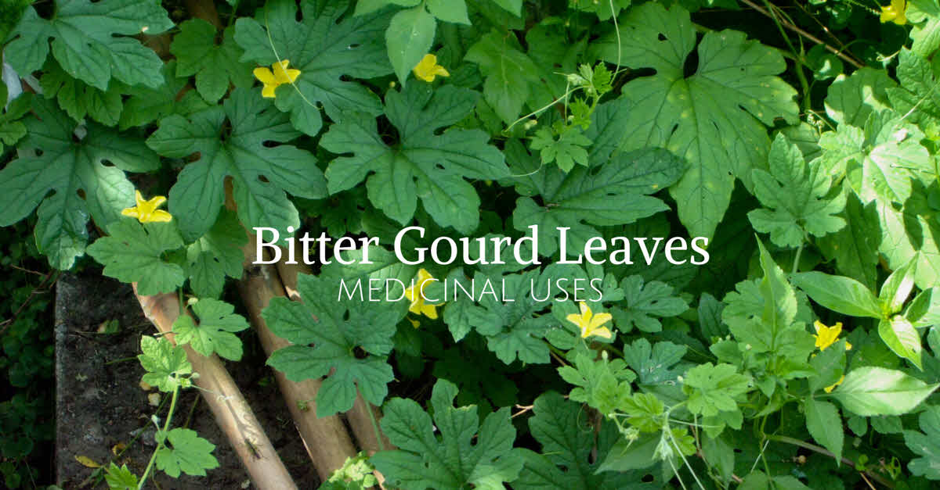

Slide 4
MEDICINAL BENEFITS
The fresh pods are an excellent remedy for curing respiratory problems like asthma, cold and cough.
Bitter melon juice benefits include helping to overcome type 2 diabetes. Type 2 diabetes is caused partially due to the inability of a cell to absorb the sugar in the blood due to insufficient insulin or due to development of resistance to insulin.
In both cases, the cells are unable to absorb the sugar due to the ineffectiveness of the insulin produced.
The absorption of sugar occurs due to the activation of AMP-activated protein kinase in the cells. Bitter gourd activates these kinases due to which the absorption of sugar increases and hence, aids in bringing diabetes under control.

Slide 5
MEDICINAL BENEFITS
Bitter melon helps in easy digestion as it contains fiber properties. The food is digested and the waste is thrown out of the body which helps in curing indigestion and constipation problems.
Bitter melon helps to maintain a healthy liver and bladder. It is also useful in curing kidney stones.
Bitter melon contains antioxidants that help to flush out your system. This improves your metabolism and digestive systems, thus helping lose weight.

Slide 6
MEDICINAL BENEFITS
The antimicrobial and antioxidant properties of bitter gourd juice help to treat skin problems, blood disorders, clear toxins from the blood and purify it, and further improves blood circulation throughout the body.
Bitter melon benefits in treating skin diseases or skin infections, eczema and psoriasis.
Bitter gourd juice helps in reducing hair fall naturally.
Finally this plant has anti-bacterial,anti-fungal,anti-carcinogenic,anti-parasitic,anit-viral,anti-fertility and hypoglycemic.

Slide 7
OVERDOSAGE
Bitter Gourd juice should be consumed in small quantity if not cause nausea and abdominal pains.
Pregnant lady must avoid drinking too much orelse it cause premature labour pains.
Even though it’s a great remedy for diabetic patients but should not taken in overdose.
Problematic for people taking diabetes drugs or with normal or low blood sugar levels. Reduced blood sugar, also called hypoglycemia, may cause dizziness, headache, irritability, hunger, sweating, shakiness, confusion and anxiety.
Ingesting large amounts of Momordica charantia seeds may result in toxicity. Severe toxicity side effects include fever and coma.

Slide 8
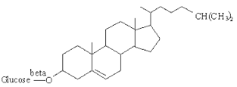
BIOCHEMICAL CONSTITUENTS
Momordica charantia (Karela) consists the following chemical constituents those are alkaloids, momordicin and charantin.
Structure of Charantin

Slide 9
HYPOTHESIS
Null hypothesis
The component of bitter gourd known as monorcharins can cause liver toxicity .
Alternative hypothesis
The component of bitter gourd known as monorcharins does not cause liver toxicity .
OBJECTIVE
General Objective
To identify the effect of Momocharica charantiaon liver.
Specific Objective
I. To determine the level of ALT and AST .
II. To identify the level of total protein .

Slide 10
METHODOLOGY
1
Momordica charantia are cut into thin slice . It were dried under sun for 10 day and finally dried in the oven for 24 hours at 50 ° C .
Dried Momordica charantia were powdered using electric grinder .
3
Momordica charantia solution prepared in different concentration .
5
4
100g of Momordica charantia were soaked in 100 ml of distilled water in beaker for 12 hours . The Soaked Momordica charantia is the filtered by muslin cloth filter .T
The filtered Momordica charantia was then evaporated by water bath system at 70 °C - 80 °C .
2
Preparation of aqueous Momordicacharantia Extract

Slide 11
1
In this experiment , 20 rats were used and divided into 4 groups with 5 rats in each group .
2
3
Group B was fed with 500 mg/kg Momordica charantia aqueous extract for 14 days consecutively .
6
4
5
Group A act as control .
Group C was fed with 600 mg/kg Momordica charantia aqueous extract for 14 days consecutively .
Group D was fed with 700 mg/kg Momordica charantia aqueous extract for 14 days consecutively .
On the 15th day , the blood was withdrawn and ALT , AST , Total Protein test was done . Data was analyzed using SPSS and anova test .
Experiment Methodology

Slide 12
RESULTS
ANOVA
 |  | Sum of Squares | df | Mean Square | F | Sig.
ALT | Between Groups | 1748.085 | 3 | 582.695 | 105.140 | .000
 | Within Groups | 66.505 | 12 | 5.542
 | Total | 1814.590 | 15
AST | Between Groups | 5942.738 | 3 | 1980.913 | 457.760 | .000
 | Within Groups | 51.929 | 12 | 4.327
 | Total | 5994.667 | 15
TP | Between Groups | 3.290 | 3 | 1.097 | 25.308 | .000
 | Within Groups | .520 | 12 | .043
 | Total | 3.810 | 15
This table shows that the value between groups and within groups are significant .

Slide 13
GROUPS
Clinical Observation | A | B | C | D
Diarrhea | Normal | Exist | Exist | Exist
Skin and Fur | Normal | Normal | Normal | Normal
Eyes | Normal | Normal | Normal | Normal
Table shows the clinical observation on rats during the study period .

Slide 14
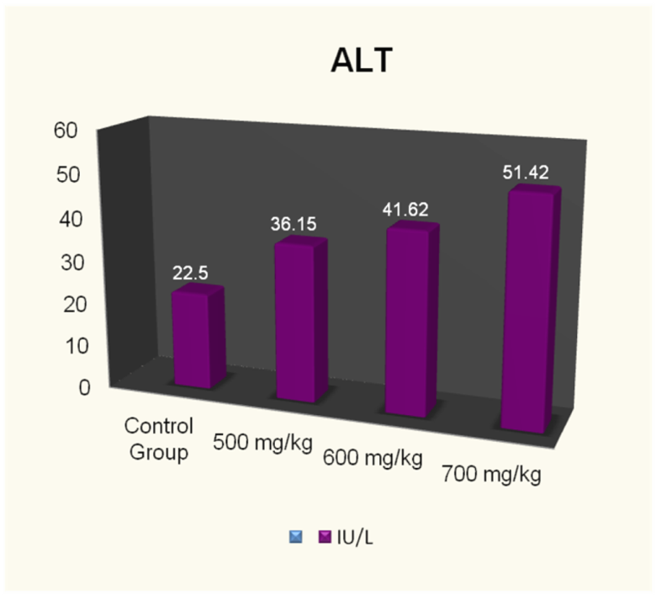
This graph shows the level of ALT in rats. It is increasing with concentration of aqueous extract Momordica charantia .

Slide 15
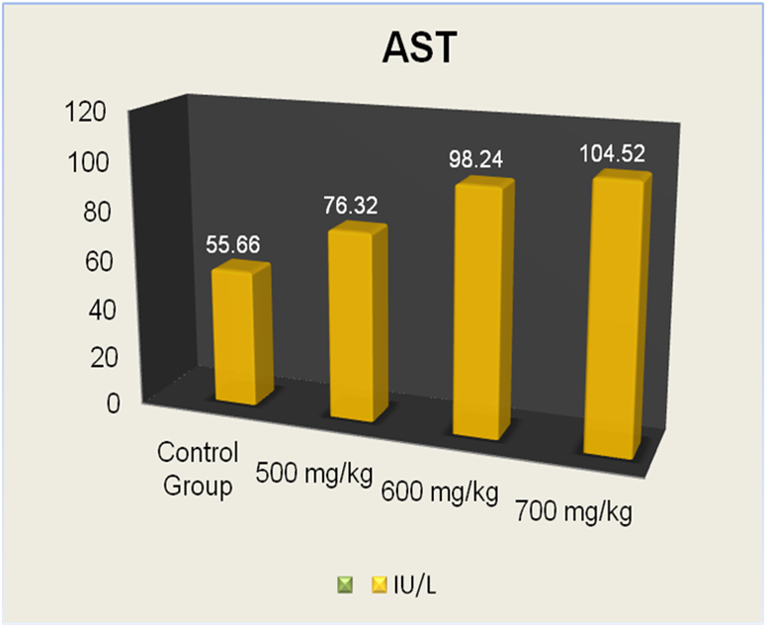
This graph shows the level of AST in rats . The value is increasing with concentration of aqueous extract Momordica charantia .

Slide 16
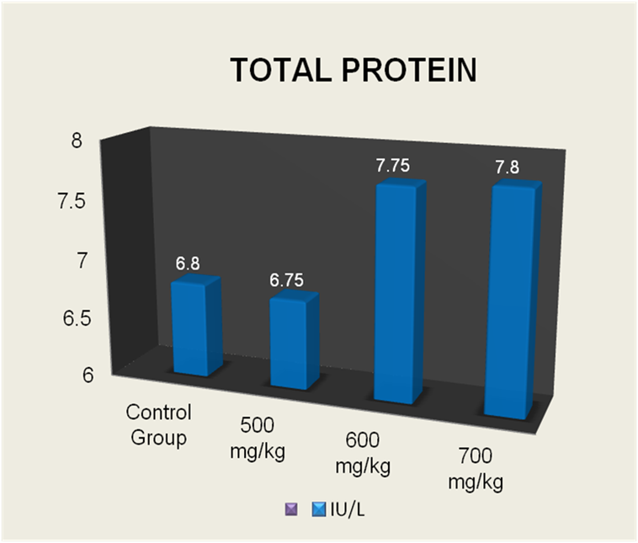
Figure 5 : This graph shows the value of total protein in rats . The value of total protein was at normal range for control group and 500mg/kg, whereas the value increased drastically for dose at 600mg/kg and 700mg/kg .

Slide 17
DISCUSSION
This study is done to find the effect of various concentration of aqueous extract of Momordica charantia fruit in liver of albino rats. Momordica charantia fruit contains monorcharin component and this component has the ability to damage the liver. The toxicity level of liver was determined using different concentration of Momordica charantia extract
Level of alanine aminotranferase (ALT) and aspartate aminotransferase (AST) increased with concentration of aqueous extract of Momordica charantia . Normal value of ALT is 17.5 – 30.2 µ/L and normal range of AST is 45.7 – 80.3 µ/L, the level both ALT and AST in albino rats which was induced with aqueous extract of Momordicac harantia was slightly higher than normal range and it indicates liver organ damage.

Slide 18
The enzyme transaminases are predominantly found in liver hepatocytes and serve as sensitive index of the degree of liver damage (Salawu.O.A et al 2004). The level of toxicity was statically significant (p<0.05) with administration of 500 mg/kg , 600mg/kg and 700mg/kg of aqueous extract of Momordica charantia .
The range of total protein increased from the normal range which is 5.6 – 7.6 g/dL among albino rats induced with 600mg/kg and 700mg/kg aqueous extract Momordica charantia . The value of total protein among rats under group B which was induced with 500mg/kg were normal . This shows that , toxicity level in albino rats starts at concentration 600mg/kg . The end result of group A for ALT , AST and total protein was normal which act as negative control was between normal range .
Therefore the null hypothesis was rejected and the alternative hypothesis which was the component of bitter gourd known as monorcharins can cause liver toxicity accepted.

Slide 19
CONCLUSION
In conclusion, the aqueous extract of Momordica charantia increases the liver toxicity significantly in rats. The chemical component in Momordica charantia which known as monorcharins is the one causing liver toxicity
Overall, the hypothesis of this present study is achieved, whereby the objective of this study is also proven.
Further studies can be done on Momordica charantia to find out other component that causing harm to human if consumed at high dosage for long term in liver, kidney and gastrointestinal tract. Studies can also be done to reveal the properties in Momordica charantia extract using methanol or alcohol for extraction.

Slide 20
REFERENCES
Palada .M.C & Chang .L.C.2003.Suggested Cultural Practises for Bitter Gourd.International Cooperators’ Guide.
Sikdar.B.,Shafiullah.M.,Sharmin&Nahar.S.2005. Agrobacterium-mediated GUS Expression in Bitter Gourd. Biotechnology 4(2):149-152,2005.
Salawu.O.A,Ezekiele.O,Adaudia.O&KwanashieH.O. 2005. Toxicological Evaluation ofMethanolic Extract of Momordica charantia leaves in rats . West Afr.J.Pharmacol.Drug Res. Vol. 20 (Nos 1 & 2 January- December 2004 ; 15 – 21)

Slide 21
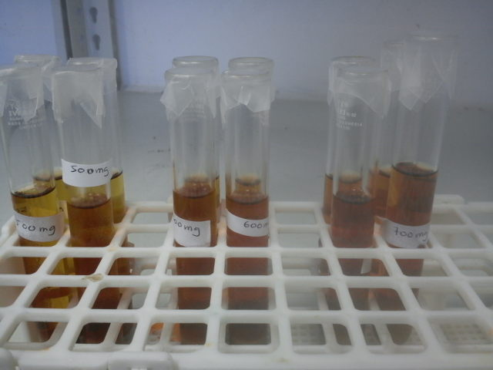
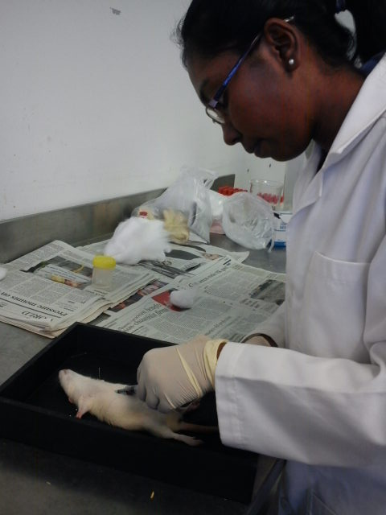
APPENDICES
Aqueous extract of Momordicacharantia
Cardiac Puncture

Slide 22
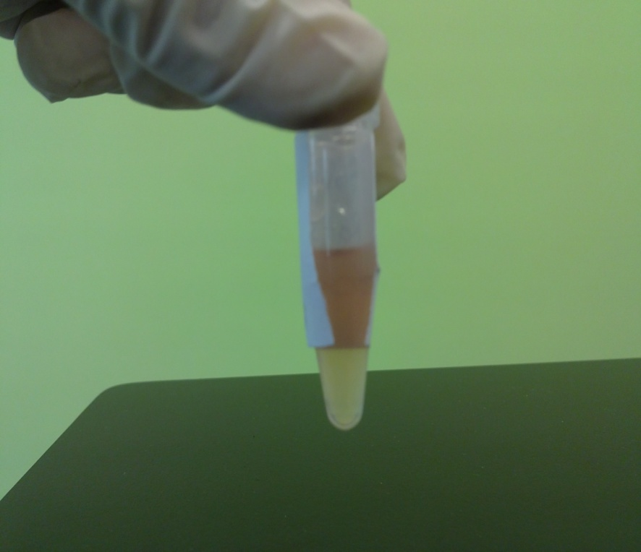
Serum

Slide 23
ACKNOWLEDGEMENT
First of all I would like to praise God for giving me the strength and patience to complete this research. I would like to express my appreciation and gratitude to my student Pavitra Velayutham for successful completion for this work. Finally I would like to thank my ever loving wife & family for giving me ample support.

Slide 24
CONFERENCE PAPERS
IN-VITRO STUDY ON EFFECT OF GARLIC AND GINGER CONSUMPTION TOWARDS LACTOBACILLUS ACIDOPHILUS, 2ND ASIAN PACIFIC PHARMACY CONFERENCE,KL,Malaysia,Dec2011.
ALTERATION IN SERUM LIPID PROFILE AND HOMOCYSTEINE LEVEL INDUCED BY PALM OLEIN AND OLIVE OIL ENRICHED DIET IN RAT, 2ND ASIAN PACIFIC PHARMACY CONFERENCE,KL,Malaysia,Dec2011.
Advanced Application of Bioinformatics in Forensic Science at 1st International Forensic Conference,MSU,Malaysia Apr 2016
NOVEL DNA PROFILING OF SHORT TANDEM REPEATS (STRs) FROM NEXT-GENERATION SEQUENCING (NGS) DATA BY ESTABLISHING A WHOLE GENOME STRs PIPELINE FOR FORENSIC BIOINFORMATICS at 1st International Forensic Conference,MSU,Malaysia Apr 2016.

Slide 25
CONFERENCE PAPERS
5. PROTEIN MODELLING OF T.GONDII PROTEIN MIC3 AND LIGAND DOCKING, International Conference on Science,Engineering and Innovative Technology, At Management and Science University
6. ANALYSIS OF CONSERVED HYPOTHETICAL PROTEIN FROM Helicobater pylori H-16 IN GASTRIC CANCER, International Conference on Science,Engineering and Innovative Technology, At Management and Science University

Slide 26
RESEARCH PAPERS
1. AB Initio Structural Analysis on Envelope (E) Glycoprotein of Dengue Virus (DENV) Type 1-4.
2.AN INTERACTIVE SEQUENCE EDITOR APPLICATION IN ANDROID PLATFORM, World Journal of Pharmaceutical Research.
ACCEPTED PAPER-SCOPEX INDEX JOURNAL
1. COMPARATIVE GENOMIC ANALYSIS OF HELICOBACTER PYLORI STRAINS CPY1124 AND SJM180 RELATED TO GASTRIC DISORDER USING NEXT-GENERATION SEQUENCE (NGS) DATA

