Slide 1
Clinical Education: An analysis of Clinical Reasoning amongst Physiotherapy Students in Fiji.
Venasio Ramabuke
Lecturer in Physiotherapy
School of Health Sciences – College of Medicine, Nursing, & Health Sciences
Fiji National University

Slide 2
Introduction
Clinical Reasoning is the thought process behind clinical practice (Smith, Higgs, & Ellis, 2008).
Vaguely assessed in curriculums (Boshuizen & Schmidt, 2008)
Cognitive process challenging objective measurement tools (Banning, 2008).

Slide 3
Research Question
What is the level of clinical reasoning among Physiotherapy students?
Aim:
Analyze level of clinical reasoning amongst Physiotherapy students.
Research Framework:
Empirico-analytical research paradigm

Slide 4
Methodology
Study Design: Cross sectional
Venue: CWMH/ Lautoka Hospital/ CMNHS
Study Period: End of Semester 2, 2016
Participants: (Recruit, inclusion and exclusion)
BPT Students (n=41:Year 3=30; Year 4 = 11).
PT Clinicians (n=13) as reference norm.

Slide 5
Methodology
Variables:
    Exposure: Level of clinical exposure
    Outcome: Clinical reasoning score
Tool: Script Concordance Test (SCT)
  17 case studies x 3 items/case = 51 items
  Good clinical reasoning = Clinician mean score – 2 SD. (57.7)

Slide 6
Methodology- SCT
Based on the ‘Illness Script Theory’
SCT:
  explores the structure and organization of the knowledge base
  how facts are linked together in memory and applied to context clinical problems
Used in medical and health sciences curricula.
Clinical vignette followed by a 3 part question:
    Part 1: Probable diagnosis
    Part 2: New clinical information
    Part 3: likert scale: -2 to 2.

Slide 7
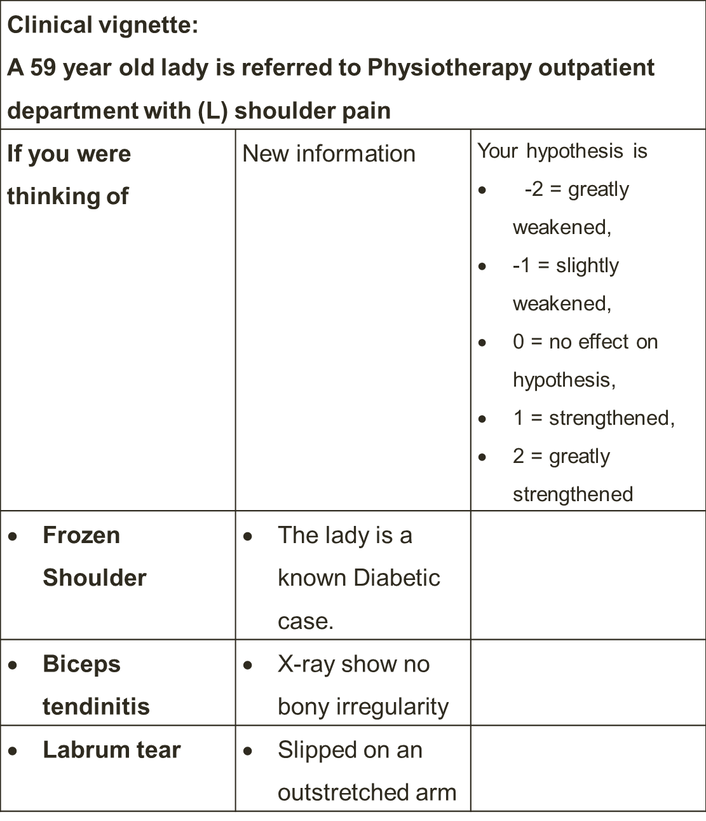

Slide 8
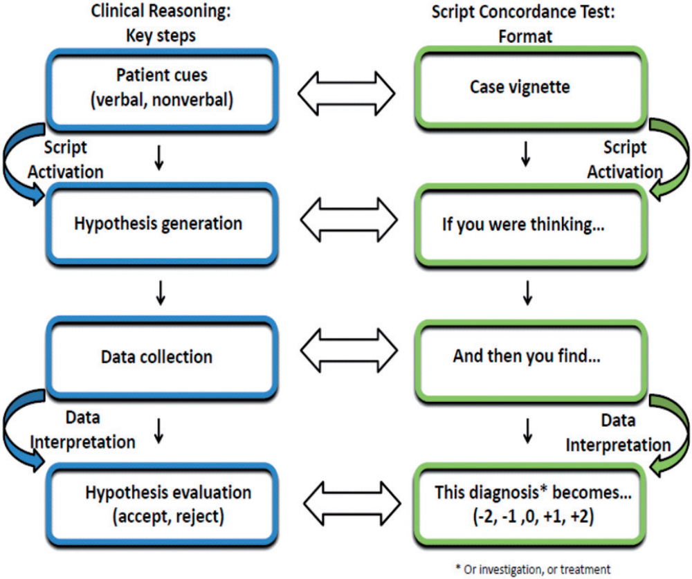

Slide 9
Methodology
Data Analysis:
  Categorical variable of level of study and number of students with good clinical reasoning skills were summarized as frequency and percentages.
  Difference in proportion of students with good clinical reasoning skill between the two level was done using Chi-square test.

Slide 10
Result
Table 1: Proportion of students with levels of CR norm referenced.
 | Levels | Good level of CR | Excellent level of CR
Exposure | Year 3 | 63.3% (n=19) | 3% (n=1)
 | Year 4 | 72% (n=8) | 27% (n=3)
Table 2: Proportion of students with levels of CR class referenced.
 | Levels | Good level of CR
Exposure | Year 3 | 83%
 | Year 4 | 80%

Slide 11
Result
Table 3: Pearson Correlations between student and clinicians level of CR (significant level set at p value = 0.05)
 |  | BPT4 | BPT3 | Clinicians
BPT4 | Sig. (2-tailed) |  | 0.295 | 0.550
 | N | 11 | 11 | 11
BPT3 | Sig. (2-tailed) | 0.295 |  | 0.398
 | N | 11 | 30 | 13
Clinicians | Sig. (2-tailed) | 0.550 | 0.398
 | N | 11 | 13 | 13

Slide 13
Discussion
A higher proportion of Year 4 students were within 1 and 2 SD of clinicians mean score compared to Year 3s. More exposure and varied clinical environment supports building of knowledge base for clinical scripts.
The two student cohorts are being supervised by same group of clinical educators consisting of clinicians thus reasoning skills adopted by students could be similar. Absolute levels varied but on average, they were not significant.
Year 3 showed least level of clinical reasoning in Women’s Health which they have no clinical experience in while Year 4s least CR level was in Neurology.

Slide 14
Recommendation
Physiotherapy program to include objective assessment of CR in its curriculum
Continuous professional development activities for reference population (clinicians) to raise normative level.
Professional association to set benchmark requirements for practising licence.
Specific needs for clinical students during clinical exposure – Quality of exposure vs Quantity (hours).
Coaching of CR in clinical students

Slide 15
Conclusion
Clinical reasoning of Physiotherapy students when compared to clinicians is at a good level.
Duration of the exposure may not necessarily result in significant development of clinical reasoning. It is imperative to focus on individual student needs and quality of the exposure.
A substantial body of research supports the SCT’s construct validity, reliability, and feasibility across a variety of health science disciplines, and across the spectrum of health professions education from pre-clinical training to continuing professional development.

Slide 16
References
Aldekhayel, S. A., ALselaim, N. A., Magzoub, M. E., AL-Qattan, M. M., Al-Namlah, A. M., Tamim, H., Zamakhshary, M. F. (2012). Constructing a question bank based on script concordance approach as a novel assessment methodology in surgical education. BMC Medical Education, 12, 100. http://doi.org/10.1186/1472-6920-12-100.
Banning, M. (2007). A review of clinical decision makings: models and current research. Journal of clinical nursing, 17, 187 – 195.
Banning, M. (2008). Clinical reasoning and its application to nursing: Concepts and research studies. Nurse Education in Practice, 8,3: 177-183
Caire, F., Sol, J-C., Charlin, B., Isidori, P. & Moreau, J-J. (2004). The script concordance test (SCT) as a tool for formative evaluation of internal Neurosurgery: Implement the test on the Internet nationwide. Medical Education, 5(2), 87-94.
Charlin B, Boshuizen HP, Custers EJ, Feltovich PJ. (2007). Scripts and clinical reasoning. Med Educ. 41(12):1178-84.
Charlin B, Tardif J, Boshuizen HP. (2000). Scripts and medical diagnostic knowledge: theory and applications for clinical reasoning instruction and research. Acad Med;75:182–90.
Boshuizen, H. & Schmidt, H. (2008). The development of clinical reasoning expertise. In J. Higgs,M. Jones, S. Loftus & N. Christensen (Eds), Clinical reasoning in the health professions. pp.113-122. London: Butterworth Heinemann Elsevier.

Slide 17
Acknowledgement
I wish to sincerely thank the following:
Dr. Jeremy Dorovolomo – Faculty of Arts, Law and Education, U.S.P. – Research Supervisor
Mrs. Maria Waloki – Physiotherapy Program Coordinator
Dr. Ayodele Akinremi – Assistant Professor: Physiotherapy
Physiotherapy academic team – Research Supervisor (Internal)
Clinical Physiotherapists – CWM & Lautoka hospital
BPT03 & BPT04 2016 cohorts

Slide 18


