Slide 1



About OMICS Group
OMICS Group International is an amalgamation of Open Access publications and worldwide international science conferences and events. Established in the year 2007 with the sole aim of making the information on Sciences and technology ‘Open Access’, OMICS Group publishes 500 online open access scholarly journals in all aspects of Science, Engineering, Management and Technology journals. OMICS Group has been instrumental in taking the knowledge on Science & technology to the doorsteps of ordinary men and women. Research Scholars, Students, Libraries, Educational Institutions, Research centers and the industry are main stakeholders that benefitted greatly from this knowledge dissemination. OMICS International also organizes 500 International conferences annually across the globe, where knowledge transfer takes place through debates, round table discussions, poster presentations, workshops, symposia and exhibitions.

Slide 2
About OMICS International Conferences
About OMICS Group
OMICS International is a pioneer and leading science event organizer, which publishes around 500 open access journals and conducts over 300 Medical, Clinical, Engineering, Life Sciences, Pharma scientific conferences all over the globe annually with the support of more than 1000 scientific associations and 30,000 editorial board members and 3.5 million followers to its credit.
OMICS International has organized 500 conferences, workshops and national symposiums across the major cities including San Francisco, Las Vegas, San Antonio, Omaha, Orlando, Raleigh, Santa Clara, Chicago, Philadelphia, Baltimore, United Kingdom, Valencia, Dubai, Beijing, Hyderabad, Bengaluru and Mumbai.

Slide 3



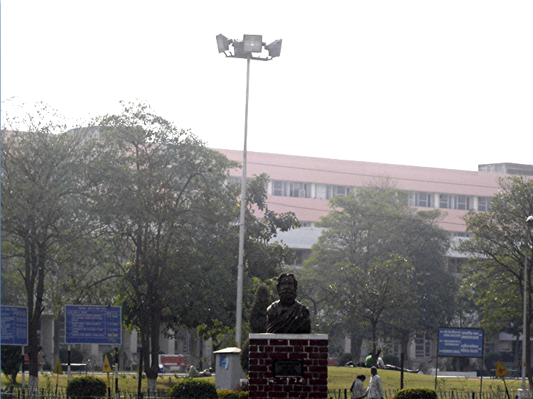
Dr. Veena Singh Ghalaut
Sr. Prof. and Head of Biochemistry
Pt. B. D. Sharma University of Health Sciences, ROHTAK
Assessment of reproductive hormones and gynaecomastia in male CML patients with imatinib therapy

Slide 4
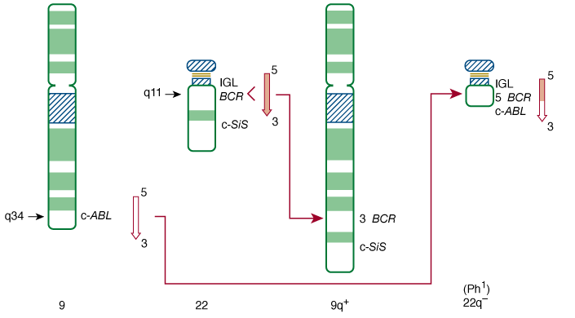
Chronic myelogenous leukaemia
Myeloproliferative disorder
characterized by:
  anaemia
  extreme blood granulocytosis
  granulocytic immaturity
  Basophilia
  Thrombocytosis
  splenomegaly
Hematopoietic cells contain the fusion gene bcr-abl
BCR-ABL encodes a constitutively active tyrosine kinase responsible for the initiation and maintenance of the chronic phase of CML

Slide 5
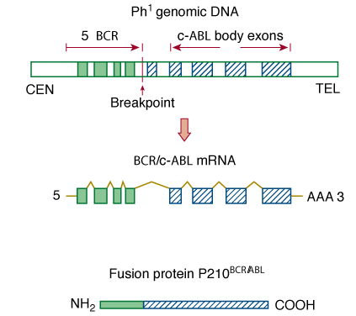
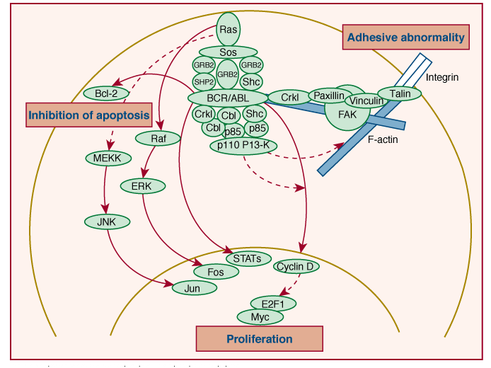
Phases
  Chronic phase
  Accelerated phase
  Blast crisis
Natural history of the chronic phase of the disease is to undergo clonal evolution into an accelerated phase and/or a rapidly progressive phase (blast crisis) resembling acute leukaemia in a median time of four years, which is refractory to therapy

Slide 6
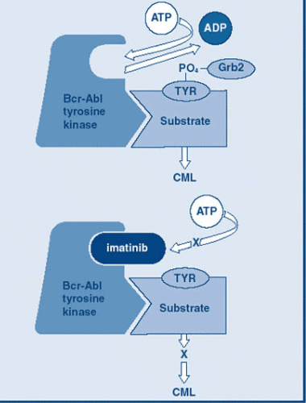
Imatinib mesylate
Small molecular analogue of ATP
Competitive inhibition at the ATP-binding site of the ABL kinase in the inactive conformation, which leads to inhibition of tyrosine phosphorylation of proteins involved in BCR-ABL signal transduction
It induces apoptosis in cells expressing BCR-ABL

Slide 7
Treatment with imatinib is suppressive and not curative
BCR-ABL +ve monoclonal hematopoiesis
Earlier therapies
Poor prognosis
I
M
A
T
I
N
I
B
Mortality < 2%
10 year survival rate > 80%
Normal life spans as long as they receive and adhere to prescribed treatments
Management of CML has become similar to that of chronic disorders such as diabetes and hypertension
Normal Polyclonal Hematopoiesis
(BCR-ABL/ABL expression ratio <0.05% by 18 months of therapy)
Advisable to maintain treatment indefinitely

Slide 8
Imatinib mesylate inhibits many tyrosine kinases
Action on these tyrosine kinases may be responsible for many of the documented side effects of imatinib.
Effects of imatinib on multiple endocrine hormones are being recognized and may affect quality of life in the CML patients or result in discontinuation of therapy
IMATINB
PDGFR-α
Arg
c-Fms
PDGFR-β
BCR-ABL
c-kit (stem cell factor receptor)

Slide 9
Endocrine effects of Imatinib: Review of literature
Reports of effects on testicular functions have emerged
PDGF and c-kit signalling is essential in testes organogenesis, Leydig cell differentiation and spermatogenesis

Slide 10
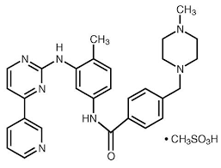
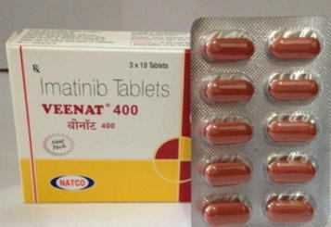
Endocrine effects of Imatinib: Review of literature

Slide 11
Imatinib & testicular function
Animal studies:
Impaired spermatogenesis in adult rats, dogs and monkeys
Treatment before puberty has more deleterious effects (Yaghmei et al, Nurmio et al and Prasad et al)
Clinical case studies:
42- year-old patient with gastrointestinal stromal tumour (GIST) developed gynaecomastia, ↓ testosterone and ↑ LH & FSH levels after treatment with imatinib mesylate for 9 months. Gynaecomastia improved after testosterone support. (Kim et al)
14.6-year-old boy given imatinib since 11 years of age for CML, developed a progressive ↓ of inhibin-B/FSH ratio, failure of spermatogenesis and bilateral gynaecomastia within a few months after normal puberty (Mariani et al)

Slide 12
18 year old man with CML developed ↓ inhibin/FSH ratio and severe oligozoospermia during long-term treatment with imatinib started before the onset of puberty (Mariani et al)
In a study by, Gambacorti- Passerini et al. it has been observed that majority of 38 men with CML had low testosterone levels and 18% developed gynaecomastia.
Patients developing gynaecomastia had greater ↓ in testosterone from baseline (median follow up of 23.6 months)

Slide 13
Aims and objectives
To study the effects of Imatinib on reproductive hormones in patients of CML.

Slide 14
Material and methods
Newly diagnosed patients in chronic phase were recruited from the Haematology clinic in Post Graduate Institute of Medical Sciences, Rohtak, Haryana with informed consent
2 groups:
  Group I : 34 male CML patients
  Group II: 34 age and sex matched healthy controls
Ethical clearance was taken from institutional board of studies

Slide 15
Diagnosis was made by clinical history, examination, complete hemogram and bone marrow aspiration
Diagnosis was confirmed by real-time PCR for BCR-ABL fusion transcript
Imatinib was given initially in a dosage of 400 mg/day and increased to 600 mg/day or to 800 mg/day (400 mg every 12 h), if required and tolerated
Haematological remission criteria were used for evaluation of response and were defined:
  Total leukocyte count<10X10⁹/L
  Platelet count<450X10⁹/L
  No immature myeloid cells in the blood
  Disappearance of all signs and symptoms related to leukaemia (including palpable splenomegaly) lasting for at least 4 weeks

Slide 16
Exclusion criteria
  other acute or chronic co-morbidities
  gynaecomastia and sexual dysfunction due to any cause
  liver and kidney diseases,
  endocrine disorders
  other malignancies
  CML- blast crisis / accelerated phase
  chronic infections like tuberculosis etc.
  History of medications besides imatinib and haematinics (folic acid, vitamin B12, vitamin B6, iron, etc.)
Accelerated phase was defined as blood or marrow blasts between 10 and 20%, or blood or marrow basophils >20%, or platelet count <100 x 109/L and blast crisis as blood or marrow blasts >20%

Slide 17
Estimation of hormones
Venous blood sample was collected after overnight fast in a red capped vacutainer under all aseptic precautions for estimation of:
  Testosterone, LH and FSH
Estimation of these hormones was done by chemiluminescence technique on ADVIA Centaur CP system from Siemens
Appropriate external quality controls were also run

Slide 18
Laboratory reference intervals used
  FSH (20–70 yrs): 1.4–18.1 IU/l
  LH (20–70 yrs): 1.5–9.3 IU/l
  Testosterone (20-70 yrs): 8.4–28.7 nmol/l.

Slide 19
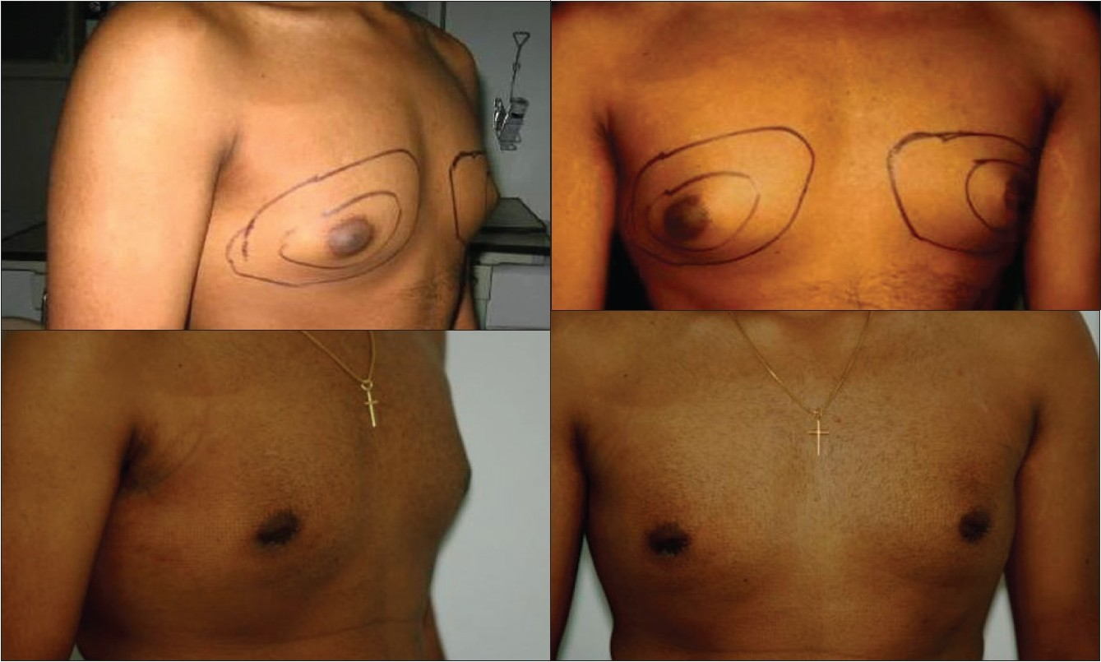
Follow up and outcome assessment
At 6 months of treatment
Testosterone, LH and FSH estimation (primary outcome) and clinical examination for gynaecomastia (secondary outcome)

Slide 20
Observations
Patient characteristics
Group I – 34 males
Median age at diagnosis | 38.5 yrs
Median Hb | 8.5 g/dL
Median TLC | 75 X 10⁹/L
Median blasts in peripheral blood | 5%
Median platelet count | 300 X 10⁹/L
Median duration of symptoms | 6 weeks
Asymptomatic patients diagnosed incidentally on hemogram examination | 6 (9.4%)

Slide 21
Treatment outcomes
Thirty patients out of 34 (88.2%) achieved remission at 6 months
Imatinib dosage was increased to 600 mg/day in 6.3% patients and to 800 mg/day in 9.4% patients

Slide 22
None of the patients had gynaecomastia at 6 months
The proportion of patients with low testosterone level ↑ significantly from 11.8% at baseline to 58.8% at 6 months (p<0.001)
The proportion of patients with high LH and FSH ↑ significantly from 26.4% and 23.5% to 82.4% and 76.4%, respectively (p<0.001 and p<0.001)
Serum testosterone levels ↓ significantly (p=0.002)
Serum LH and FSH levels ↑ significantly (p<0.001 and p=0.003)
The four patients who were not in haematological remission had testosterone levels within reference range

Slide 23
Comparison of serum LH, FSH and testosterone levels before and after 6 months of imatinib therapy
Parameter (reference range) | Baseline | % patients with abnormal levels | 6 months | % patients with abnormal levels | p value
Testosterone (8.4–28.7 nmol/l) | 15.40±4.38 | 11.8 % below reference range | 9.01±4.18 | 58.8% below reference range | 0.002
LH (1.5–9.3 IU/l) | 7.32±3.84 | 26.4% above reference range | 13.8±24.25 | 82.4% above reference range | 0.001
FSH (1.4–18.1 IU/l) | 11.77±7.23 | 23.5% above reference range | 22.30±8.74 | 76.4% above reference range | 0.003

Slide 24
Other Side effects: | Percentage of patients
peripheral edema on legs | 18.75
periorbital edema | 12.5
fatigue | 18.75
myalgia | 15.63
cutaneous reactions | 18.75
cough | 6.25
The severe periorbital edema occasionally observed is postulated to be an effect on platelet-derived growth factor receptor (PDGFR) and c-KIT expressed by dermal dendrocytes
Hair repigmentation and hypopigmentation of the skin, probably related to the inhibition of the c-KIT receptor tyrosine kinase by imatinib, have been reported

Slide 25
Discussion – testicular dysfunction
With 6 months of imatinib therapy, testosterone levels ↓ and LH and FSH ↑ significantly
The proportion of patients with low testosterone and elevated LH and FSH ↑ significantly
Similar effects have been documented as case reports for tyrosine kinase inhibitors dasatinib and sunitinib.
Caocci et al. had reported reduced levels of testosterone and free testosterone besides elevated 17-hydroxyprogesterone and gynaecomastia in a 70-year-old male on dasatinib treatment for CML

Slide 26
None of the CML patients had gynaecomastia at 6 months of therapy in the present study
Kim et al. had observed gynaecomastia after 9 months of therapy in a 42-year-old subject, while Gambacorti-Passerini et al. observed gynaecomastia in 7 out of 38 patients over a median follow-up time of 23.6 months
Thus, while the consequences of decreased testosterone production may develop slowly we found lower levels in as much as 58.8% patients at 6 months of imatinib therapy
Gynaecomastia can result from the reduced testosterone levels

Slide 27
All men with decreased testosterone levels (20) were in haematological remission at 6 months.
However, 10 patients with haematological remission had normal testosterone levels
Thus, testosterone deficiency may not develop in all patients achieving remission
Testosterone levels in patients not in haematological remission (4) were in the normal reference range. Poor compliance due to the high cost of imatinib therapy may be a possible cause

Slide 28
Imatinib reduces testosterone production through the blockade of PDGFR and c-kit in the testis
Decreased feedback inhibition leads to elevation of LH and FSH levels
PDGF and c-kit signalling is essential in testes organogenesis, Leydig cell differentiation and recruitment and spermatogenesis

Slide 29
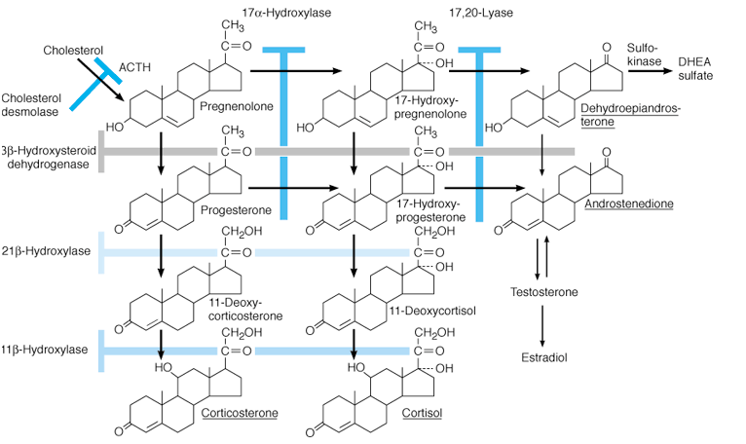
c-kit stimulation effects luteinizing hormone signalling and increases the expression of proteins involved in testosterone synthesis like:
Steroidogenic Acute Regulatory Protein (StAR)
CYP11A (cholesterol 20-22 desmolase)
CYP17 (steroid 17-alpha-monooxygenase)
3-hydroxysteroid dehydrogenase

Slide 30
Gambacorti-Passerini et al. had observed rise of progesterone and 17-hydroxyprogesterone in imatinib treated CML patients
This represented the accumulation of testosterone precursors as a consequence of impairment of key enzymes in the steroidogenic cascade
Chronic testosterone deficiency can gradually lead to sexual and metabolic derangements like reduced libido, erectile dysfunction, oligozoospermia, low bone mineral density and metabolic syndrome

Slide 31
Conclusions
The findings document the adverse effect of imatinib on testosterone levels in adult male CML patients much before than reported earlier
Testosterone estimation in all CML patients on imatinib and possibly other TKIs will help in early detection of reduction in testosterone levels and enable clinicians to plan possible interventions to prevent the future development of associated morbidities like gynaecomastia, sexual and metabolic derangements.

Slide 32

THANK
YOU

Slide 33
Let Us Meet Again
We welcome you all to our future conferences of
OMICS International
Please Visit:
www.metabolomicsconference.com
www.conferenceseries.com
http://www.conferenceseries.com/clinical-research-conferences.php

