Slide 1
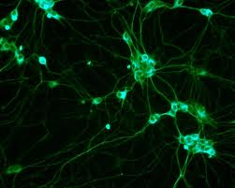

Adipose rabbit mesenchymal stem cells for the treatment of the chronic scar tissue of the vocal cords
Dr. Vasiliki E Kalodimou,
Head of Flow Cytometry-Research and Regenerative Medicine Department,
IASO-Maternity Hospital, Athens-Greece
E-mail: kalodimou@yahoo.gr

Slide 2
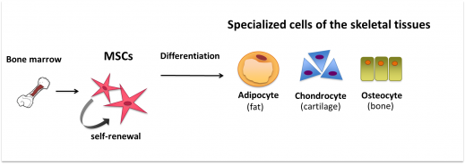
Adipose-derived stem cells (ADSCs), represents a promising approach to future cell-based therapies. These cells can be readily harvested in large numbers with low donor-site morbidity.
Mesenchymal stem cells are characterized by great “plasticity ", i.e. have the ability to differentiate to form various cell types.
For this reason it can be used in regenerative medicine to regenerate tissues and organs.
Figure 1: Mesenchymal stem cell differentiation: The MSC's can differentiate into fat, cartilage and bone cells.

Slide 3
Detection:
It is generally accepted that adult human MSC's:
do not express hematopoietic markers (Cells must show <2% positivity for expression of cell-surface antigens): CD45, CD34, CD14, CD11, CD80, CD86, CD40, CD31, CD18, or CD56,
but do express (Cells must show >95% positivity for expression of cell-surface antigens):
CD105, CD73, CD44, CD90, CD71, CD106, CD166 and CD29.
Positive markers: | Cells must show >95% positivity for expression of cell-surface antigens CD29, CD44, CD73, CD90, CD105, CD166 and CD 271.
Negative markers: | Cells must show <2% positivity for expression of cell-surface antigens CD14, CD31, CD 34, CD45, CD 133, and Lin1.

Slide 4

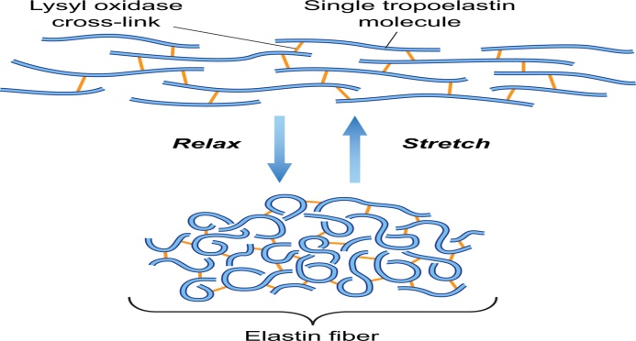
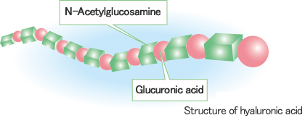
Molecular and cellular anatomy of the vocal fold
Extracellular matrix:
Complex structural entity.
Referred as the connective tissue.
The components of the extracellular matrix are produced intracellulary by resident cells and secreted into the ECM by exocytosis.
Structural proteins: collagen and elastin.
Specialized proteins: laminin, fibrillin, fibronectin.
Proteoglycans: hyaluronic acid.

Slide 5
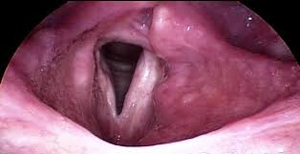
Vocal fold scarring
Causes:
trauma
surgical treatment
inflammation
post infection
injury
Symptoms:
hoarseness
breathiness
vocal strain
fatigue
decreased vocal range
Pain

Slide 6
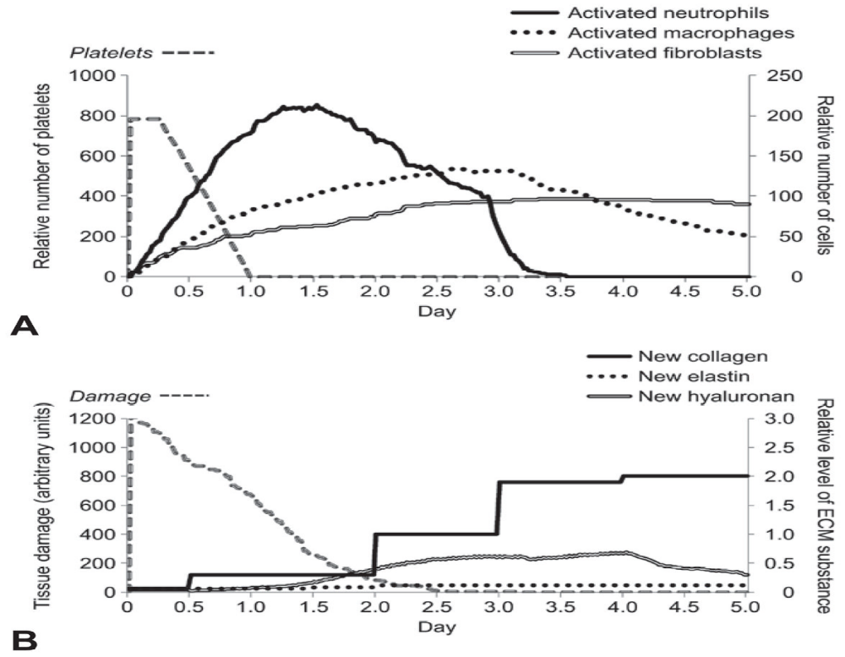
What happens the very first days of a vocal traumatism in the vocal folds?
We have a rapid increase and decrease of neutrophils, which stimulate the production of cytokines. The activation of fibroblasts takes some days.
The rate of collagen synthesis increases rapidly, approximately 5 days after injury and continues for 2 to 4 weeks. After that, the rate declines and is balanced by an increase in collagenase rapide increase of collagen.
Hyaluronic acid increase less and reach a maximum and then decrease.
Elastine fibers are rapidly produced but degratated after 2 days.
Nicole Li, 2010

Slide 7
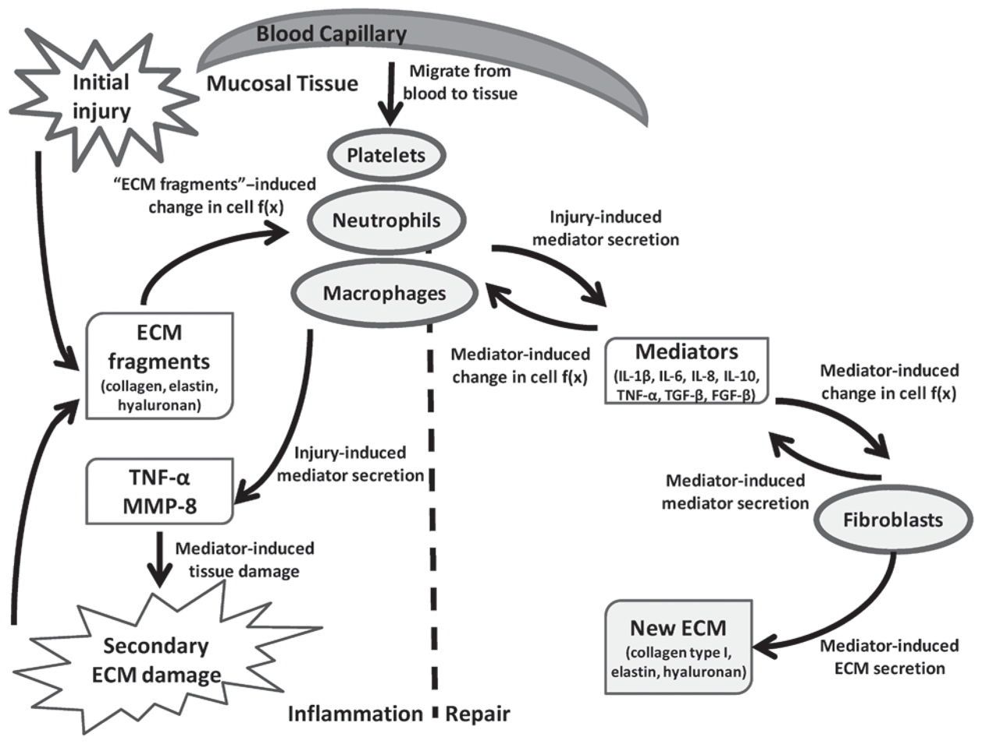
Repair process
Complex
Starts as any inflammatory condition
Interactions between cells and extracellular matrix
Ongoing remodeling for about 12 months
Available Treatments
Biocompatible scaffolds:
Teflon
Bovine collagen
Human collagen
Cymetra® ( micronized form of AlloDerm)
Fascia
Fat
Hydroxyapatite ( Radiesse®)
Hyaluronic acid
Non of these treatments achieved the restoration of the unique biomechanical properties of the layered vocal fold.

Slide 8
Animal study
Aim:
To evaluate the effects of injection of autologous adipose mesenchymal stem cells in a chronic vocal fold scar in rabbits.
Method:
We used 105 New Zealand rabbits around 3 Kg.
Surgical protocol:
The vocal folds of 8 rabbits (16 vocal folds) served as controls.
Under general anesthesia (xylazine, ketamine, diazepam and glycopyrrolate) and direct laryngoscopy we created a trauma to the vocal fold in the remaining 97 rabbits. The lamina propria was injured bilaterally with micro scissors by localized resection of the middle portion of the vocal fold down to the vocal ligament under direct laryngoscopy (endoscope 0, 4mm) with video monitoring.
Post operative follow up:
We perform direct laryngoscopy under general anesthesia at 15 days, 1 month and 3 months to investigate morphologic changes including surface irregularities, granulation tissue formation, and atrophy.

Slide 9
Seven (7) rabbits died immediately post operatively and thirteen (13) rabbits died within one month

Slide 10
After 18 months we assessed the scar to the vocal folds.

Slide 11
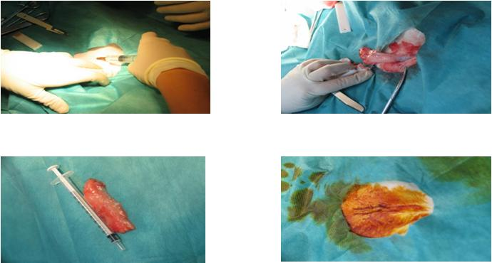
rabbits were anesthetized with intramuscular administration of xylazine and ketamine.
Adipose tissues (0,2-1 gr) were harvested from the inguinal area.

Slide 12
Few hours after isolation we proceed with the infusion of 0,1 ml adipose mesenchymal stem cells into both scarred vocal folds, under sedation and direct laryngoscopy.

Slide 13
We infused hyaluronic acid in 5 rabbits to compare our results with stems cells to those with the actual treatments proposed.
We infuse 0,1 ml of hyaluronic acid to each scarred vocal fold 18 months after the trauma of the vocal folds.

Slide 14
The identification process
Observing the adherent cells under a microscope to study their morphological characteristics.
Identifying cell surface antigens by flow cytometry (CD 34, CD 44, CD 105, CD 106 and CD271 specific for rabbits).
We used 7-AAD to asses the viability of the cells which were 98-100%.
Concentrations were 100.000 cells /ml.

Slide 15
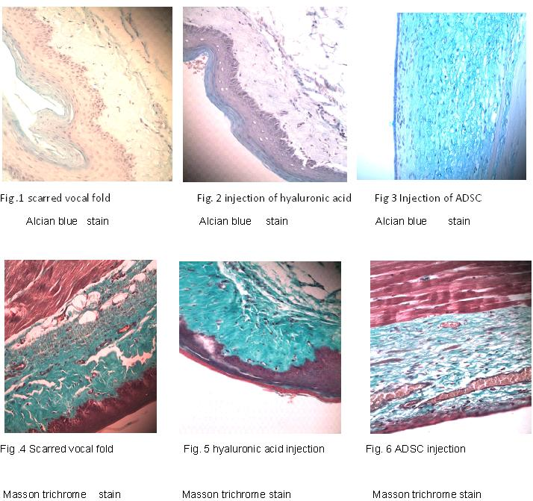
Results after 3 months
After 3 months all the rabbits were sacrificed. In the immediate post mortem period, each larynx was placed in 10 % of formaldehyde for a minimum of period of 24 hours and maximum 48 hours.

Slide 16
Lamina propria:
The thickness of the lamina propria is doubled when we have a scar in the vocal fold. This thickness is preserved when we inject hyaluronic acid. In the contrary, when we inject adipose stem cells, the thickness of the lamina propria tends to return back to normal values.
Collagen:
In the scar, the fibers of collagen are more, they occupy all the full thickness of the lamina propria and are disorganized. This structure doesn’t seem to change when we inject hyaluronic acid
Instead, when we inject adipose stem cells the fibers of collagen are less, and organized in a laminar way, like in a normal vocal fold
Hyaluronic acid:
In a scarred vocal fold, the amount of hyaluronic acid is reduced. Although we inject gel hyaluronic acid in scarred vocal folds, after three months it seems that it doesn’t integrated in the vocal fold. When we inject stem cells, the amount of hyaluronic acid returns back to normal.

Slide 17
Benefits:
In past studies the implementation of adipose mesenchymal stem cells had been done 2-5 days after the creation of the vocal cord injury. This means that the implant is in the midst of intense inflammatory reaction. In this study the implantation conducted 18 months after the injury of vocal cord.
Here we compared the effects of:
a) Implanting adipose mesenchymal stem cells
b) infusion of hyaluronic acid &
c) no treatment in the chronic scar tissue.
The study was conducted with a rabbit as an animal model, whose structure of the vocal cords is more like the human vocal chords.
In our study the implanted adipose mesenchymal stem cells derived from autologous fat while in all other studies the implantation derived from bone marrow and the placenta.
The advantages of our method are:
easy
painless preparation &
greater stability

Slide 18
Acknowledgements
Dr. V. Angelou, ENT-Head and neck surgeon, Consultant in “Phoniatric and Applied Laryngology Center”.
A. Papalois, (PhD, KGSJ), Director of Experimental & Research Center ELPEN.
A. Zaharioudaki, (DVM, MLAS), Experimental & Research Center ELPEN / Veterinary department .

Slide 19

THANK YOU FOR YOUR ATTENTION

