Slide 1


Could clinical Stenotrophomonas maltophilia be a potential pathogen in clinical setting?
3rd International Conference on Clinical Microbiology and Microbial Genomics Valencia, Spain
Associate Professor Dr. Vasantha Kumari Neela
Department of Medical Microbiology and Parasitology, Faculty of Medicine and Health Sciences
Universiti Putra Malaysia, Malaysia

Slide 2
Stenotrophomonas maltophilia, previously known as Pseudomonas maltophilia or Xanthomonas maltophilia, is ubiquitously found in nature
Well known environmental microbe with several biotechnological applications.

Slide 3

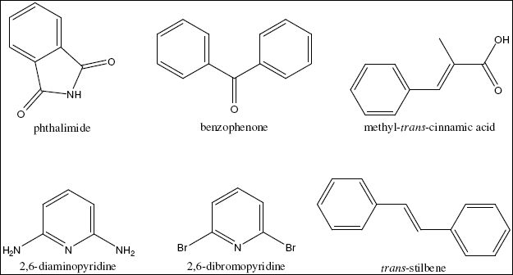
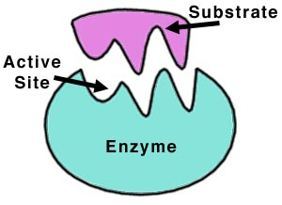
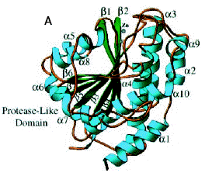
Biocontrol and growth enhancer
Biotechnological applications
Bioremediation and phytoremediation
Secondary metabolite production

Slide 4

STENOTROPHOMONAS MALTOPHILIA
Most worrisome threat among unusual non-fermentative gram negative bacteria in hospitalized patients

Slide 5
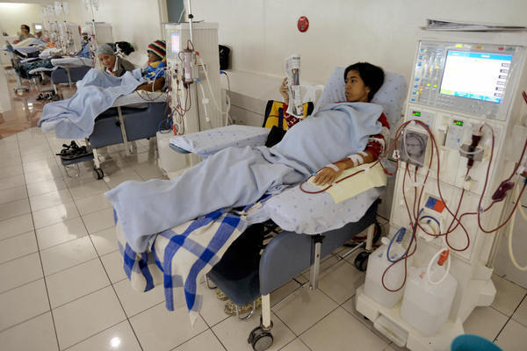
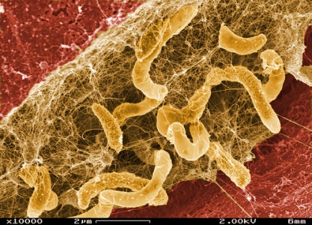
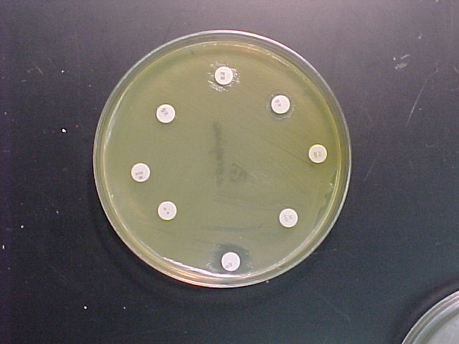

Colonizes human and medical devices
Pathogenic determinants and biofilm
Successful
Nosocomial pathogen
Antibiotic resistance
Highly diverse clones

Slide 6
History
1943: First isolated from pleural fluid in 1943 by J. L. Edwards, named as Bacterium bookeri
1961: Classified as Pseudomonas maltophilia by Hugh and Ryschenko when similar strain was isolated in 1958 from an oropharyngeal swab from a patient with an oral carcinoma.
1981: Reclassified as Xanthomonas maltophilia by Swings and group based on the rRNA cistron homology generated through the DNA-rRNA hybridization techniques.
1993: Finalized by Palleroni and Bradbury as S. maltophilia since X. maltophilia did not match well including the specific 16SrRNA gene
At present : 8 species
S. maltophilia, S. nitritireducens , S. rhizophila , S. acidaminiphila , S. koreensis, S. chelatiphaga , S. terrae , S. humi and S. africana.

Slide 7
Challenges in combating S. maltophilia infections
Management of S. maltophilia infections represents a great challenge to clinicians
in vitro susceptibility testing
lack of clinical trials to determine optimal therapy
intrinsic resistance to a plethora of antimicrobial agents
Opportunistic pathogen targets immunocompromised population, prolonged hospitalization, malignancy, immune suppression, and breakdown of muco-cutaneous defense barriers (e.g., following catheterization, artificial implantation, tracheotomy, or peritoneal dialysis
Different strains behave differently
Ubiquitously present in the environment
Source tracing is difficult
No clear information on virulence factors or pathogenicity
Debate on colonizer or pathogen

Slide 8

Epidemiology
S.maltophilia Infection
In Malaysia, highest number of S. maltophilia infections was observed among Tracheal Aspirate of about 39%.
Hospital Acquired (60%)
Community Acquired (45.8%)
Infections that occurred 48 or 72 h prior hospitalization
Respiratory Tract
Bacteremia
Bloodstream
Urinary Tract
Wound
Gastro-Intestinal
Neural
Bacteremia
Ocular infection
Respiratory tract infection
Wound / soft tissue infections
Urinary tract infection
Radical increase over the past decades
(2-4 fold increase)
[Chang et al. J Microbiol Immuno and Infect . 2014]
[Neela et al. Int j of Infect Dis. 2012]
Notes:
The incidence in the US of invasive GBS disease in adults has been reported as 2.4-4.4 cases per 100,000

Slide 9
S. maltophilia colonization or pathogen ?
    The failure to distinguish between colonization and infection has led to the belief that S. maltophilia is an organism of limited pathogenic potential that is rarely capable of causing disease in healthy individuals.
    Reports indicate that infection with this organism is associated with significant morbidity and mortality rates particularly in severely compromised patients.
    Its mechanism of pathogenesis is poorly understood

Slide 10
Study1: Extracellular enzyme profile of S.maltophilia
Extracellular Enzymes
DNase
Gelatinase
Heparinase
Hemolysis
Hyaluronidase
Lipase
Biofilm
Motility
Swimming
Swarming
Twitching
Pigment
Melanin
Pyocyanin
Fluorescein

Slide 11
Different hydrolytic enzyme assay using plate method
Enzyme | Method | Result | Reference
DNase | 1. DNase agar test - 0.01% toluidine blue was used to determine DNase production after 72 h of growth at 37°C. 2. Modified DNase tube test was also employed to evaluate the DNase production as described elsewhere. | 1. DNase activity was indicated by the formation of a large pink halo around an inoculum spot . 2. Clearing of the genomic DNA band | (Janda et al,1981; Neela, et al. 2012)
Gelatinase | Organisms were inoculated on 0.4% gelatin agar. The plates were incubated at 37°C for 24 h followed by which the plates were flooded with mercuric chloride solution. | Appearance of opaque zone around the inoculum | (Frazier et al1926; Mc and Weaver 1959)
Hemolysis | Trypticase soy agar containing 5% sheep blood was evaluated at room temperature after 24 h of growth. | Appearance of clear zone | (Travassos, et al. 2004)
Heparinase | Heparin was diluted in distilled water to a final concentration of 5 U/ml followed by filter sterilization (0.45 pm) before dispensing 20 μl into 96 well micro titration plate; each well contained 30 μl of the test bacteria, incubated overnight at 37°C. 20 μl of aqueous toluidine blue 0.01% was added to each well. | Blue color indicated positive result, while pink indicated negative | (Riley 1987)
Hyaluronidase | Incorporation of aqueous solutions of hyaluronic acid into Muller Hinton agar supplemented with bovine serum albumin (final concentration, 1%). After being inoculated and incubated for 48 h, each plate was flooded with 2 N acetic acid, which was removed after 10 min. | The appearance of a clear zone around the inoculum. | (Smith and Willett 1968)
Lecithinase | Ten millilitres of the 50% egg yolk was added to 90 ml of sterilized tryptic soya agar and served as the substrate (29). | A white precipitate around or beneath an inoculum spot indicated lecithinase formation. | (Nord, et al 1975; Edberg, et al 1996)
Lipase | Lipase activity was detected by the on Trypticase soy agar plates supplemented with 1% Tween 80 . | Appearance of a turbid halo around the inocula | (Rollof, et al. 1987)
Proteinase | Casein hydrolysis and was tested on Mueller–Hinton agar containing 3% (w/v) skimmed milk . | The presence of a transparent zone around the inoculum spot indicated a positive test | (Burke et al 1991; Edberget al 1996)

Slide 12
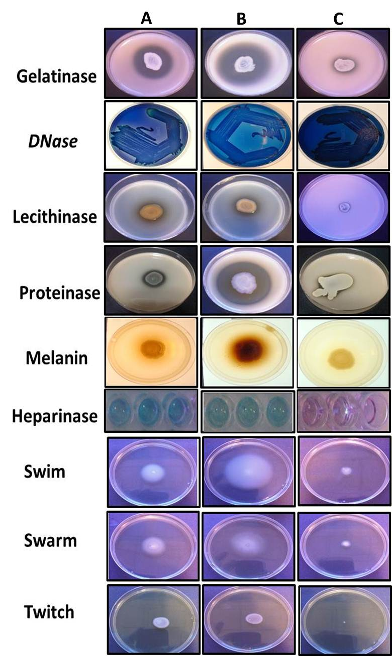
Study1: Extracellular enzyme profile of S.maltophilia
SmATCC
Clinical
Environ
 | Frequency among clinical isolates (n = 108)
Enzymes | Tracheal Aspirate | Blood | CSF | Sputum | Wound Infection | Urine
DNase | 42 (100) | 37 (94.8) | 6 (100) | 5 (100) | 13 (100) | 3 (100)
Gelatinase | 42 (100) | 39 (100) | 6 (100) | 5 (100) | 13 (100) | 3 (100)
Hemolysin | 42 (100) | 39 (100) | 6 (100) | 5 (100) | 13 (100) | 3 (100)
Heparinase | 30 (71.42) | 27 (69.2) | 4 (66.6) | 4 (80) | 9 (69.2) | 0
Hyaluronidase | 42 (100) | 39 (100) | 6 (100) | 5 (100) | 13 (100) | 0
Lipase | 42 (100) | 39 (100) | 6 (100) | 5 (100) | 13 (100) | 3 (100)
Lecithinase | 34 (80.95) | 17 (43.5) | 6 (100) | 5 (100) | 13 (100) | 0
Proteinase | 42 (100) | 39 (100) | 6 (100) | 5 (100) | 13 (100) | 3 (100)
Pyocyanin | 0 | 0 | 0 | 0 | 0 | 0
Flourescein | 0 | 0 | 0 | 0 | 0 | 0
Lecithinase and heparinase – significantly associated with invasive origin

Slide 13
Study1: Extracellular enzyme profile of S.maltophilia
 | Melanin |  | Biofilm |  | Motility
 | +ve | -ve | High | Low | Motile | Non-motile
Invasive (n = 45) | 41 (91.1) | 4 (8.8) | 9 (20) | 36 (80) | 100 | 0
Non-Invasive (n = 63) | 60 (95.2) | 3 (4.7) | 11 (17.) | 52 (82.5) | 100 | 0
Frequency among clinical isolates n=108
Enzymes | Device Related (n = 71) | Non- Device Related (n = 37)
DNase | 71 (100) | 69 (97.1)
Gelatinase | 71 (100) | 37 (100)
Hemolysin | 71 (100) | 37 (100)
Heparinase | 52 (73.2) | 23 (62.1)
Hyaluronidase | 71 (100) | 37 (100)
Lipase | 71 (100) | 37 (100)
Lecithinase | 49 (69) | 27 (73 )
Proteinase | 71 (100) | 37 (100)
Pyocyanin | 0 | 0
Flourescein | 0 | 0
 |  | Melanin |  | Biofilm |  | Motility
 |  | +ve | -ve | High | Low | Motile | Non –motile
Device Related ( n= 71) |  | 65 (91.5) | 6 (8.4) | 14 (19.7) | 57 (80.2) | 100 | 0
Non-Device Related (n = 37) |  | 36 (97.2) | 1 (2.7) | 7 (18.9) | 30 (81) | 100 | 0
Irrespective of Invasive/Non-invasive – All Isolates produces factors that destroy cell components.
Infections are multifactorial events and secreted or non-secreted components contribute equally in pathogenesis.
Certain enzymes like lecithinase and lipase might play important role in certain type of infections – Lining of lungs mainly composed of lecithin.
Reservoir for pathogenic potential enzymes.

Slide 14
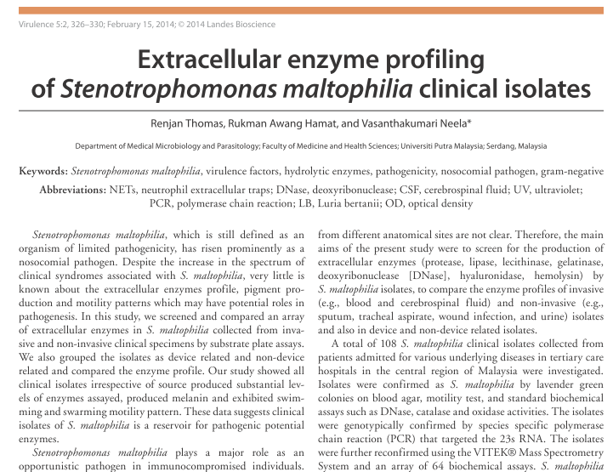
RESULTS(Cont.)
Study1: Extracellular enzyme profile of S.maltophilia

Slide 15
Study2: Prevalence of Putative Virulent Genes in S. maltophilia infections.
Virulence Genes Identified from closely related species
Shares 86 to 90% similarities with P.aeruginosa,
BLAST
S. maltophilia K279a(Clinical origin)
Positive control: S. maltophilia ATCC 13637
Negative control: P.aeruginosa: ATCC27853
Primers Designed
PCR Amplification
Electrophoresis
Analysis
Real Time- PCR

Slide 16
PCR primers and cycling parameters for virulence genes
Genes | Initial Denaturation | Denaturation | Annealing | Extention | Final Extention | Reference
Lipase | 5 min at 95ºC | 30 s at 95.1ºC | 20 s at 64.2ºC | 40 s at 72ºC | 2 min at 72ºC | This study
ICOM | 5 min at 95ºC | 20 s at 94.1ºC | 15 s at 59.9ºC | 30 s at 72ºC | 2 min at 72ºC | This study
Lux R | 5 min at 95ºC | 30 s at 95.2ºC | 20 s at 59.8ºC | 30 s at 72ºC | 2 min at 72ºC | This study
Side | 5 min at 95ºC | 30 s at 94.4ºC | 20 s at 59ºC | 40 s at 72ºC | 2 min at 72ºC | This study
PiliZ | 5 min at 95ºC | 34 s at 95.1ºC | 24 s at 64.2ºC | 44 s at 72ºC | 2 min at 72ºC | This study
TatD | 5 min at 95ºC | 30 s at 94.7ºC | 20 s at 51.9ºC | 40 s at 72ºC | 2 min at 72ºC | This study
Tox A | 5 min at 95ºC | 30 s at 95.1ºC | 20 s at 64.2ºC | 40 s at 72ºC | 2 min at 72ºC | This study
Back

Slide 17

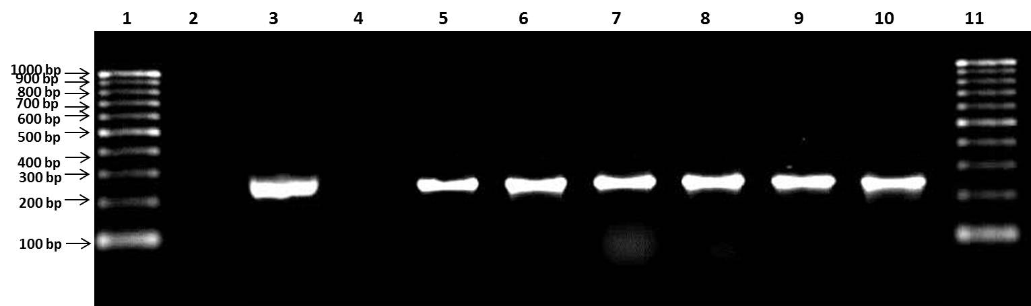
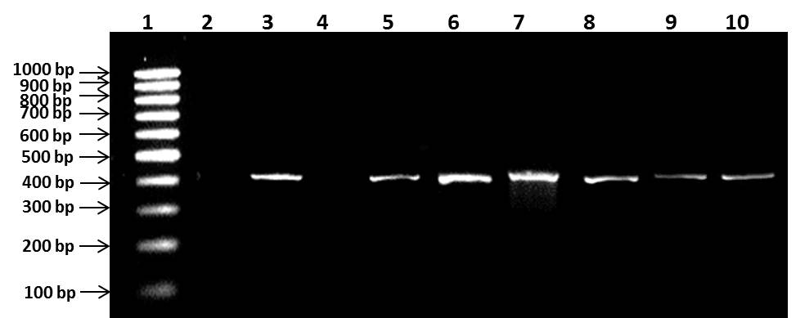
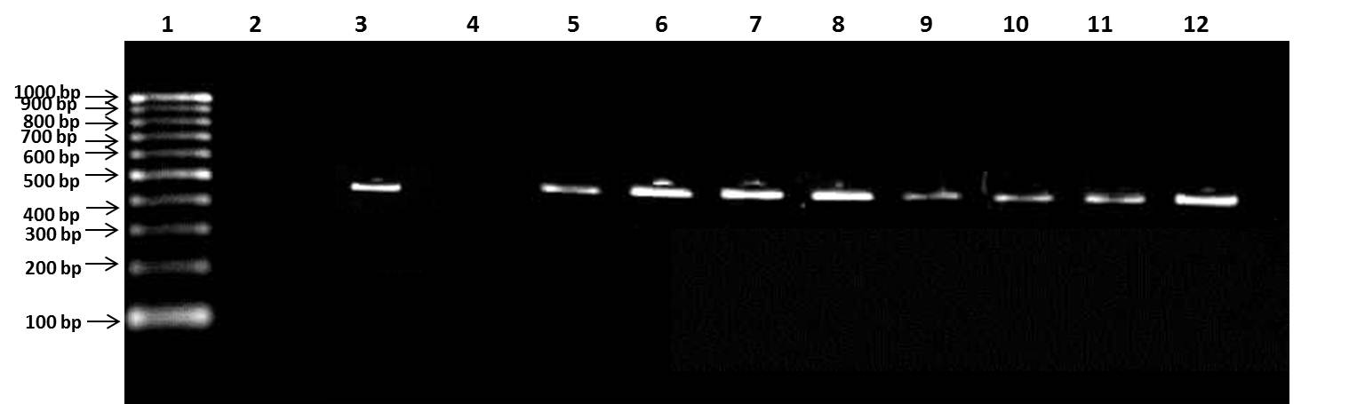
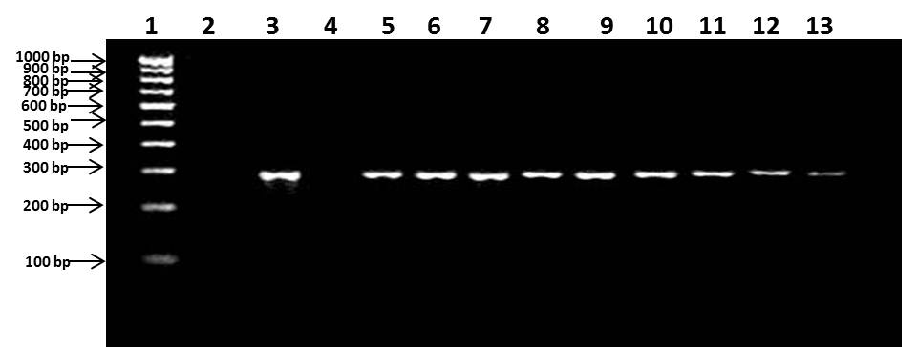
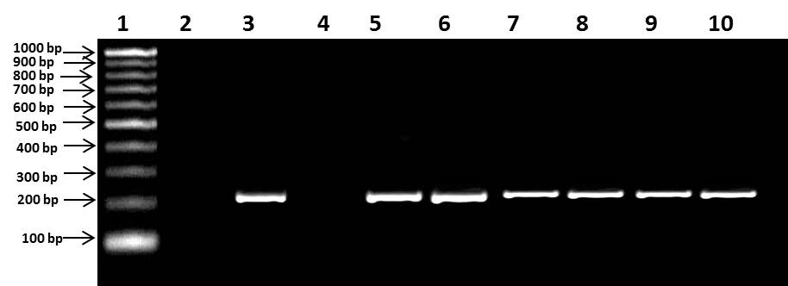
246 bp
409 bp
GENES DEPOSITED IN GENBANK - NCBI
PCR confirmation of ICOM gene
PCR confirmation of tatD gene.
Genes | Accession Number
Lipase | KJ684062
ICOM | KJ577137
Lux R | KJ684060
Side | KC751544
TatD | KJ684061
460 bp
PCR confirmation of siderophore gene.
288 bp
234 bp
PCR confirmation of luxR gene
PCR confirmation of lipase gene
Back

Slide 18
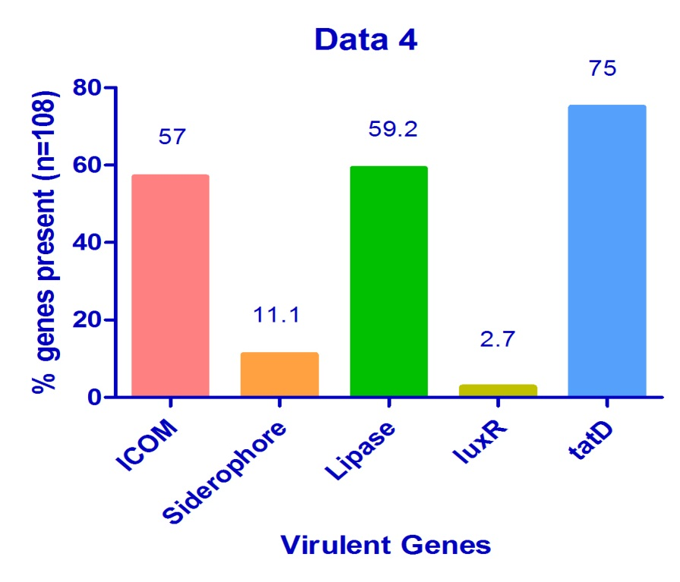
Virulent gene profile in S.maltophilia isolates
 | ICOM | SID | LUX R | LIPASE | TOX A | PILI Z | TAT D
Blood ( n = 39) | 23(59) | 4 (10.3) | 1 (2.6) | 24 (61.5) | 0.0 | 0.0 | 30 (76.9)
CSF( n = 6) | 6 (100) | 0.0 | 0.0 | 3 (50) | 0.0 | 0.0 | 3 (50)
Sputum ( n = 5) | 2 (40) | 0.0 | 0.0 | 2 (40) | 0.0 | 0.0 | 4 (80)
Tracheal Aspirate ( n = 42) | 23 (54.8) | 7 (16.7) | 2 (4.8) | 3 (54.8) | 0.0 | 0.0 | 28 (66.7)
Wound Swabs ( n = 13) | 6 (46.2) | 1 (7.7) | 0.0 | 9 (69.2) | 0.0 | 0.0 | 13(100)
Urine ( n = 3) | 2(66.7) | 0.0 | 0.0 | 3 (100) | 0.0 | 0.0 | 3(100)
Iron essential for metabolism.
Lipase - correlated to pulmonary infection.
DNase evades host immune response.
59.2% Isolates (n = 108) has Lipase.
Hydrolyzes Lipid rich pulmonary tissues
Triggers Inflammatory response
[Lanon et al. . 1992]
Back

Slide 19
METHODOLOGY(Cont.)
Study3: C.elegans as an In vivo model of infection
C.elegans culture
Age Synchronization
L4 stage larvae
Toxicity Assay

Slide 20
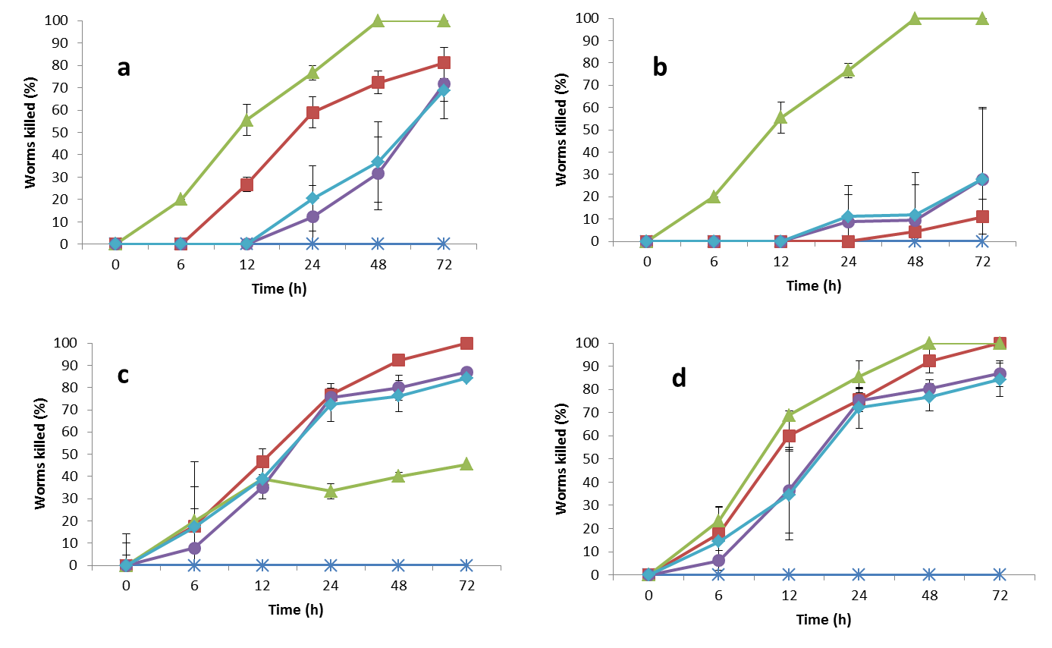
RESULTS (Cont.)
Direct contact with bacteria
Fast killing
Slow killing
No direct contact with bacteria
Heat Killed
Filter based
Different methods employed in C. elegans killing. C. elegans killing assay using: (a) the fast killing method, (b) slow killing method, (c) heat-killed method and (d) filter-based method. Vertical bar represents SD. Experiments were conducted in triplicate. *, E. coli OP50 strain; ■, S. maltophilia ATCC 13637; ▲, P. aeruginosa ATCC 27853; ●, invasive strains; ♦, noninvasive strains

Slide 21
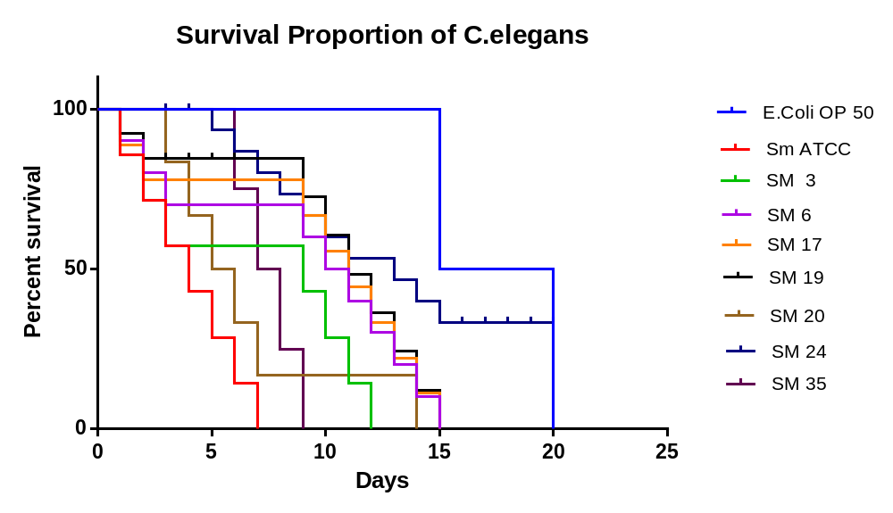
RESULTS (Cont.)
Survival curve analysis of C.elegans using graphpad prism software version 6.
Clinical isolates of S.maltophilia are detrimental
Different methods of infecting the C.elegans with test bacteria – Different Time point.
Filter based and Heat killed method – complete killing of C.elegans at 24hr.
Clinical isolates of S.maltophilia effectively kills the nematodes – Filter based and Heat killed compared to fast and slow killing

Slide 22
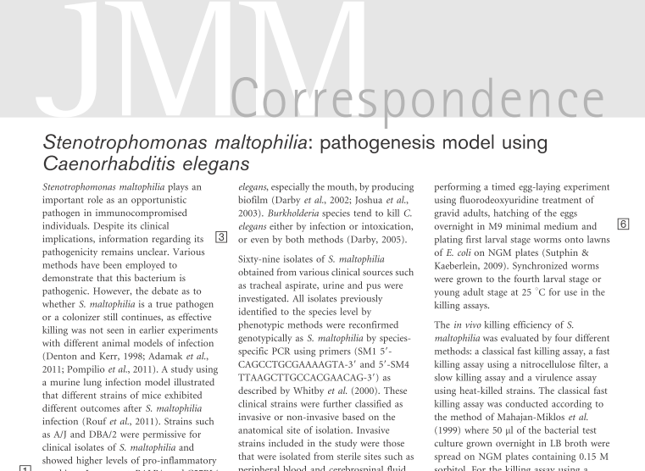
RESULTS (Cont.)

Slide 23

CONCLUSION
Final Conclusion
From this study we conclude that S.maltophilia is a serious nosocomial pathogen due to the facts that they harbour virulent factors such as the extracellular enzymes and gene products that have deleterious effect.
Lethal to nematodes makes this bacterium a potent nosocomial pathogen with high virulence potential.

Slide 24
Acknowledgements
Research Grants
Faculty of Medicine and Health Sciences, Universiti Putra Malaysia for research facilities
Ministry of Higher education through Fundamental research Grant Scheme
Ministry od Science, Technology and Innovations through Escience
Collaborators
Professor Alex van Belkum
( Erasmus MC, The Netherlands, bioMérieux, France)
Professor Richard Goering
(Creighton University, Omaha, Nebraska, USA)
Research Group Members
Dr. Rukman Awang Hamat (Clinical Microbiologist)
Dr. Syafinaz Amin Nordin (Clinical Microbiologist)
Ms. Seyedeh Zahra Rouhani Rankouhi (MSc. Medical Microbiology)
Mr. Renjan Thomas (PhD student)
MR. Shit Chong Seng (PhD student)
Hospital Kuala Lumpur

Slide 25



