Slide 1


The Incidence of Head and Neck Injuries in Extreme Sports
Vinay Sharma, BA* , Juan Rango, BS† , Alex Connaughton, BS† , Vani Sabesan, MD*
*Western Michigan University School of Medicine
†Michigan State University College of Human Medicine

Slide 2
Disclosures
No outside sources of funding were used for this study
No conflicts of interest to report
Notes:
No outside sources of funding were used for this study.

Slide 3
What is a Concussion
a complex pathophysiological process that affects the brain, typically induced by trauma
Caused either by a direct blow to the head or an indirect blow to the body → neurological impairments that may resolve spontaneously
Symptoms usually reflect a functional disturbance to the brain, and may include symptoms:
  physical (e.g., headaches, nausea)
  cognitive (e.g., difficulty with concentration or memory)
  emotional (e.g., irritability, sadness)
  maintenance' (e.g., sleep disturbances, changes in appetite or energy levels)
A concussion is considered a brain injury.

Slide 4
Concussions
Each year, U.S. emergency departments (EDs) treat an estimated 173,285 sports- and recreation-related traumatic brain injuries, including concussions
Children from birth to 19 years of age
Children and teens are more likely to get a concussion and take longer to recover than adults.
Nonfatal Traumatic Brain Injuries Related to Sports and Recreation Activities Among Persons
Aged ≤19 Years --- United States, 2001—2009
Morbidity and Mortality Weekly Report (MMWR) October 7, 2011 / 60(39);1337-1342

Slide 5
Estimated TBI vs. non-fatal injuries
Activity | TBIs | All visits for sports and recreation--related injuries | % of all visits for injuries that were TBIs
 | No.* | No.*
Bicycling | 26,212 | 323,571 | 8.1
Skateboarding | 6,004 | 101,577 | 5.9
Moped/Dirt bike riding | 3,370 | 39,363 | 8.6
Roller skating/ Unspecified skating | 1,126 | 34,717 | 3.2
In-line skating | 853 | 25,350 | 3.4
Total | 173,285 | 2,651,581 | 6.5
http://www.cdc.gov/mmwr/preview/mmwrhtml/mm6039a1.htm?s_cid=mm6039a1_w#tab1
Notes:
Estimated annual number of emergency department visits for all nonfatal injuries and nonfatal traumatic brain injuries (TBIs) related to sports and recreation activities among persons aged ≤19 years, by type of activity --- NEISS all Injury Program, United States, 2001--2009

Slide 6
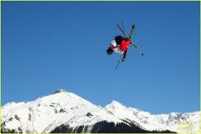
Extreme Sports
What are extreme sports?
  non-traditional, adventure sports
  high-risk activities with the potential for serious injury and danger, including the risk of a fatal injury.
  evolved to denote activities such as bungee jumping, snowboarding, extreme skiing, canyoning, surfing, skateboarding, sky-diving, paragliding, rock climbing and mountain bicycling
Notes:
“Extreme sports’ has become a popular phrase to describe a variety of non-traditional and adventure sports. The term does suggest that these are high-risk activities with the potential for serious injury and danger, including the risk of a fatal injury.
Several epidemiological studies have shown that since the organization of extreme sports in the 1960s, participation has grown exponentially^{6, 7}. They have been accepted as a separate and organized entity as evidenced by the advent and popularity of the X-games, the introduction of slope-style snowboarding events into the Winter Olympics in 2014, and an increasing number of nationally televised events over the last decade.

Slide 7
Extreme Sports
Since the mid 1960s, international participation has grown exponentially, especially among teenagers
Accepted as a separate and organized entity as evidenced by
  the advent and rising popularity of the X-games
  Winter Olympics in 2014
Notes:
“Extreme sports’ has become a popular phrase to describe a variety of non-traditional and adventure sports. The term does suggest that these are high-risk activities with the potential for serious injury and danger, including the risk of a fatal injury.
Several epidemiological studies have shown that since the organization of extreme sports in the 1960s, participation has grown exponentially^{6, 7}. They have been accepted as a separate and organized entity as evidenced by the advent and popularity of the X-games, the introduction of slope-style snowboarding events into the Winter Olympics in 2014, and an increasing number of nationally televised events over the last decade.

Slide 8
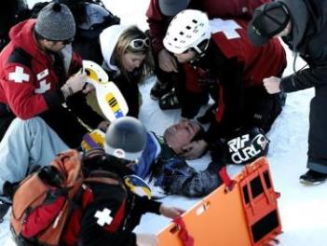
Extreme Sports
Despite heightened participation
little evidence exists describing
injury rates due to:
  non-traditional
  independent participation
  lack of official regulation
Increased risk of injury and death→ necessitates the need to better understand injury rates and trends
Specifically, head and neck injuries (HNI) are a growing concern because of increased awareness of short and long term consequences reported in the literature
Notes:
Despite heightened participation, little evidence exists describing the injury rates of extreme sports due to their non-traditional, independent participation and lack of official regulation⁶. Furthermore, unlike traditional sports, there is an increased risk of injury and death with extreme sports, necessitating the need to better understand injury rates and trends^{2, 6, 8, 9}
Injury characteristics of extreme sports vary extensively due to their high-energy, high-risk nature^{10, 11}. Specifically, head and neck injuries (HNI) are a growing concern because of increased awareness of short and long term consequences reported in the literature ^{3, 4, 12-14}. HNI include concussions, fractures, and traumatic brain injuries (TBIs), which can result in outcomes such as chronic depression, headaches, paralysis, and death¹³. Several articles have described injuries associated with extreme sports, however, they have primarily focused on mainstream activities such as snowboarding, snow skiing and skateboarding.

Slide 9
Media and Concussions
  First White House Healthy Kids & Safe Sports Concussion Summit – May 29, 2014 - President Obama said:
We need 'better data' on sports concussions
“We've got to have better research, better data, better safety equipment, better protocols."
http://www.usatoday.com/story/news/2014/05/29/obama-concussions-football-soccer-healthy-kids--safe-sports-concussion-summit/9716717/

Slide 10
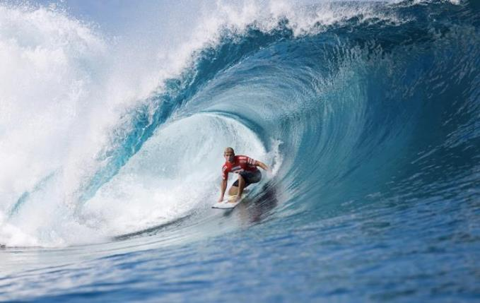
PURPOSE
    Describe the epidemiology of head and neck injuries in participants of seven extreme sports from 2000 to 2011.
Notes:
The sports were selected based on their popularity and active status in the X games (both winter and summer) and other major televised extreme sporting events.

Slide 11
METHODS
The Consumer Product Safety Commission’s (CPSC) National Electronic Injury Surveillance System (NEISS) was used
HNIs associated with 7 extreme sports were examined using the NEISS consumer product codes
Sport Participation figures were obtained using The Outdoor Foundation annual participation report
Incidence rates and incidence rate ratios were calculated from 2007 to 2012 (excluding
motocross which lacked available data)
Notes:
The Consumer Product Safety Commission’s (CPSC) National Electronic Injury Surveillance System (NEISS) was used to acquire data for this study from 2000-2011. The sampling procedure and the statistical basis for calculation of national estimates based upon the NEISS data is a validated approach. After being weighted, the NEISS data provides estimates for the total number of specific sports related injuries in the United States. Variables included in the standard NEISS case report are treatment date, sex, race, diagnostic category, body part injured, patient disposition, and location of injury. As a part of the Consumer Product Safety Mission, the NEISS database serves as a reliable and reproducible source for a wide range of epidemiological subjects.
Injuries associated with seven extreme sports were identified and examined using the NEISS consumer product codes in this study

Slide 12
METHODS
HEAD INJURIES
TYPES OF SPORTS
Concussion
Contusions/Abrasions
Fractures
Lacerations
Skateboarding
Mountain Biking
Motocross
Surfing
Snowboarding
Snow skiing
Snowmobiling
NECK INJURIES
Strain/sprains
Contusions/Abrasions
Fractures
Lacerations

Slide 13
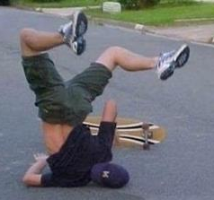
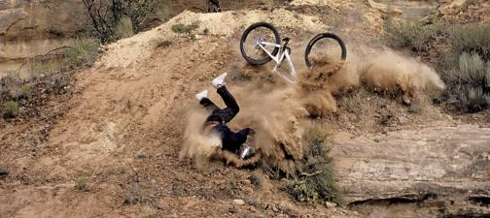
RESULTS
4,083,691 total injuries reported for all seven extreme sports
460,115 (11.3%) were head and neck injuries
    381,760 (83%) were head injuries
    78,355 (17%) were neck injuries
The risk of an extreme sport participant suffering a HNI over a one-year period was 5.16 per 10,000 person-years

Slide 14
RESULTS
The four sports with the highest total number of reported HNI injuries were:
skateboarding (129,600)
snowboarding (97,527)
skiing (83,313)
motocross (78,236)
Notes:
There was a wide range of injury rates for HNI between individual extreme sports (Figure 2). The four sports with the highest total number of reported HNI injuries during the 12-year period were skateboarding (129,600), snowboarding (97,527), skiing (83,313), and motocross (78,236) (Table I).

Slide 15
RESULTS
140,650 concussions (31% of HNI, 3.4% of all injuries)
Sport | Incidence rate* | Incidence Rate Ratio
Mountain Biking | 50 | 1.00
Snowmobiling | 60 | 1.20
Surfing | 103 | 2.06
Snow Skiing | 152 | 3.04
Skateboarding | 415 | 8.30
Snowboarding | 534 | 10.68
Notes:
There were 140,650 concussions (31% of HNI, 3.4% of all injuries) reported over the twelve-year period for extreme sports. Snowboarding had the most concussions (42,811) accounting for 30% of all reported concussions while snow skiing had the second-most occurrences (34,897) accounting for 25% of all reported concussions (Figure 3). Snowmobiling and surfing had the fewest reported concussions, 2.9% (4,054) and 2.3% % (3,242) concussions, respectively.

Slide 16
RESULTS
Skull Fractures
Sport | Incidence Rate (1,000,000 person-years)
Snowboarding | 1
Mountain Biking | 2
Snow Skiing | 2
Snowmobiling | 4
Surfing | 9
Skateboarding | 55
Neck Fractures
Sport | Incidence Rate (1,000,000 person-years)
Skateboarding | 1
Snow Skiing | 5
Snowmobiling | 6
Snowboarding | 7
Mountain Biking | 13
Surfing | 38
Notes:
There was a 55x greater calculated risk of a skull fracture for skateboarding (54.7 per 1,000,000 person-years) compared to snowboarding (0.98 per 1,000,000 person-years) (Table V). Similarly, there was a 38x greater risk of suffering a neck fracture while surfing (38.09 per 1,000,000 person-years) compared to skateboarding (1.00 per 1,000,000 person-years) (Table VI). Mountain biking was the second riskiest sport with respect to neck fractures with an incidence rate of 12.8 per 1,000,000 person-years.

Slide 17
Conclusions
This study establishes incidence rates of HNI in exteme sports
  Over 12 yrs, 4million injuries occurred, 11.3% (460,115) were HNI
Concussions were the most common HNI among extreme sports participants
  Highest risk in snowboarding and skateboarding participation
Notes:
This study presents previously unknown data and establishes incidence rates of HNI in extreme sports. Between 2000 and 2011, over 4,000,000 injuries occurred in extreme sports, of which 11.3% were HNI. Although the risk of HNI injury while participating in extreme sports was low, there was a significant increase in the number of HNI from 2000-2011, which suggests increasing injury rates in the future. Nonetheless, our study will help educate participants and physicians about the types of HNI associated with the growing arena of extreme sports. HNI can greatly alter a person’s quality of life, and as participation in these sports increases, a well-established understanding of the incidence of HNI will assist in implementing effective medical prevention programs and proper safety equipment practices.

Slide 18
Conclusions
Risk for TBI is inherent to physical activity and can occur during any activity at any age.
Minimize risk by:
  1) using protective equipment that is appropriate for the activity, fits correctly, is well maintained
  2) coaching appropriate sport-specific skills with an emphasis on safe practices and proper technique;
  3) adhering to rules of play with good sportsmanship and strict officiating
Notes:
Risk for TBI is inherent to physical activity and can occur during any activity at any age.
Minimize risk by:
1) using protective equipment (e.g., a bicycle helmet) that is appropriate for the activity or position, fits correctly, is well maintained, and is used consistently and correctly;
2) coaching appropriate sport-specific skills with an emphasis on safe practices and proper technique;
3) adhering to rules of play with good sportsmanship and strict officiating; and 4) attention to strength and conditioning (7).
Secondary prevention strategies include increasing awareness of the signs and symptoms of TBI and recognizing and responding quickly and appropriately to suspected TBI.

Slide 19
Conclusions
Secondary prevention strategies include increasing awareness of the signs and symptoms of TBI and recognizing and responding quickly and appropriately to suspected TBI.

Slide 20
Conclusions
Participants suspected of having a TBI should:
  be removed from play
  never returned to play the same day
  allowed to return only after evaluation and clearance by a health-care provider who is experienced in diagnosing and managing TBI

Slide 21
Conclusions
Return to play is a critical decision because children and adolescents are at increased risk for:
  repeat concussion during sports and recreation activities
  long-term sequelae
  delayed recovery
  cumulative consequences of multiple TBIs (e.g., increased severity of future TBIs and increased risk for depression and dementia)

Slide 22







ABC News
Extreme sport competitions such as the X Games and Core Tour were born out of athletes who live and breathe doing flips on snowmobiles, landing 1,080-degree turns on skis and BASE-jumping off 2,000-foot cliffs.
But even the best daredevils have suffered unimaginable injuries, some fatal, doing what they love
  Caleb Moore-Snowmobiler
  Jeb Corliss-Base Jumper
  Sarah Burke- Freestyle Skier
  Kevin Pearve- Snowboarder
  Mat “the condor” Hoffman- BMX Rider
  Stephan Murray- BMX Dirt Rider
  John Kucera- Downhill Ski Champion
  Bethany Hamilton- Surf Champ
  Jeremy Lusk- Freestyle Moto X Star

Slide 23


Slide 24
Conclusion
The recent death of extreme snowmobiler Caleb Moore at the 2013 Winter X games demonstrated the serious risks associated with these sports.
HNI can greatly alter a person’s quality of life, and as participation in these sports increases, a well-established understanding of the incidence of HNI will assist in implementing effective medical prevention programs and proper safety equipment practices.

Slide 25

Thanks to:
Our research team, Vinay Sharma, Juan Rango, and Abby Childs

