Slide 1

Engaging the User Community in Developing Earth Observing Remote Sensing Data Products
Vanessa M. Escobar
NASA Headquarters/ BAH
Satellite 2017 , Barcelona, Spain, May 10-13, 2017
Notes:
This paper describes the mission application development process at NASA and within the Earth Science Directorate. We present the successes and challenges faced by NASA data users and explain how ARLs helps link NASA science to the appropriate policies and decision frameworks. The methods presented here can be adapted to other programs and institutions seeking to rapidly move scientific research to applications that have societal impact.

Slide 2
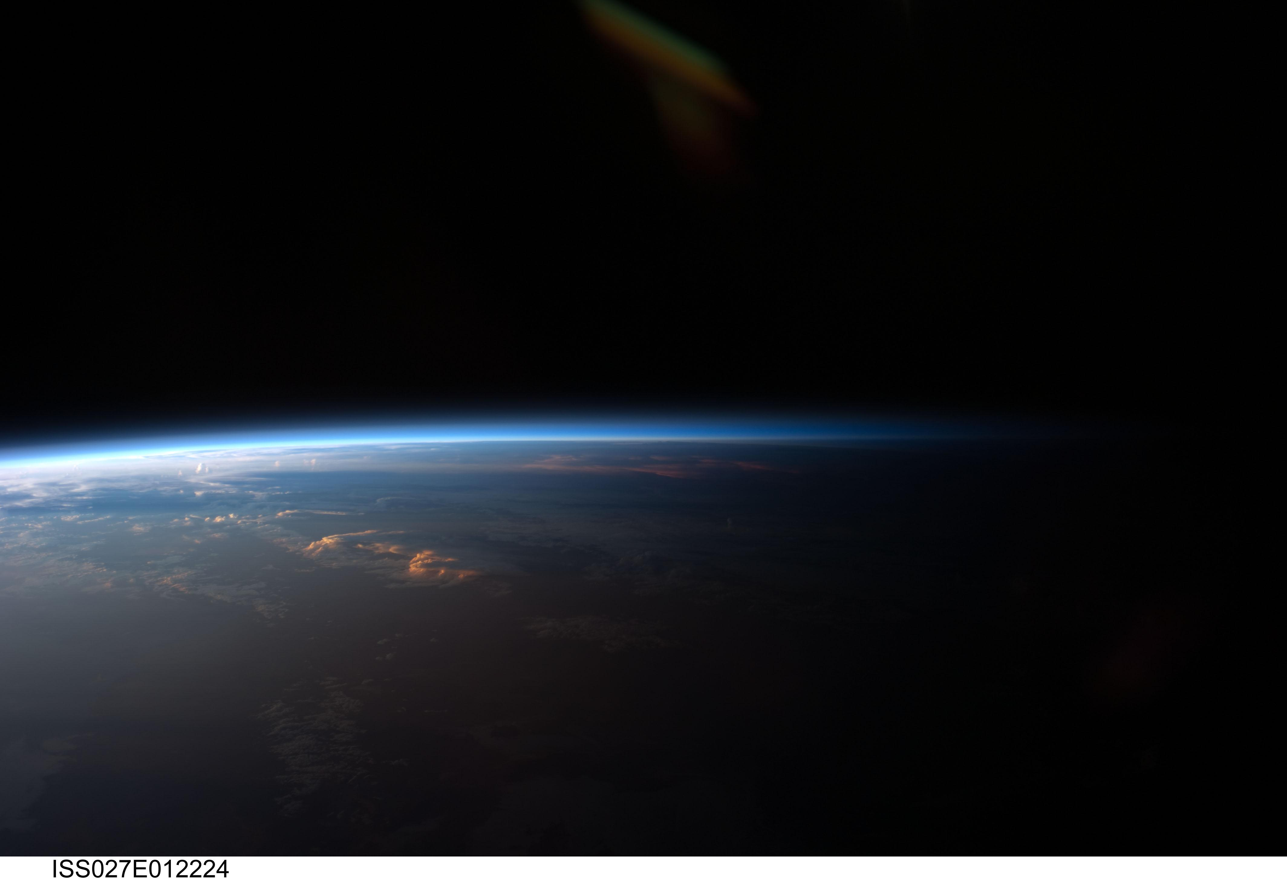

Outline
NASA and the Applied Sciences Program
Defining Applications
“ARLs”
2 Example Stories
Notes:
NASA Satellites (est Oct 1958 by Pres Eisenhower. The first was Explorer 1 in 1958.)
21 NASA satellites
ESA satellites
Partners and data…what do we cover …

Slide 3
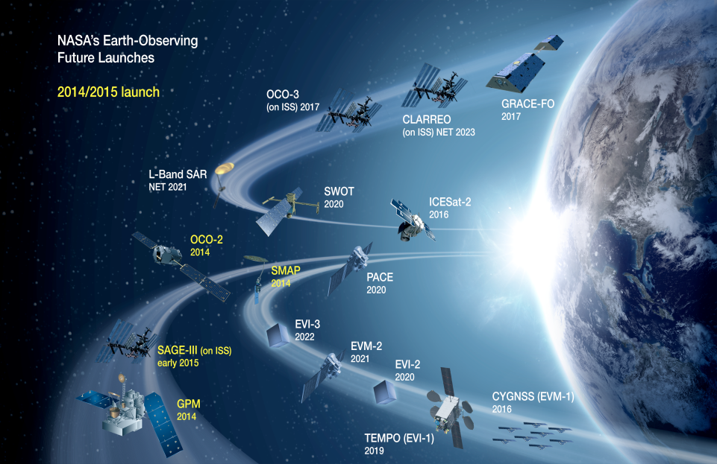

Slide 4
National Research Council
Decadal Survey
Earth Science and Applications from Space: National Imperatives for the Next Decade and Beyond
However, the compelling need for measurements in support of human health and safety and for documenting, forecasting, and mitigating changes on Earth creates a continuum between science and applications—illustrating again the need for multiple agencies to be intimately involved in the development of Earth science and applications from space.
The declarations call for a renewal of the national commitment to a program of Earth observations in which attention to securing practical benefits for humankind plays an equal role with the quest to acquire new knowledge about the Earth system.
Notes:
The NR recognizes the need for satellite data to have actionable applications and uses. However, this is not just true for NASA but other space agencies as well.
The Continuous need for measurements and monitoring of human and environmental health, and the safety of the earth and its inhabitants, makes the links between science and applications invaluable.
The NRC has made applications a requirement for all NASA missions and NASA has recently added to that requirement by asking all missions to implement engagement with users during the development of their missions-meaning the products and science from future satellites will have the feedback and influence of users in health, agriculture, flooding, droughts, and other applciations, from those that actually use and apply the data on a daily basis.

Slide 5
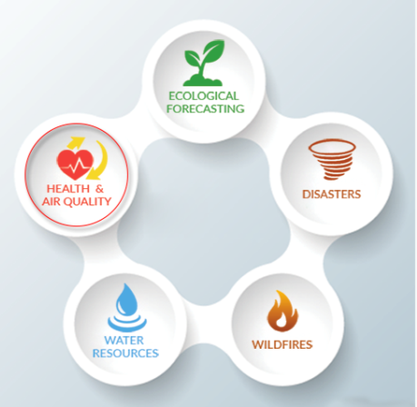
NASA Applied Sciences Program
9 Areas of Societal Benefit
Weather forecasting
Reduce loss of life and property damage from disasters
Understand assess, predict mitigate and adapt to climate variability
Support sustainable agriculture and forestry and combat land degradation,
Understand the effect of environmental factors on human health and well being
Develop the capacity to make ecological forecasts
Protect and monitor water resources
Monitor and manage energy resource
Notes:
NASA Applied sciences has 5 categories of “applications” that enable science products to help respond to 9 areas of societal benefit:
Weather

Slide 6

Society
Science Data Developer
Extended time in implementing products
Challenges with data (access latency, use, size, format, structure)
Disconnect with organization’s present day goals
Notes:
Now generally, when we talk about NASA developing science that has societal impact…this is what people see.
You have the users out here on one side of a cliff…then across this huge divide you have the science product developer. The products are too often created independent of the user and the developer.
I will provide some samples as to how this dynamic has changed at NASA. I’ll also illustrate how we at NASA continue to evolve our road maps for merging science and society.

Slide 7
What are applications?
Applications help hazard mitigation and decision-making in government, private, and civic institutions working to reduce its impact on human wellbeing.
Producing science is not enough, products must have a link to societal benefits and demonstrate value to users.
“The high-resolution data gleaned from VIIRS are available in a short time period and significantly enhance the Forest Service's current strategic fire detection and monitoring capabilities.” Brad Quayle, U.S. Forest Service
Notes:
With new satellite missions being launched every year, new types of Earth Science data are being incorporated into science models and decision-making systems in a broad array of organizations. So its important we define what is meant by applicaitns…
Ensuring that satellite missions serve both the scientific and user communities without becoming unfocused and overly expensive is a critical outcome from engagement of user communities.

Slide 8
What is an Early Adopter?
A subset of volunteers from the mission’s Community of Practice
Given access to pre- and post-launch data streams and conduct applications demonstrations in collaboration with the science team member.
The selection process may be through a competitive, peer-reviewed NASA announcement of opportunity as was done for the science definition team, or a more informal process.
Notes:
In order to ensure we are gathering user feedback and needs effectively, missions work with a community of volunteers known as early adopters.
Eas are volunteers that are interested in using mission data AND providing feedback that help stream line products and make them easier to use, access and process. More applicable to the everyday needs of society.
So as an EA, you get access to pre and post data that may be exclusive to the mission Science Team. The selection process of these Eas can vary but the end result is to have a community of users that provide thematic guidnace to the uses of the data and connect those Eas with the developers of the products so the data are impactful right after launch, rather than have to wait 1-2 years to work out the kinks….

Slide 9

Early Adopters’ feedback and engagement provides a link to science development, that helps a product move from a research effort…
Case Studies/Impact Analysis
…to a user friendly decision support system
Implement Improvement
EA
Research
Working Group Feedback
Lessons Learned
Data
Development
Improved Societal Applications
Notes:
So through case studies and a closer look at some EA efforts, We will have a qualitative example of how the early engagement, communication, outreach feedback connect to improved societal applications.
So things such as format, resolution, even latency are addresses in the pre-formulation process and help make applications more streamline and effective.
Through this inclusive process, we continuously look for ways of expanding applications, providing guidance and clarity to the uses of the products and build a community that can champion mission research and demonstrate the value.

Slide 10
Data Products
Notes:
So its all about the products… Single products are not stand alone solutions for society but rather an added compliment to a suite of data. Thus its critical we provide the unique user with the details they need to apply products accordingly.

Slide 11
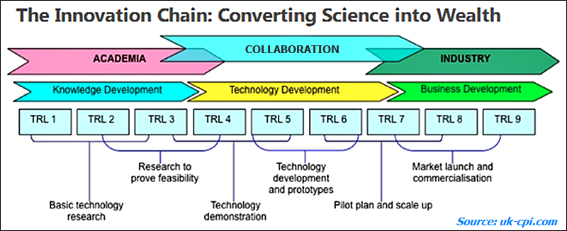
T
eadiness
evels
echnology
R
L
Notes:
Technology Readiness Levels.
Most of you are familiar with this schema.
TRLs provide description of where a product is during development and the evolution of it’s technology.
Thus in the early TRLs, 1-4 you are dealing with a product that has technology that sits in the research stages and is working its way into a prototype (beta product) before reaching TRL 8/9 where the technology is ready for commercialization.
TRLs are critical!
Can you imagine buying your iPhone at a TRL 4 or 5 (a stage where the technology is only development and not yet scaled for public use?)? As a consumer, you want to know (and have a choice) on purchasing products that are stil maturing.
So why should applications be any different? NASA wants its users to know the application maturity of data products.

Slide 12
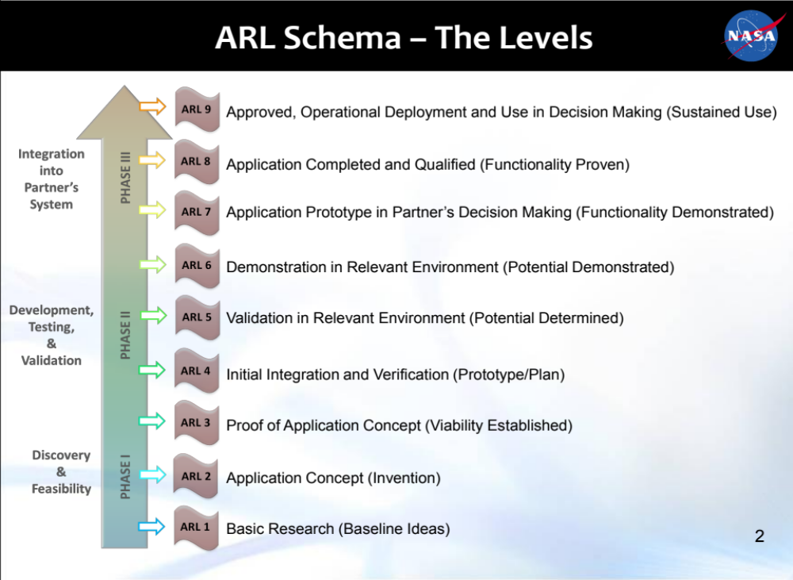
Application
Readiness Levels
Notes:
Satellites provide information about Earth's clouds, oceans, land and air. They also can observe wildfires, volcanoes and smoke. All this information helps scientists predict weather and climate. It helps farmers know what crops to plant. It helps control the spread of disease. And it helps with response to emergencies.
Policy guidance and knowledge of product maturity can influence mission design as well as development of product applications in user organizations.
ARLs are the “applied” version of TRLs.
Go over the levels
ARLS are Flexibile and act as a road map for the user on the maturity of a product.
Later provide samples for how this works

Slide 13
ARLS
Informative
  Sets expectation for what the intent of the product use(s) is (are).
  Communicated how this product can be best applied.
Thematically Flexible
  ARLs may need a temporary “reset” when passed from a developer to a user based on the user organization needs and processes.
    Modeling challenges, internal validation, organization policies, funding, etc.
Product ARL and the Use Case ARL
Notes:
Informative: is this intended to be a validation product or is it ready for operational support???
Flexible: users and developers may use a different ARL based on the theme and the scale of the application. A developer may intend their product go into operations from the moment you download it… However, the user may need to scale the ARL Back to ARL 5 based on their organizations needs, process, limitation and requirement. So ARL9 doesn't meant its ready for prime time unless the developer and the user are working together.

Slide 14
Opportunities at each ARL when collaborating with Early Adopters
Early ARLs, Level 1-3:
  Insight into research and perspective
  Opportunity to provide details and guidance
  Early feedback for development and baseline ideas
Mid ARLs Level 4-6:
  Opportunity to help validate
  Feedback into development/inform prototypes
Higher ARLs Level 7-9:
  Impact analyses on the functionality of the product
  Feedback to uses and lessons learned

Slide 15
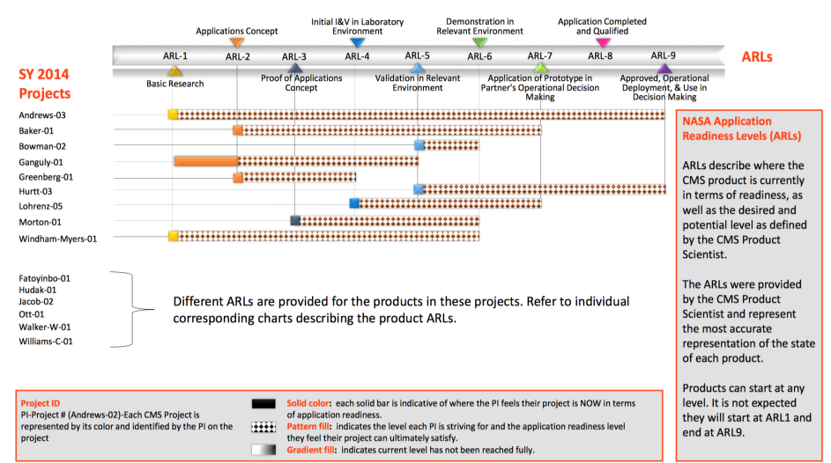
ARL
ARLs for NASA’s Carbon Monitoring System
Notes:
Products don’t have to start at an ARL 1.. And finish at an ARL 9.
They can begin in the middle as a calibration product (ARL 5) and only move up to an ARL 6- something intended to be tested and demonstrated in a relevant environment but never intended for operational uses.
Just like your iPhone-you as a data user WANT to know if the intent of this product is to remain as a beta product or if its meant to polished to an operational application use.
This figure shows the distribution of data from NASA’s CMS initiative …..products have a broad distribution of ARLs in the solid color and the intent of the PI in the hashed brown color. Thus this helps communicate where the product applications readiness is at the current moment (according to the developer) and where he or she intends to take the product …
BUT … as I mention earlier. The developers ARL is only the start of that products thematic ARL. Products defined as an ARL 5 by the developer, may be good enough for decision support and a users operation, thus making the actual use of the product an ARL 9.
The opposite can also happen-an operationally polished product (ARL-9) can shift to an ARL 6 by a user due to their need of having to test this product in their own environment and through their own organizational processes.
We now take a look at the users of data and how the ARL can evolve based on the thematic application.

Slide 16
Example Stories
Notes:
SO what Id like to do now is transition to a few stories that will provide you with a smaple of the mission, the porduct, the ARL at the developers side and then the ARL from the users end.

Slide 17
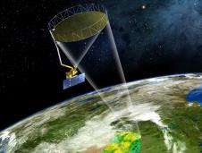
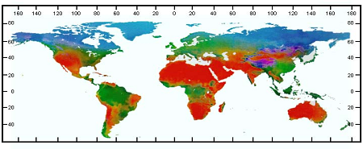

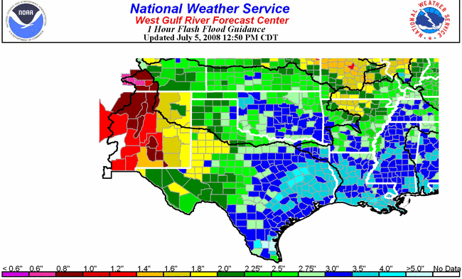
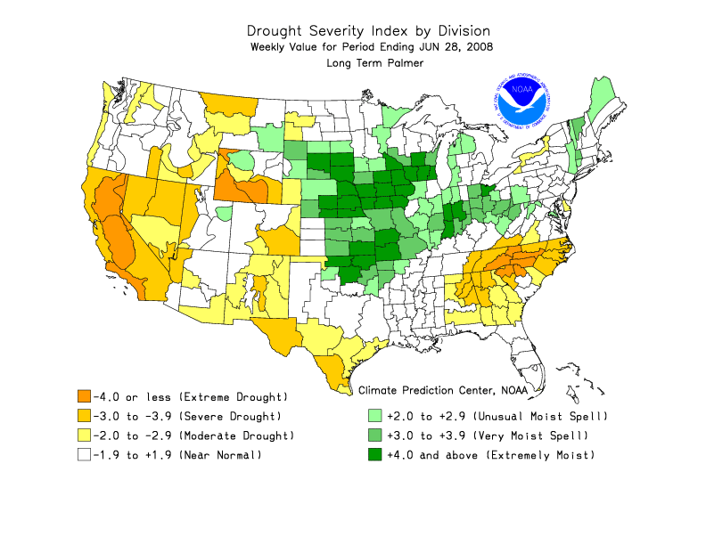
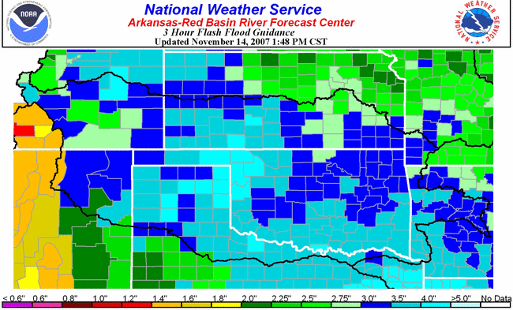
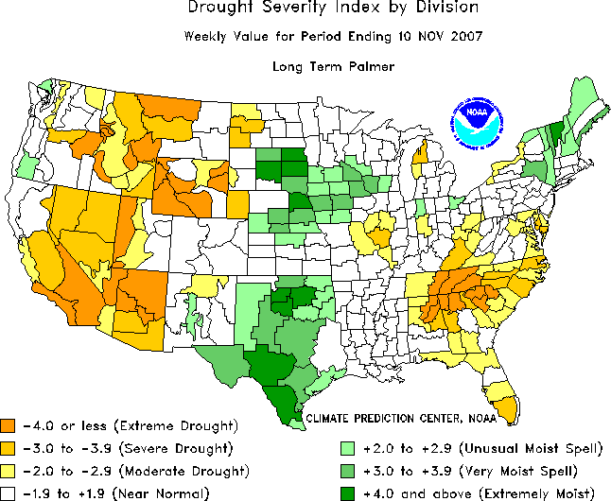
Story #1: Soil Moisture Active Passive
(SMAP) Mission
Approach
Estimating global surface water and energy fluxes
Quantifying net carbon flux in boreal landscapes
Reduce uncertainty of climate model projections
Science Returns
L-band (~21 cm; All-Weather; Canopy Penetration; Sensing Depth)
6m conically scanning
(14 rpm) antenna for
1000 km swath
Global coverage every
2-3 days
All products ARL-9
Soil
Moisture
Freeze/
Thaw
Radiation
Current NWS Operational Flash
Flood Guidance (FFG)
Current Operational Drought Indices by NOAA and National Drought Mitigation Center (NDMC)
Applications Returns
Floods
Droughts
4. Enhancing weather forecasts
5. Improving flood prediction and drought monitoring
Notes:
List objectives of mission and goals
Talk about the users and the Eas
And 2 samples of how different products are used. Use the case studies
SMAP is a mission with a 3-5 year life expectancy and product that are all ARL9.
Intended for use in system and ways operationally ready to support decisions---off they go.

Slide 18



























































PROTEZIONE CIVILE
52 SMAP Early Adopters are Spanning Agriculture, Weather, Emergency Response, Human Health, and Military Readiness
Notes:
SMAP has 52 active EA teams with over 120 collaborators in national / intl. government agencies, universities, and the private sector.
L2/3SMP are the most used products to date
38% of Early Adopter teams have provided recent results and updates using SMAP data

Slide 19
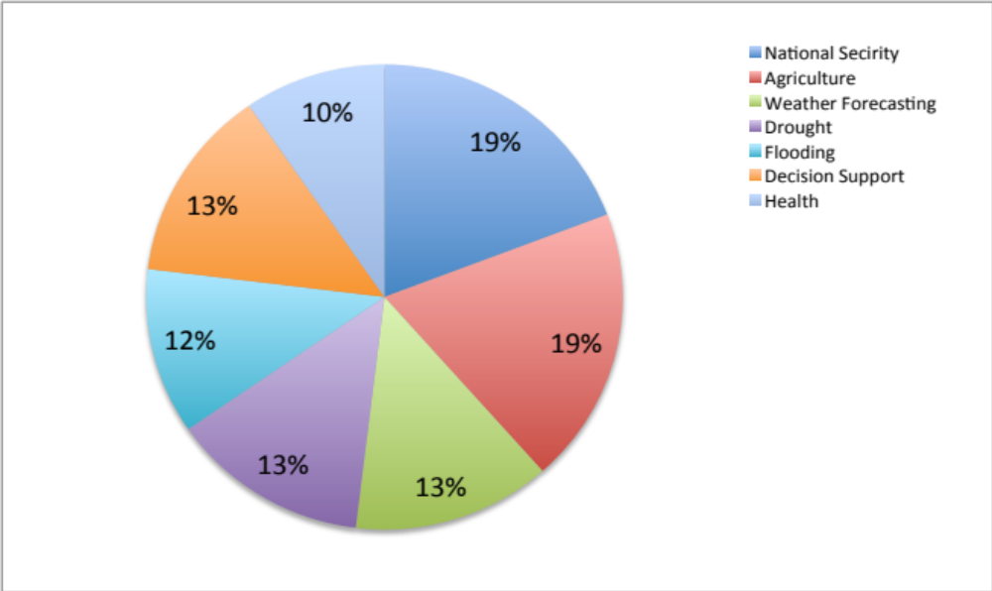
Story #1: Soil Moisture Active Passive (SMAP) Mission
SMAP Science and Application Returns
  Soil Moisture Links the Global Land Water, Energy,
  and Carbon Cycles
What was Designed
SMAP Product suite developed to an ARL-9
Intended to satisfy 5 areas of applications
(agriculture, weather, drought, flood,
health)
HDF-5 Format
Health
National Security
Decision Support
Flooding
Agriculture
Droughts
NWP
What’s actually happening post launch
Users of SMAP data average ARL5-6 due to testing SMAP products in through their organizational processes and needs.
Most demanded Format KMZ and GEOTiffs
Satisfy over 10 areas of applications
Notes:
The SMAP Application Program Goals are to:
Expedite the use of mission data products through early engagement with the user community.
Increase awareness and knowledge of SMAP mission science.
Grow a diverse user community that will represent all areas of SMAP applications.
Provide user feedback to the SMAP mission of ways of improving data development and applications.
10 areas of applications:
(agriculture, weather, drought, flood, health, military mobility, sea ice thickness, sea surface winds, IT imaging and decision support, carbon accounting)

Slide 20
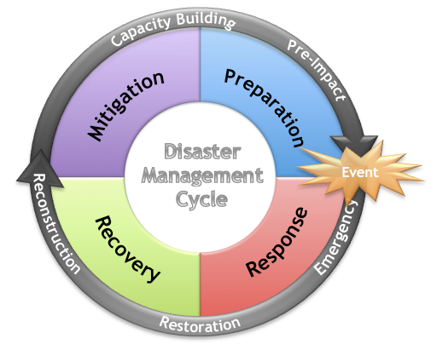

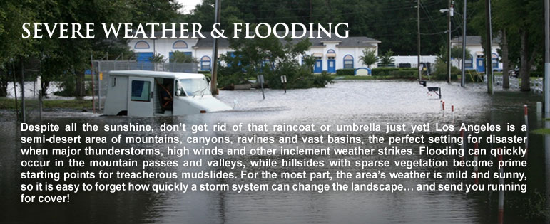

Story #1: Soil Moisture Active Passive (SMAP) Mission
Format really does matter!
SMAP Data
SMAP Data
2012 SMAP Survey
55% of the SMAP community involved hazards, risk response and post event mitigation.
73% of the hazard community was challenged by HDF5 Format and not interested in using the data.
SMAP Data
SMAP Data
HDF-5

Slide 21
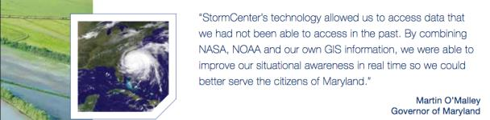
Story #1: Soil Moisture Active Passive (SMAP) Mission
Outcome
SMAP Product ARL 9 (L3 SMP), used as ARL 5 for Emergency planning and operations.
After Format change-used as ARL 8 (prototype) for flood planning in Emergency Operations. (Efforts are ongoing).
KMZ are now a NASA standard format at all Data Centers.
Personal engagement with Emergency Management centers to understand and evaluate data needs for events.
Work with Early Adopters towards developing more efficient systems and technologies.

Slide 22








Story #2: NASA’s Carbon Monitoring System
(CMS)
Initiated following a 2010 Congressional Direction.
NASA CMS has 73 projects and 181 data products.
MRV | Decision Support
Characterizing
Global Surface-
Atmosphere Flux
Land-
Atmosphere Flux
Quantifying
Ocean-
Atmosphere Flux
Understanding
Predicting
Ocean Biomass
Land-Ocean Flux
Land-Biomass
Notes:
The goal for NASA’s CMS project is to prototype the development of capabilities necessary to support stakeholders’ needs for Monitoring, Reporting and Verification (MRV) for carbon stocks and fluxes.
NASA CMS has 73 projects and 181 data products.

Slide 23
CMS Application Readiness Levels (ARLs)
Story #2: NASA’s Carbon Monitoring System (CMS) Initiative
Notes:
Because CMS is not a mission but rather an initiative, the product development milestones, the product applications and the ARLs all vary….
Most of the CMS products sit at an ARL 5 which is the cal val stage of ARLs.
This ARL is oftern good enough for users of carbon data.
CMS products of ARLs 3 (research viability has been established) have been used as reference by the IPCC for policy guidelines increasing the ARL from 3 to an ARL 8-(proven functionality of a product).

Slide 24








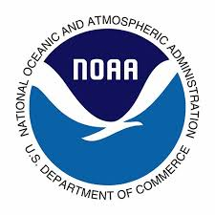













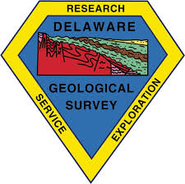
















Story #2: NASA’s Carbon Monitoring System (CMS) Initiative
43 CMS Stakeholders are spanning Forestry, Land Use, Air Quality, GHG Inventories, Conservation, and Ecosystem Services
Notes:
CMS users cover a broad range of applications covering Forest, Land use air quality, GHG inventory, conservation and ecosystem services.
CMS Applications Goals and Objectives
Understand and engage the user community and stakeholders involved in carbon monitoring and MRV.
Evaluate current and planned CMS products with regards to their value for decision making by appropriate users.
Communicate to the CMS science community the user requirement and needs to help guide prototype development and CMS product generation.
Develop user-friendly visualization and communication tools describing CMS data products, and translation of science jargon.

Slide 25
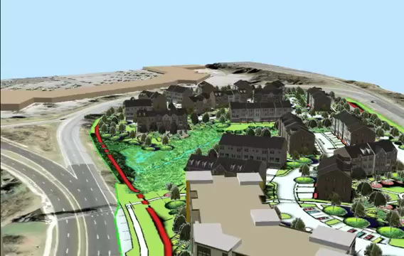
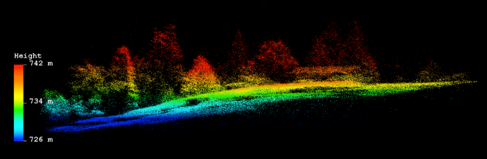
Story #2: NASA’s Carbon Monitoring System (CMS) Initiative
Policies of Interest within Maryland Department of Natural Resources (DNR) Forestry Programs
Woodland Incentive Program
Conservation Reserve Enhancement Program
Lawn to Woodland
Environmental Quality Incentive Program
Urban Tree Canopy
No Net Loss of Forests Policy
Notes:
One CMS product (Canopy Cover maps produced by Lidar imaging) is currently being developed by a CMS PI at an ARL 9.
It ready for use and application to support above ground biomass estimates as well as state forest policy programs.
Maryland counties are required to provide forest cover estimates at a county scale each year.
This is part of the National Capital Park and Planning Commission requirements.
This movie shows one MD County, Prince George’sCounty’s use of lidar data for its 2010 Forest Canopy Assessment Goal… to have countywide 44% of the County Canopy Coverage by 2025. Its new 2035 Canopy Coverage goal is to have 52% forest and tree canopy countywide: forest canopy 44% and tree canopy 8%
To reach these goals, monitoring is needed and quality data is important. By applying the CMS data to this need, MD improved their estimates by 20% simple from the new continuous data. Most the lidar applied prior to this were discontinuous data sets spanning 10-15 year and different style lidar technologies.
Policies of Interest within the MD DNR Forestry Programs
Woodland Incentive Program
Conservation Reserve Enhancement Program
Lawn to Woodland
Environmental Quality Incentive Program
Urban Tree Canopy
No Net Loss of Forests Policy

Slide 26
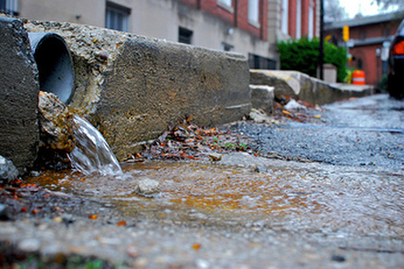
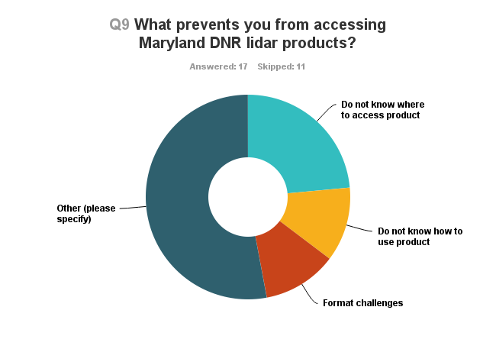
Feedback from Maryland Project
Story #2: NASA’s Carbon Monitoring System (CMS) Initiative
CMS Product: ARL 9
What prevents you from accessing Maryland DNR lidar products?
DNR use of Product: ARL 5
Notes:
So the CMS product was an obvious need and something we transitioned to DNR immediately for use.
We continue to engage with MD DNR, but this specific discussion of tree canopy mapping went on for 2 year. We gave them the data, assessed the impacts on policy… and still the data were not being used. NOTHING?! Why? The product was an ARL9.. Ready to go! It needed only to be applied.
Format was addressed early on, file size, took care of that too… what was the issue?
MD DNR was treating an ARL 9 product as an ARL 5 (a product where the potential has been determined)
What was needed at this point??
POLICY APPROVAL and funding.
MD DNR’s funding focus at that time was with the Department of Transportation… not Forest. So… even thought the product was deemed needed and useful-there was an organizational priority that needed to be addressed.
Funds and focus at DNR at that time were concentrated on Impervious surfaces!
Although their hearts were in the forests … their organization and state dollars were on the streets! So if we wanted CMS to help support forest policy-we needed to work with DNR to translate the benefits of this product for DOT and in turn, Forestry would benefit.
If we couldn’t frame biomass and canopy cover In a way that encompassed impervious surface-the data although proven valuable… were not useful!!!
So…
Well… In a meeting
The MD project has been a multi year effort to unedrstaind how CMS lidar could help the Department of Natural reources in GHG, Forestry inverntory, etc.
We have worked closely with the MD DNR to gather details on the uses of the Dubayah and Hurrt products.
We surveyed the MD DNR and gather the following details:
Conducted a Survey through MD DNR over the summer.
Elicit feedback on who uses the MD Lidar data from CMS.
28 participants
71% have accessed the data
Most common product used:
1-meter Canopy cover map (used by 80% of the participants).
The feedback we are looking into now is in this category here..
Why is access a challenge… start with low hanging fruit:
Other category:
Size,
Know knowledge on how to use the data.
Not sure how to use with other products we have
We purchase other lidar independent of DNR.
So this comes back to CMS.. How can we help make the data more accessible ?? More user friendly??

Slide 27
Story #2: NASA’s Carbon Monitoring System (CMS) Initiative
Notes:
So last year, the CMS developed an impervious surface map for the project, that has now expanded from Maryland, to Deleware and Pennsylvania.
And in doing so, this impervious map has enabled the use and applications of canopy cover, canopy extent and biomass estimates. It easily justified state employees time to work on what was both funded (impervious surface) and what was needed (canopy cover).

Slide 28
Outcome
Story #2: NASA’s Carbon Monitoring System (CMS) Initiative
CMS Product ARL 9 (Canopy cover, extent and biomass estimates for MD), used as ARL 5 (a product where the potential has been determined) due to internal policy and organization’s funding focus.
After translating benefits of data in the context of impervious surface, the CMS data was used as ARL 9 (Operational use in decision making, sustained use).
An organizations policy and time line is as important as the data requirements.
Policy evaluation is now “step one” for CMS applications in assessing data needs for users involved with state and federal decision support.

Slide 29
Take Home Message
ARLs serve as a road map to the uses and applications of Satellite data-intended to help both the scientists and the users know about where they are in the science/application journey.
ARLs are flexible and can be accelerated by collaborating with users throughout mission design.
All ARLs can serve as an operational product-dependent on user needs.
Improving the methods and approaches of applying data, provides a clearer picture for policy-value of satellite data.
Applications are central to ensuring science is used in society for improved decision making.

Slide 30


Society and Science Developers integrating feedback to improve applications of data
Society
Science Data Developer
Applications through Early Adopters bridge science development and the user community
Notes:
When we talk about NASA developing science that has societal impact…this is what people see.
You have the users out here on one side of a cliff…then across this huge divide you have the science product developer.
Conferences like this help bridge this gap and create products that will be more usable and impactful form the moment they are releases.
How SMAP does this with applications is through the feedback of the user community. Through applications strategies and the EA program we seek to make data easier to find, familiar and easier to use.
User Community includes
- individuals or groups
- public or private sectors
- national or international organizations
- local to global scales of decision making
EAs bridge science products to decision makers
The EA program links EA to the SMAP Science Team to trade ideas, guidance, and feedback in an effort to better understand the applications of SMAP data

Slide 31

Actions
Collaboration, collaboration, collaboration!
Cross mission and cross agency synergies to leverage data uses in thematic applications.
Notes:
Improve the data record, time series

Slide 32

Thank you for your attention!
Vanessa M. Escobar
NASA Missions Applications Coordinator
NASA Headquarters, Washington DC
vanessa.escobar@nasa.gov

