Slide 1


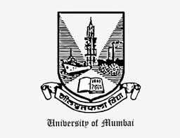
Spinacia oleracea in diet can help control obesity by its regulatory action on appetite
Dr. Vandana Panda
Assoc. Professor of Pharmacology
P.K.M.Kundnani College of Pharmacy
Mumbai University, INDIA

Slide 2

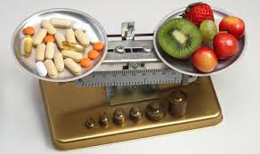
"Let food be thy medicine and medicine be thy food," said by Hippocrates nearly 2,500 years ago, is receiving renewed interest.

Slide 3
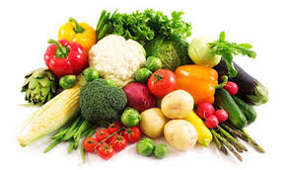
Functional foods:
“Functional foods” are foods which provide benefits beyond basic nutrition and may play a role in reducing or minimizing the risk of certain diseases and other health conditions.

Slide 4

Energy homeostasis is a complex mechanism which maintains body weight by regulating energy intake.
Obesity occurs due to an imbalance in energy homeostasis.
Four main predisposing factors for weight gain: a) low metabolic rate
b) low spontaneous physical activity
c) low sympathetic nervous system activity
d) low fat oxidation

Slide 5
CENTRAL NERVOUS SYSTEM
HYPOTHALAMUS
PARAVENTRICULAR NUCLEUS (PVN)
NUCLEUS TRACTUS SOLITARIUS
APPETITE
SATIETY
ARCUATE NUCLEUS (ARC)
VAGAL CENTRE
POMC
NPY/ AgRP
PERIPHERAL ORGANS
INSULIN & LEPTIN
GHRELIN
Signals from GIT, stomach distension, enterohormones- CCK, PYY, GLP-1
PANCREAS & ADIPOCYTES
STOMACH
LONG TERM SIGNALS
SHORT TERM SIGNALS

Slide 6
Short term satiety signals:
a. Nutrients
b. Gastrointestinal peptide hormones – Cholecystokinin(CCK), Glucagon like peptide -1 (GLP-1), peptide tyrosine tyrosine (Peptide YY)
Long term satiety signals:
a. Insulin(Pancreas)
b. Leptin (Adipose tissue)
c. Ghrelin ( stomach)

Slide 7
Background
Fruits and vegetables which are rich in flavonoids particularly flavonols, anthocyanins and flavones are associated with reduced weight gain.
Recent studies have shown thylakoids, the internal membranes of chloroplasts in green leafy vegetables to induce satiety.
Spinacea oleracea known as spinach is a green leafy vegetable consumed by people across the globe in various tasty culinary preparations.

Slide 8
Spinach leaves are a rich source of flavonoids (rutin, spinacetin, patuletin, jaceidin and their 3’,4’-trihydroxy-3-methoxy-6,7-methylene dioxy flavone-4’ glucuronides), polyphenols, carotenoids (lutein, β-carotene, chlorophyll), vitamins (A, B & folic acid, C and K) & minerals.
It is reported to possess potent medicinal properties by virtue of its above mentioned antioxidant phytoconstituents, together termed as the natural antioxidant mixture (NAO).

Slide 9
Objective
The objective of the work was to study whether spinach could curb food intake and reduce weight gain in rats by inducing satiety due to its high content of thylakoids and flavonols.
The present study evaluates the effect of a flavonoid- rich extract of Spinacea oleracea on food intake, body weight and the short term satiety markers cholecystokinin and glucose.

Slide 10
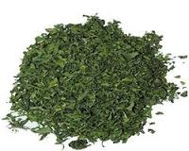
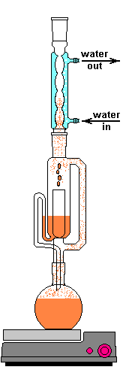
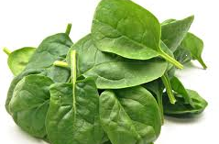
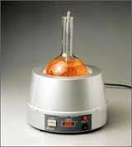
Materials and Methods
Preparation of Natural antioxidant (NAO) extract from spinach leaves:
NAO extract stored in air tight container and used for experiment
Soxhlet apparatus

Slide 11
HPTLC finger printing of NAOE
NAOE (500 mg) was dissolved in 5 mL of methanol and was applied as a band of 8 mm length on the activated HPTLC plates using a Linomat 5 applicator (CAMAG, Switzerland).
Class of the compound to be separated | Amount of solution applied on plate | Solvent system | Derivatising agent
Antioxidants | 20 mL | chloroform: toluene: ethanol (4: 4: 1) | 0.1Mm DPPH in methanol
Flavonoids | 20 mL | ethyl acetate: formic acid: glacial acetic acid: water (10: 0.5: 0.5: 1.3) | 10% methanolic sulphuric acid
Phenols | 20 mL | ethyl acetate: methyl ethyl ketone: formic acid: water (5:3:1:1) | 10% methanolic sulphuric acid

Slide 12
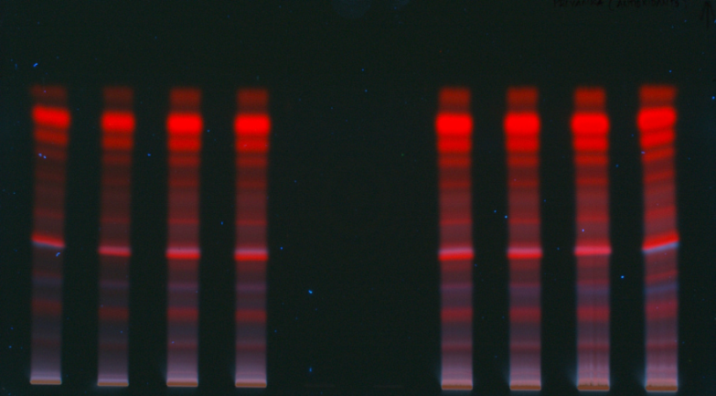
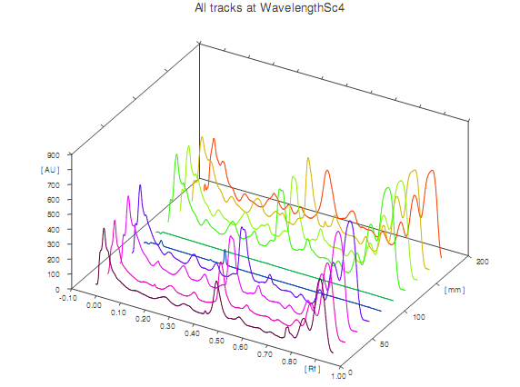
HPTLC fingerprinting of NAOE for antioxidants
HPTLC analysis showed clear separation of 13 antioxidants from NAOE (Figure 4.1). Rf values of the separated antioxidants were observed to be in the range of 0.02 to 0.93.
1 2 3 4 5 6 7 8 9 10
Chromatogram and Rf value for antioxidant compounds present in NAOE at 366 nm
HPTLC finger printing of NAOE for antioxidants at 366 nm

Slide 13
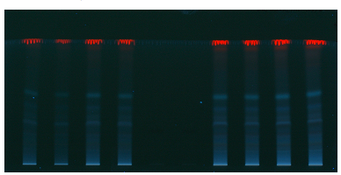
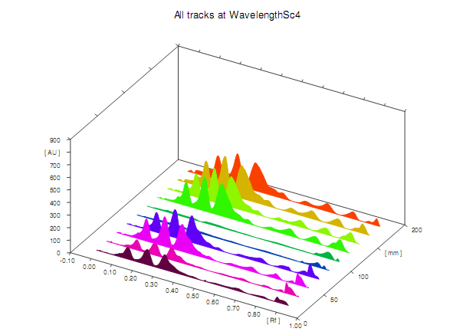
HPTLC fingerprinting of NAOE for phenolic acids
HPTLC analysis showed clear separation of 10 phenolic acids from NAOE (Figure 4.5). Rf values of the separated phenolic acids were observed to be in the range of 0.03 to 0.91.
1 2 3 4 5 6 7 8 9 10
Chromatogram and Rf value for phenolic acids present in NAOE at 366 nm
HPTLC finger printing of NAOE for phenolic acid at 366 nm

Slide 14
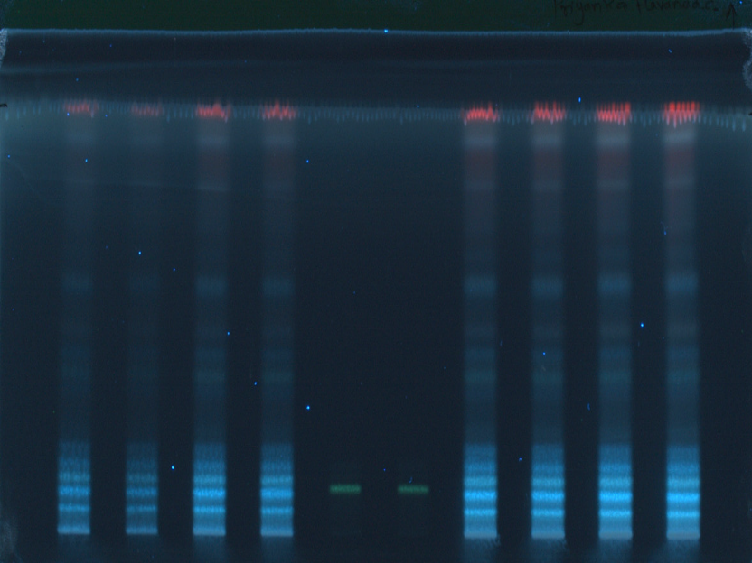
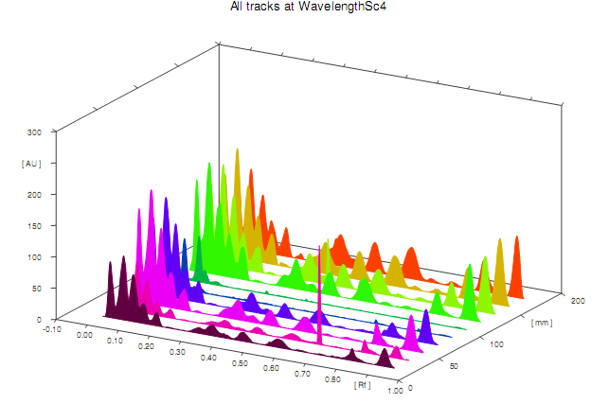
HPTLC fingerprinting of NAOE for flavonoids
HPTLC analysis showed clear separation of 14 flavonoids from NAOE (Figure 4.3). Rf values of the separated flavonoids were observed to be in the range of 0.03 to 0.93
1 2 3 4 5 6 7 8 9 10
HPTLC finger printing of NAOE for flavonoids at 366 nm
Chromatogram and Rf value for flavonoids present in NAOE at 366 nm

Slide 15
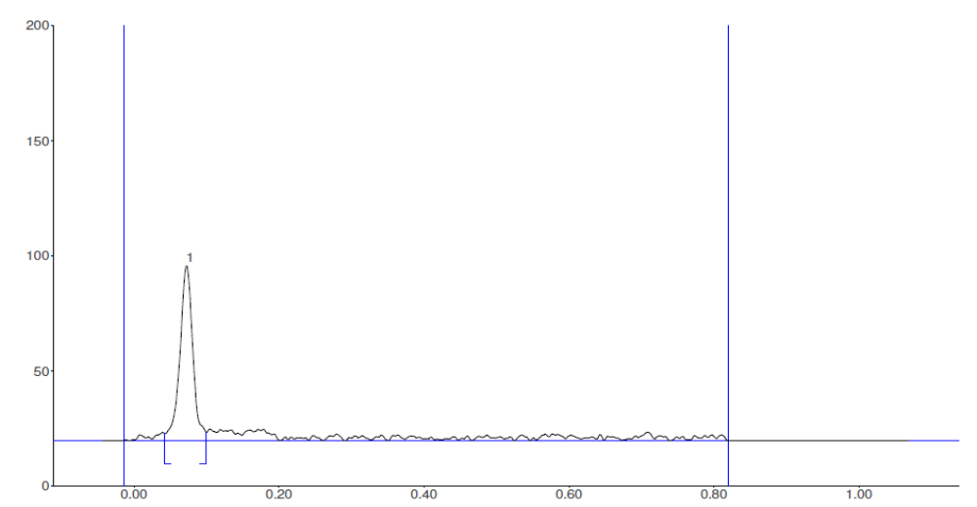
HPTLC Chromatogram of standard rutin at 254 nm
Rutin
Peak | Max Rf | Area | Area %
1 | 0.07 | 1139.7 | 100

Slide 16
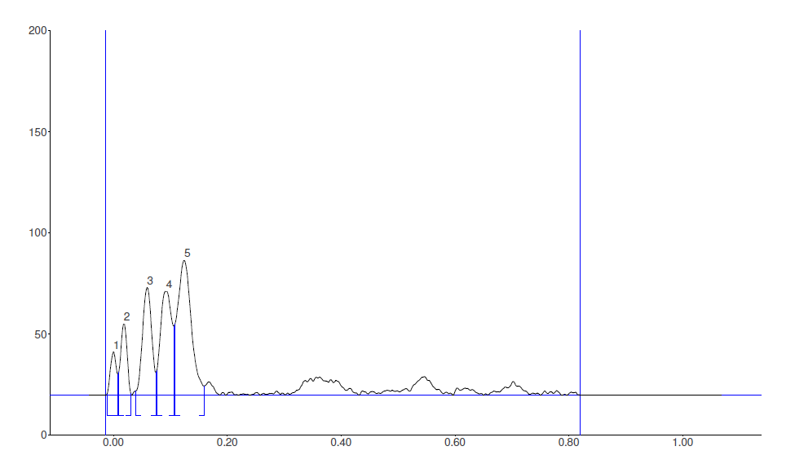
HPTLC Chromatogram of flavonoids and rutin from NAOE at 254 nm
Rutin
Peak | Max Rf | Area | Area %
1 | 0.01 | 190.1 | 5.47
2 | 0.02 | 329.6 | 9.49
3 | 0.07 | 727.6 | 20.95
4 | 0.09 | 878.4 | 25.29
5 | 0.13 | 1348.0 | 38.81

Slide 17
Quantity of rutin present in NAOE
Sample | Amount of NAOE (µg) | Max R_{f} | Peak area | Rutin (%)
NAOE (Peak 3, Figure 1c) | 150 | 0.07 | 727.6 | 8.5
Standard rutin (Figure 1d) | 20 | 0.07 | 1139.7 | 100

Slide 18
Evaluation of the satiating effect of NAOE
GROUP | TREATMENT | DOSE | DURATION
GROUP I | CONTROL | DRINKING WATER | 14 DAYS
GROUP II | REFERENCE STANDARD (FLUOXETINE) | 6 mg/kg, ip. | 14 DAYS
GROUP III | NAOE200 | 200 mg/kg p.o. | 14 DAYS
GROUP IV | NAOE400 | 400 mg/kg p.o. | 14 DAYS

Slide 19
Table 1. Effect of NAOE and fluoxetine on food intake
TREATMENT GROUP | FOOD INTAKE (g)
Control | 9.204± 0.111
Fluoxetine (6mg/kg) | 3.104± 0.298***(66.27)
NAOE200 | 5.795± 0.279*** (37.03)
NAOE400 | 5.714± 0.249*** (37.92)
All values are expressed as mean ± SEM; N = 6 in each group;One way ANOVA followed by Tukey-Krame rmultiple comparison test is applied for statistical analysis***P< 0.001when experimental groups compared with control group.

Slide 20
Table 2.Effect of NAOE and fluoxetine on reduction in weight gain
Treatment Group | % Reduction in weight gain
Control | 1.66 ± 1.17
Fluoxetine (6 mg/kg) | 11.32 ± 2.36**
NAOE200 | 7.96 ± 1.94
NAOE400 | 10.05 ± 1.76*
All values are expressed as mean ± SEM; N = 6 in each group; One way ANOVA followed by Tukey-Kramer multiple comparison test is applied for statistical analysis *P< 0.05, **P< 0.01, when experimental groups compared with control group.

Slide 21
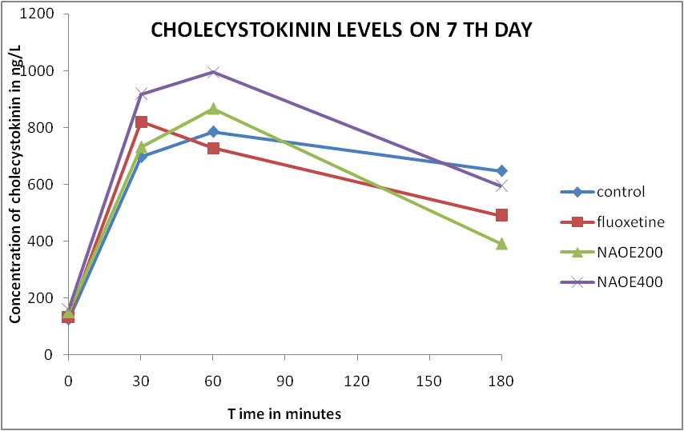
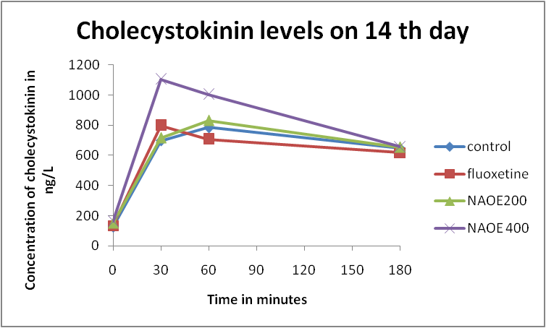
Effect of fluoxetine and NAOE on serum levels of CCK

Slide 22
Effect of NAOE and fluoxetine on plasma glucose levels
Effect of NOAE and fluoxetine on plasma glucose levels on 7th day
Effect of NOAE and fluoxetine on plasma CCK levels on 14 th day

Slide 23
Discussion
18 flavonoids representing glucuronides and acylated di and triglycosides of the 6-oxygenated flavonols (patuletin, spinacetin and jaceidin) have been identified from spinach by Howard et al, USA (Cho, Howard, Prior & Morelock, 2008).
HPTLC of NAOE in present study could detect 14 flavonoids,13 antioxidants and 10 phenolic acids.

Slide 24

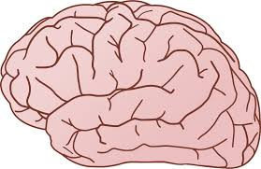
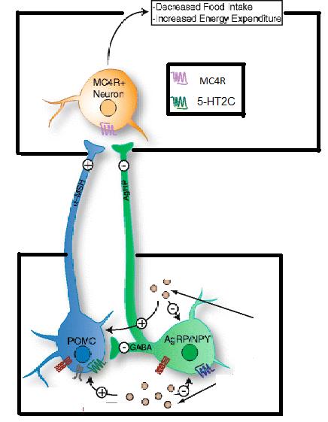
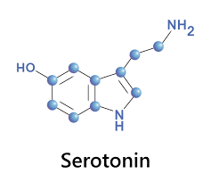
PVN
Brain
Mechanism of action of Fluoxetine on food intake
ARC

Slide 25
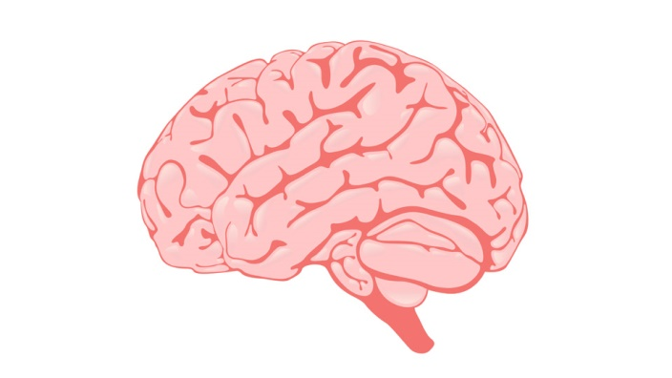
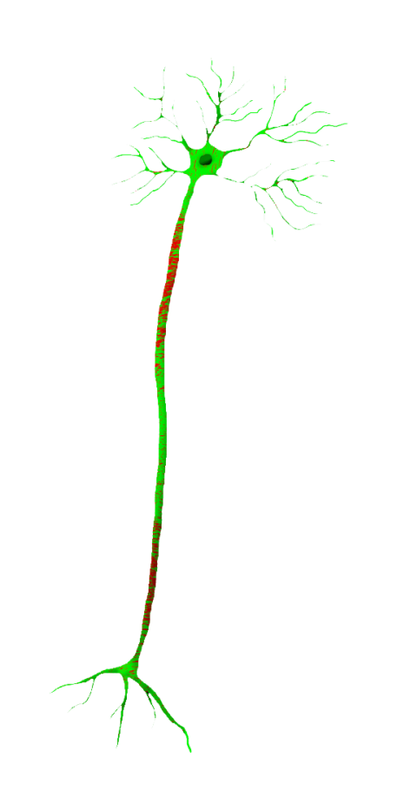
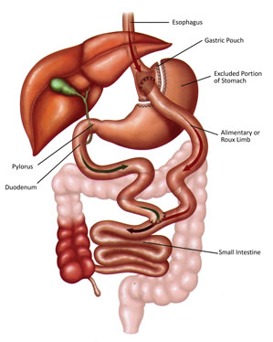
Events in brain:
Nerve signal
-> POMC(NTS)
->Secretion of α-MSH
->Activates MC4R Receptors on PVN
-> Inhibition of orexigenic AgRP/NPY signals
-> Satiety induced
Mechanism of action of CCK on food intake
Vagus nerve – Activation of CCK1 Receptors due to CCK
POMC- Pro-opiomelanocortin neurons.
NTS- Nucleus Tractus Solitarius
CCK- Cholecystokinin
α-MSH- α- Melanocyte Stimulating Hormone
PVN- Paraventricular Nucleus
CCK released from enteroendocrine I-Cell of proximal small intestine after ingestion of food

Slide 26
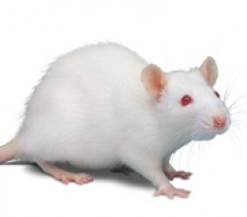
7th Day
14th Day
Control
Peaking of CCK-60 min
Reduced Food Intake and Weight gain
Peaking of CCK-60 min
Reduced Food Intake and Weight gain
Fluoxetin
Peaking of CCK-30 min
Reduced Food Intake and Weight gain
Peaking of CCK-30 min
Reduced Food Intake and Weight gain
Peaking of CCK-60 min
Reduced Food Intake and Weight gain
Peaking of CCK-60 min
Reduced Food Intake and Weight gain
NAOE200
Peaking of CCK-60 min
Reduced Food Intake and Weight gain
Peaking of CCK-30 min
Reduced Food Intake and Weight gain
NAOE400

Slide 27


Our study demonstrated a satiating effect of methanolic extract of Spinacia oleracea
This action may be due to the effect of NAOE on CCK release.
It is possible that the high content of flavonoids in this extract contributes to its satiating effect.
Further studies on the effect of NAOE on other satiety signal such as LEPTIN, GLP-1 and SEROTONIN are warranted.

Slide 28

Our Team
Ms. Priyanka Shinde & Dr. Vandana Panda
Dept. of Pharmacology
P. K. M. Kundnani College of Pharmacy
Mumbai University
India

Slide 29
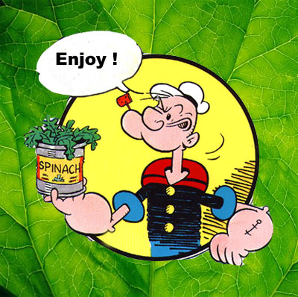
THANK YOU !!!
Stay Healthy, Stay Happy!!!!

