Slide 1
Outdoor activities like a tool of overweight and obesity management in children.
Vaclav Bunc and Marie Skalska
Faculty of P.E. and Sports, Charles University, Prague, Czech Republic

Slide 2

The present is characterized by the increasing movement deficiency leading to severe complications, including health.
Basic health concern is the rise in overweight and obesity. The reason is the mismatch of energy intake to its output.

Slide 3

Overweight and/or obesity is a growing problem in Czech Republic today, as it is in many countries.
Alongside a range of health problems associated with increased body mass (BM) it is an important limiting factor for realization of regular physical exercise and qualitative life style.

Slide 4
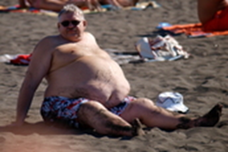

At present more than 50% of adults are overweight in the Czech Republic, of which more than 30% are obese.
We have more than 30% of overweight children in the child population. Obese are about 12%.

Slide 5

Childhood obesity is a high likelihood of adult obesity.
Therefore, it is necessary to start with a systematic influence of overweight and/or obesity in childhood.
Basic successful interventions to influence obesity is the form and manner of exercise activities.

Slide 6

Lack of an exercise regimen in childhood is most commonly the result of inappropriate way when and especially inappropriate forms of physical activity (PA) offered to children resulting in lack of physical experience.
Another possible cause can be economic and skill demands of commonly recommended PA (Brettschneider and the Naul 2007, Bunc 2008, Cheema et al. 2015).

Slide 7

Therefore, only the PA, which is cheap, safe, easily manageable and available for sale in the times and conditions, complying with the intervened individuals has any chance of success in reducing the effects of hypokinesia (Bunc 2008, Cheema et al. 2015, Choi et al., 2007).

Slide 8

Successful interventions must influence the movement of individuals both physically and spiritually.
Movement interventions must be based on the activities in which one is most adapted.

Slide 9
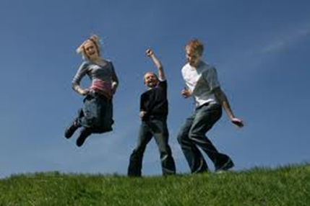
Outdoor activities are proving to be one of the possible solutions movement´s deficits.

Slide 10

The volume of realized PA is also dependent on the age, and decrease with growing age (Bunc 2004, Bunc a Skalská 2015).
This stems in unsuitable conditions for the implementation of PA adult and the lack of knowledge about prevention of obesity.

Slide 11
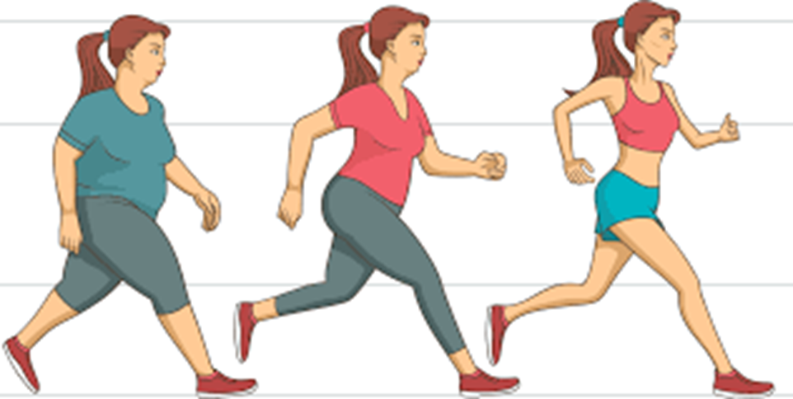
The study goal was to assess the effect of movement intervention on body composition (BM and %BF) and physical fitness (VO_{2peak}) in children with overweight and obesity.

Slide 12
Study was carried out in:
135 girls overweight or obese at the age of 6-14 years (mean age was 11.6 ± 3.6 year,,BM=66.8±3.9 kg - body mass was at least 95 percentiles of the population norms; height=156.3±4.8 cm; %BF=27.6±2.9 %; VO_{2peak}=32.6±4.6 ml.kg⁻¹.min⁻¹)
151 boys overweight or obese at the age of 6-14 years (mean age was 12.1 ± 3.1 year; BM=67.9±4.3 kg - body mass was at least 95 percentiles of the population norms; height=157.1±4.4 cm; %BF=29.8±3.1%; VO_{2peak}=33.8±4.6 ml.kg⁻¹.min⁻¹)

Slide 13

Overweight was determined on the 95 percentil of BMIpopulation´s norms and obesity on the level of the 97 percentil.
Body composition was assessed by bioimpedance method using prediction equations that are valid for the Czech child population, functional variables were determined on a treadmill.

Slide 14
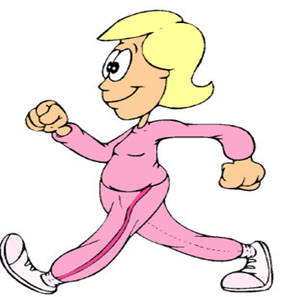
The exercise program based on outdoor activities was with energy content at least 5.5 kcal.kg⁻¹.day⁻¹.
An imposed physical activities was followed by pedometer, Sportester (HR) and by questionnaire.
By the imposed intervention should be increased of exercise regimen at least 30%.

Slide 15
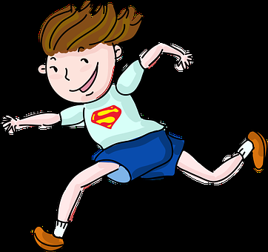
The mean energy content of exercise/week was calculated like 1.4*BMR in:
overweight 1990 ± 230 kcal (1820±200 kcal in overweight girls,
and 2070±250 kcal in overweight boys)
obese 2260 ± 290 kcal (1990±230 kcal in obese
girls, and 2410±280 kcal in obese boys)

Slide 16

72% of whole activities were walking and some form of running (Indian running, running with dog, etc.);
20% were games;
6% was cycling;
2% other movement activities.

Slide 17

Mean energy content of absolved movement activities was:
5.68 ± 1.14 kcal.kg⁻¹.day⁻¹ (5.49±1.5 kcal.kg⁻¹.day⁻¹ in overweight girls, and 5.80±1.9 kcal.kg⁻¹.day⁻¹ in overweight boys)
5.71 ± 1.30 kcal.kg⁻¹.day⁻¹ in obese (5.57±1.6 kcal.kg⁻¹.day⁻¹ in obese girls, and 5.89±1.8 kcal.kg⁻¹.day⁻¹ in obese boys)

Slide 18

In children differing in BM are absolute changes in BM like a result of imposed intervention substantively and statistically significant.
On the contrary, differences in relative terms of BM (percentages of initial BM) are non-significant.

Slide 19

Imposed physical activities caused significant body mass loss:
9.3± 1.7 kg (9.1±1.5 kg in overweight girls,
and 9.5±1.9 kg in overweight boys)
9.5 ± 1.8 kg (9.3±1.5 kg in obese girls,
and 9.8±1.9 kg in obese boys)

Slide 20
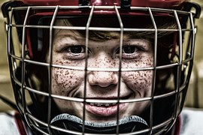
Imposed physical activities caused significant body mass loss in percentages of initial body mass:
13.8 ± 2.8 % (13.6±1.9 % in overweight girls,
and 14.2±2.0 % in overweight boys)
14.0 ± 2.9 % (13.8± 1.7 % in obese girls,
and 14.5±2.3 % in obese boys)

Slide 21
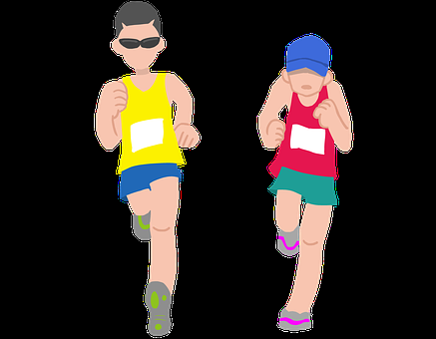
In children differing in BM are absolute changes in VO_{2peak} like a result of imposed intervention substantively and statistically significant.
On the contrary, differences in relative terms of VO_{2peak} (percentages of initial VO_{2peak}) are non-significant.

Slide 22

Imposed physical activities caused significant increase in initial values of VO_{2peak} :
5.2 ± 1.7 ml.kg⁻¹.min⁻¹ (5.0±1.5 ml.kg⁻¹.min⁻¹ in overweight girls,
and 5.4±1.7 ml.kg⁻¹.min⁻¹ in overweight boys)
5.4 ± 1.1 ml.kg⁻¹.min⁻¹ (5.1±1.3 ml.kg⁻¹.min⁻¹ in obese girls,
and 5.7±1.5 ml.kg⁻¹.min⁻¹ in obese boys)

Slide 23
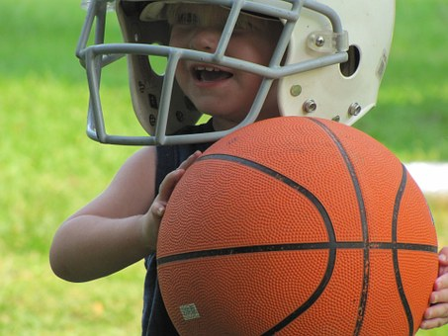
Imposed physical activities caused significant VO_{2peak} increase in percentages of initial values:
15.9 ± 2.7 % (15.6±2.5 % in overweight girls,
and 16.3±2.7 % in overweight boys)
16.0 ± 2.4 % (15.8±2.0 % in obese girls,
and 16.4±2.6 % in obese boys)

Slide 24
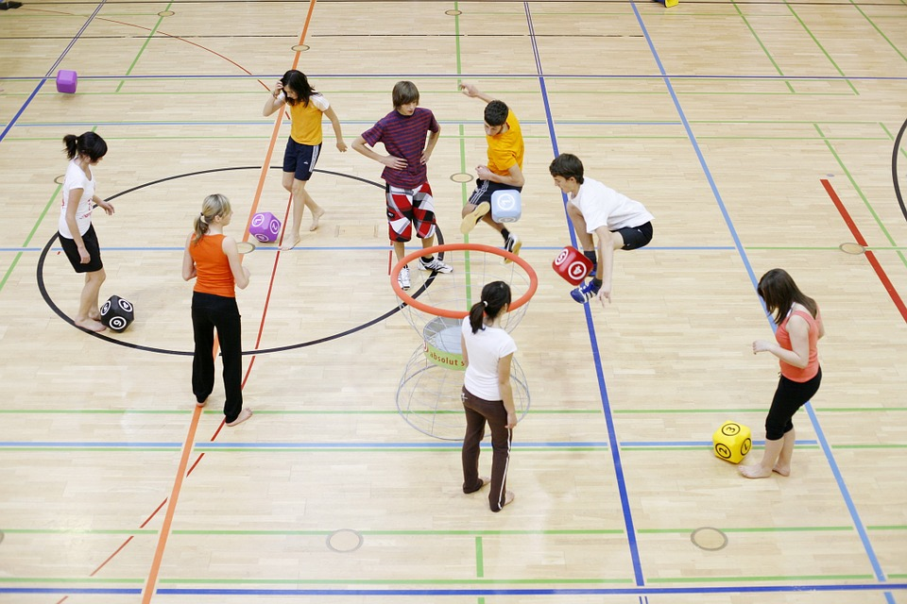
Body mass decrease expressed as a percentage of initial value was independent of age and sex and was directly proportional to the energy content of the imposed movement training.

Slide 25
ΔBM (%) = 5.071*ECE (kcal.kg⁻¹.day⁻¹) – 22.243
N = 225, R² = 0.6702
ΔBM – alteration in body mass, ECE – energy cost of exercise

Slide 26

Conclusion
We can conclude that an exercise program based on outdoor activities – walking causes the similar significant changes in BC and in functional performance in children, differing in BM.

Slide 27

Conclusion
Intervention programm based on outdoor activities with the energy minimal energy content of 5.5 kcal.kg⁻¹.day⁻¹ is able to is able to induce significant reduction of body mass (body fat) and significant increase in functional fitness in overweght and/or obese children.

Slide 28

Děkuji za pozornost

