Slide 1

DEVELOPMENT OF NANOCOMPOSITES FOR
BIOMEDICAL APPLICATIONS
V. RAJENDRAN
R. Suriyaprabha, S. Sutha, K. Kavitha and M. Prabhu
PROFESSOR AND DIRECTOR
R & D and
CENTRE FOR NANO SCIENCE AND TECHNOLOGY
K. S. Rangasamy College of Technology
K S R Group of Institutions Tiruchengode - 639 209, Namakkal (Dt.) Tamil Nadu, India
Phone Fax Email
: 91- 4288 – 274880 (Direct) 274741- 44
: 91- 4288 – 274870 (Direct) 274860
: veerajendran@gmail.com

Slide 2
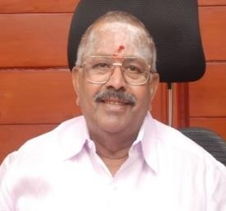

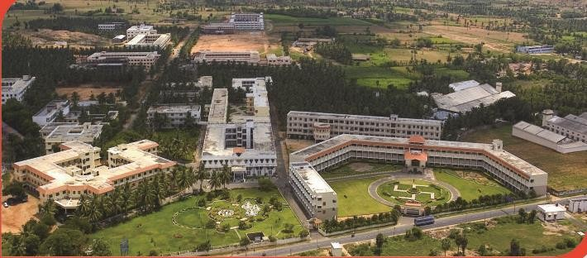

K.S.R Group of Institutions
K.S.R. Kalvi Nagar, Tiruchengode-637215 Tamil Nadu
Dr. K. S. Rangasamy, Chairman Mr. R. Srinivasan, Secretary
•
•
•
•
•
•
•
•
K.S. Rangasamy College of Technology (Autonomous) •
K.S.R. Institute of Dental Science and Research •
K.S.R. College of Engineering (Autonomous) •
K.S.R. Institute for Engineering and Technology •
K.S. Rangasamy College of Arts & Science (Autonomous) •
K.S. Rangasamy institute of Technology •
K.S.R. Polytechnic College •
K.S.R. College of Arts & Science for Women •
K.S.R. College of Education
K.S.R. Matriculation Higher Secondary School
K.S.R. Industrial Training School Rajammal Rangasamy I.T.I
Rajammal Rangasamy Teacher Training Institute Rajammal Rangasamy Higher Secondary School Avvai K.S.R. Matriculation School
K.S.R. Akshara Academy
Birds Eye view - KSR Group of Institutions
Site Map

Slide 3
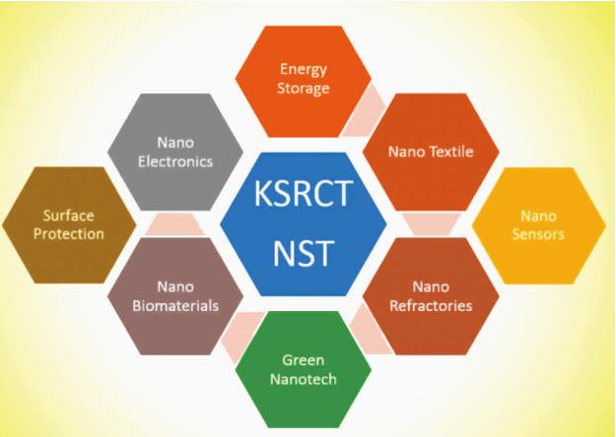
APPLICATIONS

Slide 4
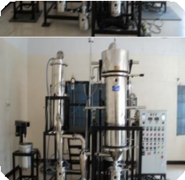
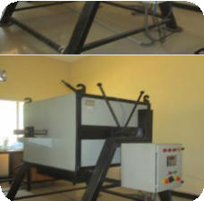


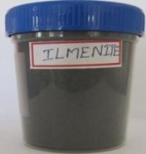
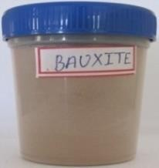
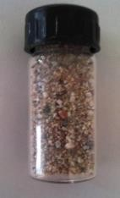
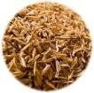
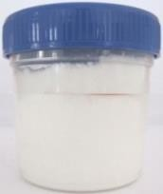
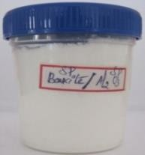
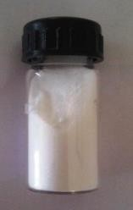
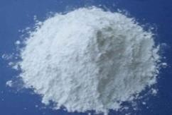
CENTRE FOR NANOSCIENCE AND TECHNOLOGY
Spray Pyrolyser Indigenous Furnace
Centre expertise - Mass production of metal oxide nanoparticles
SiO₂, TiO₂, Al₂O₃, ZrO₂, MgO
Bauxite
Ilmenite Ore Quartz Sand
Rice Husk
TiO₂ Nanoparticles
Al₂O₃ Nanoparticles
SiO₂ Nanoparticles
SiO₂ Nanoparticles
Nano Si

Slide 5
NANOCOMPISTES FOR BIOMEDICAL APPLICATIONS
Nanometal oxide composite
TiO₂-Chitosan
Optimisation –with in 5 different concentrations
Nanobioactive Glass (NBG)
NBG with MgO
NBG with Ag₂O
Nano Hydroxyapatite
HAp with Si –Coating with chitosan

Slide 6
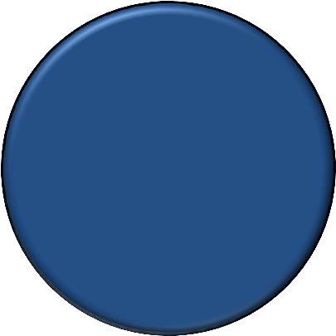
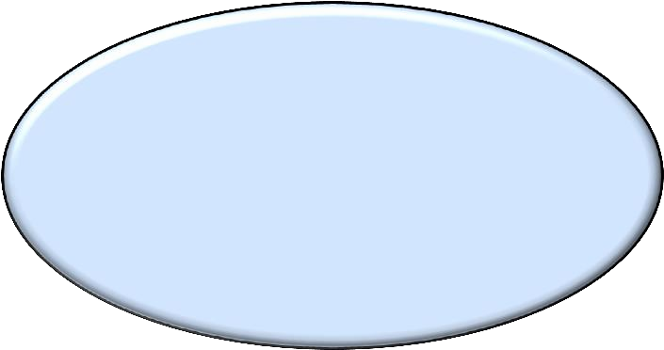
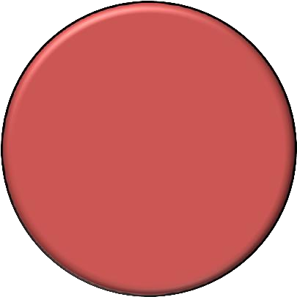

NANOBIOMATERIALS APPLICATIONS
Drug Delivery Devices
Tissue engineering
POLYMERS
Dental Implants
Orthopedic screws/fixation
NANO BIOMATERIALS
METALS
CERAMICS
Biosensor and Cosmetic
Dental Implants
Bone replacements

Slide 7
BONE REGENERATION & RECONSTRUCTION
Emerging areas
Bone tissue engineering and orthopedics
Objectives
Improve the osseointegration
•
•
Mimic the natural process to repair
Maintain the function of the bone

Slide 8
METAL OXIDE & POLYMER - NANOCOMPOSITE
METAL IMPLANT
  Bone replacement
Defects-Overcome
  In sufficient biocompatibility
  Less Infection prevention
  Less interactions with tissue
  In sufficient anti-corrosion properties

Slide 9































in situ PREPARATION OF NANOCOMPOSITES
Titanium Isopropoxide
Isopropyl alcohol
Vigorous Stirring
Add -Acetyl acetone
Vigorous Stirring for 1h
Drop by drop addition- Chitosan polymer solution
Under Vigorous Stirring in Controlled Conditions
Formation of Gel
Drying at 120 ºc - 2h
Nanocomposite powder

Slide 10
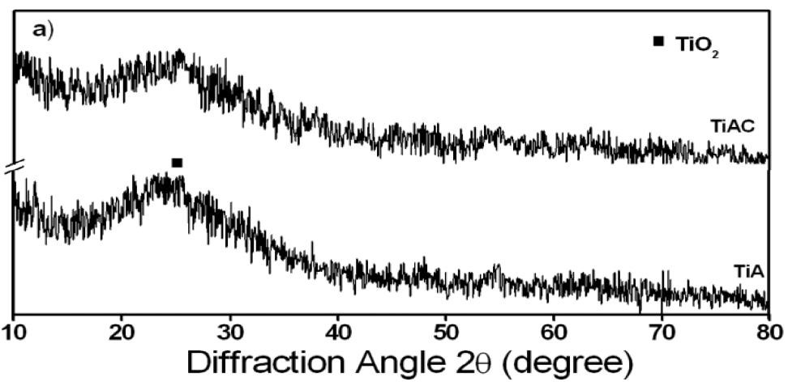
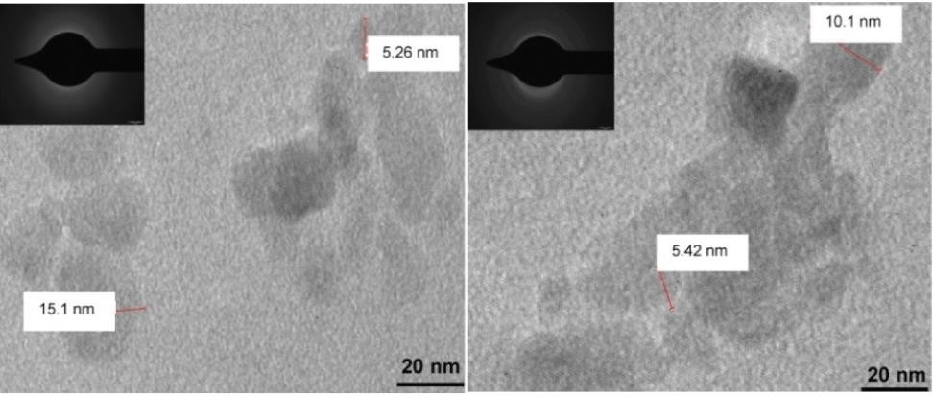
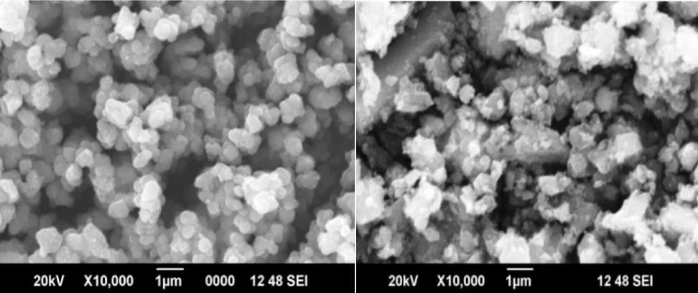
CHARACTERISATIONS
Sample code | Sample Description
TiA | Pure-TiO2
TiAC | TiO2-chitosan
C | Control
XRD
TEM
XRD- amorphous nature
TEM- particle size
TiA =10.5 nm TiAC=5.23 nm
SEM- TiAC-irregular morphology due to the addition of chitosan
SEM
TiA
TiAC

Slide 11
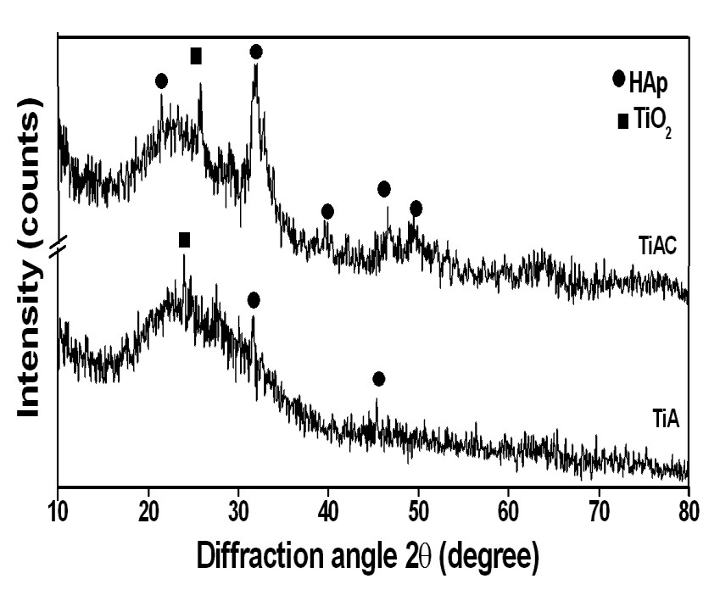



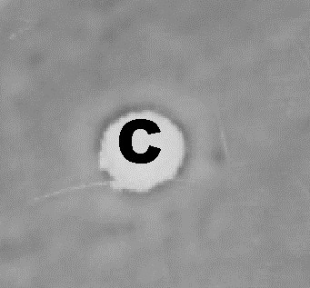
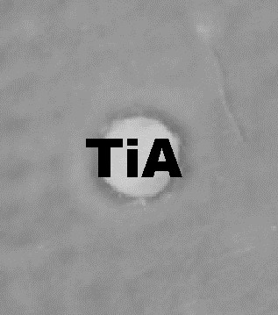
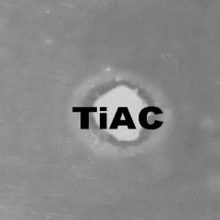
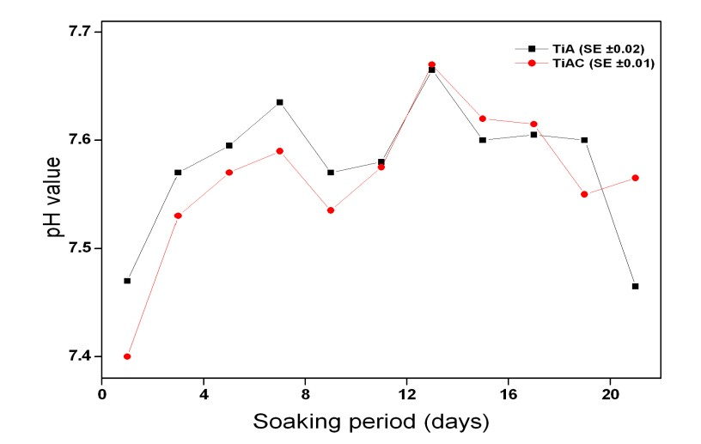
BIOLOGICAL STUDIES
Anti microbial acitivity in S.aureus
XRD- TiAC- well formed crystalline HAp
• pH – confirms good ion
exchanges – TiAc shows continuous
exchanges of ions
• Zone of inhibition =TiAc 10 mm
Bioactivity study - SBF
pH - SBF

Slide 12
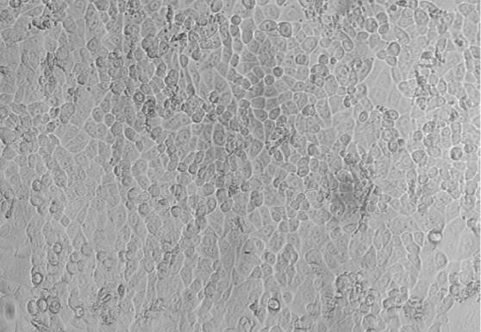
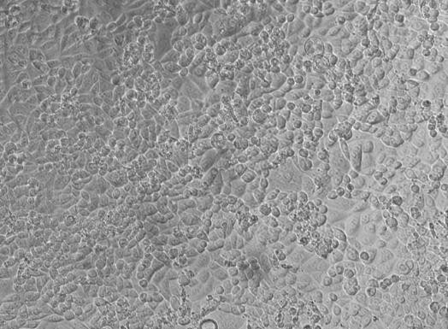
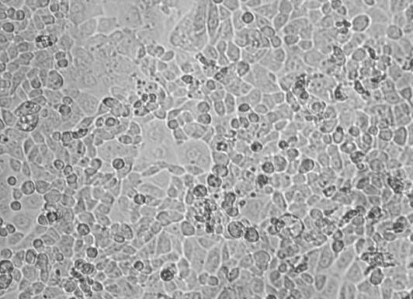

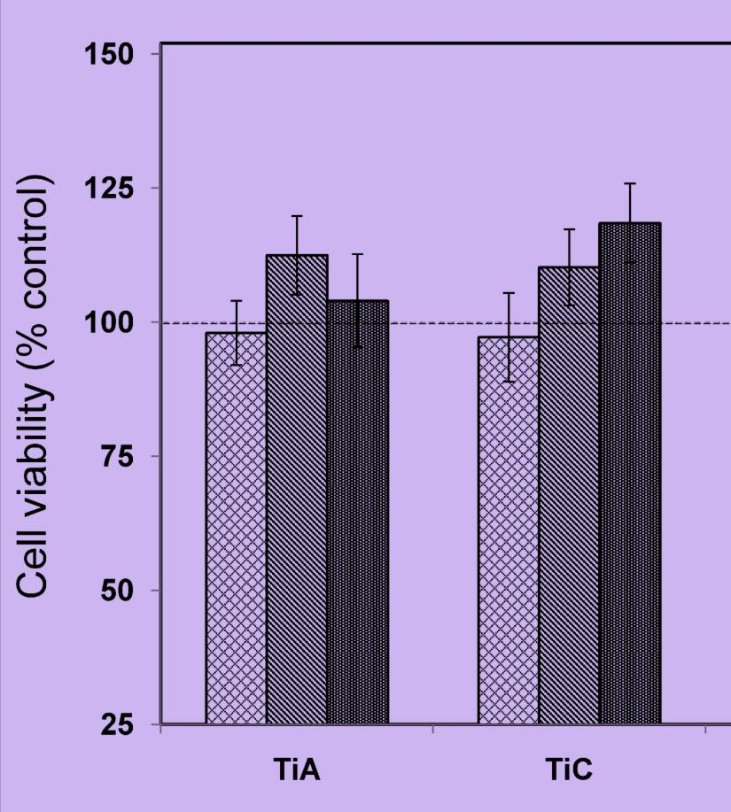
IN VITRO TOXICITY STUDIES
C
TiA TiAC
Cytotoxicity study- in AGS cell line
TiAC- composite
Cell Morphology is good
than the pure TiO₂
Cell viability is higher than attachment
K. Kavitha, M. Prabhu, V. Rajendran, P.
Manivasankan, P. Prabu, T. Jayakumar, Optimization of nano-titania and titania-chitosan nanocomposite to enhance biocompatibility, Current Nanoscience, 2013

Slide 13
OPTIMISATION - in situ SYNTHESIZED TITANIA-
CHITOSAN NANOCOMPOSITE
• TiO₂–chitosan nanocomposites with five chitosan ratios
• Synthesised by above in situ method
Sample | Concentration of chitosan (g/L) | Crystallite size (nm) | Particle size (nm) | Surface area (m²/gm)
T-C0 | 0 | 3.60 | 10.58 | 208.41
T-C0.12 | 0.125 | 3.58 | 5.98 | 114.24
T-C0.25 | 0.25 | 3.22 | 5.87 | 214.73
T-C0.5 | 0.5 | 3.00 | 5.73 | 244.47
T-C1 | 1 | 2.13 | 5.23 | 265.33
T-C2 | 2 | 2.13 | 4.50 | 237.71

Slide 14
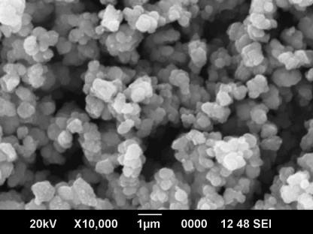
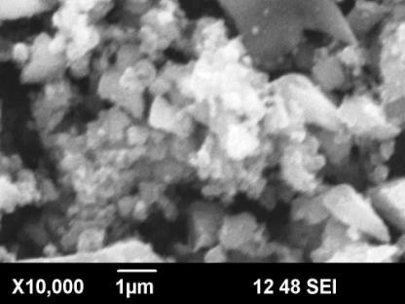
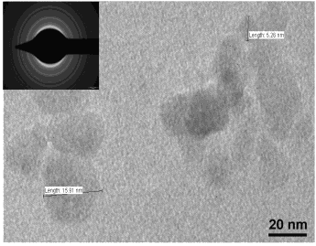
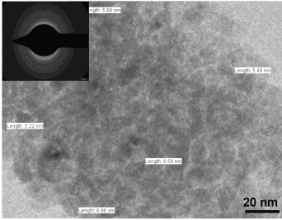
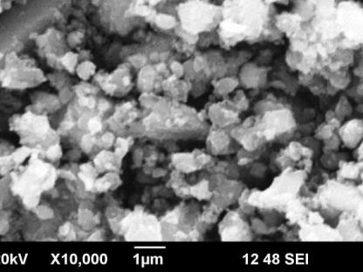
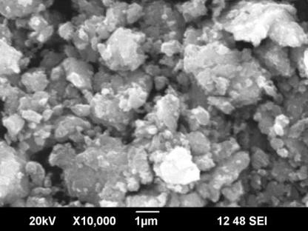
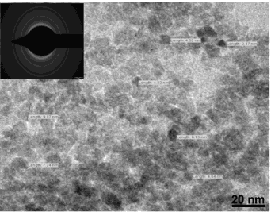
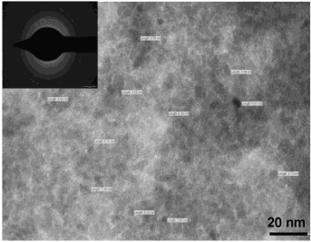
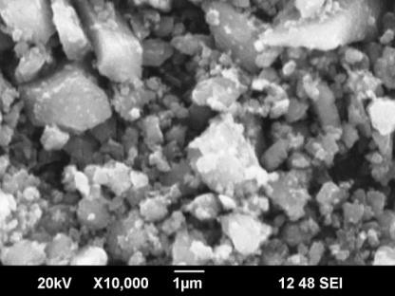
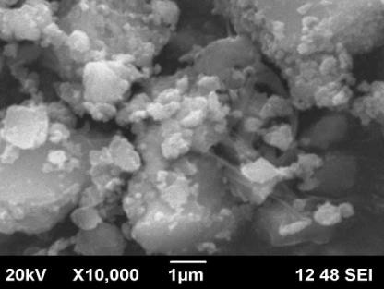
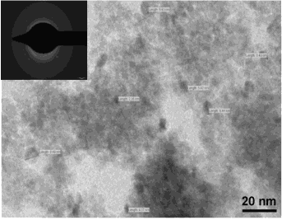
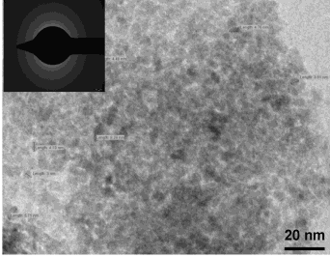
OPTIMISATION – in situ SYNTHESIZED TITANIA-
CHITOSAN NANOCOMPOSITE
T-C0
T-C0.12
T-C0
T-C0.12
T-C0.25
T-C0.5
T-C0.25
T-C0.5
TEM
T-C1
SEM
T-C2
T-C1
TEM
T-C2
chitosan
spherical morphology chitosan -increases
decreases
Particle size

Slide 15
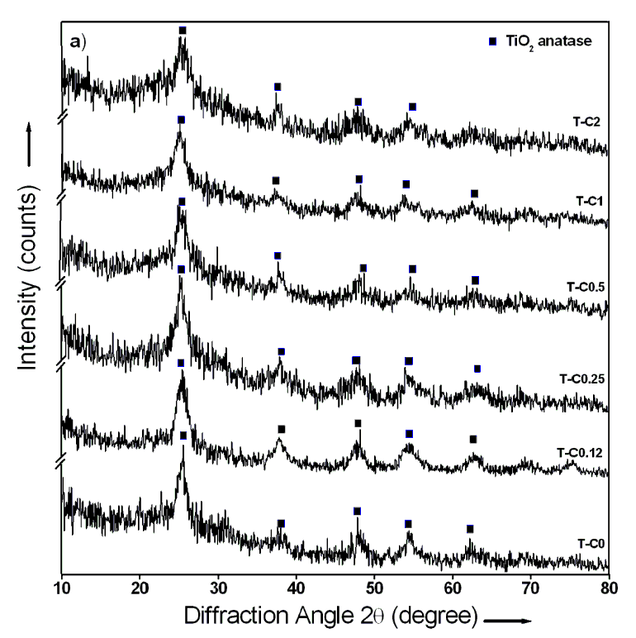
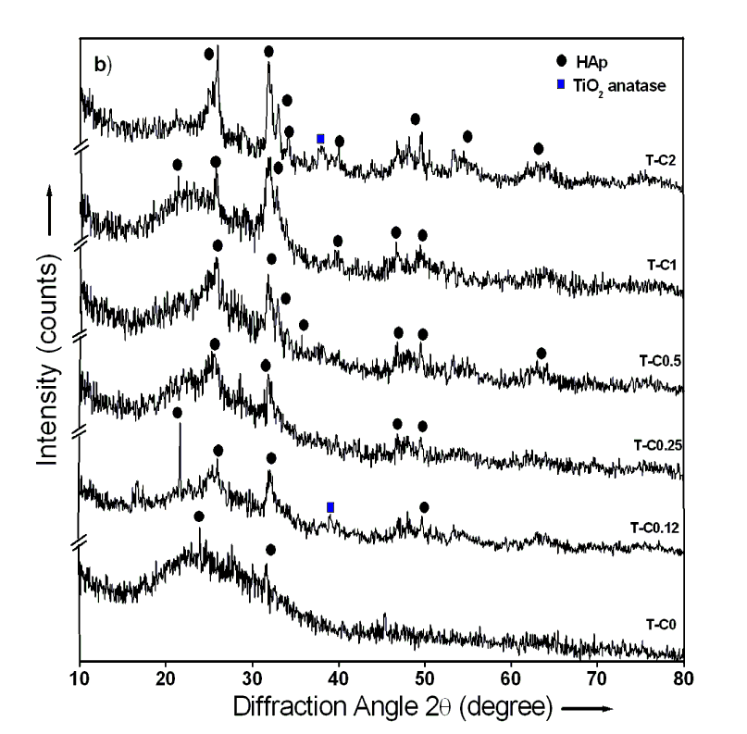
OPTIMISATION - in situ SYNTHESIZED TITANIA-
CHITOSAN NANOCOMPOSITE
In situ synthesized novel biocompatible titania-chitosan
nanocomposite
XRD – Before SBF study
XRD – After SBF study
HAp formation- well observed in composites
T-C0.5 and T-C10- well crystalline HAp

Slide 16
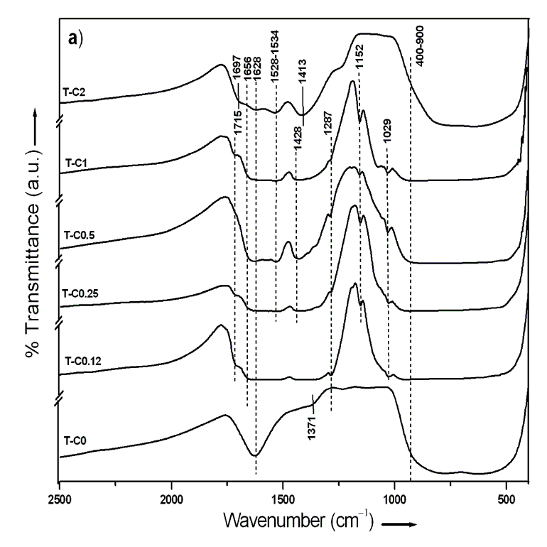
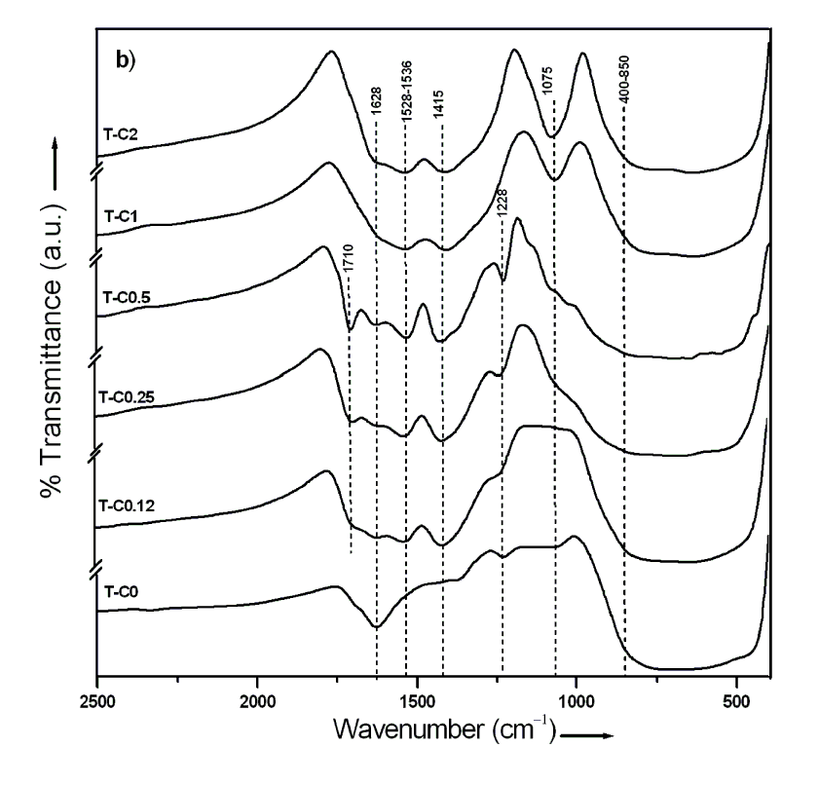
OPTIMISATION OF in-situ SYNTHESIZED TITANIA-
CHITOSAN NANOCOMPOSITE
In situ synthesized novel biocompatible titania-chitosan
nanocomposite
FTIR– Before SBF study
FTIR– After SBF study
1415 cm⁻¹ corresponds to CO₃ - formation of HAp layer
2−
chitosan addtion - facilitate well formed HAp

Slide 17
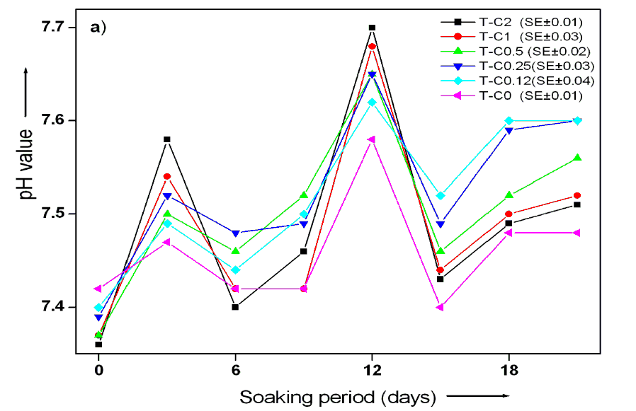
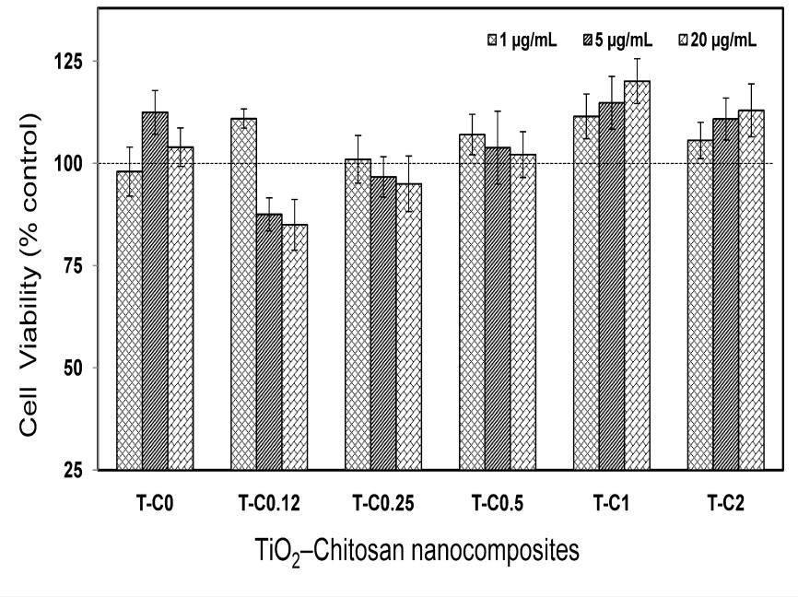
OPTIMISATION OF IN SITU SYNTHESIZED TITANIA-
CHITOSAN NANOCOMPOSITE
pH – confirms good ion exchange - progressively from T-C0.25 to T-C2
Cytotoxicity -T-C1 is the optimal concentration for the biomedical application
Ion Exchange –during SBF study
K. Kavitha, S. Sutha, M. Prabhu, V. Rajendran and T. Jayakumar, In situ synthesized novel biocompatible titania–chitosan nanocomposites with high surface area and antibacterial activity
Carbohydrate Polymers 93 (2013) 731– 739
Cytotoxicity– AGS cell line

Slide 18
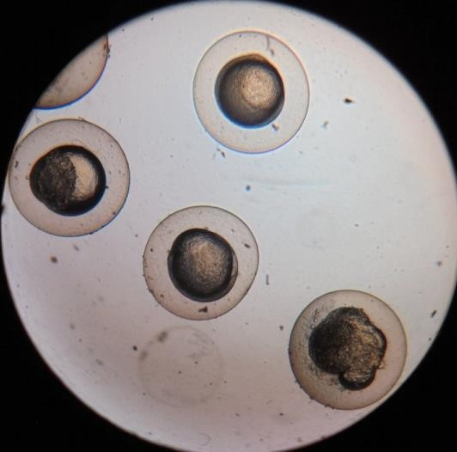
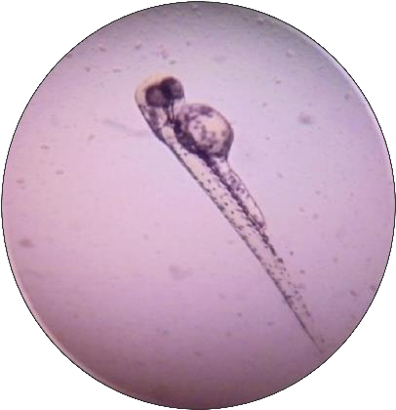
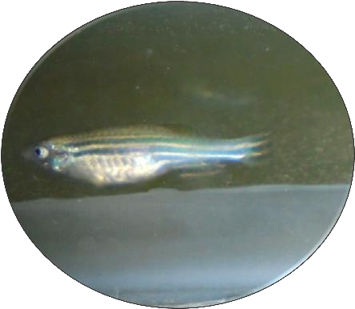
IN VIVO STUDIES IN ZEBRAFISH EMBRYOS
Zebrafish - Alternative to animal studies
Rapid screening in a feasible way
for nanotoxicity
Econimical
imaging
Easy handling
and transparent

Slide 19
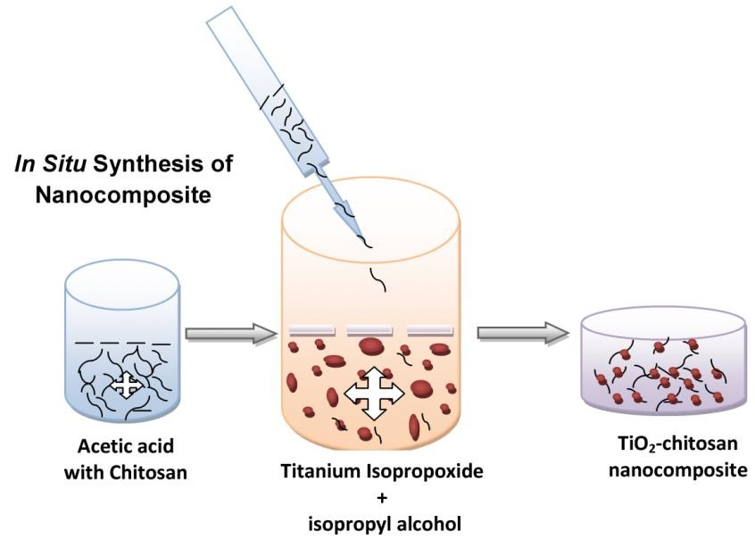


in vivo TOXICITY STUDIES
48 h
In vivo studies in zebrafish (Danio rerio)
Hatching rate was increasesd50:50
Inactive: 20%
Dead rate: 1 out of 10
72 h
In vivo Toxicity analysis

Slide 20
NANO BIOACTIVE GLASS (NBG)
Nanobioactive glass (NBG)
  Non-resorbable biomaterial (<100 nm)
  Interact with biological systems
Ability to bond with bone and soft tissues
Composed of SiO₂-CaO-P₂O₅ with additives (Na₂O, TiO₂ & ZrO₂) and antimicrobial agents (Ag₂O, ZnO, MgO)
Additives
Increase bioactivity and biocompatibility
Increase mechanical strength
•
Antimicrobial agents
- Prevent microbial contaminations

Slide 21
NANOBIOACTIVE GLASS (NBG)
Synthesis methods
Sol-gel
Sonochemical
•
•
Hydrothermal and
Spray pyroliser
Salient features of Nanobioactive glass (NBG)
Good bioactivity and biocompatibility
Osteoconductivity
•
•
Biodegradability
Bone bonding ability and load bearing applications

Slide 22

NANOBIOACTIVE GLASS (NBG) - SYNTHESIS

Slide 23


OPTIMISATION OF NANOBIOACTIVE GLASSES
Synthesis of magnesium substituted nanobioactive glass powders with various compositions (58SiO₂-(33-x)CaO-9P₂O₅-xMgO) x= 0, 10 and 20 mol %
Synthesis of silver doped nanobioactive glass powders with compositions (58SiO₂-(33-x)CaO-9P₂O₅-xMgO)
x= 0, 0.5, 1, 2 and 3 mol %
various

Slide 24


XRD AND FTIR PATTERN OF MgO SUBSTITUTED NBG
PARTICLES BEFORE AND AFTER in vitro STUDIES
NANO SILICA
No diffraction peaks
Amorphous nature
Before in vitro
10 % MgO - good formation of HAp
Better bioactivity-10% MgO
After in vitro

Slide 25






TEM IMAGES OF MgO SUBSTITUTED NBG PARTICLES
Spherical morphology < 50 nm
SAED - amorphous
10% MgO - good spherical morphology - uniform size
0% MgO
20% MgO
10% MgO

Slide 26






SEM IMAGES OF MgO SUBSTITUTED NBG PARTICLES
BEFORE AND AFTER in vitro STUDIES
SEM- Before in vitro
Before in vitro
10% MgO glasses- good spherical
morphology
EDX pattern exhibits 99% purity
0% MgO
10% MgO
SEM- After in vitro
After in vitro
10% MgO doped glass-higher hydroxyapatite formation
0% MgO
10% MgO

Slide 27

in vitro CYTOTOXICITY OF MgO SUBSTITUTED NBG
PARTICLES
In vitro cytotoxicity assay
Human gastric adenocarcinoma cell line
10% MgO glass show better biocompatibility at a concentration of 100 µg ml⁻¹
Antibacterial activity
Staphylococcus aureus and
Escherichia coli
No zone of inhibition for MgO doped glass particles
Publication
M. Prabhu, K. Kavitha, P. Manivasakan, V. Rajendran* and P. Kulandaivelu Ceramics International, 39, 1683-1694 (2013 )

Slide 28



in vivo TOXICITY STUDIES - ZEBRAFISH EMBRYO (DANIO RERIO)
Control
NBG particles - 100µg/mL
Mg- NBG particles - 100µg/mL
The mortality rate is reduced by 20% in the NBG-treated samples

Slide 29


XRD PATTERN OF Ag₂O DOPED NBG PARTICLES BEFORE
AND AFTER in vitro STUDIES
No diffraction peaks
Amorphous nature
Before in vitro
Ag₂O – Well formation of HAp
Better bioactivity - 2 and 3 mol % Ag₂O
After in vitro

Slide 30




TEM IMAGES OF Ag₂O SUBSTITUTED NBG PARTICLES
Spherical morphology < 50 nm
SAED – Amorphous
2 & 3 mol % Ag₂O -good spherical morphology - uniform size
0% Ag₂O
2% Ag₂O
3% Ag₂O

Slide 31






SEM IMAGES OF Ag₂O DOPED NBG PARTICLES BEFORE
AND AFTER in vitro STUDIES
SEM- Before in vitro
Before in vitro
2 & 3 mol% Ag₂O glasses- good spherical morphology
EDX - 98% purity
2% Ag₂O
3% Ag₂O
SEM- After in vitro
After in vitro
2 & 3 mol% Ag₂O - higher HAp layer formation
2% Ag₂O
3% Ag₂O

Slide 32

in vitro CYTOTOXICITY OF Ag₂O DOPED NBG PARTICLES
In vitro cytotoxicity assay
Human gastric adenocarcinoma cell line
2 & 3 mol % Ag₂O glass show better biocompatibility at a concentration of 100 µg ml⁻¹ with slight toxic
Antibacterial activity
Staphylococcus aureus and
Escherichia coli
Zone of inhibition for Ag₂O doped glass particles is around 1.5 mm
Publication
M. Prabhu, K. Kavitha, R. Suriyaprabha P. Manivasakan, V. Rajendran* and P.
Kulandaivelu, Journal of Nanoscience and Nanotechnology, 2013, 13(8), 5327-39.

Slide 33
HYDROXYAPATITE (HAp)
Salient Features of HAp
Composite of natural bone in nano form
Excellent biocompatibility
Direct chemical bond with hard tissues
Metal Doped Hydroxyapatite
Formation of strong mechanical bond
Improved bioactivity, Enhance osteoblast interaction
Improved bone in-growth
Antimicrobial resistance

Slide 34
COATING ON IMPLANT
METALLIC IMPLANTS
Metallic implants – Stainless steel, Titanium and its alloys and Cobalt Chromium alloys
STAINLESS STEEL (SS)
Advantages - low cost, high tensile strength
•
•
•
•
High corrosion resistance and wear resistance
Disadvantages - Release of Fe, Cr & Ni shows
Allergic and adverse reaction
Bioactive coating on stainless steel – inhibit the release of Fe, Cr
& Ni ions. Enhance bone in growth

Slide 35





SEM IMAGE OF Si DOPED HAp/CH COMPOSITE COATING ON 316L SS
0SiHAp/CTS
0.4SiHAp/CTS
0.8SiHAp/CTS
Si -HAp well coated on SS with Chitosan
Increase in Si content -good
adherent coating
1SiHAp/CTS
1.6SiHAp/CTS

Slide 36





HAp FORMATION - NANOCOMPOSITE COATED 316L SS IN SBF
0SiHAp/CTS
0.4SiHAp/CTS
0.8SiHAp/CTS
White precipitate -HAp
1 wt% Si- HAp on the implant surface
1SiHAp/CTS
1.6SiHAp/CTS

Slide 37

BIOCORROSION STUDY - 316L SS IN SBF
Corrosion stability -HAp composite increased -Si concentration
1.6 wt% Si concentration - maximum corrosion stability
PUBLICATION
S. Sutha, K. Kavitha, G.Karunakaran, V. Rajendran and T. Jayakumar, In-vitro bioactivity, biocorrosion and antibacterial activity of silicon integrated hydroxyapatite/chitosan composite coating on 316L stainless steel implants. Materials Science and Engineering C.2013.

Slide 38
OBSERVATIONS
Optimisation - NBG
Compositions of MgO and Ag₂O
Bioactivity
Enhanced biocompatibility
Optimisation of TiO₂-chitosan nanocomposite
Concentration of Chitosan
Improved specific surface area
Enhanced cytocompatibility
Si doped HAp/chitosan composite coating on 316 L SS
Increased apatite formation
Biocorrosion stability

Slide 39






NEEM DOPED NBG (58SiO₂–33CaO–9P₂O₅)
Materials | : | Azadirachtha indica - Nano powder
Composition | : | Nanobioactive glass (Neem-58SiO₂–33CaO–9P₂O₅)
Process method | : | Ball Milling / In situ preparation
Neem (Azadirachtha indica ) Leaves
Neem
Powder
Base glass (58SiO₂–33CaO–9P₂O₅)
Neem Doped NBG (58SiO₂–33CaO–9P₂O₅)
C
N
14 mm
C
N
18 mm
N - Neem doped NBG
C - Base glass
Klebsiella sp. Gram (-ve)
Bacillus sp. Gram (+ve)

Slide 40





Al₂O₃-ZrO₂-NBG (58SiO₂–33CAO–9P₂O₅)- HAp
Composition | : | Al₂O₃-ZrO₂-NBG (58SiO₂–33CaO–9P₂O₅)-HAp
Process method | : | In situ preparation
Nano Alumina
Nano Zirconia
Base glass
(58SiO₂–33CaO–9P₂O₅)
Nano Hydroxyapatite
(Al₂O₃-ZrO₂-NBG
(58SiO₂–33CaO–9P₂O₅)-HAp)
Dental Filling
Technology Transfer

Slide 41
TOXICOLOGICAL EVALUATION OF BIOMEDICAL
IMPORTANT METAL OXIDE NANOPARTICLES
To study the beneficial and adverse effects of the nano- and micro- metal oxide particles on different biological systems such as bacteria, algae for enhanced applications
The interaction of nanoparticles with the ecosystem and biological system should be studied to avoid the ill-effects on human health
Industrially important metal oxide particles which should be evaluated for their toxicity are: SiO₂, Al₂O₃, ZrO₂ and TiO₂

Slide 42
CHARACTERISATION - NANO AND BULK SiO₂ AND Al₂O₃
PARTICLES
Particles | Nature | Purity | Zeta potential (mV) | Contact angle (°A) | Particle size distribution (mean size) |  | BET Surface area (m² /g)
 |  |  |  |  | Water | Saline
Nano- SiO₂ | Amorphous | ≥ 99 % | -25.8 | 54.65 | 50 nm | 70 nm | 361
Bulk- SiO₂ | - | ≥ 99 % | -25.6 | 50.31 | - | - | -
Nano- Al₂O₃ | Cubic | ≥ 99 % | +49 | 35.67 | 58 nm | 68 nm | 190
Bulk- Al₂O₃ | - | ≥ 99 % | -21.8 | 17.37 | - |  | -

Slide 43

SOIL BACTERIAL POPULATION TREATED WITH
NANO AND BULK SiO₂ AND Al₂O₃ PARTICLES
Nano alumina shows significant toxicity towards soil bacteria than bulk
Rather, nano and bulk silica have a higher population than any other groups

Slide 44

IMPACT OF NANO AND BULK SiO₂ AND Al₂O₃ PARTICLES ON
SOIL BACTERIA
Publication
G. Karunakaran, R. Suriyaprabha, P. Manivasakan, R. Yuvakkumar, V. Rajendran, N. Kannan , Current Nanoscience, 9 (6) 2013.

Slide 45
CHARACTERISATION - NANO AND BULK ZrO₂ AND TiO₂
PARTICLES
Particles | Crystalline phase | Purity | Zeta potential | Contact angle | Particle Size Distribution (mean size) |  | BET
 |  | (%) | (mV) | (Å) | Water (nm) | Saline (nm) | (m ⁻¹)
Nano ZrO₂ | Cubic | ≥ 99 | +11.8 | 73.37 | 39 | 50 | 227
Bulk ZrO₂ | - | ≥ 99 | -13.4 | 33.20 | - | - | -
Nano TiO₂ | Tetragonal | ≥ 99 | -22.0 | 47.82 | 50 | 65 | 112
Bulk TiO₂ | - | ≥ 99 | -22.0 | 23.12 | - | - | -

Slide 46

SOIL BACTERIAL POPULATION TREATED WITH
NANO AND BULK ZrO₂ AND TiO₂ PARTICLES
Nano TiO₂ shows decrease in population with an increase in concentration
Both nano and Bulk ZrO₂ are not significantly affect the bacterial groups

Slide 47

IMPACT OF NANO AND BULK ZrO₂ AND TiO₂ PARTICLES ON
SOIL BACTERIA
Publication
G. Karunakaran, R. Suriyaprabha, P. Manivasakan, R. Yuvakkumar, V. Rajendran, N. Kannan, Influence of nano and bulk SiO₂ and Al₂O₃ particles on plant growth promoting rhizobacteria and soil nutrient contents, Current nanoscience 2015.

Slide 48

IMPACT OF NANO AND BULK SiO2 AND Al₂O₃ PARTICLES
ON GREEN ALGAE
Al₂O₃ particles reduce algal growth in contrast to SiO₂ particles.
Algal cells treated with Al₂O₃ particles settled down at the bottom of the flask and no growth is observed further.
The intensity of the medium reflects more toxic nature of Al₂O₃ nanoparticles than their micro counterparts.

Slide 49

IMPACT OF NANO AND BULK TiO₂ AND ZrO₂ PARTICLES ON
GREEN ALGAE
The OD of the medium increases for ZrO₂ particles whereas it decreases for TiO₂ particles, compared to that of control.
ZrO₂ particles enhance algal growth whereas TiO₂ particles suppress the growth.

Slide 50
BIOMEDICAL IMPORTANT HERBAL NANOPARTICLES

Slide 51

AZADIRACHTA INDICA LEAVES FOR TEXTIL APPLICATIONS
Medicinal Plant
Azadirachta indica or Neem
Antibiotic agent - bacterial pathogens
Constituents : nimbidin, nimbolide, mahmoodin, margolone, margolonone, isomargolonon

Slide 52


AZADIRACHTA INDICA – NANOPARTICLE SIZE DISTRIBUTIONS
Trial | 1 : | 30 nm
Trial | 2 : | 32 nm
Trial | 3 : | 34 nm

Slide 53

UV-VISIBLE SPECTRUM OF AZADIRACHTA INDICA LEAF NANOPARTICLES

Slide 54




SEM-EDAX IMAGE – NANOPARTILCES COATED FABRICS
Coated Fabric
Un-coated Fabric
After 5th wash
After 10th wash

Slide 55


ANTIMICROBIAL ASSESSMENT OF THE AZADIRACHTA
INDICA NANOPARTICLES
Zone of inhibition (mm)
A :25 mg/ml
B : 50 mg/ml
C :100 mg/ml
Test Organisms | 25 mg/ml | 50 mg/ml | 100 mg/ml
E .coli | 18.61 ± 0.61 | 21.78 ± 1.05 | 23.27 ± 1.66
S.aureus | 20.87 ± 0.66 | 21.91 ± 1.38 | 26.54 ± 1.14

Slide 56


ANTIMICROBIAL ASSESSMENT OF THE AZADIRACHTA INDICA
NANOPARTICLES COATED FABRICS
Zone of inhibition (mm)
A : uncoated
B : Chitosan
C :nanoparticles
Test Organisms | Chitosan coated fabric | Azadirachta caoted fabric | Control - Uncoated fabric
E .coli | 25.45 ± 0.34 | 31.58 ± 0.36 | -
S.aureus | 26.81 ± 0.97 | 34.00 ± 0.88 | -

Slide 57

INFLUENCE NANOPARTICLE SIZE ON ANTIMICROBIAL PROPERTIES OF TRIDAX PROCUMBENS LEAF NANOPARTICLES
Medicinal Plant
Diseases like respiratory and intestinal tract diseases anticoagulant, anticancer, antifungal,
insect repellent applications
Constituents: dexamethasone luteolin, glucoluteolin, β-sitosterol quercetin, procumbenetin β-sitosterol-3-O-β-D-xylopyranoside,

Slide 58


HERBAL NANOPARTICLES – DIFFERENT SIZES
Trial 1 : 6
Trial 2 : 9 h
Trial
Trial
3 :12 h
4 : 15 h

Slide 59


ANTIBACTERIAL STUDIES
A :6 h
B : 9 h
C :12 h
D: 15 h

Slide 60
PI AND TEAM @ CNST, KSRCT
Completed Projects
Total No. of Projects Completed
: 20
DST (4), DRDO (7), IGCAR (2), BRNS (2), INMAS (1), DESIDOC (1),
UGC (1), UGC-DAE CSR (1), CSIR (1)
: 325.37 (in lakhs)
PI: 17; CI: 3
Total Cost of the Completed Projects
Human Recourses
Total No. of Ph. D., Produced : 23 Total No. of Technical Staff Trained : 08 Total No. of Patents : 14
Total No. of Papers Published in Peer reviewed International Journals
On Going Projects
Total No. of Projects on Going : 2 (PI: 2)
: 204
DST -1 (2015-2018), BRNS -1 (2014-2017)
Total Cost of the on going Projects
: 48.94 (in lakhs)
Conferences Organised
NANO-15, NANO-10, NANO-5, MAM-12
Nobel laureate Association
Six Nobel laureates Visited CNST, KSRCT

Slide 61






FACULTY
Nanoscale metal oxides
Ultrasonics characterisation of nanomaterials
Nanocomposite refractories
Nano biomaterials
Nano magnetic materials
Dr. V. RAJENDRAN
DIRECTOR, R&D
CENTRE FOR NANOSCIENCE AND TECHNOLOGY
Dr. K. Saminathan
Fuel cell nanotecnology
Alternative nano energy storage
Nano sensors
Dr. P. Prabu
Nanoscale biostructures
Nano medicine
Dr. P. Manivasakan
Nanostructured surface protective coating
Solid State Chemistry of Nanomaterials
00
Mr. P. Paramasivam
Ultrasonics characterisation of nanomaterials
Dr. R Suriyaprabha
UGC- Post-Doctoral Fellow Nanobiotechnology – Agriculture Environmental Toxicology

Slide 62






RESEARCH SCHOLARS
Mr. S. Karthik Herbal Nanoparticles |  | Mr. Prem Ranjan Rauta Nano Metal Oxides Refractory Applications
Mr. M. Sridharpanday Metals Metal Oxides Ceramics and Solar cell |  | Mrs. V.S. Sangeetha Graphene Nanocomposites
Mr. P. Siva Supercapacitors Nano Metal Oxides |  | Mr. M. Vinoth Nano Photonics Solar Cell

Slide 63






INTERNATIONAL SCIENTISTS / RESEARCH SCHOLARS / STUDENTS VISITS / EXCHANGE @ CNST
 | Category | Name & Affiliation
 | Adjunct Professor | Prof. Suresh Valiyaveettil National University of Singapore, Singapore
 | Visiting Professor | Prof. Dr. Karan V.I.S. Kaler University of Calgary, Canada
 | Category | Name & Affiliation
 | Student Internship | Mr. Clement BESSON University of Auvergne, France
 | Visiting Doctoral Researcher | Mr. Victor Ochigbo National Research Institute of Chemical Technology, Nigeria
 | NAM-S & T Research Training Fellowship for Developing Countries (RTF-DCS) | Mr. Zongo Sidiki University of South Africa, Pretoria
 | NAM-S & T Research Training Fellowship for Developing Countries (RTF-DCS) | Dr. M. Abdoulaye Diallo University of South Africa, South Africa

Slide 64


INTERNATIONAL SCIENTISTS / RESEARCH SCHOLARS / STUDENTS
VISITS / EXCHANGE @ CNST
 | Category | Name & Affiliation
 | Student Internship | Ms. Emeline Moulin University of Auvergne, France
 | NAM-S & T Research Training Fellowship for Developing Countries (RTF-DCS) | Dr. Ntevhe Thovhogi, Post Doctoral Researcher, National Research Foundation/ iThemba LABS, South Africa

Slide 65




RESEARCH HIGHLIGHTS OF CNST
Highest downloaded articles in Science Direct journals
S.No. | Articles | Downloads
1. | G. Karunakaran et al., Ecotoxicology and Environmental Safety, 93, 191-197. | 554
2. | S. Sutha et al., Mater Sci Eng C Mater Biol Appl., 33, 4046-4054. | 696
3. | K. Jothi Ramalingam et al., Synthetic metals. 191, 113-119. | 574
Most reviewed Manuscript by 19 Reviewers
D. Shanmugapriya, R. Suriyaprabha, R. Yuvakkumar & V. Rajendran. (2014) Chitosan Nanoparticle- incorporated Composite HPMC Films For Food Preservation. J Nanopart Res., 16, 2248.
Highlight of our Research in Magazines

Slide 66












MEMORANDUM OF UNDERSTANDING
•
University of Aveiro, Portugal
•
Edith Cowan University, Perth, Australia
•
Mintek Inc, Johannesburg, South Africa
•
Chonbuk National University, Jeonju, South Korea
•
University of Missouri, Columbia, USA
•
Kaiserslautern University, Kaiserslautern, Germany
•
Gwangju Institute of Science and Technology (GIST), Korea
•
National Institute for Nanotechnology (NINT) Innovation Centre, Canada
•
York University, Toronto, Canada
•
University of Calgary, Canada
•
Jomo Kenyatta University of Agriculture, Nairobi, Kenya

Slide 67







MEMORANDUM OF UNDERSTANDING
Mahidol University, Bangkok, Thailand
University of Saskatchewan, Saskatoon, Canada
Centre of Molecular and Macromolecular Studies, (Polish Academy of Sciences) Warsaw, Poland
University of Witwatersrand Johannesburg, South Africa
University of Mauritius (UM), Mauritius
Institut Català de Nanociència i Nanotecnologia, Spain
Université d'Auvergne France

Slide 68

THANK YOU

