Slide 1
Mechanochemical Synthesis:
NOVEL MATERIALS FOR MAGNETIC COOLING APPLICATIONS
Viktor P. Balema
Ames Laboratory of US Dept. of Energy
Ames, Iowa, USA
This presentation does not contain any proprietary or unpublished information.
Notes:
Today, I will present some results of our ongoing effort on new materials development, which we obtained during the last few years. Unfortunately, due the proprietary nature of our work, I can only disclose information is already in the public domain. Therefore, I will focus on already published work and specifiacaly on the work that had been performed in close collaboration with the Ames Lab, which should add some additional flavor to my talk .

Slide 2
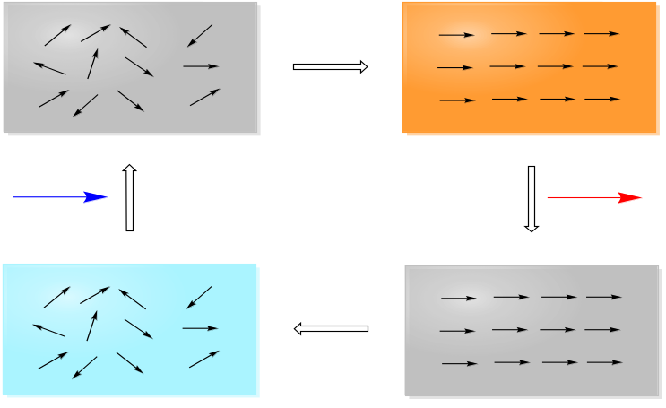


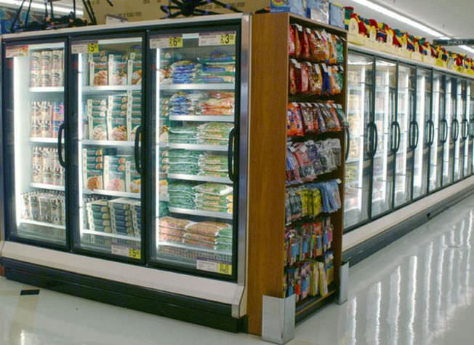
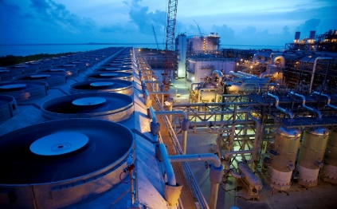

Solid-State Caloric Technology
T
Apply Field
T + ΔT
Novel Materials & Systems for improved cooling efficiency between RT and 4K
Metals & Alloys
Complex Oxides & Ceramics
Hybrid 3D Network Materials
H₂
M
Heating
m
μ₀
dH
Cooling
H₁
H
T - ΔT
Remove Field
T
Industrial
Commercial
Drivers
Magnetic field
Electric field
Mechanical Force
Residential

Slide 3
Caloric vs. Conventional
Technology | ΔT (K) | Efficiency COP/ COP_{Carnot} | Environmental impact | Cost | Ref.
Vapor-compress. | >20 | ~60% | High | Low | 1
Thermoelectric | ~30 | 10% | Low | Medium | 2
Thermoacoustic | ~10 | 40% | Low | Medium | 3
Magnetocaloric | ~40 | ~70%* | Low | High/Med. | 4
Elastocaloric | ~20 | ~80%* | Low | High/Med. | 5
Electrocaloric | ~13 | Unkn. | Low | High/Med. | 6
* Estimated based on materials performance; **Estimated based on performance of magnetocaloric and elastocaloric materials.
1. The Canadian Renewable Energy Network Report “Commercial Earth Energy System” (CANMET Energy Technology Centre-Varennes, CANETA Research &
TECHNOSIM Consulting Group For Renewable and Electrical Energy Division, Natrual Resources of Canada, 2009).
2. TE Technology, Inc., Technical Information (http://www.tetech.com/, 2010); Snyder, G. J. & Ursell, T. S. Phys. Rev. Lett. 91(14), 148301 (2003).
3. Backhaus, S. & Swift, G. W. Nature 399, 335-338 (1999); Garrett, S. L. Am. J. Phys. 72, 11-17 (2004).
4. Gschneidner, K. A. & Pecharsky, V. K. Annu. Rev. Mater. Sci. 30, 387-429 (2000); Hall, J. L. & Barclay, J. A. Adv. Cryog. Eng. 43, 1719-1728(1998).
5. Jun Cui et al. Appl. Phys. Lett. 101, 073904 (2012); Gall, K. et al. Mat. Sci. Eng. a-Struct. 317, 85-92 (2001).
6. Neese, B. et al. Science 321, 821 (2008); Mischenko, A. S. et al. Science 311, 1270-1271 (2006).

Slide 4







CaloriCool – Revolutionary Cooling Technology
Foundational to Applied
Discovery Development Scale-up Manufacturing
Material development
System development
Design Validation Economics Application
Applied to Foundational

Slide 5
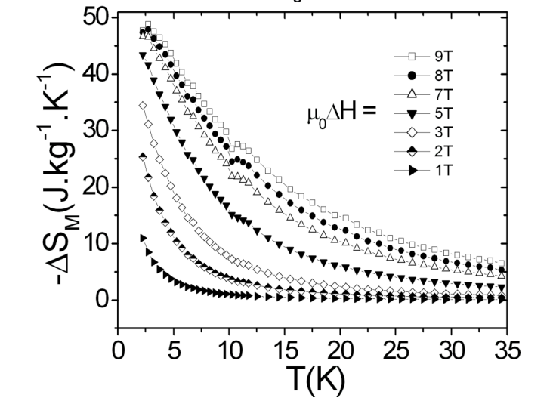
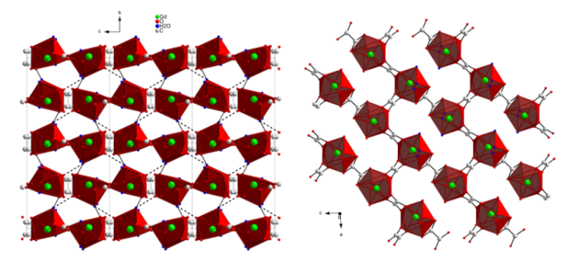
Magnetocaloric Materials
Cryogenic Cooling
  High values of −∆S_{M} ^{max}
  T_{m} appropriate for cryogenic cooling
  Tunable interatomic distances
  Substantial surface (contact) areas
Compound T_{m} (K) −∆S_{M} ^{max} (J kg⁻¹ K⁻¹)
Organic Salts
Gd(HCO₂)₃ 2.0 55 (7T)
Gd(CH₃COO)₃·4H₂O 1.2 40 (7T)
MOFs
[Gd(C₄O₄)(C₂O₄)]·0.5H₂O 2 30 44 (7T)
{[Gd₂(ida)₃]·2H₂O}_{x} 2.0 40 (7T)
[Gd₃₆(NA)₃₆(OH)₄₉(O)₆]_{x} 3.0 40 (7T)
{[Gd₂(OH)₂ (suc)₂]·H₂O}_{x} 1.8 43 (7T)
Gd₂(C₂O₄)₃(H₂O)₆·(0.6H₂O)
H(NA ) = nicotinic acid
H₂ (suc) = succinic acid
H₂ (ida) = iminodiacetic acid
Y-Zh. Zheng et al. Chem. Soc. Rev. 2014, 43, 1462; R. Sibille et al. APL Mater. 2, 124402 (2014)
Notes:
During the last few years, Gd-based hybrid organic-inorganic frameworks have demonstrate quite considerable Magnetocaloric Effects at temperatures around 2K, which makes them promising candidates for applications requiring cryogenic cooling.
A few examples of such solids, which have been published in the literature, are shown on the slide. Although attractive, MOF-like of materials have some downsides due to their limited density and thermal conductivity. However, MOFs are often porous and have large surface area, which increases their cooling efficiency. Furthermore, structures of MOFs can be easily tuned by using appropriate linker molecules or by varying i the preparation conditions.

Slide 6
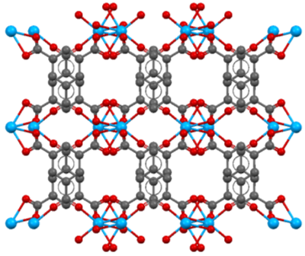
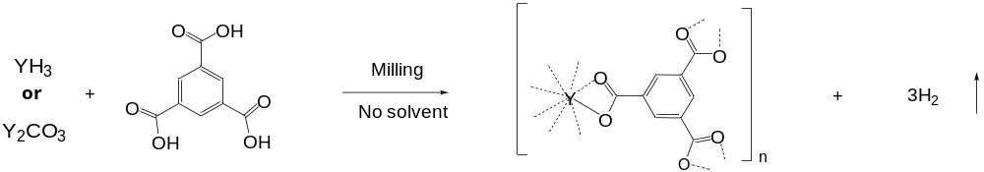
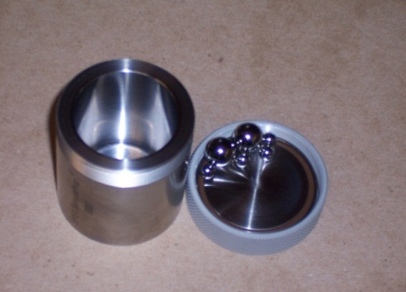
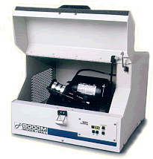
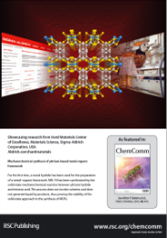
Liquid-Free MOF Synthesis
Y-MOF (MIL-78 structure)
MIL-78
No liquid eutectics or melting
No liquid by-products
No solvents added
N Singh, M. Hardi, V.P.Balema, Chem. Commun., 49, 972 (2013)
Notes:
Luckily, there is another way of making that Metal-Organic Frameworks, which can exclude liquids from the process. Recently, we were able to show that some Rare Earth based MOFs can be prepared by ball-milling of metal hydrides and solid multi-functional organic acids. For our experiments, we used a commercial yttrium hydride and trimesic acid, which were ball-milled in a standard Spex mill shown on the slide.

Slide 7
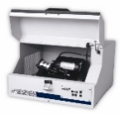
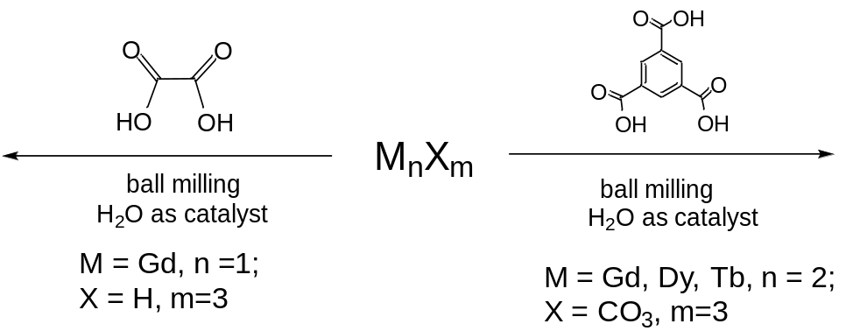

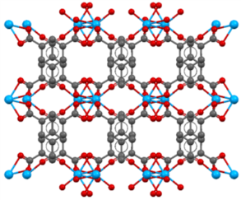

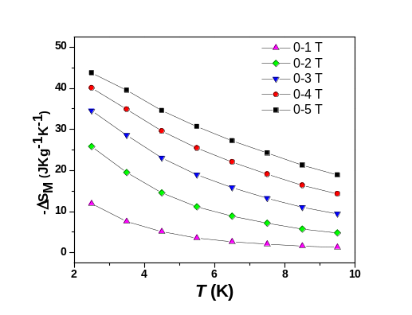
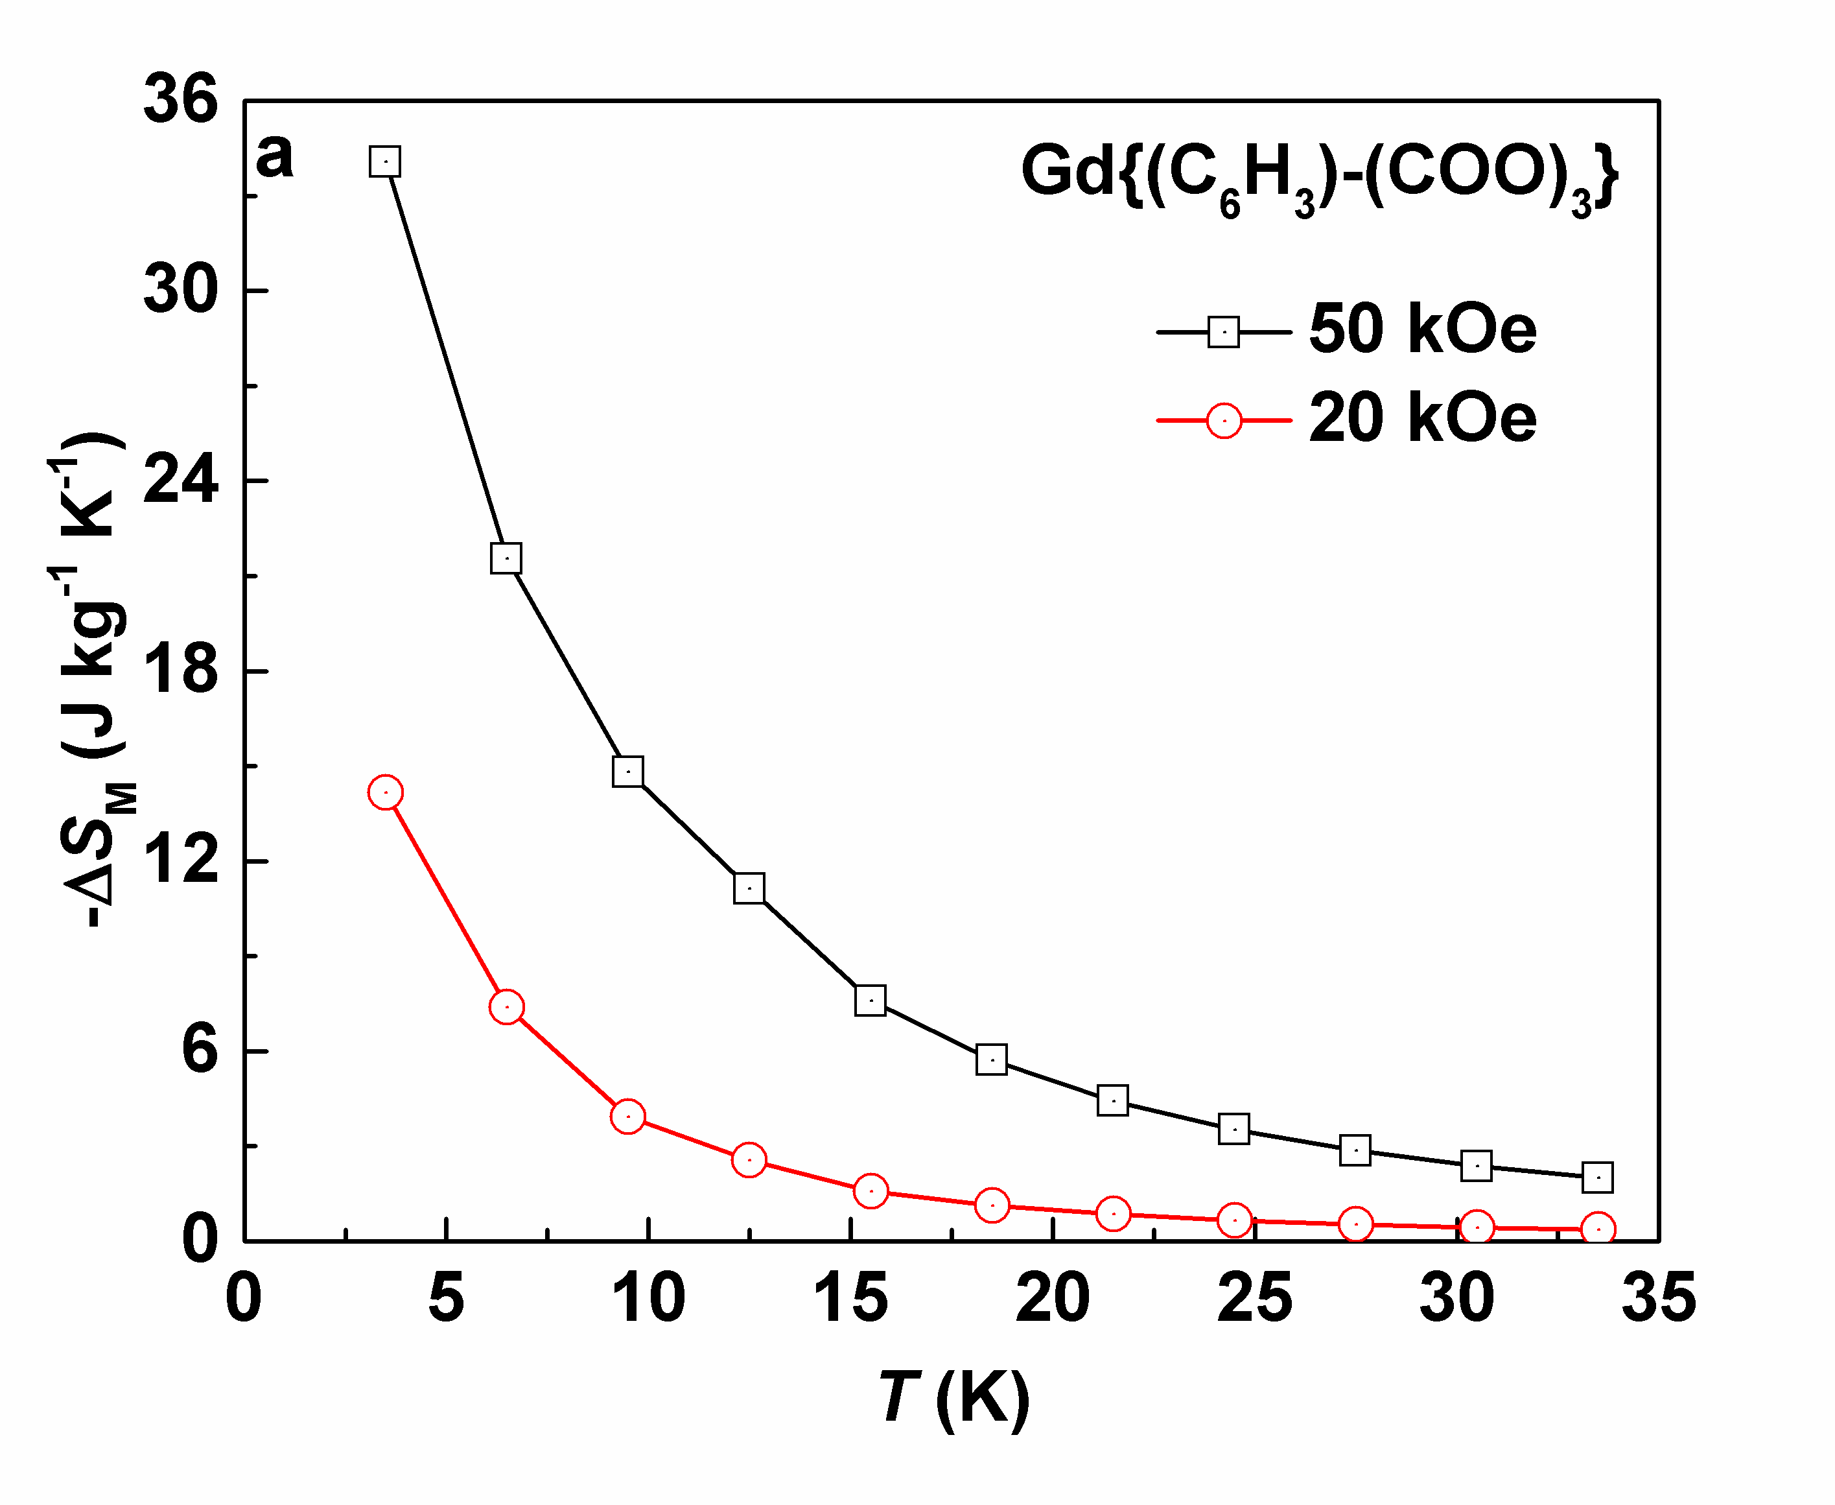
Magnetocaloric Materials
Cryogenic Cooling
Gd₂(C₂O₄)₃ • xH₂O
MIL- 78
Gd₂(C₂O₄)₃ • xH₂O
Solvent-free milling produces materials with a substantial magnetocaloric effect
Materials’ features
  Short range magnetic ordering below 20 K
  No long range ordering above 2K
  Week antiferromagnetic interactions below 2K
Performance is comparable with the best performing materials
. N.K. Singh, V.P.Balema et al. J. Alloys and Compds,, 696, 118 (2017).

Slide 8
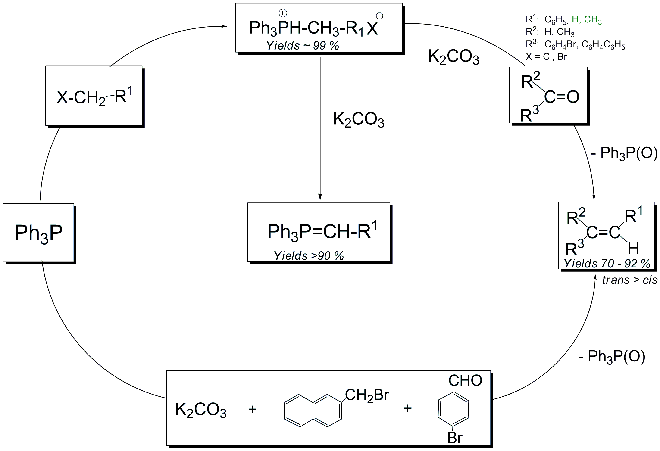
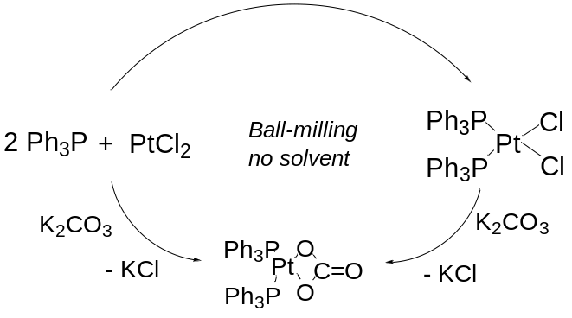

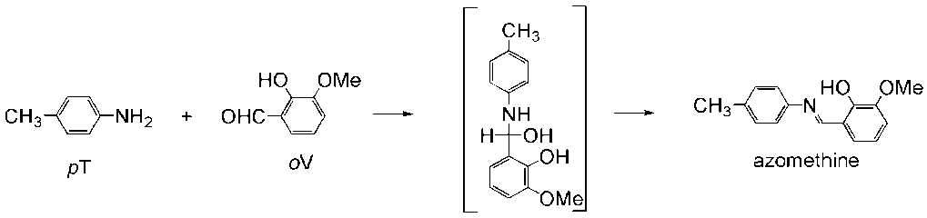
Mechanochemistry
Ph₃P-CH₂-R¹ X
Ball-milling
no solvents
room temperature
Different materials
Similar results
Complex metal hydrides and oxides
Composites, incl. polymer-based
Metal alloys
2D materials
Polymers
V. Balema et al. J.Am.Chem.Soc.124, 6244 (2002); Chem. Commun. 1606 (2002); New J. Chem. 34, 25 (2010); . J. Alloys Compds.313, 69(2000); M. Mamathab et al. J.Alloys Compds,407,78 (2006); K.Chlopek et al.J. Mat.Chem.17, 3496 (2007); H.Brinks et al. J. Phys. Chem. 110, 25833 (2006); V. Volkov et al. Inorg.Chim.Acta 289,51(1999);
Notes:
Mechanochemistry.
Now, I will depart from the exciting field of magnetism and switch to the equally enchanting field of chemistry; specifically to one of the most puzzling area of modern chemistry, which is called Mechanochemistry, under which term I mean chemical transformations in solid materials facilitated by mechanical processing such as milling or grinding.
Although chemical changes happening in molecular (organic) and ionic solids during their mechanical processing have been reported in the literature for since 1960th , the field reached its maturity only recently. One of the major events, which triggered progress in the field was a series of work performed in Ames in early 2000th when we finally managed to show that true chemical transformations can be occur during mechanical milling prior to any other treatment. We also were the first to successfully apply solid state NMR to studying mechanochemical events first in metal hydrides and later in organic materials, and the true pinnacle of our was discovery of a solvent-free Wittig reaction, which belongs to cornerstones of organic chemistry and prior to our work was always carried out in solution. We were also first who showed that hybrid organic – inorganic materials, transition metal complexes, can form during ball-milling of metal salt and organic ligands, which created the foundation for he subsequent work in the area.
During the last decade a lot has been achieved by a joint effort of international research community. Thus a variety of different mechanochemical reactions has been reported. An interesting fact about all these results is that very difficult chemical processes have been run using very similar experimental set up. Ofteny Spex type shakers or classical planetary mills. As a matter of fact, same milling set of could be used for making very different materials with very similar results as shown on this slide where I brought together experiments, which I muself or some other colleagues run in a conventional Spex mill….

Slide 9
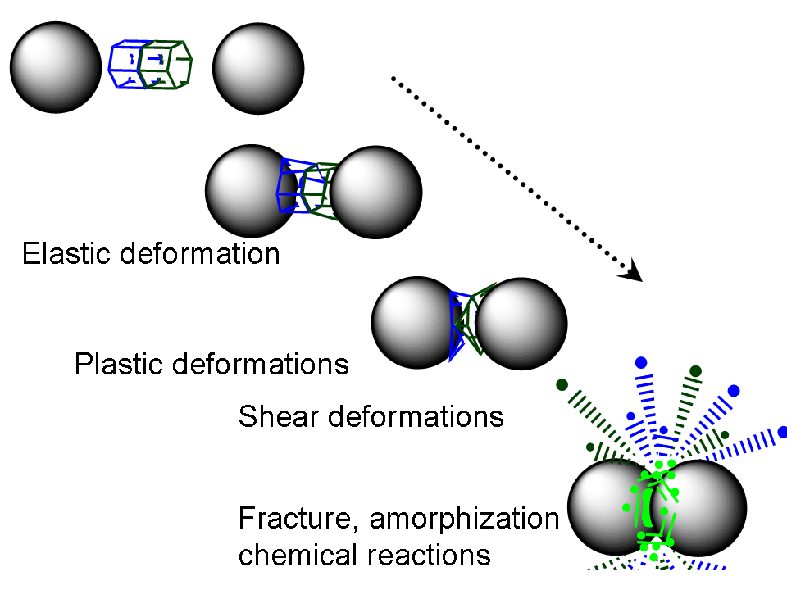
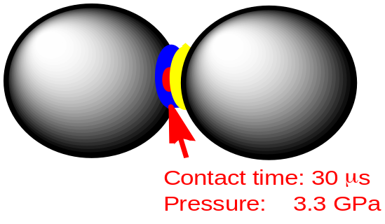
Mechanochemistry
How it Happens?
Is temperature
a factor?
V.P. Balema in Materials Challenges in Alternative Energy, Wiley, 2011, p.25; C.C. Koch, Int. J. Mechanochem. Mech. Alloying 1, 56 (1994) Maurice, et al. Metall. Trans. A 21A, 289 (1990 ); Metall. Trans. A 26A, 2432 (1995); Metall. Trans. A 27A, 1981 (1996 ); F.Fisher et al., Org. Prog. Res. Dev. 21, 655 (2017); H. Kulla et ai., Chem. Commun. 53, 1664 (2017).

Slide 10
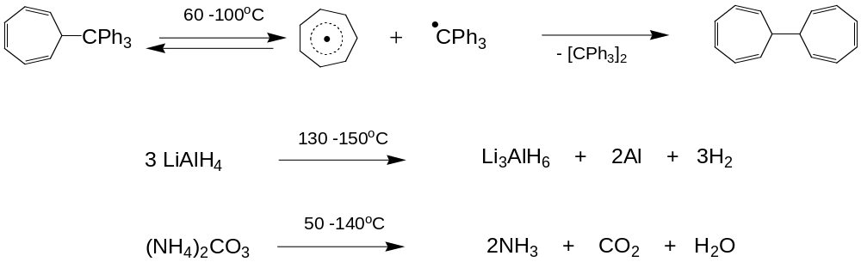
Mechanochemistry
How it Happens?
Stable during milling!
(NH
4
)
2
CO
3
¹³C MAS NMR
(NH₄)₂CO₃
DTA
ball-milled for 20h
exo
as is
endo
ball-milled for 20h
NH₂(NH₄)CO₂
CO₂
TGA
Δ
m
as is
50
100
150
C
200
250
200
150
ppm
100
Temperature
o
V. P. Balema et al. Phys.Chem.Chem.Phys. 7, 1310 (2005); Komatsu, K. Top. Curr. Chem. 254, 185 (2005)

Slide 11
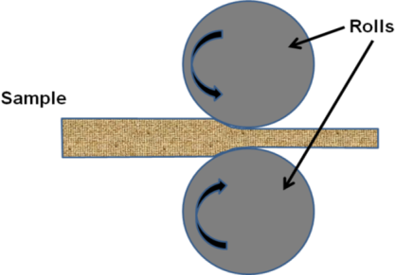
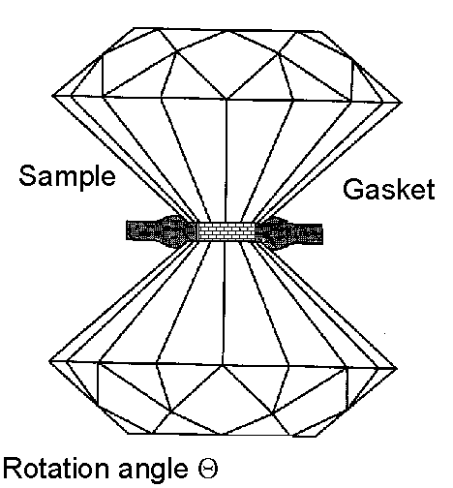
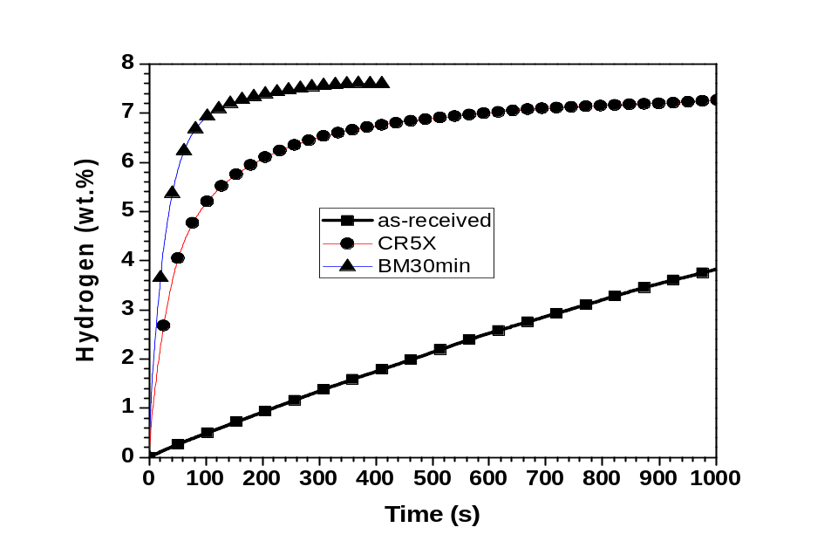
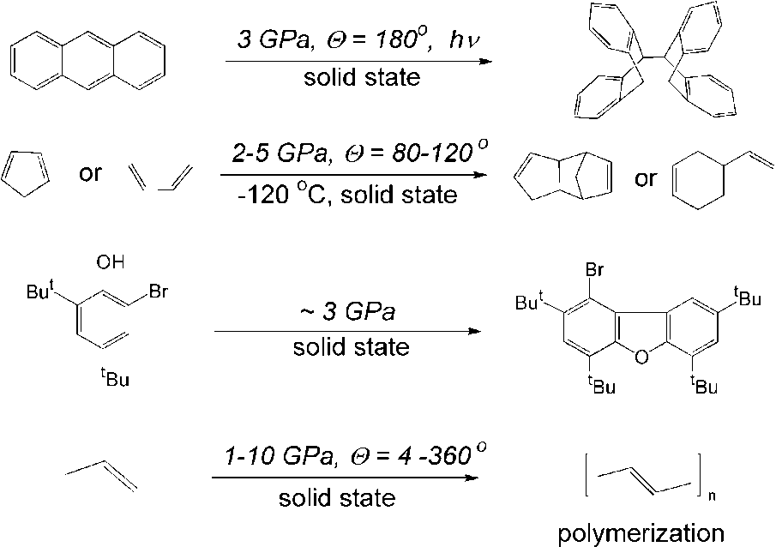
Mechanochemistry
How it Happens?
Severe deformations are probable drivers of chemical transformations observed
Mg + H₂ = MgH₂
Bridgeman’s anvil
Material: diamond or boron nitride
Pressure: up to10 GPa
H₂ absorption by Mg: as-received, cold rolled and ball-milled; 623K, 2MPa H₂
J. Hout, V.P. Balema, Material Matters 5 (4), 112 (2010). A. Zharov in High Pressure Chemistry and Physics of Polymers, Ed.: A.L. Kovarskii, CRC Press, Boca Raton, 1994, 267 p.; A.Politov et al. Doklady Phys. Chem. 371, 28 (2000)

Slide 12
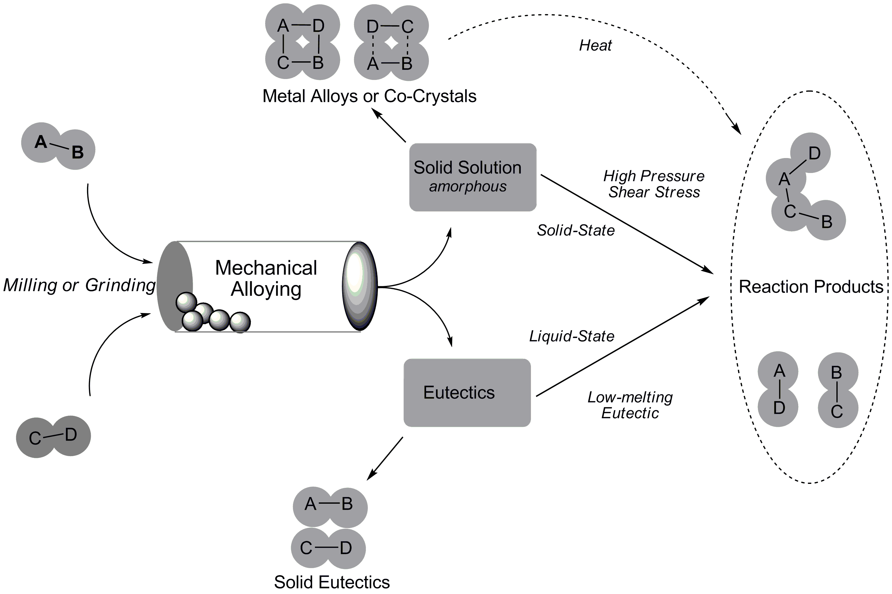
Mechanochemistry
How it Happens?
Plastic Deformations
LAG
V.P. Balema in Materials Challenges in Alternative Energy, Wiley, 2011, p.25

Slide 13
Takeaways
Gd–based 3D hybrid networks are promising materials for Magnetic Refrigeration at cryogenic temperatures
Mechanochemistry offers a simple and scalable way of making hybrid magnetocaloric materials
Severe plastic deformations are probably responsible for the formation of REE MOF structures upon mechanical milling without solvents.
Notes:
Major takeaways from our preliminary research results are shown on the slide…
First, they confirmed that that Gd–MOFs are indeed promising material for Magnetic Refrigeration in cryogenic region
The material prepared and studied together with our collaborators in Ames Lab showed a very encouraging MCE
And, Solvent-free mechanochemistry proved to be a simple and scalable way of making hybrid magnetocaloric materials
Finally, it is safe to say that Current status of mechanochemistry allows controllable design of new generations of caloric materials
And why I think such a statement has a lot of merit, I will explain in the second part of my talk.

Slide 14
Acknowledgment
Ames Laboratory of US DOE
Vitalij Pecharsky
Alexander Dolotko
Yaroslav Mudryk
Marek Prusk
Shalabh Gupta
Sigma-Aldrich (now MilliporeSigma)
Niraj Singh
Samuel Taylor
CaloriCoolTM is supported by the Advanced Manufacturing Office of the Office of Energy Efficiency & Renewable Energy and managed jointly through the Advanced Manufacturing and Building Technologies Offices of the U.S. Department of Energy. Ames Laboratory is operated for the U.S. Department of Energy by Iowa State University of Science and Technology under Contract No. DE-AC02-07CH11358. Initial work was supported by Aldrich Hard Materials, Sigma-Aldrich Corporation.
Notes:
e

