Slide 1
Assessment of Groundwater Quality and its Suitability for Irrigation and Drinking Purposes
Dr. Venkata Ramana Rao Narapraju
Professor of Civil Engineering & Registrar
JNTUH , Hyderabad , India
E-mail : rao.nvr@gmail.com
Dr. Kasi Viswanadh Gorthi
Professor of Civil Engineering &
OSD to Vice-Chancellor , JNTUH, Hyderabad , India
Email : gkviswanadh@jntuh.ac.in

Slide 2
Contents – presentation outline
Introduction
Study area
Methodology
Results and Discussions
Conclusions

Slide 3
Introduction
Groundwater has emerged as the primary democratic water source and poverty reduction tool
Due to its low capital cost, it is the most preferred source of water in India.
Ground water has made significant contributions to the growth of India’s Economy and has been an important catalyst for its socio economic development.
Its importance as a precious natural resource in the Indian context can be gauged that more than85 % of India’s rural domestic water requirements, 50% of its urban water requirements and more than 50% of its irrigation requirements are met from G.W resources.

Slide 4
Coastal aquifers prove to be an important source of ground water resource.
Seawater is the most common pollutant of fresh water in coastal aquifers
Seawater intrusion in fresh water aquifers- Results from the activities of Man.
Excessive ground water pumping
  Deterioration of water quality
  Dictating expensive remedies

Slide 5
Stress on groundwater, both in terms of quality and quantity, are increasing rapidly to growing demands, significant changes in land use pattern, sea water intrusion, industrial effluents, domestic effluent etc.
The need to assess the groundwater quality is becoming increasingly important as groundwater sources become more and more contaminated by seawater intrusion, industrial effluents and unsustainable agricultural practices.

Slide 6
Goal of coastal aquifer management – Maximize fresh water extraction without causing invasion of salt water into the wells.
Mathematical models provide a quantitative frame work for analyzing data from monitoring and assess quantitative responses of the groundwater systems subjected to external stresses

Slide 7
Study area – Chittoor District
Chittoor district is one of the chronically drought affected. It covers a geographical area of 15,152 sq. km and situated between 12° 37’ and 14°00’ North latitudes and 78°03’ and 79°55’ Eastern longitudes.
The district receives moderate rainfall. Failure of monsoons during the last few years lead to failure of bore wells and failure of crops.
The soils of the district on the basis of village records are 57% Red loamy soils, 34% red sandy soils. The remaining 9% is covered by black clay (3%), black loamy (2%), black sandy (1%) and red clayey (3%).

Slide 8
Rainfall
The annual rainfall of the district is 943 mm, which ranges from 600 mm at Molakacheruvu mandal to 1280 mm at Sri Kalahasti mandal.
In the district level, the cumulative departure of annual rainfall was scanty i.e., more than 60% below normal, in 35 mandals and deficit i.e., below normal by 20% and 59% in 11 mandals.
In the remaining 20 mandals the rainfall was above normal.
On an average, the district rainfall condition was deficient by 61% from normal.

Slide 9
Groundwater
Chittoor district is absolutely dependant on ground water for its irrigation and domestic needs.
Out of the total irrigated land, 84.34% area is irrigated through 1,16,623 dug wells, 19,849 shallow bore wells and 28,933 deep bore wells.
For irrigation purpose, there are 12,618 diesel engines and 99,402 electric pumps in the district.
Drinking and domestic requirements of 10804 habitations are met through 6229 PWS & MPWS schemes and 20,368 bore wells.

Slide 10
Groundwater
The overall stage of ground water development of the district is 72% and categorized as semi-critical.
Out of the total 66 mandals, only 28 mandals are under safe category and 11 mandals are categorized as semi-critical category.
There are as many as 781 villages declared as over-exploited villages out of 1540 revenue villages.

Slide 11
Irrigation
As such, there are no existing major irrigation projects in the district.
Though there are some ongoing irrigation projects, no irrigation through surface water except tank irrigation is being practiced.
Only, 15% of area is irrigated through surface water under tanks.
About, 84% of the irrigated area is through ground water, out of which 66% is by bore wells.

Slide 12
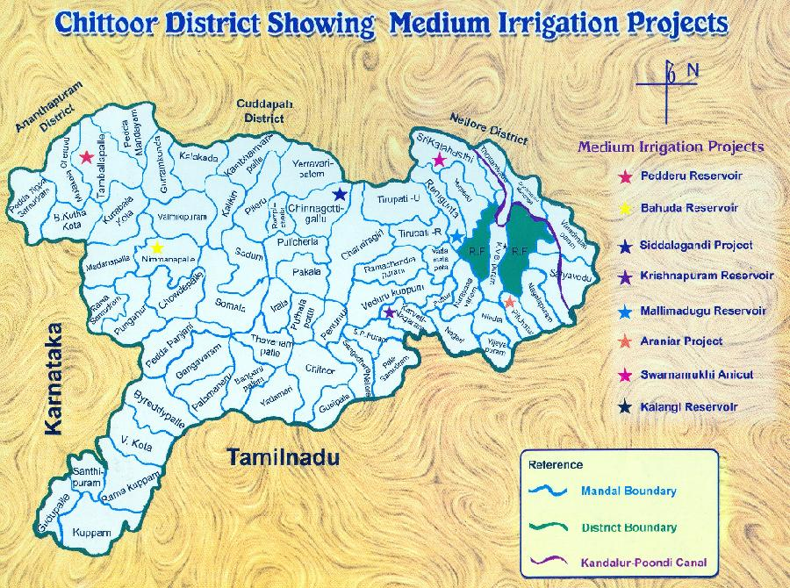

Slide 13
Water resources
The net ground water availability in the district is 1450.10 MCM.
Ground water utilization is 1038.25 MCM and the ground water balance for future irrigation development is 411.85 MCM.
The stage of ground water development arrived at 72% and hence the district falls under semi-critical category.

Slide 14
Based on the stage of development, 28 mandals are categorized as safe, 11 as semi-critical, 9 as critical and 18 as over-exploited.
The minimum stage of ground water development is in B.N. Kandriga (20%) and the highest development is in Tirupati (Rural) (98%).
Penumuru mandal of Chittoor district has 38% of excess rainfall and has been categorized as over-exploited as per stage of ground water development

Slide 15
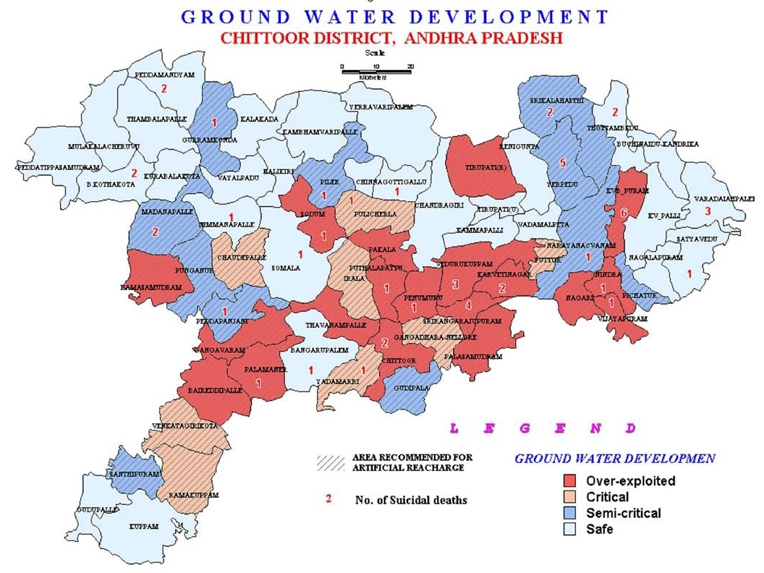

Slide 16
Study Area
Penumuru Mandal in Chittoor District of Andhra Pradesh State, India. belongs to Rayalaseema region and is located 24 KM towards North from District head quarters Chittoor, 530 KM from State capital Hyderabad towards North.
Penumuru Mandal is bounded by by Puthalapattu Mandal towards west, Pakala Mandal towards North, Gangadhara Nellore Mandal towards South, Vedurukuppam Mandal towards East.
Penumuru mandal consists of 169 Villages and 24 Panchayats. Thathireddipalle is the smallest Village and Penumuru is the biggest Village.

Slide 17
The quality of groundwater has been studied by collecting water samples from five villages of Penumuru mandal namely Matampalli, Gangupalli, Nanjarpalli, Satambakam & Settipalli in the month of January, 2014.
Twenty samples have been collected out which 19 have been collected from bore wells and 1 from Open dug well.
These samples are analyzed for groundwater quality for the following parameters/ions, viz., pH, EC, TH, DO, Na, K and Alkalinity.

Slide 18
Objective
The objectives of present work are as follows:
To analyse groundwater quality for the following parameters/ions, viz., pH, EC, TH, DO, Na, K and Alkalinity.
To assess groundwater quality and its suitability for irrigation and drinking purposes.

Slide 19
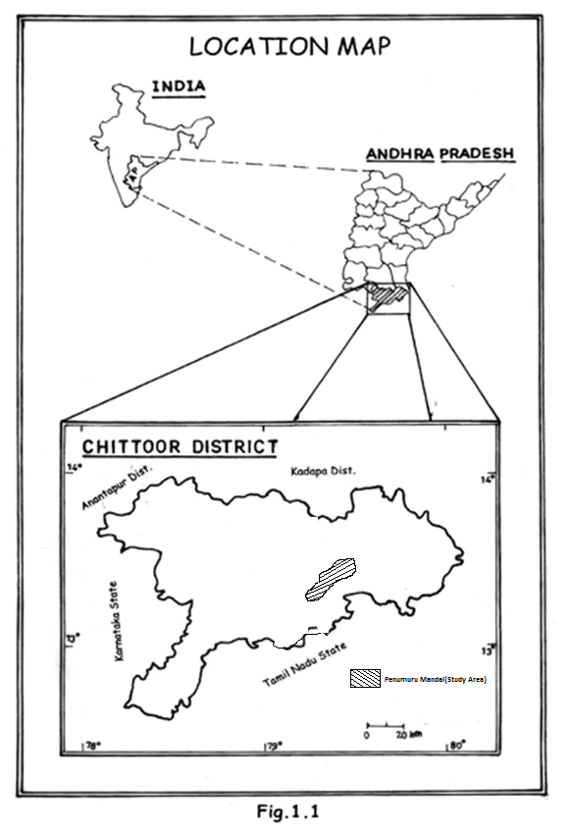
Fig. Study Area

Slide 20
Methodology
The rainfall data was collected from the groundwater department and the water samples have been collected from the bore wells of the fields. The samples were analyzed for different ion concentration. The methodology includes
Collection of hydrology particulars of wells
Collection of rainfall data
Collection of water samples
Analysis of collected water samples.

Slide 21
Results and Discussions
Water samples were analyzed and the obtained values were compared with standard values.
The drinking water standards of WHO (1971 and 2006) and Bureau of national standards (1983 and 1991) was the basis for the groundwater quality evaluation for drinking purpose.
The chemical analysis of the samples for the following parameters/ions, viz., DO, pH, TH, EC, Na, K and Alkalinity are given in Table 1.

Slide 22
S. No. | Sample No. | Village | DO (mg/l) | pH | TH (mg/l) | EC (μS/cm) | Na (mg/l) | K (mg/l) | Alkalinity (ppm)
1 | PM1 | Matampalle | 2.8 | 7.3 | 360 | 1200 | 318 | 3.0 | 765
2 | PM2 | Matampalle | 1.8 | 7.2 | 350 | 1260 | 320 | 1.5 | 1155
3 | PM3 | Matampalle | 5.0 | 7.2 | 425 | 1260 | 320 | 2.2 | 725
4 | PM4 | Matampalle | 4.2 | 7.1 | 430 | 540 | 314 | 1.4 | 760
5 | PM5 | Matampalle | 6.0 | 7.1 | 760 | 1740 | 309 | 1.6 | 340
6 | PN1 | Nanjarpalle | 8.0 | 7.3 | 405 | 960 | 390 | 6.0 | 380
7 | PN2 | Nanjarpalle | 9.0 | 7.2 | 465 | 880 | 386 | 5.2 | 540
8 | PG1 | Gangupalle | 5.4 | 7.1 | 325 | 660 | 284 | 4.1 | 670
9 | PG2 | Gangupalle | 5.4 | 7.2 | 355 | 780 | 300 | 4.5 | 745
10 | PG3 | Gangupalle | 8.0 | 7.4 | 455 | 680 | 300 | 4.4 | 710
11 | PS1 | Satambakam | 8.0 | 7.5 | 265 | 600 | 190 | 0.5 | 855
12 | PS2 | Satambakam | 8.4 | 7.5 | 300 | 620 | 188 | 0.8 | 895
13 | PS3 | Satambakam | 9.2 | 7.4 | 330 | 580 | 175 | 1.2 | 710
14 | PS4 | Satambakam | 5.4 | 7.2 | 310 | 580 | 178 | 1.0 | 660
15 | PS5 | Satambakam | 7.4 | 7.1 | 275 | 640 | 194 | 1.1 | 690
16 | PS6 | Satambakam | 7.6 | 7.2 | 740 | 620 | 194 | 1.6 | 520
17 | PSC1 | Settipalle | 9.8 | 7.1 | 230 | 200 | 74 | 1.0 | 460
18 | PSC2 | Settipalle | 8.2 | 7.2 | 325 | 540 | 102 | 1.5 | 835
19 | PSC3 | Settipalle | 9.0 | 7.4 | 530 | 200 | 84 | 1.1 | 520
20 | PSC4 | Settipalle | 8.2 | 7.2 | 340 | 360 | 82 | 2.3 | 675

Slide 23
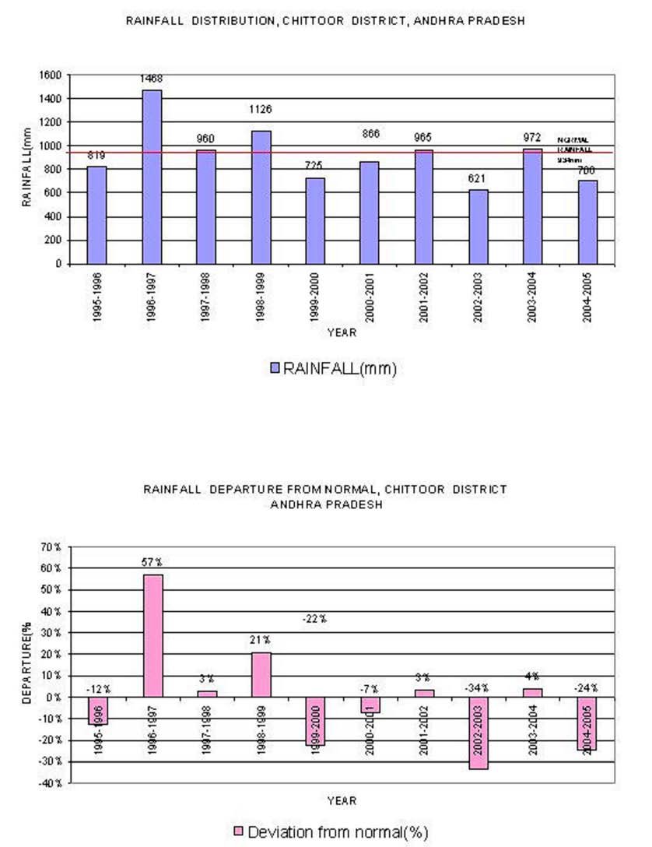

Slide 24
Dissolved Oxygen:
DO value in the majority of study area is between 4-8mg/l, and is within permissible limit. Matampalle village is having DO value less than 4mg/l, it will not suit for aquatic life.

Slide 25
pH: pH value represents the concentration of hydrogen ions in water and is measure of acidity and alkalinity of water. pH value below 7.0 indicate acidic character while pH greater than 7.0 is indicative of alkaline character of water.
The average value for the study area is 7.2, the water is slightly alkaline. However pH values is within permissible limit.

Slide 26
Total Hardness: Hardness is attributed principally to Ca and Mg. Hardness is also considered as total hardness is expressed in mg/l of equivalent CaCO3.
Most of the study area is having hard water as hardness is more than 300 ppm. Settipalle village has been reported of hardness more than 500 ppm.

Slide 27
Electrical Conductivity:
The EC value in the area of study ranges between 500-1000 μS/cm. The average value of EC is 745 μS/cm.

Slide 28
Sodium:
The average value of sodium obtained in the study area is 235mg/l which is more than the permissible value.

Slide 29
Potassium:
The average value for potassium in the study area is 3.4.

Slide 30
Alkalinity:
Normal range of alkalinity in the area of study is 500-1000mg/l and the average value is 680mg/l. Alkalinity is quite high and it shows higher resistance towards changes in pH.

Slide 31
Conclusions
The quality of groundwater plays a significant role in the crop productivity and human as well as cattle health.
Chemistry of groundwater in the area is studied with respect to the major cation, sodium and potassium.
Chemically related properties such as pH, TDS, TH are also discussed.

Slide 32
Conclusions….
Dissolved oxygen content is within the permissible limit except in Matampalli village and its range in study area is in between 4-8mg/l.
pH value in the study area is slightly higher.
Total Hardness and Alkalinity are more than the permissible limit, water is not good for industrial purposes as it is hard, it can be used for domestic purposes as there is no considerable health effect due to hardness.

Slide 33
Conclusions…..
Alkalinity is just a measure of acid neutralizing capacity of water so even its higher value is not harmful for its use in drinking and irrigation purpose.
Normal range of alkalinity in the area of study is 500-1000mg/l and the average value is 680mg/l.
Alkalinity is quite high and it shows higher resistance towards changes in pH.
Sodium is slightly more than the permissible limit.
The average value of sodium obtained is 235mg/l which is more than the permissible value.

Slide 34
Conclusions….
Normal range of alkalinity in the area of study is 500-1000mg/l and the average value is 680mg/l.
Alkalinity is quite high and it shows higher resistance towards changes in pH.
Sodium is slightly more than the permissible limit.
The average value of sodium obtained is 235mg/l which is more than the permissible value.

Slide 35
Conclusions….
Failure of the monsoon leads to less recharge to ground water and more draft from ground water reservoir.
As a result, water levels are declined, which lead to drying up of dug wells in many of the mandals and also in reduction of yields of bore wells.
This necessitates construction of additional bore wells to provide water to the standing crop. More often, the new bore wells are likely to be a failure because of absence/de-saturation aquifers.

Slide 36
Conclusions….
In the over exploited areas, large-scale artificial recharge to ground water has to be taken up at appropriate places on scientific lines, involving all stakeholders.
Maintenance of these structures should be made mandatory by providing budget.

Slide 37
Conclusions….
Mass awareness programmes should be conducted in rural areas to educate the farmers regarding the ground water management to update their knowledge.
Training for local government functionaries, NGOs, voluntary Organizations in watershed management activities needs to be imparted on the scientific techniques in selection of site, design of structure, etc. for construction of artificial recharge structure.

Slide 38
Thank you!!!

