Slide 1
Utku Buyuksahin, Ph.D.
CTO, Sensobright Industries LLC.

Slide 2
About us
Tactile Sensors
Our Technology
Questions

Slide 3
About us
Company Profile
Sensobright Industries LLC. is a technology-oriented small business company with an innovative concept and aim to advance it, translate it into a next generation scientific product and a technology for commercialization, and profit from it.
Asst. Prof. Utku Buyuksahin, Ph.D. is the founder, the majority shareholder, technology adviser, and the CTO (Chief Technology Officer) of Sensobright Industries LLC.
Dr. Buyuksahin has teamed up with Inventram to ramp up commercialization and develop tactile sensor technologies. Inventram (http://www.inventram.com/en/investment-portfolio/54/multi-point--high-sensitive-tactile-sensing-module-for-robots-and-devices), a wholly owned subsidiary of Koc Holding (www.koc.com.tr/en-us), invests equity in technology and innovation based start-ups and provides acceleration in IP management and commercialization with the best possible business models.
The City of Portland, Oregon is the location of the company and its operations.

Slide 4
About us
CTO
Dr. Buyuksahin received the B.S. and Ph.D. degree in mechanical engineering from Yildiz Technical University, Istanbul, Turkey in 2004 and 2010 respectively. He received another B.S. degree in business administration in 2007. His main interest areas are; robotics, sensors, image processing and motion control. He has received many awards and has over 30 technical publications, including a book and a book chapter. He holds total number of 6 patented and patent pending inventions. He has accomplished over 70 projects (all mechanical designs, manufacturing, electronic designs and applications, software developments) including, 3 axes CNC Milling Machine, 6 DOF. Stewart Platform for 8D Cinemas, Vehicle simulators, 11 DOF. Hepa Filter Test Robot etc.
Relevant publications
Patent Buyuksahin U., Multi Point, High Sensitive Tactile Sensing Module For Robots And Devices. US9030653B1, WO2014011126
Book Chapter Buyuksahin U., “Webcam: A Multi-Function Sensor” Comprehensive Materials Processing Volume 13. Sensor Materials and Technologies pp 375-392. Vision Based Sensors Technologies –Elsevier, ISBN 978-008- 09653-21, (2014)
Conference Papers Kırlı A., Buyuksahin U., “Fuzzy Logic Modeling of Transparent and Elastic Silicone Pad for a New and Novel Optic Based Tactile Sensor”, 14th International Conference On Advances In Materials & Processing Technologies, Dubai, United Arab Emirates, 2014
Buyuksahin U., Kırlı A., “Multi Point, High Sensitive Tactile Sensing Module for Robots and Devices”, IEEE SENSORS 2014 Conference, 2014

Slide 5
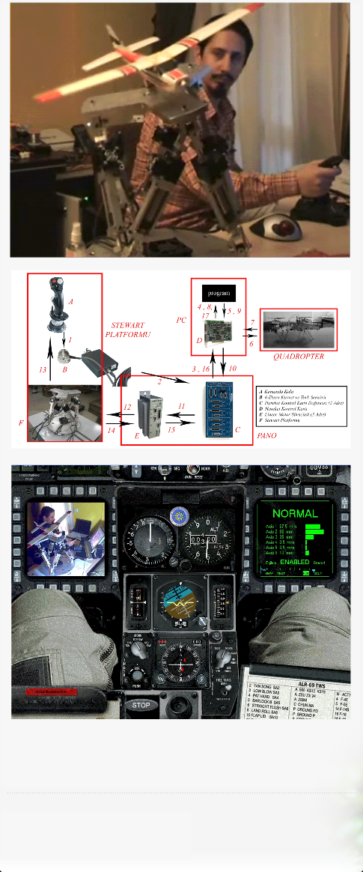
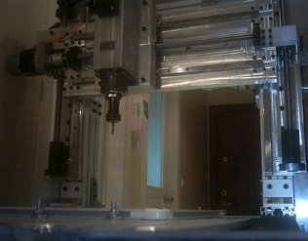
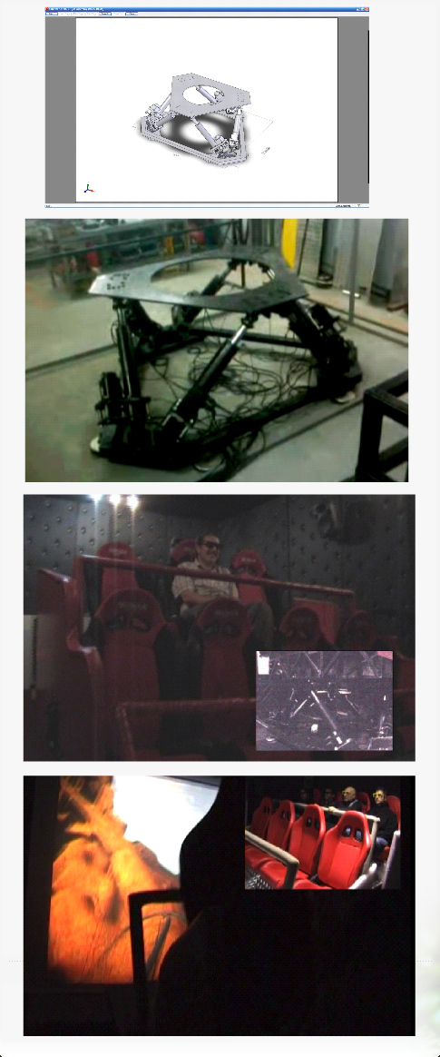
Former Projects

Slide 6
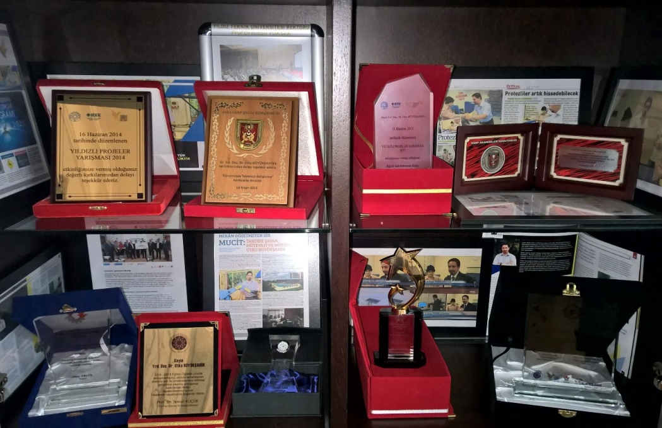
Awards
Prize Winning Technology

Slide 7
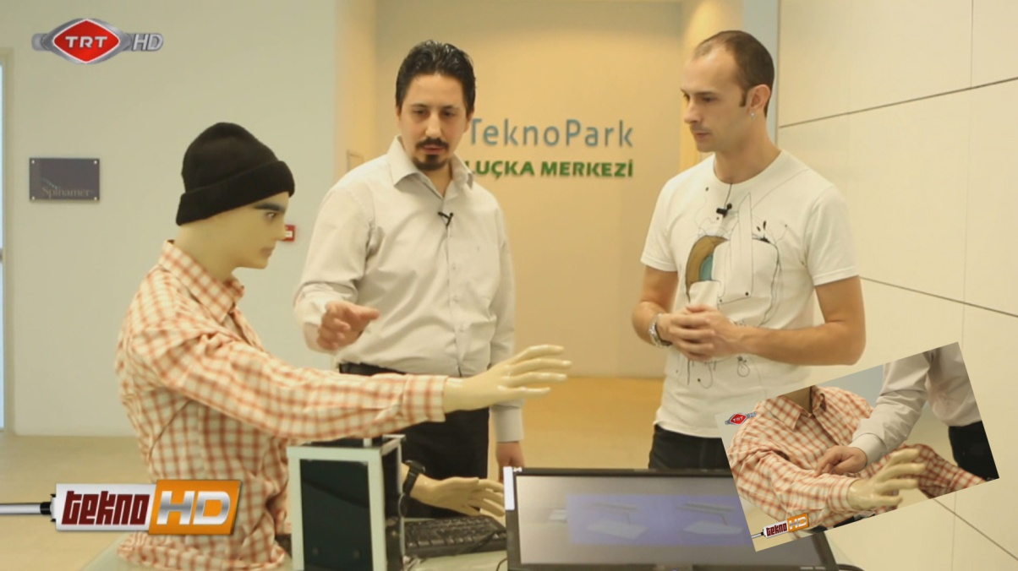
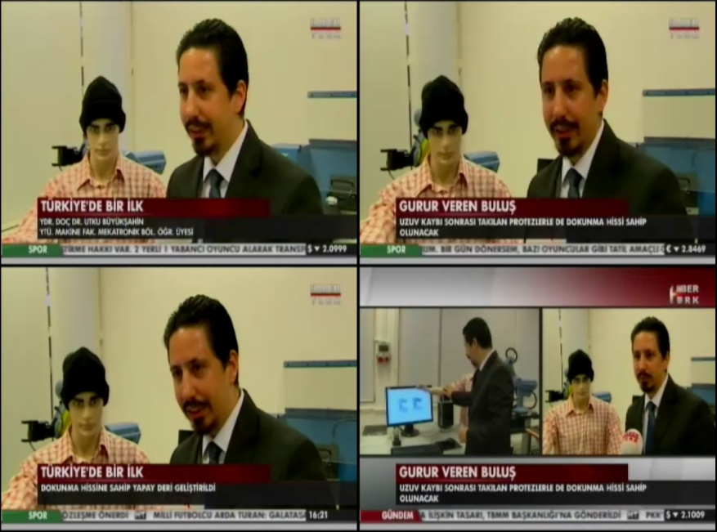
TV Shows / NEWS
TV Shows
Prime Time NEWS
Technology Programs

Slide 8
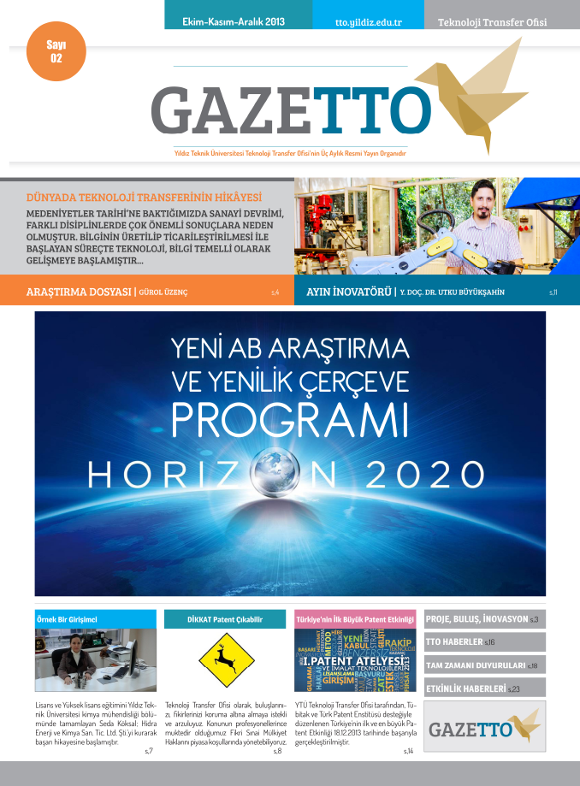
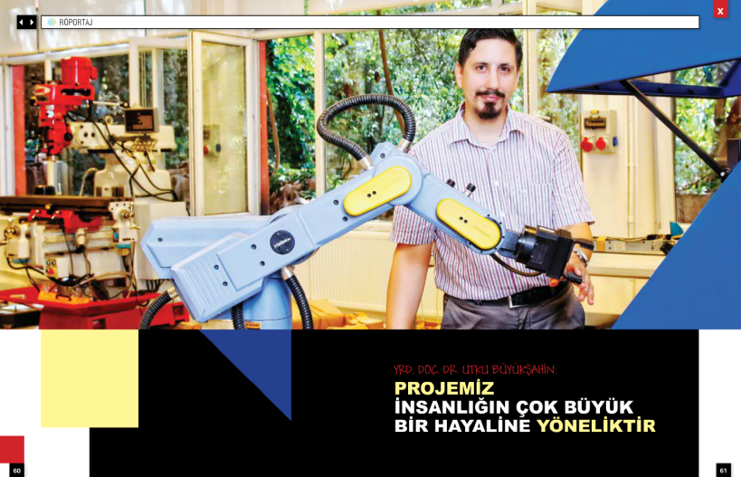
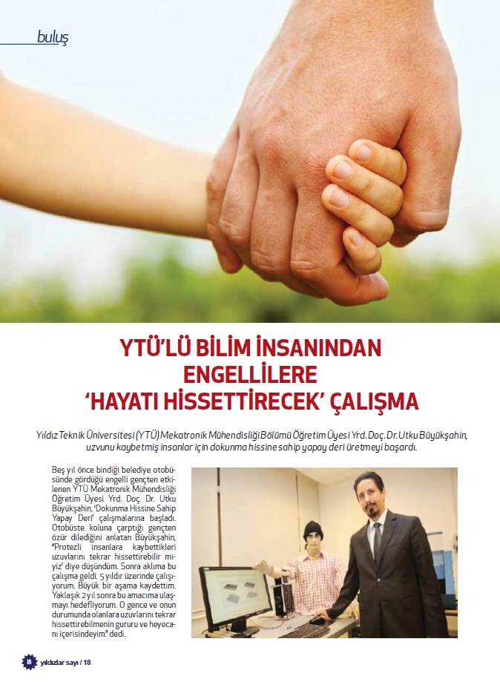
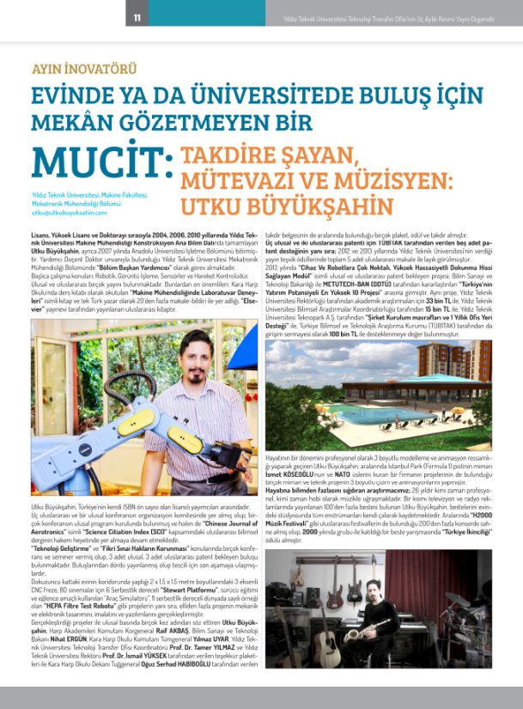
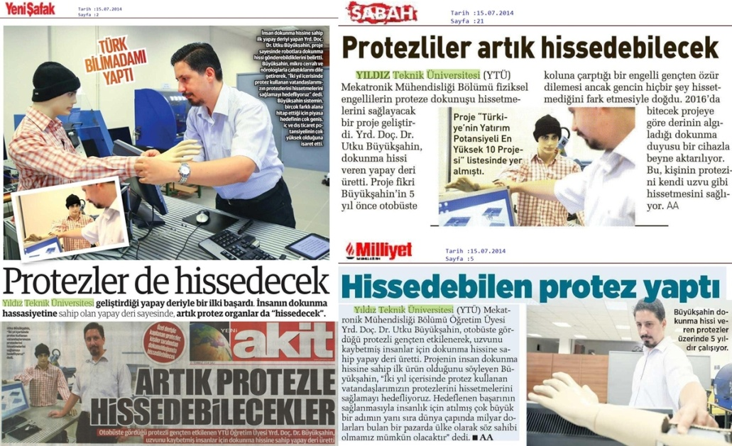
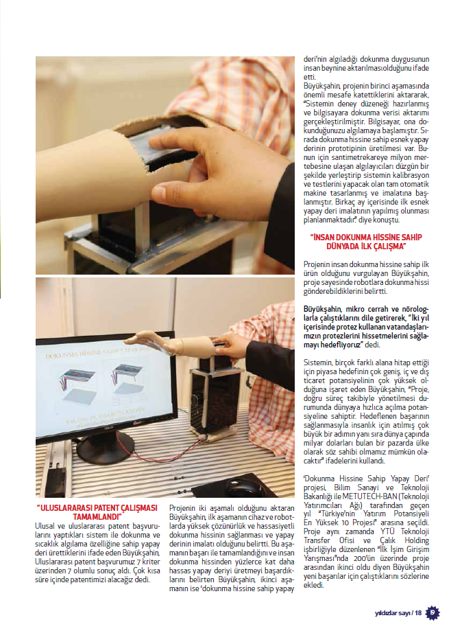
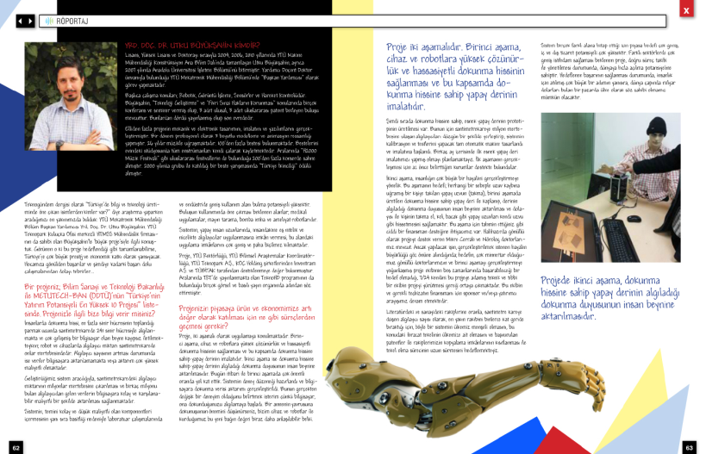
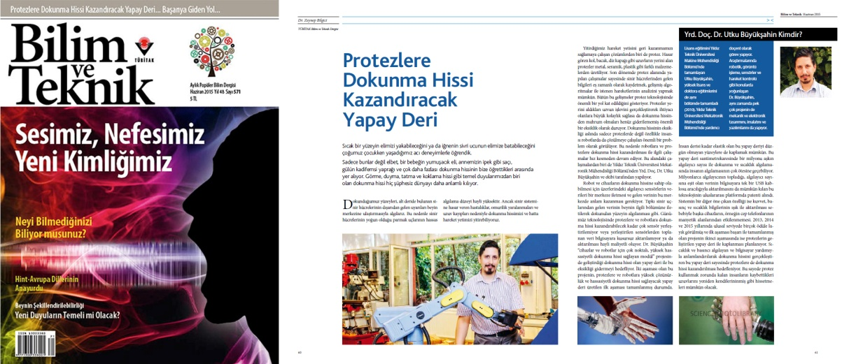
Magazines /
Newspapers
Magazines
Newspapers
Technology Magazines

Slide 9
Tactile Sensors
It is well known that automation mimics the human body. It is also observed that the computation systems of the data acquisition from sensors are basically a simple copy of human brain as well as the sensors are the simple copies of the receptors of the human body. As the biggest sensory system of the human body is its skin that covers the body, tactile sensing is useful in a wide variety of haptics applications for robotics and space technology.

Slide 10
Tactile Sensors
Most of the former robotic systems and devices can only provide the equivalent of kinesthetic sensing with force/torque sensors. Later ones use tactile sensors in order to extract properties of environment and interactions, using only cutaneous information acquired from these sensors.
Flaws of tactile sensing systems are summarized as follows,
Short number of tactile sensing unit/element per measurement area
Low spatial resolution
High costs for data acquisition of excessive analogue inputs
Computational burden
Bulky structure
Noise arising from analogue measurement
Perturbation problems at highly magnetic fields

Slide 11
Tactile Sensors
Sensobright’s products and technologies will provide a solution to a problem of current dexterous hand/grasping manipulation systems, which are typically incorporate position and torque sensing at the joints and have a limited number of sensors in fingers and palm, without enough sensory coverage to localized contact information, those systems couldn’t provide cutaneous sense of touch.

Slide 12
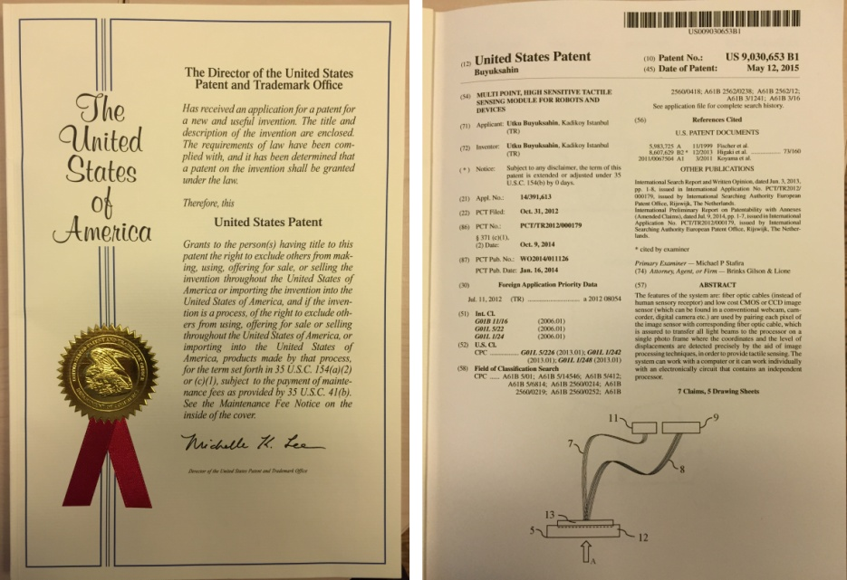
Our Technology
Due to our patented invention “Multi Point, High Sensitive Tactile Sensing Module for Robots and Devices” (US9030653B1), the number of tactile sensory receptors per centimeter square can be increased up to one million. The system also has the ability of temperature measurement in case needed.

Slide 13
Our Technology
The Key Features of the System
Very High Resolution: Single sensor receptor diameter is 9 microns, which corresponds to over 1 million receptors per cm². For average human, the densest receptor area is at fingertips which has approximately 241 tactile receptors per cm². Although the objective was 241 tactile receptors per cm² (1555 tactile receptors per inch²), with our technology over 1 million receptors per cm² could be achieved.
Force, Shape, Temperature and Multi-multi-touch-point Information: The system can measure applied force by Young Modulus phenomenon. Information on temperature and shape of deformation (i.e. can identify sharp objects) are also available. Available number of individual touch sensing data is equal to the number of receptors, which can expand to 1 million per cm². (For example on the other side smart phones and tablets’ touch pads can process a total of 11 touch points at a time.)
Skinlike Flexible Design: Can be used as human like tactile sensing artificial skin for robotics and other devices. System is constructed of all bendable materials which give us the chance of covering non-uniform shaped mechanical systems.

Slide 14
Our Technology
The Key Features Of The System ( Continued )
Compact Data Transfer: Sensor data is collected by a standard CMOS or CCD sensor and can be easily transferred over USB or Network Connection. System sends the gradual (not only I/O) tactile sensing data of each sensor individually and real time over a single USB cable which can reach up to total of 50 M+ sensor data with only 1 USB cable.
Low Power Consumption: Low processing requirements, as data from the CMOS or CCD can processed as a compact image.
Over-the-counter Components: The system is built up with only components that are common and easy to provide
No Interference: As the tactile sensing and temperature data is transferred by light, the system does not interfere with magnetic fields.

Slide 15
Our Technology
Performance Test Results
# of Receptors | # of CMOS/CCD | Sensor Frequency***
100 | 1 | Limited to CMOS/CCD frequency
241 | 1 | Limited to CMOS/CCD frequency
1,000 | 1 | Limited to CMOS/CCD frequency
10,000 | 1 | Limited to CMOS/CCD frequency
100,000 | 1 | Limited to CMOS/CCD frequency
1,000,000+ * | 1 ** | ****
* depends on the CMOS/CCD technology: the #of receptors can be 50,000,000+ per CMOS/CCD.
** incase needed, more than one CMOS/CCD can be used in one sensor bundle.
*** depends on the CPU processor speed and the image processing method used in the software. (through the tests, a 32-bit 3,2 GHz processor is used)
**** through the tests, a standard full HD webcam CMOS (supports up to 2,073,600 receptors) with the maximum frequency of 30 Hz is used.

Slide 16
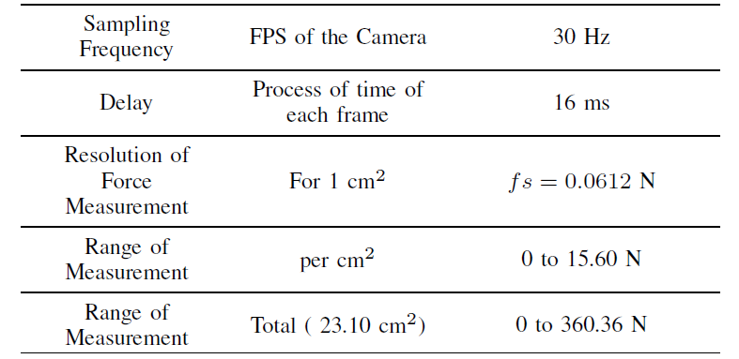
Our Technology
Sensitivity Test Results

Slide 17

Our Technology

Slide 18
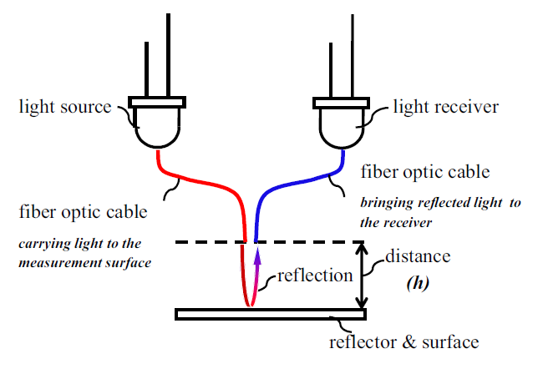
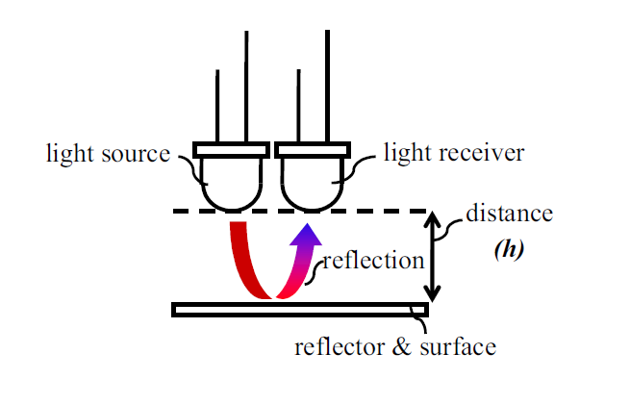
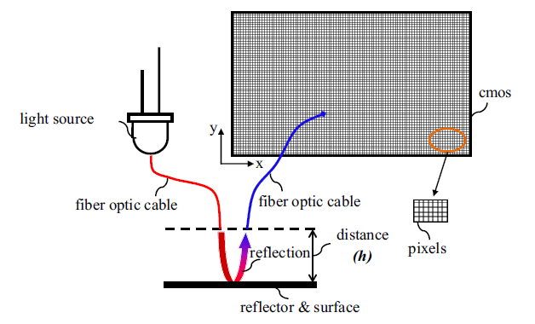
Our Technology
Working Principles
of the System

Slide 19
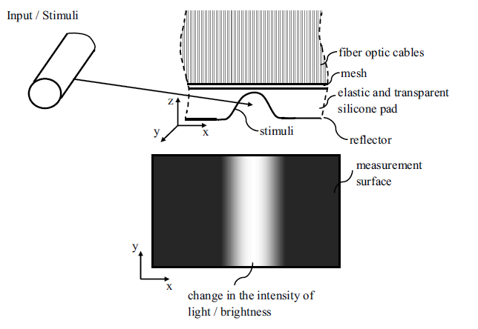
Our Technology
System

Slide 20
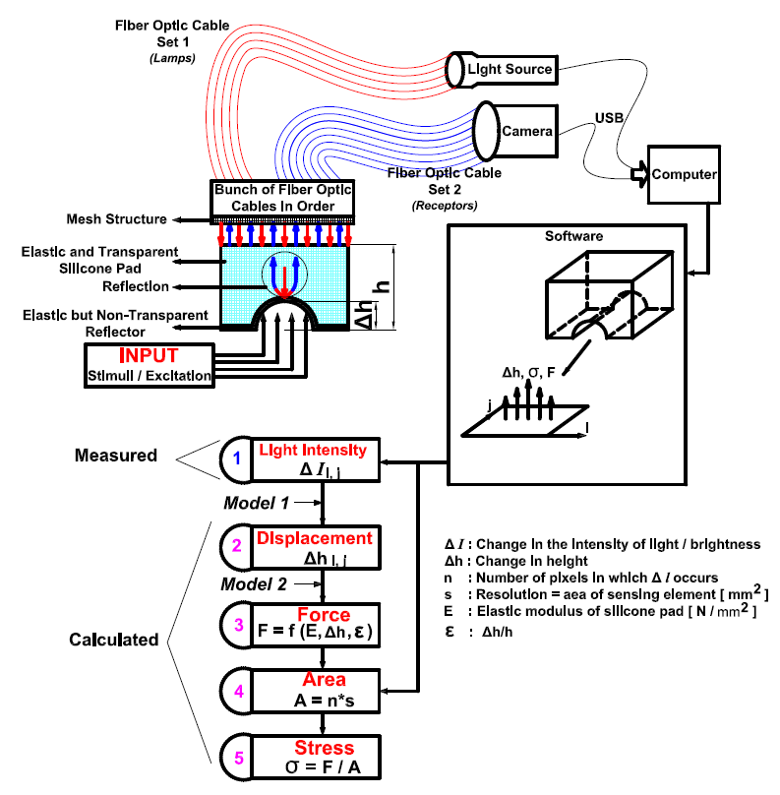
Our Technology
Schematic view
of the System

Slide 21
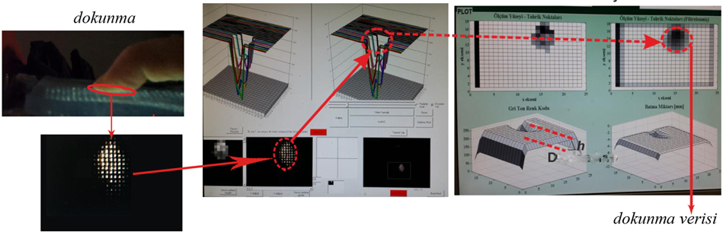
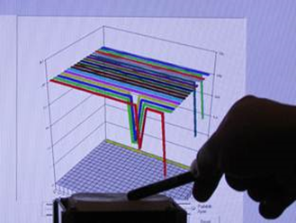
Our Technology
Operating Steps of the System
Touch
Touch data

Slide 22
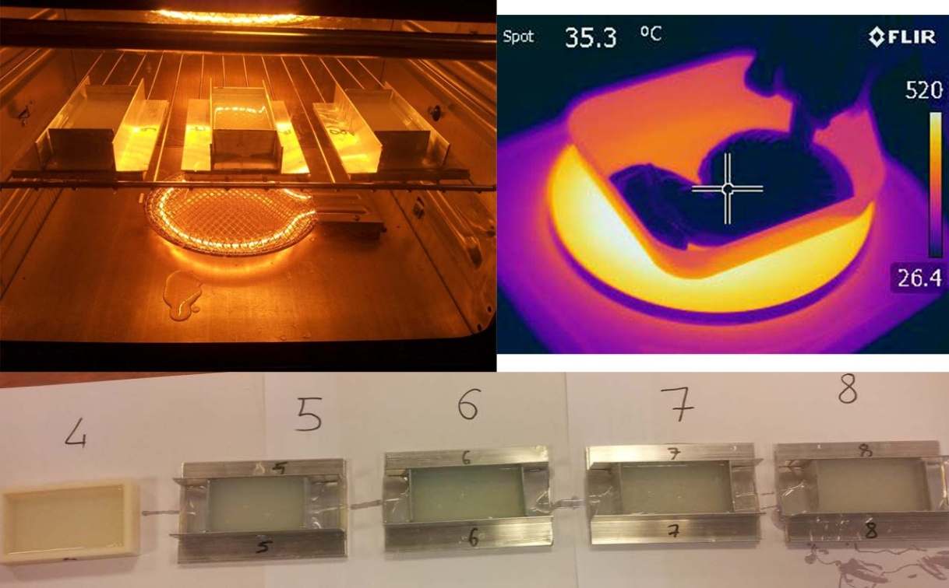
Our Technology
Silicone Manufacturing

Slide 23
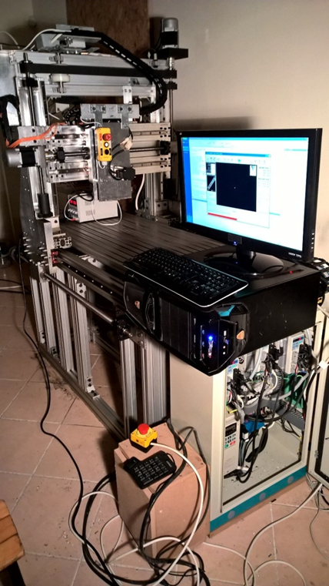
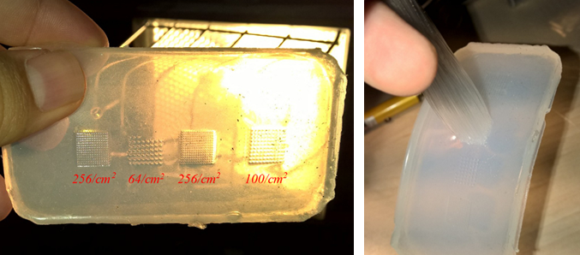
Our Technology
Fiber optic cable setting machine

Slide 24
Utku Buyuksahin, Ph.D.
CTO, Sensobright Industries LLC. www.sensobright.industries

