Slide 1
About OMICS Group
OMICS Group is an amalgamation of Open Access Publications and worldwide international science conferences and events. Established in the year 2007 with the sole aim of making the information on Sciences and technology ‘Open Access’, OMICS Group publishes 500 online open access scholarly journals in all aspects of Science, Engineering, Management and Technology journals. OMICS Group has been instrumental in taking the knowledge on Science & technology to the doorsteps of ordinary men and women. Research Scholars, Students, Libraries, Educational Institutions, Research centers and the industry are main stakeholders that benefitted greatly from this knowledge dissemination. OMICS Group also organizes 500 International conferences annually across the globe, where knowledge transfer takes place through debates, round table discussions, poster presentations, workshops, symposia and exhibitions.

Slide 2
OMICS International
OMICS International is a pioneer and leading science event organizer, which publishes around 500 open access journals and conducts over 500 Medical, Clinical, Engineering, Life Sciences, Pharma scientific conferences all over the globe annually with the support of more than 1000 scientific associations and 30,000 editorial board members and 3.5 million followers to its credit.
OMICS Group has organized 500 conferences, workshops and national symposiums across the major cities including San Francisco, Las Vegas, San Antonio, Omaha, Orlando, Raleigh, Santa Clara, Chicago, Philadelphia, Baltimore, United Kingdom, Valencia, Dubai, Beijing, Hyderabad, Bengaluru and Mumbai.

Slide 3

Prediction of in-vivo permeability, solubility,
BCS-classing, food interactions,
fraction absorbed and oral bioavailability using new in-silico methods and algorithms
Urban Fagerholm
Associate Professor
CEO at PROSILICO, Sweden
urban.fagerholm@prosilico.com
http://prosilico.com/

Slide 4
How well are fraction absorbed, oral bioavailability, solubility/dissolution, food interactions and BCS-class
in humans in-vivo predicted using lab methods?

Slide 5
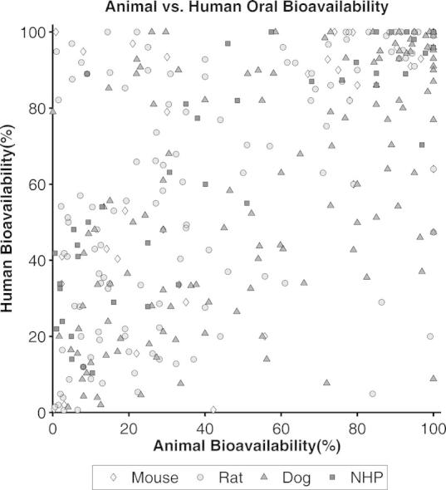
BIOAVAILABILITY
Musther et al. Eur J Pharm. Sci., 2014

Slide 6
BIOAVAILABILITY
In-vitro to in-vivo
?

Slide 7
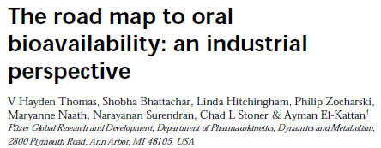
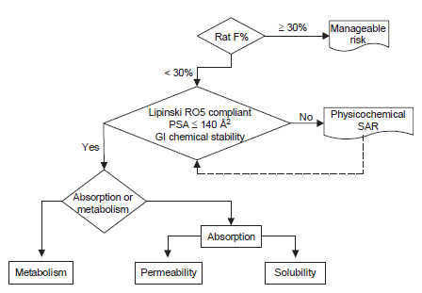
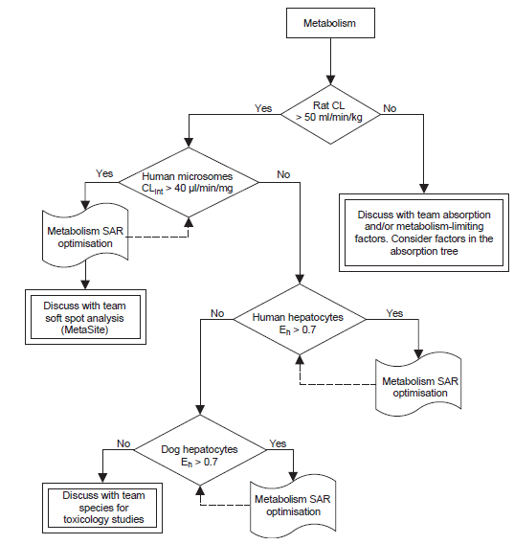
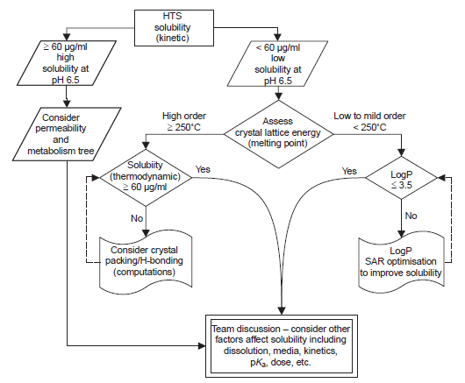
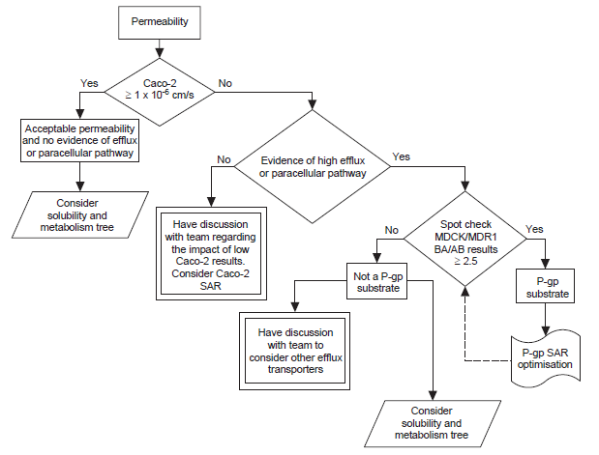

Slide 8
FRACTION ABSORBED
Caco-2
Passive uptake Passive + efflux
Matsson, Artursson et al 2005
Lin, Skolnik et al 2010

Slide 9
Caco-2 – issues with efflux
11 to 93-fold difference between labs
Poor reproducibility
Ungell et al

Slide 10
Caco-2 – issues with low solubility and recovery
Passive uptake Passive + efflux
Compounds with very low solubility
and recovery not included
Matsson, Artursson et al 2005
Lin, Skolnik et al 2010

Slide 11
Caco-2 – issues with low solubility and recovery
”Estimated that 40% of all newly developed drugs are poorly soluble or insoluble in water.” / Naseem et al. Int. J. Pharm., 2004.
“1/8 of Novartis compounds (44% of low solubility cmpds) were subject to low recovery (<30%) in Caco-2 screen”.
“Poor recovery (due to nonspecific drug binding to plastic devices and cells; in particular for lipophilic compounds) is often seen and also neglected in data interpretation.” / Skolnik et al J Ph Sci 2010.

Slide 12
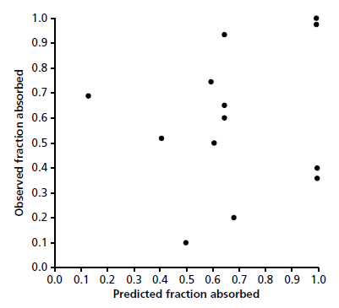
Human intestinal in-vivo Pe (Loc-I-Gut measurements)
Fagerholm, J Pharm Pharmacol 2007

Slide 13
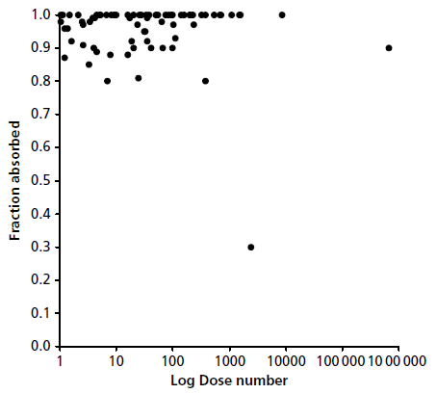
IN-VIVO SOLUBILITY/DISSOLUTION
In-vitro aq. solubility (Dose number=highest GI conc. / solubility)
Fagerholm, J Pharm Pharmacol 2007

Slide 14
BCS-CLASSIFICATION
Difficult to predict based on in-vitro and in-vivo permeability unless it is very low or very high
Difficult to predict based on in-vitro solubility (underprediction potential when low solubility)
Many cases of in-vitro BCS II-compounds
belonging to in-vivo BCS I
Yazdanian et al, Pharm Res, 2004
Fagerholm, J Pharm Pharmacol 2007

Slide 15


Data
Evaluation
QSAR
Rule-
based
systems
New, unique, true, validated
in-silico methods and algorithms
for prediction of human and
animal ADME/PK
Directly from molecular structure to in-vivo
Outperforms lab methods
ADME/PK-
algorithms
Analysis
&
Report
O=C2/N=C(\Nc1n(cnc12)COCCO)N

Slide 16
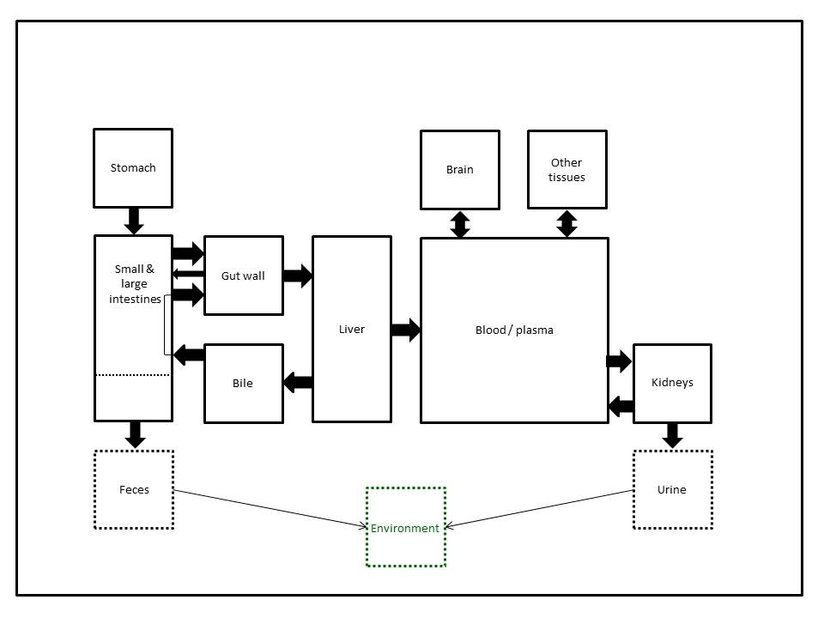
NEW, UNIQUE PBPK-MODEL
CONFIDENTIAL

Slide 17
NEW, UNIQUE PBPK-MODEL
+ Skin (Q^2=0.7)
Lung (Q^2=0.5)
CONFIDENTIAL

Slide 18
HANDLES CHALLENGING COMPOUNDS
% of compounds

Slide 19
PERFORMANCE
>3500 human predictions
1.5-fold median error
Animal models ∼1.5-3 fold median errors
Q^2 = 0.4 to 0.8 (true predictions)
Class models 70 to 86 % correct classing
11/11 successful external validations by customers

Slide 20
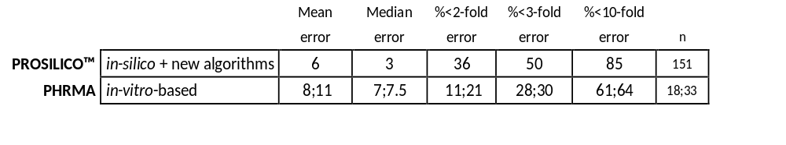
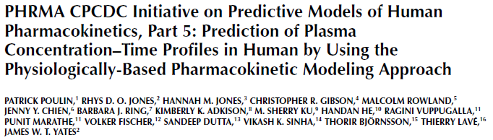
POSITIONING
BEST-IN-TESTS – vs in-vitro
AUCpo (systemic exposure after po adm.)

Slide 21
BEST-IN-TESTS – vs allometry
AUCpo (F/CL)
9-fold smaller prediction error range than allometry
CL
2800-fold smaller prediction error range than allometry

Slide 22
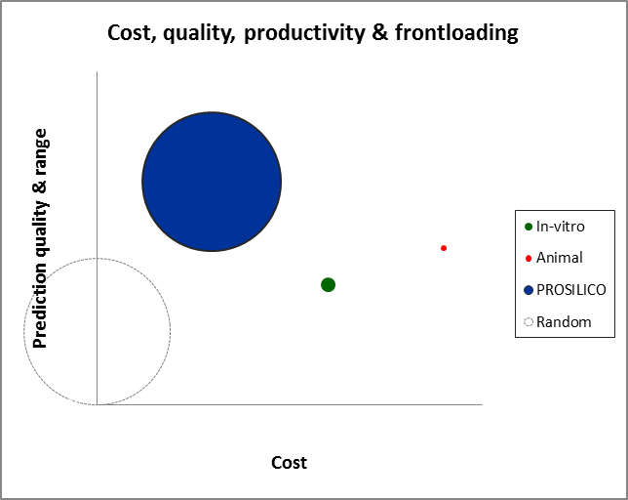

Slide 23
BIOAVAILABILITY
Observed
Predicted
Delivered together with confidence intervals

Slide 24
t½
Observed (log)
Predicted (log)
Delivered together with confidence intervals

Slide 25
FRACTION ABSORBED
Observed
Predicted
Including very low solubility and strong efflux cmpds
Excluding antibiotics, prodrugs and MW>700

Slide 26
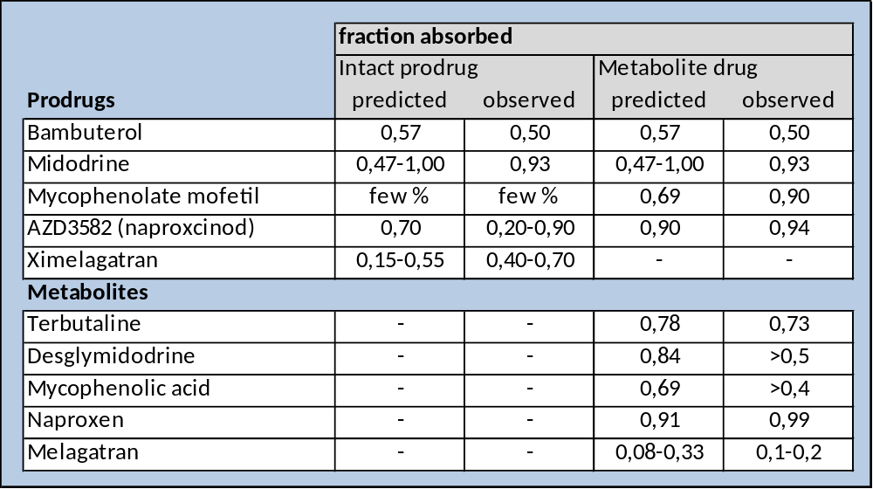
PRODRUG ABSORPTION
*added in-vitro GI stab data

Slide 27
FRACTION ABSORBED FROM COLON
Observed
Predicted

Slide 28
BCS-CLASSING OF COMPOUNDS WITH
VERY LOW SOLUBILITY
100 most insoluble cmpds with available absorption data
incl. atavaquone, danazol, dipyramidole, felodipine, itraconazole, griseofulvin, lovastatin
74 % correct BCS-classing (12 % abs. error for fa)

Slide 29

UPTAKE OF 275 VIRTUAL KINASE INHIBITOR ANALOGUES
Predicted in-vivo solubility/dissolution-based maximum uptake
BCS III BCS I
BCS IV BCS II
in collaboration with
Predicted in-vivo permeability-based uptake

Slide 30
A DIFFERENT BCS-PERSPECTIVE
Predicted in-vivo solubility/dissolution-based maximum uptake
I: Pe-rate controlled
II: Solubility/dissolution
controlled
Predicted in-vivo permeability-based uptake

Slide 31
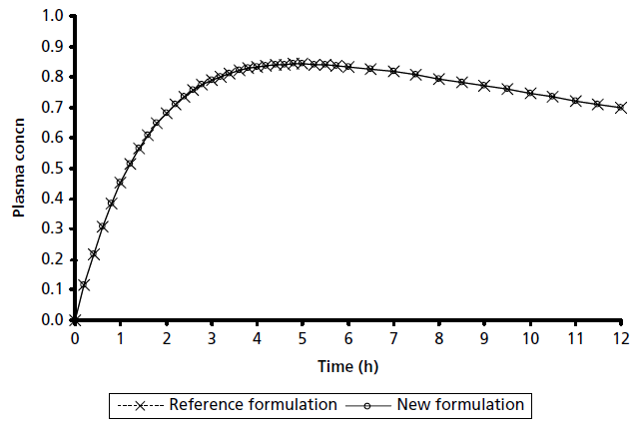
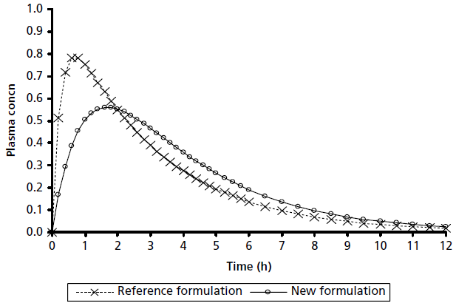
The role of t½
Simulated plasma conc vs time profiles for two formulations with
4-fold different dissolution rates
High Pe, long t½ High Pe, short t½
Fagerholm, J Pharm Pharmacol 2007

Slide 32
FOOD INTERACTION
Observed AUCfed/fast
Predicted food interaction index

Slide 33
FOOD INTERACTION
Observed AUCfed/fast
Predicted food interaction index

Slide 34
SUMMARY
Exaggerated in-vivo solubility limitations?!
Adjustments of BCS needed?!
Significant advances in predictions of absorption,
bioavailability, BCS-classing and food interactions
with new in-silico methodology
Uptake optimization enabled with the new methodology
urban.fagerholm@prosilico.com
http://prosilico.com/

Slide 35
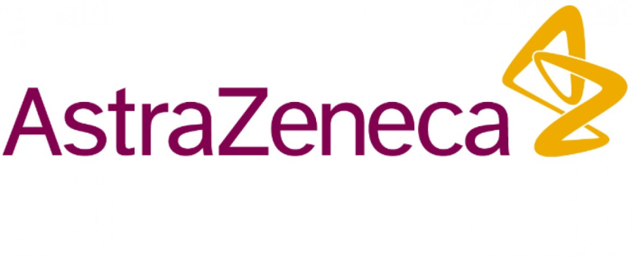










CUSTOMERS

Slide 36
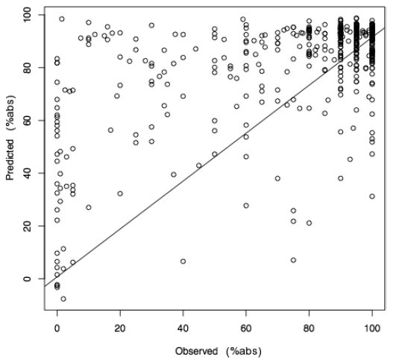

BACK-UPS

Slide 37
BACK-UPS
Fraction absorbed in-vivo
Log predicted Permeability GastroPlus

Slide 38
Let us meet again..
We welcome you all to our future conferences of
OMICS International
7th World Congress on
Bioavailability & Bioequivalence: BA/BE Studies Summit
On
August 29 - 31, 2016 at Atlanta, USA
http://bioavailability-bioequivalence.pharmaceuticalconferences.com/

