Slide 1


Bringing your Bioinformatics tools to CyVerse’s Discovery Environment using Docker
Upendra Kumar Devisetty
Science Informatician
upendra@cyverse.org

Slide 2
Outline
Overview of CyVerse
Overview of the CyVerse Discovery Environment (DE)
Overview of Docker technology
Bringing tools to Discovery Environment using Docker
  How can Docker help bringing Bioinformatics tools to DE
  Benefits of running your software in DE
  Process of Dockerizing tools in DE
  How to get started
  Word of caution
Notes:
ACTION: reword

Slide 3


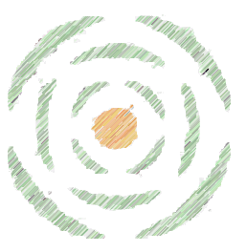
Evolution of CyVerse
2016
2013
2008
iPlant 2008
Empowering a New Plant Biology
iPlant 2013
Cyberinfrastructure for Life Science
CyVerse 2016
Transforming Science Through Data-Driven Discovery

Slide 4

Overview of CyVerse
We are funded by the National Science Foundation
We are your colleagues and collaborators!
$100 Million in investment
Freely available to the community
Spur national/international collaboration
Cite CyVerse:
  CyVerse.org/acknowledge-cite-cyverse
DBI-0735191 and DBI-1265383

Slide 5
Overview of CyVerse
Vision:
Transforming science through data-driven discovery
Mission:
Design, develop, deploy, and expand a national cyberinfrastructure for life science research, and train scientists in its use
More than 40K users, PB of data, and hundreds of publications, courses, and discoveries
CyVerse 2016
Transforming Science Through Data-Driven Discovery

Slide 6
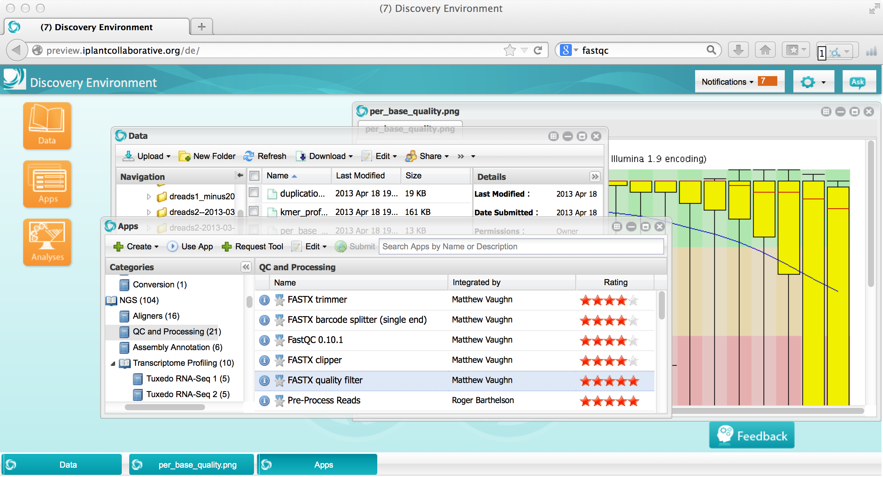
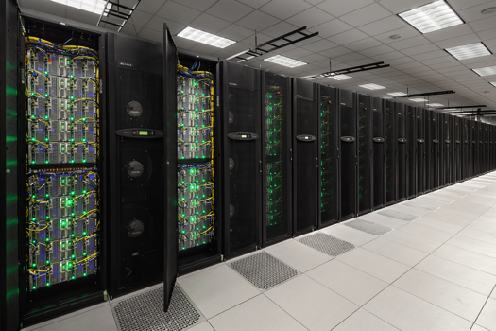
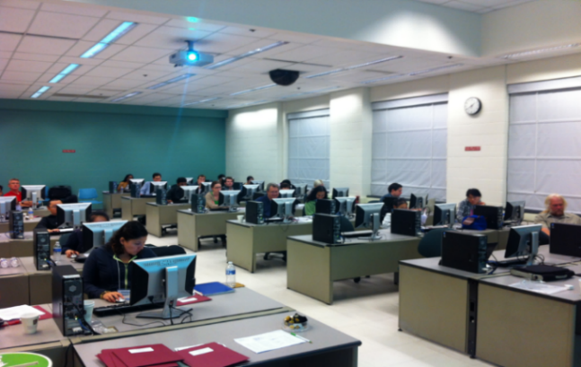
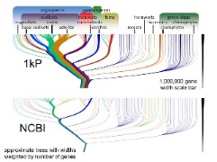
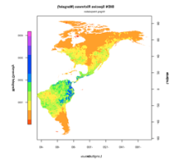
What is cyberinfrastructure?
CI provides solutions to the challenges of large-scale computational science were unapproachable because the computational requirements were too large, too complex, or simply unknown.
Platforms, tools, datasets Storage and compute Training and support
HPC People

Slide 7
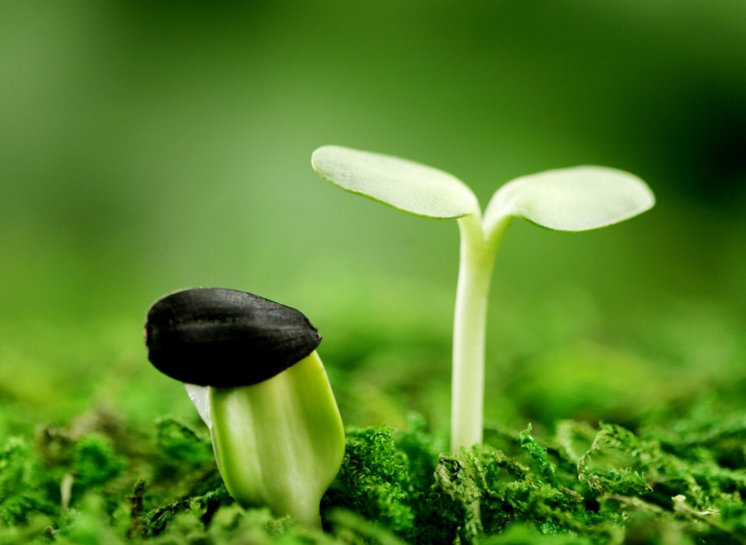
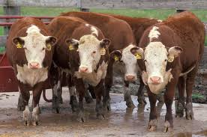
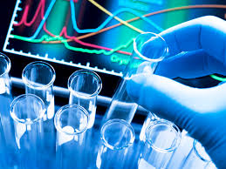

CyVerse supports all domains of life science
Plant / Microbial Animal Biomedical Ecological/Climate
CyVerse is built for data

Slide 8
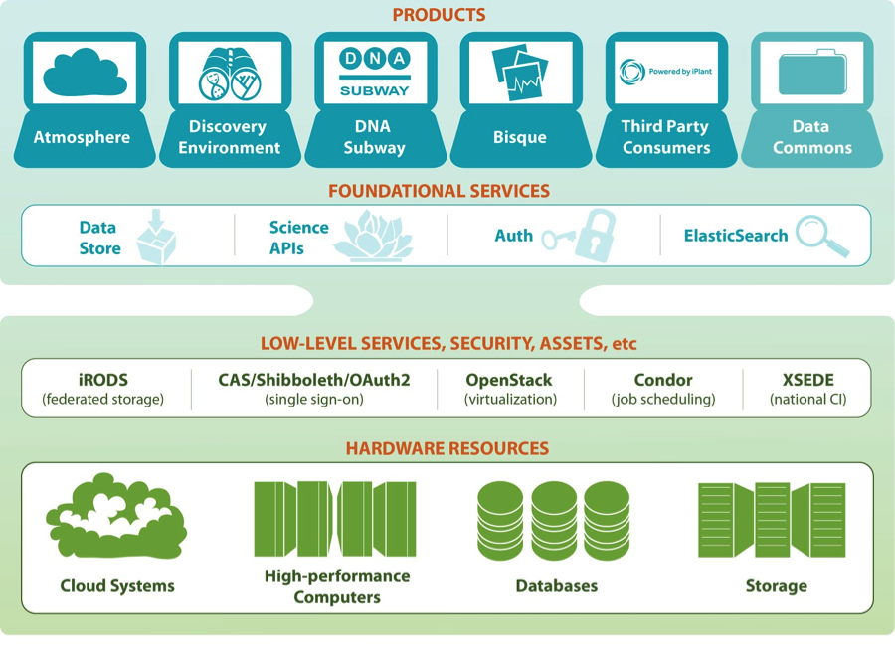
CyVerse architecture
Ready to use
Platforms
Extensible Services
Flexibility
Ease of Use
Established CI Components
Foundational
Capabilities

Slide 9






CyVerse products
From plant science, to life science, and beyond…
Data Store
Science APIs
The resources you need to share and manage data with your lab, colleagues and community
Fully customize CyVerse resources
Discovery Environment
BisQue
Hundreds of bioinformatics apps in an easy-to-use interface
Image analysis, management, and metadata
Atmosphere
DNA Subway
Educational workflows for Genomes, DNA Barcoding, RNA-Seq
Cloud computing for the life sciences

Slide 10
Discovery Environment
Hundreds of bioinformatics apps in an easy-to-use interface
A platform that can run almost any bioinformatics application
Seamlessly integrated with data and high performance computing
User extensible – add your own applications
bioinformatics workflow—data management, analysis, sharing large datasets
Notes:
Focus here is on genomics data, but not restricted to genomics data

Slide 11
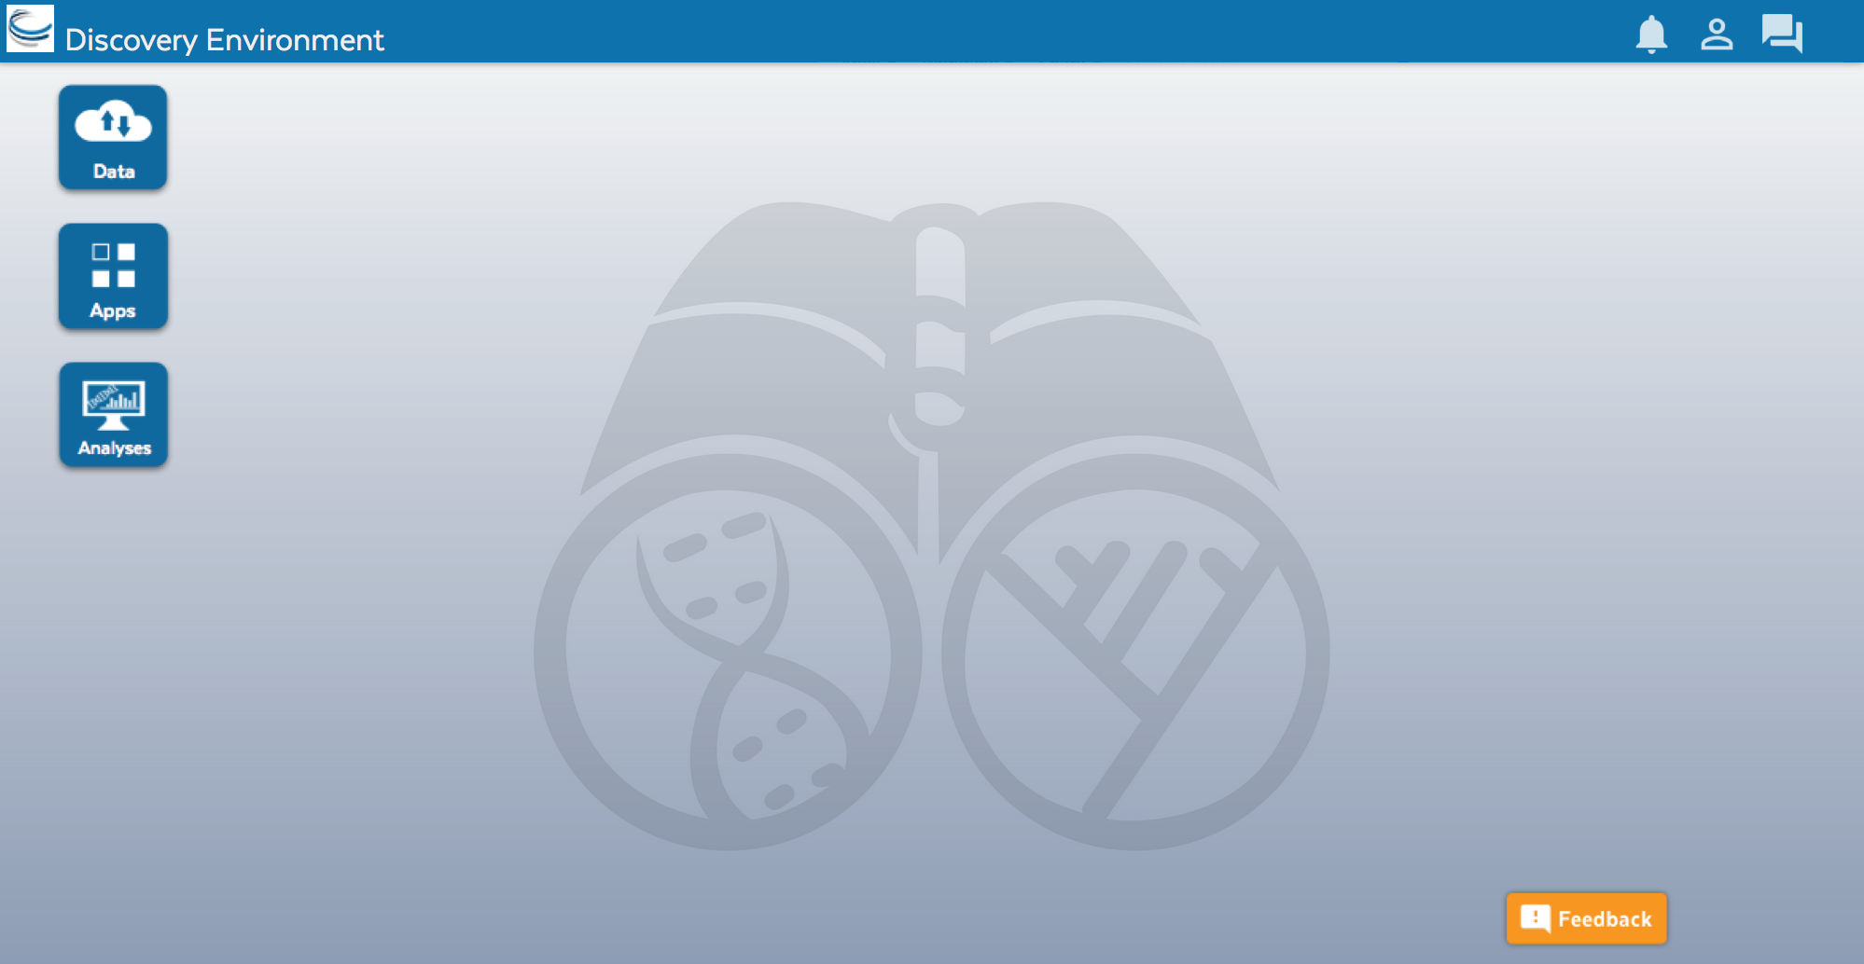
Discovery Environment Overview
Access your computational science through a single portal

Slide 12
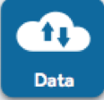
Discovery Environment Overview
Manage data
Data
Upload / Download files and folders
Share files via URL (Public Links)
Share files/folders with other users

Slide 13
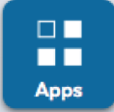
Discovery Environment Overview
Analyze data and customize Applications
Apps
Run hundreds of bioinformatics Apps
Build automated workflows
Modify Apps or integrate new ones

Slide 14

Discovery Environment Overview
View history, find results, reproduce analyses, optimize parameters
Analyses
Monitor job status and find results
Cancel jobs or re-launch jobs
Detailed job history

Slide 15



Discovery Environment Overview
Benefits
Get Science Done
Use hundreds of bioinformatics Apps without the command line
Add your own applications – an extensible, scalable platform
Create and publish Apps and workflows so anyone can use them
Analysis history and provenance – “avoid forensic bioinformatics”
High-performance computing – not dependent on your hardware
Manage a secure data repository and share data easily
Reproducibility
Productivity

Slide 16
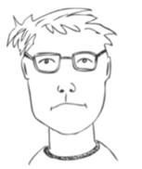

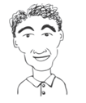
Discovery Environment Overview
User perspectives and possible applications
Does most of his data uploads/downloads/sharing here
He pushes results from his lab’s workflow into a common folder
Installed an HPC application here so that anyone can use it
Creates custom applications with default parameters exposed
Developed a workflow to QC and Filter reads for his users
Teaches about genome assembly with examples in the DE
Bench Scientist
Bioinformatician
Core Facilities
Images from personas based on: Bioinformatics Curriculum Guidelines: Toward a Definition of Core Competencies
PLOS Biology DOI: 10.1371/journal.pcbi.1003496

Slide 17


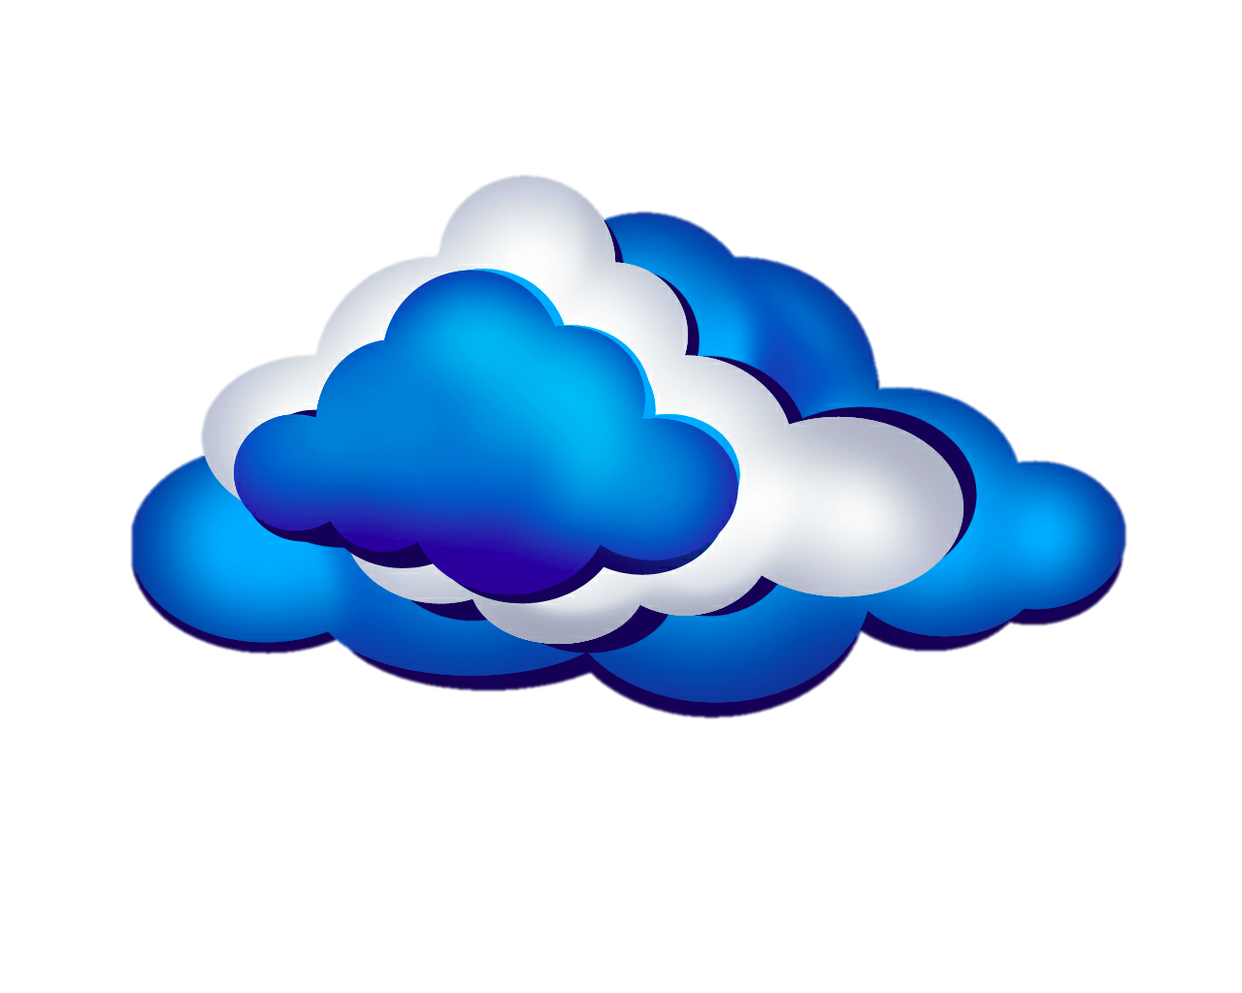

Simple Formula for Success
+
=

Slide 18


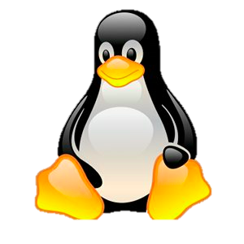
The Reality
Excel, R
PERL
Python
ARCGIS
Java Ruby
Fortran C C# C++ Matlab
etc.
Amazon
Azure
Rackspace
Campus HPC
XSEDE
Etc.
+
+
and lots of glue…..

Slide 19


Simple Formula
+
=

Slide 20

Docker is a type of virtualization for software distribution, has revolutionized the way in which scientific software and all dependencies can be packaged, distributed, and deployed.
Docker makes the complex and time-consuming installation procedures needed for scientific software a one-time process.
Docker enables platform-independent installation, easy versioning of software and redeployment, and reproducibility across environments and versions.
Docker is an ideal candidate for the deployment of software on different compute environments (XSEDE, Amazon AWS, etc.)

Slide 21
Container technology: What is it about ?
Allows you to create a self contained package that contains:
  The specific operating system version (say Ubuntu 14.04.1)
  Your application
  All of the parts your application needs (such as libraries and other dependencies)
  Ability to share this with other users
This single package can now be run on any computing system that supports Container technology (regardless of its own version of operating system)

Slide 22
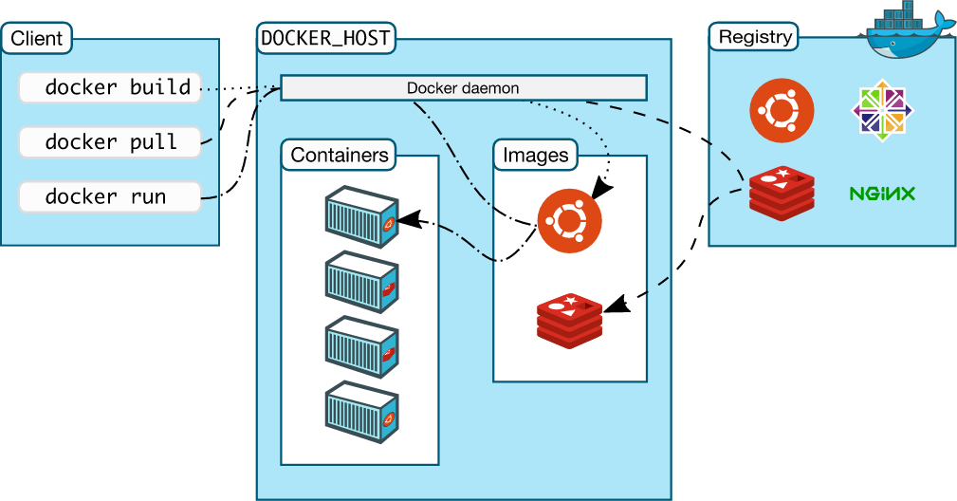
How does it work together?

Slide 23
What happens when you run a job in DE?
  CyVerse has adopted Docker for integrating software that run in the CyVerse DE’s Compute Cluster (Condor).
  Condor looks for a machine that matches your criteria (RAM, CPU, Disk Space)
  Once it find a suitable match:
    Data placement container runs and brings the data you want to operate on to that node from data store
    Your app (Docker container) runs (with the data visible to it as union file system)
    Date placement container for returning data data back to data store

Slide 24
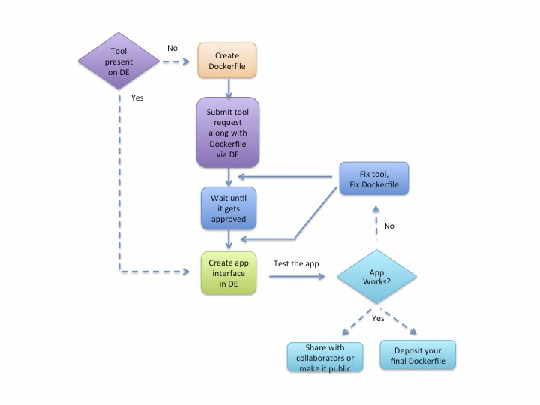
The Process for Dockerizing Tools in DE

Slide 25
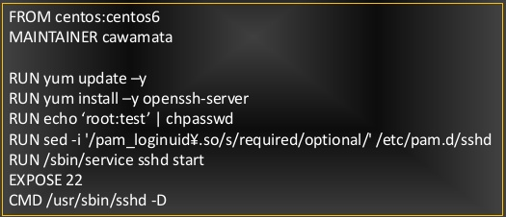
The Process for Dockerizing Tools in DE
Dockerfile → Docker image → DE app
User
CyVerse Staff
User

Slide 26
Benefits of running your software in DE
Integrating a Dockerized tool into the DE enables users to begin creating apps built on the tool.
Because Dockerized apps use fewer resources, their analyses process more quickly.
Compared to the previous method for tool integration in the DE, this method streamlines the process and makes it more likely that the final DE app will function as the user intended.
It also increases the likelihood that more complicated and difficult to install software can be used in the DE.
You can use your Dockerized apps in the CyVerse Discovery Environment and Atmosphere.
If you are a developer or just write a nice script occasionally, or teach classes, or have a collaborative project, or are publishing a paper that uses a specific workflow:
  Share a specific app.
  Share a specific version of an app.
  Share a whole analysis pipeline.

Slide 27
How to get started?
  Get Docker setup on your local machine (win,mac,linux) or use Atmosphere
  Plan your steps i.e what you want to do
  Carry out those steps and verify that things work
  Create a Docker file file from those steps
  Submit the request for a “new tool”
  Once you hear back design your interface (and profit)
    Detailed instructions with videos, manuals, documentation
      F1000 publication: https://f1000research.com/articles/5-1442/v1
      Focus forum webinar: https://goo.gl/zPvINh
      CyVerse wiki: https://goo.gl/ym2gtT

Slide 28
Word of caution
  Containers are very powerful and has many bells and whistles (only choose parts that you really need !)
  Avoid storing data inside of containers
  Keep containers light and nimble, build on provided base images from trusted source (iPlant prefers Ubuntu 14.X and CentOS 7.X from Docker hub)
  Do not trust a app without Docker file (its not easy to recreate and a blackbox, bad for reproducibility )

Slide 29

CyVerse Executive Team
https://ask.cyverse.org
info@cyverse.org

