Slide 1


OMICS
3rd International Conference on Physical Medicine & Rehabilitation
Ulrike Berzau, MM, MHS, PT, FACHE
www.AmazingResults4you.com
achieveamazingresults@gmail.com
Phone: 617 942 1193

Slide 2
Success Mindset Coaching
Certified Thinking Into Results Consultant
Certified Life Coach
Physical Therapist
Healthcare & Business Executive
Integrative (Complementary) Medicine Leader
Fellow of the American College of Healthcare Executives
International Best-Selling Author (Imagine a Healthy You @ Balboapress.com)

Slide 3

Success Mindset
Optimize Your Team’s Performance and
Your Patients’ Outcomes

Slide 4
Successful leaders Effective teams
Stellar people
Top employees
Great organizations
High
performing
athletes
Superior
patient outcomes
Success Mindset

Slide 5
“Although external forces are constantly working against a company’s growth in shareholder value, it
is the internal misconception that exists within management that places the greatest limitations on corporate performance.”
~ Beliefs, Behaviors and Results by Gillis, Mergy, Shalleck

Slide 6

Results
Our attitude and beliefs affect our mind and body, and most of all our results!
Are you achieving your goals?
What limits you?
Let’s take a closer look how
Results
happen.

Slide 7
Results
Good news
and bad news:
You have a choice!
Let’s understand how the mind works…
Whether you think you can, or you think you can’t – you’re right.
~ Henry Ford

Slide 8
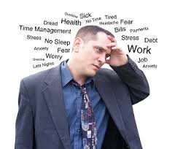
The Mind
Conscious & Subconscious Mind
“What’s on our mind” is expressed through our
body with actions, reactions and feelings
Our body is the extension
of our mind
Subconscious mind
runs 95% of our life
Image: Unknown

Slide 9
The Conscious Mind
Intellectual
think, reason, analyze
ideas, goals, wants
Constant input through our five senses
Hear Smell Taste See Touch

Slide 10
The Subconscious Mind
Feelings and Emotions
Paradigm
Beliefs
Self-Image
Cell memory
Does not know the difference
between what’s real and
what’s imagined

Slide 11

Paradigm
Other peoples’ beliefs and habits
Passed from generations to generations
Molded by the environment
Environmental
inputs on infants
Image: Gerber

Slide 12
Paradigm: Beliefs & Habits
Beliefs can be
Empowering
Limiting
We will never achieve more than we believe we can!
“The only limits you have are the limits you believe.” ~ Dr. Wayne Dyer

Slide 13
Paradigm
“Whatever we plant in our subconscious mind
and nourish with repetition and emotion will
one day become a reality.”
~ Earl Nightingale, Speaker, Writer and Author

Slide 14
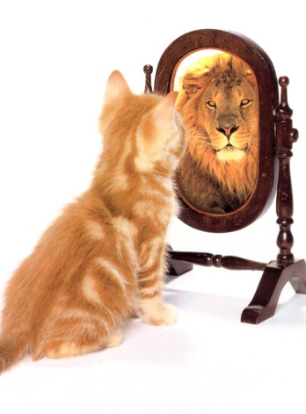
Self-Image
Dr. Maxwell Maltz (1889-1975)
Psycho - Cybernetics
We have two images:
Mirror reflection
The image we hold
in our mind (self-image)
Image: Unknown

Slide 15
Self-Image & Our Autopilot
Cybernetics is a self regulating control mechanism
  Thermostat
  Airplane’s autopilot
Self–Image is our set destination
Our actions and behaviors continuously adjust to reach the set destination

Slide 16
Self-Image & Success
“Our success in any undertaking will never be
greater than the image we have of ourselves.”
~ Bob Proctor, Thinking Into Results

Slide 17
Creating Our Success
Build the Success Mindset from the inside out!
Mental picture of who you want to be, life you want to live
Bring the image to life with your five senses
Add emotions and repetition
"I never hit a shot even in practice without having a sharp in-focus picture of it in my head. It's like a color movie. ..”
~ Jack Nicklaus, Golfer

Slide 18
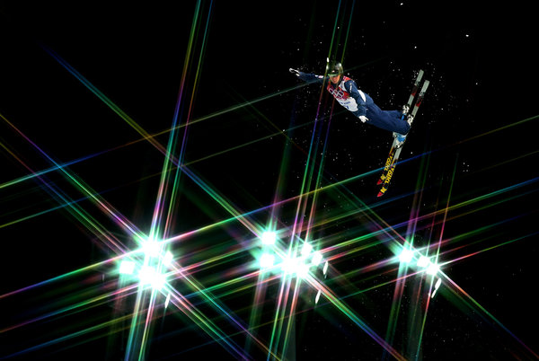
Olympians Use Imagery as Mental Training (NY Times)
Emily Cook, U.S. freestyle
aerials Olympian, goes
beyond “visualization” in
her training. “You have to
smell it,” she said. “You
have to hear it. You have
to feel it, everything.”
by Christopher Clary, NY Times, 2/2014. Getty Images

Slide 19
Motor Imagery
Mentally rehearsing and simulating an action or function without physically performing it
Effective imagery is a multi-sensory experience
“Imagery is used by virtually all great athletes and research has shown that, when combined with actual practice, improves performance more than practice alone. Imagery also isn't just a mental experience that occurs in your head, but rather impacts you in every way: psychologically, emotionally, physically, technically, and tactically.” ~ Jim Taylor, PhD, Psych Today 11/2012

Slide 20
Motor Imagery
Evidence suggests that our body has the same response to the imagined event as to the physical experience
Growing research to further explore effects of motor imagery:
  Same brain cells are activated as if the activity is actual performed
  New neural pathways - Neuroplasticity

Slide 21

Rehabilitation
Motor Imagery applied: the power of goals coupled with
desire Create the mental picture
  Use the five senses
  Add emotions

Slide 22
Rehabilitation
Patients can practice imagery on their own and during rest times to
  Enhance their physical abilities
  Increase hope, happiness and wellbeing
  Improve functional outcomes

Slide 23
We Have a Choice
“The way you think, the way you behave, the way
you eat, can influence your life by 30 - 50 year.”
~ Dr. Deepak Chopra

Slide 24
Success Mindset
From the Inside Out - building the Success Mindset results in improved wellbeing, happiness, success and health.
For YOU
Teams and organizations
Sports and fitness
Rehabilitation and prevention

Slide 25



Questions?
www.AmazingResults4you.com/free
achieveamazingresults@gmail.com
Phone: 617 942 1193

