Slide 1
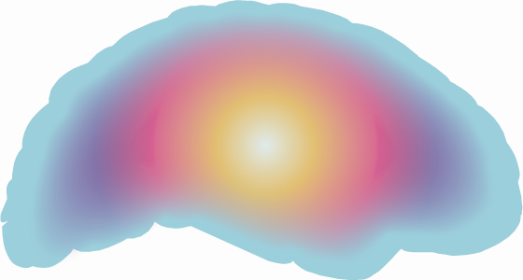

Brain on fire
Dr. ukd AJIth goonetilleke mafraq hospital
Abu dhabi united arab emirates

Slide 2
Case presentation
31 F
Admitted with generalized tonic-clonic seizures
3-day prodrome of confusion, auditory and visual hallucinations, and behavioral disturbances
MRI brain and CSF analysis- normal
∆ ? HSV encephalitis
Rx IV phenytoin and acyclovir

Slide 3
Case presentation
Condition worsened, transferred to Mafraq Hospital
Worsening behavior disturbance
Extrapyramidal features
Myoclonic jerks affecting mouth and lips
Orolingual and limb dyskinesias
Episodic oculo-gyric crises
? NMDA-receptor encephalitis

Slide 4
Case presentation
Repeat MRI brain scan and CSF analysis- normal
Blood and CSF samples positive for anti-N-methyl D-aspartate receptor (NMDA-R) antibodies
Ultrasound (transvaginal and abdominal) scans, CT scans of chest, abdomen and pelvis- normal
No evidence of ovarian teratoma

Slide 5
Case presentation
∆ anti-NMDAR encephalitis
IV immunoglobulins
IV→ oral steroids
Plasma exchanges
A first trimester miscarriage occurred
No improvement → 4 courses of IV Rituximab
monthly pulses of IV cyclophosphamide

Slide 6
Case presentation
Patient improved
Discharged home 6 months after initial admission
Independently ambulant, orientated in time, place and person, able to communicate in 3 different languages
Residual short-term memory deficits, subsequently improved
Returned to full-time employment as a chemical engineer

Slide 7
Case presentation
Remained positive for anti-NMDA-R antibodies
Pelvic investigations were repeated 6 months later
Ultrasound & MRI scans of pelvis showed a right ovarian cyst
Laparoscopic cystectomy was peformed
3 x 2 x 1.5 cm cyst removed
Histological features of an ovarian teratoma
Negative for anti-NMDA-R antibodies 9 months later

Slide 8
ANTI-NMDAR ENCEPHALITIS
syndrome of memory deficits, psychiatric symptoms,
decreased consciousness, and hypoventilation was
reported in 4 young women with ovarian teratomas
(Vitaliani R et al, 2005)

Slide 9
ANTI-NMDAR ENCEPHALITIS
2007 disorder formally described (Dalmau J et al, 2007)
autoantibodies to NMDAR detected in original 4 women and 8 other patients with similar neurological symptoms
7 also had ovarian teratomas
subsequent 3 years identified 419 patients
multi-centre, population-based prospective study of causes of encephalitis in the UK
  → 4% of patients had anti-NMDAR encephalitis
  (Granerod J et al, 2010)
second most common immune-mediated cause (after ADEM)

Slide 10
ANTI-NMDAR ENCEPHALITIS
Commonest in young women with teratomas
Men and women, with and without tumours
(Dalmau J et al, 2008)
Varying ages, 23 months – 76 years
(Florance NR et al, 2009)

Slide 11
ANTI-NMDAR ENCEPHALITIS
70% patients have prodomal symptoms (headache, fever, nausea, vomiting, diarrhoea, or URT symptoms)
Within few days (usually < 2 weeks)→ psychiatric symptoms
anxiety, insomnia, fear, grandiose delusions,
hyper-religiosity, mania, paranoia are frequent
social withdrawal & stereotypical behaviour sometimes seen
Short-term memory loss common
Rapid disintegration of language (reduction of verbal output and echolalia/echopraxia→ to frank mutism) is frequent
(Sansing LH at al, 2007; Iizuka T et al, 2008)

Slide 12
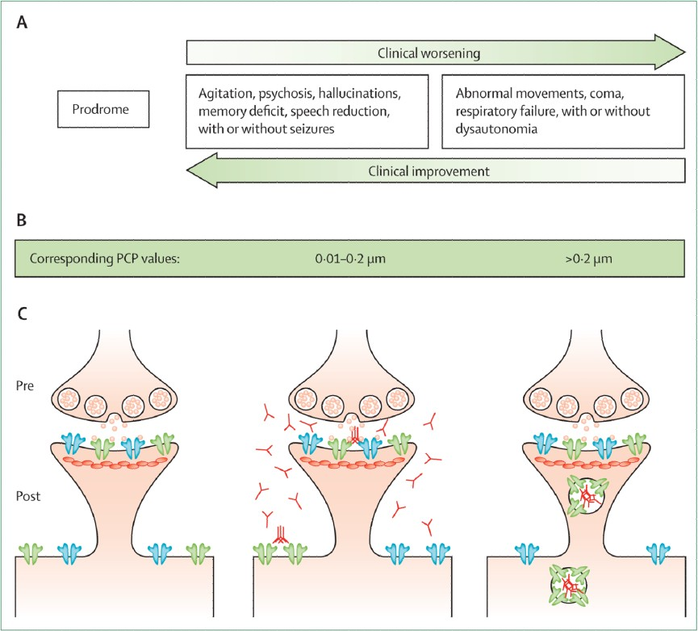
ANTI-NMDAR ENCEPHALITIS
Dalmau et al, 2011

Slide 13
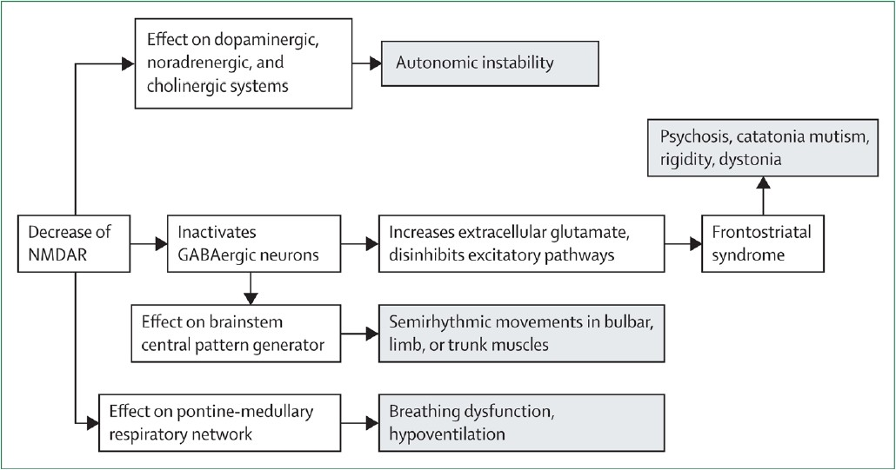
ANTI-NMDAR ENCEPHALITIS
Dalmau et al, 2011

Slide 14
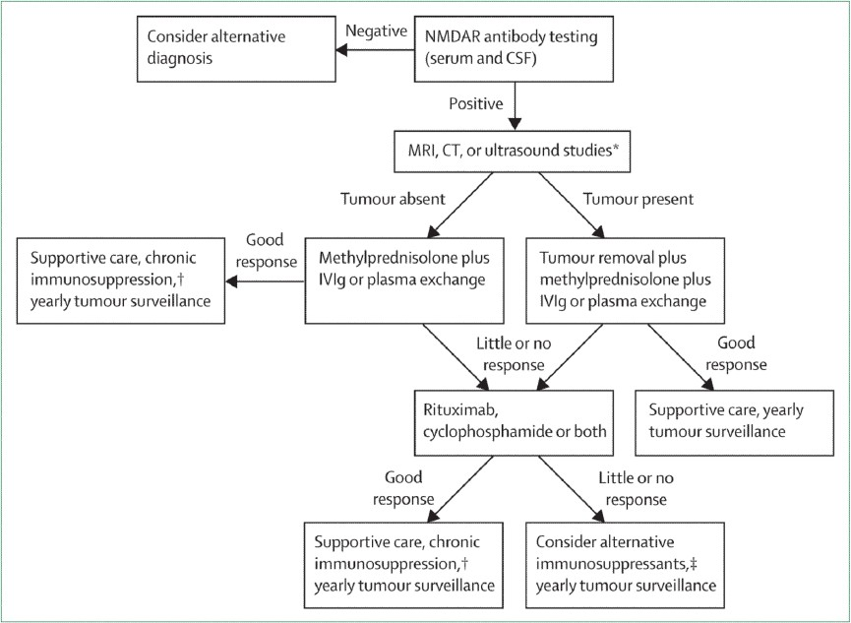
ANTI-NMDAR ENCEPHALITIS
Dalmau et al, 2011

Slide 15

ANTI-NMDAR ENCEPHALITIS-BRAIN ON FIRE

Slide 16

ANTI-NMDAR ENCEPHALITIS-BRAIN ON FIRE

Slide 17
references
Cahalan S, 2012. ISBN: 9781451621372
Dalmau J, et al. Ann Neurol 2007 January; 61(1): 25–36
Dalmau J, et al. Lancet Neurol 2008; 7: 1091–1098
Dalmau J, et al. Lancet Neurol 2011; 10(1): 63–74
Florance NR, et al. Ann Neurol 2009; 66: 11–18
Granerod J, et al. Lancet Infect Dis 2010; published online Oct 15. 10.1016/S1473-3099(10)70222-X
Iizuka T, et al. Neurology 2008; 70: 504–11
Sansing LH, at al. Nat Clin Pract Neurol 2007; 3: 291–96
Vitaliani R, et al. Ann Neurol 2005; 58: 594–604

