Slide 1
Ethnic variation in the contribution of Cardiorespiratory fitness and muscular strength to diabetes: crossectional study of 68,116 UK Biobank participants
Uduakobong Ntuk,
Institute of Health and Wellbeing ,University of Glasgow
International Conference on Epidemiology & Public Health
Valencia Spain, 2015

Slide 2
Outline
Background
Study Aims
Methods
Result
Discussion
Strengths and Limitations
Conclusion

Slide 3
Background
Type 2 diabetes is a major public health problem
Diabetes prevalence
  Black (2x White European)
  South Asian (4x White European)

Slide 4
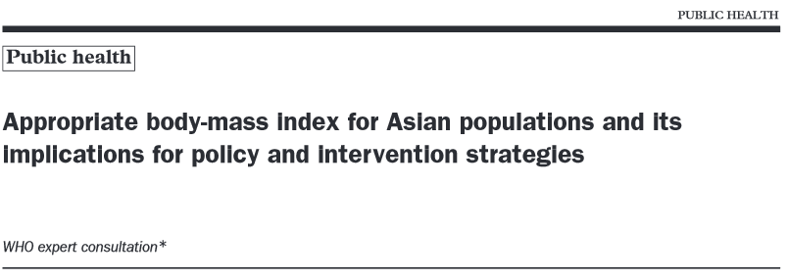
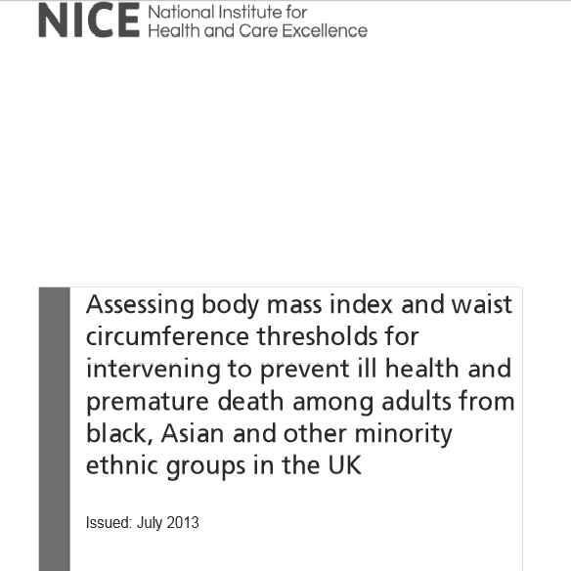


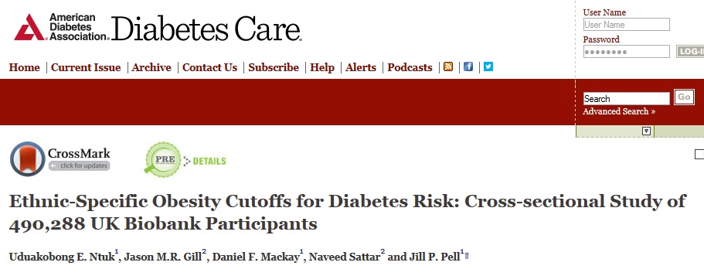

Slide 5
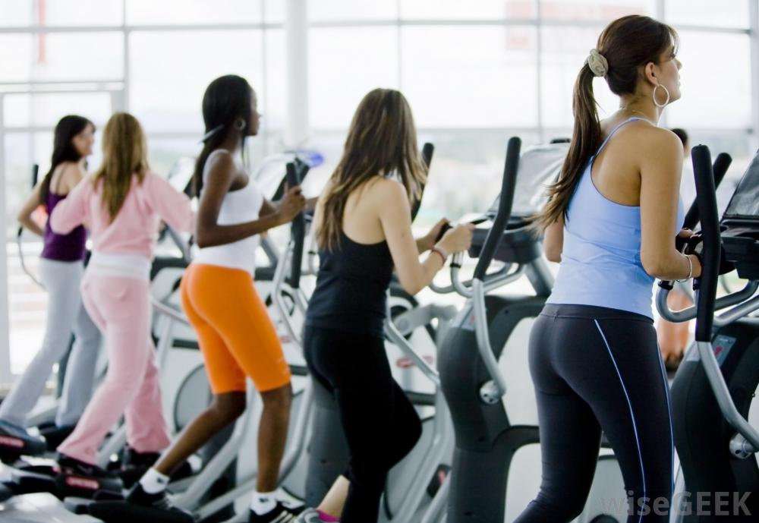
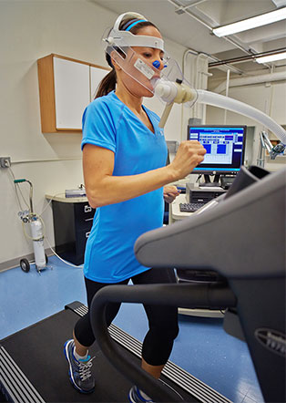
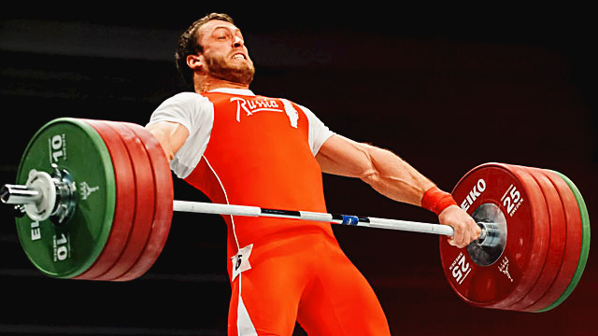
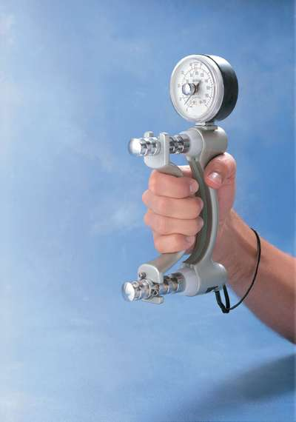
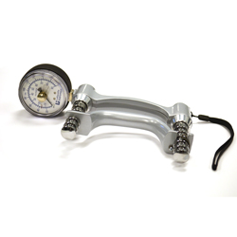

Slide 6
Background (cont’d)
Low cardiorespiratory fitness
  involved in the progression from normal glucose metabolism to type 2 diabetes (T2D);
  predictors of cardiovascular events and premature mortality in T2D individuals.
Muscular strength is a predictor of all-cause mortality, as well as disability.
No epidemiological studies on ethnic variation and diabetes prevalence
Rantanen T, et al; Sayer AA, et al; Ghouri N, et al; Wander PL, et al

Slide 7
Study Aims
To determine the associations of (a) cardiorespiratory fitness (b) muscular strength on diabetes risk in White European, Black and South Asian.
To determine the extent to which ethnic differences in fitness and muscle strength might account for observed differences in diabetes prevalence
Whether the strength of these relationships similar across ethnic groups

Slide 8
Methods
Data Source
UK Biobank
  Large sample size data >500,000
  Aged between 40 and 70 years
  Representative of the UK population in terms of age-band, sex and ethnic structure
  Self-identified as White, South Asian or black background living in the UK
Data Analysis
  Multivariate logistic regression model
  Adjusting for :
    Age, Sex ,Deprivation quintile , Smoking , Alcohol consumption, BMI and Percentage body fat

Slide 9
Results

Slide 10
Table 1.Characteristics of study participants by ethnic group and sex
 | Men |  |  | Women
 | White N=28,402 | Black N=904 | South Asian N=1,066 | White N=35,367 | Black N=1,293 | South Asian N=1,086
Age(years) | 59 (51-64) | 51 (45-59) | 54 (45-61) | 58 (51-63) | 51 (46-58) | 53 (46-60)
BMI (kg/m2) | 27.2 (25.0-29.9) | 28.2 (25.9-30.9) | 26.5 (24.4-29.0) | 25.9 (23.3-29.4) | 29.5 (26.0-33.6) | 26.3 (23.6-29.3
Hand grip strength (kg/kg body weight) | 0.45 (0.28-0.53) | 0.47 (0.37-0.55) | 0.43 (0.35-0.50) | 0.33 (0.26-0.39) | 0.32 (0.25-0.38) | 0.29 (0.23-0.36)
CRF (METS) | 10.02 (8.14-11.92) | 8.65 (6.85-10.27) | 9.20 (7.65-10.73) | 7.65 (6.09-9.31) | 6.49 (4.75-7.98) | 6.82 (5.31-8.21)
 | N (%) | N (%) | N (%) | N (%) | N (%) | N (%)
Diabetes | 1,604 (5.64) | 134 (14.77) | 189 (17.68) | 1,122 (3.17) | 108 (8.34) | 126 (11.60)

Slide 11
Impact of fitness & strength on risk of diabetes (Men)

Slide 12
Impact of fitness & strength on risk of diabetes (Women)

Slide 13
Breakdown of participantsby fitness & strength (men)

Slide 14
Breakdown of participantsby fitness & strength (women)

Slide 15
Table 2. Attributable risk and attributable fraction of low-to-moderate cardiorespiratory fitness and low-to-moderate muscular strength for diabetes in White, Black and South Asian men and women
 | Men |  |  | Women
 | White | Black | South Asian | White | Black | South Asian
Attributable risk (diabetes cases per 100 people) | 1.4 (0.5-2.3) | 4.1 (3.5-10.9) | 8.2 (2.3-18.6) | 1.0 (0.5-1.5) | 4.3 (2.2-7.8) | 5.0 (2.8-12.5)
Attributable fraction for diabetes risk (%) | 24.5 (6.3-39.1) | 28.1 (22.5-60.4) | 45.7 (18.8-81.2) | 27.3 (5.1-44.3) | 42.6 (20.1-79.9) | 47.2 (20.8-86.6)

Slide 16
Discussion
Result (contd)
Findings suggest a graded association between weaker muscular strength, low cardiorespiratory fitness and diabetes risk, particularly in South Asian and Black ethnic groups.
  remained significant after adjustment for adiposity (BMI and %body fat).
Need to include strength-training exercises, as well as aerobic physical activity, in future lifestyle interventions trials for diabetes prevention.
Need to target black and south Asian adults for interventions to increase strength and fitness.

Slide 17
Strengths and Limitations
Strength of study:
      Primary predictors objectively measured
      Large sample size
      Ethnic diversity
Limitations:
      Cross sectional study
      Can not determine causal association
      Selection bias?

Slide 18
Conclusion
Independent associations between fitness and muscular strength on diabetes risk in white European, south Asian and black adults
Low-to-moderate fitness and strength could importantly contribute to a disproportionately large proportion of diabetes cases in the south Asian and black groups
A clear case for future randomised controlled trials of interventions to improve both strength and fitness in non-white populations

Slide 19

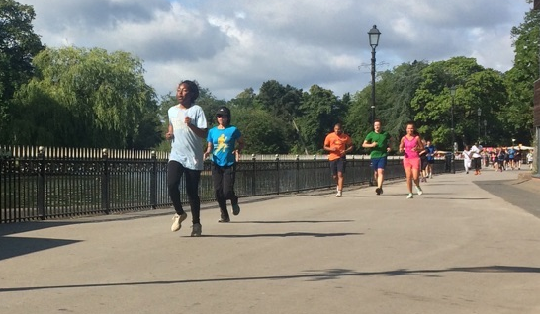
Translating research into practice ……

Slide 20
The rest of the team …..
Jason M.R. Gill,
Daniel F. Mackay,
Naveed Sattar,
Jill P. Pell

Slide 21


Thank you

