Slide 1
DEFINING CHARACTERISTICS OF DIABETIC PATIENTS BY USING DATA MINING TOOLS
Assoc.Prof.Dr. U. Tugba Simsek Gursoy, Istanbul University
08.12.2016

Slide 2
WHAT IS DATA MINING (DM)?
DM is the process of extracting patterns from huge amount of data.
DM is used mainly to find previously unknown correlations between variables that may be commercially useful.

Slide 3
DM uses computers and specialized softwares to discover hidden patterns in mass databases.

Slide 4
CRISP-DM (Cross Industry Standard Process for Data Mining)
CRISP-DM is the industry standard methodology for data mining and predictive analytics.

Slide 5
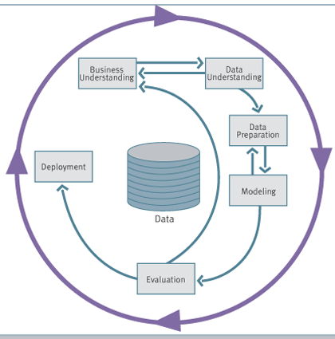
CRISP-DM-2

Slide 6

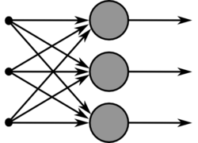


DATA MINING AND RELATED DISCIPLINES
Database Systems
Statistics
Artificial Neural Networks
Data Mining
Other Disciplines
Machine Learning
Data Visualization

Slide 7
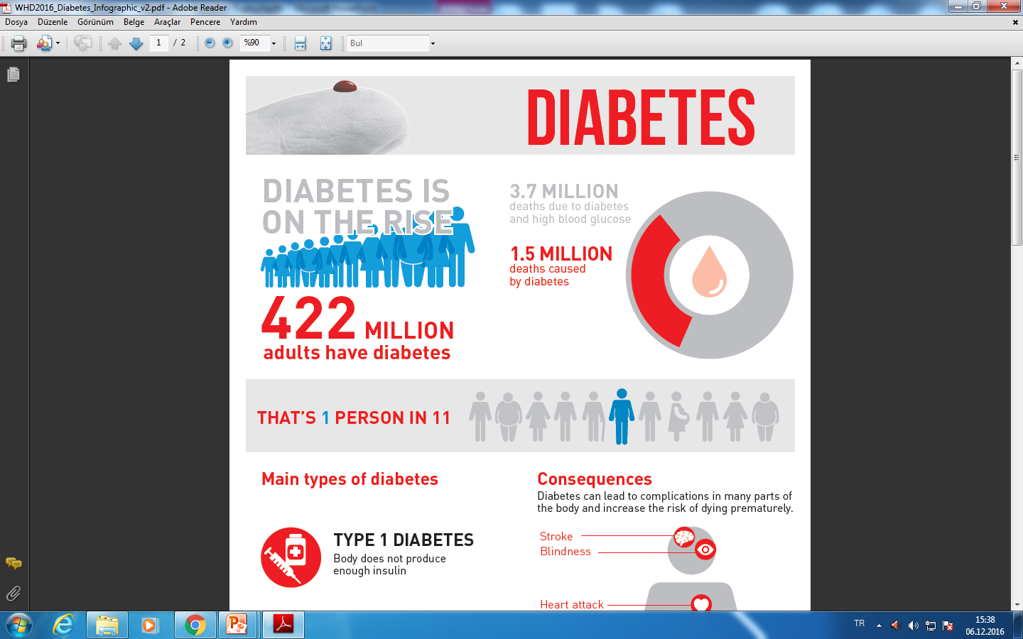
Data Visualization-1. Infographics

Slide 8
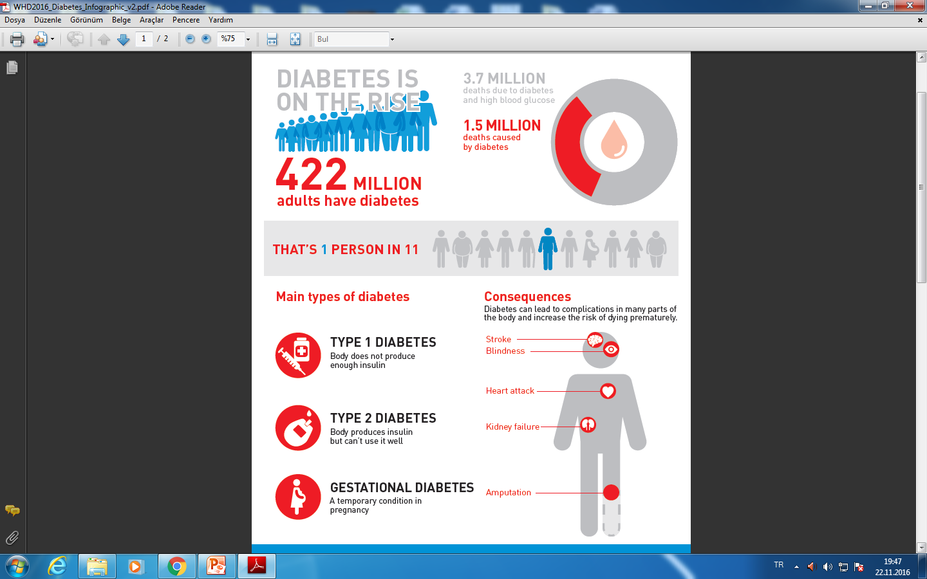
Data Visualization-2. Infographics

Slide 9
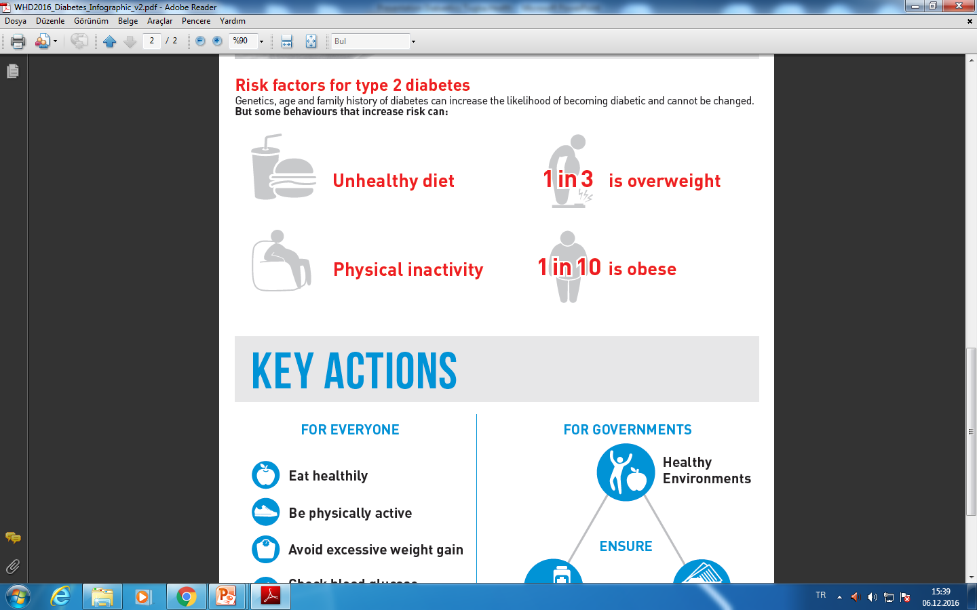
Data Visualization-3. Infographics

Slide 10
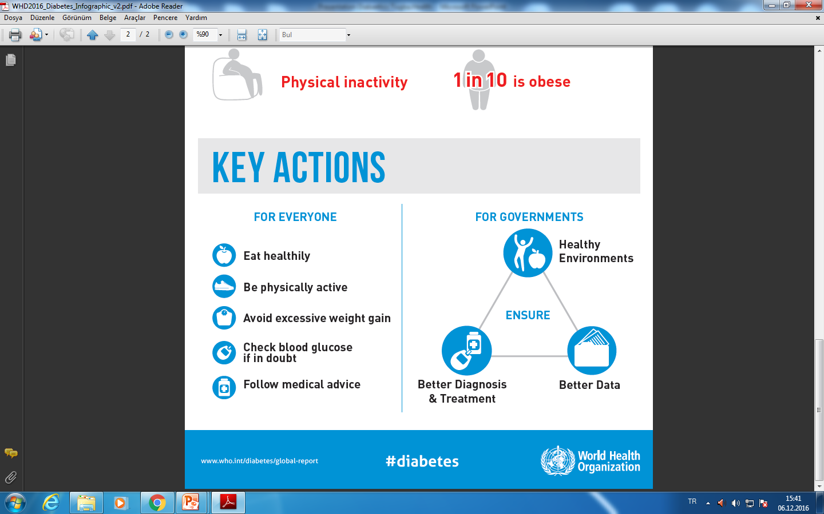
Data Visualization-4. Infographics

Slide 11
DM APPLICATION AREAS
Marketing
Retailing
Fraud detection
Telecommunication
Banking and Finance
Medical applications

Slide 12
DATA MINING TECHNIQUES
DESCRIPTIVE TECHNIQUES
  Association Rules
  Cluster Analysis
PREDICTIVE TECHNIQUES
  Classification
  Statistical Techniques

Slide 13
CLUSTER ANALYSIS
Cluster analysis is the well-known descriptive data mining method.
The objective of cluster analysis is to cluster the observations into groups that are internally homogeneous and heterogeneous from group to group.

Slide 14
ASSOCIATION RULES
Association rule mining finds interesting associations and correlation relationships among large set of data items.
Association rules analysis will be most useful when doing exploratory analyses, looking for interesting relationships that might exist within a dataset.

Slide 15
ASSOCIATION RULES-2
Association Rules Analysis is the rule of analyzes which items frequently occur together in the same transaction.

Slide 16
The classic application of association rule mining is the market basket data analysis, which aims to discover how items purchased by customers in a supermarket or a store are associated. (Diaper- beer syndrome)
Besides market basket data, association analysis is also applicable to other application domains such as education, medical diagnosis, web mining, finance and scientific data analysis.

Slide 17
ASSOCIATION RULES-3
Association Rules are considered interesting if they satisfy both a minimum Support treshold and minimum Confidence treshold.

Slide 18
Support
The percentage of transactions (records) that contain both A and B products.(illness)

Slide 19
Confidence
The percentage of transactions (records) containing A that also contain B.

Slide 20
The discovery of interesting correlation relationships can help in many business decision-making processess, such as:
Catalog design,
Cross-marketing,
Customer shopping behavior analysis.

Slide 21
APPLICATION
Among chronic diseases, diabetes is increasingly becoming a threat to all age groups on a global scale.
Diabetes mellitus prevention and control studies are being conducted commonly.

Slide 22
As well as making lifestyle changes, people with diabetes often need additional treatments such as medication like insulin to control their diabetes, blood pressure and blood fats.

Slide 23
Diabetes, often referred as diabetes mellitus, describes a group of metabolic diseases in which the person has high blood glucose (blood sugar), either because insulin production is inadequate, or because the body's cells do not respond properly to insulin, or both.

Slide 24
Worldwide, it afflicts more than 422 million people. And the World Health Organization estimates that by 2030, that number of people living with diabetes will more than double.

Slide 25
Aim
In this paper the data set of a hospital which is operated in Turkey is used. The profile of the diabetic patients are tried to be identified.

Slide 26
Data set
There are 21 variables and 148 records in the dataset. Some of the variables are
Age,
Gender,
Height,
Weight,
Hypertension

Slide 27
Methods
Cluster Analysis is used to identify the profile of the patients.
Association Rules are used to find which illness occured together.
IBM Modeler is chosen to apply analysis.

Slide 28
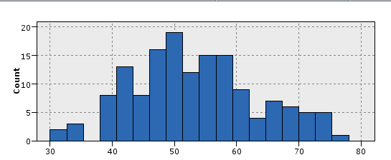
Age
The patients are between 30 and 78. The mean of the age is 53,257 and diabetes is more common in patients over 40 years.

Slide 29
Gender
77.03% of the patients are women and 22.97% are men. Diabetes affects women more.

Slide 30
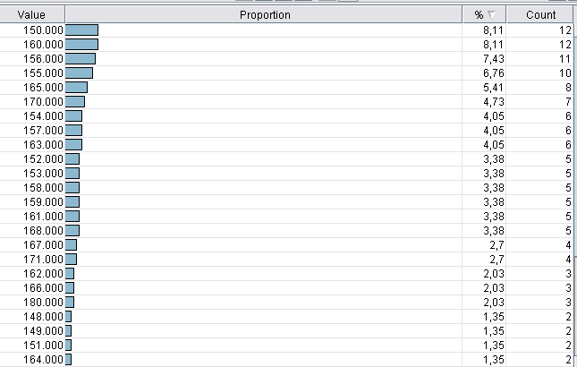
Height
Short people are at risk for diabetes. Patients who are under 170 cm in height are more likely to be affected by the risk of diabetes.

Slide 31
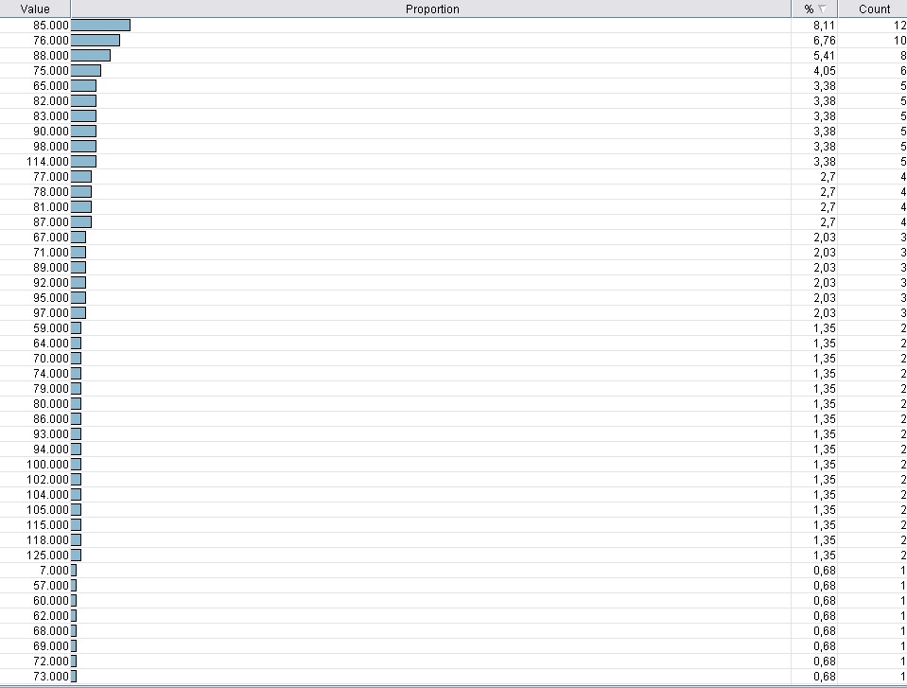
Weight
Overweight people have a higher risk of diabetes. People weighing at least 65 kg are more likely to suffer from diabetes.

Slide 32
Body Mass Index (BMI)
The body mass index (BMI) is a value derived from the mass (weight) and height of an individual. The BMI is defined as the body mass divided by the square of the body height. Commonly accepted BMI ranges are underweight:
under 18.5 kg/m2, normal weight: 18.5 to 25,
overweight: 25 to 30,
obese: over 30.
According to the results, those in the risk group and those in the diabetes are in the “Overweight obese 1, Obese 2 and Morbid obese classes”.

Slide 33
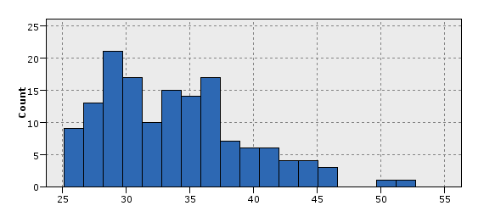
Histogram of BMI

Slide 34
Hypertension
One of the indicators of diabetes is hypertension.
63.51% of the people in the data set have hypertension, and 36.49% do not have high blood pressure.
These ratios show that almost two thirds of diabetic patients are also suffering from hypertension.

Slide 35
Hyperlipidemia
One of the indicators of diabetes is hyperlipidemia. 59.46% of the patients have this disease, while 40.54% do not have this disease.
Hyperlipidemia is abnormally elevated levels of any or all lipids and/or lipoproteins in the blood. Hyperlipidemia or dyslipidemia is also called high blood cholesterol.

Slide 36
Menopause
Menopause is a condition seen in women. For this reason, male patients are ignored. According to the results, diabetes is likely to occur in women entering the menopause process.

Slide 37
Insulin Resistance
Insulin resistance is seen in 76.35% of patients who participated in this study.
Insulin is a hormone made by the pancreas. It allows the cells to use glucose (sugar) for energy. People with insulin resistance have cells that don’t use insulin effectively.
This means the cells have trouble absorbing glucose, which causes a buildup of sugar in the blood.

Slide 38
Dual Insulin Therapy
One of the most common treatments for diabetes is dual insulin therapy. 88.51% of the patients see this treatment.

Slide 39
Metformin
Metformin is the active ingredient of diabetes medicines and is especially used for Type 2 diabetes patients.
81.08% of those participating in the study consume tablets containing this active ingredient.

Slide 40
Urea
This value should be 5 to 25 mg / dl for a healthy people. It is above the value of 25 mg / dl in participants in the dataset. When this value is exceeded, Type 2 diabetes can lead to kidney failure.

Slide 41
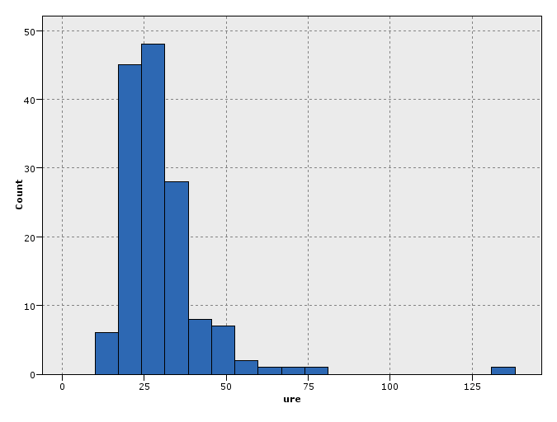
Histogram of Urea

Slide 42
Creatinine
Creatinine blood test is a biochemical test used to evaluate renal function. In healthy individuals, the creatinine value should be between 0.5 and 1.30 mg / dl.
Participants in the study are seen around 1 mg / dL intensively.

Slide 43
Total Cholesterol
Total Cholesterol values are close to the upper limit in the vast majority of participants in the study. The value is above 200 mg /dl. in a significant number of patients.

Slide 44
HDL Cholesterol
It is desirable to be at least 40, for healthy individuals. The distribution of patients is concentrated around this value.

Slide 45
LDL Cholesterol
A low value is desirable. The normal value of this measure is between 60-130 mg / dL. A value of 130 or higher is considered abnormal.
The variance of the distribution is high in the dataset.

Slide 46
VLDL Cholesterol
Very-low-density lipoprotein (VLDL) cholesterol is produced in the liver and released into the bloodstream to supply body tissues with a type of fat (triglycerides). For healthy individuals this value should be between 10-40 mg / dl.
There are patients who are quite above the level.

Slide 47
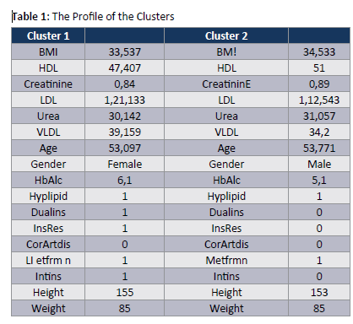
Cluster Analysis

Slide 48
Association Rules
Web graph shows which symptoms occur together. For example, patients who have hypertension, also have coroner art disease and use metformin.

Slide 49
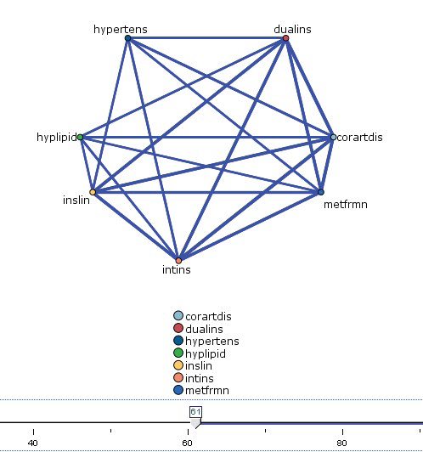
Web Graph

Slide 50
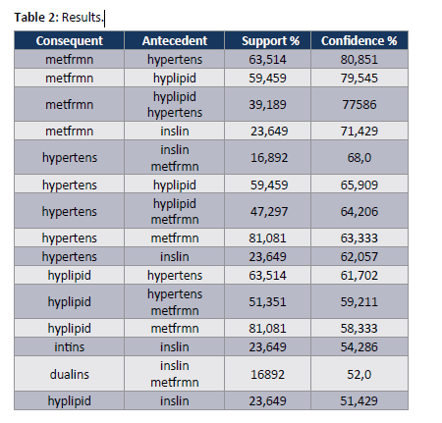
Rulesets

Slide 51
Rulesets-2
80.851% of the patients who have hypertension, also use metformin. The support rate is 63.514%.
79.545% of the patients who have hyperlipidemia, also use metformin. The support rate is 59.459%.
68% of the patients who have insulin resistance and use metformin, also have hypertension. The support rate is 16.892%.
65.909% of the patients who have hyperlipidemia, also have hypertension. The support rate is 59.459%.

Slide 52
Conclusion
Diabetes is a chronic, metabolic disease characterized by elevated levels of blood glucose, which leads over time to serious damage to the heart, blood vessels, eyes, kidneys, and nerves.

Slide 53
For people living with diabetes, access to affordable treatment, including insulin, is critical to their survival. There is a globally agreed target to halt the rise in diabetes and obesity by 2025.
Diabetes mellitus has increased all over the world in recent years. Because of its importance in this paper the profile of the diabetic patients are tried to be identified by using Cluster analysis. All of the related variables are examined in detail. Association rules show which symtoms occured together.
In next studies preventive policies can be studied.

Slide 54
Acknowledgement
This work is supported by research fund of Istanbul University (BAP) with the project number of 23408.

Slide 55
Thank you for your attention…

