Slide 1


Material Science &
Engineering,
September 14-15,
2015, Orlando, USA
Development of highly sensitive micro magnetic sensor for biomagnetic field measurement using magneto-impedance element
Tsuyoshi Uchiyama
¹Graduate school of Engineering, Nagoya University, Nagoya, Japan , tutiyama@nuee.nagoya-u.ac.jp

Slide 2
Domain Structure of Amorphous Wire and
Current Magnetization Utilizing the Skin Effect
Material Science &
Engineering,
September 14-15,
2015, Orlando, USA
H_{ex}
V
domain wall
outer shell
Ks
I(ω)
intermediate
Ki
inner core
Kc
a
μ
Skin depth
ω ： Angular frequency of a current
μ ： Maximum differential permeability along
the circumferential direction
ρ ： Electric resistivity （１３０μΩ‐ｃｍ）
H_{ex}： Applied dc magnetic field
k = (1-j) /δ
Skin effect
Magnetoimpedance (MI ) effect
Notes:
まず、磁気インピーダンス効果について説明します。
アモルファスワイヤに高周波電流を通電させ表皮効果を生じさせたとき、
ワイヤ円周方向最大微分透磁率μが外部磁界で変化するため、表皮深さδも変化します。
アモルファスワイヤのインピーダンスZは、ベッセル関数を用いてこのように表されます。そして表皮効果が起こっていないときは、このように表され、一定となります。
表皮効果が顕著な場合には、このようになり、最大微分透磁率μが磁界で変化するため、インピーダンスZもルートμに比例して変化します。
これをMI効果といいます。

Slide 3
Material Science &
Engineering,
September 14-15,
2015, Orlando, USA
Magnetoimpedance Characteristics
of Amorphous Wire
CoFeSiB (L=10mm,30 μm diameter)
ΔZ/Z₀
Z (Ω）
is more
than100%
Z₀
μ₀H_{ex} (μT)

Slide 4
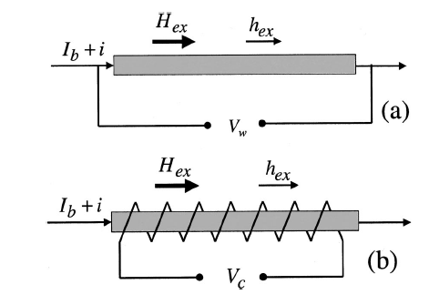
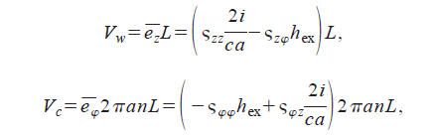
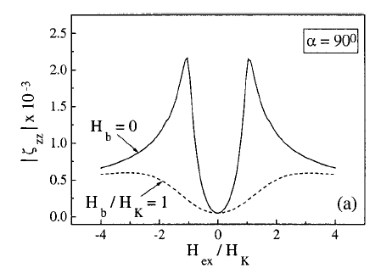
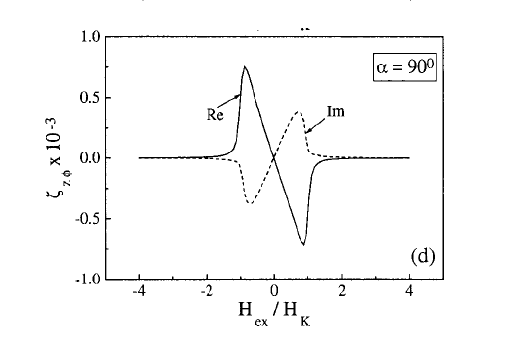
Material Science &
Engineering,
September 14-15,
2015, Orlando, USA
Magnetic Field Response of MI Element
a: radius of the wire
n: number of turns per unit length
Off diagonal component
Impedance
Off diagonal impedance

Slide 5
Material Science &
Engineering,
September 14-15,
2015, Orlando, USA
PREVIOUS WORK
( Micro Magnetic wire ＆ OFF diagonal MI sensor)
・ S. Gudoshnikov, N. Usov, A. Nozdrin, M. Ipatov, A. Zhukov and V Zhukova, “Highly sensitive magnetometer based on the off-diagonal GMI effect in Co-rich glass-coated microwire,” Phys. Status Solidi A, DOI 10.1002/pssa.201300717 , 2014.
・B.Dufay, S. Saez, C. P. Dolabdjian, A. Yelon, and D.Menard,” Characterization of an Optimized Off-Diagonal GMI-Based Magnetometer,” IEEE Sensors Journal, vol. 13, No. 1, pp. 379- 388, 2013.
・T. Uchiyama, S. Nakayama, K. Mohri, and K. Bushida, “Biomagnetic field detection using very high sensitivity magneto-impedance sensors for medical applications, ”Phys. Status Solidi A 206, No.4, pp.639-643, 2009.
・ V. Zhukova, M. Ipatov and A Zhukov, “Thin Magnetically Soft Wires for Magnetic Microsensors,” Sensors 9, 2009.
・S. Sandacci, D. Makhnovskiy, L. Panina, K. Mohri, and Y. Honkura, “Off-diagonal impedance in amorphous wires and its application to linear magnetic sensors,” IEEE Trans. Magn., vol. 40, no. 6, pp. 18–23, 2008.

Slide 6
Material Science &
Engineering,
September 14-15,
2015, Orlando, USA
CMOS Circuit for MI Sensor
H_{ex}
Vdd
ＡＳ
E-out (H_{ex})
Vdd
Pulse generation circuit
(CMOS multi-vibrator)
Signal processing circuit
MI element with pick-up coil
（Amorphous wire）
K. Mohri, Y. Honkura, Amorphous Wire and CMOS IC Based Magneto-Impedance Sensors – Origin, Topics, and Future, SENSOR LETTERS, Vol.5, pp.267-270, 2007.

Slide 7
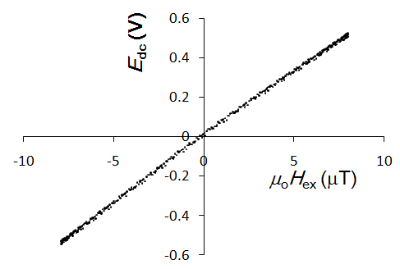
Material Science &
Engineering,
September 14-15,
2015, Orlando, USA
Magnetic Field Detection Characteristics
of CMOS MI Sensor
E_{out}
Sensitivity
70kV/T
Almost no hysteresis : It seems that single like domain structure is realized
due to dc component (total amount ) of pulse current passing through the a- wire.

Slide 8
Material Science &
Engineering,
September 14-15,
2015, Orlando, USA
Ultra Low Intrinsic Noise
It has been pointed out that magnetic field noise spectral density of the MI element within a simplified model for single domain structure is expressed as
T : the temperature
α : the magnetic damping constant
k_{B} : is Boltzman constant
g : gyro magnetic ratio
M₀ : saturation magnetization
a : diameter
l : length of a wire element
Intrinsic magnetic noise is approximately 10 fT for 1cm Co- rich amorphous wire at room temperature.
L .G. C. Melo, D. Menard, A. Yelon, L. Ding, S. Saez, and C. Dolabdjian, “Optimization of the magnetic noise and sensitivity of giant magnetoimpedance sensors”, J. Appl. Phys. vol. 103, pp. 033903-1-03303-6, 2008.

Slide 9
Magnetic Field and Magnetic Sensors
Material Science &
Engineering,
September 14-15,
2015, Orlando, USA
Bio magnetic
field
Nature magnetic
field
Industrial magnetic field
Storage and magnet
Geo-magnetisms
SC-magnet
pT
nT
μT
mT
T
kT
10⁻¹⁰
10⁻⁸
10⁻⁶
10⁻⁴
10⁻²
1
10²
10⁴
10⁶
nG
μG
mG
G
kG
MG
Hall sensor
(0 ~ 1 MHz)
Intrinsic noise level
at room temperature.
ＭＲ、ＧＭＲ sensor
(0 ~ 10 MHz)
Commercial Fluxgate sensor
(0 ~ 10 kHz)
Amorphous wire MI sensor (in developing)
(0 ~ 10 kHz)
SQUID
Proton magnetometer
（0 ~ 0.01Ｈｚ）

Slide 10
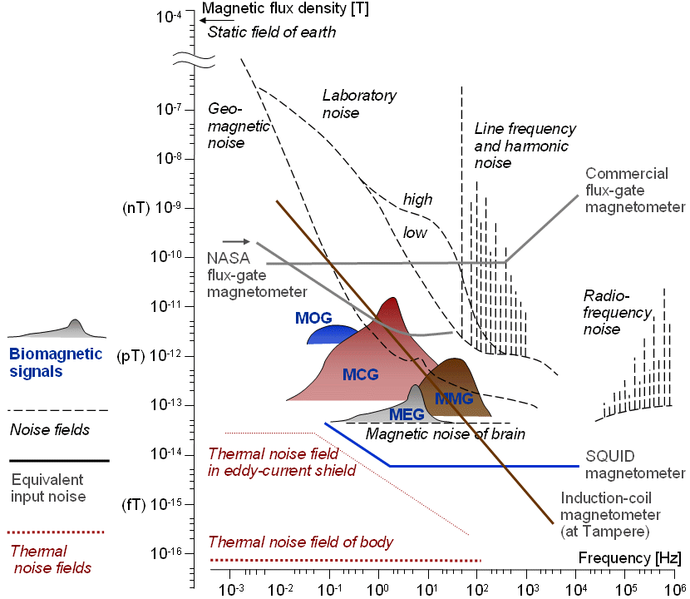
Material Science &
Engineering,
September 14-15,
2015, Orlando, USA
Magnetic noise
around 1nT
(1Hz - 30Hz)

Slide 11
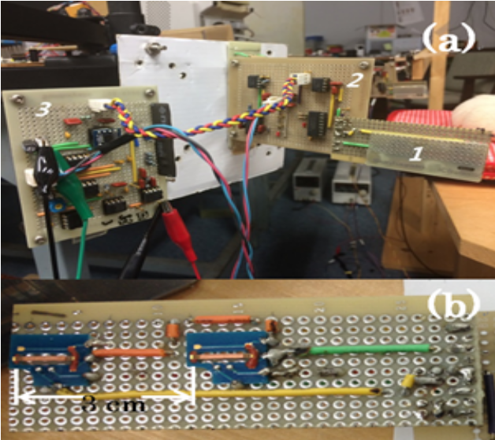
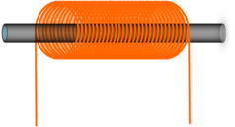
Material Science &
Engineering,
September 14-15,
2015, Orlando, USA
Prototype Biomagnetic Field Measurement System
(First order gradiometer)
MI sensor head
PG : Pulse generator
AS : Analogue switch
PG
AS
AS
d/dt
Sensing
Reference
V₂
-
+
V₁
V_{out}
ΔB
Sensing
Reference
∝ΔB
This sensor element was supplied by Aichi Steel Corp..
Notes:
センサヘッドは二つのMI素子が含まれる。素子間の距離は3センチです。前のは計測用、脳波と環境ノイズを検出します。後ろのは参照用、環境ノイズだけ検出します。この二つの素子の電圧差を出力します。
センサヘッドのアモルファスワイヤは高周波数パルス電流の状態で動作するので、計測回路は主にパルス電流を作ります。
フィルタ回路は電源ノイズと高周波数ノイズを除去します。

Slide 12
修士期間の研究内容
Material Science &
Engineering,
September 14-15,
2015, Orlando, USA
Environmental Magnetic Field in Our Lab
B_{n}: Environmental field
Measurement frequency range
⊿B: Gradiometer output
B_{n}
B( T/Hz^{1/2})
⊿B
40
f (Hz)
Influence of environmental
magnetic field noise as small
as 10 pT in the measurement
frequency range.

Slide 13
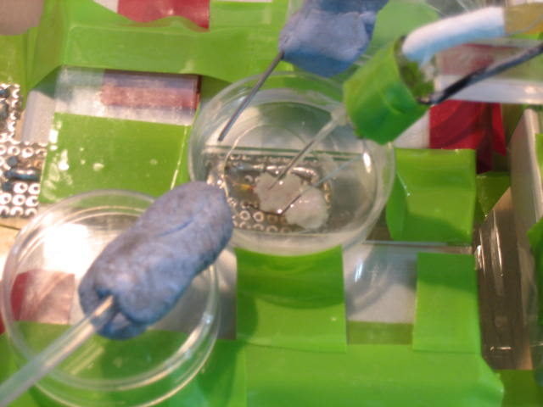
Measurement of Biomagnetic Field
from Living Tissue
Material Science &
Engineering,
September 14-15,
2015, Orlando, USA
Ag-AgCl electrode
Cell tissue
( isolated from guinea pig)
Outer solution
(circulating)
Temperature control 32～34℃
MI sensor (magnetic measurement)
electrode
Stomach musculature
(5mm square）
MI sensor

Slide 14
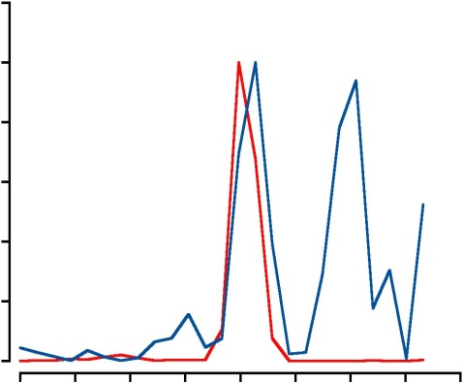
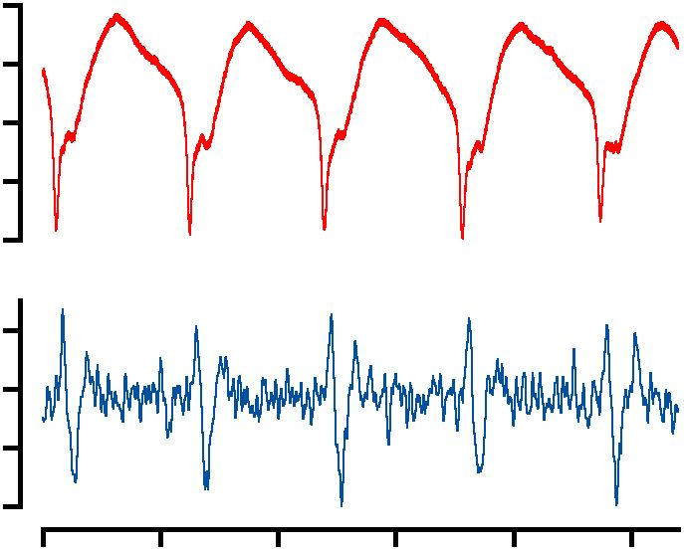
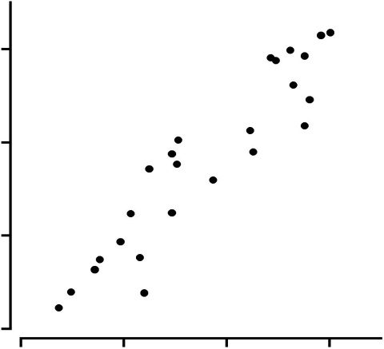
Measurement results； Biomagnteic
field from living tissue sample
Material Science &
Engineering,
September 14-15,
2015, Orlando, USA
Power spectrum
It is known that regular electrical wave is observed
in stomach musculature (after isolated)
1.0
Ex
MI
Intensity ratio (-)
Voltage
0
0
0.04
0.10
0.14
Frequency (Hz)
100μV
Interval of spike
14
Magnetic
13
MI Interval (s)
12
500pT
11
10s
11
12
13
14
Analysis
Ex Interval (s)
by Shinsuke Nakayama
Graduate school of medicine
Fundamental frequency corresponds with each other.
The time interval of the spike has correlation y=x (R=0.93).

Slide 15
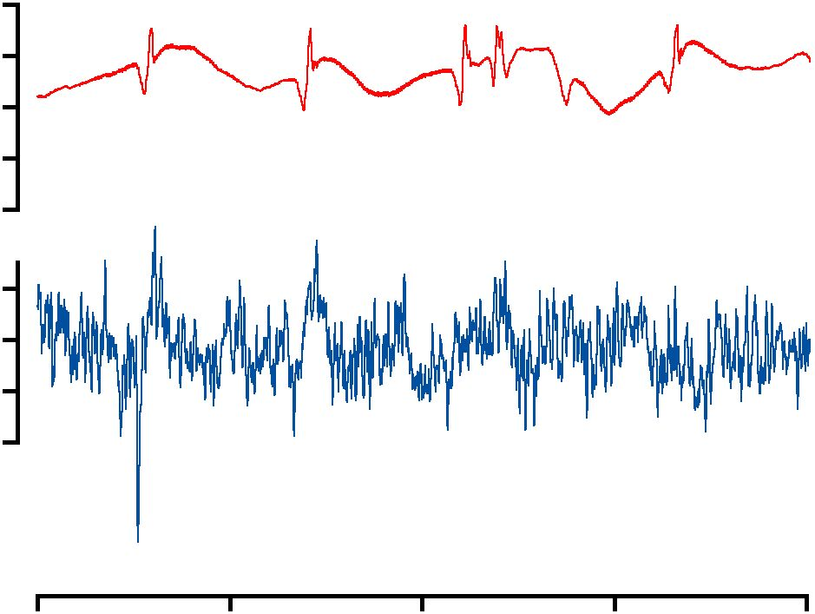
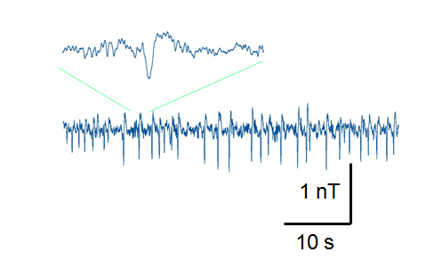
Biomagnteic measurement from different kinds of living tissue
Material Science &
Engineering,
September 14-15,
2015, Orlando, USA
Voltage
500μV
Magnetic
Taenia caeci
500pT
5s
Simultaneously measurement electrical and magnetic activity
after Tetraethylammonium (TEA) application.
Mouse heart
by Shinsuke Nakayama
Graduate school of medicine

Slide 16
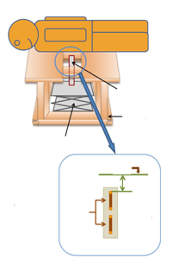

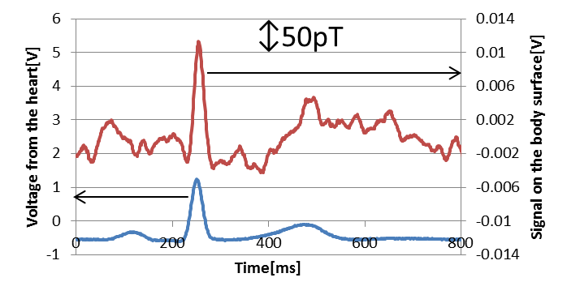
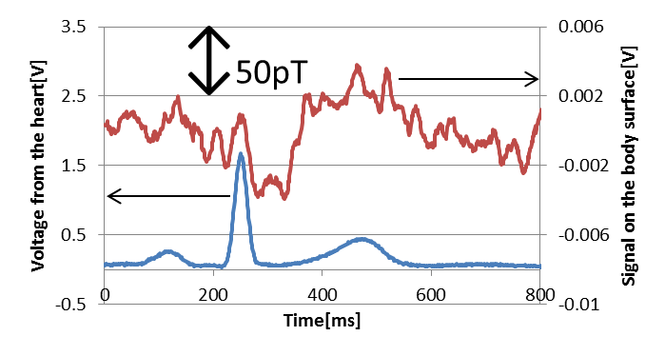
MCG Measurement
Material Science &
Engineering,
September 14-15,
2015, Orlando, USA
(Magnetic cardiography)
Pit of the stomach
MI sensor
Wooden bed
Right
Left
Table
Body surface
Pair head
~ 8 mm
40 mm
Left
Right
Ten times averaged data

Slide 17
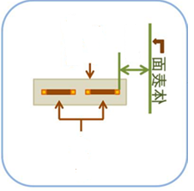



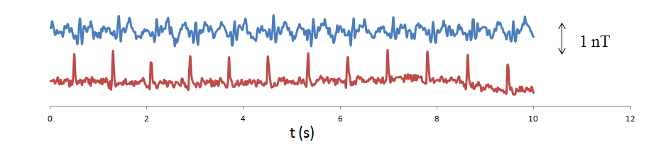
Material Science &
Engineering,
September 14-15,
2015, Orlando, USA
Top of Head
Open hole
Shield case
Body
< 5mm
Coil
Sensor is installed
in the shield case
to avoid influence
of magnetic noise
ＭＩ
ECG

Slide 18
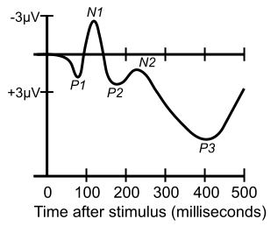
Material Science &
Engineering,
September 14-15,
2015, Orlando, USA
Event-Related Potential
An event-related potential (ERP) is the measured brain response that is the direct result of a specific sensory, cognitive, or motor event. More formally, it is any stereotyped electrophysiological response to a stimulus.
We challenged to measure event-related magnetic field

Slide 19
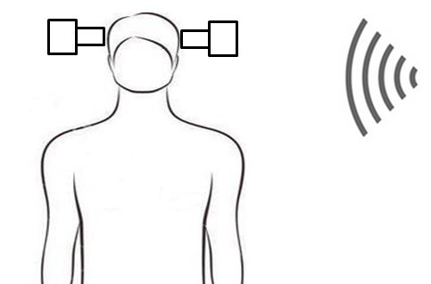
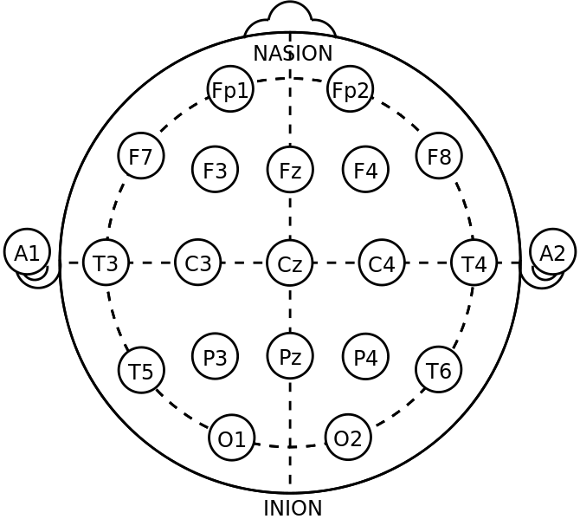
Material Science &
Engineering,
September 14-15,
2015, Orlando, USA
N100 (N1) Experiment ： Method
Audio stimuli ： f = 1000 Hz
Duration 200 ms
Interval 800ms-1400ms
(random)

Slide 20
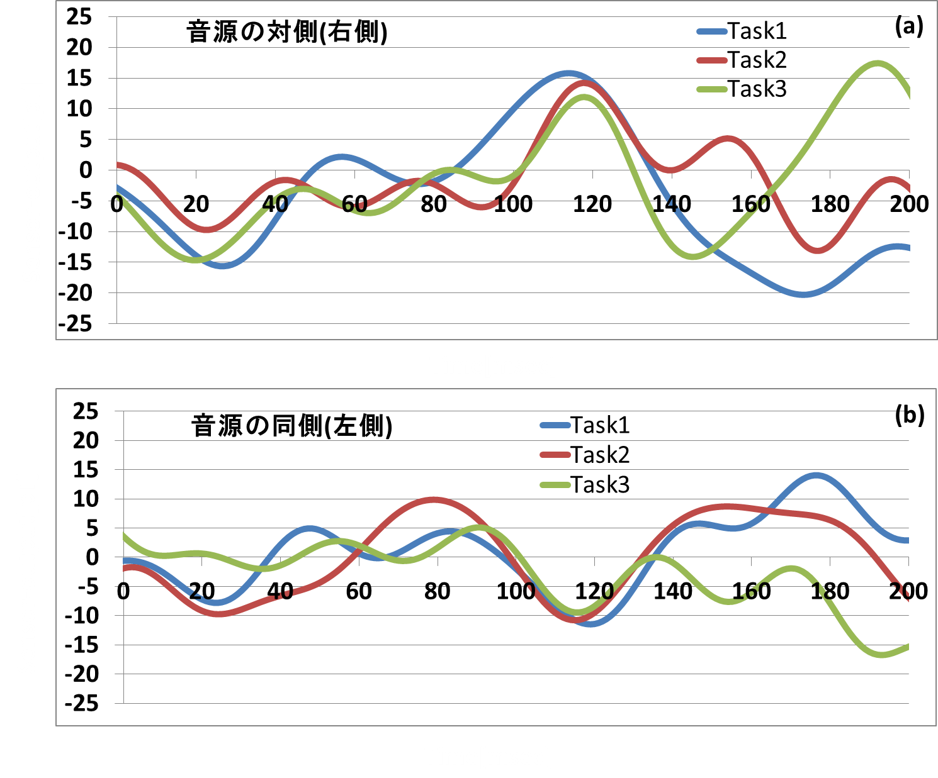
修士期間の研究内容
Material Science &
Engineering,
September 14-15,
2015, Orlando, USA
N100 Experiment ： Result
100 times averaged data (Three times repeat experiment)
N100
Sensor-output[pT]
Opposite side of audio source
(right side)
Noise level
≒１ｐＴ
Because
of 100 times
averaging.
Time[msec]
Sensor-output[pT]
Same side of audio source
(left side)
N100
Time[msec]

Slide 21
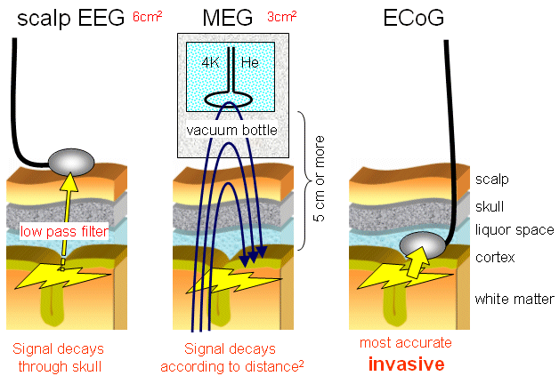
Material Science &
Engineering,
September 14-15,
2015, Orlando, USA
Discussions
Magnetoencephalography : MEG
MI
~ 1.5cm
~ 1.0 cm

Slide 22
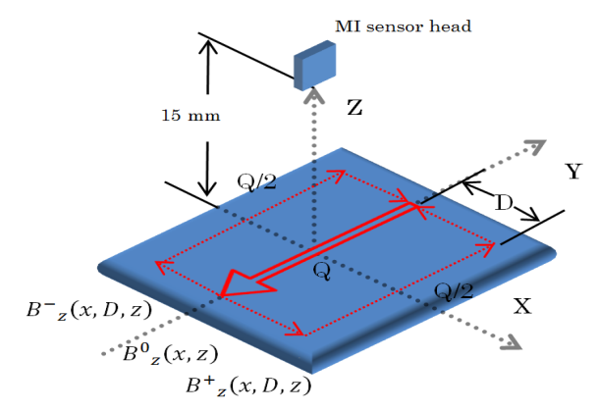
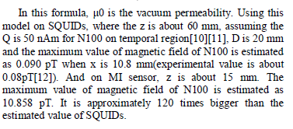
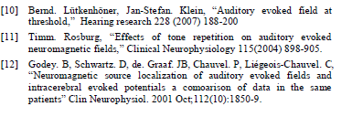
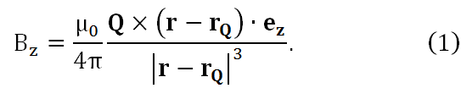
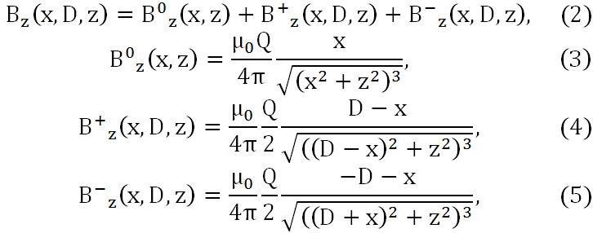
Material Science &
Engineering,
September 14-15,
2015, Orlando, USA
Dipole Current Model with Return Current
Q = 50nA・m
~100 fT for Z = 60 mm
~10 pT for Z = 15mm
(SQUID)
(MI)
Parameter : D = 20mm

Slide 23
Material Science &
Engineering,
September 14-15,
2015, Orlando, USA
Summary
We carried out biomagnetic field measurement from living cell tissue using developed precise gradiometer. We have detected magnetic field synchronized with electric potentials at the surface of stomach tissue isolated from guinea pig.
In addition, magnetic field from mouse heart with rhythmical activity can be detected using developed gradiometer system.
We have also tried to measure biomagnetic field from the heart and brain of the human. Cardiac magnetic field which corresponds to MCG was identified (ten times averaging data). The signal strength of N100 evoked magnetic field measured by MI sensor is compared with the strength measured by SQUID.

Slide 24
Material Science &
Engineering,
September 14-15,
2015, Orlando, USA
Thank you for your attentions !

