Slide 1
A presentation on
POSTHARVEST LOSSES OF YAM AND THE CONTROL WITH PLANT EXTRACTS IN BENUE STATE, NIGERIA, WEST AFRICA.
by
Tseaa Shambe
Department of Chemistry, Benue State University Makurdi, Nigeria
At the 15th International Pharmaceutical Microbiology and Biotechnology Conference London, UK
June 21-23, 2017

Slide 2
Abstract
Benue State in the north central zone of Nigeria, West Africa, is the highest producer of Dioscorea alata (water yam) and Dioscorea rotundata (white yam), but large numbers of the produce is lost annually to attack of microorganisms among other loss factors. Research conducted on yam microbial tuber rot and Pathogenicity test on yam tubers from 2014 to date, from various local government areas of Benue State show that: six microorganisms were isolated from water yam; two bacteria, Erwinia carotovora, Pseudomonas aeruginosa and four fungi; Aspergillus niger, Aspergillus flavus, Rhizopus stolonifera, Penicillium marneffei; ten were isolated from white yam; four bacteria, Erwinia carotovora, Pseudomonas aeruginosa, Serratia marcescens, Klebsiella oxytoca and six fungi, Botryyodiplodia theobromae, Rhizopus stolonifera, Aspergillus niger, Aspergillus flavus, Fusarium oxysporum, Penicillium marneffei; the fungi Botryyodiplodia theobromae, Penicillium marneffei and Aspergillus flavus appear occasionally but not consistently.

Slide 3
Abstract cont’d
They were treated with nine plant extracts (Ceiba pentandra, Jatropha tanjorensis, Azadarichta indica, Moringa oleifera, Carica papaya, Mangifera indica, Daniella oliveri, Terminalia catapa and Passiflora edulis) singly or synergistically. Three of the isolated microorganisms were completely inhibited by single plant extracts. Terminalia catapa completely inhibited the bacteria Erwinia carotovora; Jatropha tanjorensis completely inhibited the bacteria Pseudomonas aeruginosa and Passiflora edulis completely inhibited one fungi, Rhizopus stolonifera. Nine plants extract synergisticaly inhibited the four bacteria isolates at 2.0 mL incorporation in culture media.

Slide 4
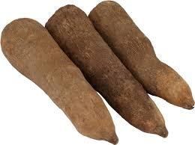
INTRODUCTION
Yam belong to the family Dioscoreaceae, genus Dioscorea comprising of more than six hundred species but only a few species are cultivated as food [3] [11].Two most important commercial species are Dioscorea alata and Dioscorea rotundata [3]

Slide 5
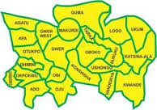

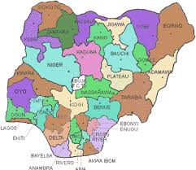
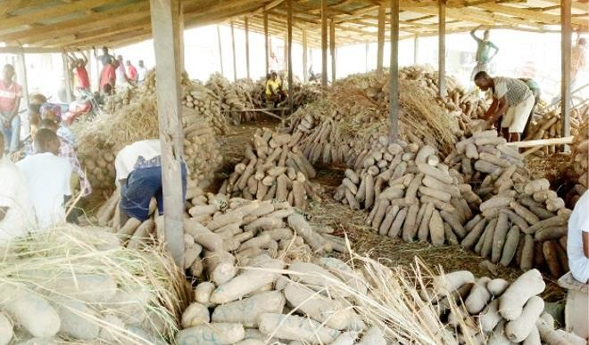
INTRODUCTION
Benue
Yams
World
Nigeria
The highest producer of yam in the world is Nigeria;
Benue state in the north central zone of Nigeria, produces more yam than any other state because of its favorable weather and soil [3] [5].

Slide 6

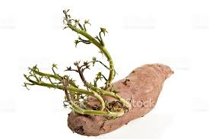
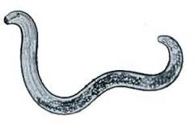
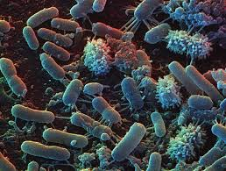
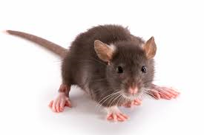
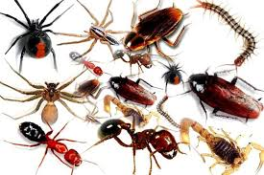
INTRODUCTION Cont’d
Main Causes Of Postharvest Losses [3] [5]
Nematodes
Temperature
Sprouting
Insects
Rodents
Microorganisms

Slide 7
INTRODUCTION Cont’d
Microbial postharvest loss is the most dangerous cause [6]
Microorganisms

Slide 8
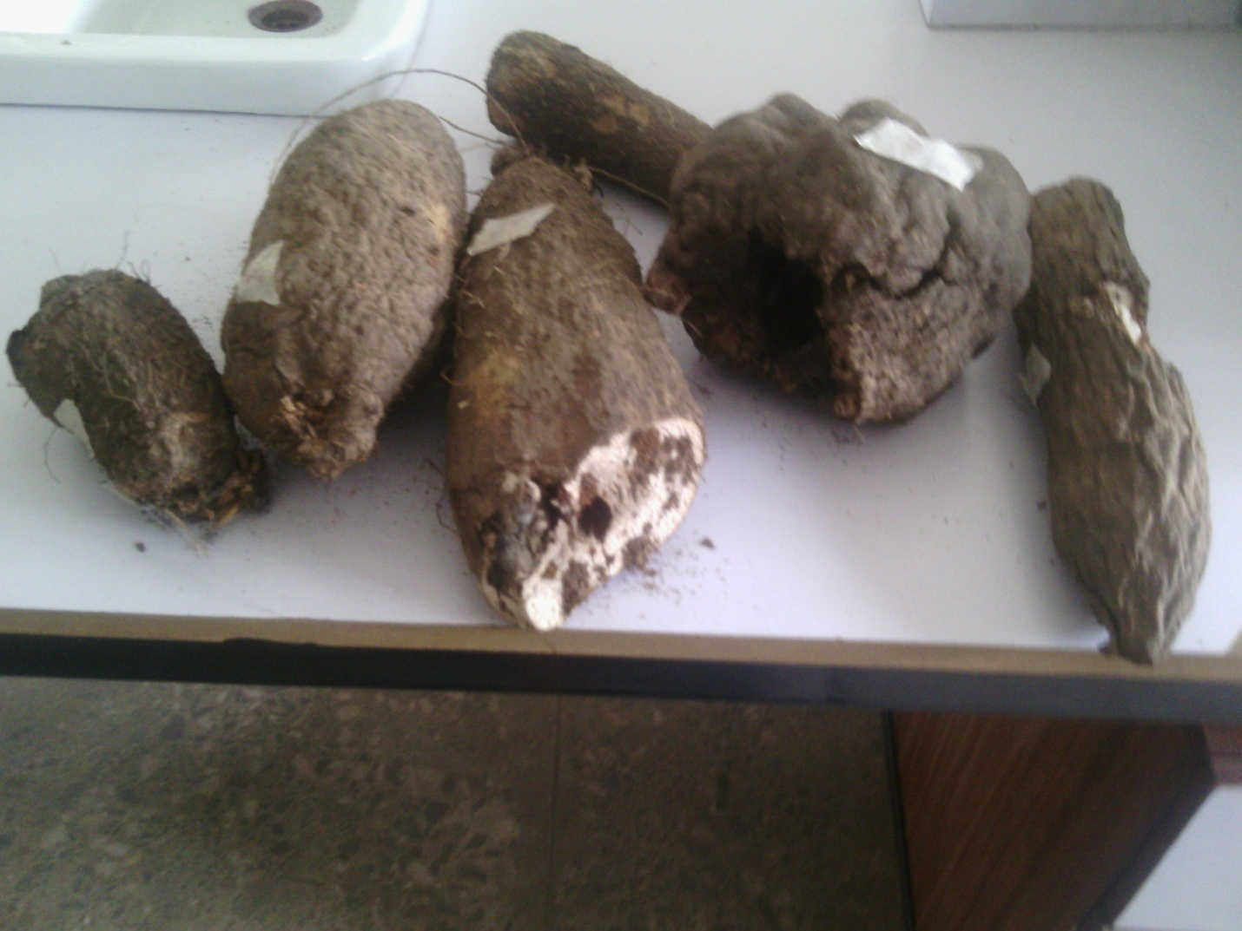
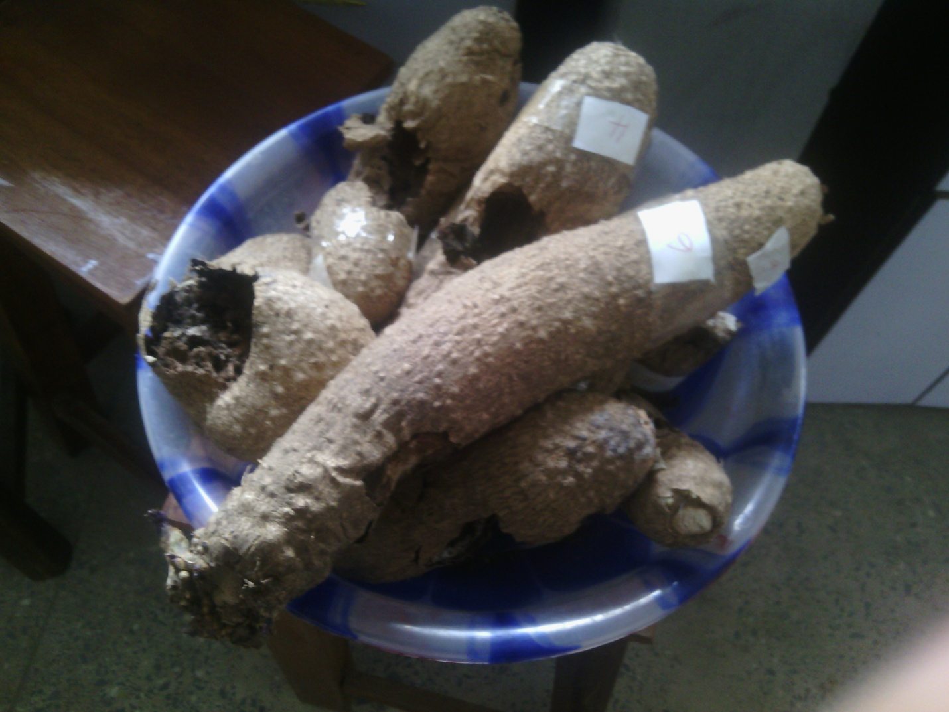
INTRODUCTION Cont’d
Rotten water yam
Rotten white yam
Laboratory investigation confirms that bacteria and fungi are responsible for these losses [5] 7] [8].

Slide 9
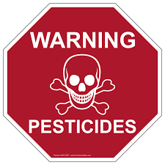
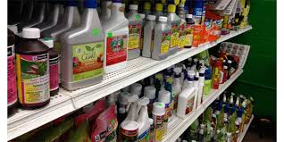
INTRODUCTION Cont’d
These damages can be stopped or at least contained by the use of Pesticides;
Pesticides however are reported to be toxic, resisted by microorganisms and causes environmental pollution[10].

Slide 10
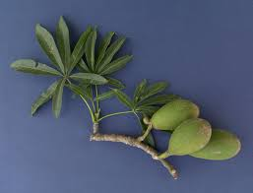
INTRODUCTION Cont’d
Plant extracts are known to inhibit partially or completely microorganisms. A composite mixture of plant extract normally referred to as synergistic plant extract often gives better result than that obtained from single plant extract [9] [10] [11].
Ceiba pentandra
One of the plants used (Tiv - Vambe)

Slide 11
Methodologies
Materials and methods used are as in [6] [7] [13].

Slide 12
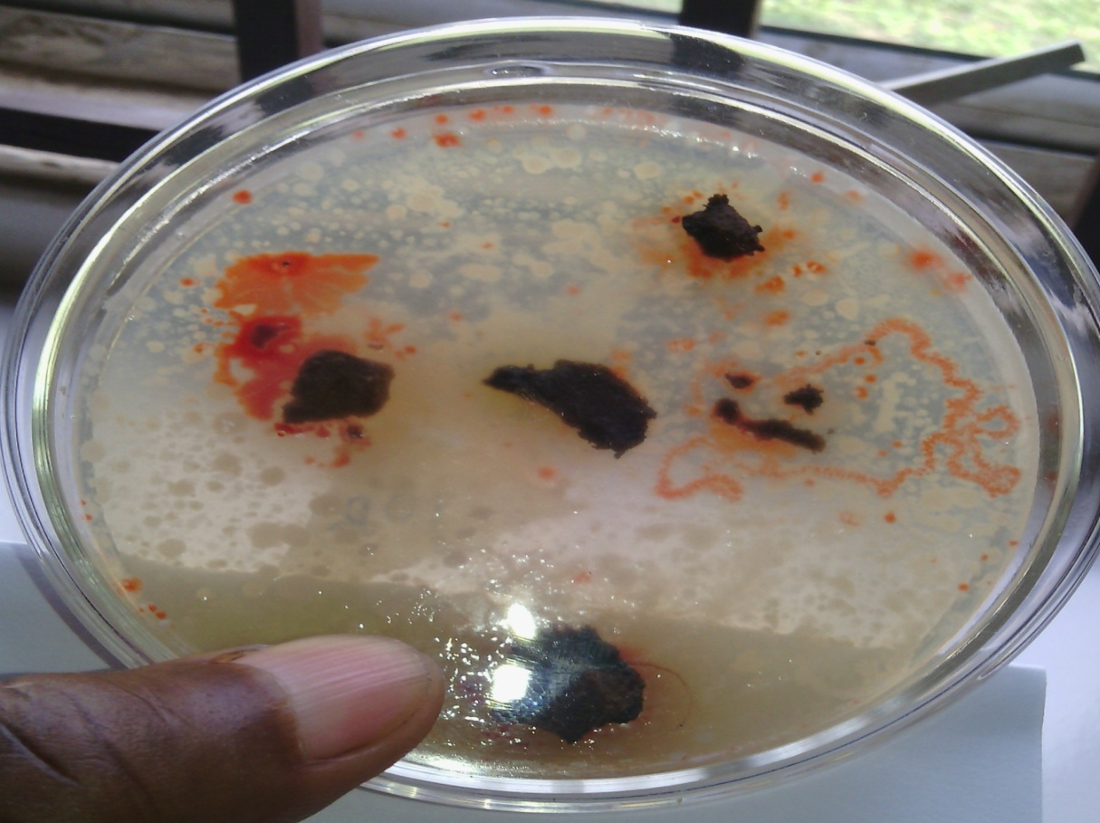
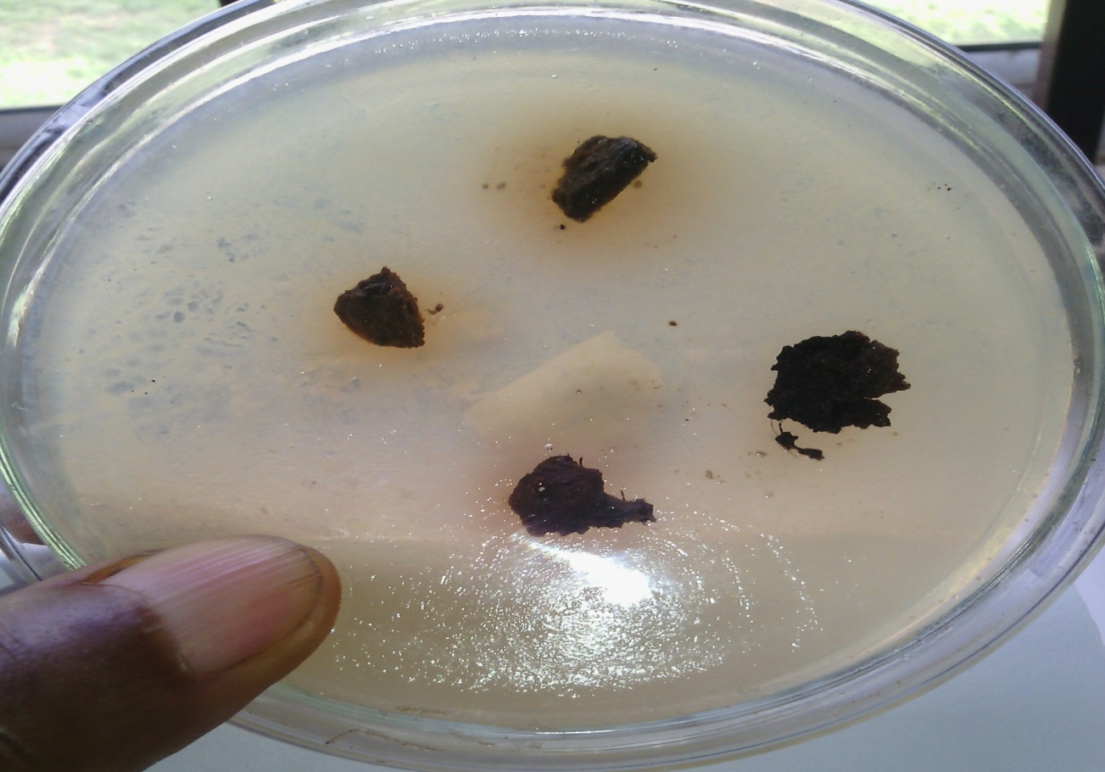
Methodologies Cont’d
Mixed bacteria growth from yam pieces on nutrient agar
1
2

Slide 13
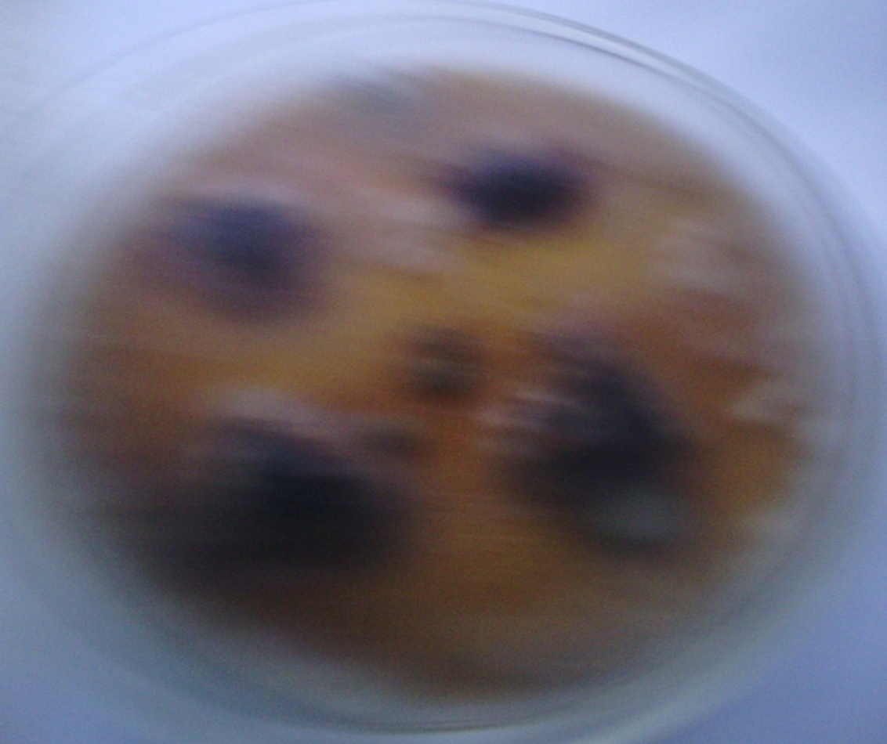
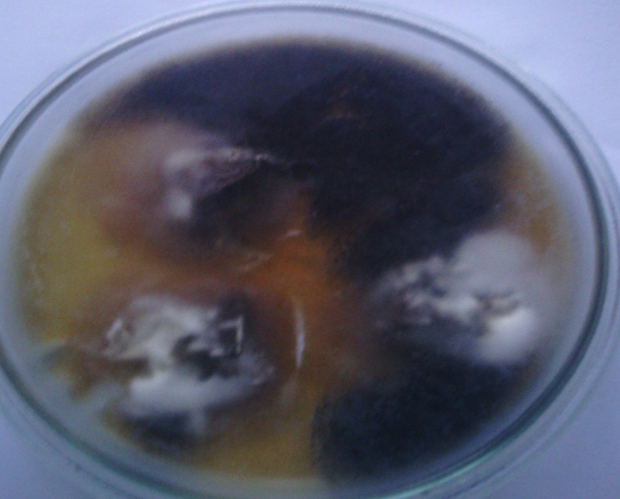
Methodologies Cont’d
Mixed Fungi Growth from Yam Pieces Cultured on Potato Dextrose Agar
1
2

Slide 14
Results
Six microorganisms were isolated from water yam; two bacteria, Erwinia carotovora, Pseudomonas aeruginosa and four fungi; Aspergillus niger, Aspergillus flavus, Rhizopus stolonifera, Penicillium marneffei (Table 1 in [7]).

Slide 15
Results
Table 1: Microorganisms isolated from Rotten Water Yam (2014 harvest, [7])
Yam Variety/ sample area | Fungi Isolated |  |  |  | Bacteria Isolated
 | Aspergillus niger | Aspergillus flavus | Rhizopus stolonifera | Penicillium marneffei | Erwinia carotovora | Pseudomonas aeruginosa
Azawele-wele
 | + | + | + | - | - | +
 | - | - | - | + | - | +
 | + | + | + | - | + | -
 | + | - | + | + | + | -
Incidence Ratio | ¾ | 2/4 | ¾ | 2/4 | 2/4 | 2/4
Kor
 | + | + | + | - | - | +
 | + | + | + | - | - | +
 | + | - | + | + | - | +
 | + | + | + | - | - | +
Incidence Ratio | 4/4 | ¾ | 4/4 | ¼ | 0/4 | 4/4
Banada
 | + | + | - | + | - | +
 | + | + | + | - | + | -
 | + | - | + | + | - | +
 | + | + | + | - | - | +
Incidence Ratio | 4/4 | ¾ | ¾ | 2/4 | ¼ | ¾
Key: First Site: 1& 2 in Tarka Local Government Area Second Site: 3 & 4 in Vandeikya Local Government Area + = presence of the microorganism- = absence of the microorganism.

Slide 16
Results Cont’d
Ten microorganisms were isolated from white yam; four bacteria, Erwinia carotovora, Pseudomonas aeruginosa, Serratia marcescens, Klebsiella oxytoca (appearing consistently) and six fungi, Botryyodiplodia theobromae, Rhizopus stolonifera, Aspergillus niger, Aspergillus flavus, Fusarium oxysporum, Penicillium marneffei; Botryyodiplodia theobromae, Penicillium marneffei and Aspergillus flavus did not appear consistently (Table 2 in [6] and Table 3 in [13]).

Slide 17
Results Cont’d
Table 2: Microorganisms Isolated from Rotten White Yam (2014 harvest, [6])
Microorganism |  | Amula | Ogoja | Hembamkwase | Gbongu
Fungi Isolated | Aspergillus niger | + | + | + | +
 | Rhizopus stolonifera | + | + | + | +
 | Botryodiplodia theobromae | + | + | + | +
 | Fusarium oxysporum | + | + | + | +
 | Penicillium marnessei | + | + | + | +
Bacteria Isolated | Serratia marcescens | - | + | - | +
 | Erwinia carotovora | - | + | + | +
 | Klebsiella oxytoca | + | + | + | -
 | Pseudomonas aeruginosa | + | + | + | +
Key: + = Present; - = Absent

Slide 18
Results Cont’d
Table 3: Microorganisms Isolated from Rotten White Yam (2016 harvest, [13])
Bacteria | Fungi
Erwinia carotovora | Rhizopus stolonifera
Pseudomonas aeruginosa | Aspergillus niger
Serratia marcecens | Aspergillus flavus
Klebsiella oxytoca | Fusarium oxysporum
 | Penicillium marneffei

Slide 19
Results Cont’d
Three of the isolated microorganisms were completely inhibited by single plant extracts. Terminalia catapa completely inhibited the bacteria Erwinia carotovora; Jatropha tanjorensis completely inhibited the bacteria Pseudomonas aeruginosa and Passiflora edulis completely inhibited one fungi, Rhizopus stolonifera (Table 4 c, e, f in [7]), (Table 5 in [6]).
Treatment with synergistic plants extract completely inhibited all the four isolated bacteria; no fungi was completely inhibited but showed inhibition of various degrees; Rhizopus stolonifera, Aspergillus flavus, and Fusarium oxysporum showed 60% inhibition and Aspergillus niger, Penicillium marneffei showed 80% inhibition (Table 6 in [13]).

Slide 20
Results Cont’d
Table 4 a-f: Single Plant Extract inhibition Test on Water Yam Isolates (2014 harvest, [7])
(a) Antimicrobial sensitivity test on the fungi Aspergillus niger;
(b) Antimicrobial sensitivity test on the fungi Aspergillus flavus;
(c) Antimicrobial sensitivity test on the fungi Rhizopus stolonifera;
(d) Anti-microbial sensitivity test on the fungi Penicillium marneffei;
(e) Antimicrobial sensitivity test on the bacteria Erwinia caro-tovora;
(f) Antimicrobial sensitivity test on the bacteria Pseudomonas aeruginosa.

Slide 21
Results Cont’d
(a) Antimicrobial sensitivity test on the fungi Aspergillus niger;
Plant | Fresh Extractconcentrations |  |  | Dry Extract concentrations
 | 100% | 10⁻¹ | 10⁻² | 100% | 10⁻¹ | 10⁻²
Terminalia catapa | ++^{d} | _^{f} | _^{f} | +^{e} | _^{f} | _^{f}
Passiflora edulis | ++++^{b} | ++++^{b} | ++^{d} | +++^{c} | +++^{c} | +^{e}
Daniella oliveri | ++^{d} | _^{f} | _^{f} | +^{e} | _^{f} | _^{f}
Ceiba pentandra | +^{e} | ++^{d} | ++^{d} | _^{f} | +^{e} | +^{e}
Jatropha tanjorensis | ++^{d} | ++^{d} | +^{e} | +^{e} | +^{e} | +^{e}
Azadirachtaindica | +++^{c} | ++^{d} | _^{f} | ++^{d} | _^{f} | -^{f}
Carica papaya | +++^{c} | ++^{d} | _^{f} | ++^{d} | _^{f} | -^{f}
Moringaoleifera | +++^{c} | +^{e} | _^{f} | +^{e} | _^{f} | _^{f}
Mangiferaindica | ++^{d} | +^{e} | _^{f} | +^{e} | _^{f} | _^{f}
Summary: | a =0 d =9 |  | a = 0 d=2
 | b =2 e =4 |  | b = 0 e =10
 | c = 3 f =8 |  | c=2 f= 12
Key:
100 % = undiluted plant extract; +++++= complete inhibition ++++ = high inhibition; +++ = good inhibition; ++ = moderate inhibition; + = mild inhibition; - = no inhibition. Variance of plant extracts (fresh and dry) inhibition of various microorganisms: a = Complete inhibition, b = high inhibition, c = good inhibition, d = moderate inhibition, e = mild inhibition, f = no inhibition.

Slide 22
Results Cont’d
(b) Antimicrobial sensitivity test on the fungi Aspergillus flavus;
Plant | Fresh Extract concentrations |  |  | Dry Extract concentrations
 | 100% | 10⁻¹ | 10⁻² | 100% | 10⁻¹ | 10⁻²
Terminalia catapa | ++^{d} | +^{e} | -^{f} | +^{e} | -^{f} | -^{f}
Passiflora edulis | ++++^{b} | ++++^{b} | ++^{d} | +++^{c} | +++^{c} | +^{e}
Daniella oliveri | ++^{d} | +^{e} | -^{f} | +^{e} | -^{f} | -^{f}
Ceiba pentandra | +^{e} | +^{e} | +^{e} | -^{f} | +^{e} | +^{e}
Jatropha tanjorensis | ++^{d} | +^{e} | +^{e} | +^{e} | +^{e} | -^{f}
Azadirachtaindica | +++^{c} | ++^{d} | -^{f} | ++^{d} | +^{e} | -^{f}
Carica papaya | +++^{c} | ++^{d} | -^{f} | ++^{d} | +^{e} | -^{f}
Moringaoleifera | +++^{c} | ++^{d} | -^{f} | ++^{d} | -^{f} | -^{f}
Mangiferaindica | +++^{c} | ++^{d} | -^{f} | +^{e} | -^{f} | -^{f}
Summary: | a =0 d=7 |  | a=0 d=3
 | b=2 e=7 |  | b=0 e=10
 | c=4 f=6 |  | c=2 f=12

Slide 23
Results Cont’d
(c) Antimicrobial sensitivity test on the fungi Rhizopus stolonifera;
Plant | Fresh Extractconcentrations |  |  | Dry Extract concentrations
 | 100% | 10⁻¹ | 10⁻² | 100% | 10⁻¹ | 10⁻²
Terminalia catapa | +++^{c} | ++^{d} | +^{e} | ++^{d} | +^{e} | +^{e}
Passiflora edulis | +++++ª | +++++ª | ++++^{b} | ++++^{b} | ++++^{b} | +++^{c}
Daniella oliveri | -^{f} | -^{f} | -^{f} | -^{f} | -^{f} | -^{f}
Ceiba pentandra | -^{f} | -^{f} | -^{f} | _^{f} | -^{f} | -^{f}
Jatropha tanjorensis | ++++^{b} | +++^{c} | +^{e} | +++^{c} | +^{e} | -^{f}
Azadirachta indica | +^{e} | -^{f} | -^{f} | -^{f} | -^{f} | -^{f}
Carica papaya | +^{e} | -^{f} | -^{f} | -^{f} | -^{f} | -^{f}
Moringa oleifera | -^{f} | -^{f} | -^{f} | -^{f} | -^{f} | -^{f}
Mangifera indica | -^{f} | -^{f} | -^{f} | -^{f} | -^{f} | -^{f}
Summary: | a=2 d=1 |  | a=0 d=1
 | b=2 e=4 |  | b=2 e=3
 | c=2 f=16 |  | c=2 f=19

Slide 24
Results Cont’d
(d) Anti-microbial sensitivity test on the fungi Penicillium marneffei;
Plant | Dry Extract concentrations |  |  | Dry Extract concentrations
 | 100% | 10⁻¹ | 10⁻² | 100% | 10⁻¹ | 10⁻²
Terminalia catapa | ++^{d} | -^{f} | -^{f} | +^{e} | -^{f} | -^{f}
Passiflora edulis | ++++^{b} | ++++^{b} | ++++^{b} | +++^{c} | +++^{c} | +++^{c}
Daniella oliveri | ++^{d} | +^{e} | -^{f} | +^{e} | -^{f} | -^{f}
Ceiba pentandra | +^{e} | +^{e} | -^{f} | +^{e} | +^{e} | -^{f}
Jatropha tanjorensis | ++^{d} | -^{f} | -^{f} | +^{e} | -^{f} | -^{f}
Azadirachta indica | ++++^{b} | ++^{d} | +^{e} | ++^{d} | +^{e} | +^{e}
Carica papaya | ++++^{b} | ++^{d} | +^{e} | ++^{d} | +^{e} | +^{e}
Moringa oleifera | ++++^{b} | ++^{d} | +^{e} | ++^{d} | +^{e} | +^{e}
Mangifera indica | ++++^{b} | ++^{d} | +^{e} | ++^{d} | +^{e} | +^{e}
Summary: | a=0 d=5 |  | a=0 d=4
 | b=7 e=7 |  | b=0 e=13
 | c=0 f=6 |  | c=3 f=7

Slide 25
Results Cont’d
(e) Antimicrobial sensitivity test on the bacteria Erwinia carotovora;
Plant | Fresh Extract concentrations |  |  | Dry Extract concentrations
 | 100% | 10⁻¹ | 10⁻² | 100% | 10⁻¹ | 10⁻²
Terminalia catapa | +++++ª | +++++ª | +++++ª | +++++ª | +++++ª | ++++^{b}
Passiflora edulis | ++++^{b} | +++^{c} | ++^{d} | +++^{c} | ++^{d} | +^{e}
Daniella oliveri | +^{e} | -^{f} | -^{f} | -^{f} | -^{f} | -^{f}
Ceiba pentandra | ++^{d} | +^{e} | +^{e} | +^{e} | +^{e} | +^{e}
Jatropha tanjorensis | ++++^{b} | +++^{c} | ++^{d} | +++^{c} | ++^{d} | ++^{d}
Azadirachta indica | +++^{c} | +^{e} | -^{f} | ++^{d} | +e | -^{f}
Carica papaya | ++++^{b} | +^{e} | -^{f} | ++++^{b} | +^{e} | -^{f}
Moringa oleifera | +++^{c} | +^{e} | -^{f} | ++^{d} | +^{e} | -f
Mangifera indica | +++^{c} | +^{e} | -^{f} | ++^{d} | +^{e} | -^{f}
Summary: | a=5 d=3 |  | a=2 d=6
 | b=3 e=7 |  | b=2 e=8
 | c=5 f=6 |  | c=2 f=7

Slide 26
Results Cont’d
(f) Antimicrobial sensitivity test on the bacteria Pseudomonas aeruginosa.
Plant | FreshExtract concentrations |  |  | Dry Extract concentrations
 | 100% | 10⁻¹ | 10⁻² | 100% | 10⁻¹ | 10⁻²
Terminalia catapa | ++++^{b} | +++^{c} | +^{e} | +++^{c} | ++^{d} | +^{e}
Passiflora edulis | ++^{d} | ++^{d} | +^{e} | +^{e} | +^{e} | +^{e}
Daniella oliveri | +++^{c} | +++^{c} | ++^{d} | ++^{d} | ++^{d} | +^{e}
Ceiba pentandra | ++++^{b} | +++^{c} | ++^{d} | +++^{c} | +++^{c} | ++^{d}
Jatropha tanjorensis | +++++ª | +++++ª | ++++^{b} | ++++^{b} | ++++^{b} | ++++^{b}
Azadirachta indica | +++^{c} | +^{e} | -^{f} | ++^{d} | +^{e} | -^{f}
Carica papaya | ++++^{b} | ++^{d} | +^{e} | ++^{d} | +^{e} | +^{e}
Moringa oleifera | +++^{c} | ++^{d} | +^{e} | ++^{d} | +^{e} | -^{f}
Mangifera indica | ++^{d} | +^{e} | -^{f} | ++^{d} | -^{f} | -^{f}
Summary: | a=2 d=7 |  | a=0 d=8
 | b=4 e=6 |  | b=3 e=9
 | c=6 f=2 |  | c=3 f=4

Slide 27
Results Cont’d
Table 5: Single plant Extracts Inhibition Test on White Yam Isolates (2014 harvest, [6])
Plant | Fungi / Extract concentrations |  |  | Bacteria/Extract concentrations
 | Aspergillus niger |  |  | Serratia marcescens
 | 100% | 10⁻¹ | 10⁻² | 100% | 10⁻¹ | 10⁻²
Terminalia catapa | + | - | - | - | - | -
Passiflora edulis | +++ | +++ | + | - | - | -
Daniella oliveri | + | - | - | + | - | -
Ceiba pentandra | - | + | + | ++ | + | -
Jatropha tanjorensis | + | + | + | + | - | -
 | Rhizopus stolonifera |  |  | Erwinia carotovora
Terminaliacatapa | ++ | + | + | +++++ | +++++ | ++++
Passiflora edulis | ++++ | ++++ | +++ | +++ | ++ | +
Daniella oliveri | - | - | - | - | - | -
Ceibapentandra | - | - | - | + | + | +
Jatrophatanjorensis | +++ | + | - | +++ | ++ | ++
 | Fusariumoxysporum |  |  | Klebsiellaoxytoca
Terminaliacatapa | + | + | + | + | + | +
Passiflora edulis | +++ | ++ | ++ | + | + | +
Daniella oliveri | + | + | ++ | + | + | +
Ceibapentandra | +++ | +++ | + | ++ | + | +
Jatrophatanjorensis | +++ | ++ | + | ++++ | ++ | +
 | Botryodiplodiatheobromae |  |  | Pseudomonas aeruginosa
Terminaliacatapa | - | - | - | +++ | ++ | +
Passiflora edulis | +++ | +++ | +++ | + | + | +
Daniella oliveri | + | - | - | ++ | ++ | +
Ceibapentandra | - | - | - | +++ | +++ | ++
Jatrophatanjorensis | - | - | - | ++++ | ++++ | ++++
Key:
100 % = undiluted plant extract; +++++, ++++ = high sensitivity or activity; +++ = good sensitivity or activity;++ = moderate sensitivity or activity; + = mild sensitivity or activity; - = no sensitivity or activity.
The effect of dry plant extracts on various microorganisms.
Terminalia catapa completely inhibited the bacteria Erwinia carotovora.

Slide 28
Results Cont’d
Table 6: Synergistic Activity of Plant Extracts Incorporation on Isolates 2016 harvest [13].
Microorganism | Extract volume applied
 |  | 1ml | 2ml | 3ml | 4ml | 5ml
Bacteria
Erwiniacarotovora | ₊ ^{e} |  | +++++ª | NA | NA | NA
Pseudomonas aeruginosa | -^{f} |  | +++++ ª | NA | NA | NA
Serratiamarcescens | -^{f} |  | +++++ ª | NA | NA | NA
Klebsiellaoxytoca | + ^{e} |  | +++++ ª | NA | NA | NA
Fungi
Rhizopusstolonifera | - ^{f} |  | -^{f} | - ^{f} | + ^{e} | +++^{c}
Aspergillusniger | - ^{f} |  | - ^{f} | +^{e} | ++^{d} | ++++^{b}
Aspergillusflavus | - ^{f} |  | - ^{f} | - ^{f} | ++ ^{d} | +++ ^{c}
Fusariumoxysporum | - ^{f} |  | - ^{f} | - ^{f} | + ^{e} | +++ ^{c}
Penicilliummarneffei | - ^{f} |  | - ^{f} | + ^{e} | ++ ^{d} | ++++^{b}
Key:
= no inhibition, + =mild inhibition(about 10% inhibition), ++ =moderate inhibition(about 50% inhibition), +++ =good inhibition(about 60% inhibition), ++++ =high inhibition(about 80% inhibition), +++++ = complete inhibition (100% inhibition),
NA = not applicable, f =no inhibition, e =mild inhibition, d = moderate inhibition, c = good inhibition, b = high inhibition, a = complete inhibition.

Slide 29
DISCUSSION
The organisms isolated on the yam pieces were confirmed by pathogenicity test as being responsible for the yam rot and were partially or fully inhibited by plant extracts; these findings are in agreement with [2].
Fresh plants leaves extracts showed higher inhibition than that of the dried leaves, this is in agreement with the findings of [2].

Slide 30
DISCUSSION Cont’d
The inhibition of the microorganisms decreases with decrease in concentration. It is therefore most probable that the active ingredients in the dried leaves were hydrolyzed by enzymes till denatured before the hydrolyses stopped thereby leaving a smaller quantity of the active ingredients. Alternatively, a change in their conformation partially occurred thus leaving the active ingredients apparently reduced in quantity [6] [7] [13].

Slide 31
DISCUSSION Cont’d
The bacteria, Erwinia carotovora, and Pseudomonas aeruginosa and the fungi, Rhizopus stolonifera were completely inhibited by single plant extracts (Terminalia catapa, Passiflora edulis and Jatropha tanjorensis) respectively [6] [7].
All the isolated bacteria, four, were completely inhibited by the synergistic mixture [13] showing that all or some of the extracts collectively participated in the inhibition (ratio of synergistic concentration to singlet concentration is 1.0: 4.5) [13].

Slide 32
DISCUSSION Cont’d
No fungi was completely inhibited due to lower concentration of the extract as when used in the single plant extract but showed 60% to 80% inhibition [13]. Addition of synergistic plants extract did not enhance inhibition of the plant extract on fungi. The addition of 5 mL of the synergistic mixture which produce equivalent concentration of passiflora edulis in the singlet extraction which inhibited the fungi Rhizopus stolonifera was unable to completely inhibit it.

Slide 33
DISCUSSION Cont’d
Fewer microorganisms were detected in water yam [6] than in white yam [7] [13]. This explains the observed phenomena that white yam is more readily attacked by microorganisms than water yam.

Slide 34
Conclusion and recommendation
Pesticides as of now provide an easier way for prevention of postharvest microbial losses but their toxic and health hazards pose a danger to mankind. They have negative impact on sales of crops treated with them. There is the need to look for an alternative. Plant extracts, with more research may be this alternative. This research shows that proper dosage can completely inhibit the microorganisms.

Slide 35
references
[1]Osunde, Z.D. (2008) Minimizing Postharvest Losses in Yam (Dioscorea spp.): Treatment and Techniques. International Union of Food Science and Technology, Raleigh, 1-12.
[2] Okigbo, R.N., Agbata, C.A, Echezona, C.E. (2010). Effects of Leaf Extracts of Azadirachtaindica and Chromolaenaodorata on Post Harvest Spoilage of Yams in Storage. Current Research Journal of Biological Sciences 2(1): 9 - 12
[3] Imeh, J., Onimisi, M.Y. and Jonah, S.A. (2012) Effect of Irradiation on Sprouting of Water Yam (Dioscorea alata) Using Different Doses of Gamma Radiation. American Journal of Chemistry, 2, 137-141. http://dx.doi.org/10.5923/j.chemistry.20120203.07
[4] Ajayi, A.O. and Olorundare, S.D. (2014). Bacterial and Fungal Species Associated with Yam (Dioscorearotundata) Rot at Akanugba—Akoko, OndoStaste, Nigeria. Applied Science Research Journal, 2, 12-28.

Slide 36
references
[5]Taiga, A. (2012) Differential Rate of Dry Rot in Dioscorearotundata (white yam) along the Tuber Length Due to Rot Causing Fungi. Advances in Microbiology, 2, 452-455
[6] Shiriki, D., Ubwa, S.T. and Shambe, T. (2015) Isolation of Nine Microorganisms from Rotten Dioscrearotundata (White Yam) and Antimicrobial Sensitivity Test with Five Plant Extracts. Food and Nutrition Sciences, 6, 825-835. http://dx.doi.org/10.4236/fns.2015.610086
[7] Onuh, J.O., Shiriki, D., Ubwa, S.T. and Shambe, T. (2015) Isolation of Six Microorganisms from Rotten Dioscoreaalata (Water Yam), and Antimicrobial Sensitivity Test with Nine Plant Extracts. Food and Nutrition Sciences, 6, 1381-1394. http://dx.doi.org/10.4236/fns.2015.615144

Slide 37
references
[8] Deshi, S.N., Wonang, D.L., Dafur, B.S. (2014). Control of Rots and Spoilage of Agricultural Products: A Review. Academic Journal of Interdisciplinary Studies. MCSER Publishing, Rome-Italy. Vol 3 No 7 Doi: 10.5901/ajis.2014.v3n7p38
[9] Okigbo, R.N. and Emeka, A.N. (2010) Biological Control of Rot-Inducing Fungi of Water Yam (Dioscorea alata) with Trichoderma harzianum, Pseudomonas syringae and Pseudomonas chlororaphis. Journal of Stored Products and Postharvest Research, 1, 18-23.
[10] Priti, M., Aditi, S., Vivek, R.S., Dharmendra, S. and Yati. M. (2013) Antimicrobial Activity of Indigenous Wildly Growing Plants: Potential Source of Green Antibiotics. African Journal of Microbiology Research, 7, 3807-3815. http://www.academicjournals.org/AJMR

Slide 38
references
[11] Gajera, H.P. and Vakharia, D.N. (2012) Production of Lytic Enzymes by Trichoderma Isolates during in Vitro Antagonism with Aspergillus niger, the Causal Agent of Collar Rot of Peanut. Brazilian Journal of Microbiology, 43, 43-52. http://dx.doi.org/10.1590/S1517-83822012000100005
[12] Asare, P. and Oseni, L.A. (2012) Comparative Evaluation of Ceiba pentandra Ethanolic Leaf Extract, Stem Bark and the Combination thereof for In-Vitro Bacterial Growth Inhibition. Journal of Natural Sciences Research, 2, 44-49. www.iiste.org
[13] Shiriki, D., Obochi, G.O., Eke, M.O. and Shambe, T. (2017). Synersgistic Effect of Nine Plants Extrast on Nine Microorganisms Isolated From Dioscorea Rotundata (white yam). Food and Nutrition Science in press

Slide 39


