Slide 1

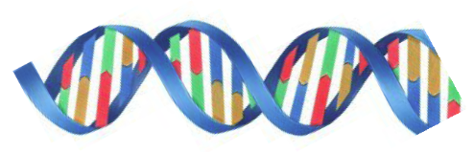
Early preclinical study of BO-1978 for the treatment of non-small cell lung carcinoma (NSCLC), in combination with Gefitinib
5th International Conference and Exhibition on
Pharmaceutics and Novel Drug Delivery System
Dubai, March 16-18, 2015
Tann-Long Su
(tlsu@ibms.sinica.edu.tw)
Institute of Biomedical Sciences, Academia Sinica,
Taipei 115, Taiwan.

Slide 2
Estimated Mortality Rate of New Cancer Cases by Sex for All Sites, US, 2010
100 (1,529,560)
37.2 (569,490)
16
15
14
14
14
Estimated New Cases
12
Estimated Deaths
10.6
10
Percentage (%)
8
7
6
5
4
3.5
4
4
2.7
3
3
3
2.5
3
2
2
2
1
1.2
1.5
1.6
1.4
1.4
1.4
1.3
1.1
1
0.8
0.5
0.8
0.7
0.9
0.7
0.8
0.3
0
0.1
All Sites
Prostate
Breast
Colon
Thyroid
Pancreas
Leukemia
Stomach
Ovary
Myeloma
Non-Hodgkin
lymphoma
Esophagus
Uterine corpus
Brain & other
nervous system
Uterine cervix
Lung & bronchus
Urinary bladder
Kidney & renal pelvis
Liver & intrahepatic
bile duct
Causes of cancers Atlanta: American Cancer Society; 2010.

Slide 3
Trends in 5-year Relative Survival Rates (%) by Race and Year of Diagnosis, US, 1975-2005
100
100
97
94
93
96
93
93
90
90
87
86
88
84
83
82
84
82
1975-1977
80
76
79
79
78
1984-1986
75
74
74
72
70
69
70
68
69
69
69
1999-2005
68
66
67
66
63
63
60
57
59
54
53
56
55
54
50
51
52
53
Percentage (%)
49
50
48
46
42
40
40
35
37
37
36
30
26
29
29
27
24
20
18
19
16
16
13
14
10
13
10
5
6
6
4
3
3
0
All sites
Thyroid
Testis
Rectum
Kidney
Colon
Larynx
Ovary
Brain
Prostate
Leukemia
Myeloma
Stomach
Pancreas
Breast (female)
Uterine corpus
Uterine cervix
Non-Hodgkin
lymphoma
Esophagus
Urinary bladder
Lung & bronchus
Hodgkin lymphoma
Liver & bile duct
Melanoma of the skin
Oral cavity & pharynx
Causes of cancers Atlanta: American Cancer Society; 2010.

Slide 4
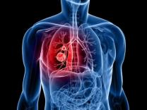
Human Lung Cancer
Non-small call lung cancer (NSCLC)
Small cell lung cancer (SCLC)
NSCLC
The most common cancer worldwide.
About 85% to 90% of lung cancers are
non-small cell lung cancer
• Squamous carcinoma (25% of lung cancers).
Adenocarcinoma (40% of lung cancers)
Large cell carcinoma (10% of lung cancers)
High incidence, most mortality: 1.18 million deaths (17.6% of the world’s total cancer deaths)
American Cancer Society 2013

Slide 5
The Role of EGFR in Oncogenesis
■ Epidermal Growth Factor Receptor's (EGFR)
overexpression in 62% of NSCLC
■ Oncogenesis:
  Cancer cell proliferation
  Blocking apoptosis
  Activating invasion and metastasis
  Stimulating tumor-induced neovascularization

Slide 6
Drugs Approved for Non-Small Cell Lung Cancer
Antimetabolites | Methotrexate Pemetrexed Disodium Gemcitabine Hydrochloride
DNA alkylating agents | Mechlorethamine Cisplatin Carboplatin
Antimitotic agents | Paclitaxel Docetaxel Vinorelbine Navelbine
Topoisomerase inhibitor | Etoposide Doxorubicin Topotecan
EGFR inhibitor | Afatinib Dimaleate Gefitinib (Iressa) Erlotinib Hydrochloride
ALK inhibitor | Ceritinib Crizotinib
VEGFR antibody | Avastin (Bevacizumab) Ramucirumab

Slide 7
Target therapeutic against EGFR for NSCLC
  Gefitinib (Iressa)
  inhibitor of epidermal growth factor receptor's (EGFR)
  tyrosine kinase domain
Erlotinib
  EGFR inhibitor
Cetuximab
    Monoclonal antibody recognizes EGFR

Slide 8
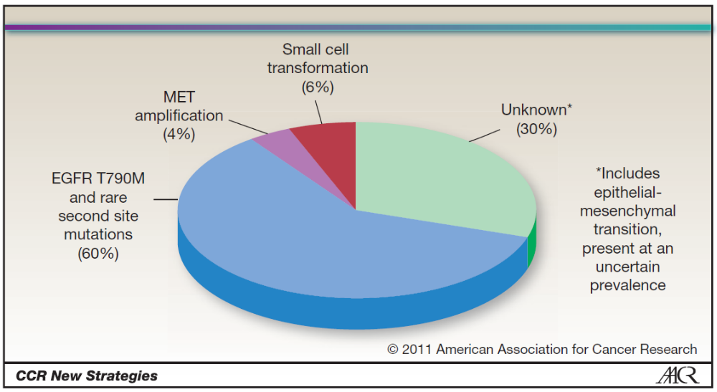
Limitation of using TKI inhibitors (EGFR inhibitors) for treating NSCLC
■ Only effective in certain small subpopulations
of NSCLC patients
■ Eventually, nearly all patients become resistant to
EGFR inhibitors
Developing of new therapeutic agent against TKI resistance is of critical and essential
■ Patients with EGFR mutant lung cancer develop
disease progression after a median of 10 to 14
months on TKI treatment

Slide 9
Naturally occurring pyrrolizidine alkaloids
DNA cross-linking agents
White, Biochem. J. 1972, 128, 291
Pyrrolizines
Bis(hydroxymethyl)pyrroles

Slide 10
The proposed mechanism of action of DNA cross-linking by
bis(hydroxymethyl)pyrroles or
their bis(alkylcarbamate) derivatives
X = OH
X = OCONHR'
R' = Me, Et or iso-Pro, etc.
Anderson WK, J. Med. Chem., 1977, 20, 812-818.

Slide 11
Antitumor bis(hydroxymethyl)pyrrole derivatives
and their analogues
R¹ = H, -CONHMe, -CONHEt or -CONH-i-Pr
R²= Me, Et, Substituted Ph, or MeO, etc.
■ Anderson, WK
■ Su, T.-L.

Slide 12
Rational drug design of new bifunctional DNA interstrand cross-linking agents
5,10-Dihydropyrrolo[1,2-b]-
isoquinolines
3a-Azacyclopenta[a]indenes
BO-1509 + ATO or DNA repair inhibitor
Effectively inhibits MDR tumors
Bioorg. Med. Chem. 2011, 19, 275.
Bioorg Med Chem. 2009, 17, 5614.
Neoplasia. 2010,12, 376.
R¹ = OH, CONHR (R = Me, Et, iso-pro)
R² = alkyl or substituted phenyl
R³ = H, Me, CH₂C₆H₅
.
4H-Benzo[d]pyrrolo-
[1,2-a]thiazoles
Eur. J. Med. Chem. 2012, 53, 28-40.
Indolizino[6,7-b]indoles
J Med Chem. 2013 Jan 29

Slide 13
Indolizino[6,7-b]indole, a hybrid of β-carboline and bis(hydroxymethyl)pyrrole
Bis(hydroxymethyl)-
pyrrole
DNA cross-linker
β-Carboline
Topo I and II,
Inhibitor,
CDK inhibitor
R¹ = Me, Et, or CH₂Ph
R² = H, or CONH-alkyl
R³ = Alkyl or substituted phenyl

Slide 14
Chemical synthesis of bis(hydroxymethyl)- indolizino[6,7-b]indole derivatives
Reagents and conditions: (a) formaldehyde, MeOH; (b) R³COCl, TEA; (c) NaH, MeI, THF; (d) DMAD, Ac₂O, 60–75 °C; (e) LAH, ether, DCM, 0 °C; (f) R²NCO, TEA.
Chaniyara, R. J. Med. Chem. 2013, 56, 1544

Slide 15
The cytotoxicity of selected indolizino[6,7-b]indole derivatives against NSCLC cells growth in vitro (IC₅₀, µM)
BO-1922, R¹ = Me, R² = H, R³ = Me
BO-1978, R¹ = Me, R² = H, R³ = Et
BO-1972, R¹ = Et, R² = H, R³ = Me
BO-1973, R¹ = Et, R² = CONHEt, R³ = Me
BO-1974, R¹ = Et, R² = CONH-i-Pr, R³ = Me
 | PC9 | PC9/gefb4 [RF]ª | CL141T | H460 | A549 | H1299 | HEL299
BO-1922 | 0.43±0.02 | 0.57±0.16 [1.32x] | 0.51±0.16 | 0.38±0.09 | 0.64±0.16 | 2.89±0.35 | 0.61±0.28
BO-1978 | 2.10±1.06 | 2.45±1.21 [1.17x] | 1.32±0.47 | 3.11±0.38 | 3.15±1.20 | 3.02±0.65 | 4.23±2.22
BO-1972 | 0.92±0.23 | 0.87±0.22 [0.95x] | 0.79±0.33 | 0.73±0.35 | 2.97±1.00 | 2.07±0.55 | 0.99±0.48
BO-1973 | 2.28±0.48 | 2.68±0.90 [1.18x] | 1.40±0.30 | 2.81±0.46 | 5.32±1.01 | 1.87±0.13 | ND
BO-1974 | 1.52±0.43 | 1.40±0.43 [0.92x] | 1.88±0.59 | 1.51±0.33 | 2.64±0.72 | 0.85±0.16 | ND
Cisplatin | 8.12±1.14 | 36.50±2.55 [4.50x] | 2.80±0.36 | 8.88±1.86 | 31.10±3.03 | 16.53±0.90 | 1.8±0.41
Gefitinib | 0.53±0.26 | 14.15±4.13 [26.70x] | 20.56±3.34 | 28.41±7.44 | 17.65±1.55 | 27.87±2.34 | ND
ªRF = Resistant factor

Slide 16
The cytotoxicity of BO-1978 against cell growth of human lymphoblastic leukemia (CCRF-CEM) and various solid tumor cell lines
 | IC₅₀ (µM)ª
 | CCRF/CEM | PC3 | OECM1 | MX-1 | HCT-116 | CL141T | A549 | H460 | HT-29 | HEL299
BO-1978 | 0.20 | 3.32 | 2.11 | ND | ND | 1.32 | 3.15 | ND | 8.56 | 4.24
Cisplatin | ND | 6.32 | 3.77 | ND | 9.93 | 2.45 | 28.76 | 8.88 | 33.31 | 1.80
ªThe data represent the mean ±STDEV of each compound from three to six independent experiments. ND: Not determined.

Slide 17
The cytotoxicity of BO-1978 against KB, KBvin10, MES-SA and MES-SA/dx5 cell growth in vitro
Cell lines | IC₅₀ (µM)ª
 | BO-1978 | Vincristine^{b} | Doxorubicin
KB | 1.97 ± 0.39 | 2.11 ± 0.45 | ND^{c}
KBvin10 | 1.56 ± 0.51 [0.79×]^{d} | 303.2 ± 34.12 [143.7×] | ND
MES-SA | 0.77 ± 0.08 | ND | 0.038 ± 0.0028
MES-SA/dx5 | 0.47 ± 0.12 [0.61×] | ND | 2.30 ± 0.98 [60.52×]
Human KB carcinoma cells
Human sarcoma cell lines MES-SA and MES-SA/Dx5
ªIC₅₀ values in µM. The data represent the mean ±STDEV of each compound from three to six independent experiments. ^{b}IC₅₀ values in nM. ^{c}Not determined. ^{d}Resistance Factor.
No multi-drug resistance to Vincristine or Doxorubicin

Slide 18
Therapeutic efficacy of BO-1978 in PC9 and H460 xenograft-bearing nude mice
BO-1978: 40 mg/kg, QDx5, i.v. inj., N=4
Cisplatin: 6 mg/kg, Q4Dx3, i.v. inj., N=3
PC9
H460 (200 mm³)
H460 (600 mm³)
18

Slide 19
Therapeutic efficacy of BO-1922 and BO-1978 against Gefitinib-resistant lung tumor PC9/gefb4 in xenograft model
BO-1978: 25 mg/kg, QDx5, i.v. inj., N=3
BO-1922: 25 mg/kg, QDx5, i.v. inj., N=3
BO-1099: 50 mg/kg, QDx5, i.v. inj., N=3
Cisplatin: 6 mg/kg, Q4Dx3, i.v. inj., N=3
-37%
-44%
-49%
-77%
BO-1978 > BO-1922 > cisplatin > BO-1099

Slide 20
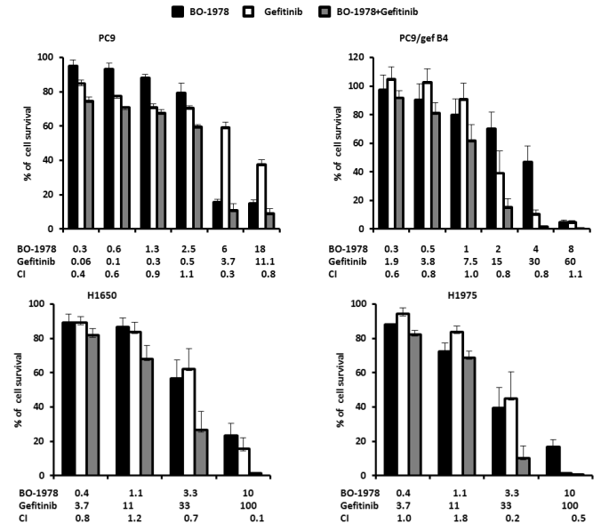
The enhanced suppression effects of combined BO-1978 with gefitinib on PC9, PC9/gef B4, H1650, and H1975 cells

Slide 21
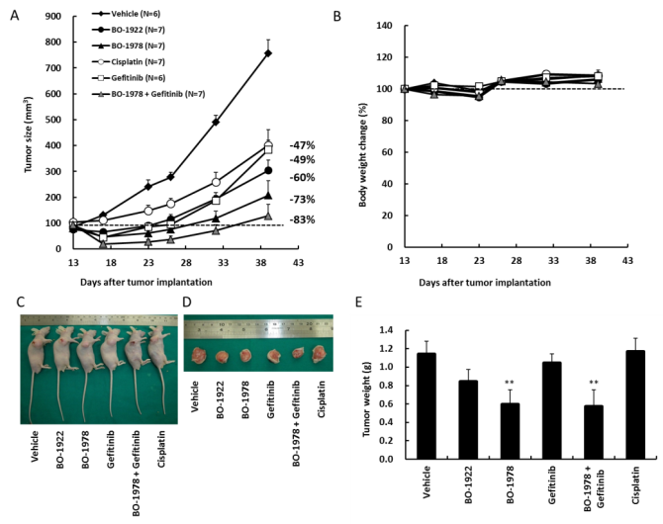
The therapeutic effects of BO-1922, BO-1978, and combined
BO-1978 with gefitinib on PC9/gef B4 xenograft tumors
BO-1922: 25 mg/kg, QDx5 (Day 13 to 17) BO-1978: 40 mg/kg, QDx5 (Day 13 to 17)
Cisplatin: 6 mg/kg, Q4Dx3 (Day 13, 17, and 21) Gefitinib: 10 mg/kg, QDx5 (Day 13 to 17)
BO-1978 + Gefitinib > BO-1978 > BO-1922 > Gefitinib

Slide 22
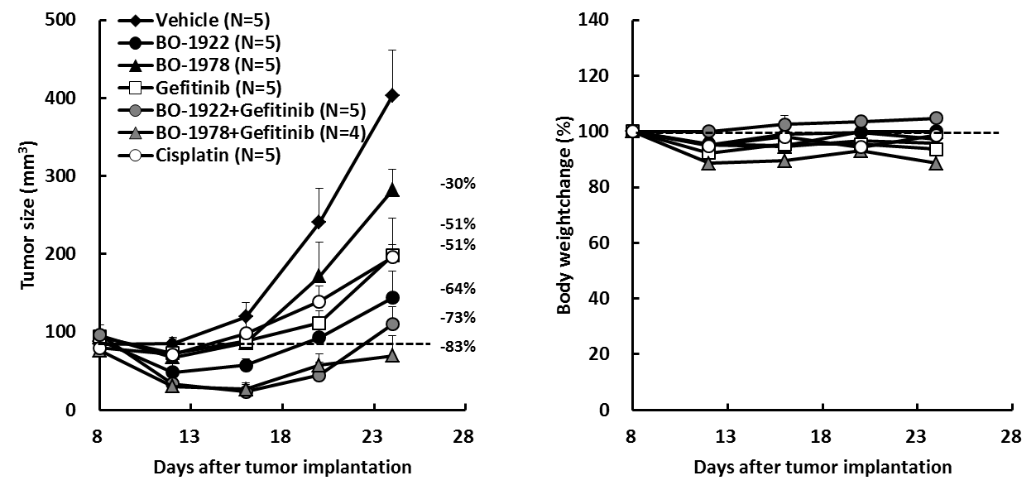
The therapeutic effects of BO-1922, BO-1978, and combined BO-1978 with gefitinib in nude mice bearing human NSCLC H1650 xenograft
BO-1922: 25 mg/kg, QDx5 (Day 8 to 12), BO-1978: 40 mg/kg, QDx5 (Day 8 to 12)
Cisplatin: 6 mg/kg, Q4Dx3 (Day 8, 12, and 16), Gefitinib: 10 mg/kg, QDx5 (Day 8 to 12)
BO-1978 + Gefitinib > BO-1922 + Gefitinib > BO-1922 > Gefitinib > BO-1978

Slide 23
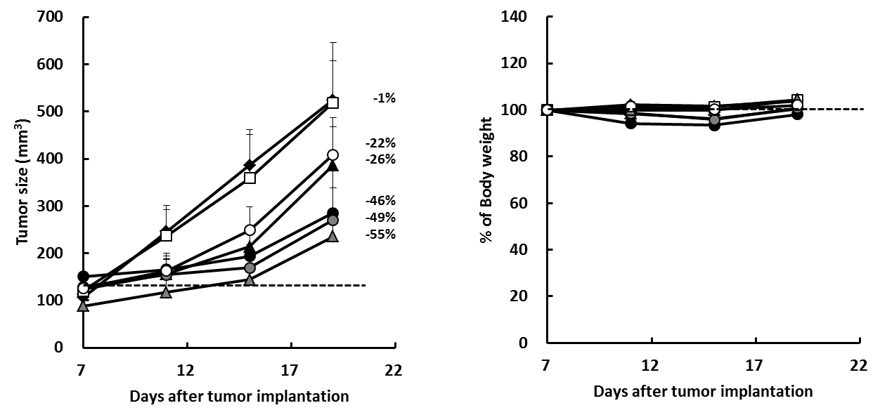
The therapeutic effects of BO-1922, BO-1978, and combined BO-1978 with gefitinib on human NSCLC H1975 xenograft tumors
BO-1922: 25 mg/kg, QDx5 (Day 7 to 11) BO-1978: 40 mg/kg, QDx5 (Day 7 to 11)
Cisplatin: 6 mg/kg, Q4Dx3 (Day 7, 11, and 15) Gefitinib: 10 mg/kg, QDx5 (Day 7 to 11)
BO-1978 + Gefitinib > BO-1922 + Gefitinib > BO-1922 > BO-1978 > Gefitinib

Slide 24
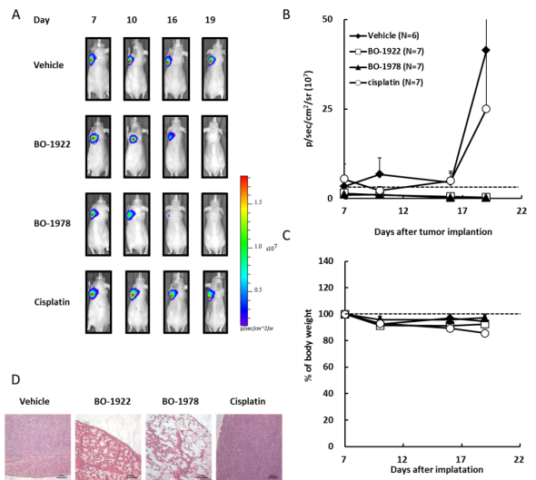
The therapeutic efficacy of BO-1922 and BO-1978 in nude mice bearing CL1-5/GFP-Luciferase orthotopic lung tumors models
BO-1922: 25 mg/kg, QDx5 (Day 7 to 11)
BO-1978: 40 mg/kg, QDx5 (Day 7 to 11)
Cisplatin: 6 mg/kg, Q4Dx3 (Day 7, 11, and 15)
BO-1978 >
BO-1922 >
Cisplatin

Slide 25
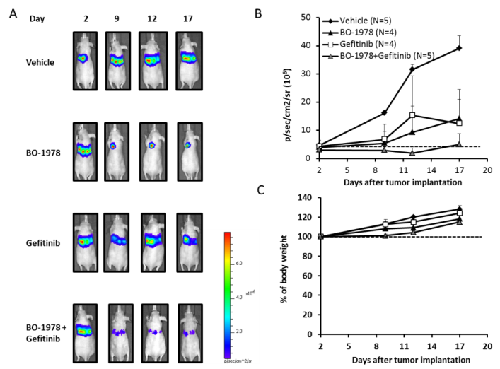
The therapeutic effects of BO-1978 alone and combined with gefitinib on PC9-Luc orthotopic lung tumors
BO-1978: 40 mg/kg, QDx5 (Day 2 to 6); Gefitinib: 10 mg/kg, QDx5 (Day 2 to 6)
BO-1978 + Gefitinib > BO-1978 > Gefitinib

Slide 26
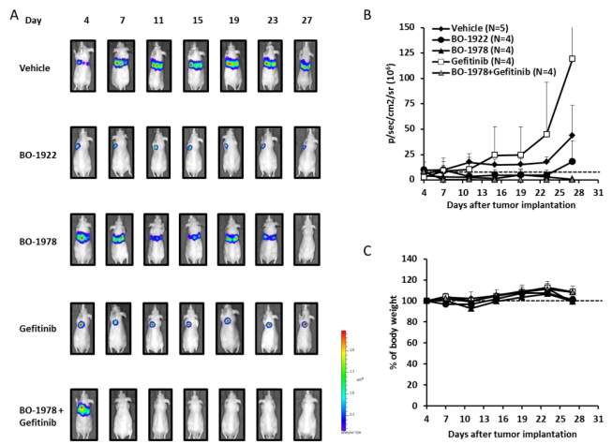
The therapeutic effects of BO-1978 alone and combined with Gefitinib on PC9/gef B4-Luc orthotopic lung tumors
BO-1922: 25 mg/kg, QDx5 (Day 4 to 8) BO-1978: 40 mg/kg, QDx5 (Day 4 to 8)
Cisplatin: 6 mg/kg, Q4Dx3 (Day 4, 8, and 12), Gefitinib: 10 mg/kg, QDx5 (Day 4 to 8)
BO-1978 + Gefitinib > BO-1978 > BO-1922 > Gefitinib

Slide 27
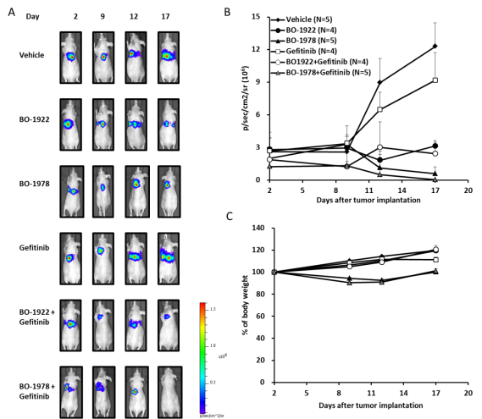
The therapeutic effects of BO-1978 alone and combined with Gefitinib on H1650-Luc orthotopic lung tumors
BO-1922: 25 mg/kg, QDx5 (Day 2 to 6) BO-1978: 40 mg/kg, QDx5 (Day 2 to 6)
Gefitinib: 10 mg/kg, QDx5 (Day 2 to 6)
BO-1978 + Gefitinib > BO-1922 + Gefitinib > BO-1978 > BO-1922 > Gefitinib

Slide 28
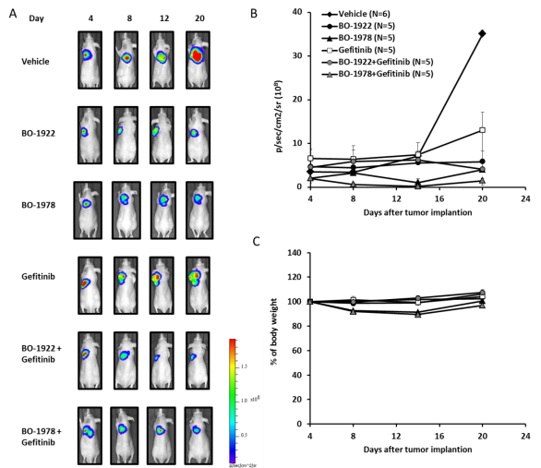
The therapeutic effects of BO-1978 alone and combined with Gefitinib on H1975-Luc orthotopic lung tumors
BO-1922: 25 mg/kg, QDx5 (Day 4 to 8) BO-1978: 40 mg/kg, QDx5 (Day 4 to 8)
Gefitinib: 10 mg/kg, QDx5 (Day 4 to 8)
BO-1978 + Gefitinib ≅ BO-1922 + Gefitinib > BO-1978 ≅ BO-1922 > Gefitinib

Slide 29
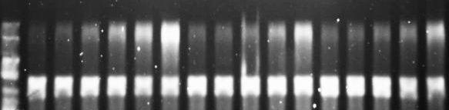
The indolizino[6,7-b]indole derivatives, BO-1922 and BO-1978, are able to induce DNA double-strand cross-linking in vitro
BO-1922 R = Me
BO-1978 R = Et
BO-1922
BO-1978
Cisplatin
Control
Marker
0.1252
0.125
0.1252
0.25
0.5
1
2
0.25
0.5
1
2
0.25
0.5
1
2
XL
SS

Slide 30
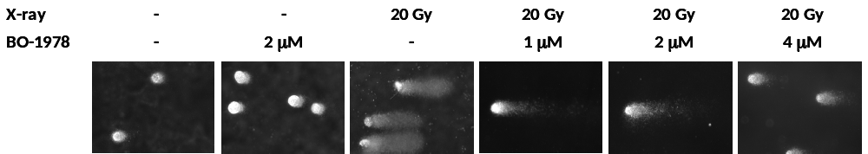
BO-1978 causes DNA interstrand cross-linking
in PC9/gefb4 cells by the modified Comet assay

Slide 31

Inhibition of Topo I by BO-1922 and BO-1978
Supercoiled pHOT DNA
Supercoiled pHOT + 1 unit of Topo I
Relaxed DNA marker
200 mM BO-1978
200 mM BO-1922
BO-1978
BO-1922
Irinotecan
50 100 200
50 100 200
50 100 200 μ M
Nicked open
circular DNA
Supercoiled
DNA substrate
Inhibition of Topo II by BO-1922 and BO-1978
Supercoiled pHOT DNA
Supercoiled pHOT + 3 unit of Topo II
Relaxed DNA marker
200 mM BO-1978
200 mM BO-1922
BO-1978
BO-1922
Etoposide
Nicked open
circular DNA
50 100 200
50 100 200
50 100 200 μM
Linear DNA
Supercoiled
DNA substrate

Slide 32

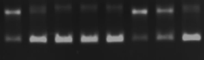

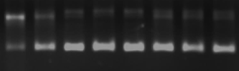
Inhibition of Topo I by BO-1922 and BO-1978
Topo I buffer with pEGFP-N1 plasmid DNA (200 ng)
H460 nuclear extracts (2.5 μg)
BO-1922
BO-1978
Irinotecan
Nicked open
circular DNA
- 0 0* 0.25 0.5 1 2 4
0.25 0.5 1 2 4 1 2 4 (μM)
Supercoiled
DNA substrate
Inhibition of Topo II by BO-1922 and BO-1978
Topo II buffer with pEGFP-N1 plasmid DNA (200 ng)
H460 nuclear extracts (10 mg)
BO-1922
BO-1978
Etoposide
Nicked open
circular DNA
- 0 0# 0.25 0.5 1 2 4
0.25 0.5 1 2 4 1 2 4 (μM)
Supercoiled
DNA substrate

Slide 33
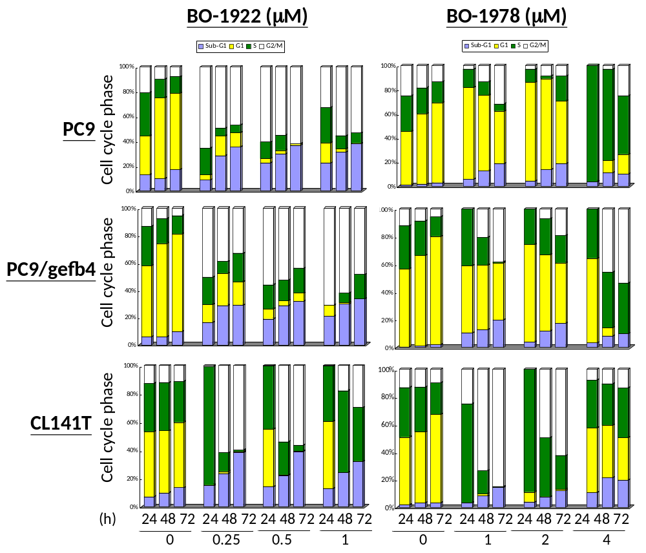
Effects of BO-1922 and BO-1978 on cell-cycle progression in
in human NSCLC cells PC9 PC9/gefb4, and CL141T cells
BO-1922 induces G2/M-phase arrest
BO-1978 incuses S-phase arrest

Slide 34
The acute intravenous injection 14-day toxicity of
BO-1978 in ICR mice - Mortality.
Dose (mg/kg) | Incidence occurring at the study period (Number of Survival mice/treated mice) |  |  |  |  |  |  |  |  |  |  |  |  |  | LD₅₀ (mg/kg)
 | 1 | 2 | 3 | 4 | 5 | 6 | 7 | 8 | 9 | 10 | 11 | 12 | 13 | 14
0 | 6/6 | 6/6 | 6/6 | 6/6 | 6/6 | 6/6 | 6/6 | 6/6 | 6/6 | 6/6 | 6/6 | 6/6 | 6/6 | 6/6 | 93.7
20 | 6/6 | 6/6 | 6/6 | 6/6 | 6/6 | 6/6 | 6/6 | 6/6 | 6/6 | 6/6 | 6/6 | 6/6 | 6/6 | 6/6
40 | 6/6 | 6/6 | 6/6 | 6/6 | 6/6 | 6/6 | 6/6 | 6/6 | 6/6 | 6/6 | 6/6 | 6/6 | 6/6 | 6/6
50 | 6/6 | 6/6 | 6/6 | 6/6 | 6/6 | 6/6 | 6/6 | 6/6 | 6/6 | 6/6 | 6/6 | 6/6 | 6/6 | 6/6
60 | 4/6 | 4/6 | 4/6 | 4/6 | 4/6 | 4/6 | 4/6 | 4/6 | 4/6 | 4/6 | 4/6 | 4/6 | 4/6 | 4/6
80 | 3/6 | 3/6 | 3/6 | 3/6 | 3/6 | 3/6 | 3/6 | 3/6 | 3/6 | 3/6 | 3/6 | 3/6 | 3/6 | 3/6
100 | 1/6 | 1/6 | 1/6 | 1/6 | 1/6 | 1/6 | 1/6 | 1/6 | 1/6 | 1/6 | 1/6 | 1/6 | 1/6 | 1/6

Slide 35
The tests of blood cells and blood chemistry of the treatments of
BO-1978 combined with gefitinib post 14 days in ICR mice
 |  | 48 hours |  | 14 days
Item^{b} | Unit | BO-1978 | BO-1978 + Gefitinib | BO-1978 | BO-1978 + Gefitinib
WBC | 10⁹/L | 3.20±0.42 | 1.63±0.39 | 3.47±0.42 | 4.75±0.49
NEU | 10⁹/L | 0.51±0.08 | 0.31±0.04 | 0.53±0.08 | 1.18±0.47
LYM | 10⁹/L | 2.31±0.33 | 1.24±0.34 | 2.65±0.38 | 3.07±0.64
MONO | 10⁹/L | 0.16±0.04 | 0.01±0.00 | 0.08±0.01 | 0.12±0.08
EOS | 10⁹/L | 0.15±0.02 | 0.04±0.01 | 0.16±.05 | 0.31±0.07
BASO | 10⁹/L | 0.07±0.02 | 0.02±0.00 | 0.06±0.01 | 0.06±0.02
RBC | 10¹²/L | 7.89±0.16 | 6.95±0.10 | 7.8±0.10 | 7.68±0.43
HGB | g/dL | 12.88±0.17 | 11.95±0.27 | 12.86±0.23 | 13.73±0.96
HCT | % | 42.29±0.75 | 40.03±0.60 | 43.69±0.63 | 44.53±2.43
MCV | fL | 57.50±0.47 | 57.63±0.74 | 56.07±0.37 | 58.03±0.04
MCH | Pg | 16.56±0.25 | 17.23±0.29 | 16.48±0.14 | 17.90±0.24
MCHC | g/dL | 28.78±0.30 | 29.88±0.19 | 29.42±0.27 | 30.83±0.41
PLT | 10⁹/L | 807.26±65.41 | 877.00±56.77 | 736.20±92.30 | 842.00±65.89
AST | U/L | 130.16±37.88 | 67.60±11.27 | 154.86±26.11 | 253.50±77.44
ALT | U/L | 12.66±3.95 | 25.40±4.45 | 97.17±24.22 | 96.75±21.52
ALP | U/L | 243.79±16.53 | 343.80±37.91 | 275.60±13.55 | 238.50±53.60
BUN | mg/dL | 24.49±0.82 | 23.18±0.92 | 25.90±1.01 | 25.73±2.30
CRE | mg/dL | 0.28±0.02 | 0.40±0.10 | 0.20±0.02 | 0.38±0.03
GLU | mg/dL | 224.89±8.06 | 239.00±12.66 | 230.56±9.24 | 224.25±18.36

Slide 36
Early pharmacokinetic parameters of BO-1978 following an intravenous or an oral dose to rats
Group | Dose | C₀ | C_{max} | T_{max} | t_{1/2} | AUC_{(0-last)} | AUC_{(0-∞)} | CL_{ss} | V_{ss} | F*
 | (mg/Kg) | (ng/mL) | (ng/mL) | (hr) | (hr) | (ng*hr/mL) | (ng*hr/mL) | (mL/min/Kg) | (L/Kg) | (%)
IV(N=3) | 5 | 4091.55 ± 1952.06 | NA | NA | 23.12 ± 5.21 | 1939.36 ± 461.83 | 2067.16 ± 368.5 | 41.18 ± 7.31 | 14.33 ± 13.95 | ND
PO(N=3) | 50 | NA | 55.80 ± 16.38 | 2.33 ± 1.44 | 17.02 ± 4.17 | 156.89 ± 13.15 | 177.49 ± 32.84 | ND | ND | 0.86 ± 0.16

Slide 37
Early preclinical studies of BO-1978
Indications:
human lung cancer
BO-1978
Antitumor efficacy:
in vitro: broad antitumor spectrum
effective against human NSCLC cell lines and cell lines
resistant to Gefitinib (PC9/gefb4)
in vivo: PC9/gefb4 in xenograft : BO-1978 > Cisplatin
H460: BO-1978 > Cisplatin
Mechanism of action: DNA cross-linking, Topo I and Topo II inhibition
Stability: human plasma binding (stable)
rat liver microsomes (stable)
Pharmacokinetics (PK): t_{1/2} = 23.12 h in rat h (iv injection) in rats
Acute Toxicity: LD₅₀ = 93.7 mg/kg male CD-1 (ICR) mice
No obviously pathological changes in blood or organs in
the drug treated mice
hERG binding (no cardiac toxicity)

Slide 38
Strength of BO-1978
■ Compound BO-1978 is more cytotoxic than Gefitinib against
cell growth of human lung cancer CL141T, H460, PC9, and
Gefitinib-resistant PC9/gefb4 cell lines.
■ Compound BO-1978 is more potent than Cisplatin against the
cell growth of tumor PC9/gefb4 xenograft in animal models.
■ Compound BO-1978 may have potential to developing as
a potent agent against NSCLC with EGFR mutations and
Gefitinib resistance.
■ Compound BO-1978 has a long half-life (t_{1/2} = 23.12 h) in rat
following intravenous administration.
■ Compound BO-1978 has multi-modes of action including DNA
cross-linkers and topo I and II inhibitors
■ Compound BO-1978 has low toxicity to the host; no apparent
changes in blood or organs in the drug treated mice.

Slide 39

Thank you
Water lily pane in Academia Sinica

