Slide 1
Device-To-Device (D2D) Communication in
5G Cellular Networks
Presented by: Trung-Dinh Han

Slide 2
Contents
Cellular Network Evolution
5G Key Enabling Technologies
Network Models
Research Perspective
User & Operator Perspective
D2D Comm. Framework Proposal
Research Challenges & Trends

Slide 3



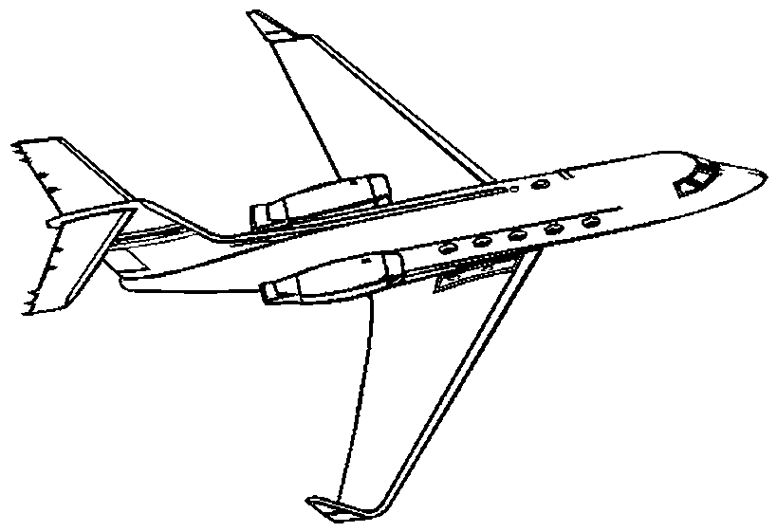
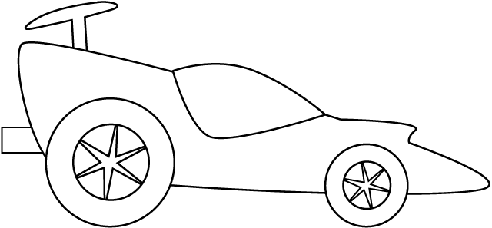
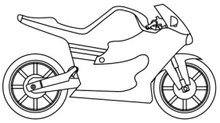

Cellular Network Evolution
The higher speeds,
the more services
1980s
1G
(Voice band)
1991
2G/GSM
9.6Kbps
2002
3G/UMTS
384 Kbps
2009
4G/LTE
100Mbps
2020
5G
10Gbps

Slide 4
5G Key Enabling Technologies (1/2)
Advanced Network
Device to Device
Communication
(D2D)
mmWave System
ACM & Multiple Access
Advanced MIMO
Advanced Small Cells
Multi-RAT

Slide 5
5G Key Enabling Technologies (2/2)
 | Peak Data Rate | Cell Edge Data Rate | Cell Spectral Efficiency | Mobility | Energy/ Cost Efficient | Simultaneous Connection | Latency
D2D |  |  | ☑ | ☑ | ☑ | ☑ | ☑
mmWave System | ☑ | ☑ | ☑ |  | ☑ | ☑ | ☑
Multi-RAT | ☑ |  |  | ☑ | ☑ | ☑
Advanced Network |  |  |  | ☑ | ☑ | ☑ | ☑
Advanced MIMO |  | ☑ | ☑ |  | ☑ | ☑
ACM & Multiple Access |  | ☑ | ☑ |  |  | ☑
Advanced Small Cell |  | ☑ |  | ☑ | ☑

Slide 6

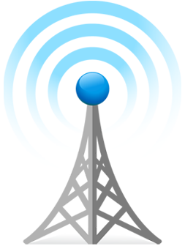
Network Models
Multi-hop Comm. with Operator(MCO)
Multi-hop Comm. withOut Operator (MCOO)
Direct link
Relay link
Control link
Direct Comm. with Operator(DCO)
Direct Comm. withOut Operator(DCOO)

Slide 7
Research Perspective
Security threads
Interference avoidance, Quality of Service (QoS)
Cooperative comm.?
MCO
DCO
(licensed Band)
Power Utilization
Future models?
Conventional
comm. Models
MCOO
DCOO
(Unlicensed Band)
Network Speed, Bandwidth

Slide 8
User & Operator Perspective
Pricing &
QoS models?
MCOO
DCOO
User expectation
Future models?
Conventional
comm. models
MCO
DCO
Operator expectation

Slide 9
D2D Comm. Framework Proposal
Device to Device applications
Communication Services Interface
Telephony Manager
Wireless Comm. Framework
(e.g., Samsung Chord SDK,
Bluetooth APIs…)
Security
(Open Access/ Closed Access)
Power Management
QoS
Wireless Routing Protocol
(e.g., TMRP/OLSR/AODV)
Telephony Protocols suite
Linux Kernel

Slide 10
Research Challenges & Trends
Security
Pricing Models
Power Consumption
D2D Communication
Mobility Management
Bandwidth Utilization
Wireless Multi-hop Routing
Spectral Interference
Cognitive Radio
QoS

Slide 11
References
DMC R&D Center, Samsung Electronics, “5G Vision,” Jun. 2015
M. N. Tehrani, M. Uysal, H. Yanikomeroglu, “Device-to-device communication in 5G cellular networks: challenges, solutions, and future directions,” IEEE Communications Magazine, vol. 52, no. 5, pp. 86-92, May 2014
A. Asadi, Q. Wang, V. Mancuso, “A Survey on Device-To-Device Communication in Cellular Networks,” IEEE Communication Surveys & Tutorials, vol. 16, no. 4, pp. 1801-1817, Apr. 2014
T.D. Han, H. Oh, “A Looping Problem in the Tree-Based Mobility Management for Mobile IP Supported Ad Hoc Networks,” the Journal of Communications and Networks (JCN), vol. 13, no. 4, pp. 385-392, Oct. 2011
T.D. Han, H. Oh, “A Topology Management Routing Protocol for Mobile IP Support Mobile Ad Hoc Networks,” Springer-Verlag, LNCS 5793, pp. 341-346, Sep. 2009

Slide 12
Thank you for your listening
Q&A

